Slide 1
2021 CEOS Chair Proposed Theme & Priorities
Dr. Karen M. St. Germain
Director, NASA Earth Science Division,
NASA Principal for CEOS,
Incoming 2021 CEOS Chair
2020 CEOS Plenary
Virtual Meeting
Agenda Topic 5.1
20-22 October 2020

Slide 2
Celebrating CEOS
Now in its third decade, CEOS continues to demonstrate that it is a dynamic international forum, uniquely capable of coordinating space-based Earth observation (EO) activities of major impact, scope, and scale.
CEOS remains a well-led organization, whose contributions and coordination are both vital and highly relevant to the remote sensing community and to science worldwide.
As we look toward 2021, NASA welcomes the role of CEOS Chair. We thank and applaud CEOS Chair, ISRO, and SIT Chair, CSIRO-GA for their leadership throughout 2020, an unprecedented year during which the world and CEOS dealt with challenges for which science, technology, international cooperation and communication—all of which come together in CEOS—have been essential.

Slide 3
Keep Advancing our Priorities
The 2021 CEOS Chair team will continue advancing activities in the CEOS 2020-2022 Work Plan, including major focus areas of the current CEOS SIT co-Chairs, CSIRO and Geoscience Australia, and leverage results from the priorities of the 2020 CEOS Chair, ISRO, and the 2019 CEOS Chair, VAST-VNSC:
Carbon and Biomass
CEOS Analysis Ready Data Strategy and regional Data Cube applications
CEOS support for Sustainable Development Goals
CEOS Support for disaster science, decision support, and capacity development

Slide 4
Proposed 2021 Chair Theme
NASA invites the CEOS community to dedicate the 2021 CEOS Chair term as a benchmark year to elevate and more widely communicate how CEOS is actively realizing its vision through the theme:
“Space-based Earth Observation Data for Open Science and Decision Support”.
Our intent is to not add to the significant number of commitments that CEOS already has. Instead, the concept is to broadly disseminate the relevance of CEOS remote sensing activities and contributions in support of Open Science and decision making.
In the next 2 months (by end of year), with your input, our team will develop a detailed list of tasks/outcomes to lay out how the theme will be integrated into CEOS existing activities. We welcome the feedback and insights of the CEOS community.

Slide 5
What are Open Science and Decision Support?
Across communities, common themes characterize the concept of “Open Science”
(e.g., availability, accessibility, transparency, collaboration).
All of them align with increasing impact and accelerating science and decision support by lowering the barriers for all to contribute and benefit.
Open Science aims to ensure the free availability and usability of scholarly publications, the data that result from scholarly research, and the methodologies, including code or algorithms, that were used to generate those data. (Reference: Open Science by Design, Realizing a Vision for 21st Century Research (2018))
The Open Decision framework describes a process for making transparent, inclusive decisions in organizations that embrace open source principles. It brings together ideas and best practices from across the organization into a flexible tool that helps you make better business decisions. (Reference: https://openpracticelibrary.com/blog/open-decision-framework/)
Open Science is the movement to make scientific research and its dissemination accessible to all levels of an inquiring society, amateur or professional. Open science is transparent and accessible knowledge that is shared and developed through collaborative networks. (Reference: Wikipedia)

Slide 6

Why Open Science?
Growing volumes of free/open data
Growing numbers of global data users
Growing demand … climate, disasters, COVID-19
Aligning with global endeavors …
U.N. Sustainable Development Goals (SDG)
First UNFCCC Global Stocktake in 2023
Alignment with the GEO Knowledge Hub
AND
CEOS data must be accessible, its use must be transparent,
and the products must be reproducible.
Image Credit: European Geoscience Union (EGU)

Slide 7
Demonstrating Open Science with Purpose
Accessibility … call attention to CEOS datasets (free and open) and create more efficient access points (e.g., MIM, CWIC/FedEO, COVE) with connected training and capacity building.
Transparency … promote sharing of data and algorithms among users and call attention to CEOS projects (e.g., EAIL, ODC Sandbox, COVERAGE) where this is demonstrated.
Reproducibility … promote workflows (e.g., CARD4L, GEO Knowledge Hub) that support reproducible products where users can demonstrate open science
Support Global Initiatives … demonstrate decision support for global endeavors (e.g., UN-SDG, GFOI, GEOGLAM) using an “open science” approach.

Slide 8
Collaborating with Purpose
Increase our value to those that know us .. amplify science and inform decision making
Create value for those that do not know us yet … tell our story and reach new beneficiaries
Be the leader of Open Science in global remote sensing … affirm open data principles
The 2021 CEOS Chair team at NASA and I look forward to working with you between now and December 15 as, together, we propose specific tasks and define measures of success for our one-year term
Notes:
Since 1984, CEOS has been instrumental in the remote sensing community and we shall continue to amplify science and inform decision making. The community knows us, our work, and its relevance.
We, CEOS, must continue to “tell our story” among forums and communities that are not aware of, or could more fully benefit from engagement with the expertise in CEOS entities and volumes of freely accessible data, products, tools, and algorithms
We propose that in 2021, CEOS formally affirm the GEOSS Data Sharing and GEOSS Data Management Principles in the GEO Strategic Plan 2015-2026, by means of a “CEOS 2021 Plenary Statement. The Statement will be drafted with CEOS Agencies for endorsement by the 2021 CEOS Plenary.

Slide 9
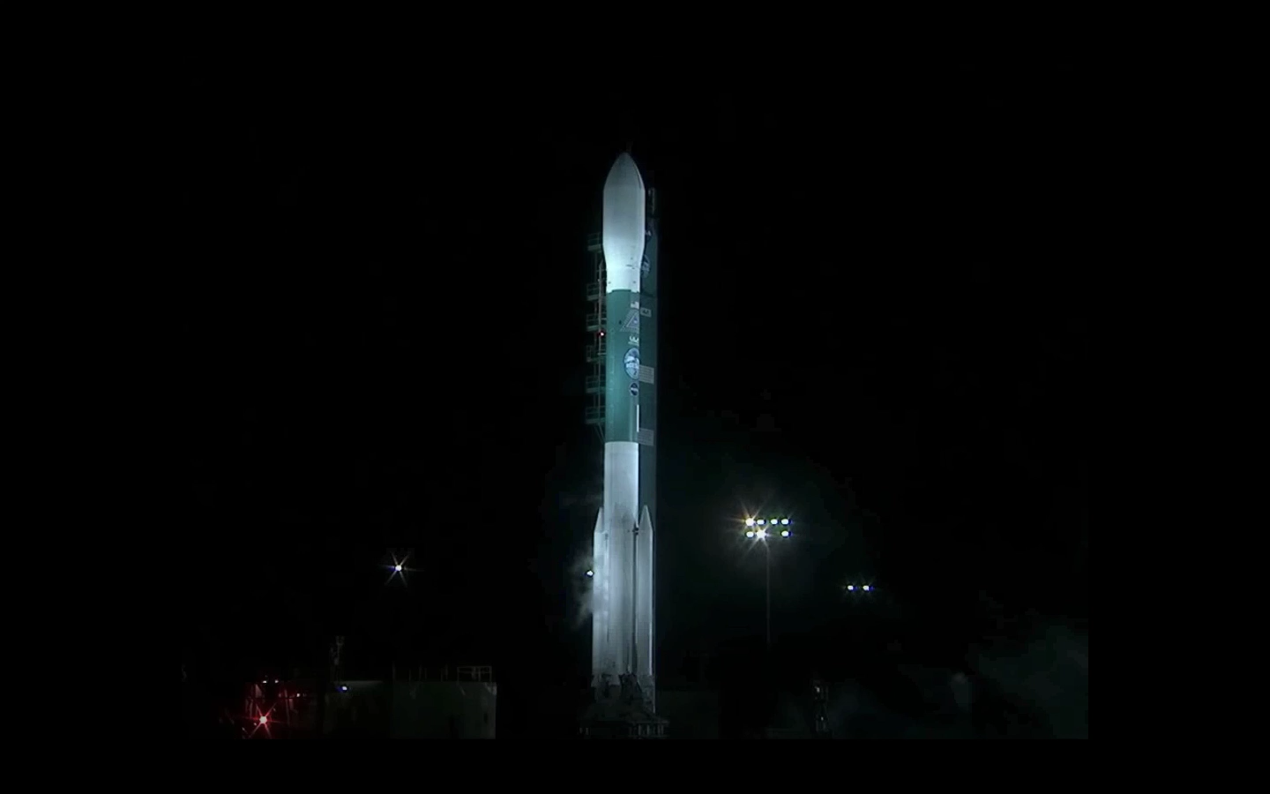
Thank You
We look forward to the launch of NASA’s CEOS Chair term and an exciting year ahead.
NASA Contact for CEOS: Christine Bognar - Christine.M.Bognar@nasa.gov

