Slide 1

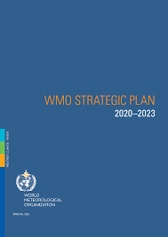
WMO Plenary Presentation
Constituent Body Reform, Coordination with CEOS, Major Initiatives
34th CEOS Plenary

Slide 2
Contents
Status of WMO Reforms
Impacts of COVID-19 on observing systems
Status of Vision 2040
Major initiatives
  Data Policy
  GBON and SOFF
  WICAP
Space Programme Status
  Oscar/Space
Upcoming events

Slide 3
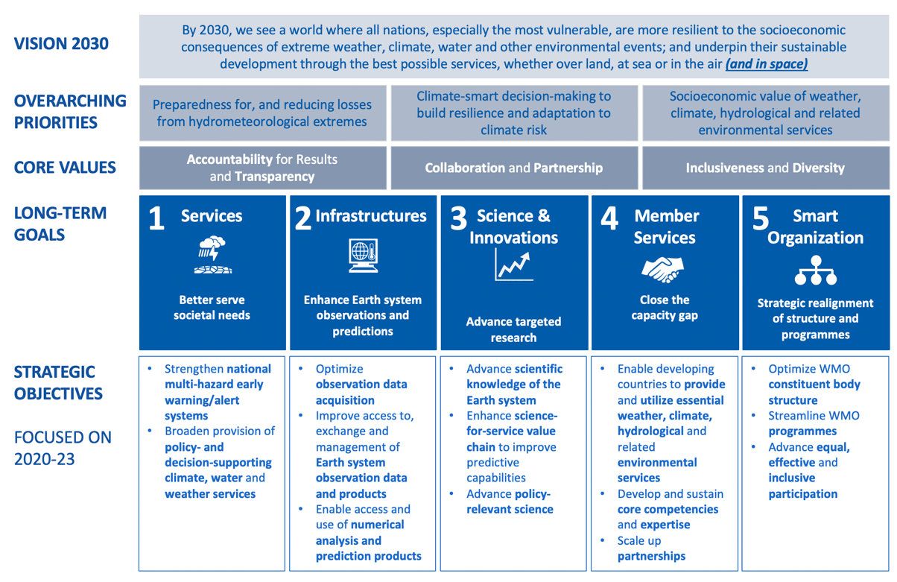
WMO Constituent Body Reform
See https://library.wmo.int/index.php?lvl=notice_display&id=21525

Slide 4
WMO Constituent Reform

Slide 5
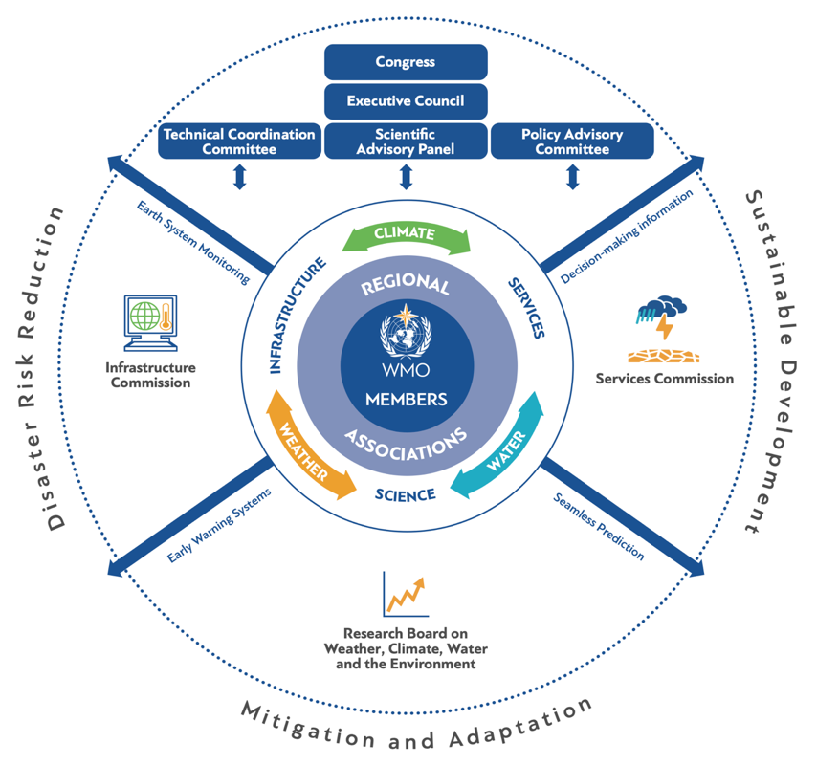
WMO Constituent Body Reform

Slide 6
INFRASTRUCTURE COMMISSION (INFCOM)
Standing Committees and Study Groups
Standing Committee on Earth Observing Systems and Monitoring Networks (SC-ON) ,
Standing Committee on Measurements, Instrumentation and Traceability (SC-MINT) ,
Standing Committee on Information Management and Technology (SC-IMT) ,
Standing Committee on Data Processing for Applied Earth System Modelling and Prediction (SC-ESMP) ,
Study Group on Data Issues and Policies (SG-DIP) ,
Study Group on Ocean Observations and Infrastructure Systems (SG-OOIS) ,
Study Group on Cryosphere Crosscutting Functions (SG-CRYO) ,
Study Group on Implementation of the Global Basic Observing Network (SG-GBON)
Joint Study Group on the Global Climate Observing System (JSG-GCOS)

Slide 7
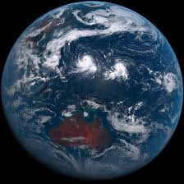
INFCOM Expert Teams
Expert Team on Space Systems and Utilization (ET-SSU)
Joint Expert Team On Earth Observing Systems Design And Evolution (JET-EOSDE)
Expert Team on Radio Frequency Coordination (ET-RFC)
Proposed Expert Team on Space Weather – to be confirmed

Slide 8
Monitoring of Observing Networks
WMO has been improving the monitoring of the status of observations and access to the data
WMO’s WIGOS Data Quality Management System (WDQMS, https://wdqms.wmo.int)
  Provides information on the status of reporting of observations in near-real time
  WMO and GCOS are extending this to include the GCOS Climate Networks, the GCOS Surface Network (GSN) and the GCOS Upper Air Network (GSRN)
  Work is also underway to provide similar information on ocean observations to complement the work of JCOMMOPS
Updates at https://public.wmo.int/en/media/press-release/covid-19-impacts-observing-system
WMO is coordinating global monitoring and working with Members to identify risks
GCOS will include the impacts of COVID-19 in their upcoming revision of the status report

Slide 9
Impact of COVID-19 on climate observations
Increased Upper Air measurements in Europe to compensate for loss of Aircraft Observations
Reduced Aircraft Observations globally
Upper Air
Reduced Observations in some countries with manual observations
Other Surface Observations
It is difficult to quantify the impact on other observations (e.g. cryosphere, biosphere), as these are not (yet) monitored daily
Surface observations are being interrupted where they are made manually and there is a slow degradation of automatic measurements where maintenance and calibration cannot be performed.
e.g. the Long-Term Ecological Research programme (LTER) in the US, noted that this might lead to the first interruption in more than 40 years at some sites.
Surface
Notes:
Studies carried out at ECMWF have shown that, without aircraft-based observations, the quality of forecasts at cruising altitude can drop by up to 15%. The quality of near-surface weather predictions can also go down, by up to about 3%.

Slide 10


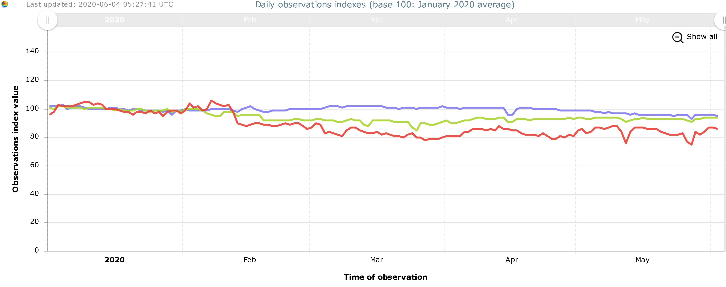
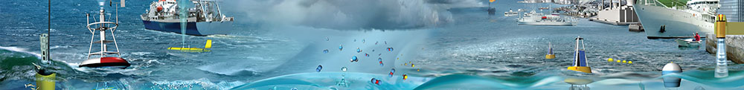
GOOS survey on COVID -19
impact on the observing system
Limited immediate impact on data flow
GLOSS: maintaining function
SOT-ASAP: decreased data but maintaining function
SOT-SOOP: data stream is impacted in the near term
SOT VOS: data flow decreased (~15%)
Argo: deployments impacted
DBCP Drifters: maintained for now
OceanSITES: major risks appear to be unfolding, complex
DBCP Moored buoys: some data flow affected
OceanGliders: heavily impacted in the near term, uncertainty remains
GO-SHIP: major impacts to long established observing lines
Total observations
observations from
commercial ships
observations from
autonomous surface
drifters
Lessons learned:
Autonomous platforms and sensors are key
Need increased international cooperation, sharing of resources such as ship-time
Prioritize sustained observations can allow them to operate under different conditions
data: JCOMMOPS
(Slide courtesy Toste Tanhua, GOOS SC Chair)
Notes:
The first message is that there is limited immediate impact of the limitations on movement imposed by the Covid-19 pandemic.
This is a time series of the real-time flow of observations from January 2020 to the present, from two representative types of platforms: autonomous surface drifters measuring temperature and currents in purple, and observations from commercial shipping vessels outfitted with scientific instrumentation in red. The impact on the network based on commercial vessels has been a drop of about 15% in data flow, as demand for global shipping has dropped; and for the autonomous drifters, the drop in data flow has been limited to about 5%.
So, weather and ocean forecasting systems and early warnings of hazards can continue to operate normally, supplied with the ocean data they need.

Slide 11
WIGOS Implementation Status
Describes the space- and surface based observing networks we desire to operate by 2040
The space-based component consists of four subcomponents:
  Backbone system with specified orbital configuration and measurement approaches
  Backbone system with open orbit configuration and flexibility to optimize the implementation
  Operational pathfinders, and technology and science demonstrators
  Additional capabilities (e.g. contributions by commercial operators)
See https://community.wmo.int/vision2040

Slide 12
WIGOS Vision 2040 Implementation
WMO plans a consultancy to develop a high-level plan
  Guidance on the Evolution of the Global Observing Capabilities in Response to the WIGOS Vision 2040
  Guidance on the development of a national implementation strategy for the Vision of WIGOS 2040
  Capacity development opportunities and guidance based on Systematic Observations Financial Facility (SOFF) and Country Support Initiative (CSI)
  Communication Plan on the need to respond to Vision for WIGOS in 2040

Slide 13

Implementation of WIGOS Vision 2040
WMO welcomes updated CGMS baseline and CGMS contributions towards implementation of the Vision for WIGOS in 2040
However, this does not cover all key aspects for comprehensive Earth-System modelling, hence CEOS support is also essential

Slide 14
WMO Network Standards
National Capability
Data Policy
What observing networks are required
Resolution 40 (Annex)
Global Basic Observing Network (GBON)
What data is shared
Intellectual property
Resolution 40, 60, 25
Capability gaps
Capacity gaps
Funding limitations
Systematic Observations Funding Facility (SOFF)
14

Slide 15
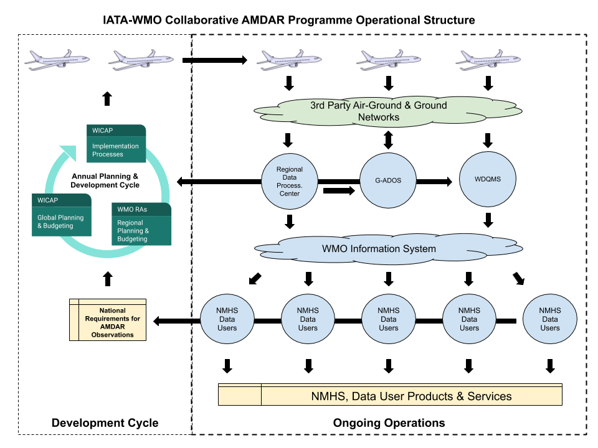
WMO-IATA Collaborative AMDAR Programme (WICAP)
Working Arrangement established between IATA and WMO on AMDAR Program
  2017 - to develop concept of operations and principles for future collaboration
  2020 update - to cover collaborative development of AMDAR – WICAP
Roles of organizations
  WMO
    Requirements for data and coverage
    Operation and resourcing of regional programs
    Reception, management and use of data
  IATA
    Airline and aviation business case and promotion of benefits of participation
    Technical process for onboard implementation
    Data policy, licensing and aviation utilization
Benefits
  Formalised data policy
  Coordinated expansion over data-sparse areas including turbulence and water vapour monitoring
  WMO Regional approach can halve cost of program operation and data comms costs
  More effective and efficient partnership with new airlines – expect increase 40 -> ~80

Slide 16
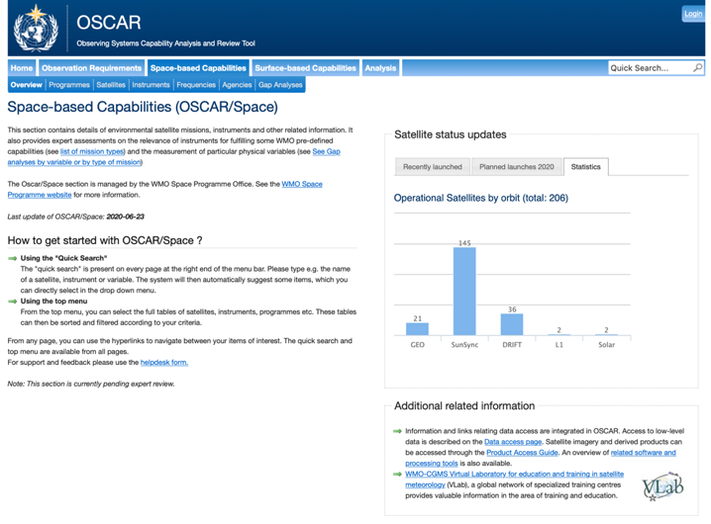
OSCAR/Space Development and Maintenance
WMO has established a framework for continuing OSCAR/Space development
IT company contracted to further develop OSCAR/Space
Phase 1: upgrades to the OSCAR/Space technical stack – presently in user acceptance testing.
Phase 2: upgrades to OSCAR/Space to make it compliant with WIGOS metadata records - to be kicked off in Q4/2020
Continuous content maintenance with the support of O/SST (OSCAR Space Support Team)
See https://www.wmo-sat.info/oscar/spacecapabilities

Slide 17
OSCAR/Space Development and Maintenance
OSCAR Space Captures
  770 satellites
  1000 instruments: 650 for Earth Observation and 350 for Space Weather.
  Around 4000 individual content edits annually
  On average 200 user visits per day
Supported by CGMS Members and hence also by a significant sector of CEOS
However, additional support is requested from CEOS through the appointment of Points of Contact with the remaining Agencies
See https://www.wmo-sat.info/oscar/spacecapabilities

Slide 18
Satellite Data Use Surveys
See https://library.wmo.int/index.php?lvl=notice_display&id=20787 and https://library.wmo.int/index.php?lvl=notice_display&id=21723

Slide 19
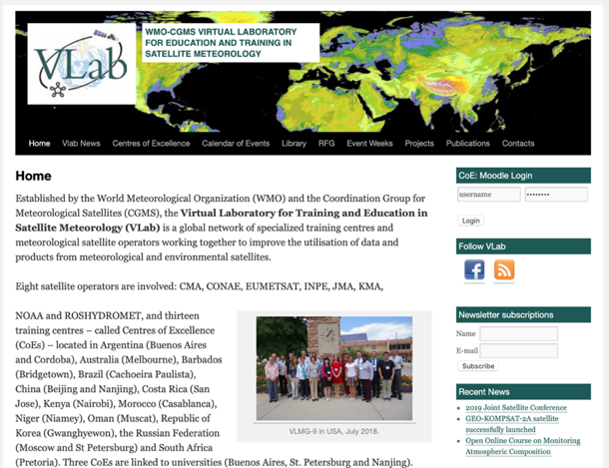
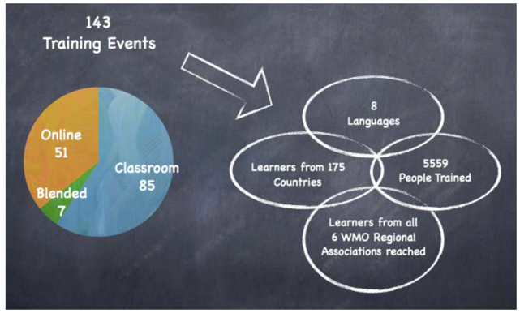
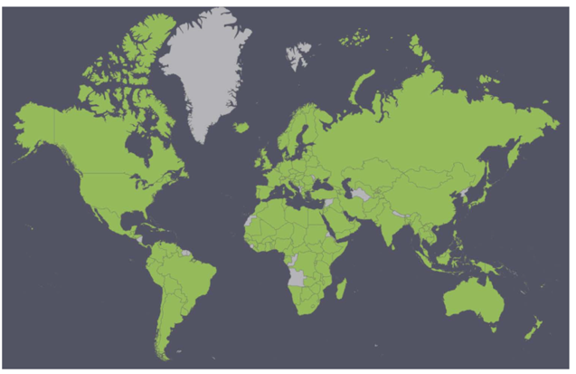
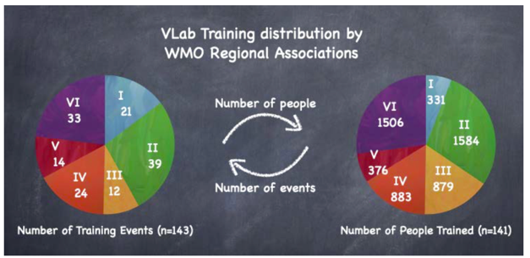
Virtual Laboratory for Training and Education in Satellite Meteorology
See https://www.wmo-sat.info/vlab/

Slide 20
WMO and UN-Space
WMO contributes to annual reports of the UN Secretary General on the coordination of space-related activities within the UN System
2020-2021: Megatrends and Sustainable Development
WMO mentioned 37 times
See https://www.unoosa.org/oosa/en/ourwork/un-space/index.html

Slide 21
WMO and CEOS
Noting the 18th World Meteorological Congress approved the new WMO strategic Plan:
  Embracing an Earth systems approach
  Stronger focus on water resources and the ocean,
  More coordinated climate activities
  A more concerted effort to translate science into services for society.
The integration of basic systems for hydrology, oceans and climate within multi-purpose networks and space-platforms essential for WIGOS.
The strong commitment from the Space Agencies through the WMO Expert Team on Satellite Systems in developing Vision for the space based component of WIGOS 2040 and the WMO Expert Team on Space Systems and Utilization for the implementation of the Vision

Slide 22
WMO and CEOS
Important to strengthen a mutually beneficial relationship
Benefits for WMO
  Considering the Earth-System Approach, Technical and Scientific Challenges and Opportunities, Focus on Extreme Weather ad Climate Change
  Access to additional expertise on space-based remote sensing e.g. through
  The CEOS Working Groups, Virtual Constellations, ad hoc teams/Project/initiatives
Benefits for CEOS
  Access to a wider range of global WMO programmes
  Stronger and wider outreach to end users
  WMO training and outreach activities
  Coordinated ground-based observations for validation and intergrated observing systems
It is proposed to strengthen collaboration through a number of existing projects and programmes of common interest, e.g.
  Wild fire monitoring
  Flood monitoring
  Climate and GHG monitoring

Slide 23
Important Events
28 Sept to 2 Oct 2020 - WMO Executive Council 72nd Session
23 Oct – Stakeholder Consultation on on satellite data and WMO Data Policy
9 to 13 November 2020 - Joint Session of Infrastructure and Services Commission and Research Board
16 to 19 November – WMO Data Conference
April 2021 – Extraordinary Executive Council
Mid 2021 – Extraordinary Congress

Slide 24
Conclusions
CEOS is requested to take note of
  WMO Constituent Reform.
  New Governance Structures.
  WIGOS developments.
  Key initiatives
  Calendar of events
  WMO Space Programme activities
CEOS is requested to
  support stronger collaboration with WMO for specific projects and programmes of common interest
  Support the WMO OSCAR activities through the nomination of Agency Points of Contacts

Slide 25

Thank you
Merci

Slide 26
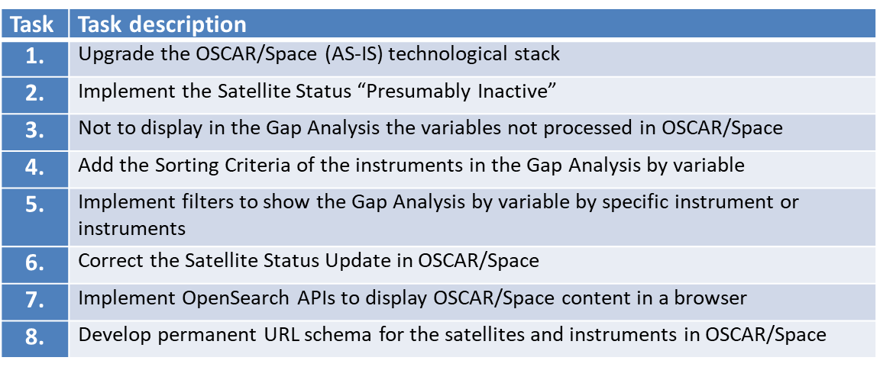
OSCAR/Space development work Phase 1
In addition to functionality improvements, a main goal of the ongoing development work is to upgrade the OSCAR/Space technical stack
  Upgrade the CakePHP framework, MySQL and related plugins and libraries, including jquery, to the latest supported versions
  Make an analysis of virtual development, deployment and operations platforms (e.g Docker, Kubernetes, Heroku, Jelastic cloud) and migrate the OSCAR/Space platform to it

Slide 27
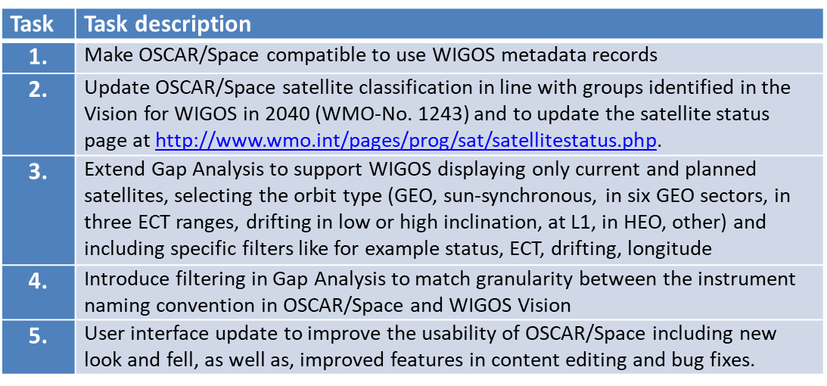
OSCAR/Space development work Phase 2
The main theme for the next development phase is to make OSCAR/Space compliant with WIGOS metadata records.
The implementation plan will be based on the work conducted by ICG/WIGOS Task Team on the WIGOS Metadata and will integrate WIGOS metadata records into the OSCAR/Space database

Slide 28
WMO Constituent Reform
WMO Members nominated Experts through the WMO Experts Data Base
Technical Commissions (INFCOM, SERCOM) and Research Board established
Standing Committee and Expert Teams established under the Technical Commissions
Discussions with co-sponsored programmes (GCOS, JCOMM/JCB)

