Slide 1
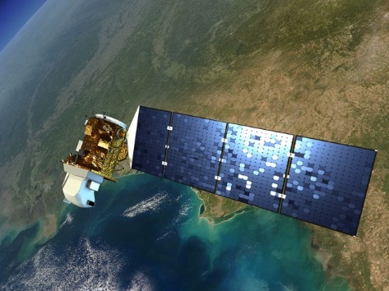
ESD Upcoming Launches
Sentinel-6 Michael Freilich
Landsat 9
November 2020
June 2021
Provide ongoing measurements of global sea level rise, and support operational oceanography, improving forecasts of ocean currents as well as wind and wave conditions. (With NOAA, ESA, EUMETSAT)
Designed and operated to repeatedly observe the global land surface at a moderate scale that shows both natural and human-induced change. (With USGS)

Slide 2



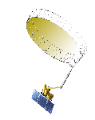































Timeline of Current and Future Earth Science Missions
2015
2017
NASA Earth Science Focus Areas
2002
Atmospheric Composition
Earth Surface and Interior
DSCOVR
JPSS-1
Carbon Cycle and Ecosystems
Water and Energy Cycle
Aqua
EPIC
*OMPS-L
Climate Variability and Change
Weather and Atmospheric Dynamics
NISTAR
CERES
2021
2023
2025
2006
SMAP
ISS
TSIS-2
Sentinel 6B
CloudSat
2013
SAGE III
2019
Landsat 9
2027
TSIS-1
CALIPSO
*Landsat 8
LIS
ISS
ISS
JPSS-3
ISS
Libera
OCO-3
EMIT
CLARREO-PF
*OMPS-L
2004
2014
2020
2024
2026
2031
2018
Aura
Sentinel-6
Michael Freilich
JPSS-4
OCO-2
PACE
GLIMR
*OMPS-L
1999
GPM
ICESat-2
2022
Terra
NISAR
TROPICS
2016
GRACE-FO
2011
JPSS-2
SWOT
GeoCarb
*OMPS-L
*Landsat 7
Suomi-NPP
CYGNSS
ISS
CERES
GEDI
MAIA
TEMPO
PREFIRE
*Operations not funded by ESD
05.18.20
ECOSTRESS
Notes:
Moved PACE to 2024
Moved JPSS-3 to 2027, added Libera 2027
Dele SORCE
Updated S6MF name

Slide 3
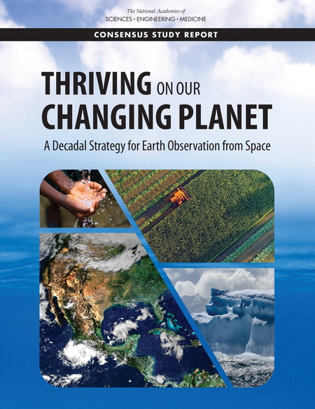
2017 Earth Science Decadal Survey
Thriving on Our Changing Planet
An Inherent Tension
  Thriving
  The growing reliance on Earth information in the daily lives of people and businesses compels improved knowledge of our planet
  Changing
  Achieving the scientific and practical ability to reliably understand an Earth system is challenging when it changes (natural and human causes) nearly as fast as we characterize it
June 2018

Slide 4

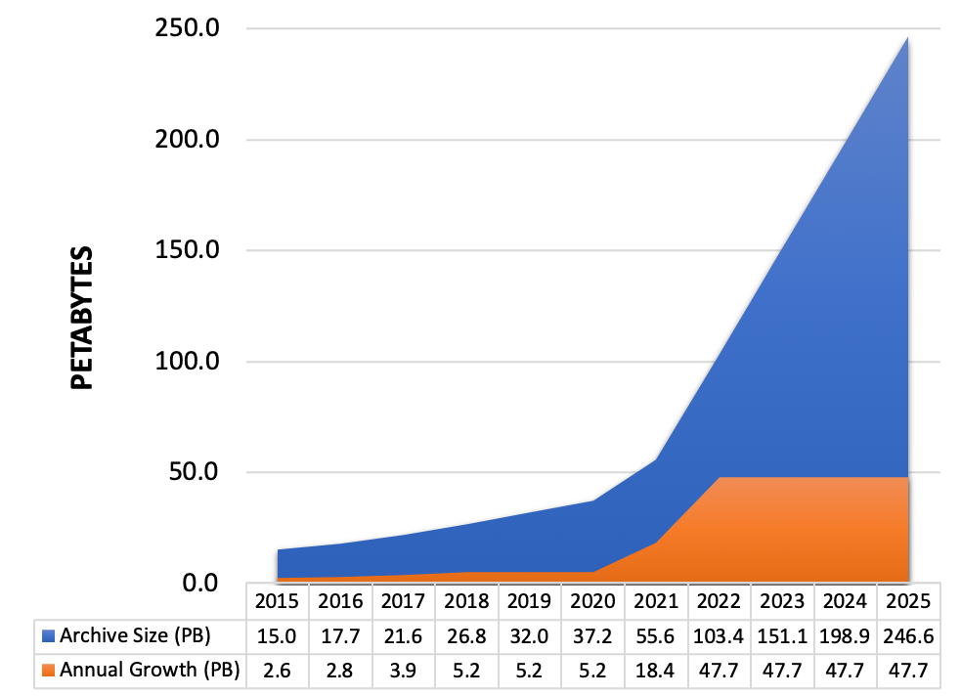
Big Data: Earth Science
Challenges
Volume of data in NASA Earth science archives alone to increase to 250 Petabytes by 2025
Multi-platform, multi-instrument, multi-program nature of the data – Multi-science data fusion
Need
Efficiently handle storage and computation needs for large data volumes through new data management technologies and architectures
New paradigm is required
Cloud offers performance and cost benefits
Realize storage, processing and operational efficiencies
Improve cross-archive center collaboration
Enable users to work across multiple datasets managed by different archives without transmitting data over networks
Supporting open science with open source software and open data
Notes:
To efficiently handle storage and compute needs for the large SWOT and NISAR data volumes, new data management technologies and architectures are needed.
NASA’s Earth Observing System Data and Information System (EOSDIS) acquires, processes, preserves, and distributes observational data from various sources (satellites, aircraft, field measurements, and various other programs) to support Earth Science research focus areas. From its current size of approximately 30 petabytes (PB), the volume of data in the EOSDIS archive is expected to increase to approximately 250 PB by 2025.
Growth of Mission Data & Processing: Projected rapid archive growth and the need to effectively process significantly larger volumes of new mission data requires rethinking existing architectures. Estimating 132 TB daily ingest by 2022
Data Systems: More cost effective, flexible, and scalable data system ingest, archive, and distribution solutions are needed to keep pace with new mission advancement and capabilities
Science Users: Significantly larger data volumes requires additional ways to access and utilize these data, with “Data Close to Compute”

