Slide 1
JAXA Agency Report
October 20-22, 2020
Takeshi Hirabayashi
Senior Chief Officer of Satellite Applications
Space Technology Directorate I
Japan Aerospace Exploration Agency

Slide 2



JAXA’s Satellite Development and Operation Schedule
JFY |  | 2016 | 2017 | 2018 | 2019 | 2020 | 2021 | 2022 | 2023 | 2024 | 2025 | 2026 | 2027 | 2028 | 2029 | 2030
Earth Observation
National Security
Disaster
ALOS-2/PALSAR-2
ALOS-3 (Optical)
Land Monitoring
ALOS-3 Follow-on
ALOS-4 (SAR)
ALOS-4 Follow-on
Climate Change
AMSR-3
(Hosted by GOSAT-3)
GCOM-W/AMSR-2
Water Cycle
Precipitation
GPM/DPR
Vegetation
Aerosol
GCOM-C/SGLI
Clouds
EarthCARE/CPR
GHG
GOSAT/FTS
GOSAT-2/FTS-2
GOSAT-3 (MOE Mission)

Slide 3
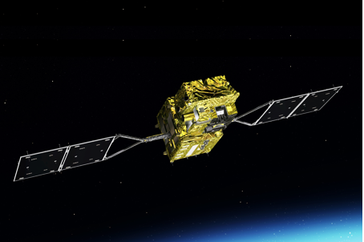
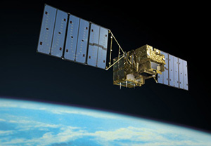
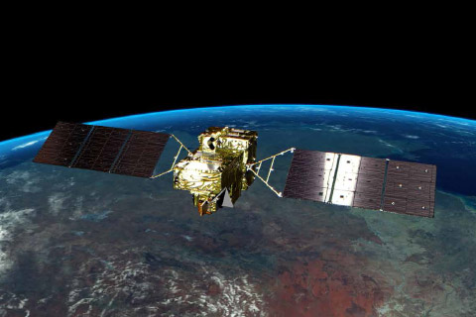
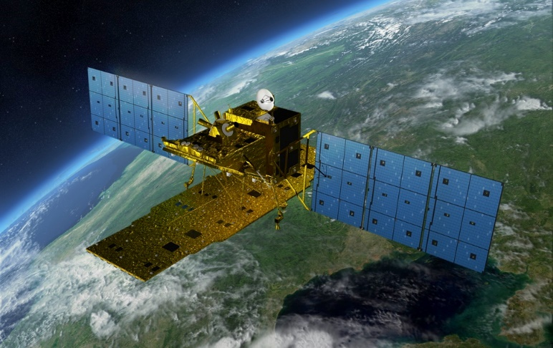
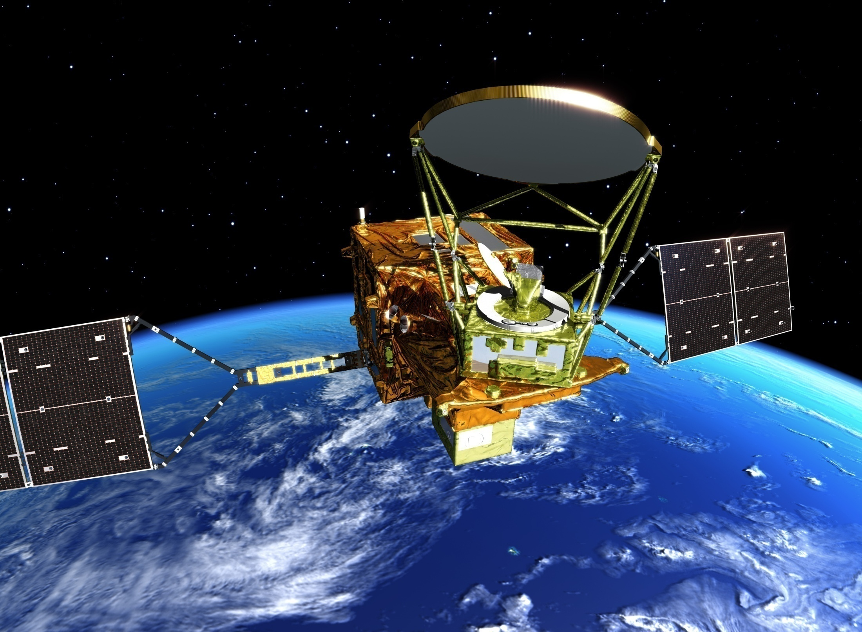
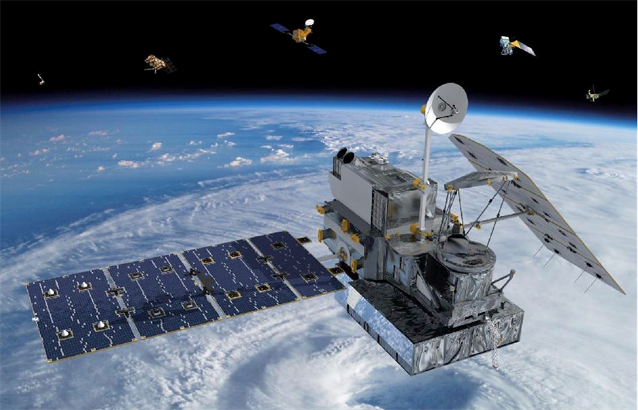

Current JAXA Earth Observation Satellites
Climate Change
Disaster Risk Management
GOSAT
GOSAT-2
GCOM-C
ALOS-2
Launched:
23 December 2017
Cloud/
Aerosols/
Vegetation
Launched: 2009
Launched:
29 October 2018
Greenhouse Gases
GCOM-W
GPM
DPR:
Dual Frequency Radar
Precipitation
Land Surface
(Radar)
Launched: 2014
Launched: 2012
Water Cycling
Launched: 2014
Courtesy of NASA

Slide 4
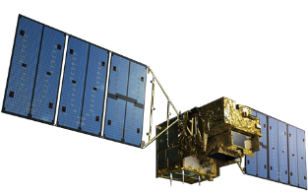
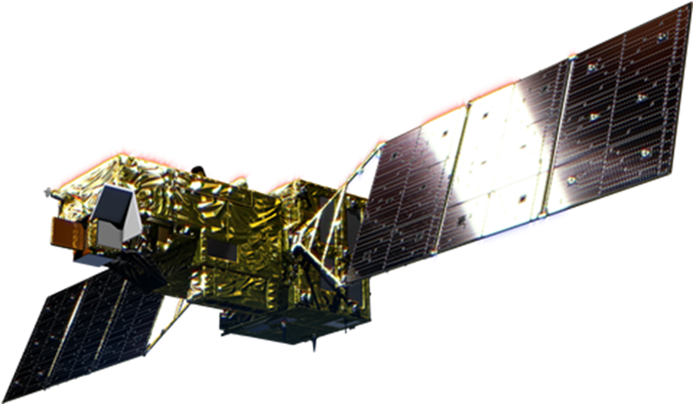
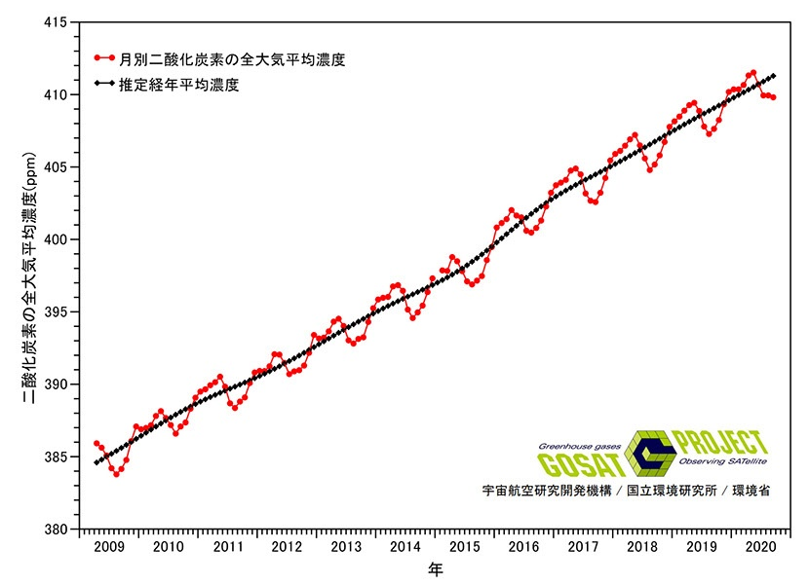
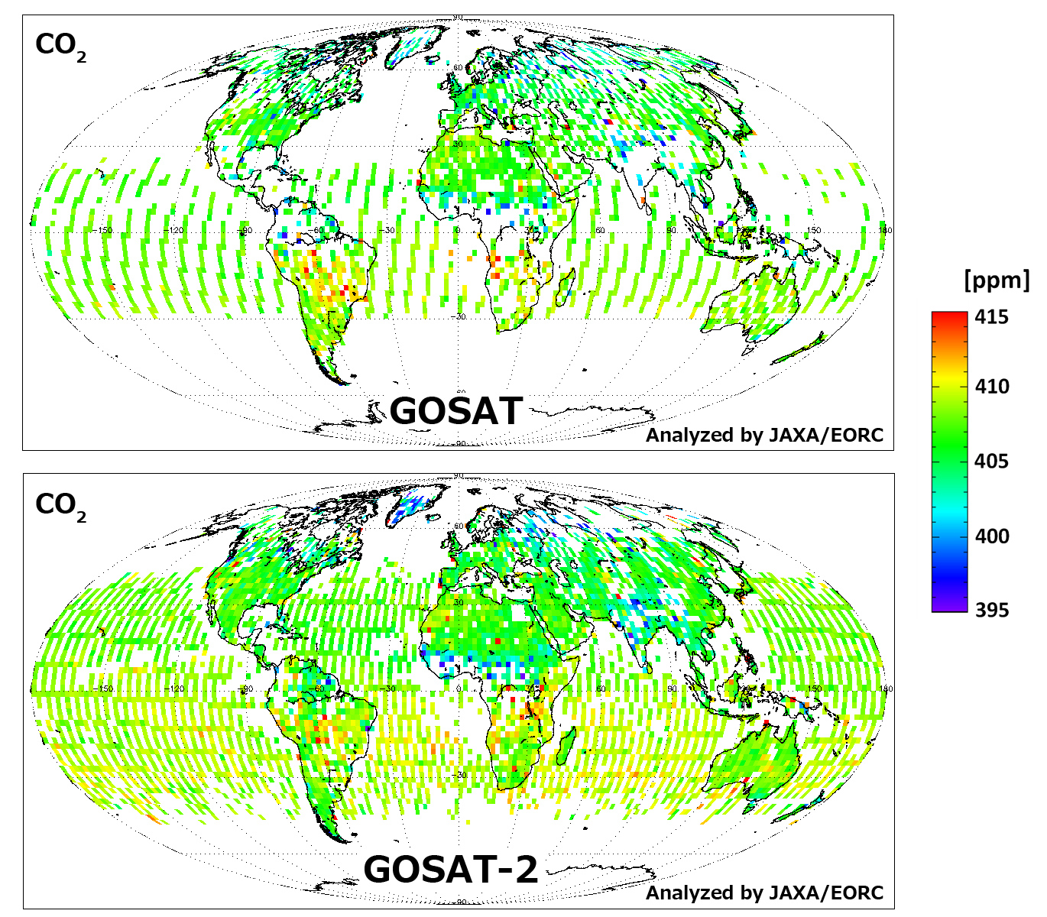
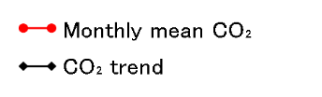

A-decade-long GHG observation by GOSAT and GOSAT-2
2009
2018
2019
2020
GOSAT
GOSAT-2
May 2020
411.5 ppm
ppm
Exceeded 400ppm December 2015
Year
GOSAT Whole-atmosphere Mean CO₂ April 2009 – September 2020
Global CO₂ concentrations observed by GOSAT and GOSAT-2 (September 2019)

Slide 5
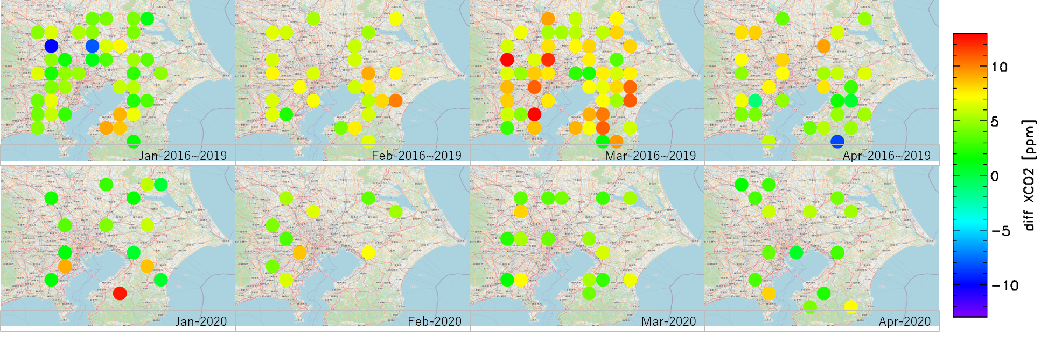
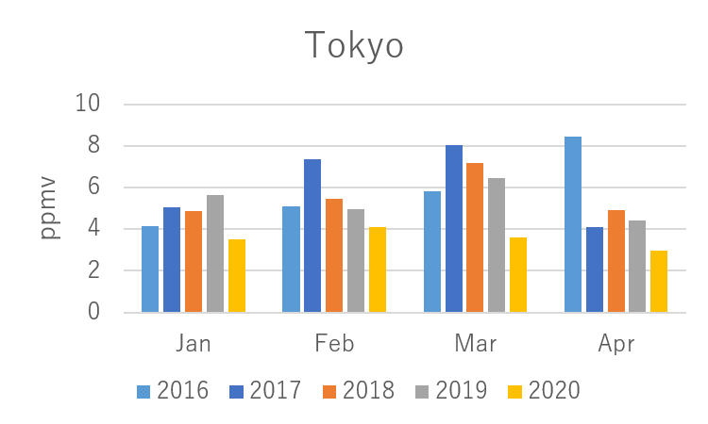
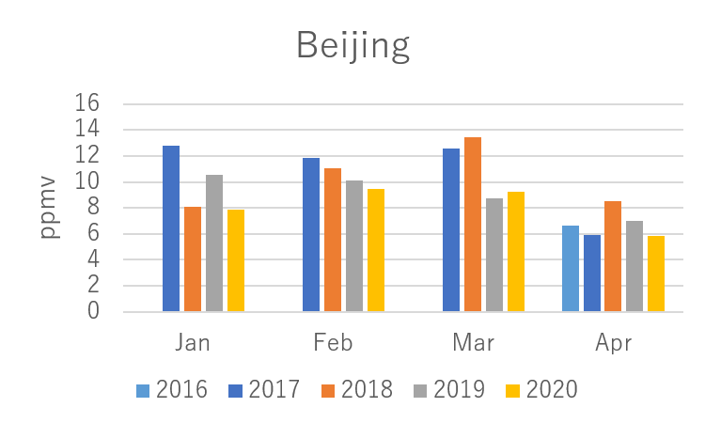
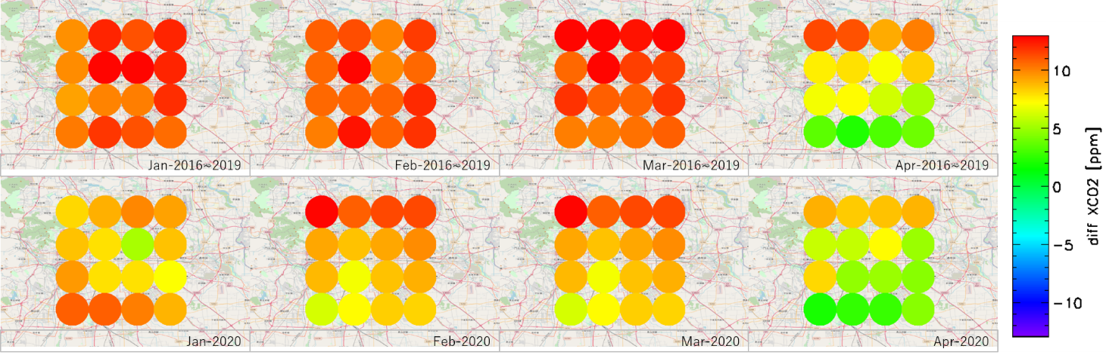
City Scale GHG Monitoring on COVID-19
Average monthly abundances of CO2 in the lower troposphere for the past 4 years (upper) and 2020 (lower) from GOSAT
The difference in CO₂ density in the upper and lower troposphere is smaller in 2020 compared to 2016-2019 in Tokyo and Beijing.
Analyzed by JAXA/EORC
Analyzed by JAXA/EORC
Analyzed by JAXA/EORC
Analyzed by JAXA/EORC

Slide 6
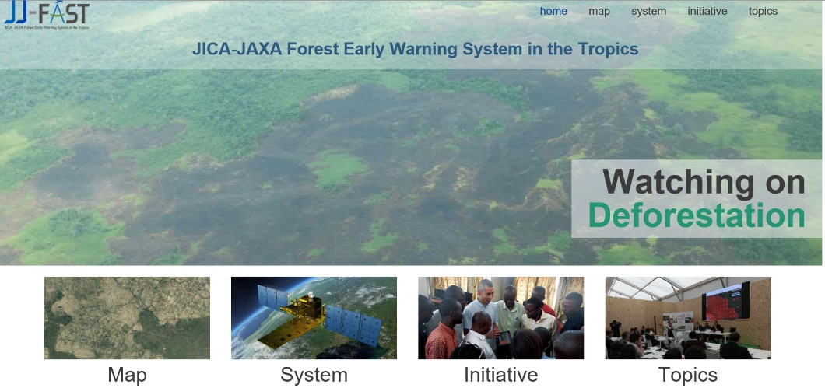
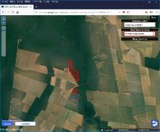
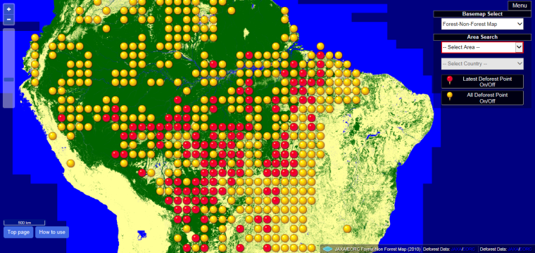
JICA-JAXA Forest Early Warning System in the Tropics (JJ-FAST)
JJ-FAST has been operated as a deforestation monitoring tool under the JICA-JAXA collaboration project since November 2016
JJ-FAST covers 77 tropical countries and disseminates deforestation areas detected by PALSAR-2/ALOS-2 (ScanSAR) for every 1.5 months
Deforestation polygon
Total detected number: 308,353 points as of April, 2020
(92,787 points were detected in Brazil)
Red indicates the latest Deforest Point
Yellow indicates all Deforest Point

Slide 7
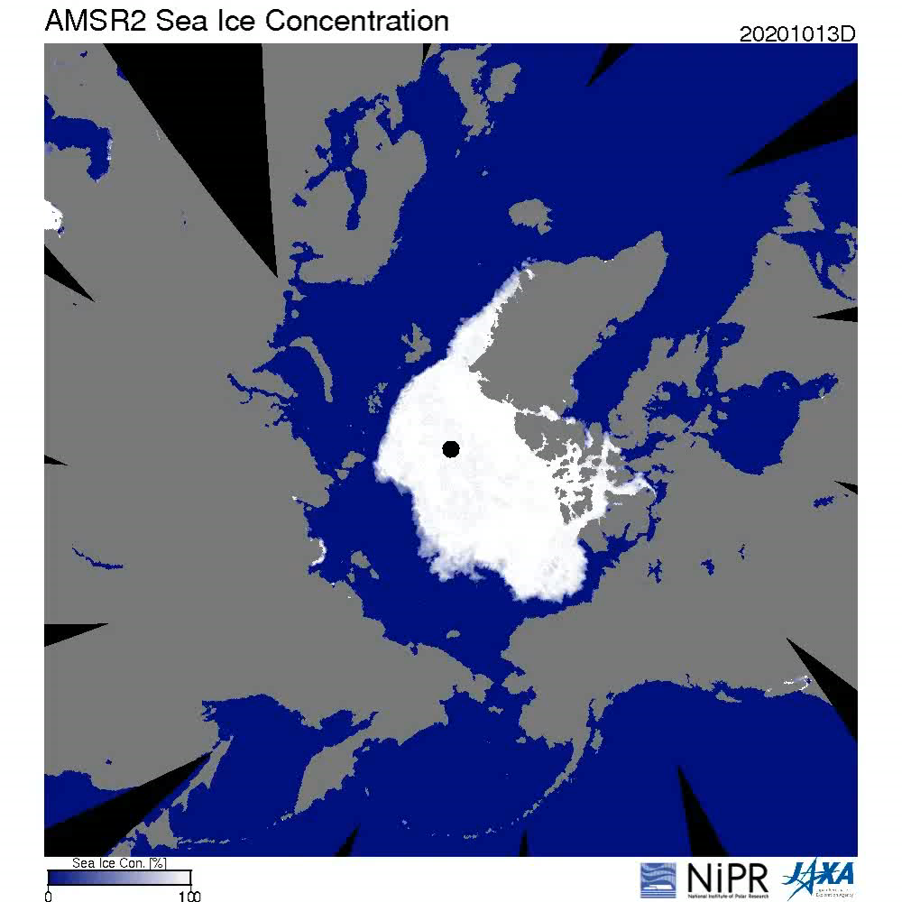
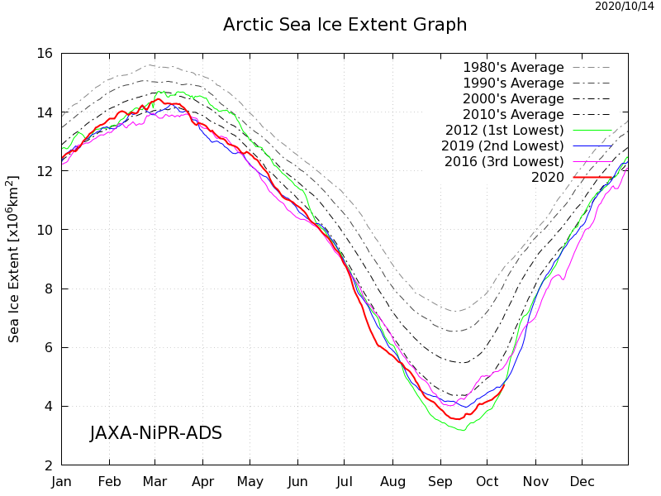
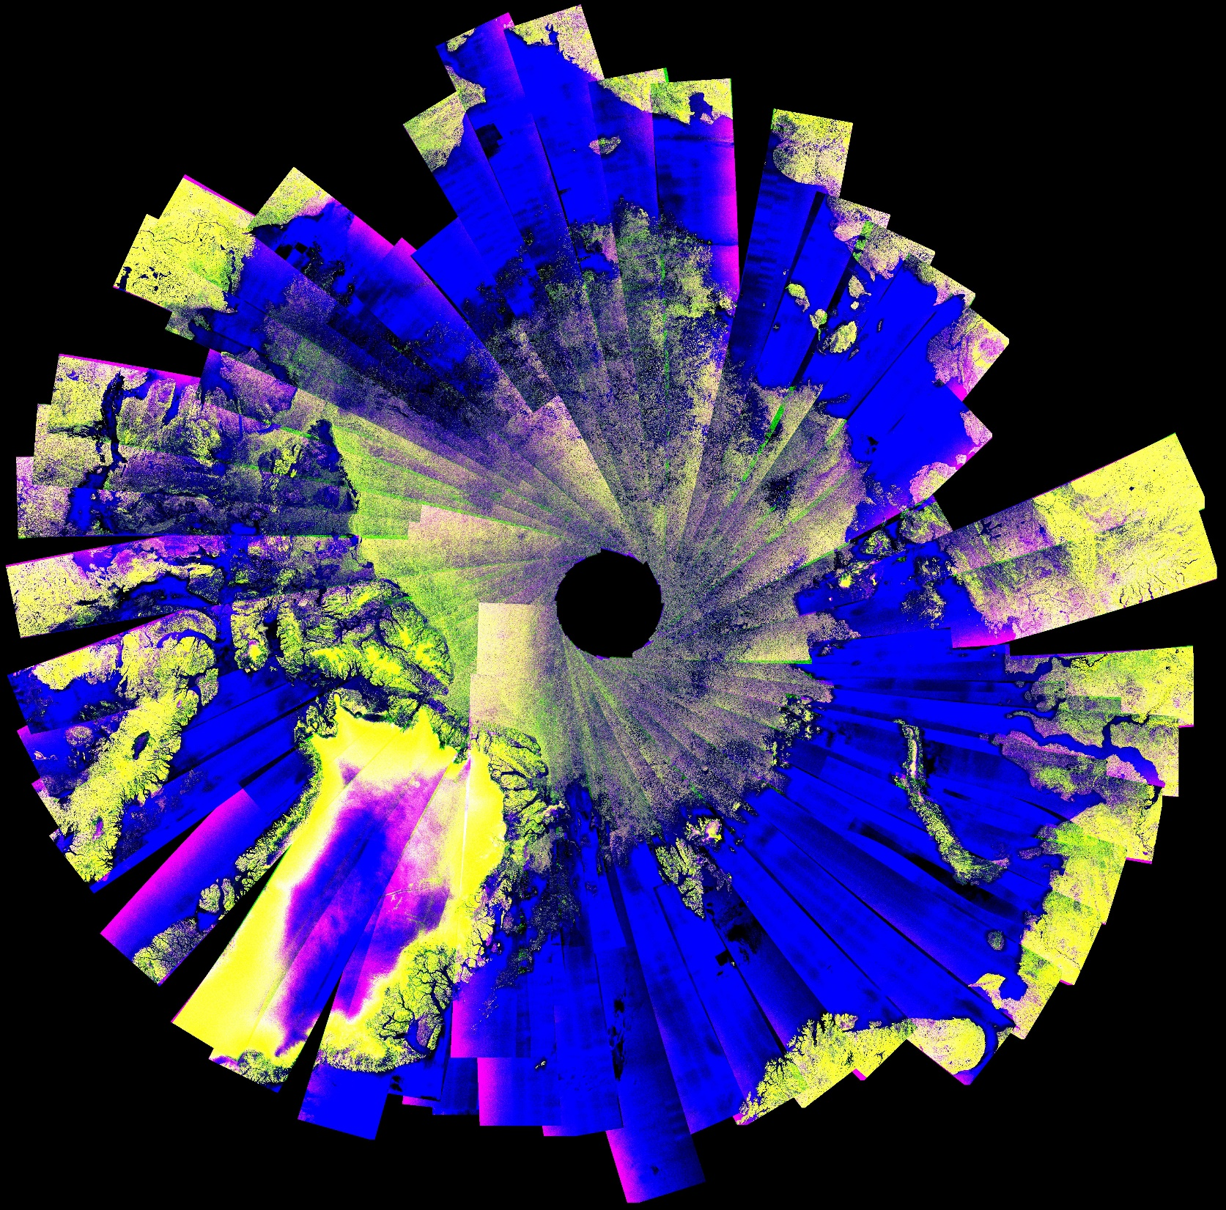
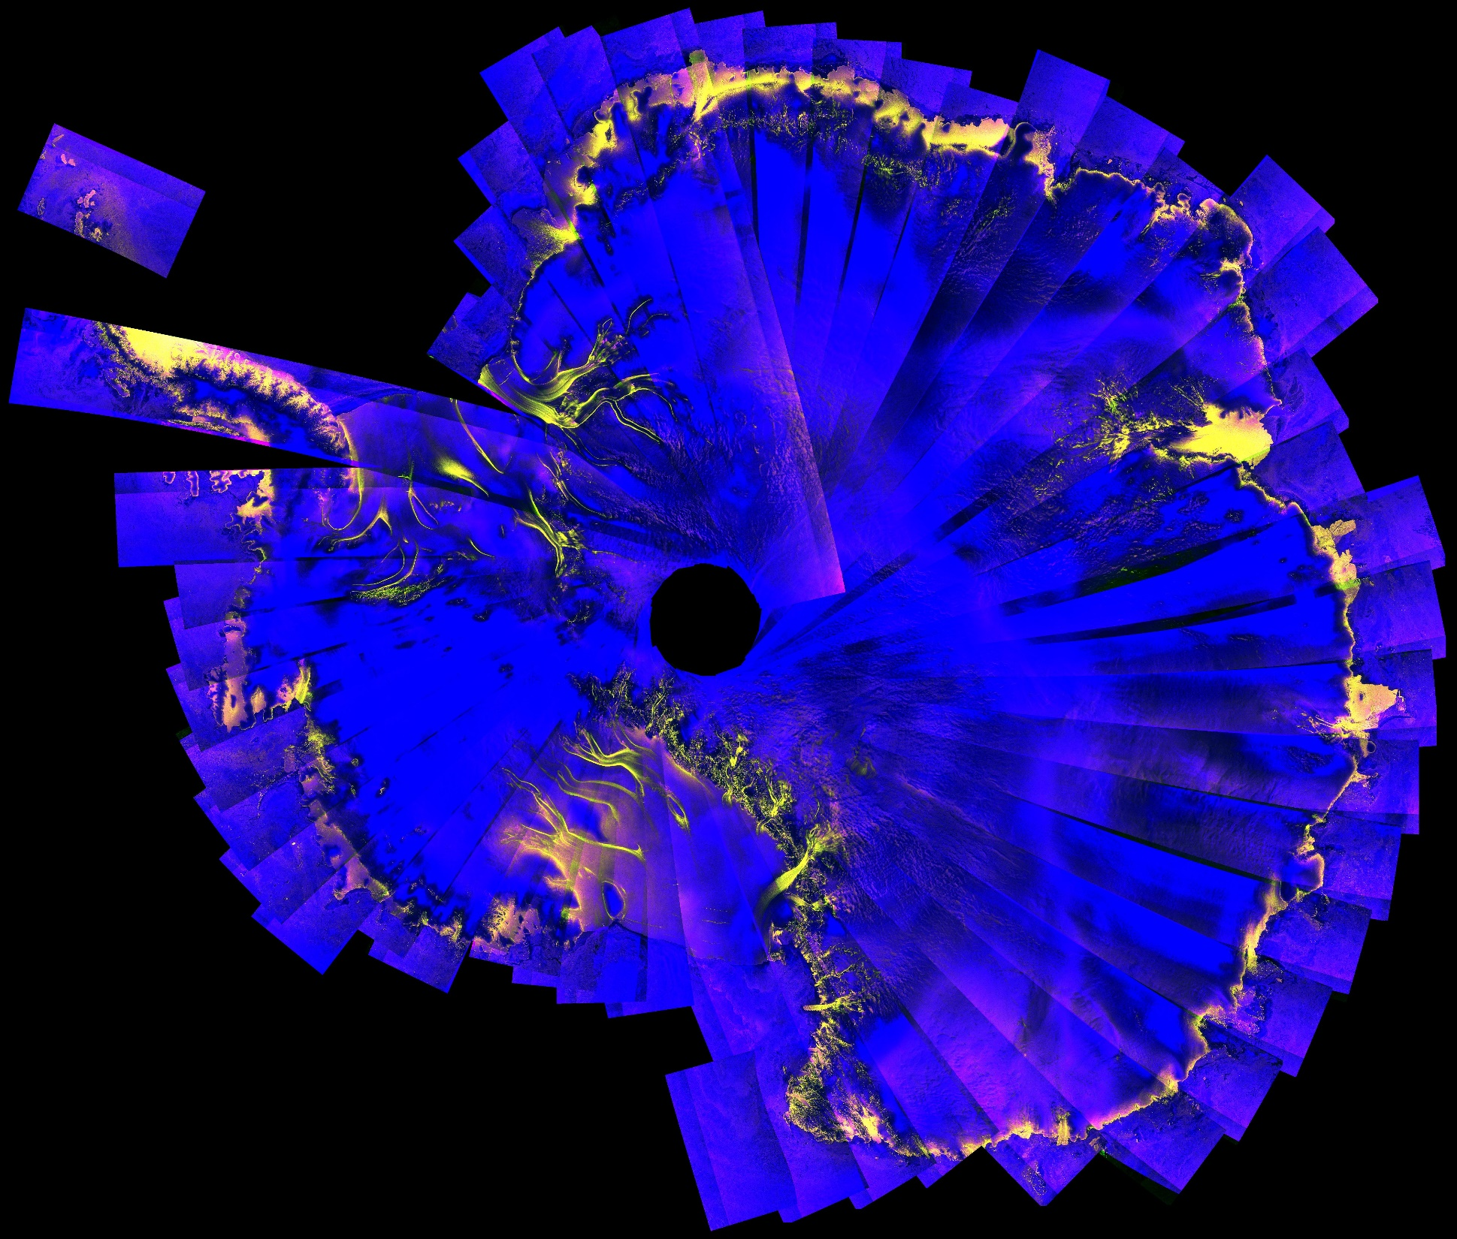
Monitoring Sea Ice
Arctic Sea Ice Concentration
GCOM-W/AMSR2 observes sea ice concentration everyday.
Arctic: August 2017
Antarctic: August 2017
Arctic/Antarctic
Sea Ice Mosaic Products
ALOS-2/PALSAR-2 ScanSAR Mosaic Products in Arctic and Antarctic for 2017.

Slide 8
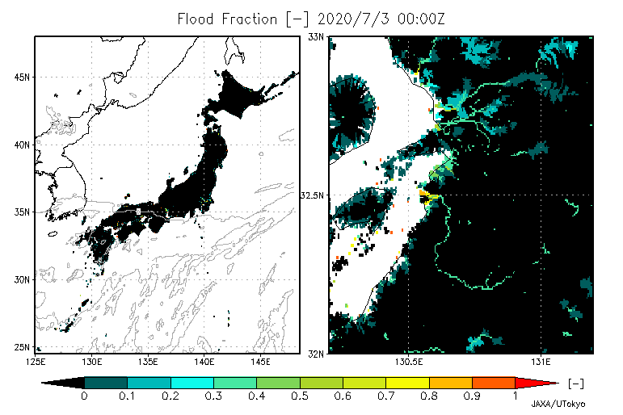
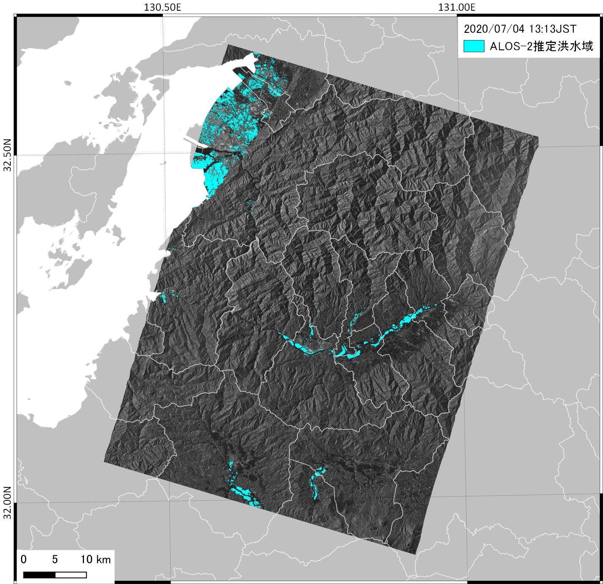
Land surface & river simulation system: Today’s Earth
JAXA has developed “Today’s Earth” under the joint research with University of Tokyo ( https://www.eorc.jaxa.jp/water/ )
Today’s Earth distributes & visualizes various hydrological products with 1km resolution for Japan and 25km resolution for global
Today’s Earth 3 days simulation results, flood area fraction for heavy rain event (July 3 -6, 2020) in Kumamoto prefecture
Flooded areas detected by ALOS-2 on July 4, 2020

Slide 9
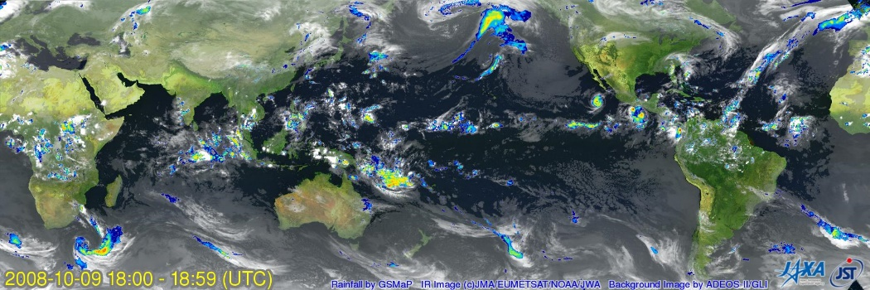
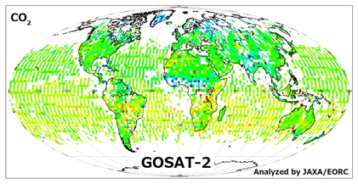
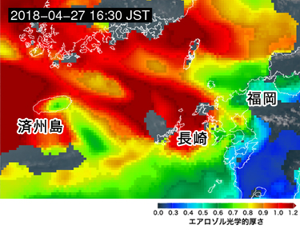
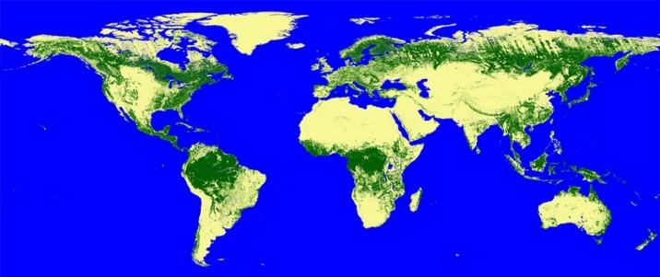
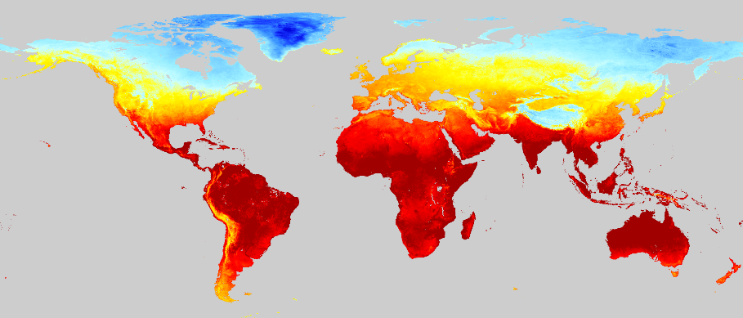

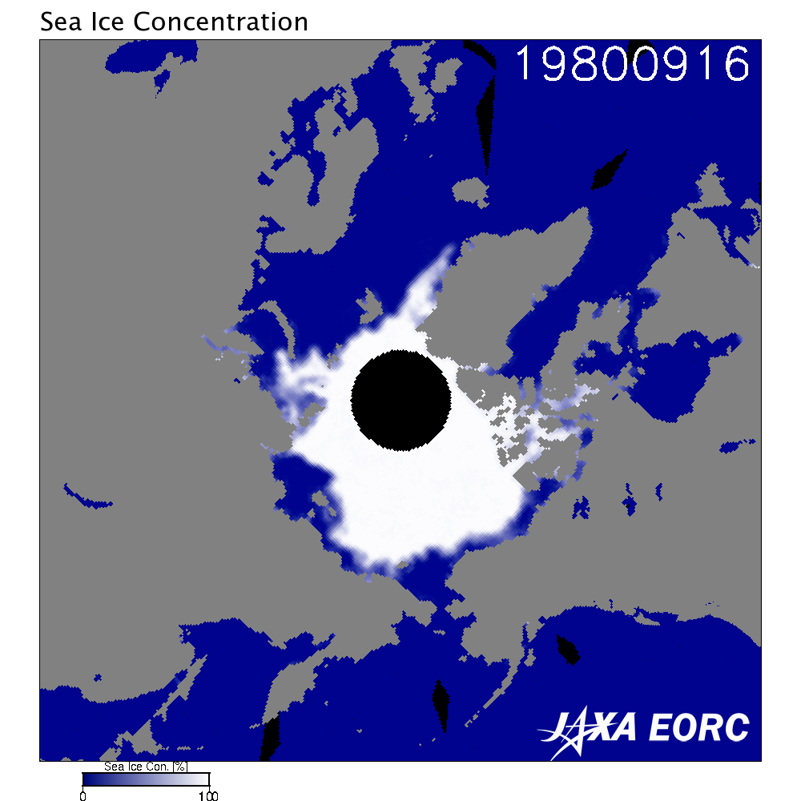
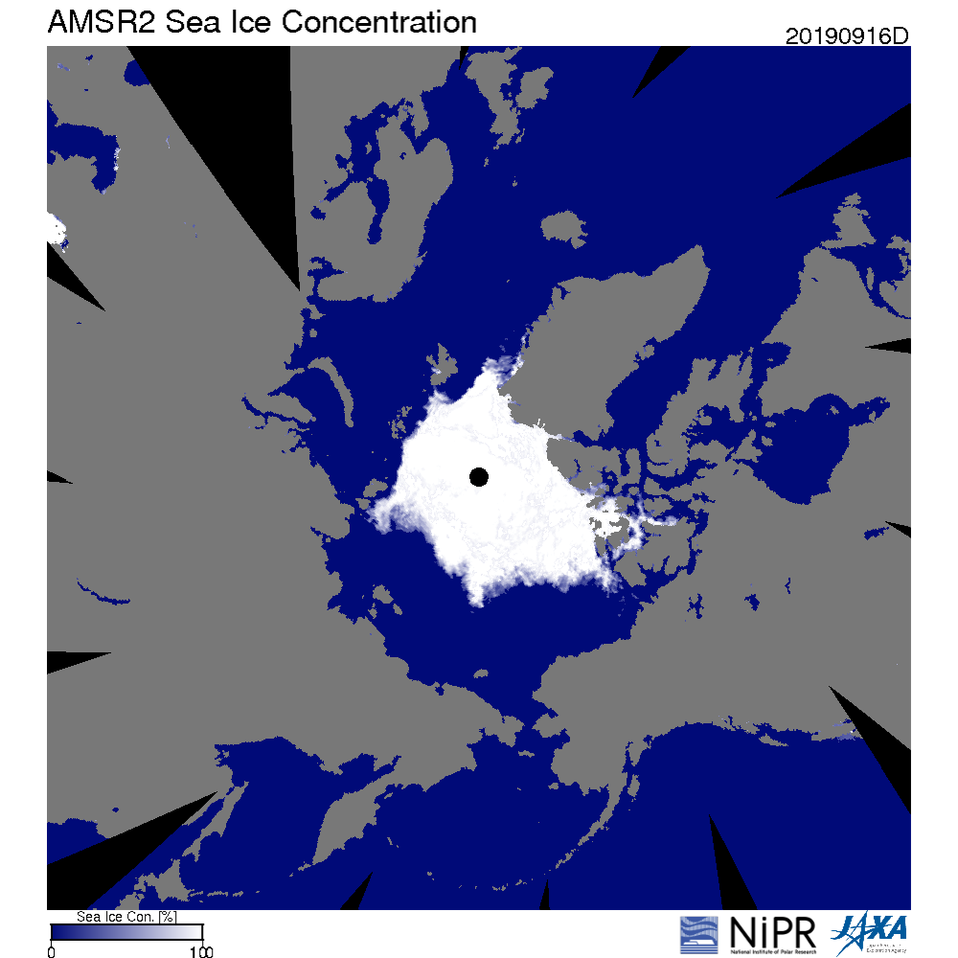
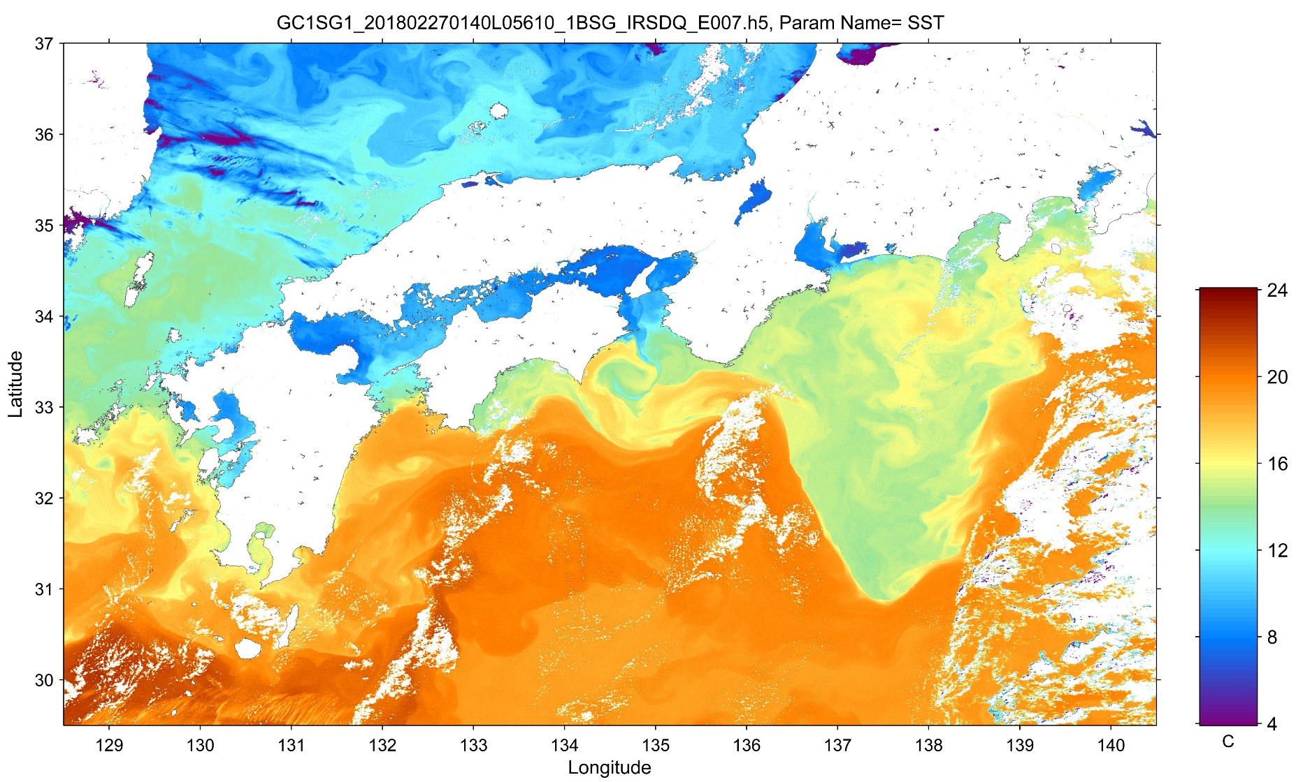
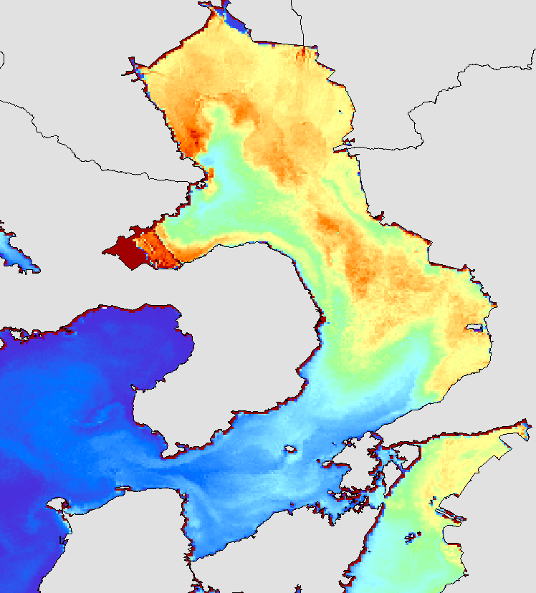
Sharing EO data for tackling Climate Change
Atmosphere
Precipitation
Greenhous Gasses
Aerosols
Land
Forest/Non-Forest
LST
1980
2019
Ocean
Arctic Sea Ice
SST
Chlorophyl-a Concentration

Slide 10

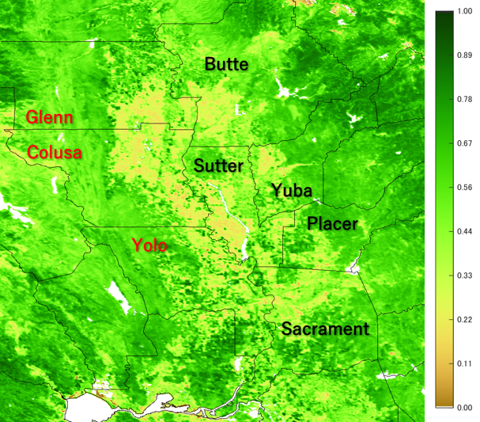
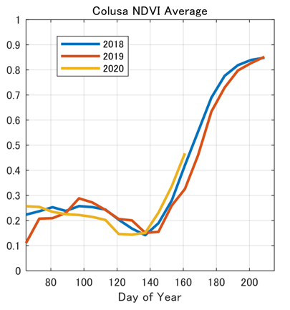
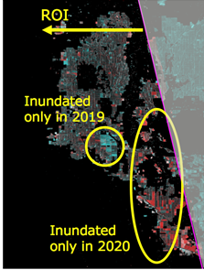
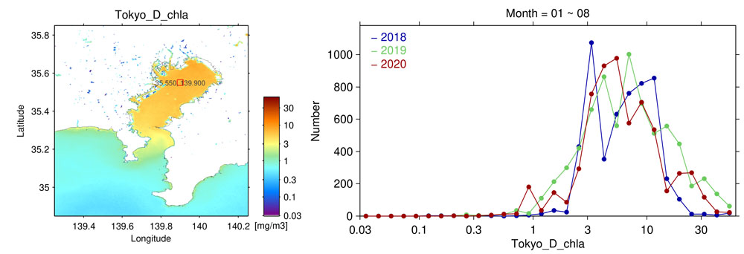
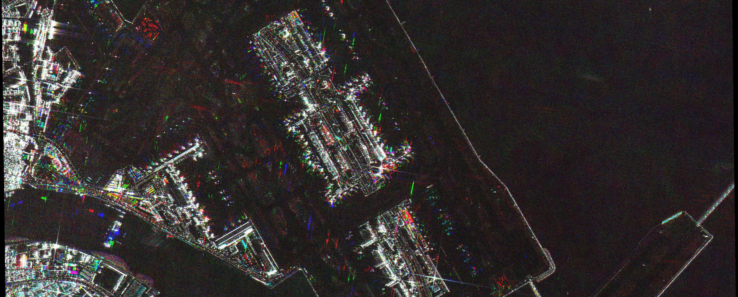
JAXA for Earth on COVID-19 http://earth.jaxa.jp/covid19/en.html
GOSAT
GCOM-C
ALOS-2
Climate: City scale greenhouse gasses
Agriculture: Rice planting
Water quality: Chlorophyll-a concentration
Industry & E activity : Airport throughout

Slide 11
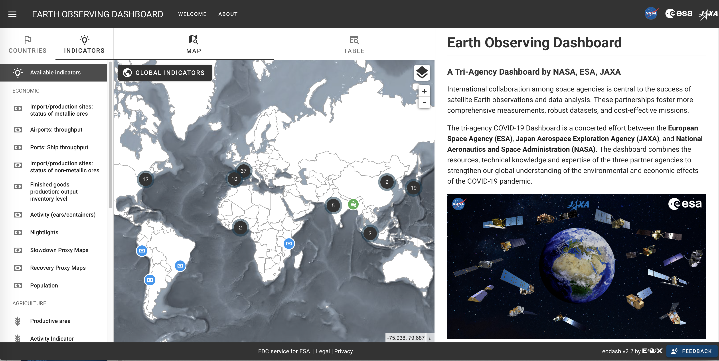
NASA-ESA-JAXA cooperation: Earth Observing Dashboard https://eodashboard.org

Slide 12
Free and open access to ALOS/ALOS-2 data
JAXA will provide free and open access to the wide-swath observation data from the L-band Radar satellites, such as ALOS (ALOS/AVINIR-2, PALSAR) and ALOS-2(ALOS-2/ScanSAR)
 |  | CY 2020 |  |  |  | CY 2021
 |  | 1Q Jan Mar | 2Q Apr Jun | 3Q Jul Sept | 4Q Oct Dec | 1Q Jan Mar | 2Q Apr Jun | 3Q Jul Sept | 4Q Oct Dec
ALOS | AVNIR-2 (10 m)
 | PALSAR FBS, FBD (10 m)
ALOS-2 | PALSAR-2 ScanSAR (25m)
Data Processing (Antarctic area)
Open to public
< -60 deg.
Global
Data Processing
Open to public
Japan
Global
Data Processing
Open to public
Japan

Slide 13
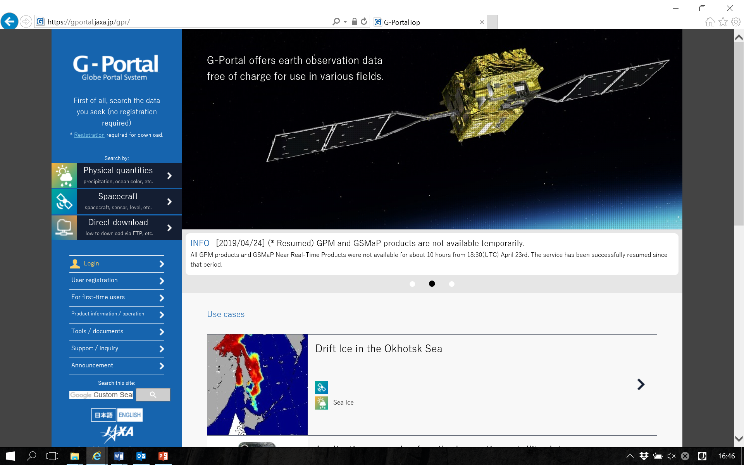
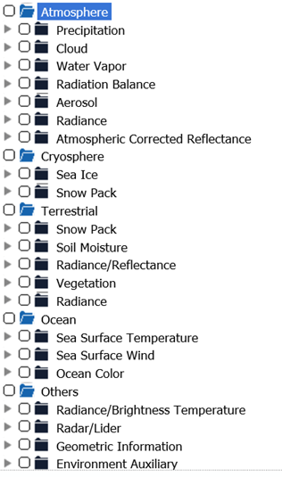
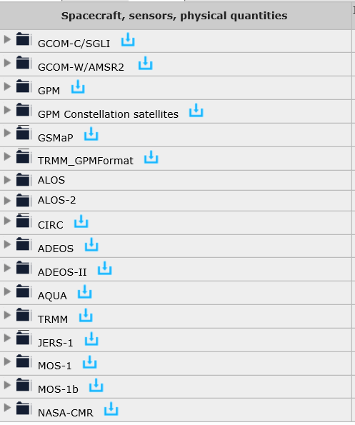
JAXA’s Data distribution system: G-Portal
https://gportal.jaxa.jp/gpr/

Slide 14
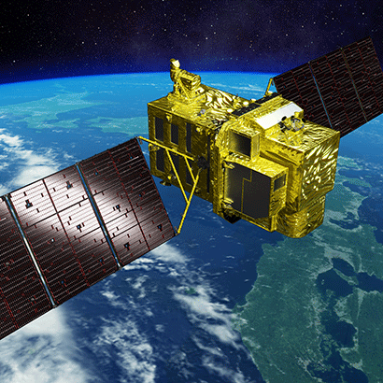
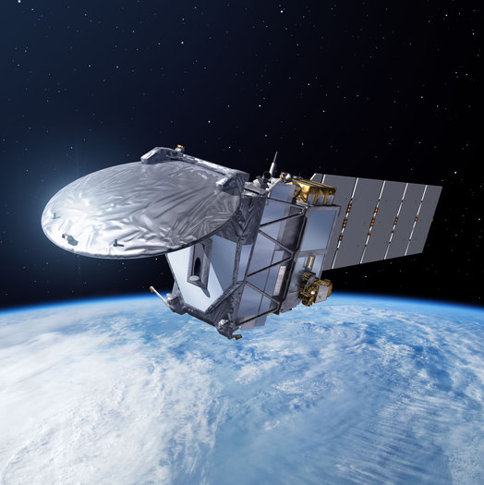
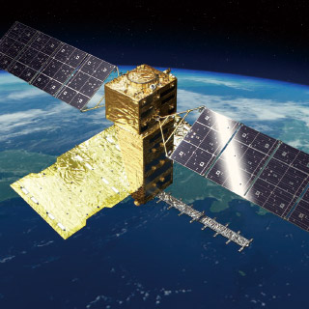
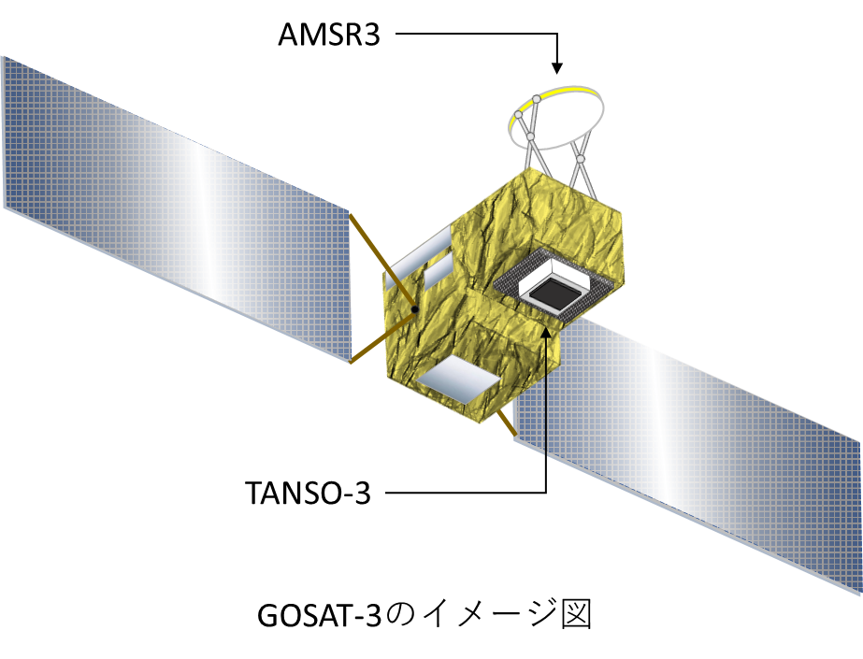

Future JAXA Earth Observation Satellites
2021-2022
2022-2023
2023-2024
ALOS-3, ALOS-4
Launch
EarthCARE
Launch
GOSAT-2 Follow-on Mission
/ AMSR3
Launch
Land
Surface
Cloud/Aerosol
Radiation Budget
Water Cycling
Land
Surface
ALOS-3
(Optical)
CPR:
Cloud Profiling Radar
GHG
ALOS-4
(Radar)
(MOE Mission)

Slide 15

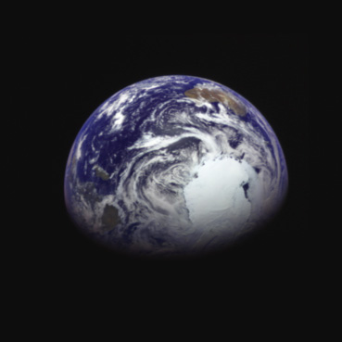
For Our Sustainable Future
Thank you for your attention.
Images of the Earth about 340,000 km from the center of the Earth took by the Hayabusa2 after the swing-by on December 4, 2015.

