Slide 1
Update on the ESA Earth Observation Programme
Committee on Earth Observation Satellites
Simonetta Cheli
European Space Agency
CEOS Plenary 2020
Agenda Item 4.9
20 – 22 October 2020

Slide 2
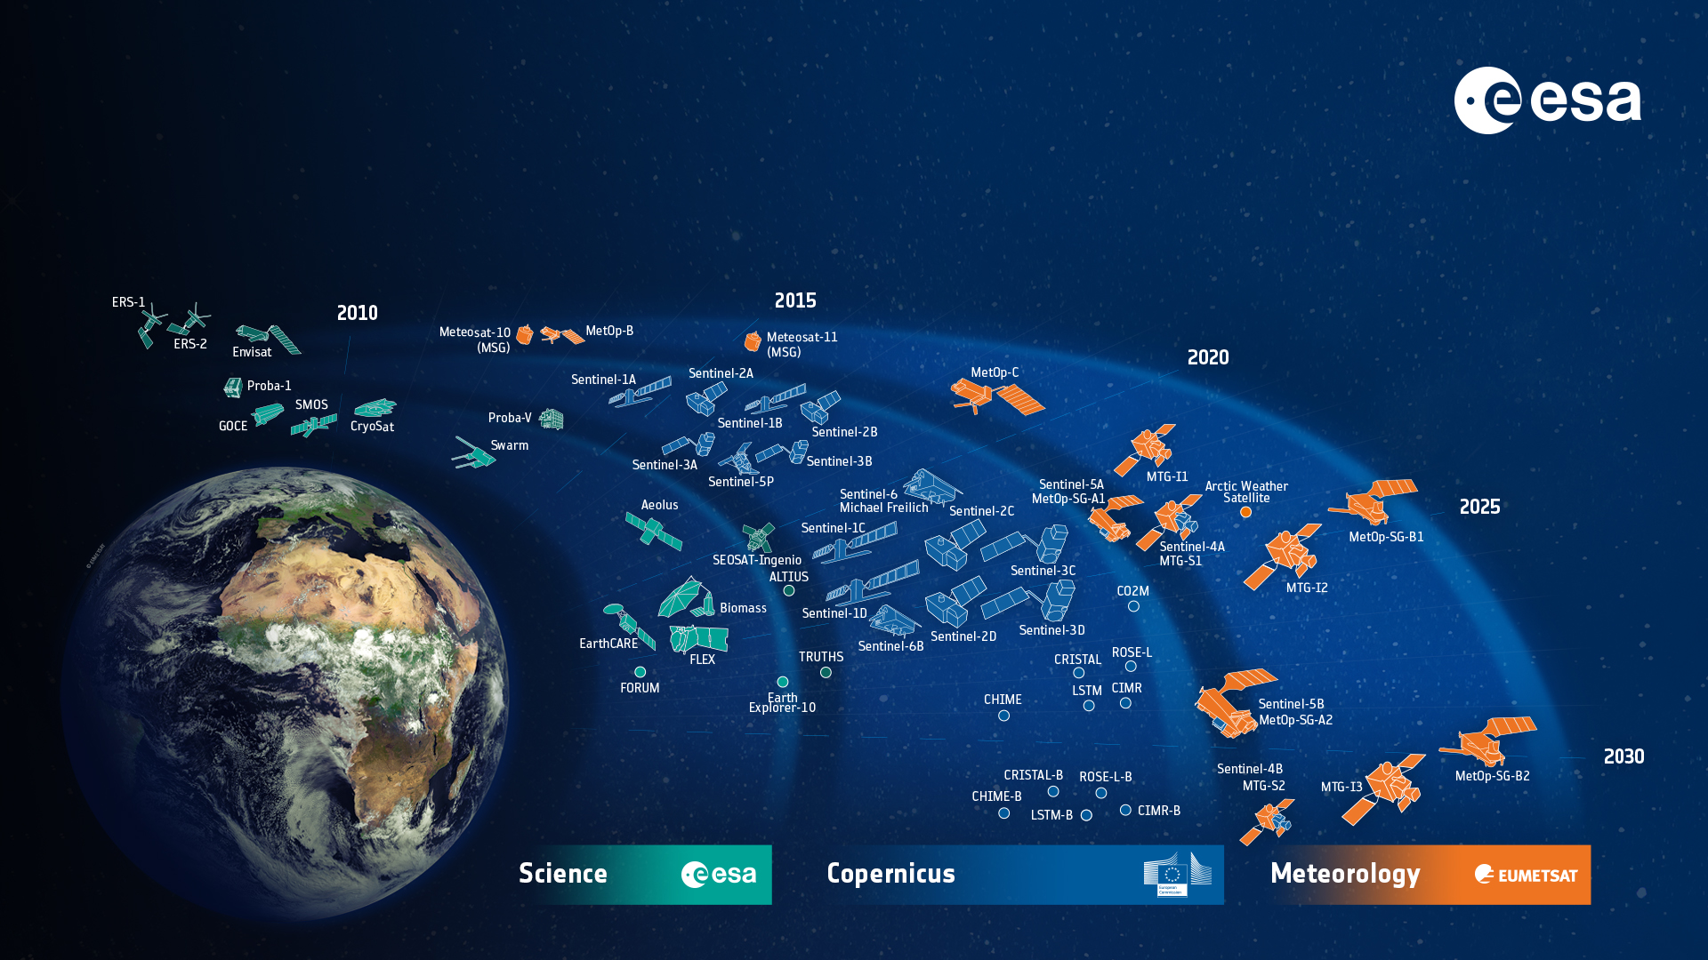
ESA-Developed Earth Observation Satellites
15 in operation
40 under development
13 under preparation
ESA UNCLASSIFIED – For Official Use
Notes:
D/EOP has three main lines of activities: Earth Science, Copernicus and Meteorology
Since the latest launch of Aeolus on 22 Aug. 2017, we have 25 satellites in development and 15 satellites in operation.

Slide 3
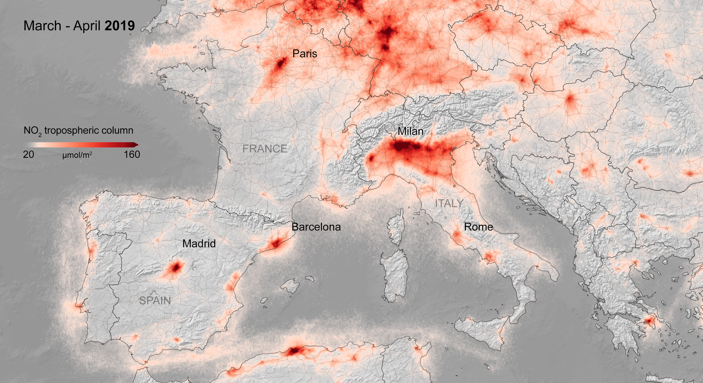
Impact of Covid-19 Lockdown on Air Pollution
Copernicus Sentinel-5P
ESA UNCLASSIFIED – For Official Use
Notes:
First of all, there are unexpected changes that have a strong impact of society, of course I am referring to Covid-19
Interestingly, EO has again proven its utility for society in this crisis
In this image, we see the NO2, which is an indicator for air pollution (data: 14-day average tropospheric column) for the months March – April for the years 2019 and 2020
As you can see most pollution in Europe is above major cities and industrial areas
Copernicus Sentinel-5P has shown how much the air pollution dropped as society went in lockdown (compare 2019 dark red to lighter red in 2020)
In most cities, the pollution dropped as much as 50% (see numbers in image, the second percentages are the error margins)

Slide 4
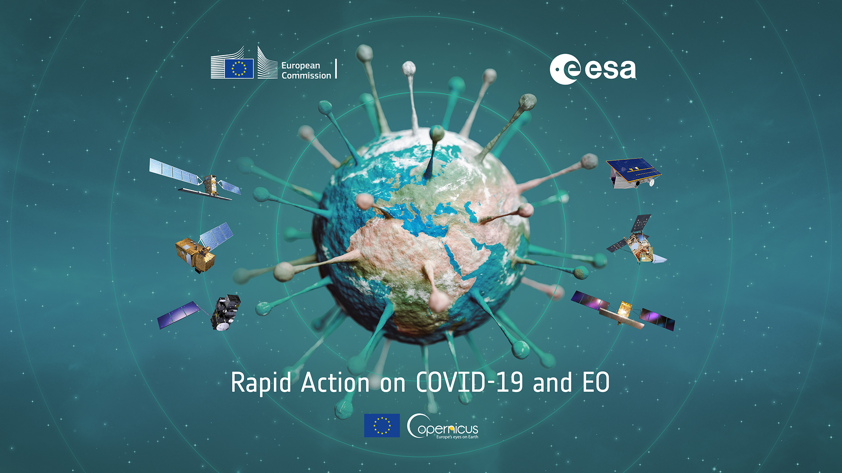
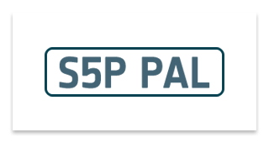
Rapid Action on Covid-19 and EO (race.esa.int)
66
28
35
31
COMPANIES
Single source of truth – EO data from Copernicus Sentinels and Third Party Missions
Made in Europe
Straightforward to use
Informative
Engaging public & community via EuroDataCube contest
ECONOMIC
AGRICULTURE
ENVIRONMENT
ESA UNCLASSIFIED – For Official Use
Notes:
Single source of truth – EO data from Copernicus Sentinels and Third Party Missions
Made in Europe, combining ESA expertise with European industrial skills and EO Platforms leveraging AI4EO
Straightforward to use by non-technical users
Informative for general public and decision makers
Communicates the effects of the lockdown on the environment and the economy, observable from space
Engaging public and community via the EuroDataCube contest
Showcases real examples of the pandemic’s effects
in 200+ representative Areas of Interest across the EU*
through 129 Indicators* such as air and water quality, agricultural production, travel, manufacturing or trade.
All went from idea to launch in 2 months
Over 100.000 visitors by now!!

Slide 5
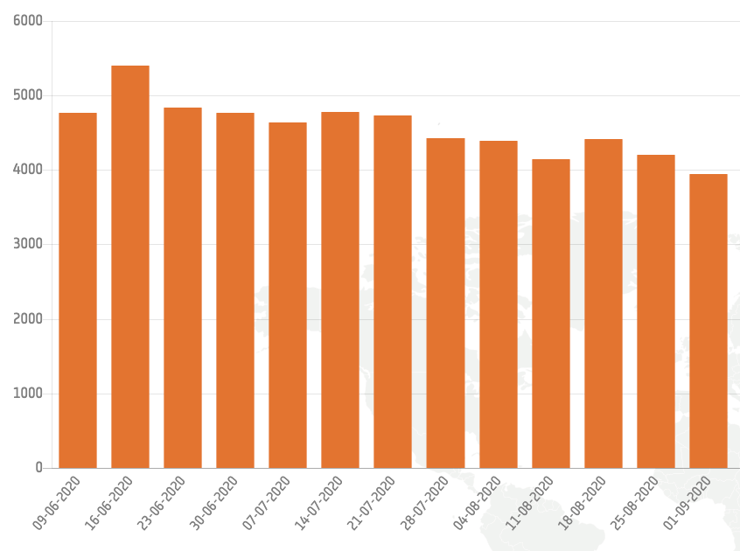
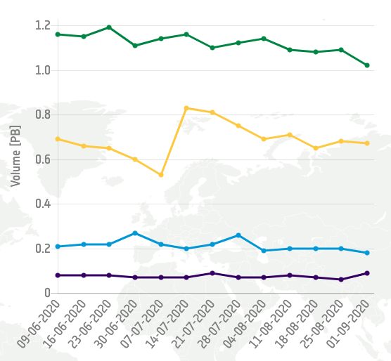
Copernicus Sentinel User Demand remains high
Weekly trend of Sentinel active users
Weekly volume of downloaded products
Sentinel-2
Sentinel-1
Sentinel-3
Sentinel-5P
ESA UNCLASSIFIED – For Official Use
Notes:
Note: there seems to be a slight dip in the numbers but that is most likely the annual summer holiday effect!

Slide 6
SEOSat - Ingenio
Launch scheduled on 13 November 2020 from Kourou
© Airbus Defence and Space, Spain
ESA UNCLASSIFIED – For Official Use
Notes:
SEOSAT–Ingenio in the cleanroom at Airbus in Spain.
The mission will provide high-resolution multispectral images of the environment for applications such as cartography, monitoring land use, urban management, water management, risk management and security.
While SEOSAT–Ingenio is a Spanish national mission, it has resulted thanks to an international collaborative effort.
The mission is funded by Spain’s Centre for the Development of Industrial Technology (CDTI) but developed and managed by ESA in the context of the European Earth Observation Architecture.

Slide 7
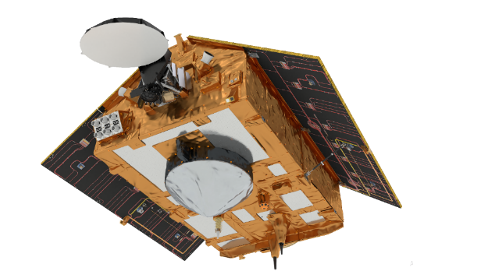
Sentinel-6 Michael Freilich
Launch date stable for years: 10 Nov 2020
Shipping to the United States for launch with SpaceX marks beginning of launch campaign
Major work-around solutions for AIT/AIV under COVID constraints implemented between ESA, Airbus, Eumetsat, NASA, CNES etc.
ESA UNCLASSIFIED – For Official Use

Slide 8
Copernicus – 6 HPCMs Contract Progress
31 July: ESA and OHB System AG signed the contract for the development of the Copernicus CO2M
21 September: CRISTAL contract signed with ADS DE (Prime) and TAS FR (Instrument Prime)
ESA UNCLASSIFIED – For Official Use

Slide 9
Thank you for your attention!
www.esa.int

