Slide 1

USGS Status
Committee on Earth Observation Satellites
Timothy Stryker, USGS
CEOS Plenary 2020
Additional Reference Item
20 – 22 October 2020

Slide 2
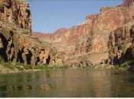


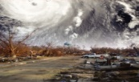


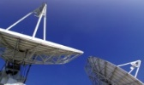
USGS – Organization & Mission
Mission: Provide reliable scientific information to describe and understand the Earth; minimize loss of life and property from natural disasters; manage water, biological, energy, and mineral resources; and enhance and protect our quality of life.
USGS:
≈8,500 employees
65 science centers
400 field offices
1,000s of stream gauges and seismic monitoring stations
≈ 40 PB EROS Data Archive
2 orbiting Landsat satellites
Ecosystems
Energy and Mineral Resources and Environmental Health
Natural Hazards
Water Resources
Land Resources
Core Science Systems
Notes:
USGS had 7 mission areas, however this has been streamlined down to 5 with Environmental Health being combined with Energy & Mineral, and Land Resources combined into Core Science Systems.
The National Land Imaging (NLI) Program, as part of that consolidation, is now within the Core Science Systems Mission Area.

Slide 3
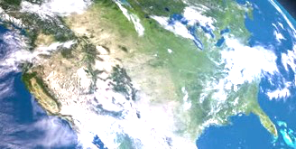
EarthMAP
Earth Monitoring, Assessment and Projection
An interdisciplinary, multi-scale, multi-process system of data, tools, models, and supporting science for earth system monitoring, assessments, and projections that answer pressing stakeholder questions
INTEGRATED PRODUCTS
Earth Monitoring, Analyses, and Projections (EarthMAP)
Delivery
Atmospheric Science
Analyses
Humans
Communication
Fauna
Modeling and
Integration
Flora
DATA SYNTHESIS
EARTH SYSTEM
CHARACTERIZATION
Water Chemistry
Observations and
Monitoring
Water, Ecosystem,
Resource, Hazard
Surface and Groundwater
Land Surface
Soils
Research and Development
Geologic Setting
Crust
TEMPORAL
SPATIAL
Notes:
Earth Monitoring, Assessment and Projections – it’s the guiding vision for USGS
Drawing upon the full range of EO data, integrated modeling, and actionable science, we seek to better characterize the current state and future behavior of the entire Earth system
This is a significant advancement from the current state of research, monitoring, and forecasting
More integrated, more real-time actionable approach
But will be within reach in the coming years
Wide range of well-curated data sets
Cutting-edge science
Cloud hosting, computing, and analysis (drawing upon AI and ML approaches)
Synthesize a wide range of data at various temporal and spatial scales
Model, analyze, and deliver actionable decision support to our Department and other external stakeholders

Slide 4
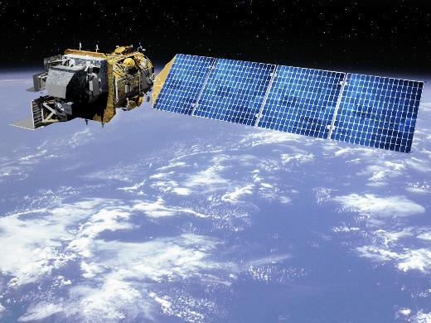
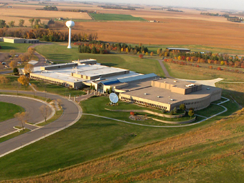
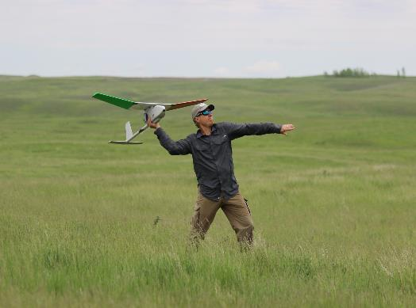
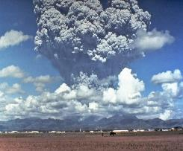
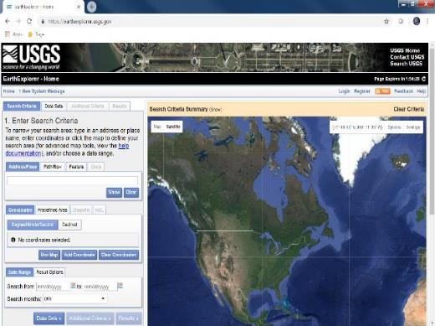
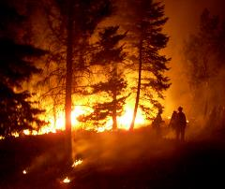
National Land Imaging Program (NLI)
Delivers a national and global capability to ensure broad public and scientific availability of observations of the Earth’s land surface
EROS Center
Landsat 7, 8, 9, and beyond
Earth Explorer –
https://earthexplorer.usgs.gov/
Hazards Data Distribution System -
https://hddsexplorer.usgs.gov/
Nat’l Civil Applications
Center
Unmanned Aerial Systems (UAS)
Notes:
The NLI Program is the USGS HQ component supporting the conduct of a wide range of land-imaging activities for societal benefit.
It establishes priorities and objectives for land remote sensing system operations, data management, and science applications, and funds a variety of USGS science centers to carry out their associated activities.

Slide 5
USGS NLI Program
Satellite Operations & Data Records
  Create and preserve a long-term record of the Earth’s land surface at local, regional, and global scales
  Develop and operate systems to acquire, produce, preserve, and deliver products and services to meet civil Earth observation research and operational requirements
Science, Research & Collaboration
  Expand scientific understanding and application of remotely sensed data to government and private users
  Conduct science, research, and technology investigations to improve upon and develop new products and services
    Applied science & applications, including drought monitoring, global cropland estimates
    Remote sensing research and development, including unmanned airborne systems
  Support government policy and decision makers, to help guide national decisions to meet needs for land science and land observation
  Coordinate and integrate civil Earth observations with other sources of data, including international, commercial and National Security space systems
Fundamental goal: Ensure public availability of a primary data record about the historical condition and current state of the Earth’s land surface and to predict its future condition
Notes:
The NLI Program is focused on the operational delivery and use of land imaging data for public benefit, including the “front end” planning, coordination, and analysis
NLI Program priorities for 2020
Work with NASA, the Administration, and Congress to define and begin implementing Landsat-Next
Maintain operational continuity of Landsat 7 and Landsat 8
Collaborate with NASA on Landsat 9 space and ground system development and launch
Define and prepare for Global Analysis Ready Data
Release operational product for Land Change Monitoring, Assessment, and Projection (LCMAP)
Place all Landsat data on the Commercial Cloud
Have Landsat Collection 2 available > one year before Landsat 9 launch
Advance Strategic Partnerships to enhance operational land-imaging capacity
Continue working toward Landsat/Copernicus Sentinel-2 harmonization
Investigate UAS/small satellite/Landsat harmonization potential
Align NLI projects toward achieving the EarthMAP vision
NLI Program components
Satellite operations: L7 and L8 operations, L9 ground system development, analyze user requirements and determine system specifications for Landsat-Next
Science, Research, and Engineering: Improve land-imaging products/services, remote sensing R&D (incl UAS), Civil Applications activities
NLI Statistics
≈$99M annual budget, ≈145 Gov’t employees, ≈300 Contractors, HQ+6 science centers, ≈ 45 PB EROS Archive, 2 Landsats

Slide 6
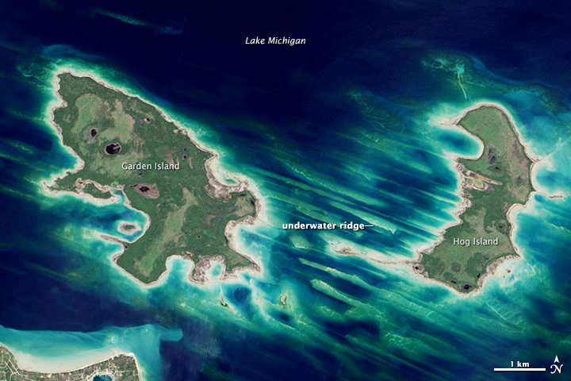
What is Landsat?
The world’s longest-lived series of land imaging satellites, providing a 47+ year archive of natural and human-induced changes to the global landscape, informing land and natural resource management decisions, and helping us understand Earth system change
Multi-spectral coverage in VNIR-SWIR-TIR*
-> to map surface composition and temperature
15 / 30 / 100 meter spatial resolution
-> to resolve human-scale land dynamics
16-day revisit frequency (8-days w/ two operational satellites)
-> global, seasonal coverage
Broad area collection => 12,000+ square miles per image
-> 1200 images/day = 15 million square miles/day
Highly-calibrated “science quality” data
-> to resolve long-term trends & retrieve biophysical variables
Free and Open Data policy since 2008
-> 20 million products distributed by USGS last year
Common Uses of Landsat data by Federal Agencies, States, and the private sector:
Agriculture and Forestry
Regional Land Use Planning
Mapping
Fire/Disaster Management
Land Use/Land Cover
Water Resources Planning
Global Change Science
Flood Management
National Security
Ecosystem Monitoring
Famine Early Warning
Carbon Assessment
Drought Monitoring
Transportation Planning
Calibration/Validation
*VNIR: Visible & Near Infrared SWIR: Shortwave Infrared TIR: Thermal Infrared
Notes:
Landsat is the foundational, “flagship” land-imaging system for our program
Long-time series of science quality data essential to informed public- and private-sector decisions in these application areas listed here

Slide 7
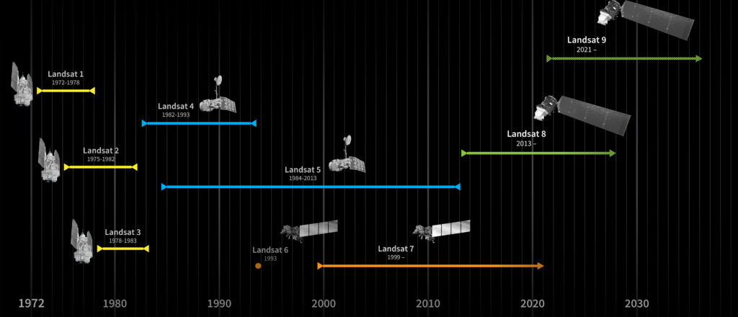
Landsat Program
The Landsat Program has amassed the longest and most comprehensive record of the Earth’s land surface in existence
Joint SLI Architecture Study Team (AST) completed its final report in 2019
AST delivered a set of viable architecture concepts for the next mission providing a basis for formulating future acquisition strategies
NASA and USGS Leadership working to develop details and options as part of their FY 2022 budget requests
Sustainable Land Imaging (SLI) is an interagency partnership between DOI/USGS and NASA to maintain a sustainable program for spaceborne land imaging:
-NASA: Space Segment & Launch
- USGS: Operations & Data
Notes:
As part of the SLI partnership, USGS documented user requirements across Federal agencies, while NASA conducted technology investigations to reduce cost & risk in future missions.
Information on USGS’s and NASA’s plans for Landsat Next will be publicly released in February 2021.
Landsat is inherently international, and we continue to benefit tremendously from our many ground station partnerships.
Technology is advancing rapidly, and we must collectively determine how best to leverage it to advance global Landsat observations.

Slide 8
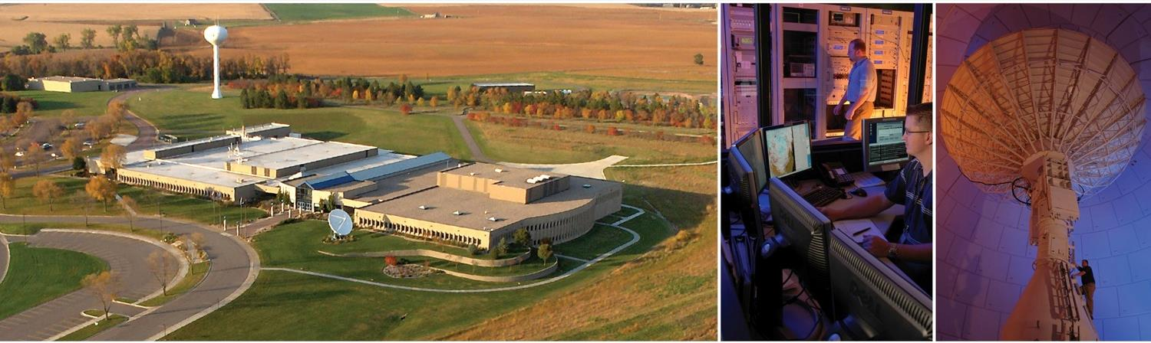
Earth Resources Observation and Science Center (EROS)
A USGS science center and one of the world’s largest land remote sensing centers
Landsat satellite mission ground segment – developer and operator
National Satellite Land Remote Sensing Data Archive (NSLRSDA)
Hosts NASA Land Processes Distributed Active Archive Center (LPDAAC)
Member of the International Charter for Major Disasters and Space
One of six Department of the Interior Core Data Centers
Notes:
Traditional “on-prem” facility for Landsat
Manages 46.7 PB (Aug 2019) of science data (17.1 PB Landsat)
Last 12 months (Aug 2019), distributed 46.4 PB, (20.9 PB Landsat)
Whether cloud or on-prem, USGS still manages, and will always manage/own the data to ensure the quality.
Landsat includes:
Landsat-MSS, TM, ETM+, OLI/TIRS, OLI, TIRS, Landsatlook, ESPA, as well as Landsat Derivative Products: Image of the Week, Earth As Art, Other Image Gallery Images, MRLC, NALC, NLDC, TriDecadel, LIMA, GLS, Landsat Systematic L1G, Landsat Film, NLCD
ESPA -Landsat Surface Reflectance Climate Data Records (CDRs)
Analysis Ready Data (ARD) Tiles include:
For each tile, there are six available files to download (4 .tar.gz, 1 Browse). The files are Surface Reflectance (SR), Top of Atmosphere (TA) Reflectance, Brightness Temperature (BT), Quality Assessment (QA), Full-Resolution Browse.
NASA LPDAAC includes: MODIS, ASTER, SRTM, Community (GED), MEaSURES, VIIRS, and WELD
Sentinel-2 includes: Sentinel-2A and Sentinel-2B
ISRO Resourcesat includes: ISRO Resourcesat1 (AWIFS & LISS-3) and ISRO Resourcesat2 (AWIFS & LISS-3)
Other Satellite includes: AVHRR, Declassified, EO-1 ALI, EO-1 Hyperion, SPOT, IKONOS, AWIFS, OrbView, QuickBird, WorldView, HCCM, Aster (EE), MODIS (EE/GloVis), eMODIS, and CEOS
Non-Satellite includes: Historical/SCAR, AHAP, NAPP, NHAP, DOQQ, DLG, DRG, SRTM, SIR-C, DEM, Image Gallery, Aircraft Scanners, and ASAS
Geospatial includes:
Orthoimagery-High Resolution Orthoimagery, DOQQ's, DRG's, NAIP, and Landsat 7 Mosaic
Land Cover-All National Land Cover Database (NLCD) versions
Other-National Atlas, BTS R

Slide 9
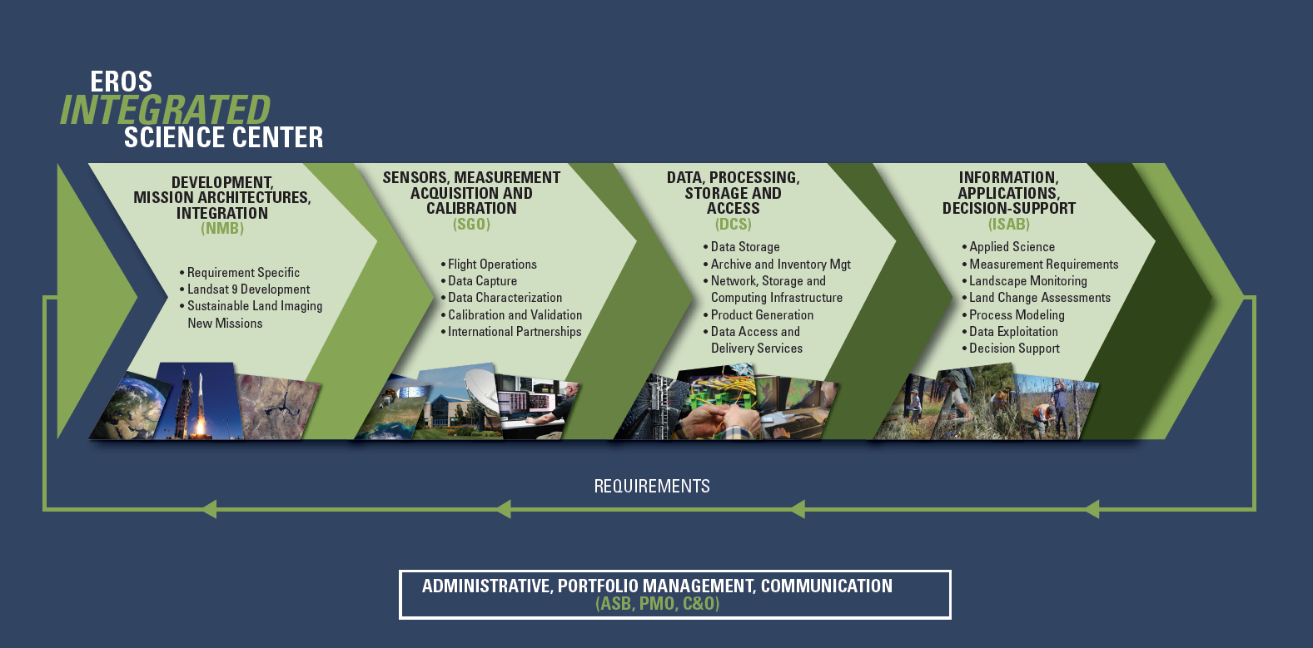
EROS
Notes:
EROS is much more than a data center:
Develops and integrates mission architectures
Characterizes remote sensors and their measurements
Processes, stores, and distributes vast amounts of data
Conducts a broad range of science, applications development, and decision-support activities
An end-do-end activity informed by known user requirements

Slide 10
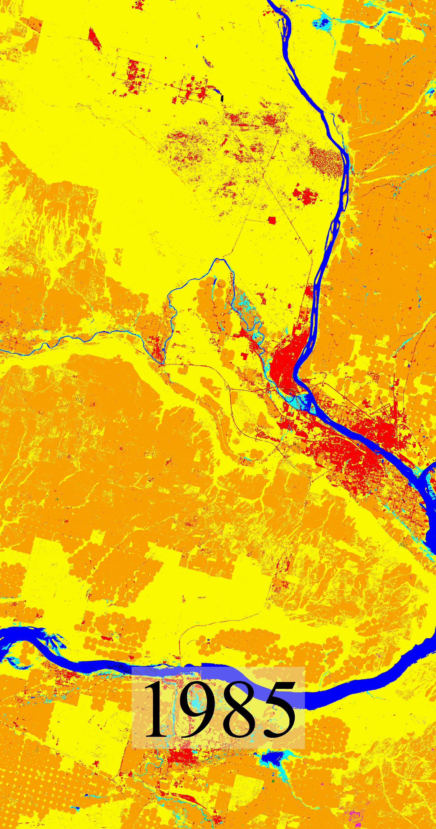

Land Change Monitoring Assessment and Projection (LCMAP)
Monitoring:
Continuous tracking of land surface change using Landsat Analysis Ready Data
Assessment:
Summarizing landscape change, its causes, and consequences
Projection:
Modeling past and future landscapes and facilitating applications
  Map Land Cover at any point across the full Landsat record
  Understand and explain historical change to better anticipate future land change to inform decision makers
“Level 3” data
Expansion of urban and agriculture classes,
Richland Washington
Notes:
Land Change Monitoring, Assessment, and Projection (LCMAP) represents a new generation of land cover mapping and change monitoring.
Uses Landsat archive to generate land change information to explain how the patterns, processes, and consequences of changes in land use, land cover, and land condition affect people and nature.
The LCMAP project funded by the NLI Program will utilize Landsat Analysis-Ready Data
Comprehensive land cover mapping across the full Landsat data record
Contribute to better understanding of past land change dynamics and how they will drive current and future land changes
You can see in this animation the change in land cover in Richland, Washington, from 1985 through 2014
Aligned with the EarthMAP vision
Available via Earth Explorer or the LCMAP viewer (https://eros.usgs.gov/lcmap/viewer/) as of Jun 2020.

Slide 11
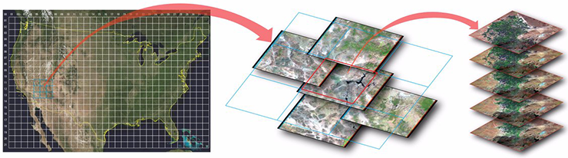
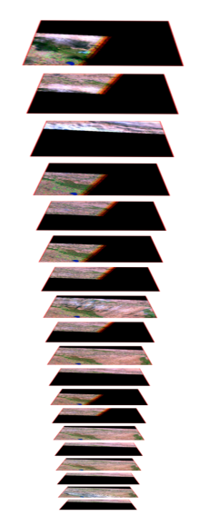
ARD: Analysis Ready Data Foundation for LCMAP
Reconditioning of the Landsat archive
Based on Collection 1, Tier 1 TM-OLI imagery
Radiometric processing to TOA, surface reflectance,
& brightness temperature
All available high-quality observations packaged in 150 x 150 km tiles. There are 422 tiles over CONUS
USGS/EROS began distribution of USGS U.S. Landsat ARD in October 2017

Slide 12
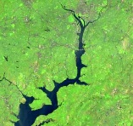
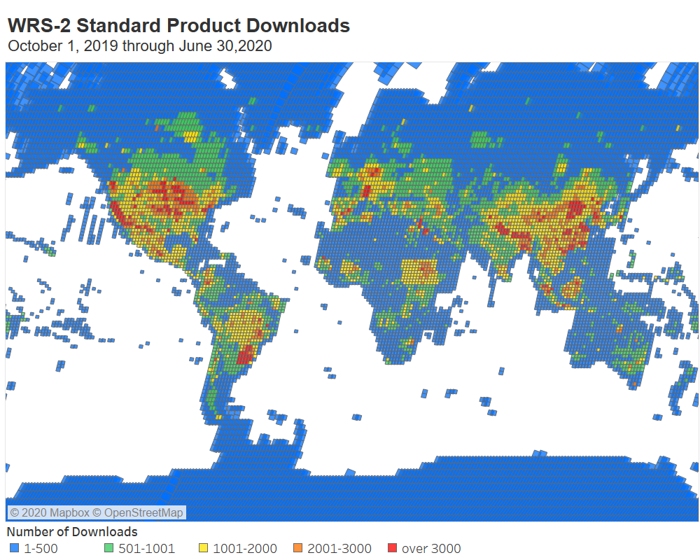
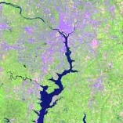
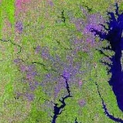
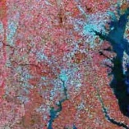
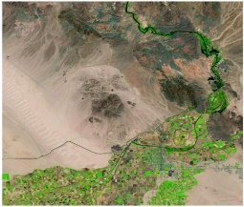
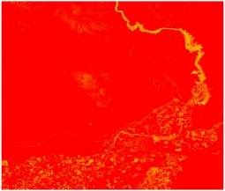
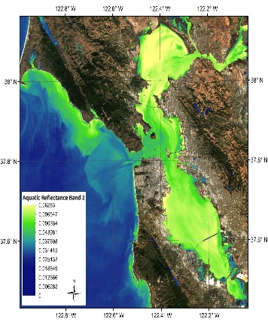
USGS Landsat Level-2/CARD4L Data Sets
Global availability and use of Level-2 products from USGS
Landsat Collection 2 to include CARD4L-compliant Surface Reflectance and Surface Temperature products
Provisional Aquatic Reflectance product available for coastal and inland waters
Landsat 8 Provisional Aquatic Reflectance Science Product, OLI Band 2 (Blue band)
San Francisco Bay, CA - Scene ID: LC80440342018280LGN00

Slide 13
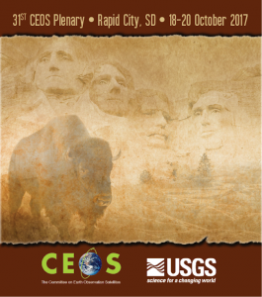
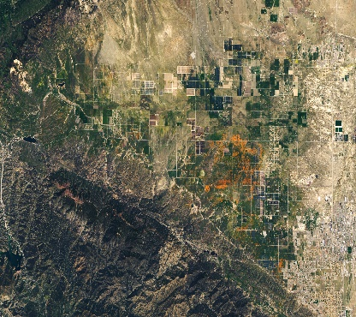
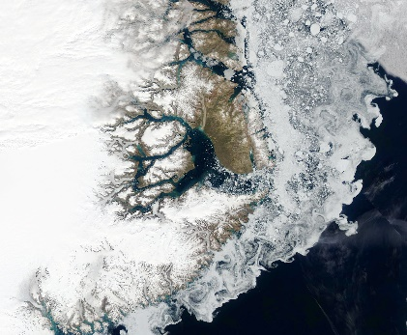

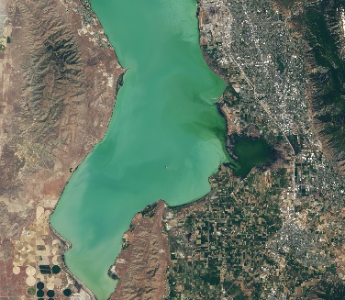
USGS CEOS Engagement
Plenary and Strategic Implementation Team Meetings
Land Surface Imaging Virtual Constellation
Working Groups
  Calibration and Validation
  Information Systems and Services
  Climate
  Capacity Building and Data Democracy

Slide 14


The Future of Land Imaging at USGS
Improve Operational Capabilities
Enhance Research, Development and Innovation
Expand Product and Service Usability
Ensure Community Engagement
Landsat Next
Cross-Calibration of sensors
Hyperspectral Technology Investigations
International & Commercial Partnerships
Increasing User Satisfaction
Landsat 9
Sentinel/Landsat Ops & Data Harmonization
Investigate new science and technologies
National Security Space Data & Services
Land Change Monitoring Assessment and Projection / EarthMAP
Analysis Ready Data
Thoroughly understand user needs and capabilities available to meet them

