Slide 1
CEOS Agency Updates
Highlight Synthesis Report
Committee on Earth Observation Satellites
2020 CEOS Chair Team
CEOS Plenary 2020
Agenda Item #4.7
22 October 2020

Slide 2
ROSHYDROMET
Currently, the Russian orbital constellation consists of 10 EO satellites:
Four meteorological satellites (polar-orbiting METEOR-M N2 and N2-2, geostationary ELECTRO-L N2, and N3);
Five natural disaster monitoring satellites of the KANOPUS-V series;
One high-resolution satellite of the RESURS-P series.
ELECTRO-L N3 was launched on December 24th, 2019, and is still in the commissioning phase. In order to provide coverage of the Indian Ocean region, ELECTRO-L N3 (geostationary meteorological satellite) has been placed at 76 E orbital position, whereas Electro-L N2 was moved to the 14.5 W position.
The next high-resolution satellite of the RESURS-P series is scheduled for 2020.
The next Russian polar-orbiting meteorological satellite of the METEOR-M series, Meteor-M N2-2 is to be launched in 2021.
The launch of the first ARCTICA-M satellite on the “Molnya” highly elliptical orbit is delayed to the beginning of 2021.

Slide 3
ESA EO Programme Update
All ESA EO missions are operating nominally
Rapid Action on Covid-19 and EO Dashboard launched: race.esa.int
ɸ-Sat-1 successfully launched on 3 Sept. as part of FSSCat
First deep Convolutional Neural Network in space (AI chip)
Will perform inference on the Hyperscout hyperspectral images to detect clouds and “remove” the cloudy pixels
Copernicus Sentinel Expansion Missions
CO2M and CRISTAL contracts signed
CIMR, CHIME, LSTM contract negotiation concluded, signature soon
ROSE-L contract negotiation on-going
ɸ-Week 2020 Digital Twin Earth was an online success
ESA UNCLASSIFIED – For Official Use

Slide 4
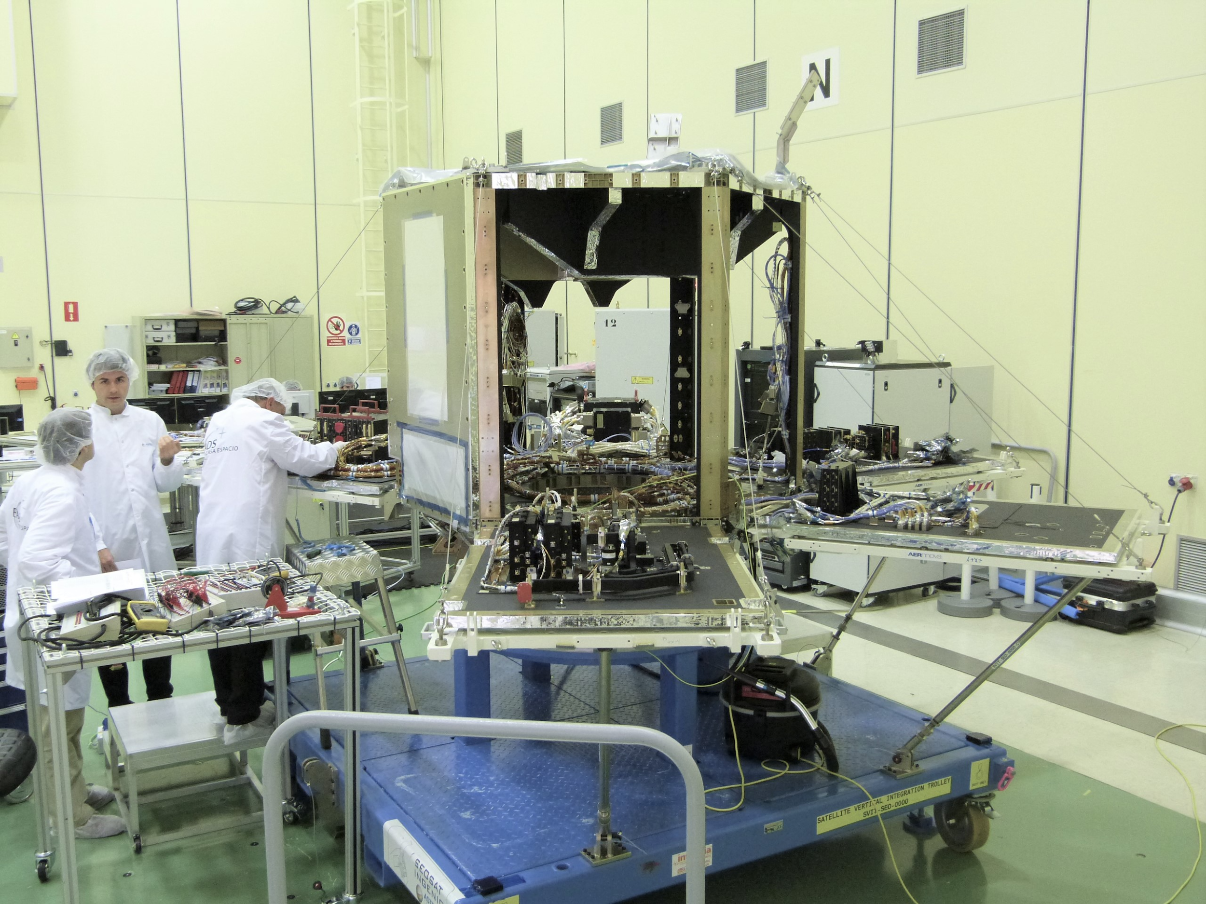
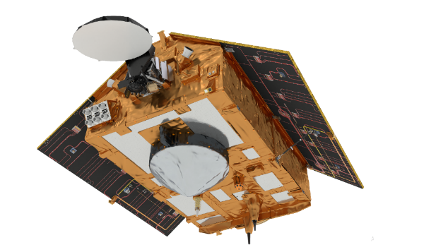
ESA EO Update and Outlook
Copernicus
250 TB of EO data disseminated daily to society
SEOSat - Ingenio
Launch scheduled on 13 November 2020 from Kourou
© Airbus Defence and Space, Spain
Sentinel 6 Michael Freilich
Launch date stable for years: 10 Nov 2020
Shipping to the United States for launch with SpaceX marked beginning of launch campaign
ESA UNCLASSIFIED – For Official Use
Notes:
SEOSAT–Ingenio will provide high-resolution multispectral images of the environment for applications such as cartography, monitoring land use, urban management, water management, risk management and security.
While SEOSAT–Ingenio is a Spanish national mission, it has resulted thanks to an international collaborative effort.
The mission is funded by Spain’s Centre for the Development of Industrial Technology (CDTI) but developed and managed by ESA in the context of the European Earth Observation Architecture.

Slide 5
ASI
PRISMA Mission
•National EO Mission fully funded by ASI, aimed at technology demonstration
•Satellite with state-of-the-art Hyperspectral / Pancromatic sensor, 30m spatial resolution (5m in PAN), 30km x 30km…1800km scene, 240 total bands in Visible & Near IR (#66, 400–1010 nm) & Short Wave IR (#174, 920–2505 nm)
•Data processed for obtaining at-top-of-atmosphere radiance, at-surface radiance and at-surface reflectance, in satellite geometry or geocoded
•Capable to acquire up to 230 images/day and process 200 of them up to geocoded level data
•Open data policy with image disseminated at no user cost
•Opened to users
https://prisma.asi.it/
COSMO-SkyMed 2nd generation
•National EO Mission fully funded by ASI and Italian Ministry of Defence, aimed to
•Ensure operational continuity to the currently operating constellation – an unique system
•Achieve a step ahead in terms of functionality, performances and system services for the Earth Observation users
•The 2 CSG Satellites will have an operational lifetime of at least 7 years
•1st CSG satellite: commissioning
SIASGE
•COSMO-SkyMed constellation + SAOCOM
SAR multi-band capabilities: X+L
•Opening to institutional and scientific users

Slide 6
JAXA
We are operating 6 satellites and developing 4 satellites for Earth observation.
JAXA for Earth on COVID-19 (http://earth.jaxa.jp/covid19/en.html )
Provides analysis results of environmental and socio-economic activities before/after global pandemic
City scale greenhouse gasses monitoring by GOSAT
Chlorophyll-a concentration monitoring by GCOM-C
Rice planting/harvesting monitoring by GCOM-C and ALSO-2
Airport throughout by ALOS-2
Collaboration with NASA and ESA for Earth Observing Dashboard
JAXA has developed a land surface & river simulation system “Today’s Earth” under the joint research with University of Tokyo ( https://www.eorc.jaxa.jp/water/ ) and provided various hydrological products with 1km resolution for Japan and 25km resolution for global
JAXA will provide free and open access to the wide-swath observation data from the L-band Radar satellites, such as ALOS (ALOS/AVINIR-2, PALSAR) and ALOS-2(ALOS-2/ScanSAR)

Slide 7
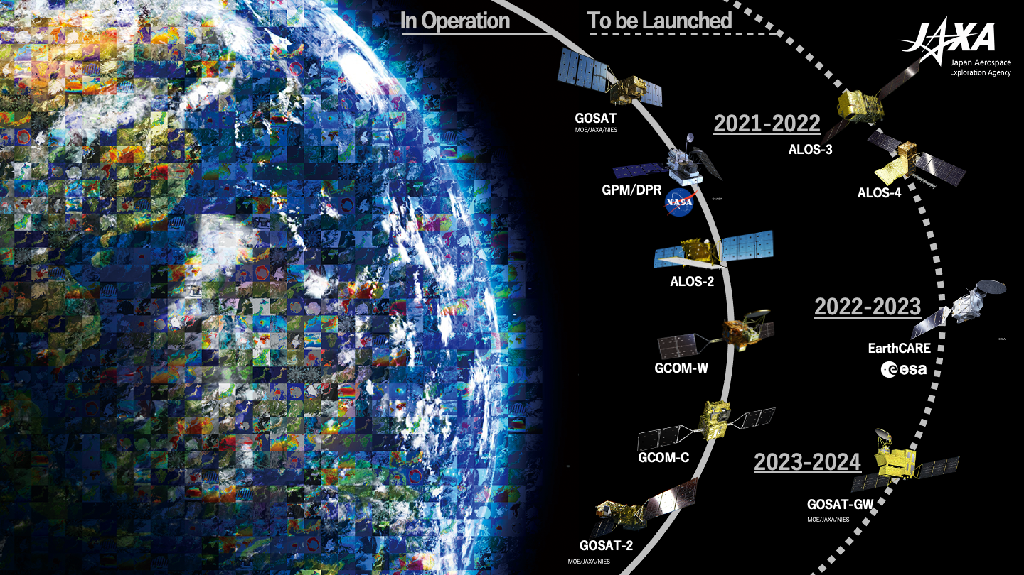
JAXA
Overview of JAXA EO satellites

Slide 8
European Commission Copernicus
Copernicus will be a component of the EU Space Programme
Finalising with the EU Member States the legal and financial framework for the EU Space Programme for the timeframe 2021 – 2027
Negotiating with our partners on agreements for
Space Component
Service Component
To ensure Continuity of Service
Possibility of Evolution of Copernicus
Expansion missions
New products of the Copernicus Services
=> Ongoing discussions with our partners

Slide 9
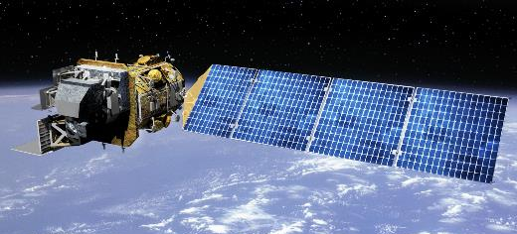
USGS
Land Change Monitoring Assessment and Projection (LCMAP) & EarthMAP
Integration of ARD Datasets
Ongoing support of LSI-VC and CEOS Working Groups, and data provision for GEO Flagships
Operating Landsat 7 & 8, and maintaining full Landsat archive as well as other land-imaging data sets
Landsat 9 in development with NASA, expected launch in second half of 2021
Landsat-Next in formulation with NASA
Landsat Collection 2 in final preparation stages, should be released imminently

Slide 10
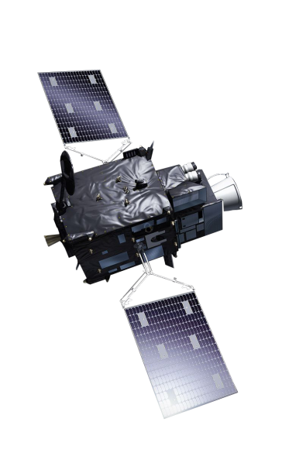
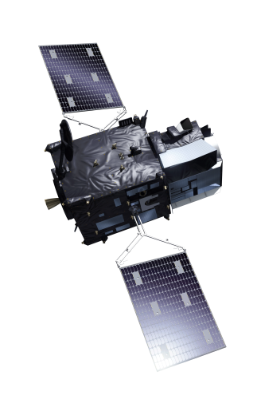
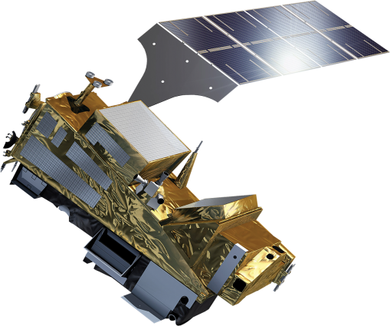
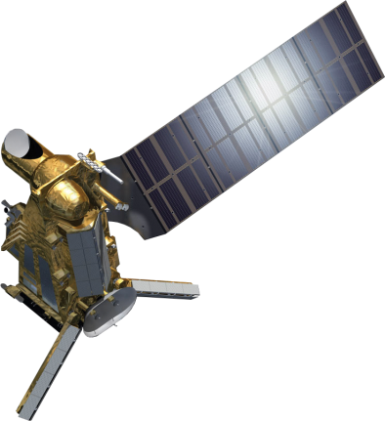
EUMETSAT: Launch of 1 next-generation satellite per year in 2020-2025
2022
2023
2024
2025
2026
MTG-I1 LAUNCH
MTG-I1
SYS IV&V
LC
SIOV
CAL/VAL
MTG-S1 LAUNCH
MTG-S1
SYS IV&V
LC
SIOV
CAL/VAL
MTG-I2 LAUNCH
MTG-I2
SYS IV&V
LC
SIOV
CAL/VAL
METOP-SG A1 LAUNCH
Metop-SG A1
SYS IV&V
LC
SIOV
CAL/VAL
METOP-SG B1 LAUNCH
Metop-SG B1
SYS IV&V
LC
SIOV
CAL/VAL

Slide 11
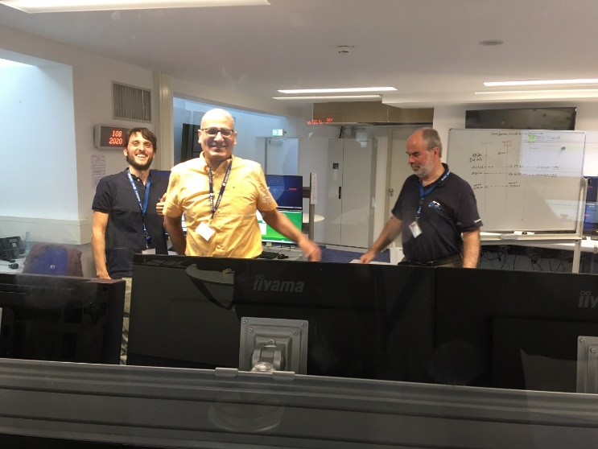
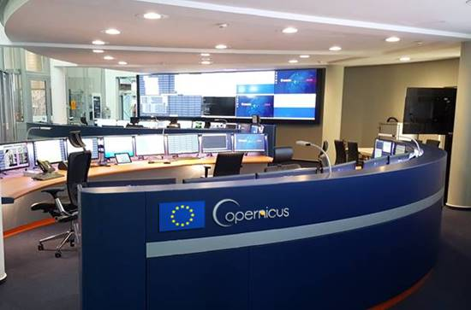
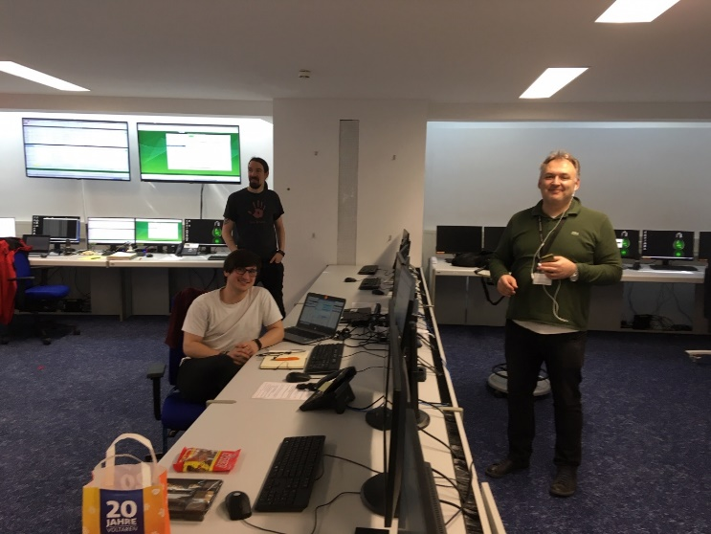
EUMETSAT: Preparing for New Copernicus Missions – starting with Sentinel-6 !

Slide 12
And as of 1 January 2021 ...
Phil Evans will be the new Director-General of EUMETSAT ...

Slide 13
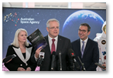
Team Australia
CEOS SIT Co-chairs (2020-21) – planned SIT-35 in Hobart, then held virtually, as well as SIT TW 2020 (planned in Zagreb)
Adelaide Innovation Precinct (‘Lot14’): hub for emerging technology (including Space), hosting the new Australian Space Agency (ASA) headquarters, the Australian Institute for Machine Learning, SmartSat CRC, CSIRO, and BOM’s Space Industry lead on Space Weather, alongside with >40 start-ups
Australian Space Agency (ASA):
Following the devastating 2019-2020 bushfire season, the Australian Government commissioned a taskforce to study the use of satellite imagery in support of bushfire risk management, incl. the importance of international cooperation and data sharing.
Leading the development of an Australian Satellite Earth Observation Roadmap, engaging both domestically and internationally on this document
Officially opened ASA’s headquarters at Lot14 (in Adelaide) in February 2020
Bureau of Meteorology (BOM):
Working on improvements of OceanMAPS (the Bureau's global, high-resolution, data assimilating ocean forecast system), incl. a sea ice analysis and forecast capability,
In April 2020: upgraded the daily global SST analysis, referred to as Global Australian Multi-Sensor SST Analysis (GAMSSA), improving its performance and making it one of the best in the world. On 29 April, GAMSSA began ingesting Visible Infrared Imaging Radiometer Suite datasets from two more weather satellites, Suomi-NPP and NOAA-20.

Slide 14
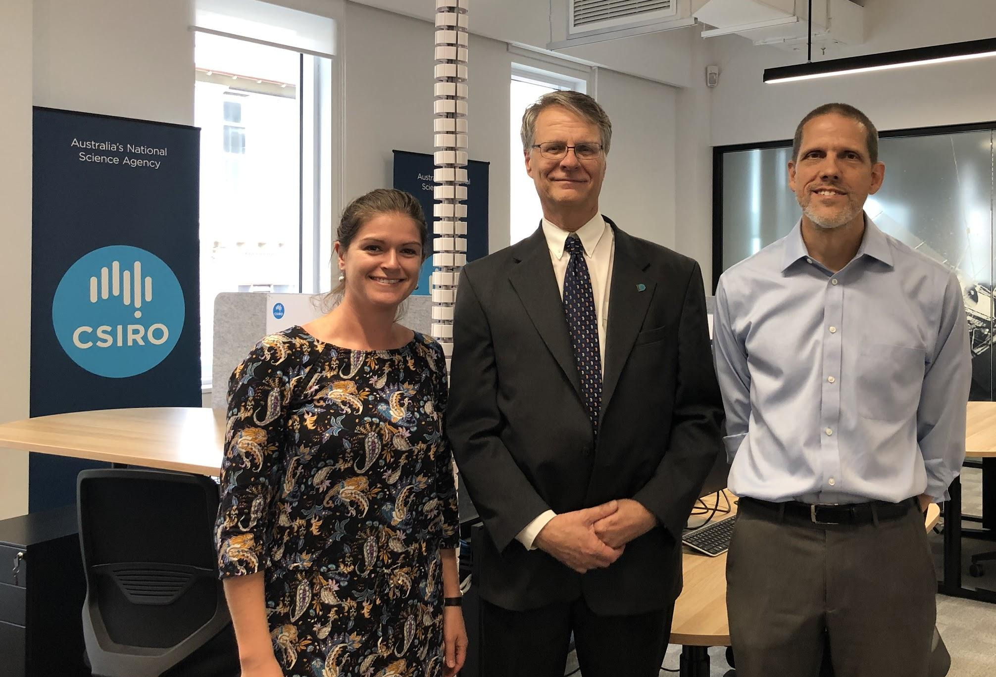
CSIRO
CSIRO strongly supports key CEOS activities and priorities such as:
Biomass and Cal/Val activities (WGCV led by CSIRO), including the Biomass Protocol (in its final review phase) and the proposed Forest Biomass reference Network – a tremendous international scientific collaboration
Earth Analytics Interoperability Lab (EAIL) developed by WGISS (CSIRO lead) and SEO (NASA) – another great example of CEOS activity supporting multiple Agencies
UN SDG efforts with the SDG AHT co-leadership, and leadership (Good Practice Guidance document, with version 2 currently developed) in GEO Land Degradation Neutrality Initiative (LDN) (co-lead) where CEOS datasets are strongly considered in identification of datasets for global, regional and local uses
Key CSIRO activities and engagement around Earth observation in 2020:
‘Centre for Earth Observation’ in our Astronomy & Space Program turned 2 in June –
strong motivation to keep this as a home for our domestic and international EO activities
Stronger & valued collaboration with domestic partners like GA (our SIT ‘partner in crime’), ASA and BOM
International partnerships consolidated or developed (discussions and/or agreements signed) with ASI, CONAE, CSA, DLR, ESA, NASA, VNSC - to deeper our collaborations on EO activities (focus on NovaSAR data and/or AquaWatch)
CSIRO’s share of NovaSAR officially becoming a National Facility in November
“AquaWatch Australia Phase-0, an Australian contribution to the GEO AquaWatch, with some ideas extracted from the CEOS report on Aquatic Ecosystems, has started:
International Science Team established including some CEOS partners
Introduction Webcast held on 13th October
And official ‘local’ presence in Lot14 (Adelaide) as well…...

Slide 15
Geoscience Australia
Digital Earth Africa now provides operational analysis ready EO data over Africa, using free and open images captured by the European Sentinel-2 satellites. This leverages Open Data Cube tech to provide the first ever continuously updated satellite data for Africa at the continental scale.
GA’s Alice Springs Ground Station Facility’s second 9m antenna has now been certified for Landsat-7. A range of upgrades are underway at the site, which is ramping up to support Landsat-9 and CSIROSat-1 launches in 2021.
The first round of the Digital Earth Australia Labs program was completed in 2020. All three project partners were successful in developing new commercial products and services using CEOS Agency satellite data. The next round of the project will launch later this year.
The Digital Earth Australia Waterbodies product is now supporting operational water compliance activities across Australia’s largest and most productive drainage basin. All of the science and technology is available on a full, free and open basis for CEOS Agencies and the international community.

Slide 16
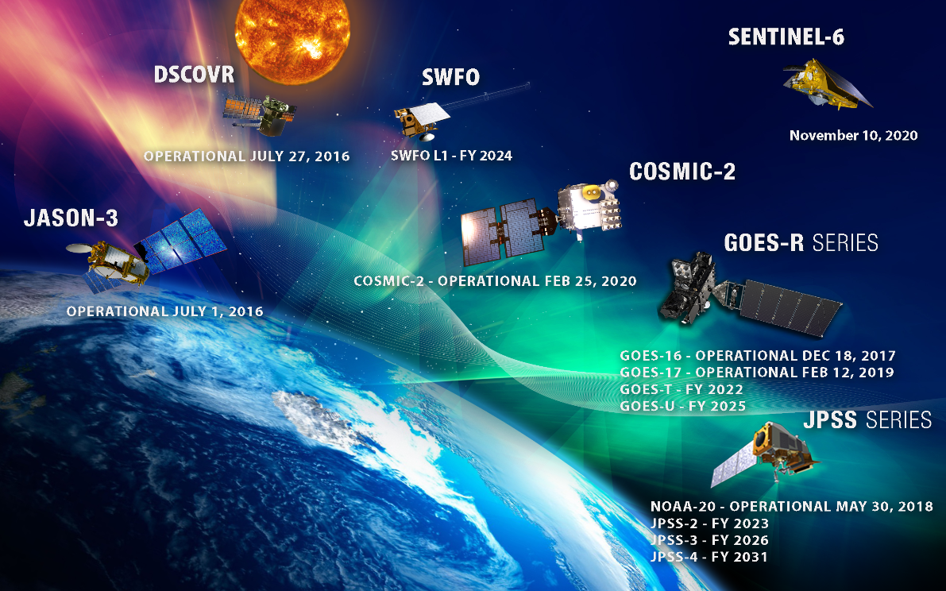
National Oceanic and Atmospheric Administration
Notes:
Current Status of NOAA’s observing constellation
Upcoming launches:
November 10 (VAFB) Sentinel -6 Michael Freilich - Although not formally part of our NOAA program, the next launch we look forward to will provide continuity of the JASON –series of missions.
For our two main observing systems there will be several years before next launches:
FY 2022 GOES-T
FY2023 – JPSS-2
Several years ago NOAA initiated it’s future satellite architecture studies after GOES-R and JPSS series. In this regard, a major Community Satellite Meeting was held by NOAA in late September with robust international participation.

Slide 17
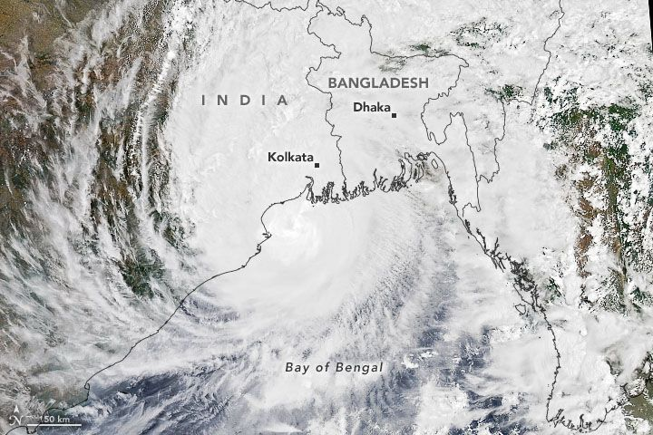
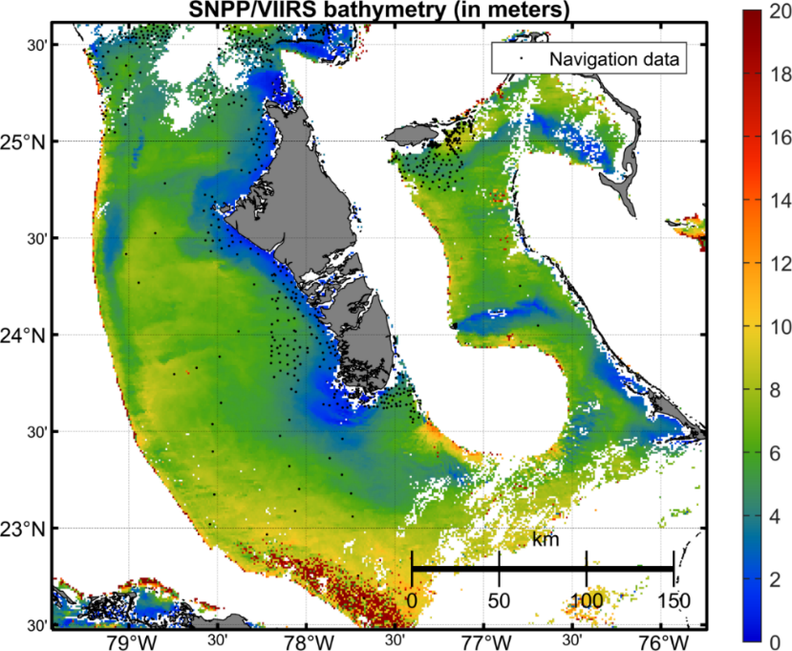
NOAA SUPPORT for CEOS-COAST
Coastal zones are highly important from a social, economic & ecological perspective.
Earth observations are underutilized for their stewardship & can provide great value
COAST was initiated at 33rd CEOS Plenary to define a CEOS Coastal Strategy and is now proposed to become a CEOS Ad Hoc Team, Co-Chaired by NOAA and ISRO
COAST will bridge land, aquatic & atmospheric observations, and facilitate their use globally for effective coastal zone management and sustainable development
It will focus on coastal hazards (flooding/inundation) and ecological impacts (water quality), providing value by integrating capabilities/capacity across CEOS (e.g., ARD)
COAST will enable broader utilization of Earth observations for greater societal benefits within coastal zones and enhancing CEOS engagement with external stakeholders such as GEO, IOC, UN Environment, WMO and UN Decade of Ocean Science for Sustainable Development (2021-2030).
Depth (m)
Bahamas
Notes:
One Key Focus Area for NOAA in CEOS currently the COAST initiative. NOAA has many Coastal programs and users. NOAA is pleased that Plenary approved the Ad hoc Team which will be co-chaired by NOAA with ISRO.
Upper image: Cyclone Amphan in the Bay of Benegal
Lower image: Bathymetric map for the Bahamas derived from NOAA VIIRS-SNPP ocean color data, using the newly developed spectral optimization algorithm by Wei and Wang (NESDIS-STAR) – allows for weekly and better global coastal zone bathymetry at 750 m resolution.

Slide 18
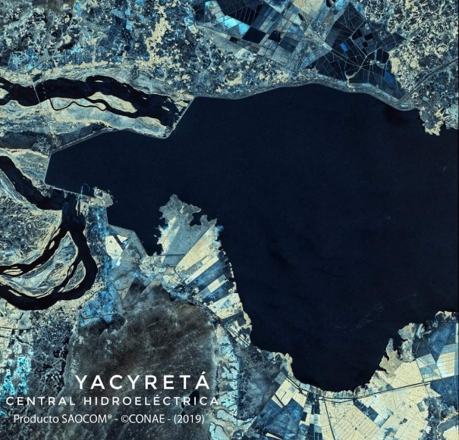
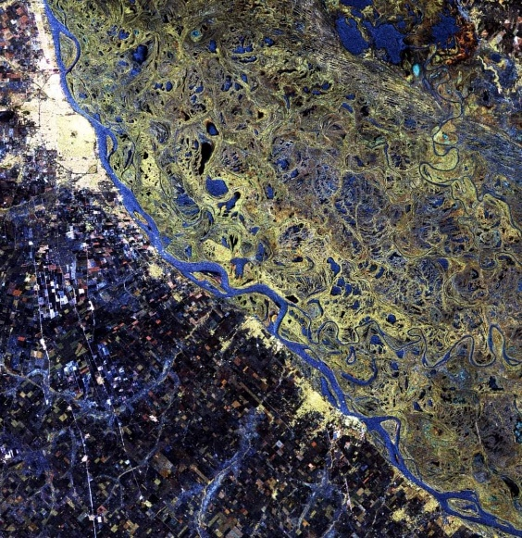
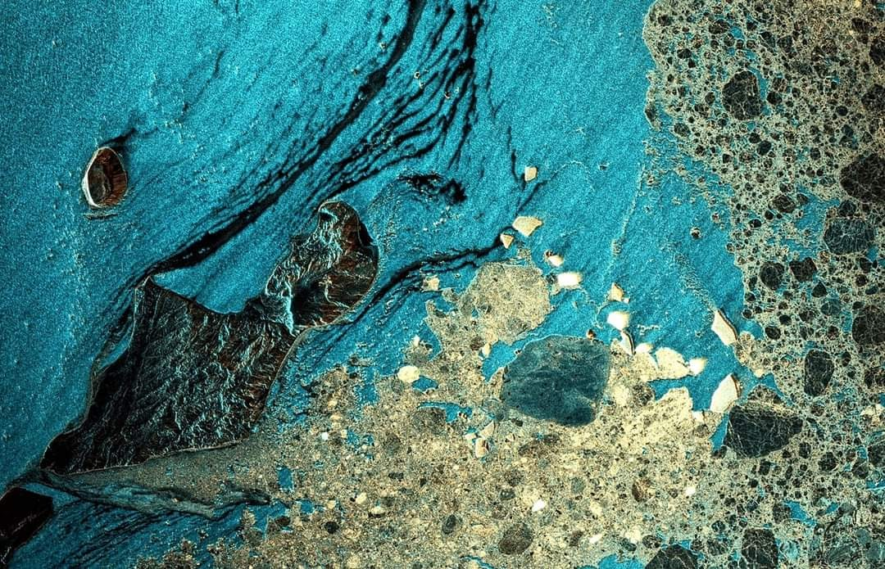
CONAE Highlights
2 Satellites with identical full polarimetric
L-Band SAR instruments
SAOCOM 1A, in orbit since October 7th, 2018. Already operative.
SAOCOM 1B successful launch on August 30th, 2020. Preliminary tests of the Service Platform and SAR Instrument were succesfully completed. Maneuvers are being carried out to bring the satellite to its final orbit while working on the satellite commissioning.
SIASGE Cooperation
SAOCOM and COSMO-SkyMed Constellations.
X+L Capabilities
IMAGEN SAOCOM1A.CONAE 2019.PARANA
IMAGEN SAOCOM1A.CONAE 2019.MAR DE WEDELL
‹#›

Slide 19
CNES Highlights

Slide 20
CNES Highlights

Slide 21
CNES Highlights

Slide 22
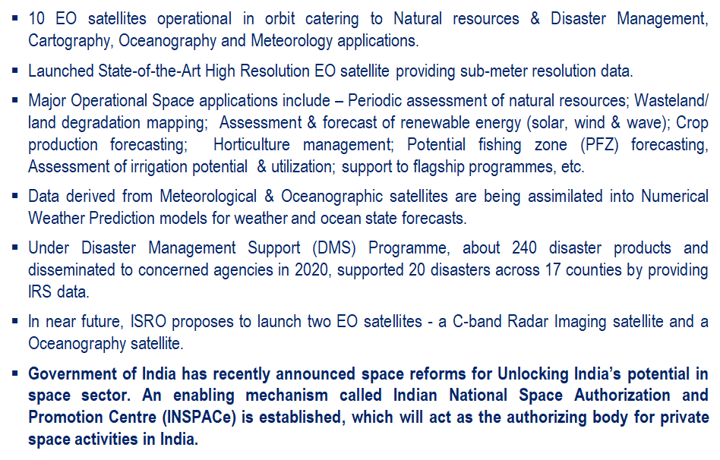
ISRO - Agency Updates

Slide 23
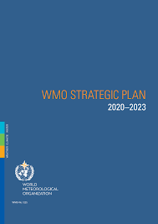
WMO and CEOS
The 18th Congress approved the new strategic Plan:
- Embracing an Earth systems approach
- Stronger focus on water resources and ocean
- More coordinated climate activities
- Translation of science into services for society
The integration of basic systems for hydrology, oceans and climate within multi-purpose networks and space-platforms essential for WIGOS
Space Agencies through CGMS committed to WIGOS 2040*
To cover all key aspects for comprehensive Earth-System modelling, CEOS support is essential
CEOS is requested to support
Stronger mutually beneficial collaboration with WMO for specific projects and programmes of common interest through CEOS Working Groups, Virtual Constellations, ad hoc teams/Project/initiatives and relevant WMO Programmes and activities
The WMO OSCAR activities through the nomination of Agency Points of Contacts
*WMO Integrated Global Observing System Vision 2040 https://community.wmo.int/vision2040

Slide 24
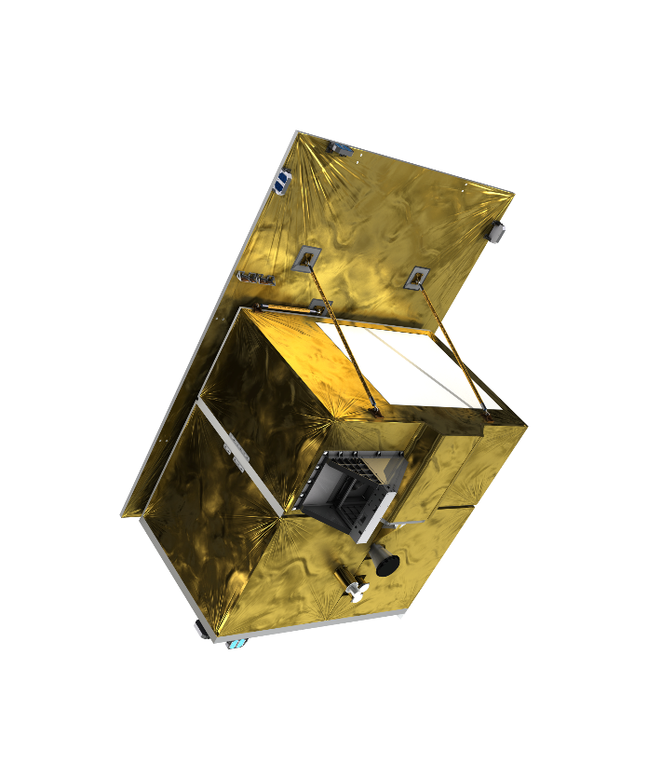
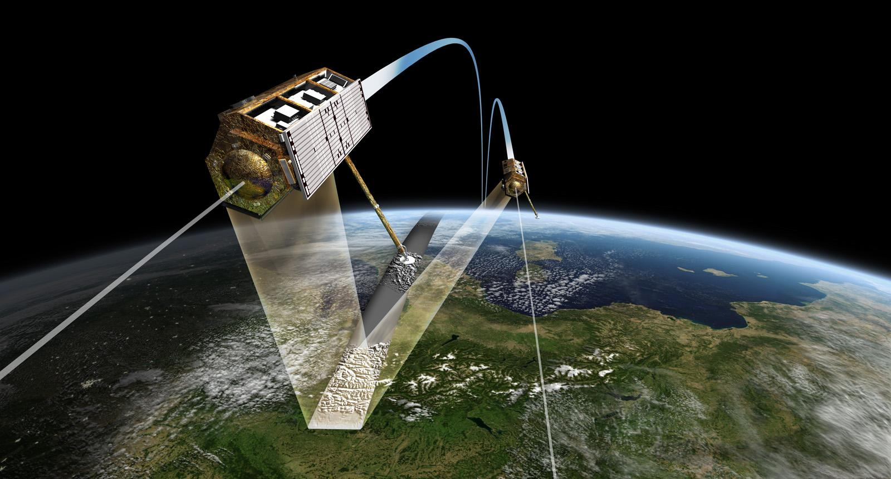
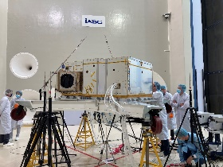
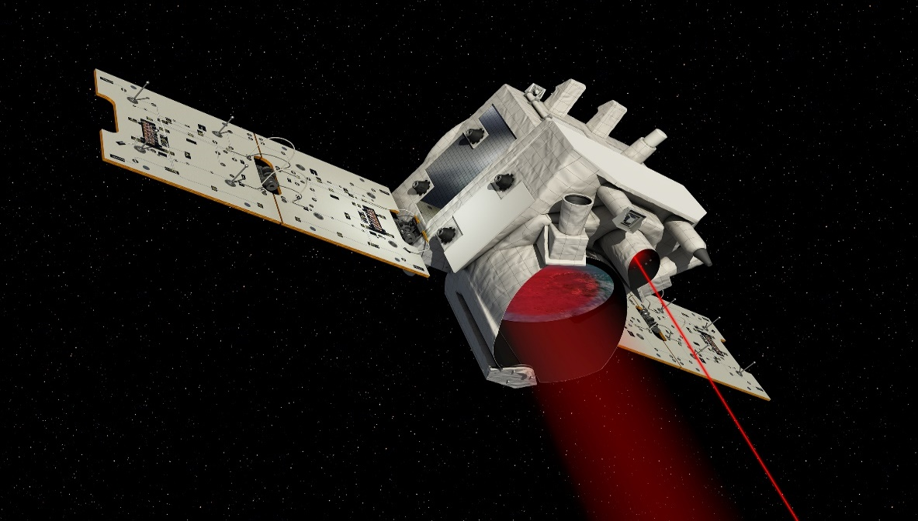
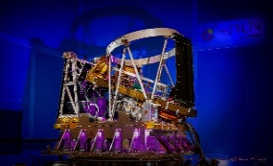
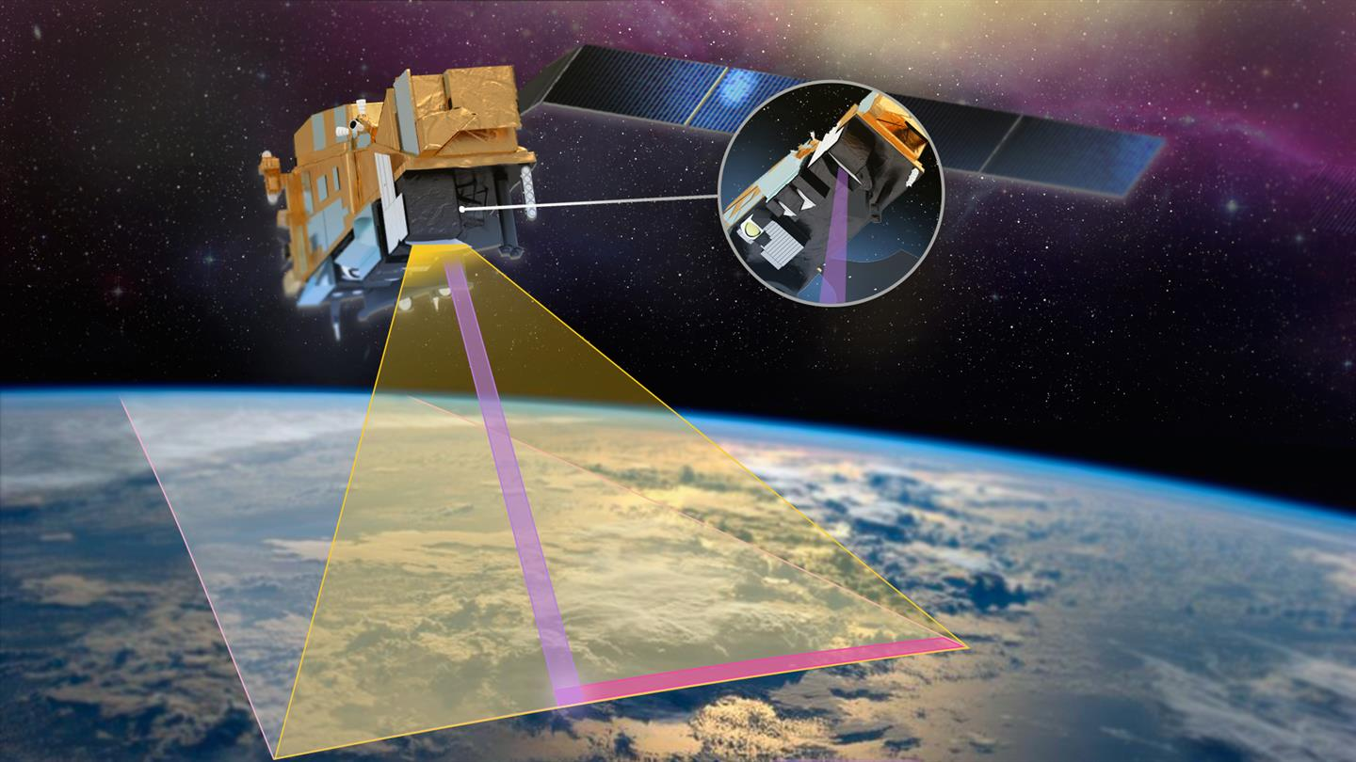
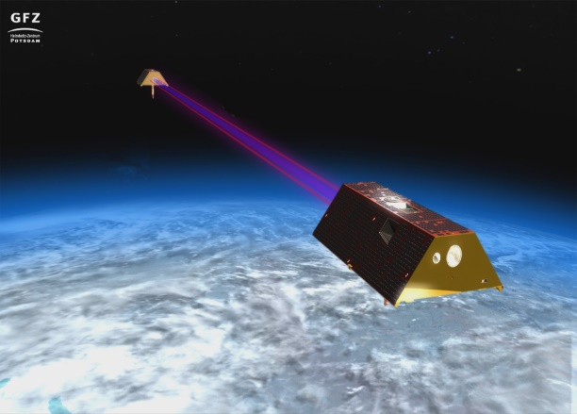
Earth‘s surface
Environment, Resources
Mission X-Band-Radar
- TerraSAR-X (2007)
- TanDEM-X (2010)
- HRWS (2026)
Objectives HRWS
- Technology lead
- Continuity in PPP
Current status
- HRWS: Ph. B Preparation
Mission Hyperspectral
EnMap (2022)
Objectives
- Technology lead, F&E
- Establish applications
- Continuity in Copernicus
Current status
- Phase C/D
Climate
Weather
Mission LIDAR
Merlin (2025)
Objectives
Measurement of global CH4-concentration
Current status
Phase C/D
Mission Multispektral
METimage (2023) + 2 recurrent units
Objectives
- Establish German technology in MetOP-Program
- Strengthen German industry in optics
Current status
Phase C/D
Gravity, Hydrology
Mission Laserlink/Platform
GRACE FO (2018)
Objectives GRACE-I
Continuity to GRACE FO
Collaboration with NASA/ESA
Current status
Phase 0

Slide 25
Canadian Space Agency
CSA new President : Lisa Campbell
CSA Missions
Radarsat Program
Radarsat-1 : Working to make Radarsat-1 Archives open and freely available
Radarsat Constellation Mission (RCM)
Fully operational and supporting Canadian Government services
Data access improvements in place for Canadian industry. Canadian Federal Departments can share data with their international partners and work progresses on international user access
EO Service Continuity (SAR Data continuity)
Mission architecture concept studies in progress
Missions in development
Arctic Observing Mission (Atmospheric Imaging Mission for Northern Regions)
Canadian instruments for NASA A-CCP mission
WildfireSat (Forest fire detection and monitoring)
Terrestrial Snow Mass Mission (Monitoring snow surface to quantify the spatio-temporal dynamic amount of freshwater stored in seasonal snow, and the snow state (wet/dry))
WaterSat (monitoring ocean, coastal and inland water quality)
Advancing A Space-Based Earth Observation Strategy for Canada
Recognizing the urgency for long-term planning and infusion of state-of-the-art capacities in the public sector, and in response to the 2019 Canada Space Strategy, the CSA has built a partnership with 17 other federal departments in an effort to develop a new strategy for the collection and use of satellite Earth observation data in Canada. Consultations are underway with stakeholders and decision makers.
smartEarth : New applications and capacity development program

Slide 26
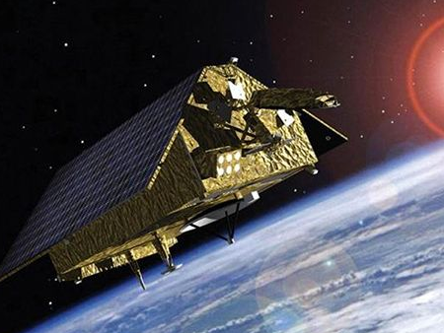
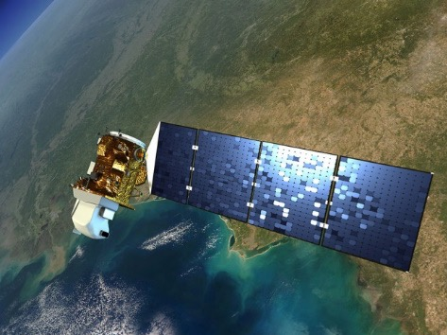
NASA: ESD Upcoming Launches
Sentinel-6 Michael Freilich
Landsat 9
November 2020
June 2021
Provide ongoing measurements of global sea level rise, and support operational oceanography, improving forecasts of ocean currents as well as wind and wave conditions. (With NOAA, ESA, EUMETSAT)
Designed and operated to repeatedly observe the global land surface at a moderate scale that shows both natural and human-induced change. (With USGS)

Slide 27
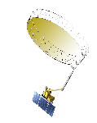
Timeline of Current and Future Earth Science Missions
2015
2017
NASA Earth Science Focus Areas
2002
Atmospheric Composition
Earth Surface and Interior
DSCOVR
JPSS-1
Carbon Cycle and Ecosystems
Water and Energy Cycle
Aqua
EPIC
*OMPS-L
Climate Variability and Change
Weather and Atmospheric Dynamics
NISTAR
CERES
2021
2023
2025
2006
SMAP
ISS
TSIS-2
Sentinel 6B
CloudSat
2013
SAGE III
2019
Landsat 9
2027
TSIS-1
CALIPSO
*Landsat 8
LIS
ISS
ISS
JPSS-3
ISS
Libera
OCO-3
EMIT
CLARREO-PF
*OMPS-L
2004
2014
2020
2024
2026
2031
2018
Aura
Sentinel-6
Michael Freilich
JPSS-4
OCO-2
PACE
GLIMR
*OMPS-L
1999
GPM
ICESat-2
2022
Terra
NISAR
TROPICS
2016
GRACE-FO
2011
JPSS-2
SWOT
GeoCarb
*OMPS-L
*Landsat 7
Suomi-NPP
CYGNSS
ISS
CERES
GEDI
MAIA
TEMPO
PREFIRE
*Operations not funded by ESD
05.18.20
ECOSTRESS
Notes:
Moved PACE to 2024
Moved JPSS-3 to 2027, added Libera 2027
Dele SORCE
Updated S6MF name

Slide 28
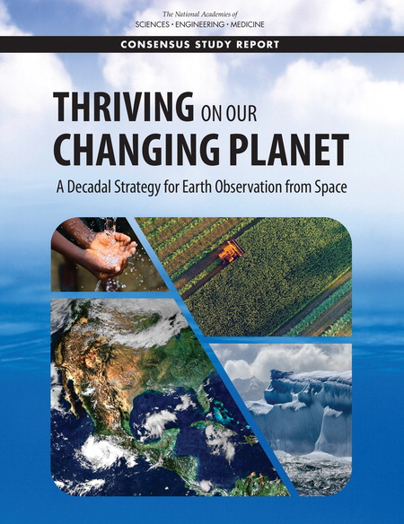
2017 Earth Science Decadal Survey
Thriving on Our Changing Planet
An Inherent Tension
Thriving
The growing reliance on Earth information in the daily lives of people and businesses compels improved knowledge of our planet
Changing
Achieving the scientific and practical ability to reliably understand an Earth system is challenging when it changes (natural and human causes) nearly as fast as we characterize it
June 2018

Slide 29
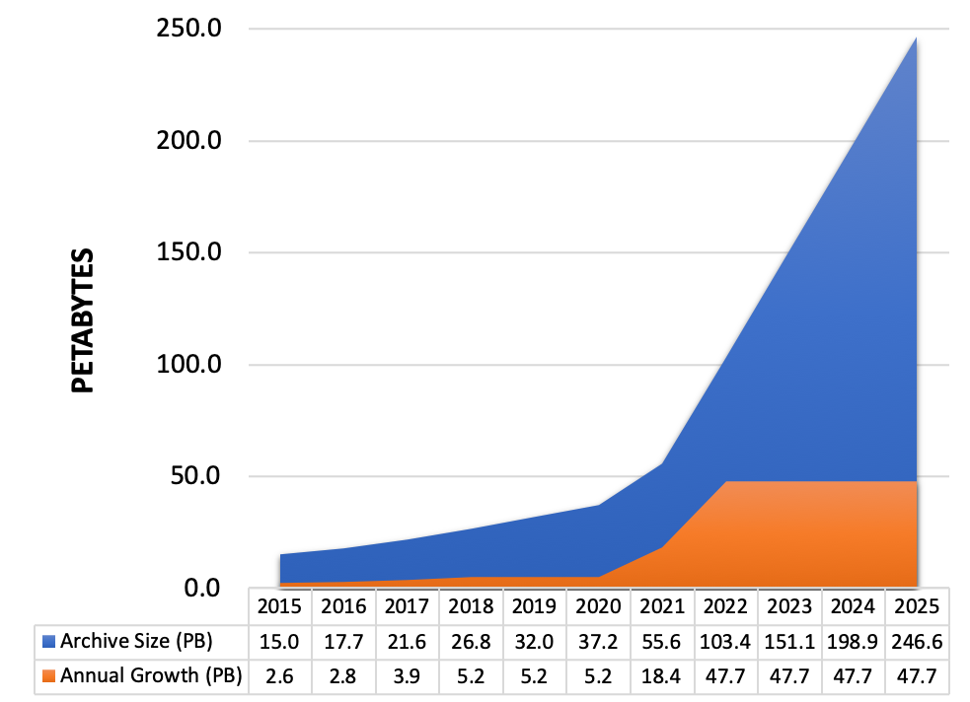
Big Data: Earth Science
Challenges
Volume of data in NASA Earth science archives alone to increase to 250 Petabytes by 2025
Multi-platform, multi-instrument, multi-program nature of the data – Multi-science data fusion
Need
Efficiently handle storage and computation needs for large data volumes through new data management technologies and architectures
New paradigm is required
Cloud offers performance and cost benefits
Realize storage, processing and operational efficiencies
Improve cross-archive center collaboration
Enable users to work across multiple datasets managed by different archives without transmitting data over networks
Supporting open science with open source software and open data
Notes:
To efficiently handle storage and compute needs for the large SWOT and NISAR data volumes, new data management technologies and architectures are needed.
NASA’s Earth Observing System Data and Information System (EOSDIS) acquires, processes, preserves, and distributes observational data from various sources (satellites, aircraft, field measurements, and various other programs) to support Earth Science research focus areas. From its current size of approximately 30 petabytes (PB), the volume of data in the EOSDIS archive is expected to increase to approximately 250 PB by 2025.
Growth of Mission Data & Processing: Projected rapid archive growth and the need to effectively process significantly larger volumes of new mission data requires rethinking existing architectures. Estimating 132 TB daily ingest by 2022
Data Systems: More cost effective, flexible, and scalable data system ingest, archive, and distribution solutions are needed to keep pace with new mission advancement and capabilities
Science Users: Significantly larger data volumes requires additional ways to access and utilize these data, with “Data Close to Compute”

Slide 30
UK Space Agency
The UK is continuing to develop its EO sector in line with its National Space Strategy. A dedicated innovation programme to build the skills, technologies and supply chains that will put cutting-edge British innovation in satellites at the heart of the world’s space economy has been launched and the first projects will be announced later this autumn – many are EO and Climate related.
We are preparing to host the United Nations Framework Convention on Climate Change COP26, here in the UK, in Glasgow in 2021. Space4Climate (http://www.space4climate.com/), chaired by the UK Space Agency, is coordinating the satellite EO community and will highlight the pivotal role EO can play in climate monitoring and action as well as deleveraging on legal mandates to accelerate climate action and finalise the Paris Rulebook.
The UK-led ESA mission, TRUTHS (https://www.npl.co.uk/earth-observation/truths), will be the first ‘measurement standard reference’ in space and will allow a step change in the accuracy in our understanding of Earth radiation balance and its contribution to climate change. It will also improve the performance and interoperability of other satellites through provision of high accuracy reference calibration from space. Funded by the UK, Greece, Romania, Czech Republic and Switzerland the industry consortium across those countries is about to begin work on the first 18 month phase.
The UK is pleased to confirm that ten new projects have recently been added to the UK Space Agency’s International Partnership Programme (IPP) portfolio. Through the Global Challenges Research Fund, IPP is now grant-funding 43 projects to the tune of £150M which are developing ground-breaking satellite solutions to tackle real-world problems faced by almost 50 developing countries across Africa, Asia-Pacific and Latin America – with capacity building playing a crucial role to their sustainability.

