Slide 1
Committee on Earth Observation Satellites
Studies on environmental impact over India
ISRO, 2020 CEOS Chair Team
CEOS Plenary 2020
Agenda Item #4.5
22 October 2020

Slide 2
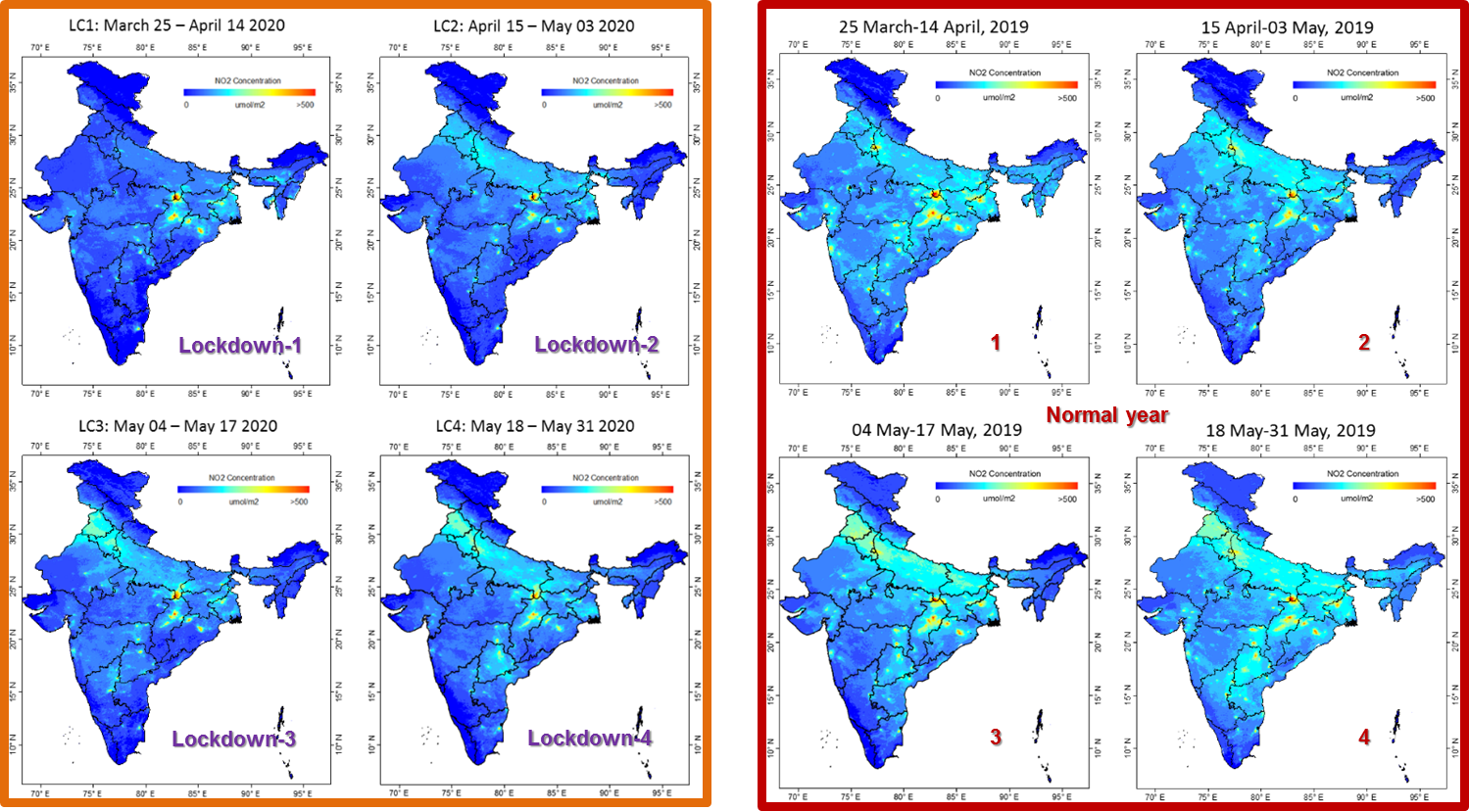
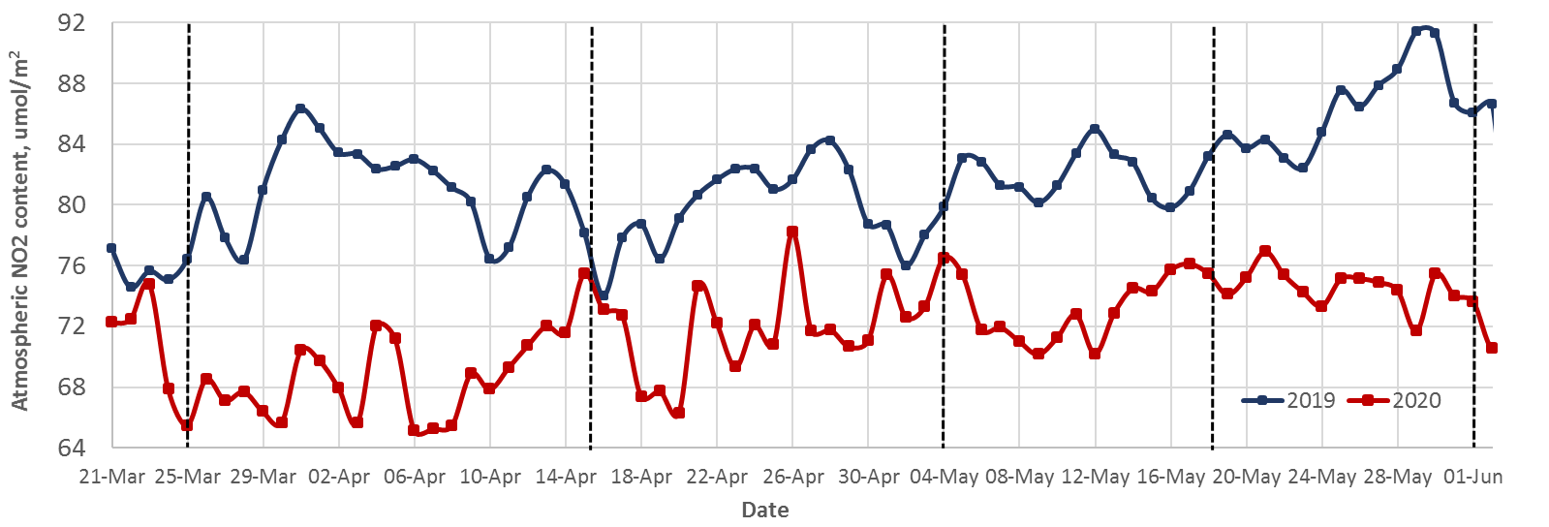
Environmental Changes during COVID-19 induced Lockdown
AEROSOL OPTICAL DEPTH
(2a)
NO2 Reduction over India during various lockdowns studied with TROPOMI data
(1a)
(1b)
(2b)
In general a decrease in AOD is observed after lockdown over most of the Indian sites, excepting a few sites.
A reduction in NO2 up to 65-70% has been observed over some parts of India, especially over Indo-Gangetic Plains and major cities. Overall, India-level NO2 comparison w.r.to normal year showed a drop up to 24%.
(1c)
LD1
LD2
LD3
LD4
UL1
Source: Pandya et al. (Under review), Manoj Mishra, SAC

Slide 3
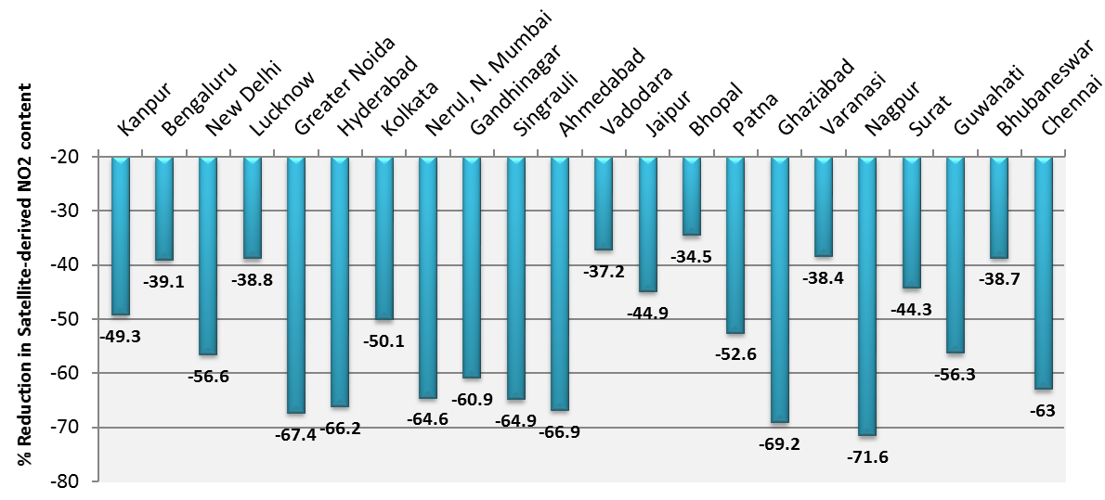
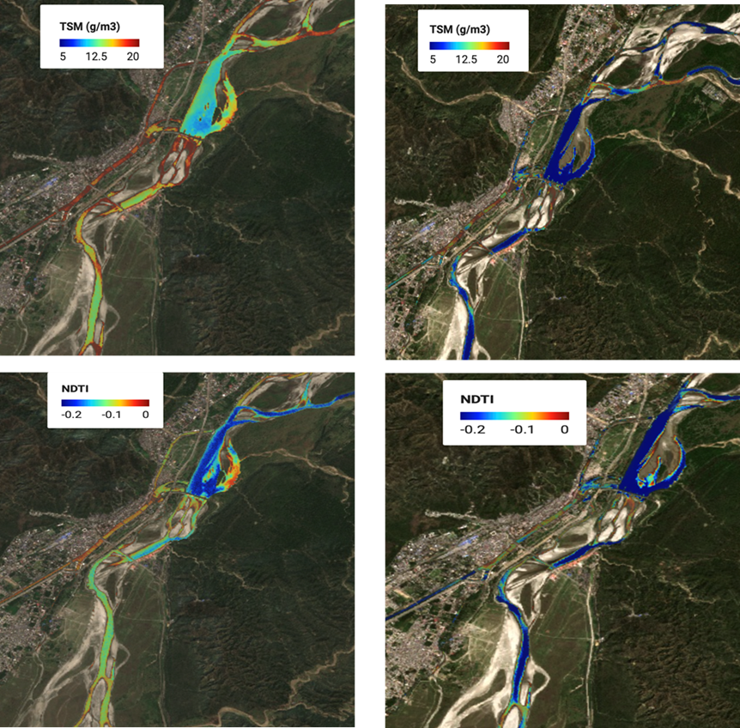
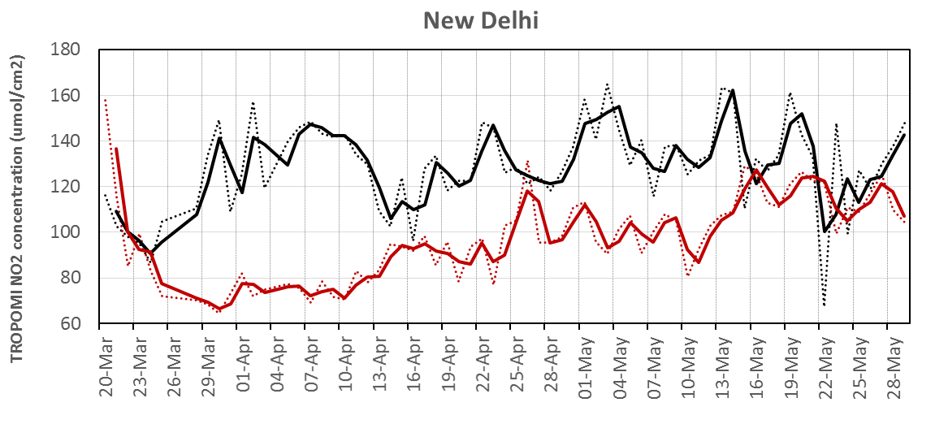
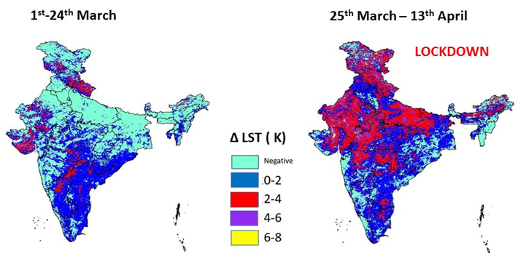
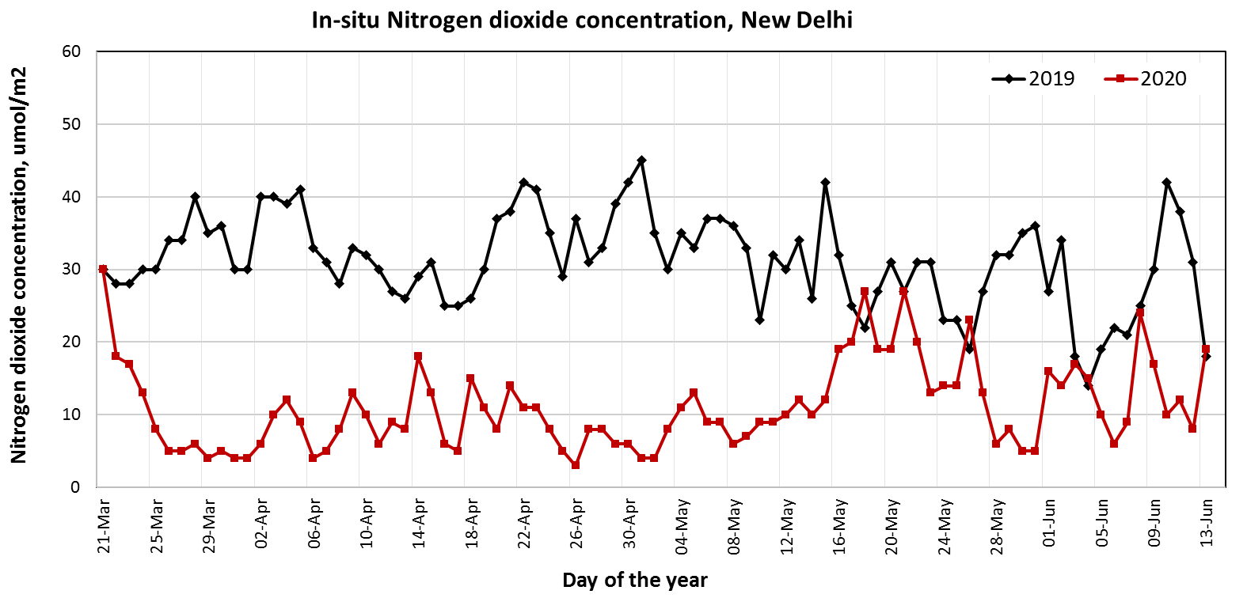
Environmental Changes during COVID-19 induced Lockdown
NO2 Reduction observed from Satellite over major Indian cities
WATER QUALITY
Sediments
City-level NO2 reduction observed from satellite during Lockdown w.r.t 2019
Turbidity
Satellite-derived NO2 (TROPOMI) over New Delhi
Effect on water quality: Before and After lockdown. Ganga river near Haridwar
In-situ NO2 measurements at New Delhi
Source: Pandya et al. (Under review),
Lele et al. (Under review), Chander S.,
Night time LST deviation from 2019 with more cooling in year 2020 during pre-lockdown and lockdown-1

Slide 4
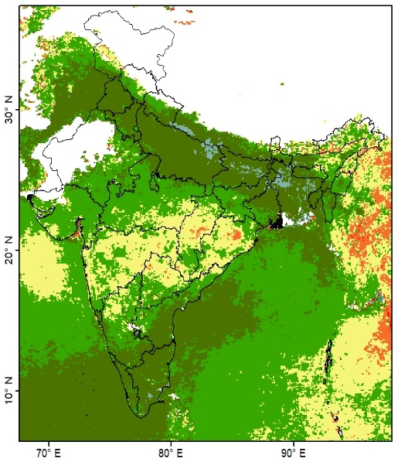
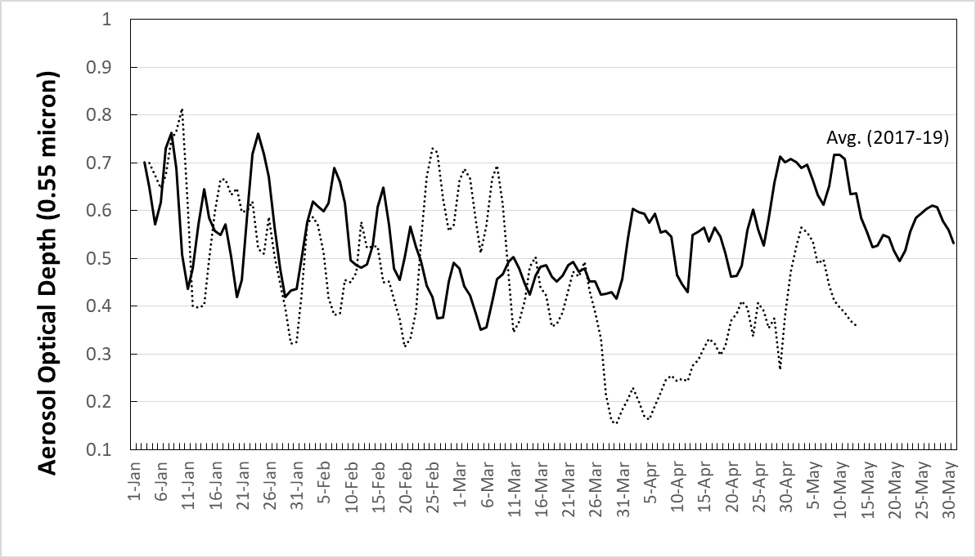
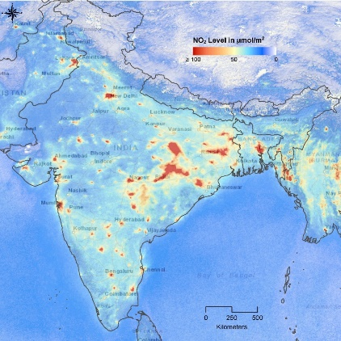
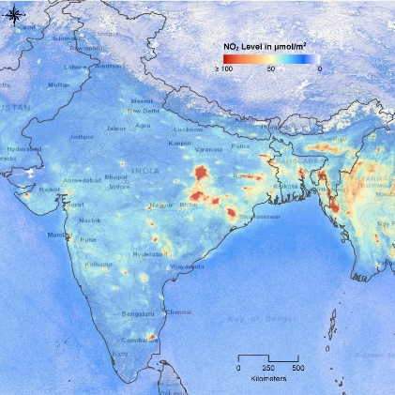
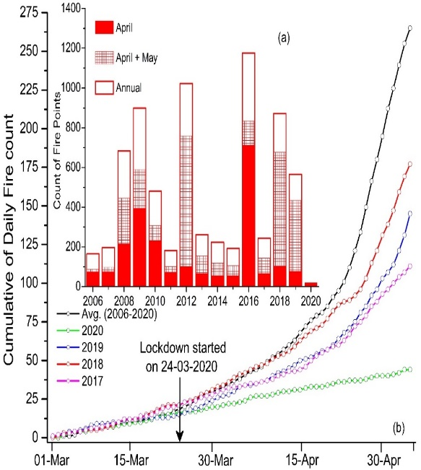
Environmental Changes during COVID-19 induced Lockdown
Abrupt decrease in Aerosol Optical depth
Comparison of During lockdown period of 2020 to the same period of 2017-19 reveals AOD is reduced by: Northern India: 46%; Eastern IGP: 42%; Peninsular India: 30%
Aerosol Optical Depth (0.55 μm)
MODIS observations showed an average reduction of 20–37% in aerosol loading during the lockdown period (25 March–3 May 2020), compared to 2017–2019 across India¹.
TROPOMI observations showed large reduction (30–50%) in tropospheric column NO₂ over India during the lockdown period². In-situ observation of NO_{x} also showed abrupt decrease over different Indian cities after lockdown implementation³.
Significant reduction (83.4%) in the cumulative fire incidences during 24 March to 5 May 2020 was observed over Western Himalaya compared to the average fire incidences during this period of 2006–20⁴.
Daily AOD variation over Northern India
2020
Trop Column NO₂ (µmol/m²)
Strong reduction in Nitrogen Dioxide
AOD Anomaly in 2020 (25Mar-3May) with Avg. AOD (2017-19)
Less forest fire incidences over Western Himalayan region
24 March – 7 April 2019
NO₂: 24 March – 7 April 2019
24 March – 7 April 2020
Almost 3 times less fire events than non-severe fire years (observed by MODIS)
¹Yogesh Kant et al., Current Science, 2020
²Siddiqui et al., Journal of ISRS, 2020
³Srivastava et al., Current Science, 2020
⁴Gupta et al., Current Science, 2020

