Slide 1
CEOS Coastal Observations Applications Services & Tools (COAST): Phase 1 Report & Phase 2 Implementation as Ad Hoc Team
Paul DiGiacomo, NOAA, COAST Co-Chair
Raj Kumar, ISRO, COAST Co-Chair
CEOS Plenary 2020
4.3 CEOS-COAST
22 October 2020

Slide 2
CEOS Coastal Observations Applications Services & Tools (COAST)
CEOS Coastal Observations and Applications Study Team (CEOS-COAST): Initiated at 33rd CEOS Plenary to define a CEOS Coastal Strategy and facilitate engagement with key international stakeholders
Bridging land and aquatic observations within CEOS, helping to integrate across multiple CEOS entities and domains, both thematic and technical.
Leveraging CEOS Systems, services and interoperability approaches, including the CEOS Analysis Ready Data (ARD) framework already demonstrated for terrestrial and oceanic applications.
Facilitating the broader utilization of Earth observations for greater societal benefits within coastal zones and enhancing CEOS engagement with external stakeholders such as GEO, IOC/GOOS, UN Environment, WMO and the UN Decade of Ocean Science for Sustainable Development (2021-2030).
COAST Study Team Approach:
Virtual monthly+ meetings
Collaborative offline document and project work via GoogleDocs
CEOS SIT Side Event and Technical Workshop Session
Numerous briefings to partners, collaborators and stakeholders

Slide 3
CEOS Coastal Observations Applications Services & Tools (COAST)
COAST Team Members:
CEOS COVERAGE: Jorge Vazquez (JPL), Vardis Tsontos (JPL)
CEOS Executive Officer: Kerry Sawyer (NOAA)
CEOS SEC Support: George Dyke, Matt Steventon (Symbios)
CEOS Systems Engineering Office (SEO): Brian Killough (NASA)
CEOS VCs: Ed Armstrong (JPL), SST-VC; Eric Leuliette (NOAA), OST-VC
CEOS WGCapD: Nancy Searby, Lauren Childs-Gleason (NASA)
CEOS WGClimate: Albrecht von Bargen (DLR-DE), Joerg Schultz (EUMETSAT)
CEOS WGCV: Philippe Goryl (ESA)
CEOS WGISS: Rob Woodcock (CSIRO)
CEOS WG Disasters: David Green (NASA), David Borges (NASA)
CEOS SDG AHT: Flora Kerblat (CSIRO)
CNES: Aurelien Carbonniere
CSIRO: Janet Anstee
ESA: Jérôme Benveniste
EUMETSAT: Estelle Obligis
European Commission: Astrid-Christina Koch, Fabienne Jacq
GEO AquaWatch Initiative: Steve Greb (Univ of Wisconsin)
GEO Blue Planet Initiative: Emily Smail (UMD), Leah Segui
GEO Secretariat: Douglas Cripe
Geoscience Australia: Stephen Sagar
ISRO: Rashmi Sharma, Raj Kumar (Co-Chair)
JAXA: Osamu Ochiai, Ko Hamamoto
NASA: Laura Lorenzoni (OCR-VC)
NOAA: Paul M. DiGiacomo (Co-Chair); Merrie Beth Neely (Project Manager)
USGS: Steve Labahn (LSI-VC)

Slide 4
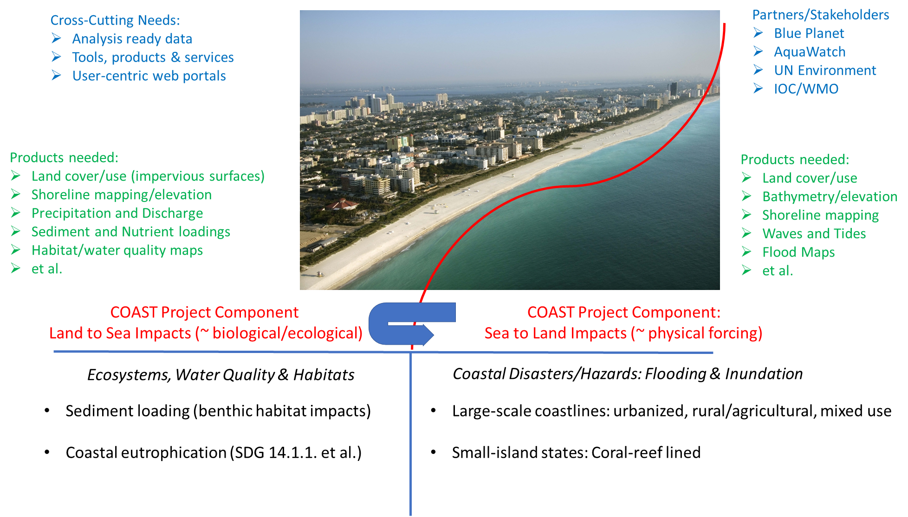
CEOS Coastal Observations Applications Services & Tools (COAST)

Slide 5
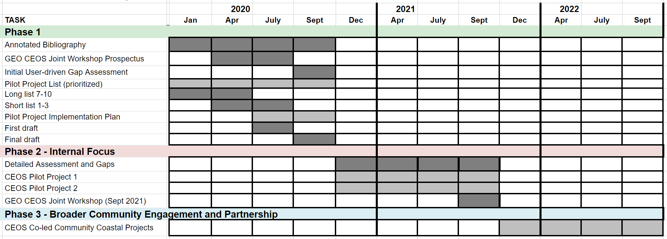
CEOS Coastal Observations Applications Services & Tools (COAST)
COAST Project: Phases, Milestones and Schedule

Slide 6
CEOS Coastal Observations Applications Services & Tools (COAST)
COAST Project: Phases, Milestones and Schedule

Slide 7
CEOS Coastal Observations Applications Services & Tools (COAST)
Summary of COAST Phase 1 Deliverables
(Status as of 30 September 2020)
⮚ Established - CEOS-COAST website: http://ceos.org/ourwork/ad-hoc-teams/ceos-coast/
⮚ Completed – Annotated COAST Bibliography; available at CEOS-COAST website
⮚ Completed – Compilation of COAST-related projects/activities; pending for CEOS-COAST website
⮚ Completed – draft satellite data requirements inventory for SDG 14.1.1a (coastal eutrophication)
⮚ Completed - Phase 2 Pilot project components, priorities and sites identified
⮚ Delivered – Draft CEOS-COAST Phase 1 White Paper #1: “Sea to Land Impacts: User Needs,
Observations, and Services”
⮚ Delivered – Draft CEOS-COAST Phase 1 White Paper #2: “Land to Sea Impacts: User Needs,
Observations, and Services”
⮚ Delivered – Draft CEOS-COAST Phase 1 White Paper #3: “Cross-Cutting Tools, Systems and Services”
⮚ Pending – COAST Phase 2 Implementation Plan (now in draft, final to be delivered by December 2020)
⮚ Pending – COAST AHT ToR (now in draft review)
NB: On hold due to COVID: Planning for Joint GEO-CEOS COASTAL Workshop (~Summer 2020; now TBD)

Slide 8
CEOS Coastal Observations Applications Services & Tools (COAST)
Delivery of Coastal Strategy Documents for CEOS
CEOS-COAST Phase 1 White Paper #1: “Sea to Land Impacts: User Needs, Observations, and Services”
CEOS-COAST Phase 1 White Paper #2: “Land to Sea Impacts: User Needs, Observations, and Services”
CEOS-COAST Phase 1 White Paper #3: “Cross-Cutting Tools, Systems and Services”

Slide 9
CEOS Coastal Observations Applications Services & Tools (COAST)
Delivery of Coastal Strategy Documents for CEOS
CEOS-COAST Phase 1 White Paper #1: “Sea to Land Impacts: User Needs, Observations, and Services”
CEOS-COAST Phase 1 White Paper #2: “Land to Sea Impacts: User Needs, Observations, and Services”
CEOS-COAST Phase 1 White Paper #3: “Cross-Cutting Tools, Systems and Services”
Focusing on user needs & integration, technology transfer & capacity building
Facilitating broader utilization of EO data for societal benefits within coastal zones, and foster CEOS engagement
w/key stakeholders including GEO, IOC/GOOS, UN Environment, WMO and the UN Ocean Decade
Trans-boundary approaches required: Coupling of processes/phenomena across the land-sea interface
Integration of multi-sensor, multi-parameter satellite observations (physical and biological/biogeochemical)
Integration of satellite and in situ observations (in future: adding model output/forecasts to the portfolio)
Trans-disciplinary approaches required: Integration across environmental data, along with social sciences data
Leverage mature/emerging data products, tools & services, and build capacity from developed to developing regions
> Transition products – initially via regional project demonstrations then to global implementation
> Ensure interoperability – through use of consistent standards, best practices, Analysis Ready Data (ARD)
> Usage of cloud-based processing/knowledge hubs (CEOS Earth Analytics Interoperability Lab) to build capacity

Slide 10
CEOS Coastal Observations Applications Services & Tools (COAST)

Slide 11
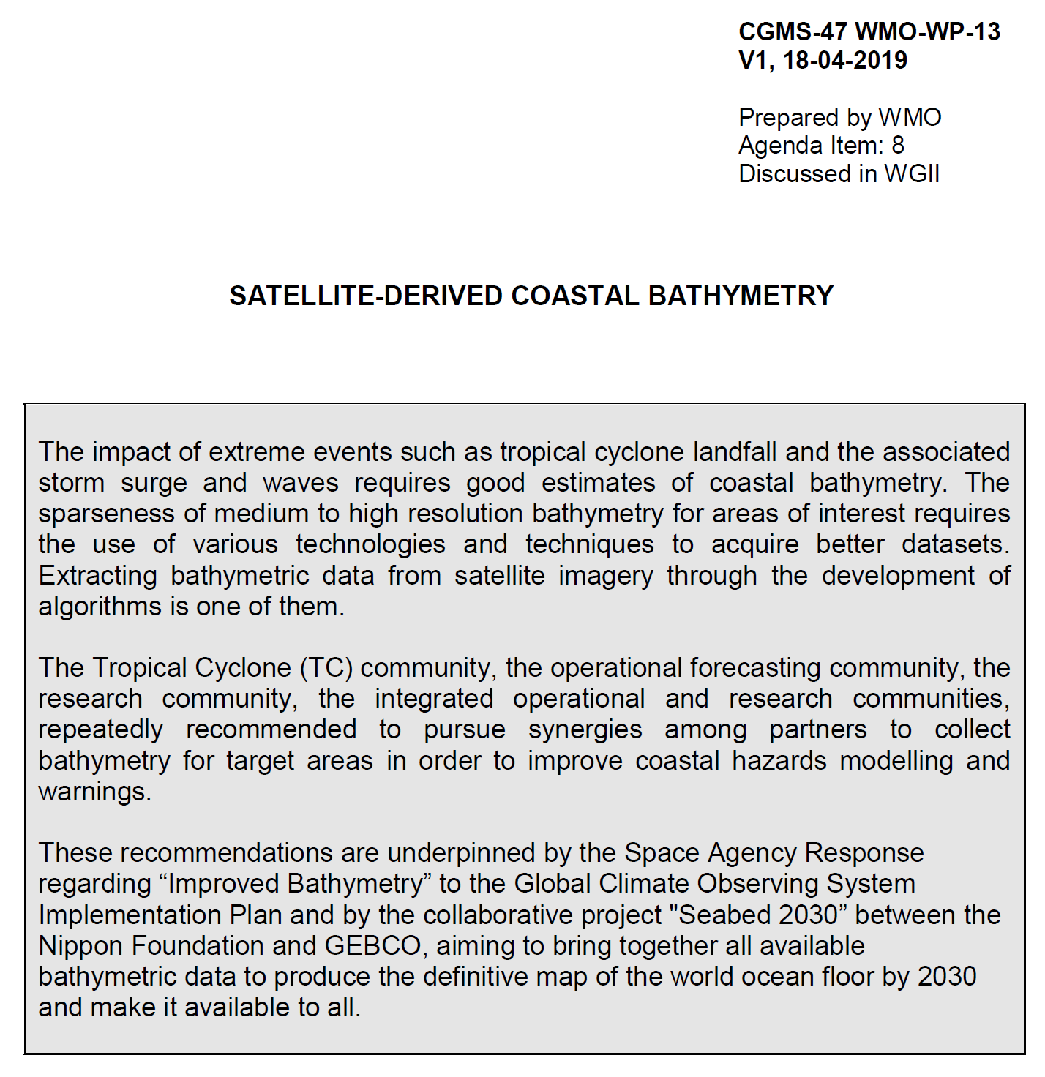
Coordination Group for Meteorological Satellites - CGMS
Pursuant to CGMS-47 WMO-WP-13: Satellite-Derived Coastal Bathymetry
Key issues of relevance to CGMS:

Slide 12
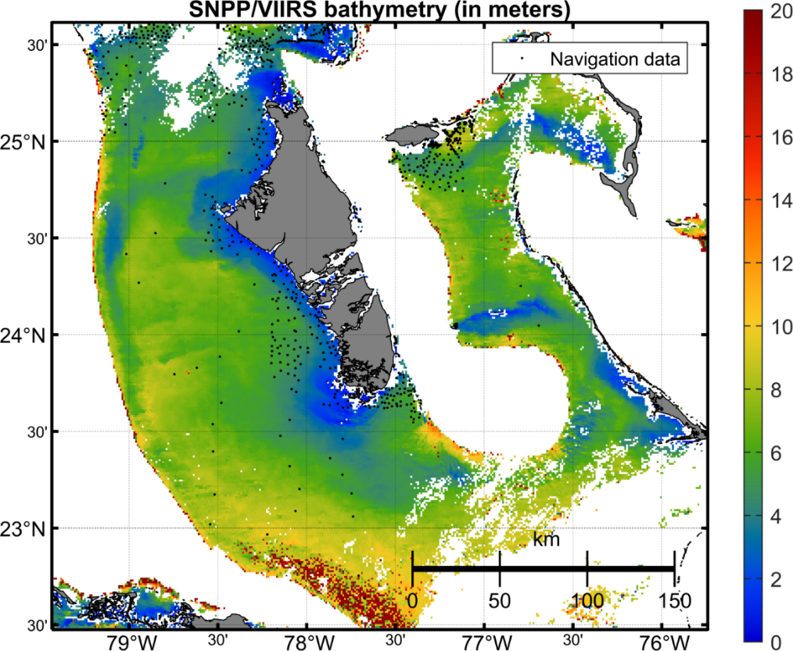
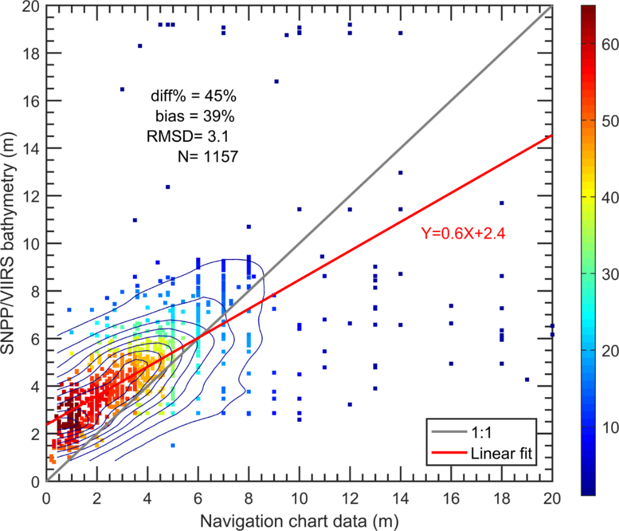
xxx
Bathymetry from NOAA Multi-Spectral Ocean Color Satellite Measurements
Depth (m)
density
Bahamas
Bathymetric map is derived from VIIRS-SNPP ocean color data, using the newly developed spectral optimization algorithm.
Validation of satellite-derived and Navigation Chart data (sampling locations are indicated in the map), showing useful data from VIIRS.
Jianwei Wei & Menghua Wang,
NOAA Ocean Color Team

Slide 13
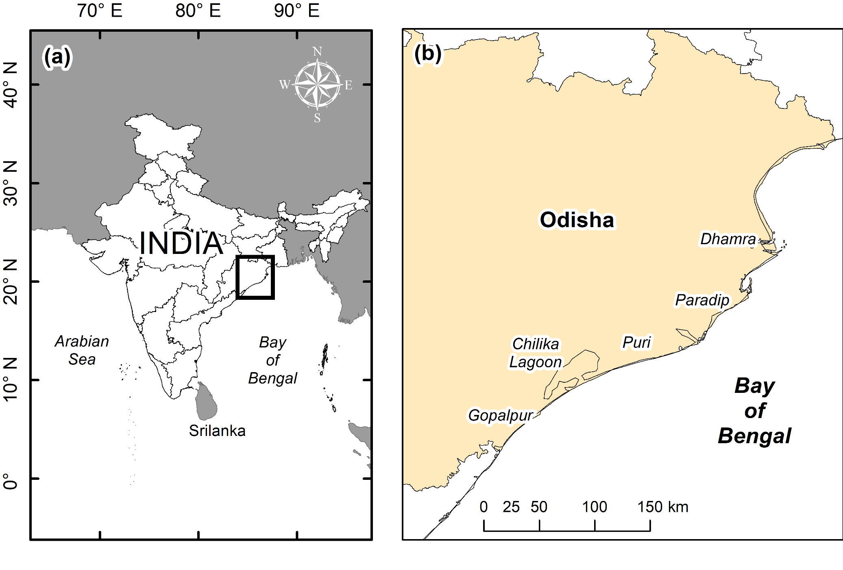
COAST Pilot Site: Bay of Bengal

Slide 15
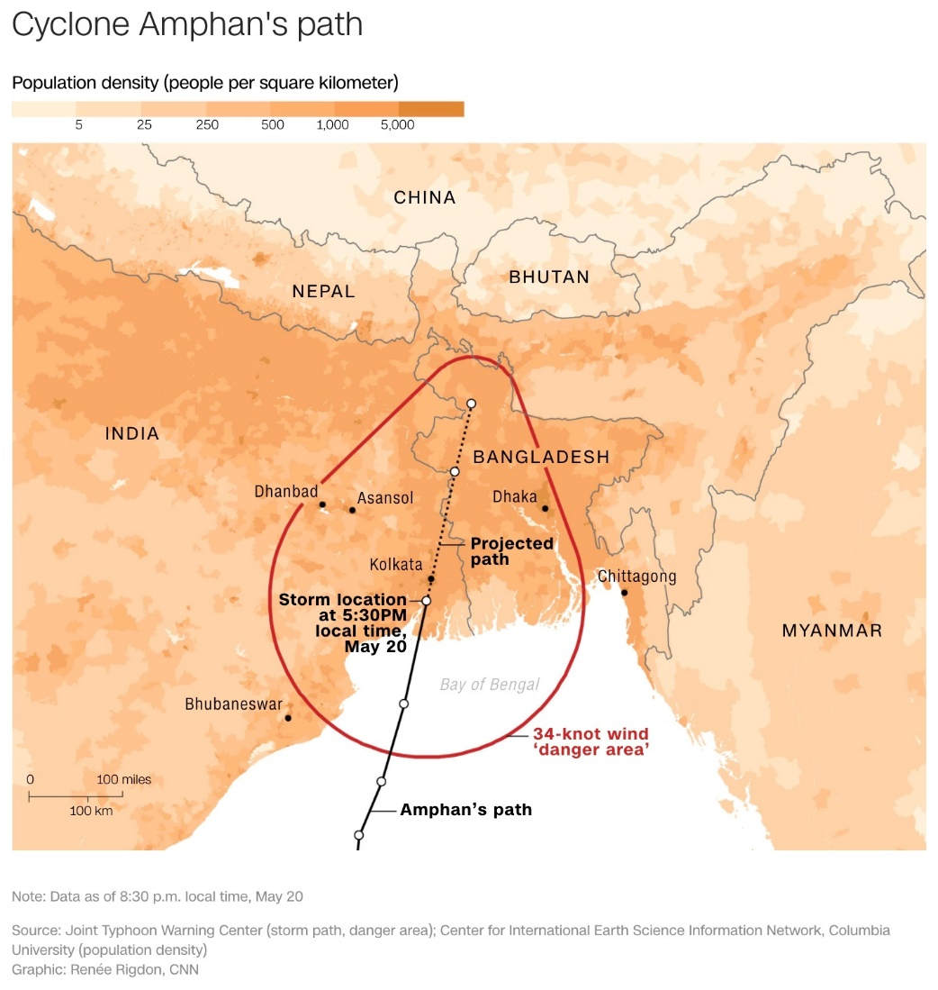
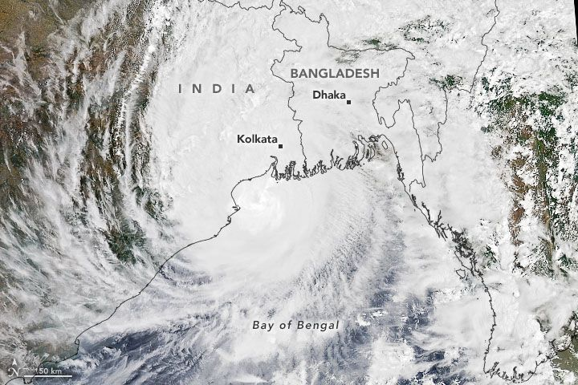
CEOS Coastal Observations & Applications Study Team: COAST
Anticipated COAST Pilot Locations
Continental:
Odisha/Bay of Bengal
Coastal Virginia/Chesapeake Bay
West Coast of Africa
Rio de la Plata region (TBD)
Small Island Nations:
Caribbean: Bahamas, Puerto Rico (TBD)
Pacific: Tahiti et al. (TBD)
Other sites pending

Slide 16
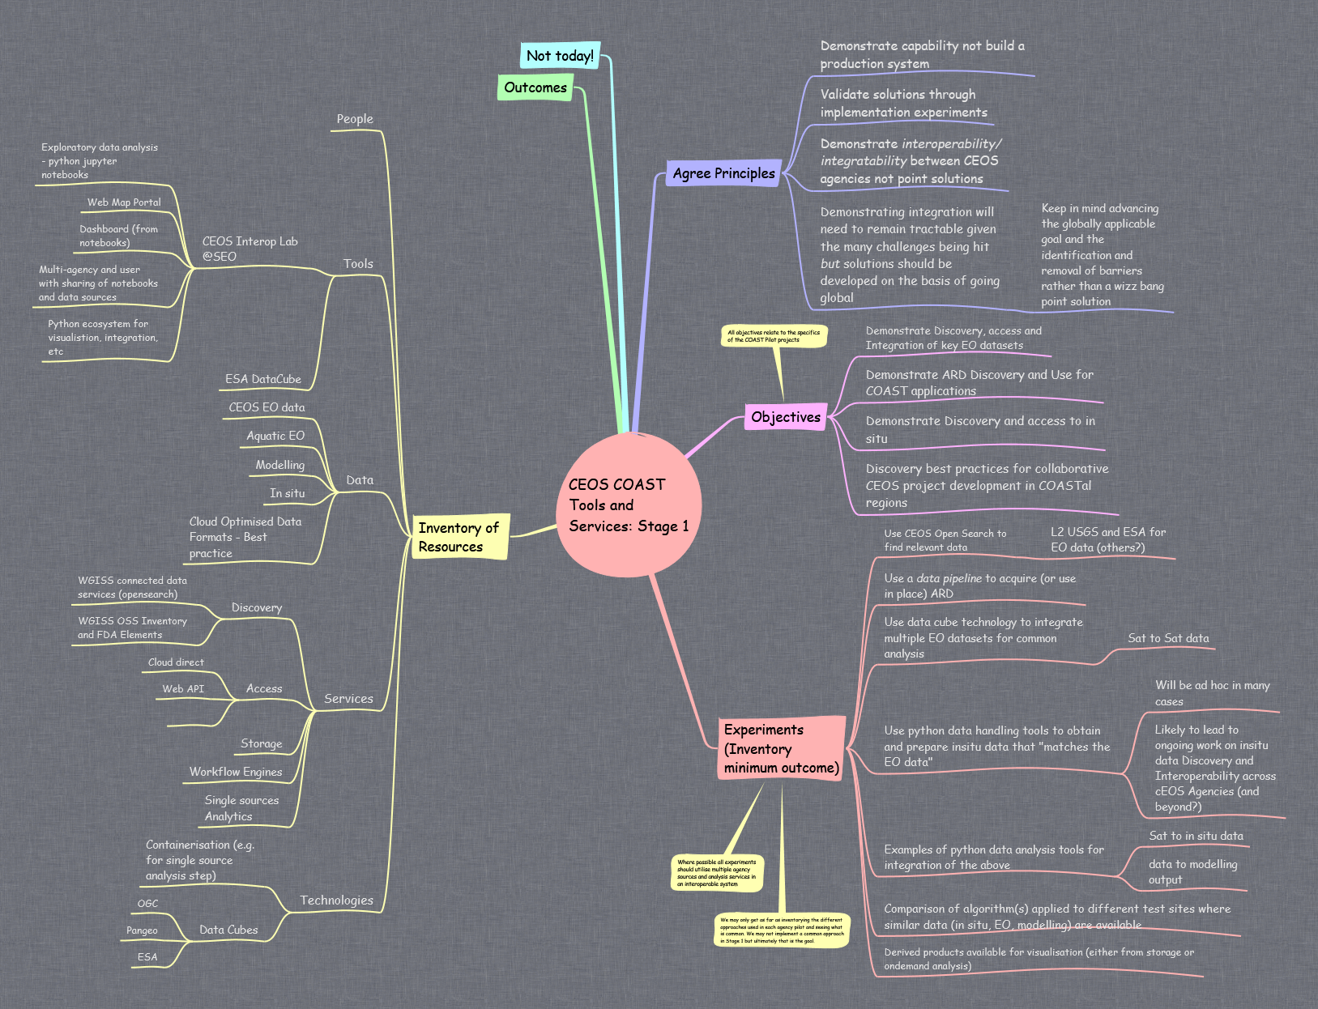
CEOS COAST Architecture Mind Map

Slide 17
CEOS COAST Architecture Mind Map

Slide 18
CEOS Coastal Observations & Applications Study Team: COAST
Summary and Request to Continue COAST as Ad Hoc Team for 2 years (2021-2022)
Recognize: That the COAST Team has made significant progress to date, including meeting and exceeding its initial deliverables as identified in its Phase 1 work plan for 2020
Endorse: That COAST has identified a compelling strategy with high impact/priority user needs and opportunities that CEOS can readily address via COAST
Decision: Requesting continuation of COAST activities through Sept 2022 as CEOS-AHT; Final Terms of Reference & Phase 2 Implementation Plan will be delivered by Dec 2020
Decision: Requesting CEOS submit COAST as a submission to the U.N. Ocean Decade to address international coastal stakeholder needs through its global implementation

Slide 19
CEOS Coastal Observations & Applications Study Team: COAST
Thank You!

Slide 20
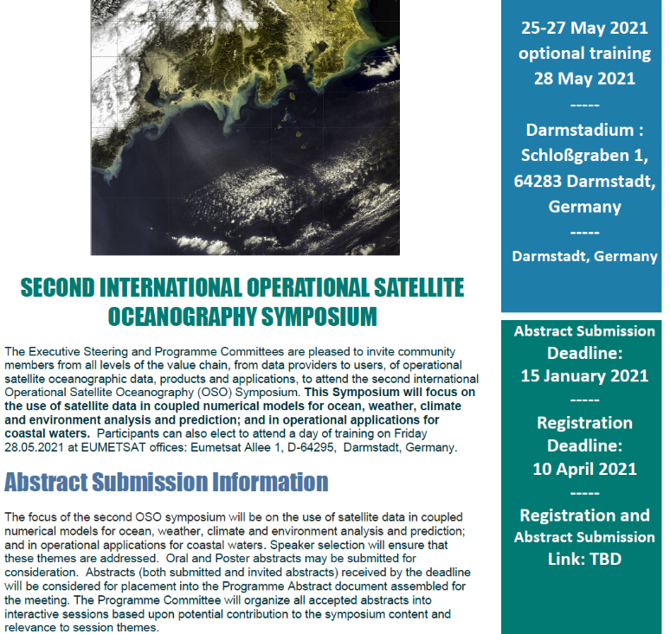
2nd International Operational Satellite Oceanography Symposium (OSOS-2) Virtual Meeting, 25-27 May 2021

