Slide 1
Joint CEOS-CGMS Working Group Climate
Committee on Earth Observation Satellites
J. Schulz (WGClimate Chair)
A. von Bargen (WGClimate Vice Chair)
2020 CEOS Plenary
Agenda Item # 3.9
20 – 22 October 2020

Slide 2
Content
ECV Inventory, gap analysis, action plan
Climate Monitoring Architecture - Use Case Exercise
WGClimate and GCOS
WGClimate and UNFCCC
WGClimate and GEO CC-WG
WGClimate and WCRP
CEOS Action and Climate Deliverable Status

Slide 3
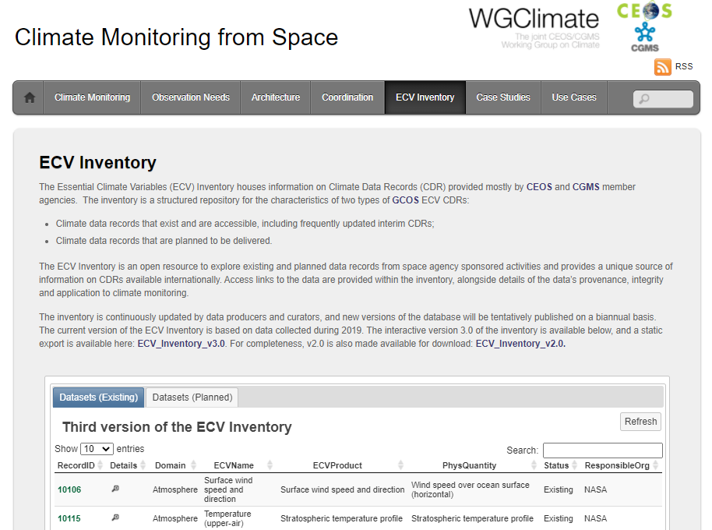
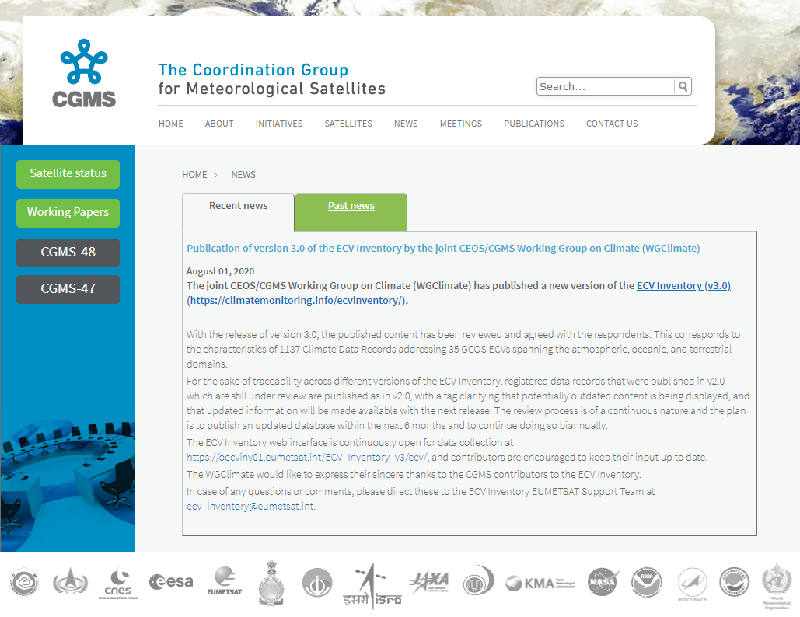
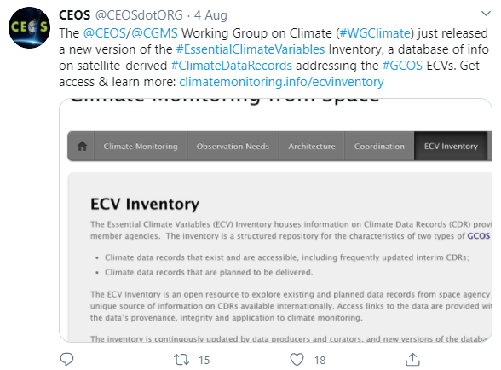
Status of ECV Inventory:
Publication of v3.0
Publication of the ECV Inventory v3.0:
Database live since 30th July on https://climatemonitoring.info/ecvinventory
Announcement / advertising e-mail message sent to WGClimate and ECV Inventory contributors (31st of July) [followed by dissemination through CEOS and CGMS mailing lists in early August]
Publication of a news story on the CGMS website (https://www.cgms-info.org/index_.php/cgms/news) and Twitter note from CEOS [followed by re-tweet by EUMETSAT] (https://twitter.com/CEOSdotORG/status/1290703991563857921?s=20) (early August)
Big THANKS to all agencies and involved people!

Slide 4
ECV Inventory V3.0 content
Domain | Existing | Planned | Total
Atmosphere | 535 | 266 | 801
Ocean | 90 | 43 | 133
Land | 141 | 62 | 203
Total | 766 | 371 | 1137
GCOS IP space-observables: 37 ECVs (13 Atmosphere, 15 Land, and 9 Ocean) – 35 ECVs covered with some contribution in Inventory V3
ECVs Lightning, Permafrost, and Above-ground Biomass represented for the first time
From current ECVs only Ocean Surface Currents and Anthropogenic GHG fluxes appear as gaps, but some more ECVs can be addressed from space, e.g., river discharge.

Slide 5
Gap analysis and coordinated
action plan
The delivery of the Cycle 3 Gap Analysis and Coordinated Action Plan has moved to autumn 2020 (due to COVID-19 impact), and is unfortunately not ready for CEOS Plenary (20-22 October) approval. Aim at virtual endorsement until end of 2020
Gap analysis process will be further rationalised to ensure affordability. It will involve an annual workshop to which agencies are requested to send experts on ECVs
Encourage CEOS members to inform us about particular needs for gap analysis that are most useful for them
Many of the Coordinated Actions found their way into the CEOS work plan, not all though

Slide 6
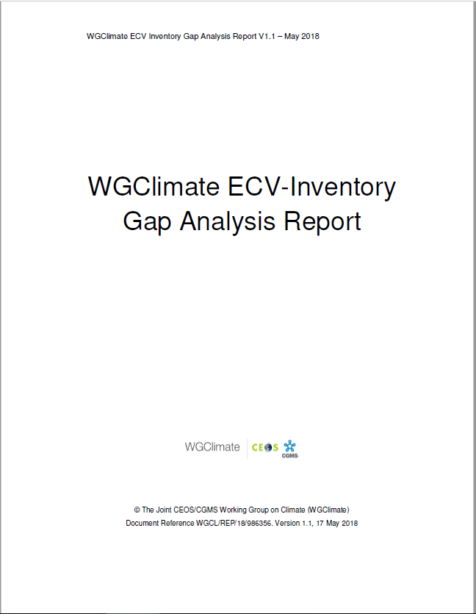
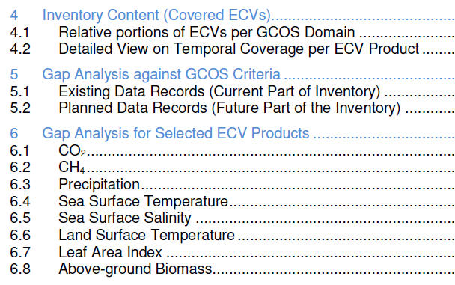
Gap analysis concept
Automatic assessment
Statistical analysis tools and graphical display
Statistical analysis tools and graphical display on the web interface
Analysis of delta to version #2
Detailed analysis per ECV / ECV Product:
Assesses progress for 8 ECVs addressed for V2.0
Selected 13 additional ECVs (5 atmosphere, 5 land, 3 ocean) not addressed before that are specifically part of 2016 GCOS-IP actions
Postponed 2 land (FAPAR, Glaciers) and 1 atmosphere (lightning) due to missing support and late availability of Inventory inputs

Slide 7
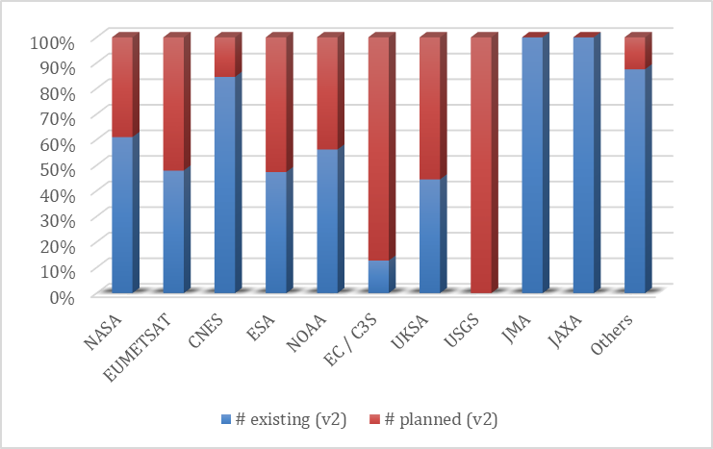
Relative number of existing and
planned data records per agency
ECV Inventory #2
ECV Inventory #3

Slide 8
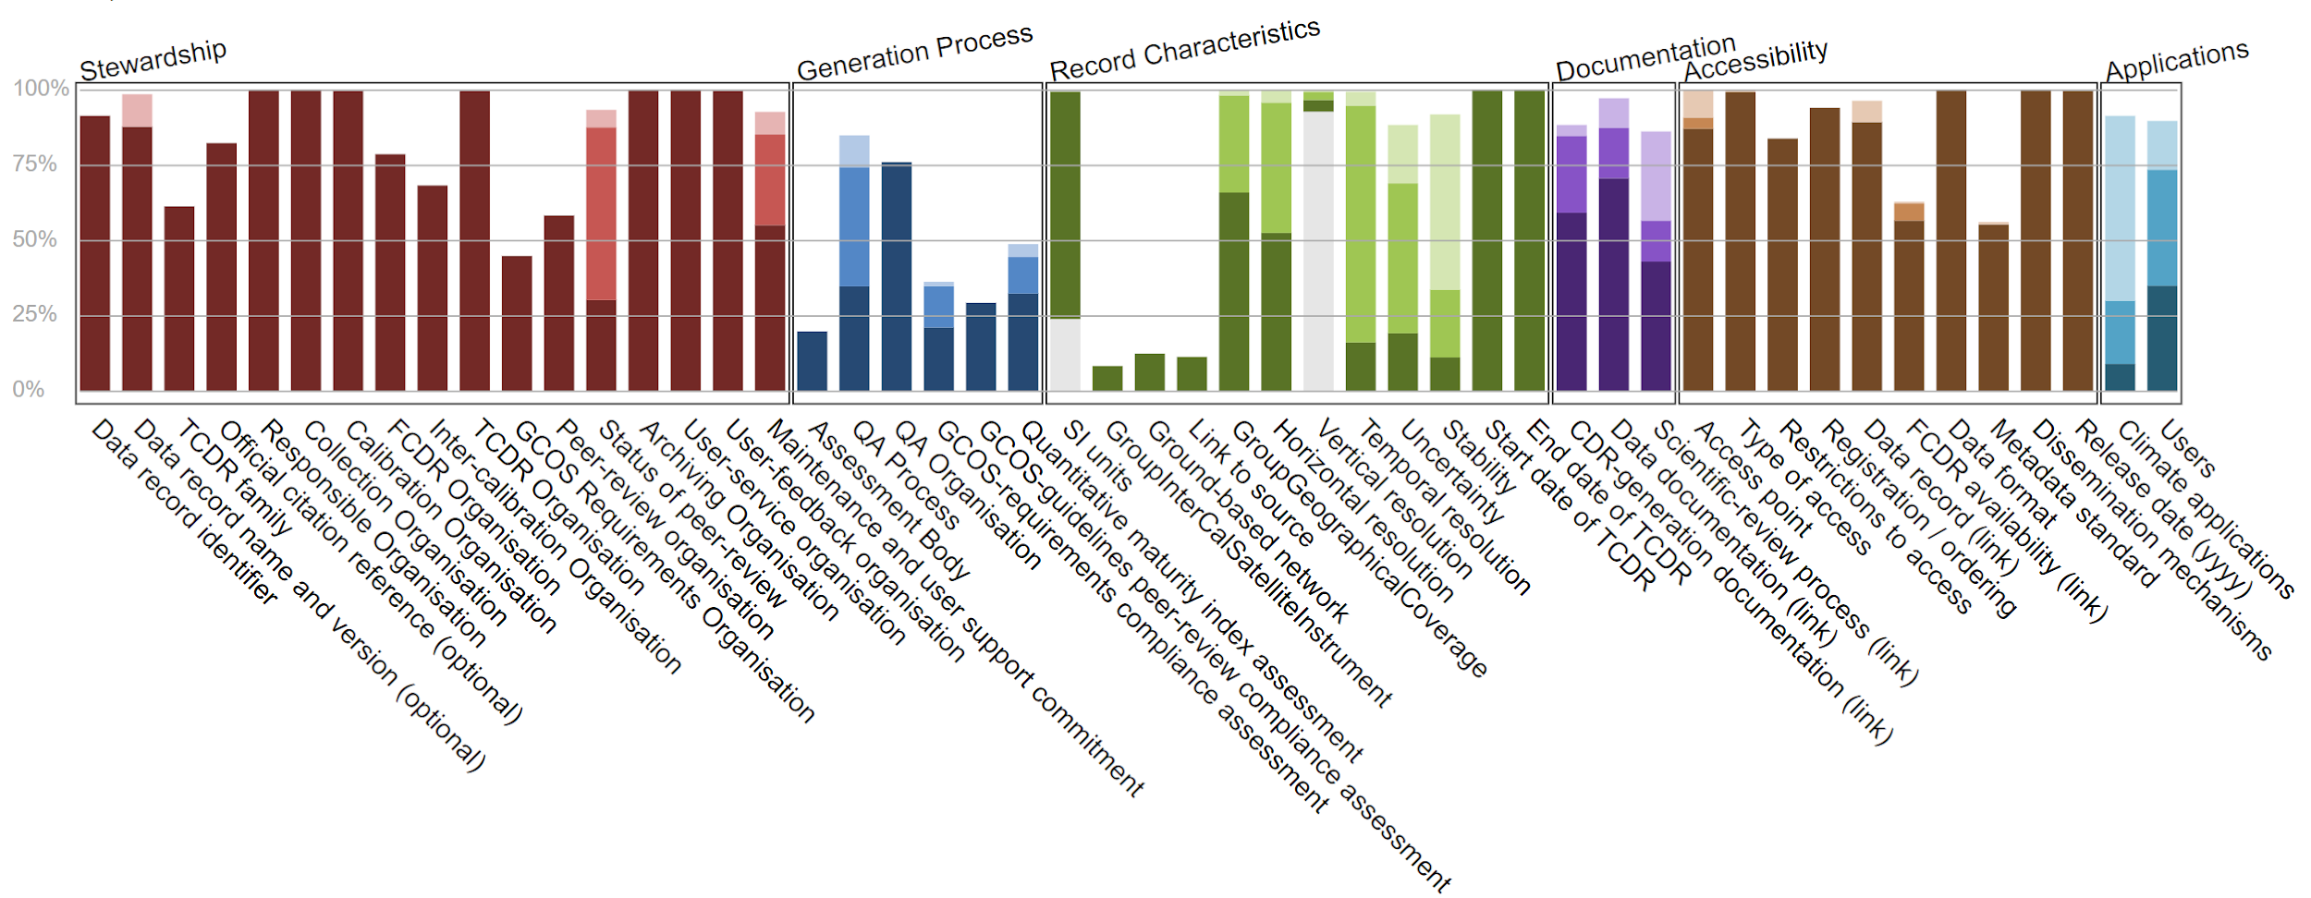
Assessment of GCOS Criteria for existing data records
x
x
x
x
x
x
x
x
x

Slide 9
Other key findings -1
Gaps in the ECV Inventory have been detected for ECVs aerosol, sea level, soil moisture, land cover, and fire (burnt area)
Detected issues in WMO OSCAR concerning the relevance category of missions for aerosol retrieval
Maintenance of existing and non delayed launch of new multi-channel passive microwave radiometers (AMSR-3, MWI, Weather Satellite Follow-on – Microwave (WSF-M)) is needed to avoid gaps for several ECV data records. The earliest next launch is in 2022
For upper air winds there is a big potential to use instruments that haven’t been used including Russian and Indian imagers, and sounders for 3D winds
After demonstration of positive impact on NWP Aeolus type missions should be operationalised to build long term records

Slide 10
Other key findings - 2
For ECV water vapour, there is an impending gap in water vapour measurements from stratospheric limb sounders used for profiling, e.g., from solar occultation, limb scattering, or limb emission
For ECV aerosol, lacking cross-sensor consistency for long-term multi-sensor CDRs is a principal issue which is due to responsibilities at space agencies being assigned on single mission level (e.g. ATSR-2 / AATSR / SLSTR or MODIS /VIIRS series) – planning of future instruments should consider this aspect.
For ECV sea level raw data (FCDR) quality is affected by the change of measurement approach, it will be essential to ensure the production of the Sentinel-6/Jason-CS FCDR based on the historical Low Resolution Mode measurements to support climate applications
Altimetry data could play a stronger role deriving sea ice extent and snow thickness, which should be encouraged for cross comparisons and reduction of uncertainty in all products

Slide 11
Evolution of ECV Inventory V4.0
* mid-October ← (continuous data collection) ← [*] delta wrt. WGC#12 [early May]
1686 records in the database ↑ [+131*]
1557 records “available” ↕ [+129*]
1478 records “submitted” ↕ [+148*]
129 records “deleted”
79 records “in progress”
1080 records “verified” ↕ [+6*]
398 records “TBC”
More entries on Above Ground Biomass (NASA)
MODIS Fire products (NASA) [identified missing datasets in GA Report on v2]
Existing entry on Temperature of deep atmospheric layers [(A)MSU: 1978-now] (NOAA)
CMA has initiated its contribution process, JAXA and KMA consolidating contribution raising hopes to have more completeness in V4
C3S and CCI started update process
Way forward:
“Pen-testing” of system led to need for fixing tools/features for safety 🡪 delay in migration to the new URL [~late October], verification process, and evolution of tools
Resumed verification process in October & try to fill identified gaps 🡪 publish v4.0 in Q1/2021

Slide 12
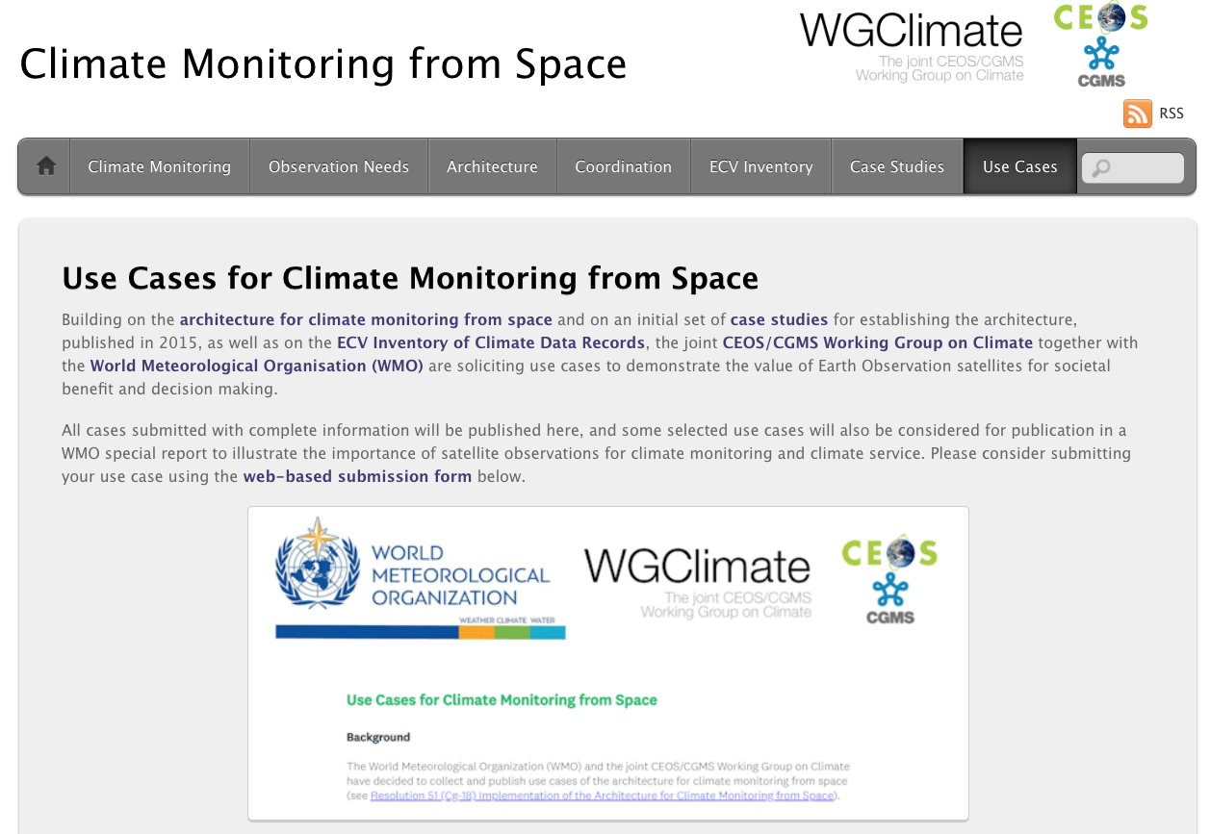
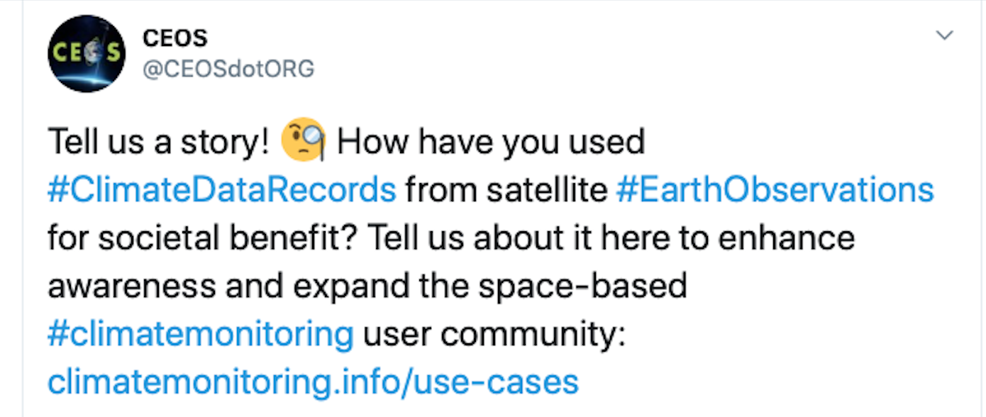
Use Cases for Climate Data Records
WGClimate#12 in May 2020 decided to start a new routine activity on collecting use cases for climate data records.
Use Case gathering tool, developed by WMO Space Programme Office, has been integrated into climate “Use Cases” web page (https://climatemonitoring.info/use-cases), which was opened on July 27, 2020 for submission with widespread distribution on social media.
Use cases will be published on the web and selected use cases will become part of a special report issued by WMO in 2021/22.

Slide 13
Use Cases for Climate Data
Records: Major Objectives
Optimize the use of climate data records in applications relevant for climate services and science
Demonstrate the value of climate data records for decision/policy making, e.g., usage of satellite data in a use case with UNFCCC Parties to support the Global Stocktakes
Understand the application needs to provide feedbacks towards quality improvements for the ECV requirements defined by GCOS
Validate the top-down architecture for climate monitoring from space with a down-top approach ensuring traceability from usage to space-based observing system
Support capacity building by providing/receiving use cases for/from training activities, e.g., for developing countries (link to CGMS and CEOS capacity building activities)
Take Earth observations from space
Create Climate Data Records/
Indicators
Use Climate Data Records
Decision Making
Sensing
CDR Making
Application
Use information derived from Climate Data Records
Tailored Data
Tailored information (Reports)
Observations

Slide 14
Use Cases Received - 1
Coastal Risk Information Service (C_RISe)
Satellite-derived sea-level record, ocean surface wind speed/direction, currents and wave height are used to provide coastal risk information service for countries on the east coast of Africa. This helps reducing the social and economic impact of coastal inundation and extreme weather through coastal zone management, infrastructure protection and development, operational planning, fishery support, etc.
Parametric insurance for agricultural communities using weather and climate information
Satellite-derived precipitation, temperature, land cover, soil moisture, and leaf area index are used to provide real-time risk assessment profiles for insurance policies that are designed to protect individual farmers and agribusinesses against drought, flood, excess rainfall, heatwave, hail, cyclone, etc.
Satellites remote sensing monitoring of the agricultural situation in the main producing region of winter wheat of China
Satellite-derived crop growth, snow cover, soil moisture, and land surface temperature are used to monitor wheat growing condition in China during winter

Slide 15
Use Cases Received - 2
NOAA Climate Data Record informs food security decisions to manage global famine
The Gridded Satellite (GridSat) B1 Climate Data Record (CDR) from NOAA provides homogenous satellite infrared brightness temperature data for the past 40 years. The data derived from meteorological geostationary satellite data is combined with in situ and model data to produce estimates of precipitation and surface temperature in data sparse regions, which help inform food security managers on the extent and severity of drought and famine.
Alaska Disasters: Development of a Snowmelt Monitoring Tool Using NASA MODIS and NOAA Climate Data Records to Aid Wildfire Managers in Alaska
This project worked with the Alaska Interagency Coordination Center (AICC) and the National Weather Service Alaska Region to aid fire risk and monitoring efforts. Analysed climatological trends in seasonal snow cover melt using NOAA’s Snow Cover Extent - Climate Data Record (SCE-CDR) to provide end users with a better understanding of historic and expected changes in snowmelt, which can be correlated to wildfire probability.

Slide 16
Way forward
All received use cases will be published on climatemonitoring.info
Need to trigger more use cases! – Please encourage within your countries´ institutions that use satellite climate data to submit a use case at https://climatemonitoring.info/use-cases. Contacts: Wenying Su (NASA) and Werner Balogh (WMO)
Reached out to European project CHE and VERIFY for carbon related cases, received positive response – there are many more opportunities, e.g., on AFOLU, adaptation, etc.
Conversations with WGDisaster and WGCapD pending, both are seen as possible contributors
Have the opportunity to demonstrate some use cases on posters at Earth Info Day 2020 (including new arrivals in the next 3 weeks)
Plan for a publication by WMO on a representative set of use cases end of 2021

Slide 17
WGClimate and GCOS: Efficiencies in Requirements process
GCOS has been an effective partner, and the GCOS IP and requirements are the primary framework against which agencies make substantial investments in the space segment for climate and climate data record production
There is increasing need for application specific requirements (e.g. for GHGs)
Would make the space agency coordination, as well as individual agency investment more efficient. Our preference is to maintain GCOS as primary “source” of EO requirements
CGMS-48 Recommendation: WMO to ensure that the GCOS requirements, as well as the process to define them, are designed in such a way that requirements stemming from the agencies need to assess performances can be captured
Continued the discussion at the CEOS TW 2020 and agreed to jointly start working on it, keeping in mind the resource limitations on both sides.

Slide 18
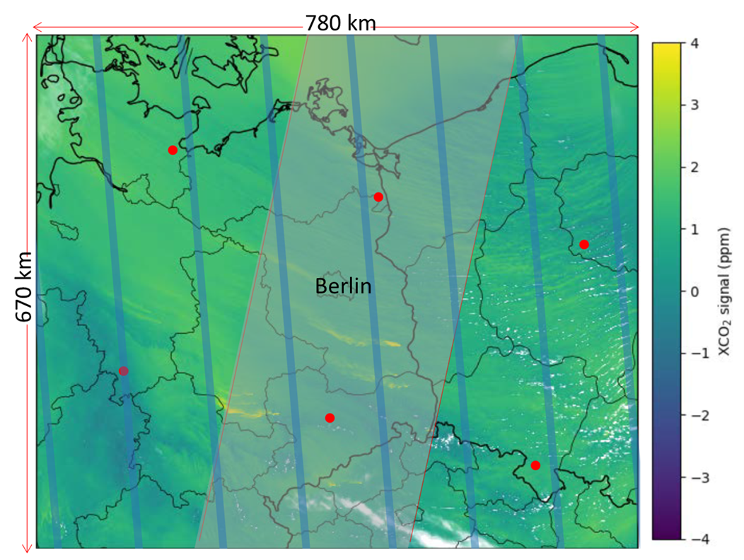
“Shifting” Requirements – An example
Requirements are changing – need to reflect this in GCOS IP
Figure: Simulated XCO₂ and NO₂ plumes originating from power plants and other emission sources in a larger area around Berlin. Simulated data come from the COSMO-GHG model as used in the SMARTCARB study simulating a swath width of 250 km. Credit: ESA SMARTCARB.
Figure: The XCO₂ distribution over 780 km by 670 km region centered over Berlin, Germany (adapted from Kuhlmann et al. 2018) is shown along with the spatial coverage and resolution for GOSAT (red dots), OCO-2 (blue tracks) and a proposed CO₂ Sentinel mission with a 250 km-wide swath (light grey region). Credit: ESA SMARTCARB.

Slide 19
Way forward with GCOS
At CEOS TW WMO agreed that changes to the GCOS IP can be addressed by GCOS Secretariat and the current GCOS Steering Committee
WGClimate will develop specific needs for changes and make proposals to GCOS, in particular, addressing typology in all domains. This helps linking the requirements with the GCOS objectives, i.e., facilitate support to UNFCCC, climate model development and perfomance monitoring, etc.
Could utilise different sources for emerging additional and refined requirements, e.g., WGClimate use case exercise, WMO GFCS, GEO Climate Change WG, National Adaptation Plans. A starting point could be carbon related requirements
It is advisable that AFOLU roadmap team engages with this activity and checks GCOS IP Land chapters for existence of needed ECVs including related requirements, e.g. related to biomass
GCOS is underway to organise a telecon with WGClimate to further discuss our concerns on the ECV requirements and to devise a way forward
GCOS Study team will start work soon and will look at governance and outputs. The proposal made at CEOS TW on interim updates of the ECV requirements could be looked at by the study team. This would be interesting to improve the situation incrementally and not only every 5 years
Notes:
Can we define a typology of requirements for ECV products in all domains, i.e., linking the requirements with the GCOS objectives?
Can we use the WGClimate Case Study Exercise to emerge some additional and refined requirements?
What are opportunities for gathering requirements, e.g., for adaptation through other initiatives e.g. WMO GFCS, GEO Climate Change WG?
Can the envisaged GCOS study team help in this process? What could be realistically achieved for next GCOS IP?
What are the implications for ECV Inventory, Gap Analysis, and Action Plan process?

Slide 20
GCOS Timeline
SEPTEMBER 2021: 4th Status Report published
OCTOBER 2021:
Climate Observation Conference
11-15 October
OCTOBER: SC Meeting: 4th Implementation Plan published
Jan 2020
Jan 2021
Jan 2022
Jan 2023
panels draft SR4
Review SR4 & finalise
Public consultation
Panels consider comments on requirements
panels draft IP4
Review IP4 & Finalise
Mar
Aug
Oct
Feb
Feb
Input from other groups, e.g. CEOS/CGMS WG Climate, on ECV Requirements, contributions to the Status Report and Implementation Plan and review comments.
Courtesy of GCOS

Slide 21
WGClimate and UNFCCC - 1
Provided full reporting including a CEOS/CGMS statement SBSTA-51 in Madrid, Spain in December 2019.
Participated in Earth Info Day and received good recognition for space agency contributions, full report: https://unfccc.int/sites/default/files/resource/EarthInformationDay2019.SummaryReport.pdf

Slide 22
WGClimate and UNFCCC - 2
SBSTA-52/COP-26 has been postponed to 2021 due to the COVID-19 pandemic. No formal statements will be made in 2020
An Earth Info Day is planned for the second week of the climate change dialogues – one day between 30 Nov – 4 Dec 2020, will catch up on agenda with UNFCCC Sec soon
The CEOS/CGMS WGClimate will further provide support to the UNFCCC Secretariat and the Parties in the Synthesis and Assessment phase of the first Global Stocktake process and will actively engage in the newly established ad hoc group on Systematic Observations on support of the Global Stocktake.
At the CEOS TW WGClimate nominated 3 CEOS representatives on behalf of CEOS: David Crisp (WGClimate GHG Task Team), Osamu Ochiai (AFOLU), and Jörg Schulz (other items including adaptation)
More on the how to engage in agenda item 3-10!

Slide 23
WGClimate and UNFCCC - 3
Current main themes of the Earth Information Day will broadly include:
Updates on the state of the global climate
State of the global climate and impact of Covid-19
Information on drivers of climate change
Updates on ocean and cryosphere
Updates on knowledge on Earth’s energy imbalance
Data and information on ecosystem changes
Updates on the state of climate observation
Updates on state of climate observation
Updates on options and opportunities for systematic observation community to support decision making
Understanding associated risks and consequences of changes in global climate, particularly ocean and cryosphere
Findings from attribution studies
Earth system monitoring by satellites and utilization of observation data (GHG, biomass, etc.)

Slide 24
GEO Climate Change Working Group
Subgroup 1: Coordination of climate issues across the GEO Work Programme & Synergies with key partners (including WMO)
Co-chair: Virginia BURKETT (USGS - United States)
Members: WGClimate: Jörg Schulz (EUMETSAT)
Subgroup 2: Engagement with UNFCCC and IPCC
Co-chair: Mark DOWELL (JRC - European Commission)
Members: WGClimate: Wenying SU (NASA)
Susanne Mecklenburg (ESA)
Osamu Ochiai (JAXA)
4 Subgroups established, led by Co-chairs
97 members from governments, academia, UN agencies, IGOs, NGOs and private sector
Co-chairs will present roadmap and subgroup work plans to CC-WG on 27 October, followed by subgroup meetings for final review and approval
Work plans come without resource estimates, thus need to apply a realism check. CEOS contributions need to be existing or feasible in near future CEOS work plan.
Subgroup 3: Enhancing the use of EO for Mitigation
Co-chair: Lucia PERUGINI (CMCC – Italy)
Members: WGClimate: Wenying SU (NASA)
Subgroup 4: Enhancing the use of EO for Adaptation and Loss & Damage
Co-chair: Angel VALDIVIEZO AJILA (National Service for DRR and Emergencies – Ecuador)
Members: WGClimate: Jörg Schulz (EUMETSAT)
Susanne Mecklenburg (ESA)
Other WGClimate stakeholders who are also members of the GEO CC-WG: Joanna Post (UNFCCC), Simon Eggleston (GCOS). Many CEOS and CGMS members are represented by other experts.

Slide 25
Early Observations on CC-WG
See connection with Subgroups on:
Organizing twinning of EO experts with the negotiation teams of SBSTA Parties – produce briefings on EO progress tailored for countries and regions
Find support on requirements analysis, e.g., on mitigation and adaptation in regional GEOs
GEO response on EO gaps identified by IPCC can be supported by findings from the ECV Inventory
GEO plan to provide supplementary guidance for NAPs can be connected with use case exercise in WGClimate
Can certainly support expert meetings such as planned joint GEO-IPCC Expert meeting on the topic of “Land representation, the role of remote sensing and field measurements, and uncertainty” with EO experts
etc.

Slide 26
Interaction with WCRP
As ex officio member of the WCRP Data Advisory Council, we took part in discussions of an overall coordination mechanism across necessary model, data and observations activities within WCRP as part of the implementation of new WCRP strategy
Consulted directly with WCRP core project GEWEX Science Steering Group (SSG) on space agency support on a new global cloud climatology project called ISCCP-NG:
Space agency engagement is necessary to provide a cross-calibrated geostationary ‘ring’ radiance record to support development of several ECV data records (aerosols, clouds, motion vectors, radiation flux including for solar energy, etc.)
Will mostly engage CGMS agencies operating geostationary satellites and related bodies such as GSICS and SCOPE-CM, but there will be a component on polar orbiting satellites as well
WGClimate is seen as suitable body providing oversight together with GEWEX SSG – will explore role in more detail during 2021

Slide 27
Open Plenary Actions
No. | Action | Due Date
CEOS-32-02 | WGClimate to develop a ‘decision-maker’ version of the Statement of Space Agency Contributions in Support of Each Article of the Paris Agreement. | In Progress Targeting completion by the next CEOS Plenary.
Developed presentation used at ESA Living Planet and several workshops, but were not able to implement due to resource limitations. Propose to postpone and enrich material with newest developments on GHG and AFOLU activities as well as partnership with GEO in CC-WG.
New Action from CGMS-48 affecting CEOS
No. | Action | Due Date
CGMS-48 | JWGC/GHG TT Chair to define priorities for CGMS WG contributions (The CGMS WGs have two actions: identify the relevant PoCs in each of the 4 standing WGs and to reflect the operationalisation of the GHG monitoring system discuss with the WGClimate GHG Task Team the roles of each WG for the implementation that becomes part of the GHG roadmap’s work plan ) | CGMS-49

Slide 28
CEOS Climate Deliverables
Number | Title | Status | Creation year | Completion date | Description
CMRS-20-01 | Implement plan for case studies on CDRs | open | 2020 | 30/09/2022 | Based on the plan presented at CEOS Plenary 2019 case studies will be collected and presented in similar style as in first WMO publication 2015. A subset will be published as WMO report and the rest will be presented on https://climatemonitoring.info.
CMRS-19-06 | Implements Coordinated Actions 5 on FCDR Inventory; 6 on nomenclature document for CDRs; 10 on meta data standards | open | 2019 | 30/09/2021 | Upgrade the ECV Inventory technically that it can provide information on Level 1 base data records (FCDRs) used for CDRs of GCOS ECVs. Provide to CEOS agencies documentation on CDR related nomenclature and metadata standards.
CMRS-19-04 | Provide oversight to the implementation of the greenhouse gas monitoring activities (Coordinated Actions 11; 13; and 14). | open | 2019 | 30/09/2026 | Three tasks are described: Establish a roadmap for the development of a GHG monitoring system ✔ Deliver first data from a prototype GHG monitoring system to the Global Stocktake 2023 and engage users with it Develop the initial operational GHG monitoring system
CMRS-19-05 | Update definitions for FCDR, CDR, ICDR (Coordinated Action 1) | open | 2019 | 30/09/2020 | Update definitions for Fundamental Climate Data Records;Climate Data Records for GCOS ECVs and Interim Climate Data Records for both types of data records. It is planned to agree on definitions at 10th and 11th WGClimate meetings during 2019.
CMRS-19-03 | Support to the GCOS Status report on observing systems for climate monitoring | open | 2019 | 30/09/2021 | WGClimate shall support to the assessment of the fulfilment of the 2016 GCOS IP. Outputs from the gap analysis reports shall provide a solid picture of space agencies contributions. In addition;WGClimate will provide direct inputs to the text of the GCOS Status Report for relevant sections.
ECV Inventory, gap analysis, coordinated action plan as well as statements to UNFCCC/SBSTA are annually performed tasks
CEOS climate deliverables are now fully aligned with CGMS-48 High-Level Priority Plan

Slide 29
Summary
CEOS Plenary is asked to decide that a virtual endorsement of gap analysis and updated coordinated action plan until end of 2020 is acceptable
CEOS Plenary to endorse way forward for interaction with GCOS on the work on the requirements framework
CEOS agencies to engage with the Use Case Exercise and facilitate the submission of use cases

Slide 30
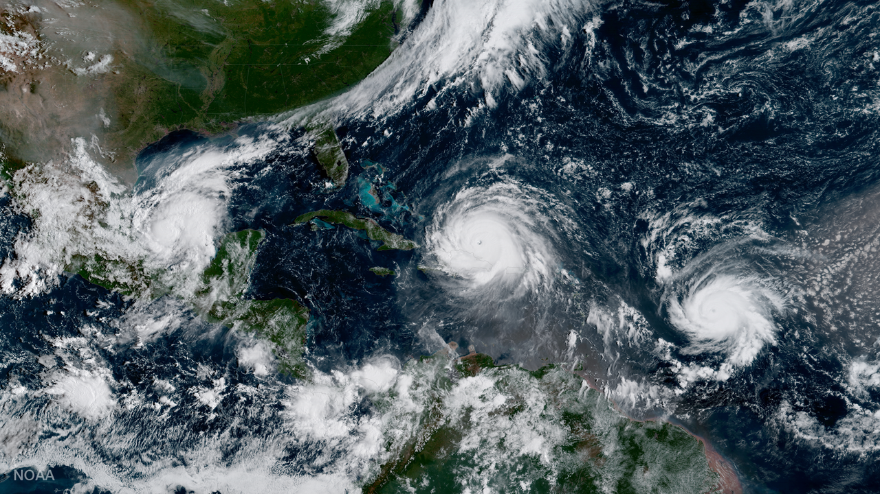
THANKS TO ALL FOR YOUR SUPPORT!
IRMA
September 2017
By NOAA National Environmental Satellite, Data, and Information Service (NESDIS) - https://www.nesdis.noaa.gov/content/goes-16-sees-three-hurricanes-atlantic, Public Domain, https://commons.wikimedia.org/w/index.php?curid=67039446

