Slide 1

Biomass Protocol Implementation: A Global Forest Biomass Reference System
Committee on Earth Observation Satellites
Laura Duncanson, University of Maryland, College Park, WGCV LPV Biomass
CEOS Plenary 2020
Agenda # 3.7
20 – 22 October 2020

Slide 2
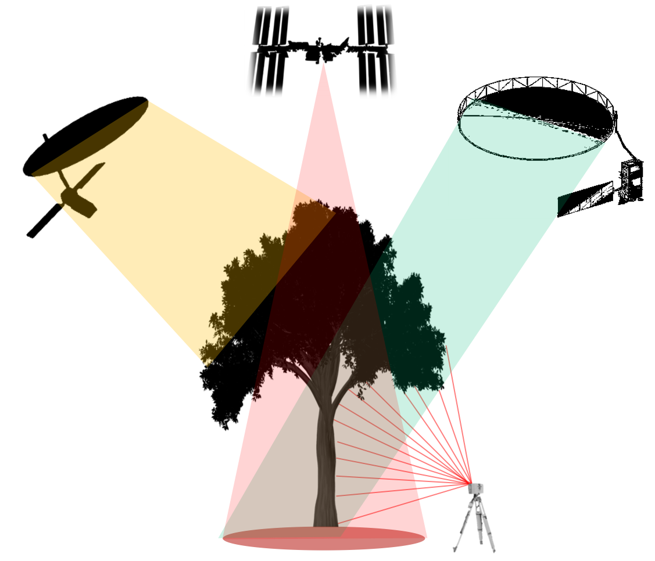
Toward a Global Forest Biomass Reference System
Seeking Guidance, Support and Feedback from the CEOS Community
Implementation Agency Slides from:
JAXA, ISRO, ESA, TERN, NASA
Presented on behalf of:
Jerome Chave, Stuart Davies,
Laura Duncanson, Nicolas Labrière,
Oliver Phillips, Sassan Saatchi, Klaus Scipal, Dmitry Schepaschenko, Shaun Quegan

Slide 3
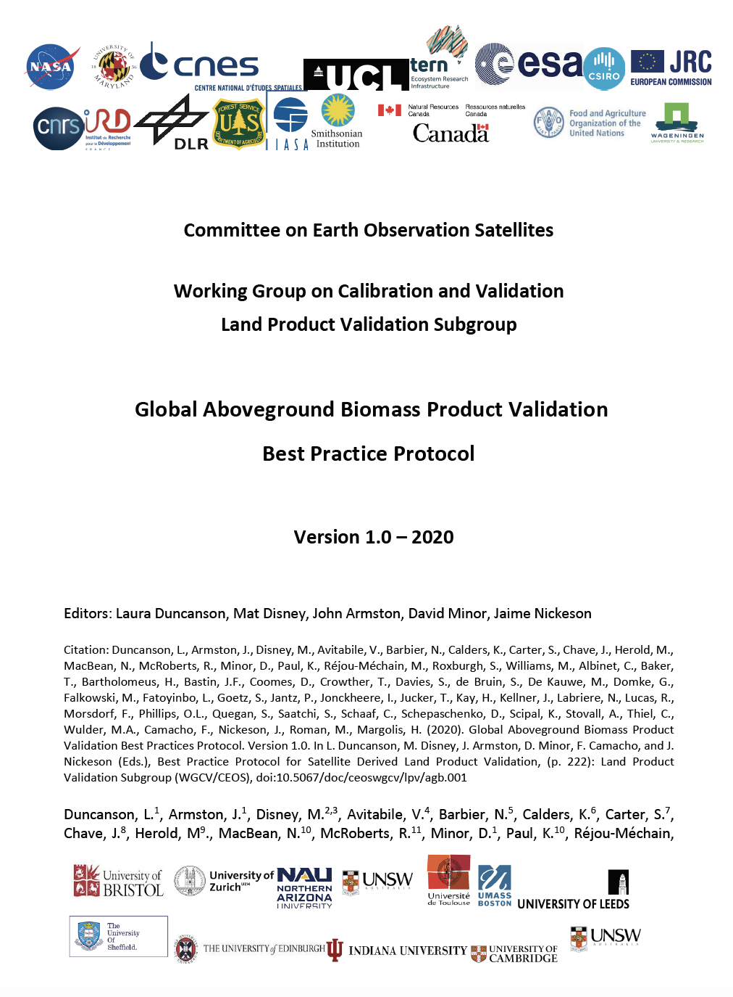
Protocol Implementation Considerations
Updated Reference Datasets
CEOS-Endorsed Biomass Product Validation
Validation Tools

Slide 4
Toward the Creation of a Global Forest Biomass Reference System
We propose the creation of a Global Forest Biomass Reference System as an equitable and sustainably-funded system of recurrent site-based measurements that will serve as a lasting interface between the Earth Observation agencies and ground-based tree-by-tree measurement initiatives.
No single EO mission, agency, or organization would alone support the costs of this implementation; this infrastructure is designed to become a common good for the entire EO and forest science community.
Jerome Chave et al., Biomass Validation Strategy Document

Slide 5
Benefits of a Global Forest Biomass Reference System
The greatest value for the enormous EO investment will be gained if products are verified by extensive, independent and openly available reference data.
Would leverage existing investments by agencies, missions, and established ecosystem and forest networks; we are not starting from scratch
Develops a framework for lasting contributions to the advancement of the field, independent of grant cycles, mission lifetimes or shifting agency priorities
Added value for training and validation of other land products (e.g. LAI, LCLUC)
Enables open forest reference data by providing ongoing support to local researchers and field stations

Slide 6
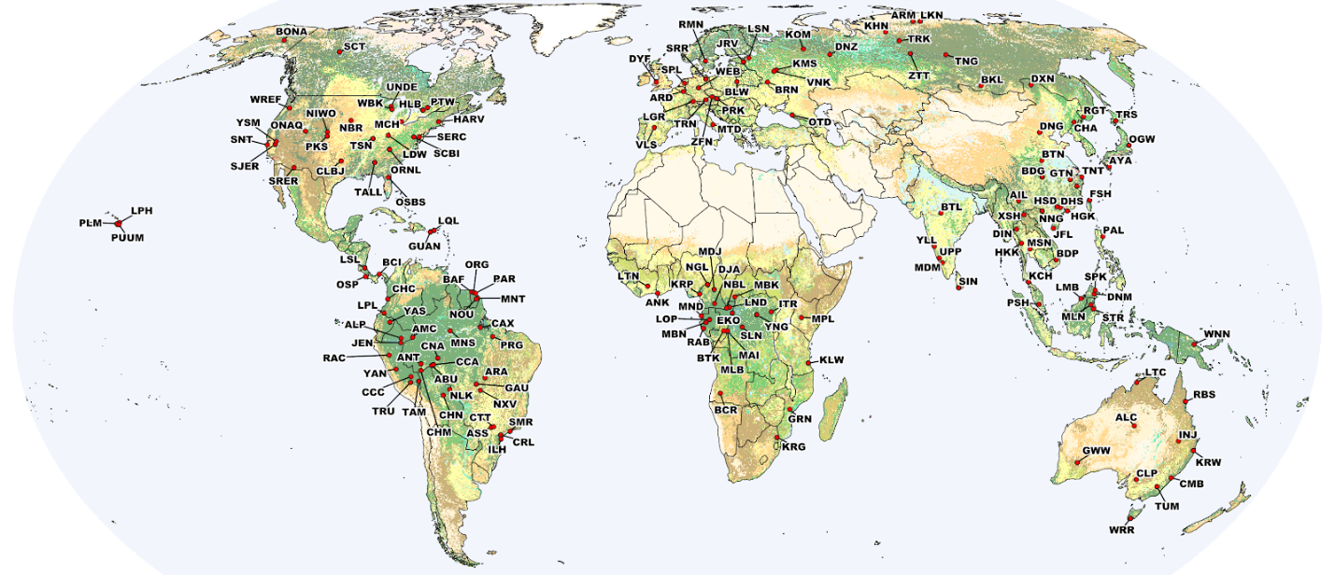
Proposed Biomass Reference Sites Require Significant Funding
We propose the creation of a Global Forest Biomass Reference System, a network of 100 Biomass Reference Measurement sites, plus 210 additional distributed sites. Such an infrastructure is needed to provide confidence in the outputs of biomass EO missions.
These sites are potential reference sites; many need augmentation (+lidar, +TLS), and all need recensus as will be outdated by the 2022/2023 missions. They require significant funding for coordinated re-measurement to meet protocol standards for validation of forthcoming biomass products.

Slide 7
Tropics Reference Sites are Particularly Challenging for Long-term Support
The tropics host the majority of aboveground biomass, have the highest productivity, and host the vast majority of tree species on Earth
The tropics are where the majority of forest carbon is being lost due to both natural dynamics and land-use change (e.g. deforestation and degradation)
The tropics have the greatest challenges in terms of human and technical capacity to support these global efforts
Tropical forests are arguably the most challenging ecosystems for mapping forest biomass with remote sensing (tall, dense, cloud-covered forests)
Most climate policy is primarily focused on the tropics, and also where the potential impact of policy initiatives is the greatest
We seek to establish a global long-term reference network, and the tropics are of particular global importance.

Slide 8
How can we establish this network?
We encourage collaboration amongst CEOS agencies and with established networks (e.g. ForestGEO, RAINFOR, NEON, TERN, AfriTRON, TMFO, IIASA, Forestplots.net, etc.) as well as local collaborators.
Support is required both for data collection (field and airborne), as well as data curation and publication. Public and transparent data are crucial.
The biggest support gap is in the tropics. We seek help to fill this gap.
We encourage agencies to explore possibilities of how to contribute to the proposed reference system. A first step is to document current and planned biomass activities, and several agencies have begun this process.
We welcome feedback on how to achieve the proposed creation of a Global Forest Biomass Reference System.

Slide 9

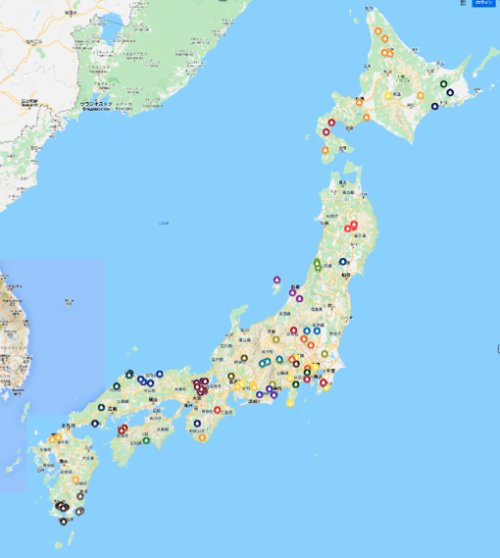

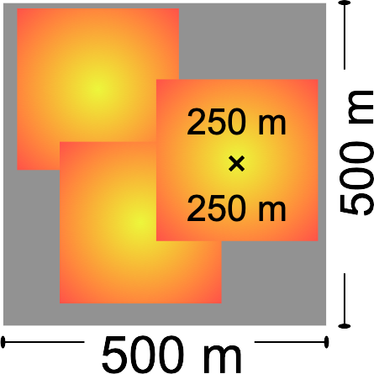
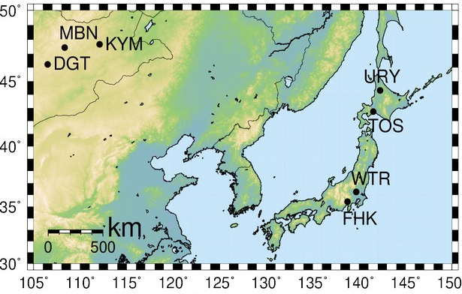
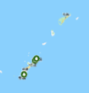



Opportunities and Challenges for Implementation of Biomass Protocol
Agency: JAXA
Opportunities:
Well established long-term forest ground measurement networks in Japan (e.g. JSS500, JAUF, JaLTER, JapanFlux)
    In situ measurements of biomass-related parameters and C flux
    Limited airborne LIDAR
Relevant JAXA missions
  Historical L-band SAR baseline: JERS-1, ALOS, ALOS-2
  Near-future key missions: MOLI, ALOS-4
Emerging close collaboration: JAXA & forest research institutions
Challenges:
Adaptation of ground sites for spaceborne measurements
Lack of contemporary airborne & spaceborne LIDAR observations
Limited long-term availability of spaceborne LIDAR
Requirements:
Resources for contemporary airborne & spaceborne LIDAR over key sites
CEOS coordination
  MOLI continuation following GEDI
  Joint observation strategy planning for optimal ALOS-4/NISAR/BIOMASS synergy

Slide 10
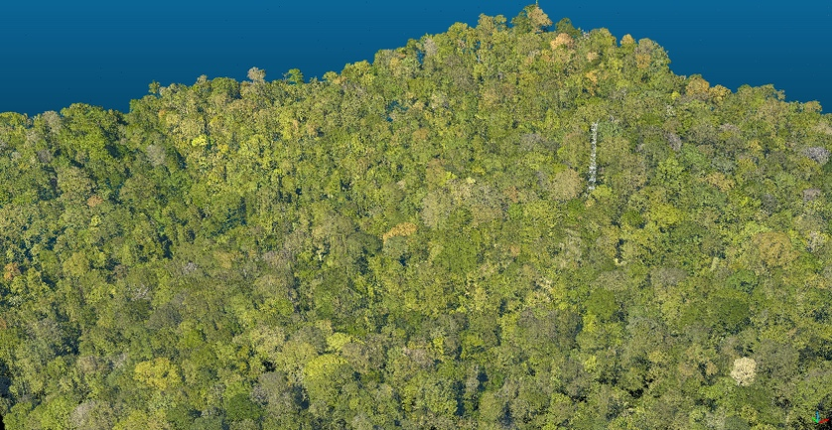


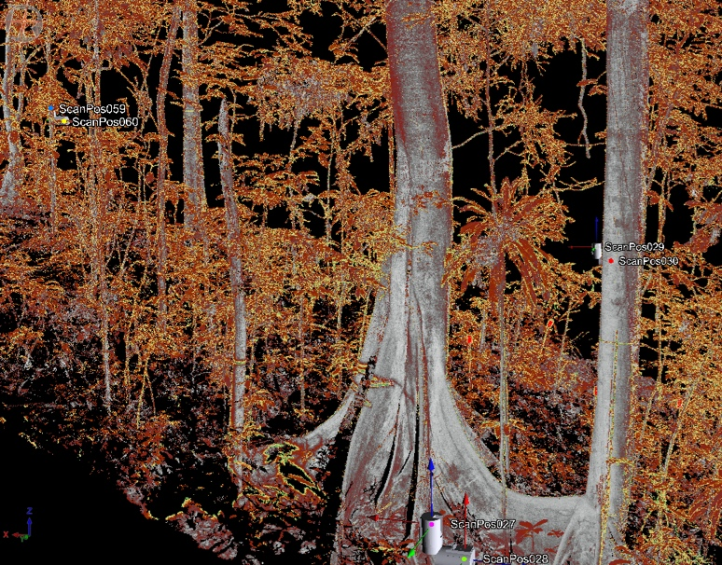





Opportunities and Challenges for Implementation of Biomass Protocol
Agency: ESA
New technology for
characterising forest structure
and biomass at Biomass Reference for EO cal/val across the tropics
Opportunities:
The ForestScan project.
ESA-funded initiative starting in 2020 led by UCL (TLS), with Wageningen (UAV), Leeds (census), Edinburgh (UAV), Cambridge (ALS), AMAP (UAV), CIRAD (logistics). Three reference sites:
  Paracou, French Guiana 10+ ha w TLS, census, UAV, ALS, all within a single campaign / time window
  Lopé, Gabon, 4+ ha w TLS, census, UAV, but with time differences of eg 1-2 years
  Sepilok, Malaysia, 4+ ha w TLS, 20+ ha census, ALS (2020) but with time differences of eg 1+ year for TLS and census
Challenges: Temporal gaps between new field measurements and airborne campaigns.

Slide 11
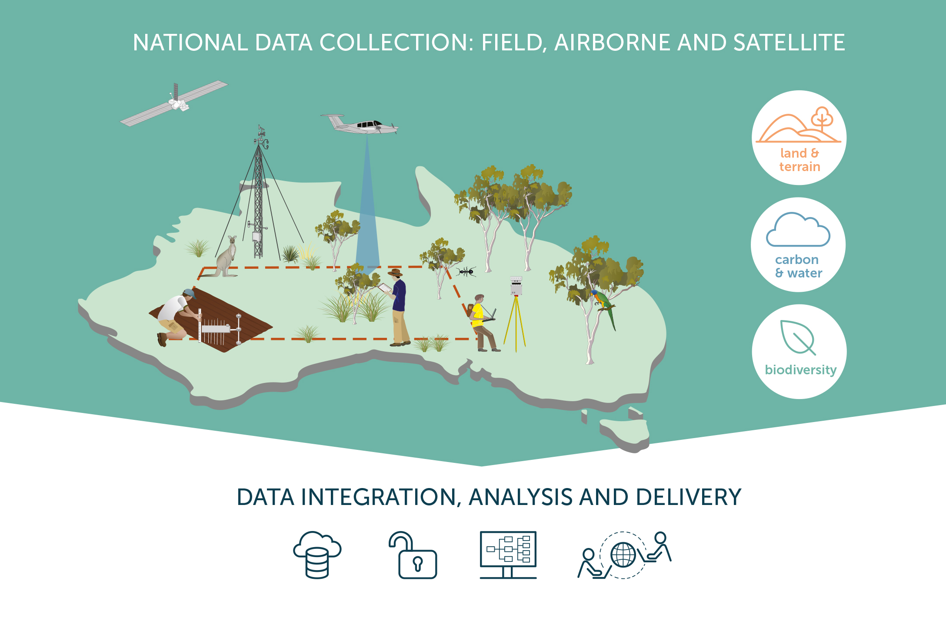

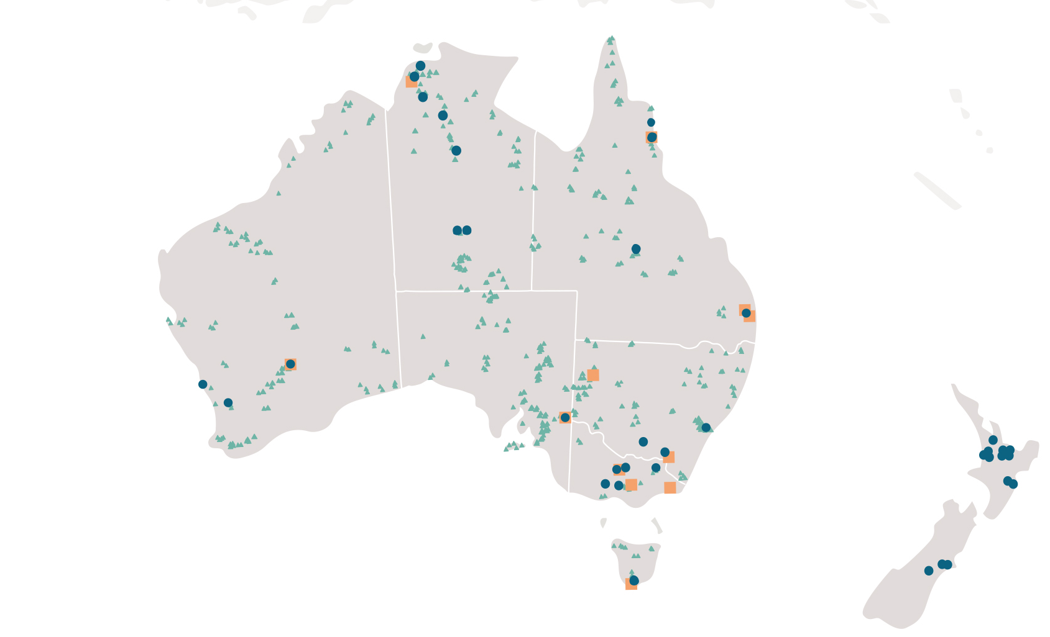
Opportunities and Challenges for Implementation of Biomass Protocol
TERN Australian Terrestrial Ecosystem Research Network
10 yrs of national collaborative partnerships between research and government
12 high intensity monitoring sites and a national flux tower network
600+ 1 ha ecological survey plots
Opportunities: New collaborations with TERN and its partner institutions including protocol compliant collection of new high quality field data (Stem measures, UAV/Airborne LIDAR, TLS) including uncertainty assessments
Challenges: This will require extra funding to acquire field stem maps over a suitable spatial extent with coinciding airborne/UAV LIDAR and TLS acquisition
What is needed to overcome challenges?
Additional funding will allow biomass data collection at our existing field sites, suitable for training LIDAR models, in a timely manner.

Slide 12
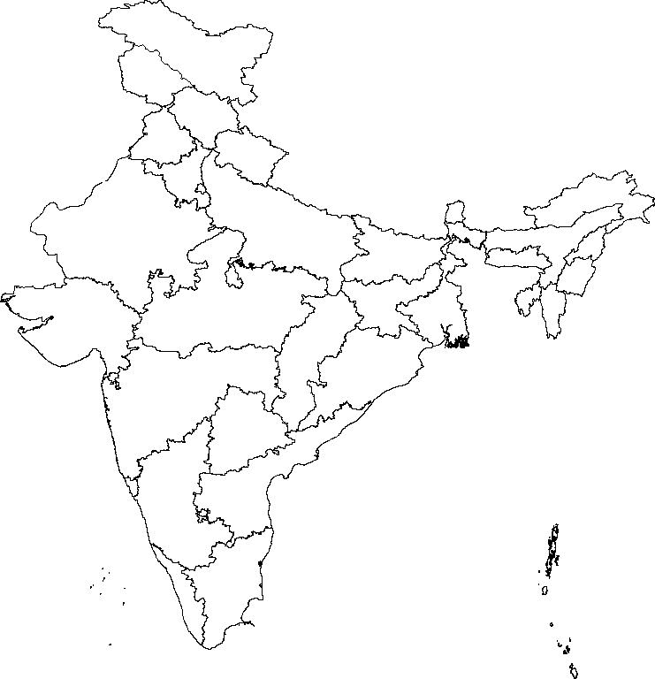
Opportunities and Challenges for Implementation of Biomass Protocol
Agency: ISRO
Opportunities:
Five sites in India have been identified as potential biomass reference sites
Necessary data collected under other projects can be used
Field and TLS data collection in place
Existing collaborations with NFI teams exist.
Challenges:
Exploring the possibility of drone-based lidar data acquisitions for all sites at the desired times.
Permissions would be required for lidar data acquisition over the designated sites.
Approvals from other ministries are needed in order to share the field data with international community.

Slide 13
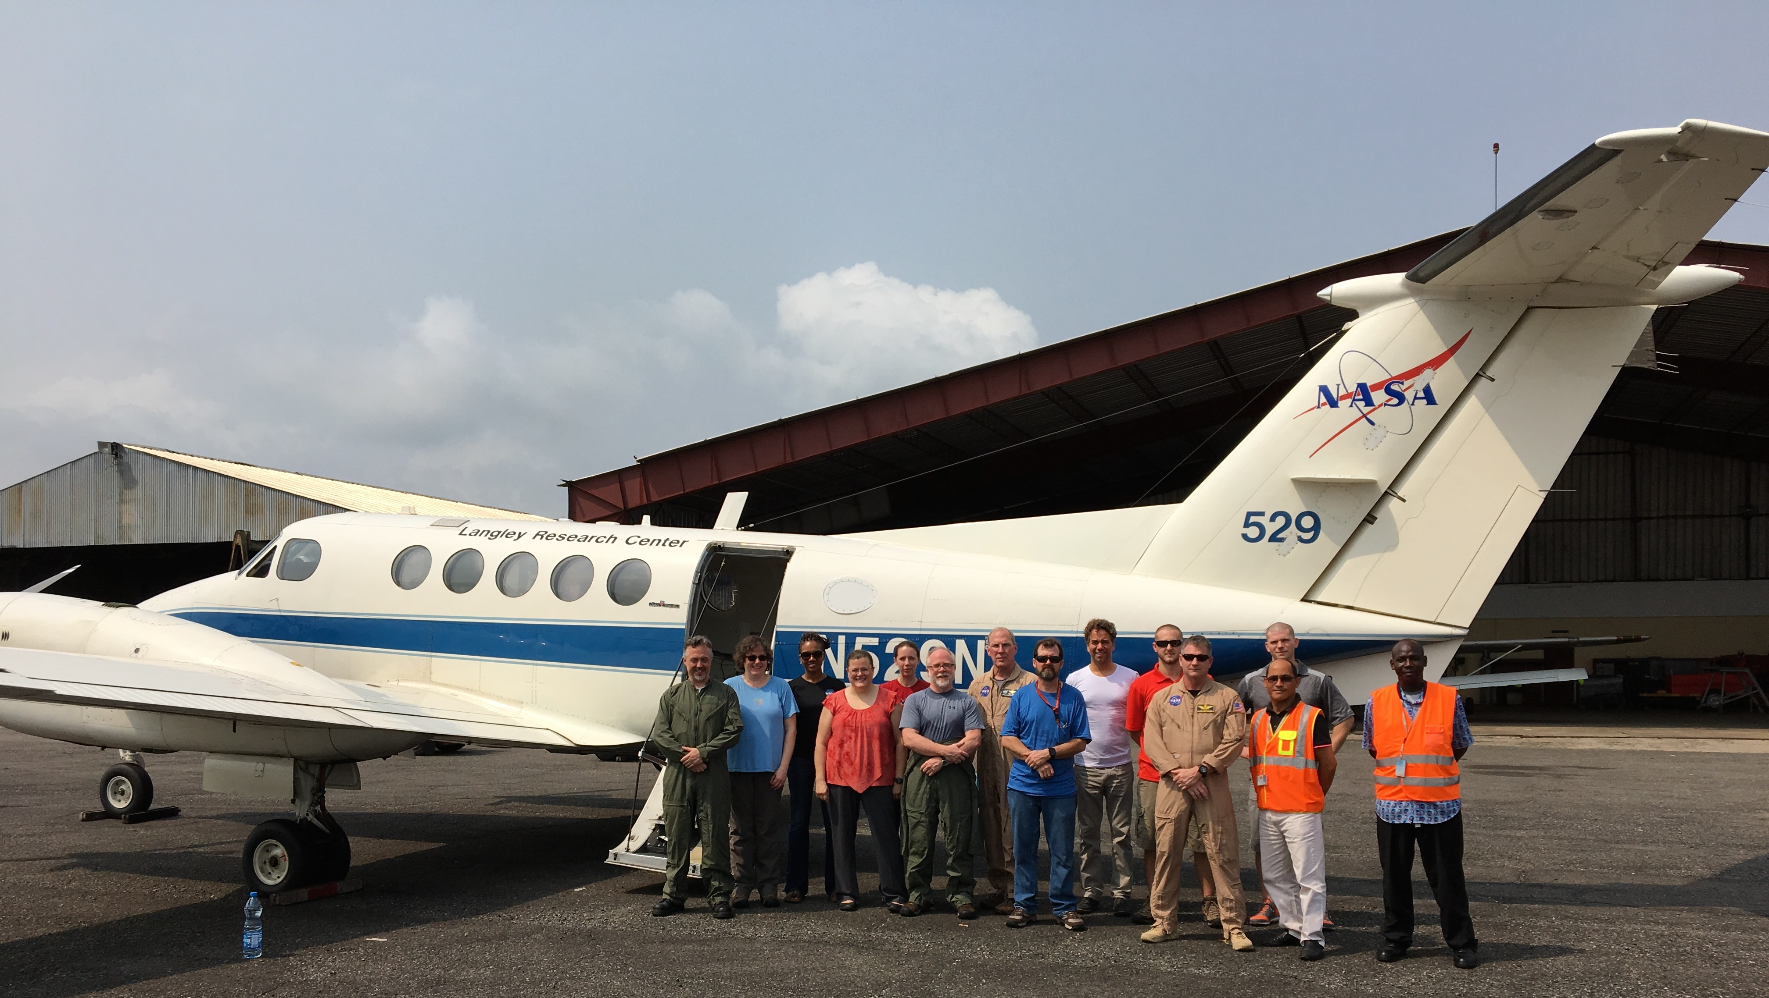
Opportunities and Challenges for Implementation of Biomass Protocol
Agency: NASA
Opportunities:
Continued coordination between NASA biomass relevant missions on reference data collection
Airborne campaigns over established reference sites with NASA instruments (LVIS, GLiHT) where practicable
Encourage adoption of protocol by NASA funded biomass research projects:
  NASA Terrestrial Ecology program projects
    e.g. Arctic Boreal Vulnerability Experiment
  NASA Carbon Monitoring System (CMS) projects
Challenges:
Large scale field campaigns are challenging
Foreign permissions for field and airborne acquisitions are time consuming
GLiHT

Slide 14
Recommendations from Biomass Community
Significant funding for new and updated reference datasets is required. We propose establishment of a Global Forest Biomass Reference System of new and ongoing field, terrestrial and airborne lidar acquisitions
Particular support is needed in the tropics because this is where most biomass, tree growth, and diversity is located, and where long-term security for measurements is lacking.
The proposed system enables all interested stakeholders to contribute (e.g. CEOS agencies, NGOs) to a global and lasting effort for forest carbon monitoring
Biomass reference data should be free and open to enable transparency in product validation.
While several agencies are already contributing, more coordination and support is required; we seek guidance toward establishing the proposed reference system.

Slide 15




















Thank you to the many data collaborators and protocol co-authors – this is a community driven activity!
Thank you!

