Slide 1
Greenhouse Gas Roadmap
Committee on Earth Observation Satellites
Mark Dowell (EC) & Albrecht von Bargen (DLR) on behalf of WGClimate GHG Task Team
CEOS Plenary 2020
Agenda Item #3.4
20th – 22nd October 2020

Slide 2
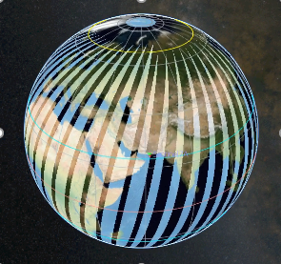
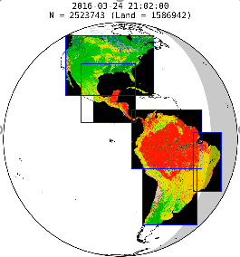
The Architecture for Monitoring Atmospheric CO₂ and CH₄ Concentrations
The CEOS Atmospheric Composition Virtual Constellation (AC-VC) white paper defines a global architecture for monitoring atmospheric CO₂ and CH₄ concentrations from instruments on space-based platforms
166-page document, 88 authors from 47 organizations
Executive Summary (2 pages)
Body of report (75 pages)
Technical Appendices (42 pages)
http://ceos.org/document_management/Virtual_Constellations/ACC/Documents/CEOS_AC-VC_GHG_White_Paper_Publication_Draft2_20181111.pdf

Slide 3
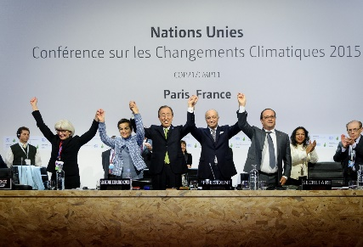
High Level GHG Roadmap Timeline
Global Stock
Take 1
Global Stock
Take 2
using inventories through 2021
using inventories through 2026
2015
2017
2019
2021
2023
2026
2028
CEOS GHG Whitepaper
Pilot
atmospheric
CO₂/CH₄
Data sets
Atmospheric
GHG data sets
from operational system
Initial
Operational
GHG
Constellation
Deployment
Consultation
of
Inventory
requirements
Refined
atmospheric
GHG
requirements

Slide 4
Proposed Architecture Actions
Link the atmospheric GHG measurement and modeling communities and stakeholders in the national inventory and policy communities (through UNFCCC/SBSTA).
Exploit the capabilities of the CEOS and CGMS member agencies and the WMO Integrated Global Greenhouse Gas Information System (IG³IS) to integrate surface and airborne measurements of CO₂ and CH₄ with those from available and planned space-based sensors to develop a prototype for the 2023 global stock take.
to implement a complete, operational, space-based constellation architecture with the capabilities needed to quantify atmospheric CO₂ and CH₄ concentrations that can serve as a complementary system for estimating NDCs in time to support the 2028 global stock take.

Slide 5
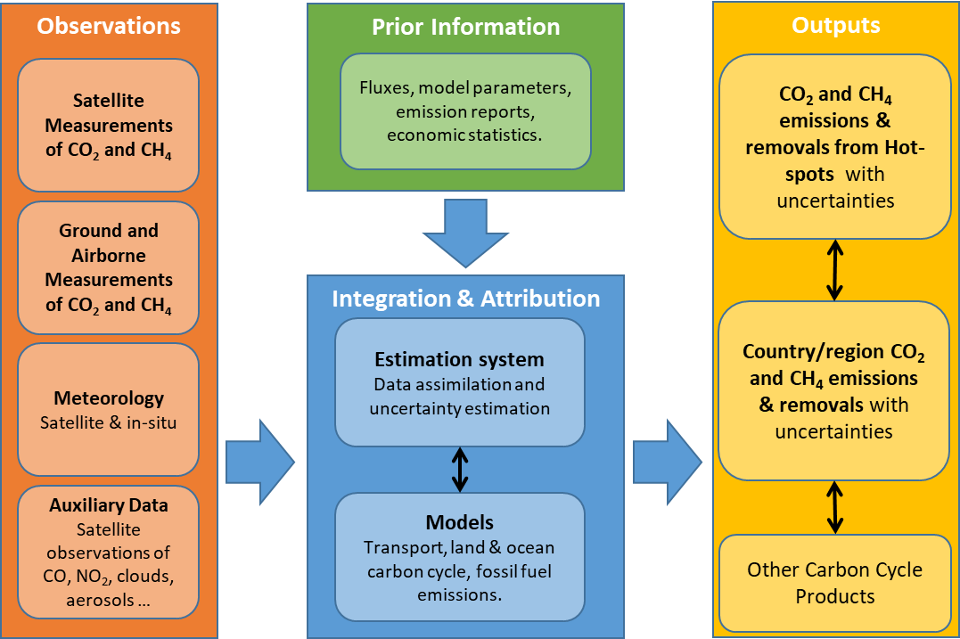
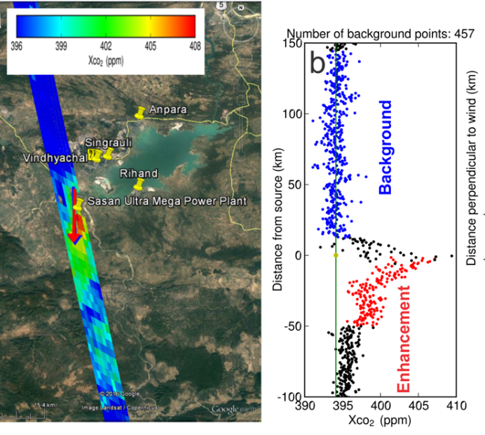
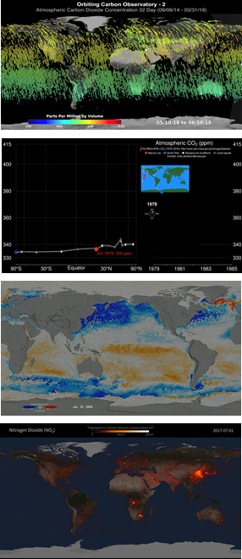
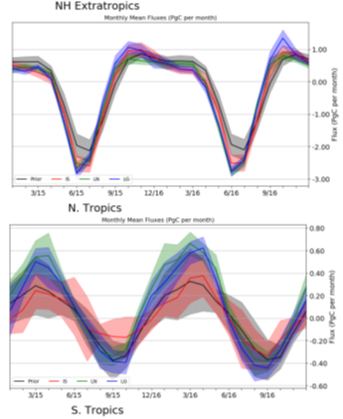
A System Approach is Adopted to Deliver Atmospheric CO₂ and CH₄ Inventories

Slide 6
Recent RSO conclusions
SBSTA 51 (2019) FCCC/SBSTA/2019/5 Earth Information Day 2019
35. The SBSTA welcomed the work of the scientific community, Parties, climate service providers, and space agencies in collecting, managing and openly sharing data and processed data products for addressing climate change and current and future climate risk.
The SBSTA urged Parties and relevant organizations to continue to establish and support open data sharing, and the development of openly available, relevant and accessible data products, particularly for supporting and monitoring adaptation and mitigation.
40. Recalling the conclusions of SBSTA 47, the SBSTA welcomed the continued work of the Joint CEOS/CGMS Working Group on Climate in response to the GCOS implementation plan.
It recognized the systems approach of the constellation architecture, which combines satellite, in-situ and modelling components for emission estimates, for monitoring CO₂ and CH₄ from space.
It encouraged meaningful engagement among the space agencies, modellers and Parties in the implementation and use of the system.
Constellation architecture recognized by the SBSTA

Slide 7
GHG Roadmap Objectives and Status
The GHG Roadmap was established to coordinate ongoing and planned greenhouse gas measurement and analysis activities across space agencies and foster the development of interfaces with stakeholders and users.
The GHG Roadmap (v2.4) describes an approach for implementing the GHG Strategy and specifies resource needs
Maintained by the WGClimate GHG Task Team
Considered to be a living document whose Actions (Annex C) provide a snapshot of the work plan, which will be updated over time
This version of the Roadmap was endorsed by CGMS at the 2020 Plenary.

Slide 8
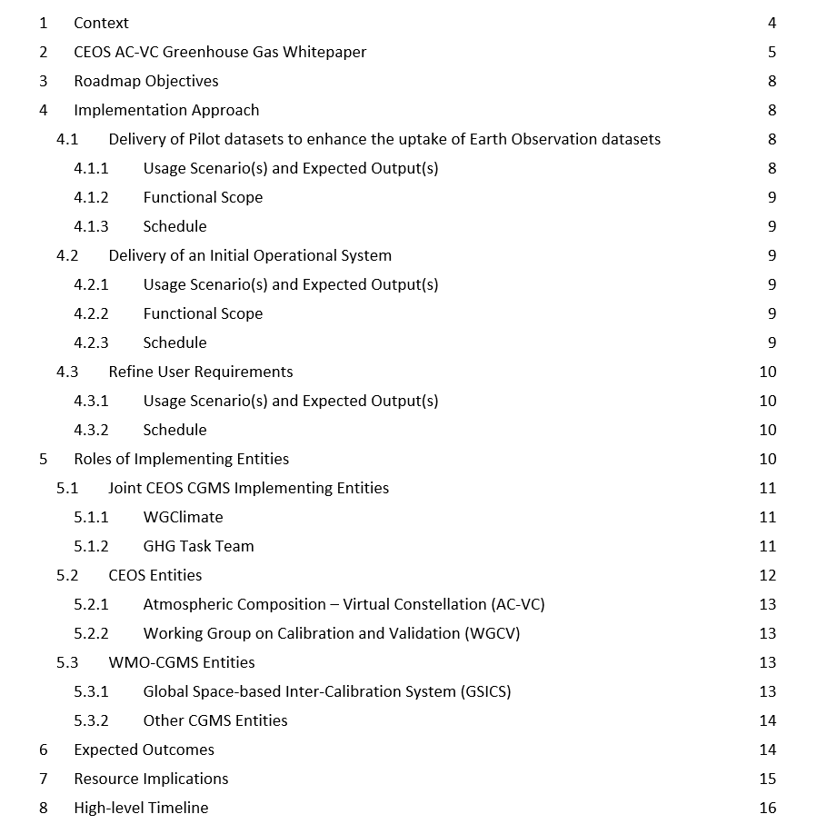
Roadmap Table of Contents

Slide 9
Interface to and Feedback from External Communities
Strong interface to external stakeholders and end-users is fundamental to the implementation of the system approach:
Engagement with the emission inventory community is critical to the iterative feedback approach, both:
Through existing international coordination mechanisms (e.g. Global Emissions InitiAtive - https://www.geiacenter.org )
Through working with champion users on real applications – «beta testers»
Continued engagement within international policy framework:
SBSTA: SBSTA reporting, Earth Info days
UNFCCC Sec: new adhoc group on Systematic Observation support to the Global Stocktake (CEOS/ CGMS members D. Crisp - GHG, O. Ochiai - AFOLU, J. Schulz - rest incl. adaptation - M. Dowell with GEO CC WG)
IPCC TFI: Guidelines for reporting
Engagement with other technical implementing entities at international level, i.e. WMO IG³IS and Joint Programmes supporting the Convention, i.e., GCOS, as well as the broader modelling community.

Slide 10
Expected Outcomes of the Roadmap Activities
Roadmap Products
The delivery of pilot datasets of CO₂ and CH₄ fluxes to enhance the uptake of Earth Observation satellite data sets in support of the Global Stocktake 2023;
The delivery of an operational system for producing future atmospheric CO₂ and CH₄ flux products to support the Global Stocktake 2028; and
The refinement of user requirements in preparation of the implementation of the operational system.
Progress
Established critical interfaces with the UNFCCC SBSTA and GCOS.
Made progress pilot atmospheric CO₂ and CH₄ inventory
Delivery of the OCO-2 version 10 XCO₂ and SIF data products
Advances in GHG flux inversion models by the NASA OCO-2 and CMS and Copernicus CAMS

Slide 11
Resource Implications and Needs from CEOS/CGMS
Three broad categories of resources are envisaged and requested for consideration by Agencies (introduced at CEOS Plenary 2019):
Dedicated human resources supported through Agency programmes & grants :
Agencies are asked to provide support to the WGClimate Task Team (~17 PM/yr) Assumption: 15 members with 1PM/yr effort per member & 2 PM/yr effort for the two leads
Agencies are asked to continue, and in some cases increase support to the GHG relevant staff (time & travel) contributing to the technical implementation tasks in CEOS and CGMS
Support for travel and hosting of workshops and networking with:
National inventory community
Atmospheric GHG measurement and modelling communities
Stakeholders (GCOS, UNFCCC/SBSTA)
[On longer-term] Through internal funding mechanisms support research, development and infrastructure for priorities identified by GHG Task Team and Roadmap Implementation (annual updates will be provided to Agencies)

Slide 12
GHG TT Skill Request
For WGClimate GHG Task Team, the following “profiles” are needed:
Core team ensuring linkages to internal CEOS/CGMS entities (i.e., WGClimate – Dowell/von Bargen, AC-VC – Crisp, WGCV – Kuze)
CEOS and CGMS Agency staff representing GHG missions/programmes
Agency staff from “operational” agencies to ensure operational transition
Agency Staff/Experts with links to Inventory Community
Agency Staff/Experts involved in modelling aspects

Slide 13
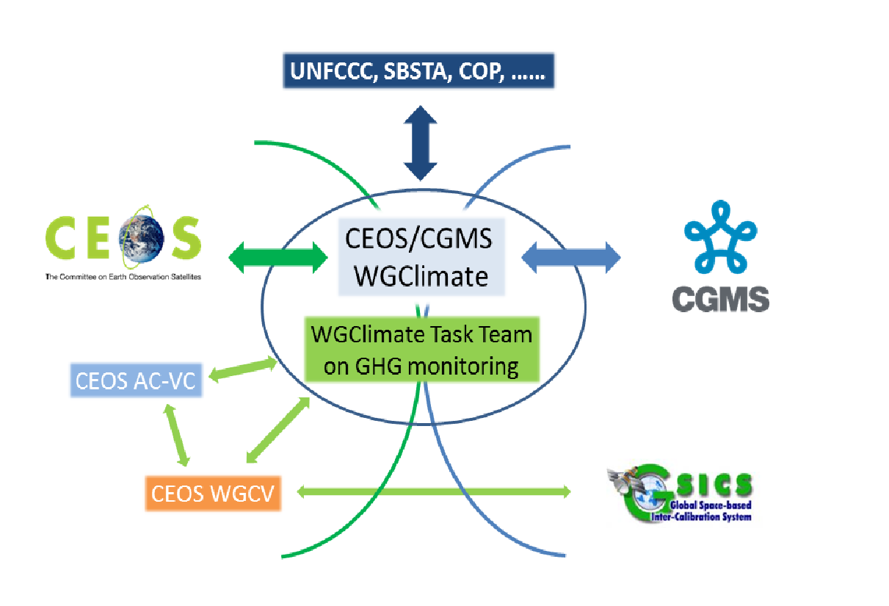
CGMS involvement in the GHG Task Team
Working Group I: Ensuring that the implementation of the GHG roadmap addresses the objectives of the WIGOS vision
Working Group II: Facilitating the definition and application of standards for operational GHG constellation products and operational aspects of the satellite data production systems at international level
Working Group III: Mapping the CGMS agency plans for CO₂ and CH₄ relevant measurements onto the CGMS baseline, identifying continuity issues and proposing contingency planning
Working Group IV: Addressing operational access and end user support as well as training for GHG constellation products in cooperation with CEOS WGISS and WGCapD
As reported by Jörg Schulz: [The CGMS] Plenary endorsed the GHG roadmap version 2.4 and welcomed the proposal to have dedicated Points of Contacts (PoCs) for the JWG Climate GHG Task Team identified in all CGMS Working Groups (I - IV). The lead of the GHG Task Team is requested to define priorities for CGMS WG contributions

Slide 14
Agencies who have offered resources
Mark Dowell (EC, WGClimate, Task Team lead)
Albrecht von Bargen (DLR, WGClimate Vice-chair, deputy Task Team lead ex officio, transition to Jeff Privette)
David Crisp (NASA, CEOS AC-VC)
Akihiko Kuze (JAXA, CEOS WGCV)
Frederic Chevallier (LSCE/IPSL)
Carole Deniel (CNES)
Richard Engelen (ECMWF)
Hiroshi Suto (JAXA)
Rüdiger Lang (EUMETSAT)
Yaska Meijer (ESA)
Paul Palmer (UKSA)
Hiroshi Tanimoto (NIES)
Alisa Young (NOAA)
N.N. (agency representative)
N.N. (CGMS WG representative)
N.N. (CGMS WG representative)
N.N. (GSICS representative)

Slide 15
Starting Discussion
GHG-AFOLU Workshop
Workshop on synergies and opportunities between GHG and Agriculture Forestry and Other Land Use (AFOLU) Earth Observation communities working in support of UNFCCC
[Postponed] Originally planned July 9-10th 2020 Varese-Italy
Start dialogue between the different Earth Observation communities addressing the needs of UNFCCC.
In particular, atmospheric GHG monitoring and those addressing aspects of the AFOLU sector (incl. REDD+).
Co-organised, based on an identified gap, both at the European level through discussions in Copernicus as well as at the international level CEOS, GEO

Slide 16
GHG-AFOLU Workshop
The workshop plans to address:
both the "soft" coordination and stakeholder engagement aspects of the interface with the Convention, the UNFCCC Secretariat and, Parties (including through their inventory agencies/compilers) but also;
more technical aspects of reporting, outputs datasets, formats, avoiding "double-accounting" and the longer-term ambition, and perhaps different requirements of using diverse earth observation datasets in the modelling and data integration systems being developed.
Now postponed till ~Q2 2021, but plan:
initial discussion at CEOS SIT Technical Workshop [Done]
European discussion in context of CHE-VERIFY Q4 2020 (organised by ECMWF).
International meeting in 2021 should include CEOS/CGMS, GFOI, GEO, UNFCCC Sec, GCOS, GOFC-GOLD etc.

Slide 17
CEOS Plenary is invited to endorse:
.
The GHG Roadmap document (v2.4), describing an approach and resource needs for the implementation of the GHG Constellation Strategy. This is to be considered a living document and the Actions in Annex C provide a current snapshot of the work plan definition which will be updated over time. CEOS Agencies will strive to provide the identified resources for the specific activities and entities.

