Slide 1
WGCV
RadCalNet Uptake
CARD4L Review Process
LPV Biomass Validation Protocol
Cindy Ong, CSIRO, WGCV
CEOS Plenary 2020
Agenda Item #3.3
Virtual Meeting
20-22 October 2020

Slide 2
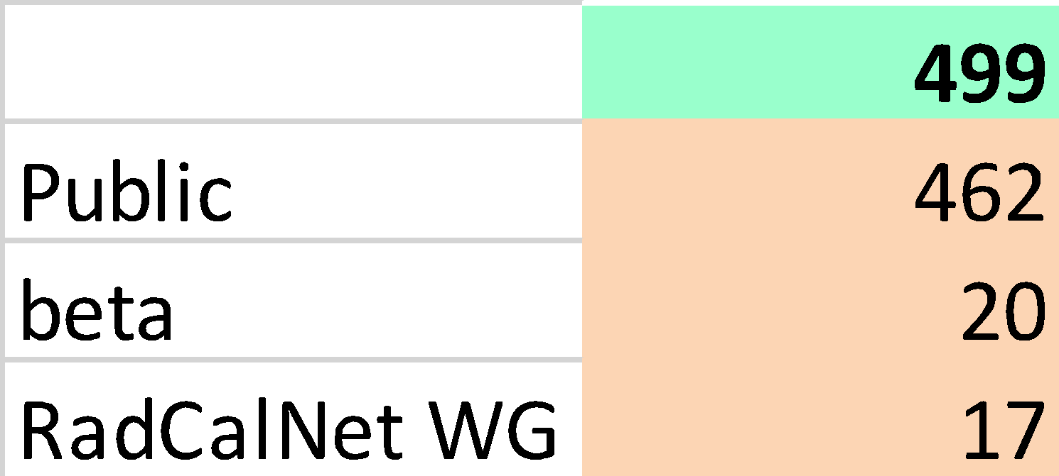
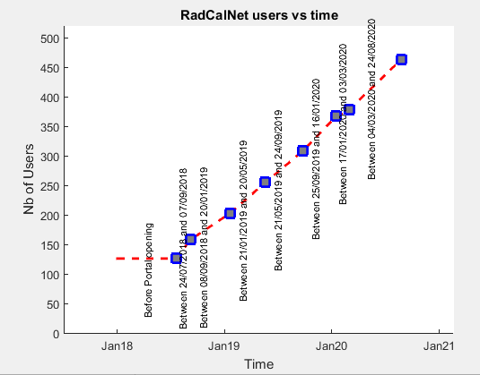
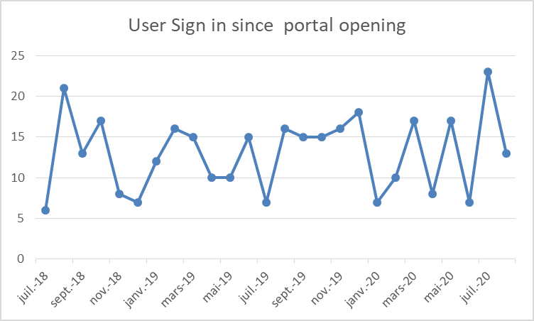
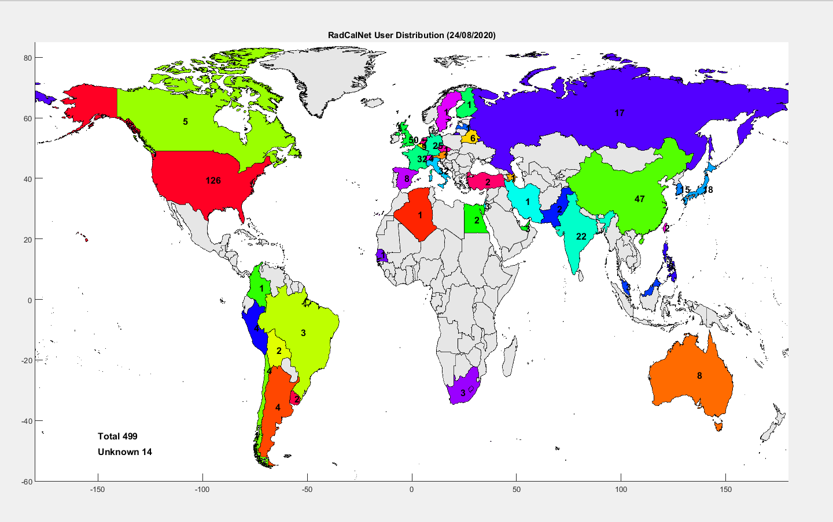
Uptake of RadCalNet since going public

Slide 3
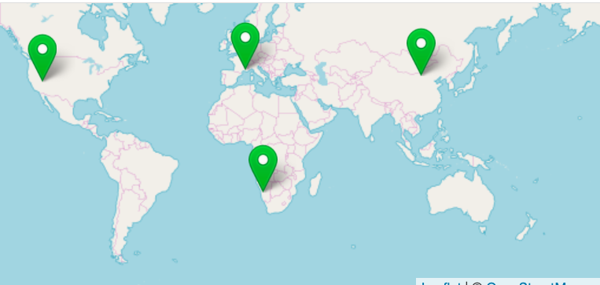
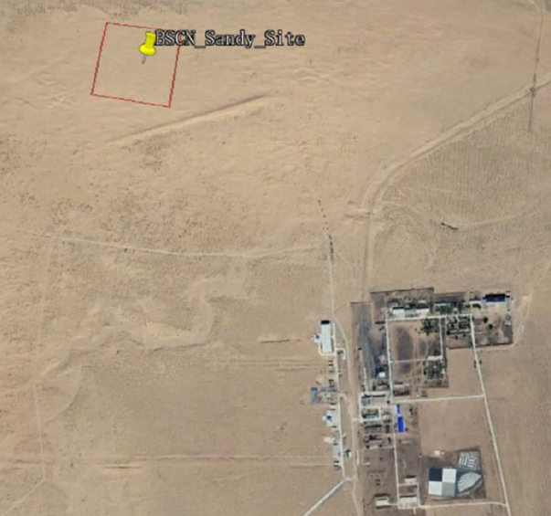
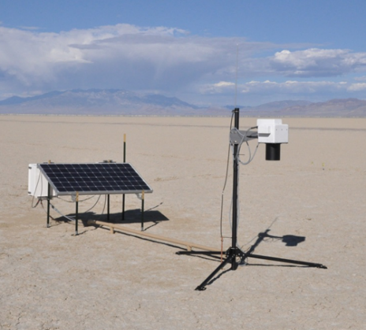
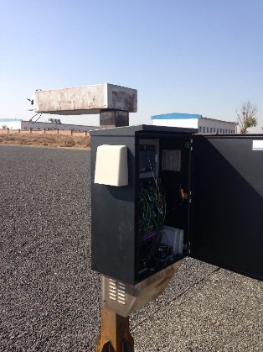
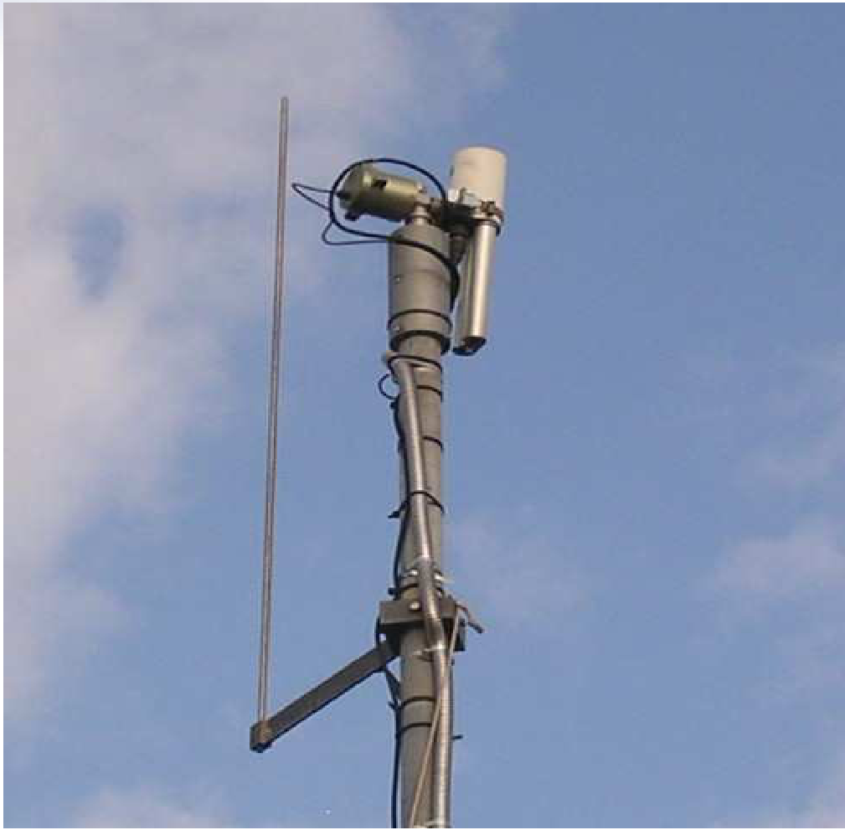
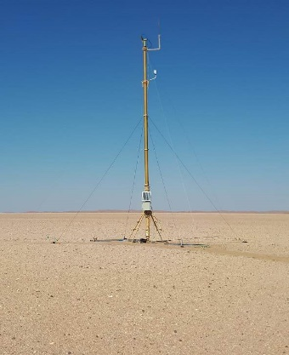
New RadCalNet site
BSCN
LCFR
BTCN
RVUS
GONA
BSCN is 50 km from Baotou city, Inner Mongolia, China; ~ 300 m² in sandy desert; ~ 1.8 km NW of BTCN artificial site.

Slide 4
RadCalNet Documentation
G0-RadCalNet Guidance – Becoming A RadCalNet Site G1-RadCalNet Guidance – Site Selection G2-RadCalNet Guidance – Site Characterisation G3-RadCalNet Guidance - Instrumentation And Data Processing G4-RadCalNet Guidance – Uncertainty Analysis G5-RadCalNet Guidance - Peer-Review And Comparison update R1-RadCalNet Requirements - RadCalNet Membership Criteria R2-RadCalNet Requirements – Data Format Specification RadCalNet Data Policy T1-RadCalNet Templates - Site Questionnaire T2-Uncertainty Summary Report – Template

Slide 5
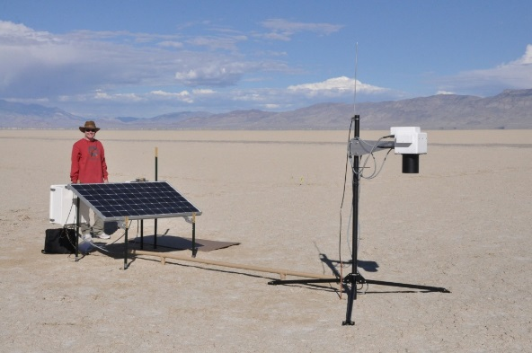
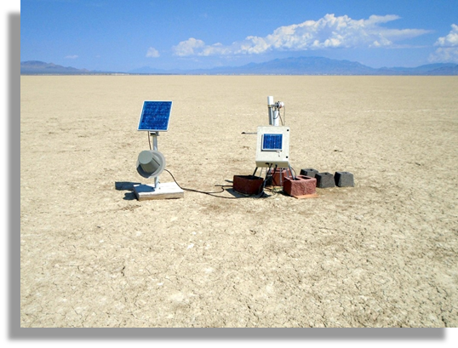
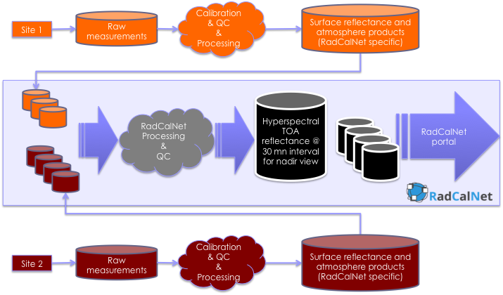
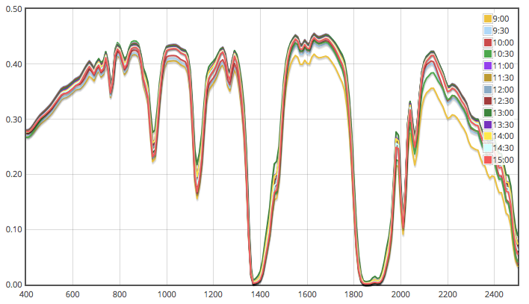
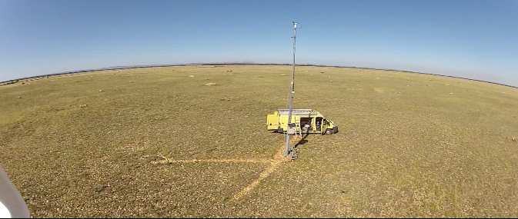
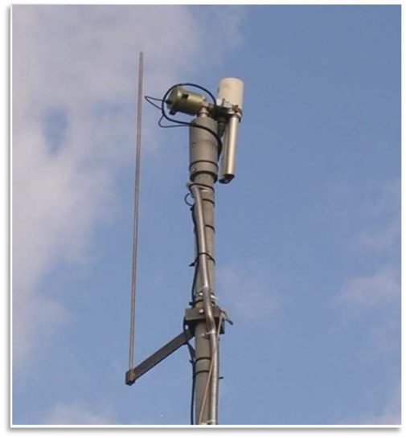

Systematic calibration, QC, processing & delivery
Architecture developed has three main parts
1) Test sites provide data to RadCalNet
2) Centralized processing of data
3) Distribution of top-of-atmosphere reflectance
RadCalNet - Radiometric Calibration Network

Slide 6

Acceptance process for new sites
RadCalNet members contribute to the review
Process overseen by WGCV
Through an acceptance panel reporting to WGCV

Slide 7
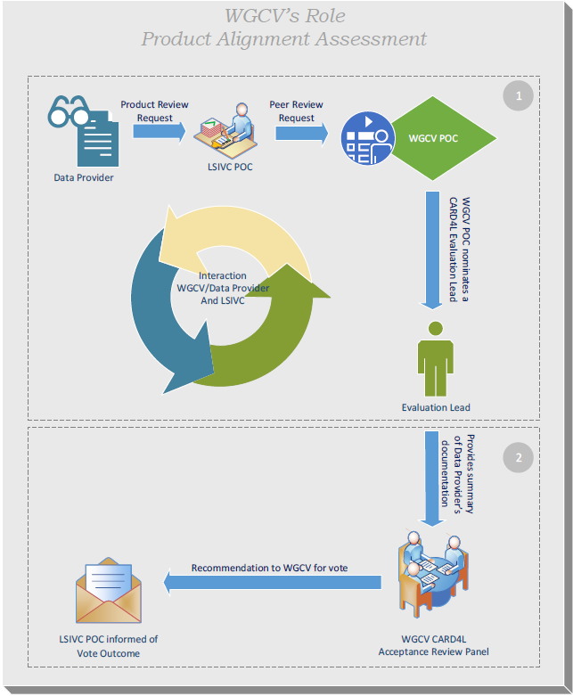
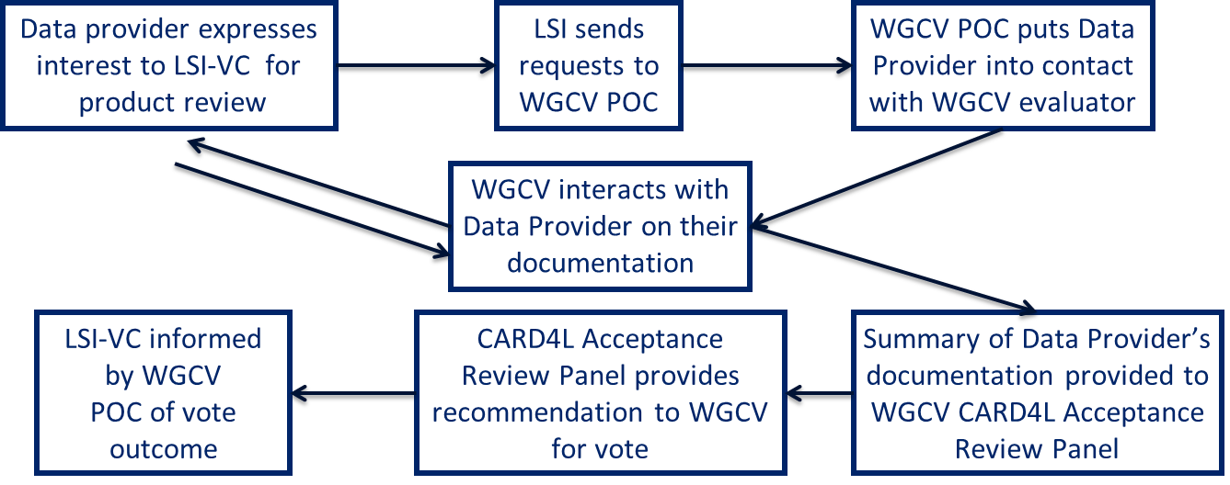
CARD4L peer reviews: WGCV role
More information at ceos.org/ard
Notes:
The graphic here and flow chart show the procedure for the CARD4L peer-review and WGCV’s role in completing the review

Slide 8
CARD4L submissions for peer-review
USGS Landsat Surface Reflectance (Collection 2)
USGS Landsat Surface Temperature (Collection 2)
ESA Sentinel-2 Surface Reflectance (for Threshold only)
USGS Landsat Surface Reflectance (Collection 2 – updated PFS)
USGS Landsat Surface Temperature (Collection 2 – updated PFS)
Separate CARD4L Review Panels for Landsat and Sentinel-2 products
Notes:
Out of a total of five CARD4L peer-review submissions to the WGCV so far, reviews for two products have been completed

Slide 9
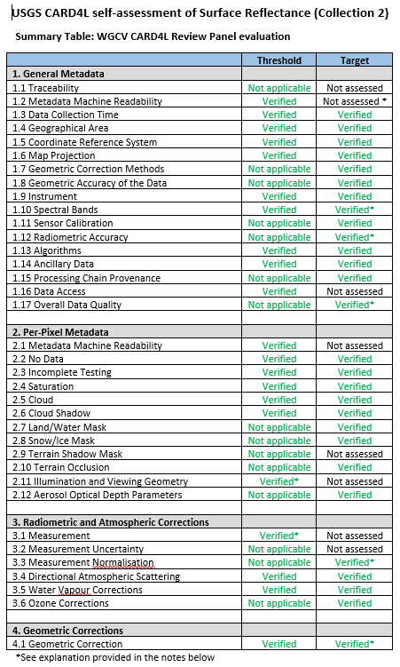
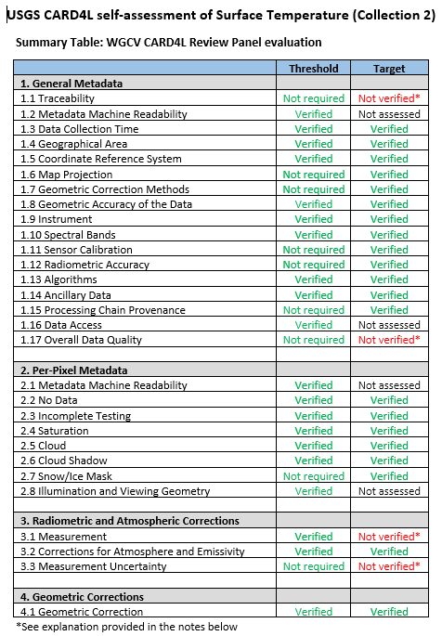
CARD4L peer-reviews completed
USGS Landsat Collection 2
  Surface Reflectance
  Surface Temperature
Both products verified as CARD4L compliant at Threshold
Landsat C2 SR
Landsat C2 ST
Notes:
The two Landsat Collection 2 products – Surface Reflectance and Surface Temperature submitted by the USGS were verified by the WGCV Peer Review Panel to be compliant at the Threshold level, due to recent changes in the PFS requirements documents, USGS have also resubmitted the two products for a peer-review in line with the changes to the PFS documents.

Slide 10
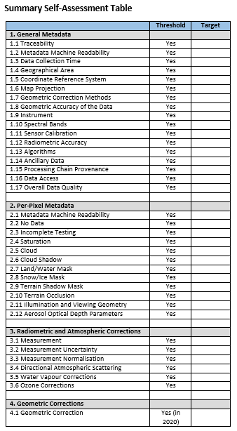
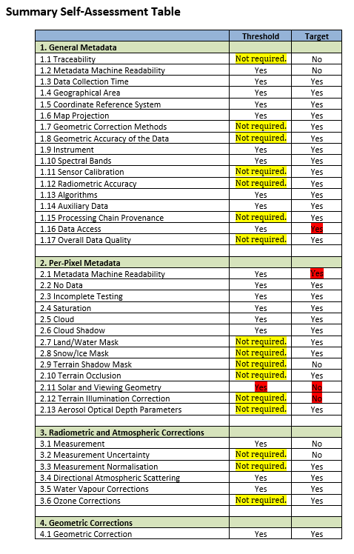
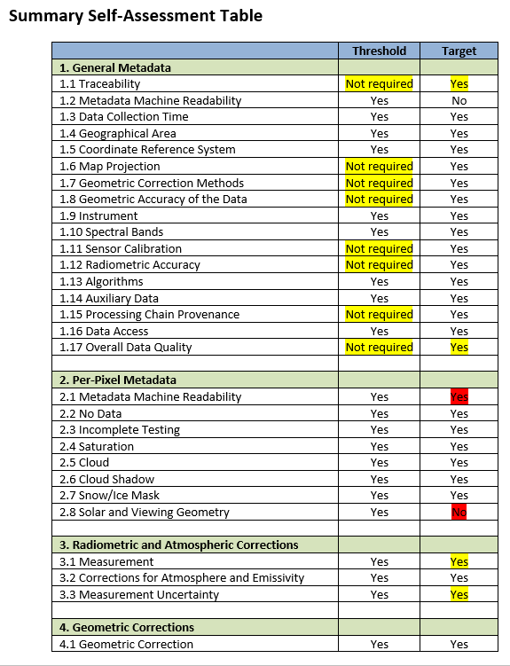
CARD4L peer-reviews in progress
ESA Sentinel-2 surface reflectance (Threshold only)
USGS Landsat Collection 2 (updated PFS)
  Surface reflectance
  Surface temperature
USGS Landsat C2 ST
USGS Landsat C2 SR
ESA Sentinel-2 SR
Notes:
The CARD4L peer-review for the ESA sentinel-2 surface reflectance product is currently in progress for compliance verification of the self-assessment at the Threshold level only. The USGS has re-submitted the Landsat Collection two surface reflectance and surface temperature products for peer-review on recently updated PFS documents after the initial review of the same two products which were verified to be CARD4L compliant at the Threshold level. There are indications that WGCV is expected to get more requests for CARD4L peer-review

Slide 11
For Information: CEOS WGCV LPV Biomass Validation Protocol
3.6: CEOS WGCV LPV Biomass Validation Protocol
  Open for feedback until 15 December 2020;
  Seeking endorsement at SIT meeting March 2021;

Slide 12
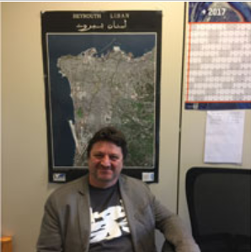
For Endorsement: Vice Chair – Philippe Goryl (ESA)
At ESA since 1993 from young graduate on JERS-1, Landsat & Along Track Scanning Radiometers on ERS-1 & ERS-2, Advanced Along Track Scanning Radiometer & MERIS on Envisat, Ocean & Land Colour Instrument & Sea Land Surface Temperature Radiometer instrument on Sentinel-3 to currently head of Sensor Performance, Products & Algorithms section (since 2016);
ESA representative in CEOS WGCV IVOS since 2005, ESA representative in CEOS WGCV since 2016, contributed to
  Cal/Val Portal Development, RadCalNet, Metrology, Uncertainties, Fiducial Reference Measurement, Miami intercomparison, OC intercomparison, FRM4STS, FRM4SOC, FRM4GHG, FRM4DOS, FRM4VEG, FRM4SAR …

