Slide 1
CEOS-Branded Webinar Plans
WGCapD
Committee on Earth Observation Satellites
Nancy D. Searby, Ph.D., NASA &
Pham Thi Mai Thy, Ph.D., VNSC
CEOS Plenary 2020
Agenda Item 3.2
21 October 2020

Slide 2
Purpose & Background
Recommendation: CEOS should create a “Webinar Toolkit” that includes guidelines and good practices for creating webinars, templates for documentation, presentations, and questionnaires, and provides branding design assets like a thematic nomenclature and color scheme, logos, and a bank of icons.
WGCapD also proposes a framework for CEOS working teams to gain WGCapD support during the webinar creation process and amplification of promotional efforts.
Why?
The world is living online more than ever
In-person workshops and trainings replaced by webinars and e-Learning
CEOS can contribute to the advancement of space-based Earth observation community efforts through webinars
CEOS working teams are offering more webinars
A Webinar Toolkit can amplify and strengthen CEOS efforts

Slide 3
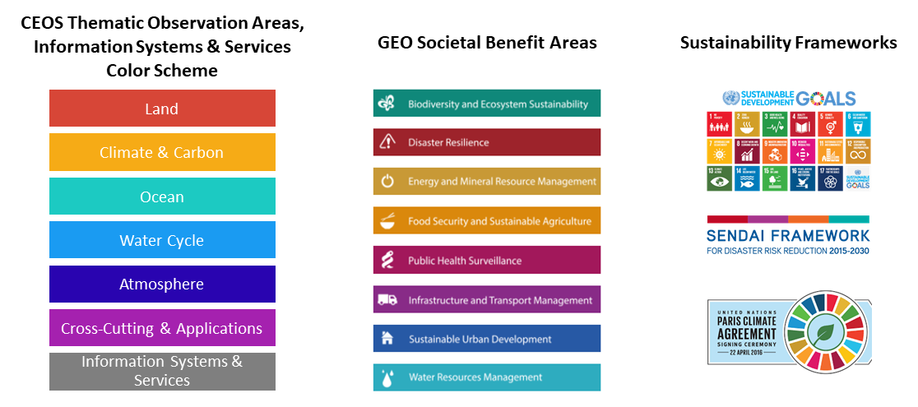
Objectives & Benefits
Objectives:
Increase awareness of CEOS, its activities, and resources available
Harness the work done by SIT Chair on branding the CEOS thematic observation strategies (TOS)
Increase recognition of CEOS-sponsored activities and resources through standardization
Bring WGCapD lessons learned on webinar good practices to CEOS working teams
Benefits:
Strengthened implementation and increased effectiveness of CEOS webinars
Simplified webinar creation process
Clarified and highlighted CEOS working team attributions
Enhanced community awareness, access, and ability to use satellite data, supporting technologies and results
Increased number of people benefiting from the CEOS working team efforts
Curated archive of supporting documentation and files

Slide 4
Proposed Approach
Webinar Toolkit would include:
Guidance for webinar creation steps and good practices
Design elements such as thematic nomenclature with a supporting color scheme (and potentially supporting thematic icons)
Guidelines for using distinctive elements (logos, textual references)
Templates for standardized documentation (promotional flyers, training reports), presentations, and pre/post-training questionnaires for use when appropriate
Current Resource: Training Methods & Best Practices document http://ceos.org/document_management/Working_Groups/WGCapD/WGCapD-Best-Practices_V2.0.pdf

Slide 5
WGCapD Support
Pre-Webinar: 60-90 days before
Conduct Needs Assess-ment
Identify Target Audience & Trainers
Define Webinar Learning Objectives
Develop Webinar Materials
Promote Webinar to Potential Attendees
During Webinar:
Webinar Good Practice
Share Rubric
Trouble-shoot Technical Difficulties
Publicize Ongoing Event
Offer Interactive Participation for Attendees
Use Exercises to Convey Material Presented
WGCapD can review
Post-Webinar: 5-45 days after
WGCapD actions
Conduct Post-Training Survey
Prepare Lessons Learned Document
Complete a Training Report
Post Report on CEOS Website
Include Participants in CEOS Training Distribution List

Slide 6
Implementation Steps
Create the Webinar Toolkit (WGCapD)
Consider options for an updated thematic color scheme and thematic icons
Collect useful logos
Create a guidelines document to model use of distinctive elements (logos, textual references)
Compile currently available CEOS-branded templates and create a suite of documentation templates
Compile and update the webinar leading practices and “how-to” guidance documentation
Review & Test the Review Framework (WGCapD, WGISS & Working Teams)
WGCapD will share the draft Webinar Toolkit with the CEOS SIT Chair Team and other working teams for feedback, and will iterate and finalize the Webinar Toolkit
WGCapD will test use of the Webinar Toolkit and review framework for the future WGISS webinar focused on Jupyter Notebooks with branding, quality checks, good practices, and promotion
Promote the CEOS Branded Webinar Toolkit (WGCapD & CEOS SIT Team)
WGCapD will poll CEOS working teams to understand who is conducting webinars and/or who could benefit from hosting webinars but is not at this time
WGCapD will post the Webinar Toolkit on the CEOS website
CEOS SIT Team will help promote the Webinar Toolkit to the broader CEOS community and working teams

Slide 7
Discussion & Decision
Questions? Thoughts?
3.2 | WGCapD: CEOS Branded Webinar Toolkit | Decision: agreement to proceed with preparing CEOS Branded Webinar Toolkit
Thank You!
nancy.d.searby@nasa.gov & ptmthy@vnsc.org.vn

