Slide 1
Systems Engineering Office (SEO) Report
Brian Killough, PhD
NASA Langley Research Center
CEOS Systems Engineering Office (SEO)
CEOS Plenary 2020
Virtual Meeting
Agenda 2.6
20-22 October 2020

Slide 2
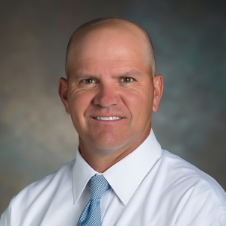
SEO Reminder ... What we do
The CEOS Systems Engineering Office (SEO) was established in April 2007 (sponsored by NASA HQ) to support the CEOS organization and facilitate global space agency initiatives. 13+ years of support to CEOS!
The SEO technical functions include: systems engineering tool development, requirements and gap assessments, data acquisition planning, and special projects.
The SEO management functions include: improving communications through web-based tools, managing CEOS social media, meeting logistics, and developing education and outreach products.

Slide 3
SEO Accomplishments in 2020
SEO Technical Team:
Open Data Cube (ODC) ... detailed chart to follow
Analysis Ready Data (ARD) ... worked with DE-Africa to co-fund the development of a Sentinel-1 Data Cube processing pipeline, supported development of product specifications, advertisement and prototype testing
Support to SDG AHT ... development and testing of ODC algorithms focused on SDG 6.6.1 (water) and SDG 11.3.1 (urbanization).
ODC Sandboxes ... planning new data cube “sandboxes” on the Amazon Cloud and the Google Cloud. AWS version will connect to the new Landsat Collection-2 and Sentinel-2 global archives. Google version connects to Earth Engine datasets.
Africa Regional Data Cube ... supported the transition to Digital Earth Africa and participated in the Technical Advisory Committee (TAC)
Earth Analytics Interoperability Lab (EAIL) ... Worked with CSIRO to plan implementation of the EAIL to support CEOS initiatives (COAST, Disasters, Rice Monitoring, GHG, DEM evaluation).
COVE Tool ... released new tools for coverage/revisit performance and coincident observations and a new API for enhanced analyses.
GEO Tasks … support to countries for GEO-Amazon project, participate in new GEO Data Working Group
WGCapD Training Database (https://training.ceos.org) … completed new online tool
SEO Management Team:
Updated to the CEOS website and social media content
Provided meeting logistics support across many CEOS groups
External Request Process Paper ... Worked with a team to develop a new process and gain endorsement. Also included updates to the New Initiatives Process Paper.
Worked with CEO to significantly modify the CEOS Deliverables Database
Continued updates to the mailing lists and server software

Slide 4
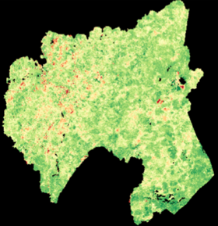
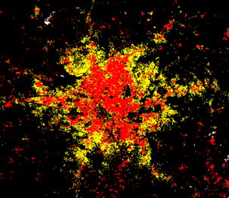
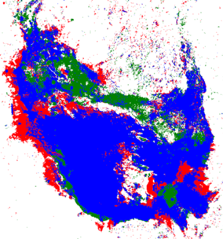
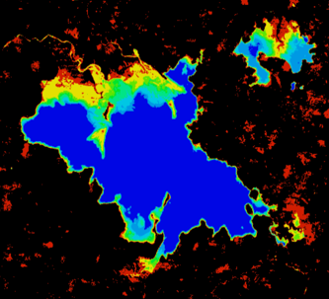
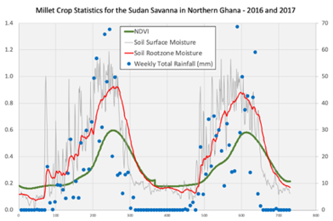
Open Data Cube (ODC)
Open Source Geospatial Foundation (OSGeo) ... working with the ODC team to add the ODC to OSGeo.
Google Cloud Prototype ... testing ODC installed on Google Cloud and connected to Earth Engine datasets ... working very well!
Advancing ODC Algorithms ... improving Jupyter notebooks for easier use and training (with DE-Africa) and enhancing products
Digital Earth Americas ... first meeting (limited attendance) was held on August 19. Exploring user needs and next-steps.
Digital Earth Pacific ... contacted by SPC (Pacific Islands) to discuss ideas for a DE-Pacific data cube.
User Forum ... investigating the forum used by “Sentinel Hub” to support the growing number of global ODC users
ODC Website: www.opendatacube.org
ODC GitHub: https://github.com/opendatacube

Slide 5
ODC Global Impact
Operational In-Development or Under Consideration
100+ countries in 3 years

Slide 6
Communications
Outreach and Exhibits: No “typical” meetings in 2020 but we did participate in the IGARSS and will participate in the AGU conference and GEO Week.
CEOS website: 29,939 visits in the last year! 88% new (not returning)
Social Media ... 2736 Twitter followers, 1630 Facebook likes
Contact Kim Holloway (Kim.E.Holloway@nasa.gov) for ... updates to the CEOS website (including news items), meeting announcements/registration, Go-To-Meeting telecon support, Facebook posts, or Twitter posts
Twitter: @ceosdotorg
Facebook: @socialceos

Slide 7
SEO Plans for 2021
Earth Analytics Interoperability Lab (EAIL) ... work with CSIRO to implement the EAIL and support data and algorithm testing for CEOS initiatives (COAST, Disasters, Rice Monitoring, GHG, DEM evaluation).
Open Data Cube (ODC) ... advance country/region prototypes, advance tools (sandboxes), advance algorithms (Jupyter notebooks), develop a new user forum, and investigate new datasets.
Analysis Ready Data (ARD) ... support the development of product specifications (e.g. Nighttime Lights), promote and demonstrate value thru ODC prototypes, improve production and access to Sentinel-1 products
Support to SDGs ... development, testing and sharing of ODC algorithms and focused contributions to the SDG Toolkits (e.g. sandboxes, training/documentation, case studies)
COVE and CEOS Mission Database (MIM) ... work with ESA/Symbios to improve the MIM database and investigate API connections with COVE
Continue CEOS outreach at major meetings ... IGARSS, GEO, AGU
Let us know how the SEO can better serve you (CEOS)!

