Slide 1
Committee on Earth Observation Satellites
Overview & Potential CEOS Contribution to UN Decade of the Oceans for Sustainable Development
Vardis Tsontos & Jorge Vazquez (NASA)
2020 CEOS Plenary
Agenda Item 2.5
20-22 October, 2020

Slide 2
COVERAGE Overview
CEOS Initiative endorsed as a 3-year pilot project, currently in its 2nd year of technical implementation
Cross-cutting, collaborative effort - Enable more widespread use of ocean satellite products in support of science & applications for societal benefit - Improved access to a coherent set of global, interagency data products from the 4 Ocean VCs at common resolution - Implementation of an advanced technology platform providing access to complementary satellite & in- situ datasets via value-added data services - Demonstrate utility in the context of an example thematic application relating to: “the environment and high seas biodiversity & pelagic fisheries” - Touches upon several CEOS program areas: VCs, WGISS (FDA, ARD), Biodiversity
Response to known needs of the ocean community for improved, more integrated access to analysis ready data (ARD) in support also of the United Nations Sustainable Development Goals (UN-SDGs) (#14 in particular) relating to marine biodiversity & sustainable/ecosystem-based resource management
Advisory Board & Contributors
Approach & Status

Slide 3
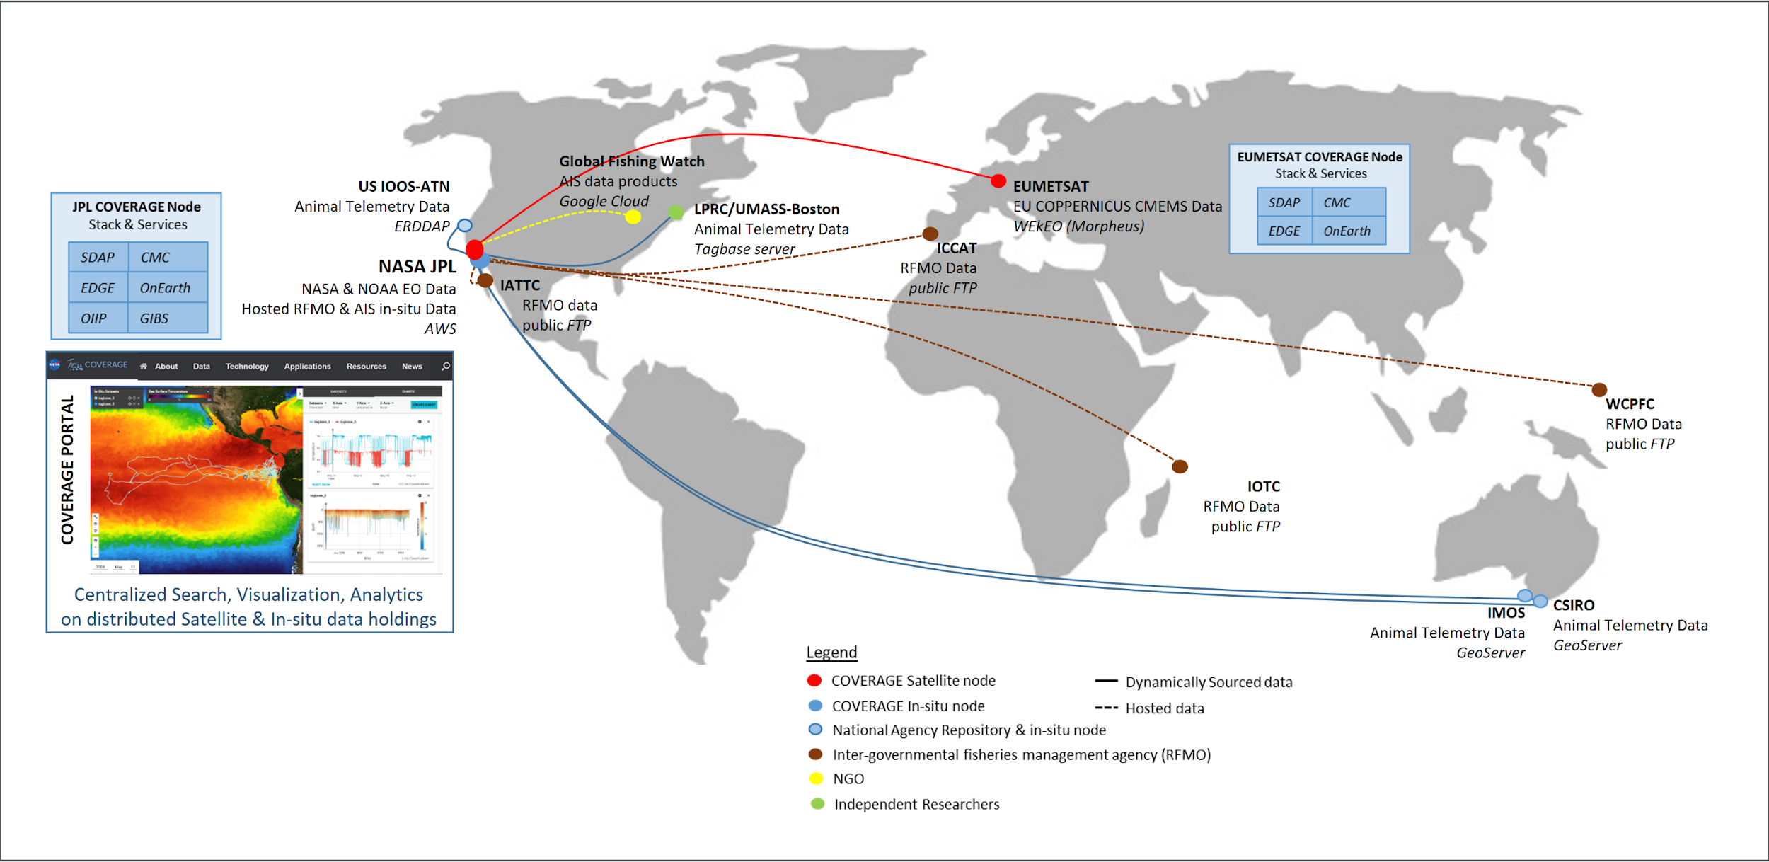
Distributed System Architecture

Slide 4
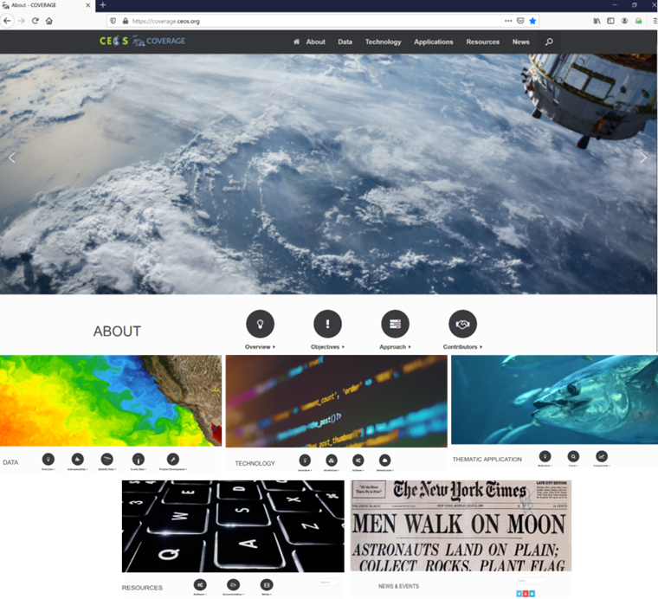
COVERAGE Web-Portal https://coverage.ceos.org
Descriptive information on COVERAGE Initiative
Data services/tool integration coming soon
Transition of site to Portal by end of Phase B

Slide 5
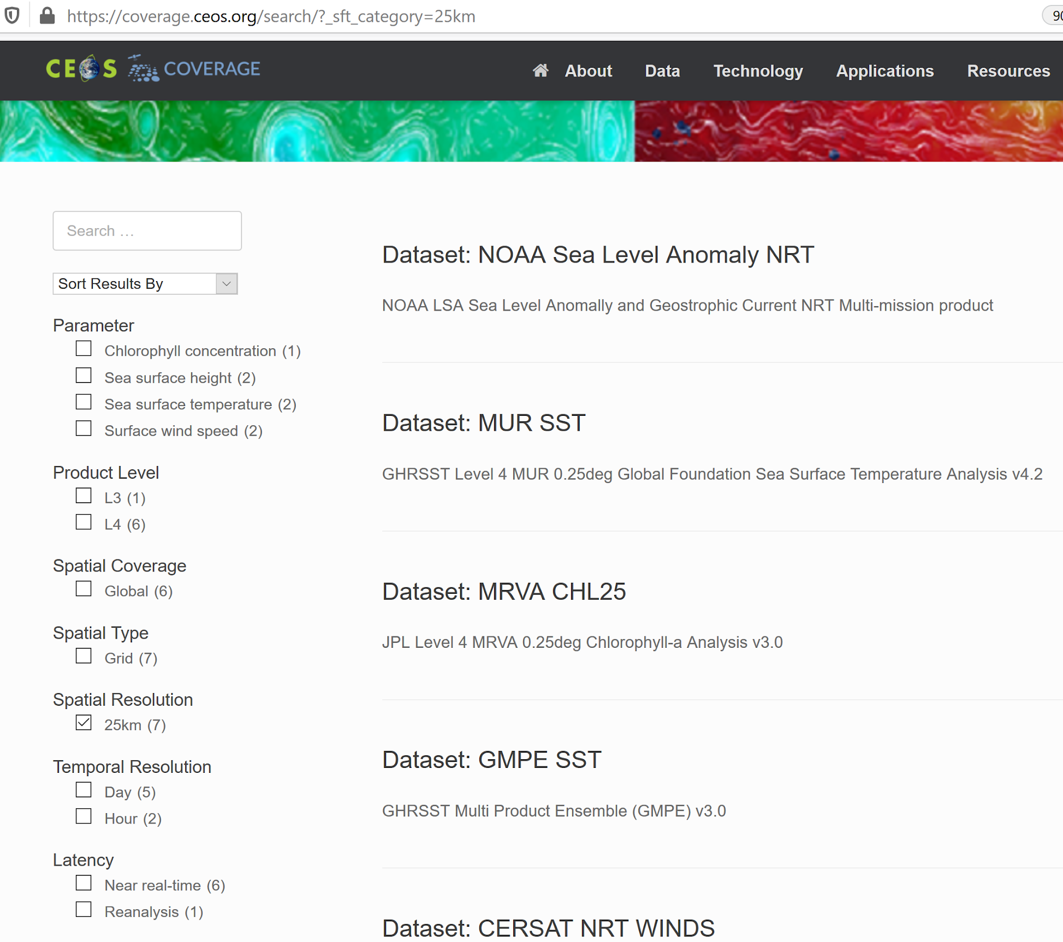
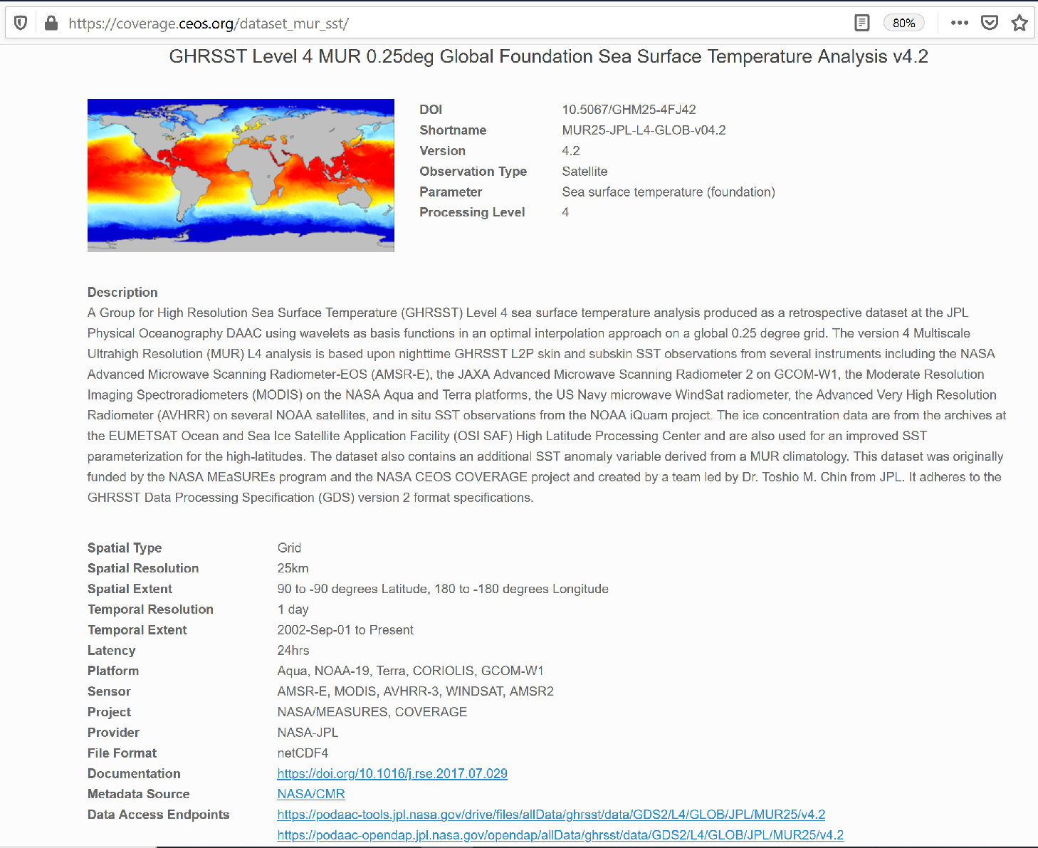
Integrated Data Search
Prototype Portal Value-added Services
Leverages CEOS-WGISS IDN and CDA
Integrates Dataset Metadata from multiple repositories: e.g. - NASA/CMR - FedEO (CMEMS) - IMOS - CSIRO “Marlin”
Features
Keyword search
Facetted search filters
Returns dataset descriptive & access point information
satellite
in situ

Slide 6
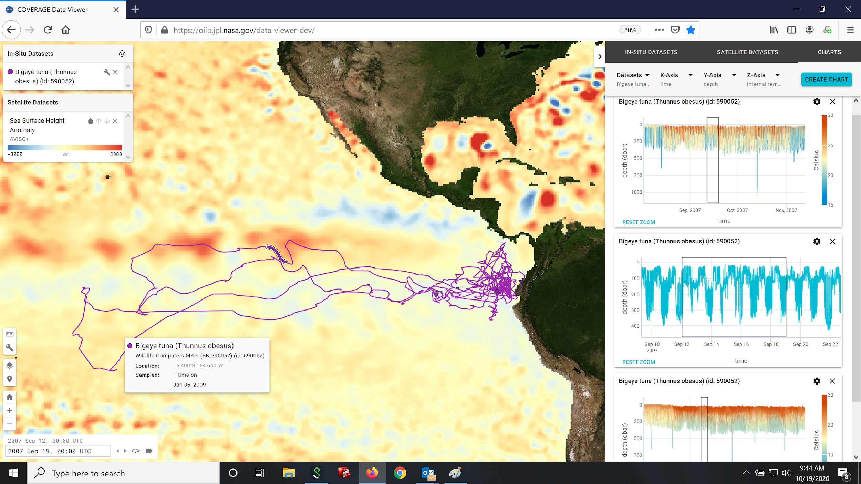
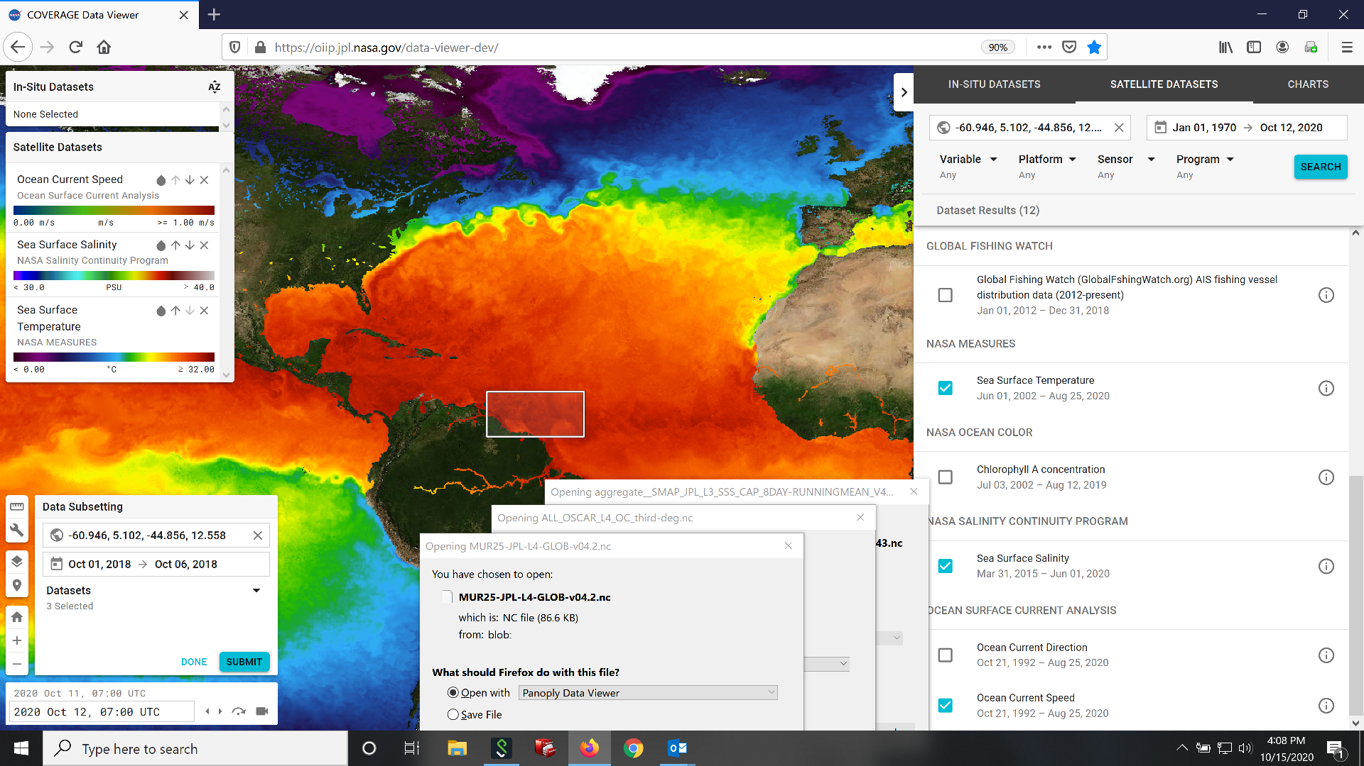
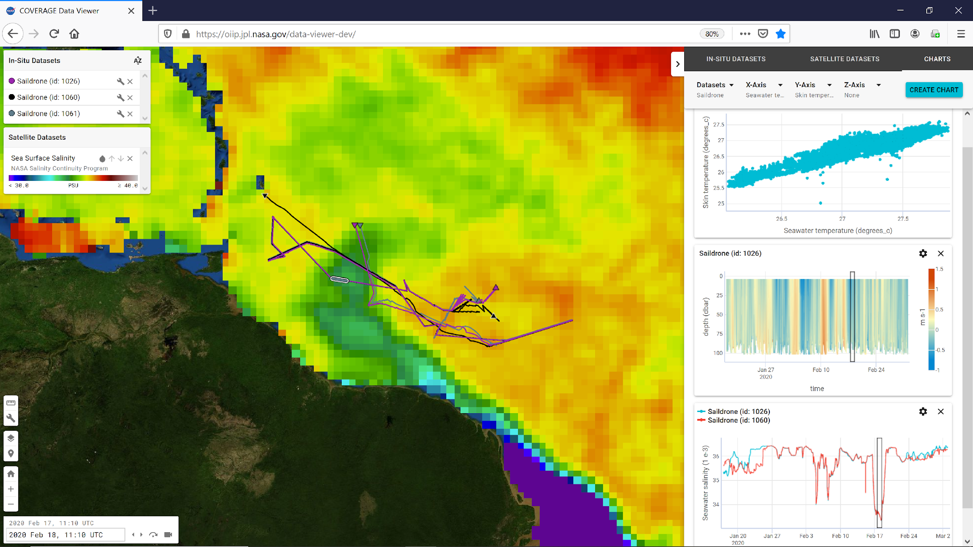
Web-based Data Visualization
Prototype Portal Value-added Services
Integrated visualization of satellite & in-situ data
Synchronized horizontal and vertical views of data and their evolution over time
Integrated dataset Search
“One-stop” Data Subsetting capability (both satellite & in-situ)
Open Source: JPL Common Mapping Client
What’s Next: Analytics API integration
IATTC Bigeye Tuna archival tag spatial distribution data in relation to AVISO-SSHA and animal telemetry environmental measurements
Data search & Subsetting
Saildrone ATOMIC cruise ADCP and CTD data overlaid on Sea Surface Salinity data from SMAP

Slide 7
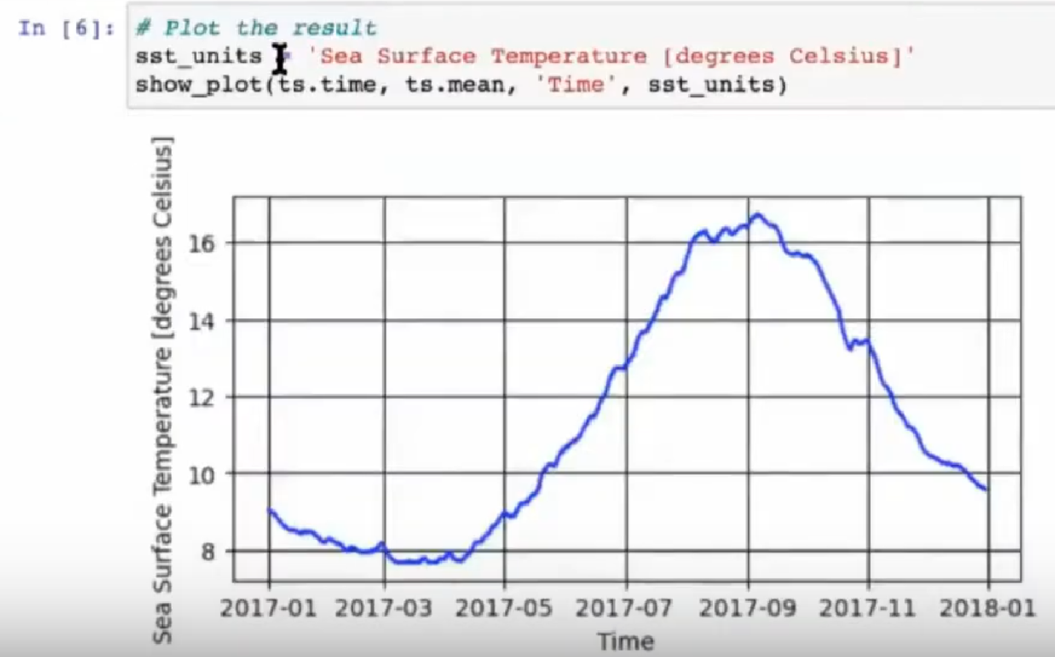
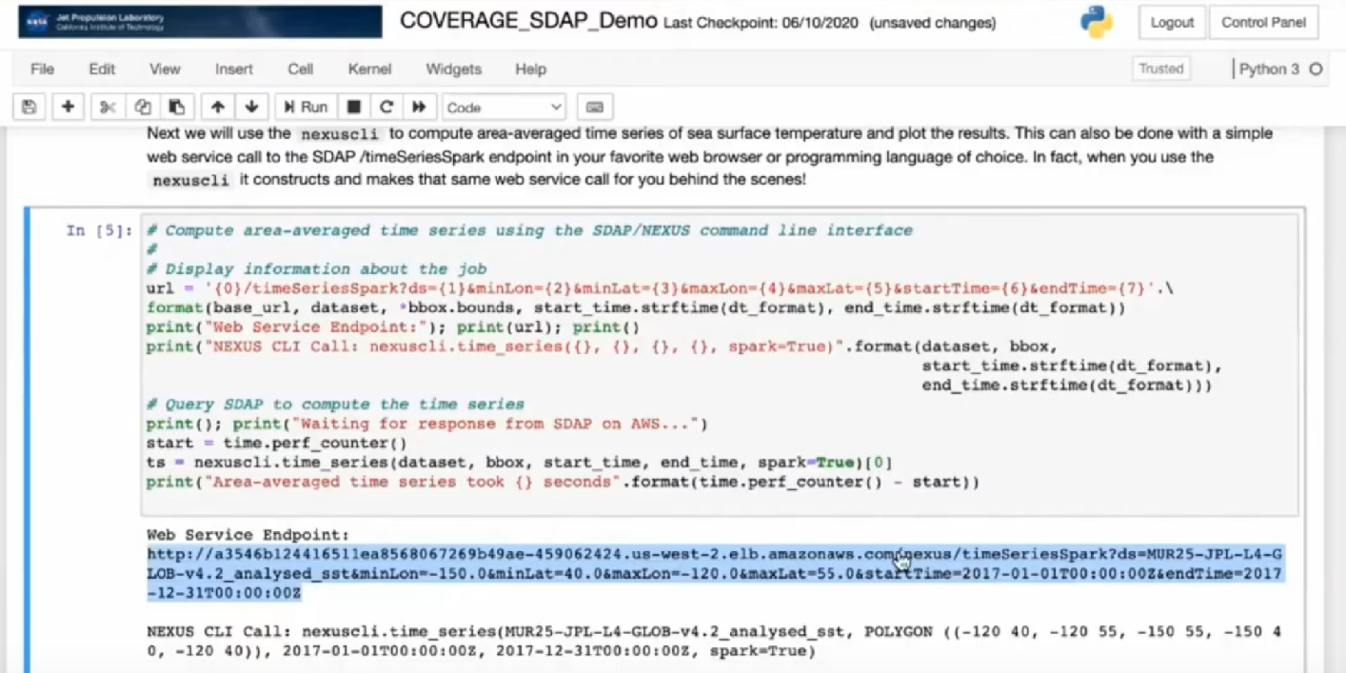
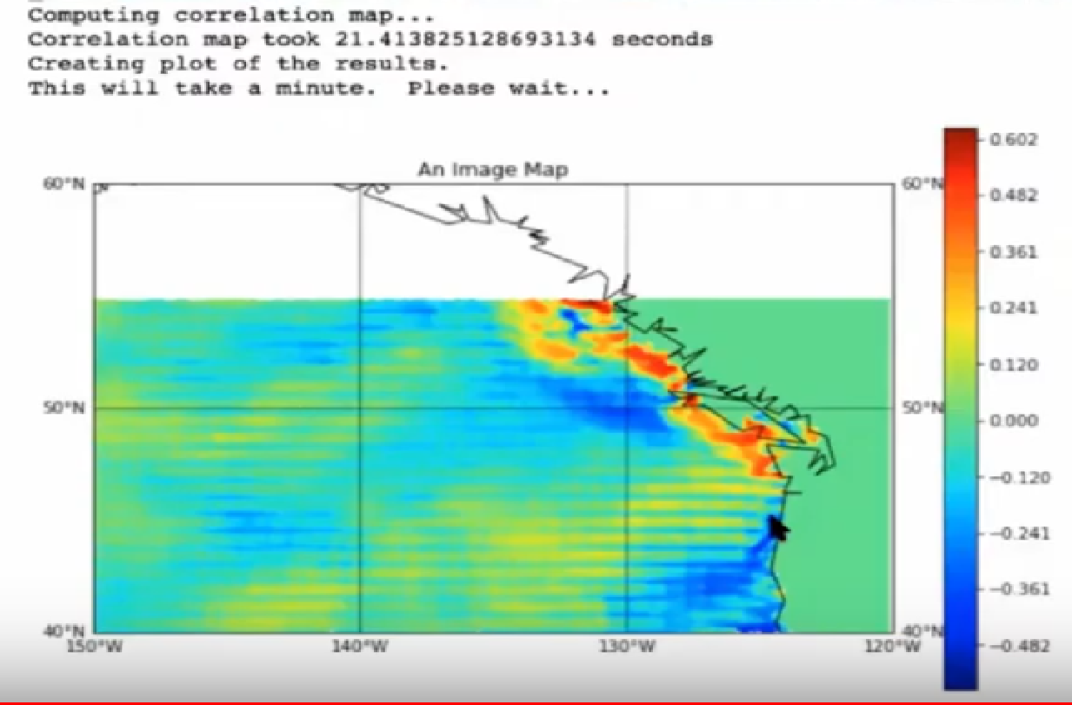
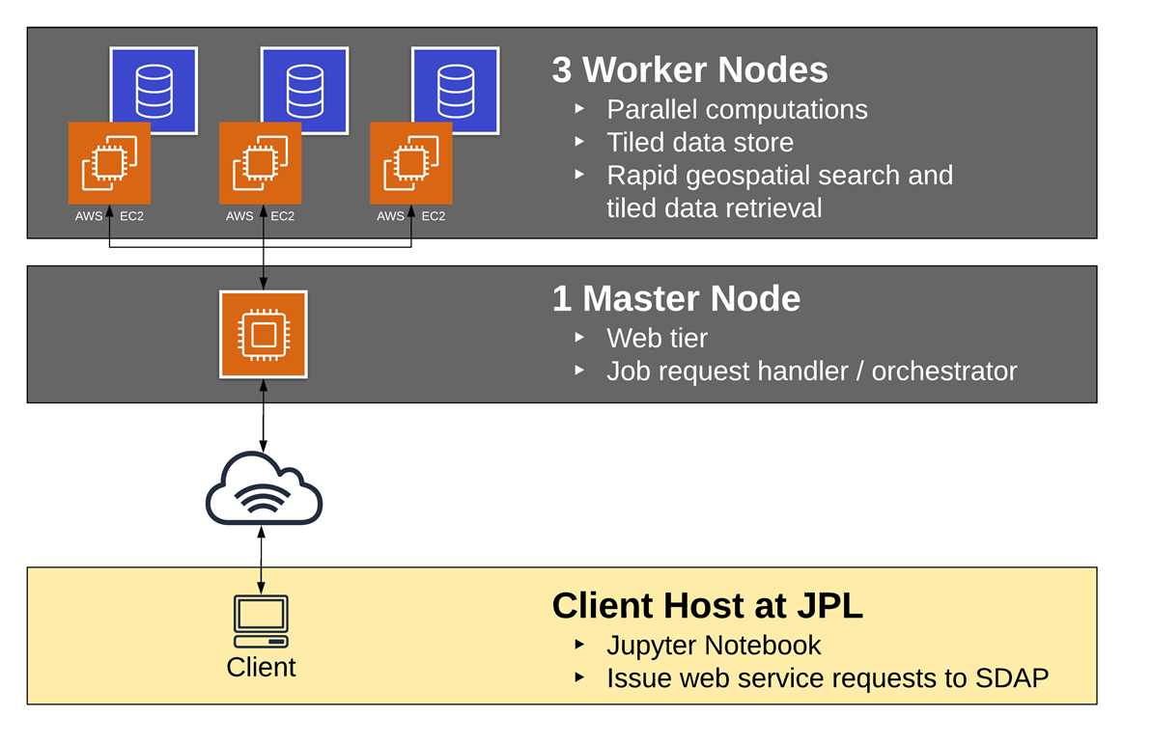
Satellite Data Analytics Services
Prototype Portal Value-added Services
Science Data Analytics Platform (SDAP)
http://sdap.apache.org
“Enabling Big Data science without download”
Cloud Deployments: AWS & WEkEO
Interfaces: Jupyter notebooks & APIs
SDAP WEkEO Deployment Instance

Slide 8
Discussion Topic
“Positioning COVERAGE as a cumulative contribution to the Decade on Ocean Science”
(e.g., via programmatic connectivity to GOOS)

Slide 9
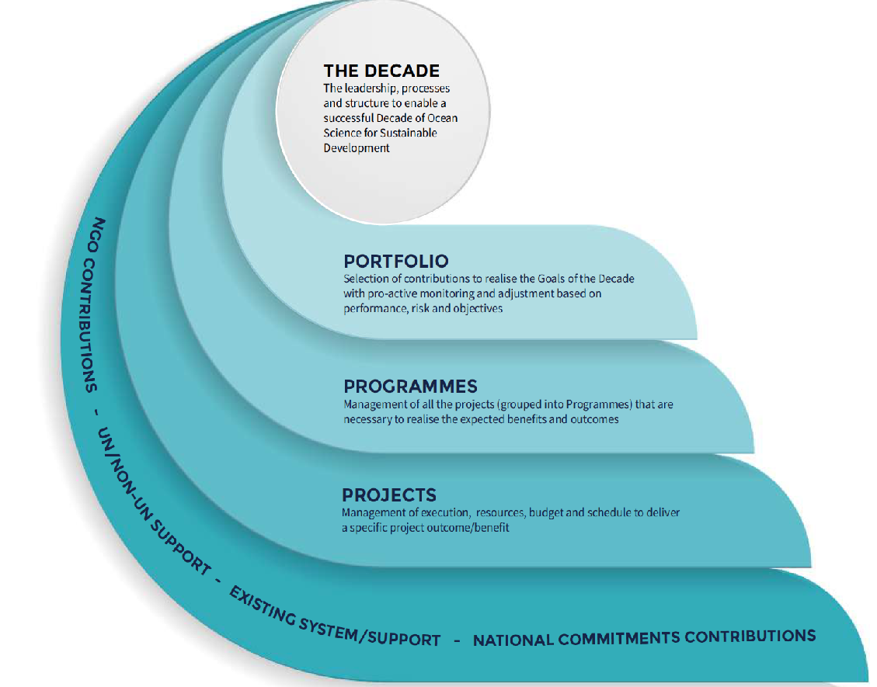
UN Decade of the Oceans for Sustainable Development
UN-International Oceanographic Committee (IOC) initiative mandated by UN General Assembly
Goals: Mobilize resources & tech. innovation to deliver key societal outcomes for the oceans: “clean, healthy, resilient, sustainable, safe, transparent”
9 Priority Applications: Fisheries management, Marine spatial planning, Marine protected areas, Coastal Zone management/adaptation, Early warning systems, …
7 Priority Areas: Comprehensive digital ocean atlas, observing system, ocean data & info portal, multi-hazard warning system, …
Calls for: large scale, multi-country/agency, transformative Decade programs & projects
Official launch event Berlin, May 2021 but initial call for actions Oct. 14, 2020

Slide 10
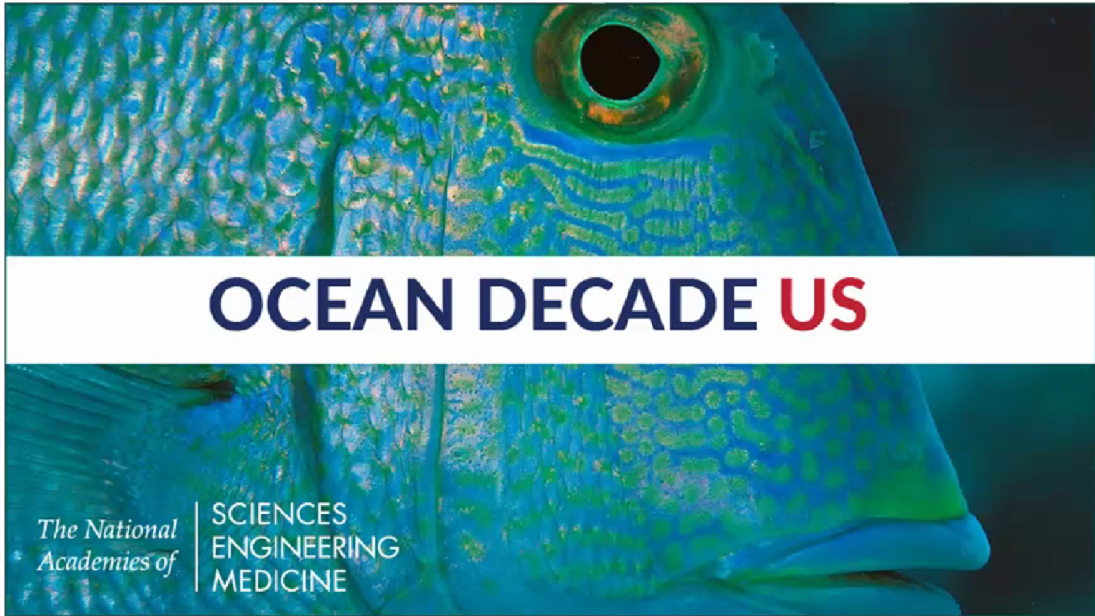
Opportunities via UN Decade National Committees
At the national level, Ocean Decade National Committees coordinate/guide the process. e.g. US National Academy of Sciences Decade Steering Committee
“Catalyze & foster transformative projects that support Decade goals”
Establish communication channels and connect national activities internationally.
First round of annual Calls out for Ocean Shots
“An ambitious transformational concept consistent with Decade themes that draws inspiration & expertise from multiple disciplines and fundamentally advances ocean science for sustainable development”
Initial round submissions due Dec.1, 2020 (1 pager)

Slide 11
Status & Possible Next Steps for a CEOS
COVERAGE Contribution to the Decade
Discuss CEOS position regarding COVERAGE as a cumulative contribution:
- COVERAGE interested in pursuing the Decade as a collaborative venture under CEOS
- Are there entities with the CEOS community interested in working with COVERAGE on this?
COVERAGE has initiated discussions with GEO-Blue Planet on Decade collaboration
COVERAGE to engage Advisory Board, comprised of GOOS representatives (e.g. IMOS) to discuss possible/desired connections to GOOS.
COVERAGE to further explore & develop Decade implementation strategy further as part of upcoming Phase C activity (initiating early 2021)
COVERAGE considering a submission to current US Ocean Shots call for Dec. 1, 2020

Slide 12
Backup

Slide 13
Thematic Demonstration Application
Satellite Data in Support of Ecosystem Assessment & Management
Increasing need for synergistic use of satellite environmental data in support of Fisheries & Marine Biodiversity Applications (e.g. habitat analyses, spatial stock structure, MPAs)
Stakeholder agencies: Intergovernmental RFMOs, National Fisheries Agencies, GEO-MBON, GBIF
Importance of addressing challenges associated with in-situ & Biological datasets (eg. data interoperability, diverese spatial data types)
Example Demonstration Application: supporting data (publicly available)
RFMO monthly spatial catch & effort data series by species (62 total), aggregated spatially at 1 & 5 deg. spatial resolution, 1952-2018
Electronic tagging datasets: high resolution trajectory-profile series
AIS fishing vessel distribution data products : daily, since 2012 from Global Fishing Watch

