Slide 1
CEOS Earth Analytics Interoperability Lab
Committee on Earth Observation Satellites
Dr. Robert Woodcock, CSIRO, WGISS Chair
Dr. Brian Killough, Systems Engineering Office, NASA
CEOS Plenary 2020
Agenda Item 2.4
20 – 22 October 2020

Slide 2
WGISS
Interoperability Initiatives
CEOS Interoperability Terminology
Focus on ARD and Cloud
Agenda 4.2
CEOS Earth Analytics Interoperability Lab
Agenda 2.4
Best Practices in:
Jupyter Notebooks for EO Analytics
Cloud data formats
CEOS Data Discovery and Access in the Cloud
Notes:
The [interoperability] work is relevant to all of CEOS and connected to LSI-VC, WGISS, WGCapD and the SEO. Plus specific projects (CEOS-COAST), and collaborators (GEO GLAM, GEO Aquawatch)

Slide 3
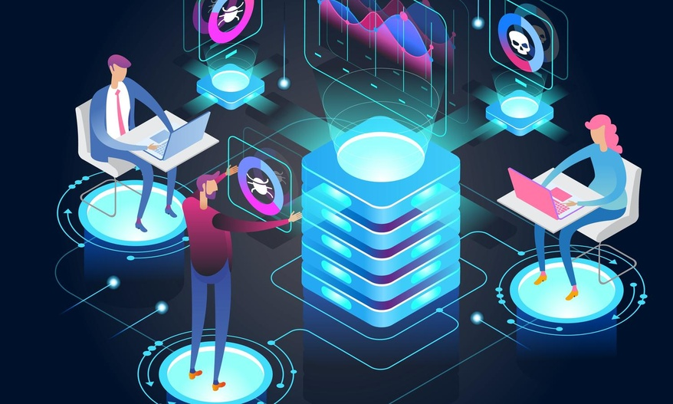
Why do we need an Interoperability Lab?
A significant number of CEOS activities are now engaged in the CEOS ARD and FDA strategies and in integrated EO data analysis
All recognize the broader implications
ARD relates to Discovery and Access, Analytics & Cloud Data Formats
Many are looking for advice or implementations
Validating interoperability between multiple CEOS organizations and working groups is complex
Notes:
Efforts to coordinate are high
Strong linkages to ARD Strategy and FDA

Slide 4
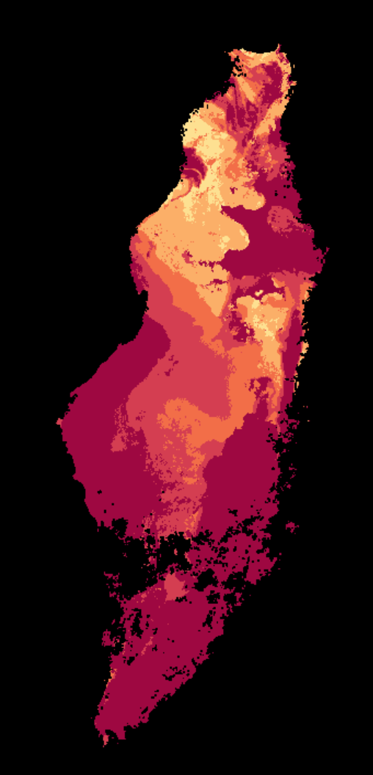
The Opportunity
The first Lab node is hosted by CSIRO and jointly operated by WGISS and SEO to provide:
Examples of FDA components in active use
A shared candidate ARD storage and access capability
Connection to existing and emergent services for Discoverability and Access
Collaboration on Analytics tools for integrated analysis using Jupyter Notebooks
Jointly develop CEOS Best Practices via interop experiments
Goal: Validate and demonstrate interoperability approaches
Notes:
WGISS would document best practices learned from the Lab experiments to support CEOS agencies in implementing them at scale across CEOS.

Slide 5
The Interest
Stronger interest than expected:
CEOS COAST
Paul DiGiacomo (NOAA)
WGCV – DEMIX
Peter Strobl (EC)
WGDisasters Flood Pilot
David Borges (NASA)
CEOS Rice Monitoring Community
Shin-ichi Sobue (JAXA)
WGISS 50 Session:
CEOS Earth Analytics Interoperability Lab (EAIL): a practical toolset for coordinating change
This Photo by Unknown Author is licensed under CC BY
Notes:
WGISS would document best practices learned from the Lab experiments to support CEOS agencies in implementing them at scale across CEOS.

Slide 6
Features: Jupyter Labs
exploratory data analytics
WGISS Survey on use of Jupyter in CEOS agencies in progress
Customise per CEOS activity as necessary
Interactive visualisation

Slide 7
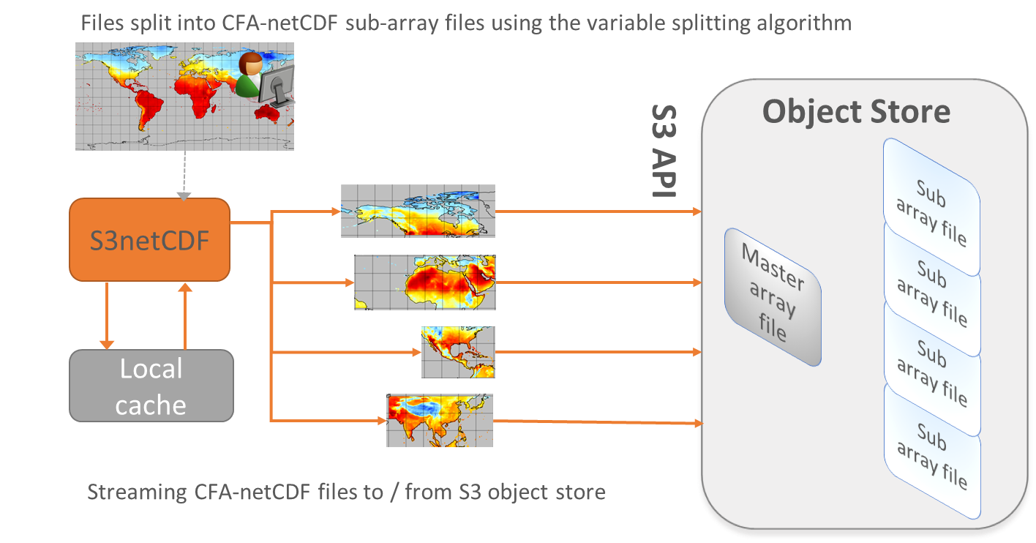
Cloud data formats – Best Practices
Direct data access
COGS – Cloud optimised geoTIFFs (ready for Sentinel and Landsat)
NetCDF in the Cloud
Zarr – Cloud native array storage (e.g. hyperspectral)

Slide 8
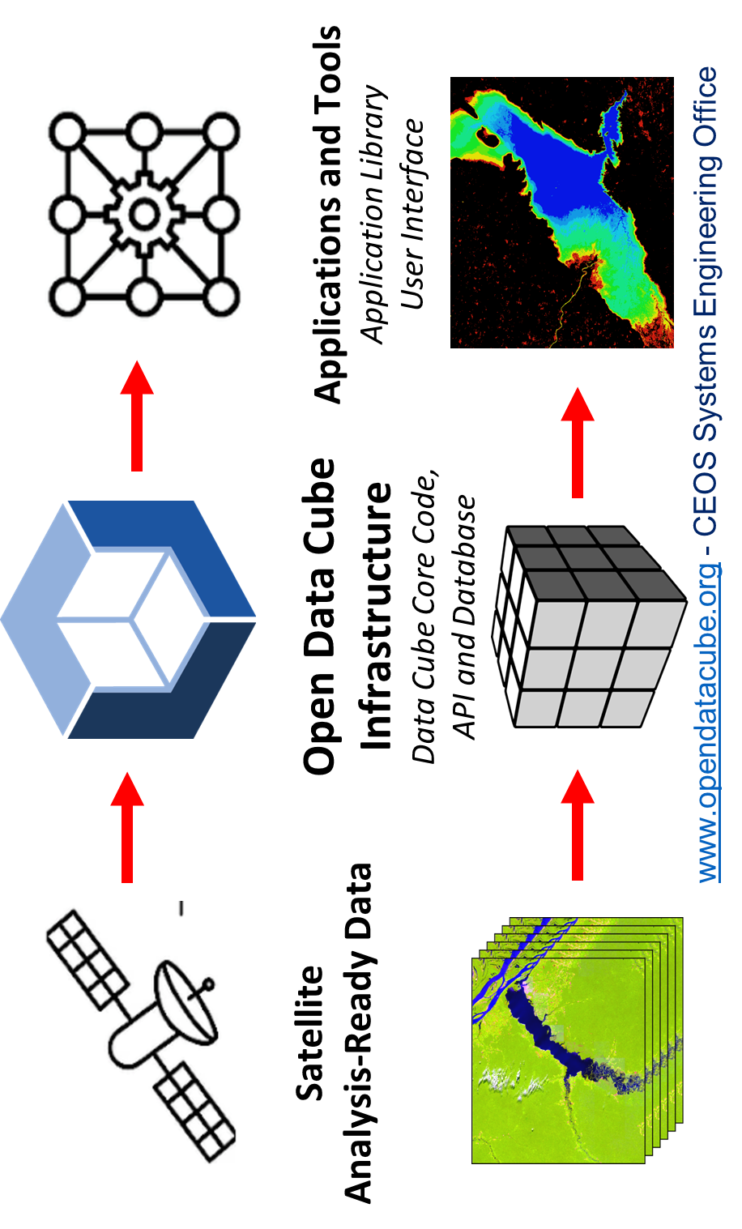
Additional nodes?
SEO EAIL with Open Data Cube
ESA Data Cube ecosystem
Storage
Infrastructure/resources
Compute
Notes:
Most CEOS FDA prototypes use a similar breakdown of the architectural layers for simplicity (ODC and ESA for example)
In practice they are federated service ecosystems with a variety of interface points at all levels available to users of all types – drawing that though is unhelpful to communication.
Unfortunately the simplified view also hides very important changes in the ecosystem.
We can see a few though – practically all CEOS FDA pilots include the three interface types shown:
Web based users interfaces – not just data discovery, view and download. Full analytics capabilities for common use-cases (e.g. NDVI, Carbon, Hazards). These are often themed (e.g. ESA Thematic Exploitation Platforms is an entire family of themed web portals with common with shared components and data sources.
Jupyter notebooks – Interactive data analysis directly available to users. Opens up a whole new range of possible applications
APIs – a much lower level interface to both the data and analytical capabilities. Allows for direct integration with other third party applications and development.

Slide 9
Next steps
Roadmap:
WGISS+SEO deploy the lab
CEOS COAST et al:
inventory of data, analytics, etc
Define joint interop experiments for capabilities needed by these projects
Demonstrate and validate jointly in the Lab(s)
Cookbook of Jupyter notebook examples
Solicit interest in ongoing EAIL support and additional Nodes

