Slide 1
WGDisasters
Committee on Earth Observation Satellites
David Green, NASA, WGDisasters Chair
Pierric Ferrier, Vice Chair
David Borges, Secretary
CEOS Plenary 2020
Agenda Item # 2.2
20 – 22 October 2020

Slide 2
WGDisasters Strategy Document for Endorsement
Deliverable: Strategic paper
“Promoting Space Data for Disaster Risk Management”
Way forward
Increase data access, use and utility
Workplan implementation
Supports outcomes of WG Pilot and demonstration projects;
Aligns with GEO, Sendai and SDGs
Implications and Value
Facilitates engagement with users and decision makers;
Guides data policy/business evolution;
Informs gap-filling observations and background missions; data and information systems design; analysis ready data
Content
Introduction and background
Stakeholder and Partner Engagement
Open and Free Data Access
Licensed and Commercial Data Access
Applications, Services and Exploitation Platforms
Earth Observation Gaps in Disaster Risk Management
Findings and conclusions
Notes:
TOR 2019 and WG Group with experience captured from pilots and projects: Landslide, Geohazards, Volcano, EQ, Seismic, RO, GSNL, GEODARMA
Updating data strategy: NASA, CNES, ASI, ISRO, NOAA, CONAE, CAS, CSA, USGS, ESA, DLR, ROSCOSMOS, CSIRO

Slide 3
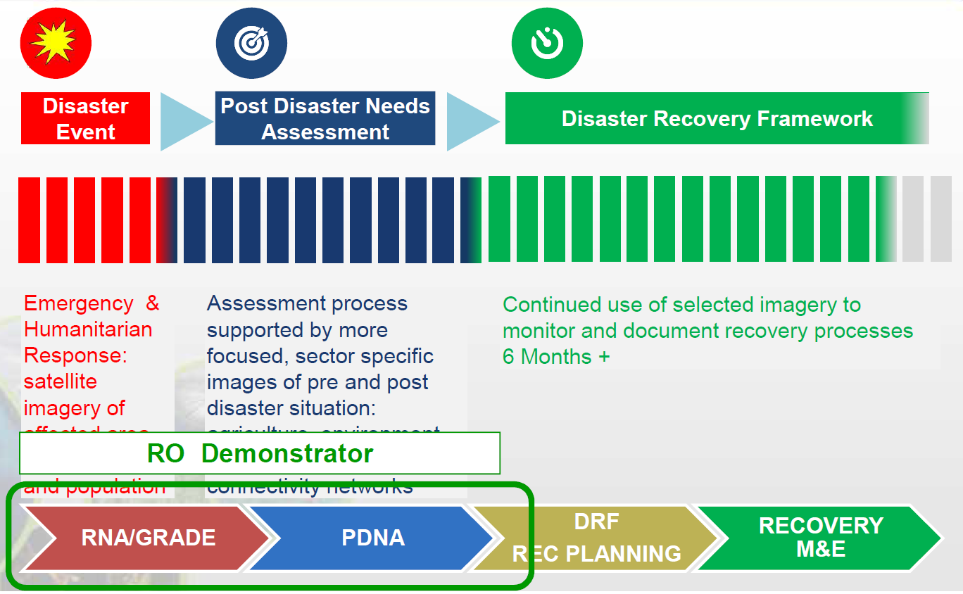
Recovery Observatory Demonstrator Implementation Plan for Endorsement
Based on successful national pilot
Haiti Recovery Observatory Pilot
Stakeholder feedback & lessons captured
Deliverable: Implementation plan
Generic Recovery Observatory
Way forward and Workplan
Demonstrate reproducibility and global extension for disaster recovery
Implications and Value
Increased access to data for communities and areas highly impacted (data plan)
Timely data use to inform early action and intervention, guide humanitarian relief, disaster assistance and reconstruction for early and sustained recovery;
Support capacity and resilience development
Continuity and full complementarity with the International Charter and other services dedicated to emergency response and disaster risk management
Notes:
Need a data sharing plan

Slide 4
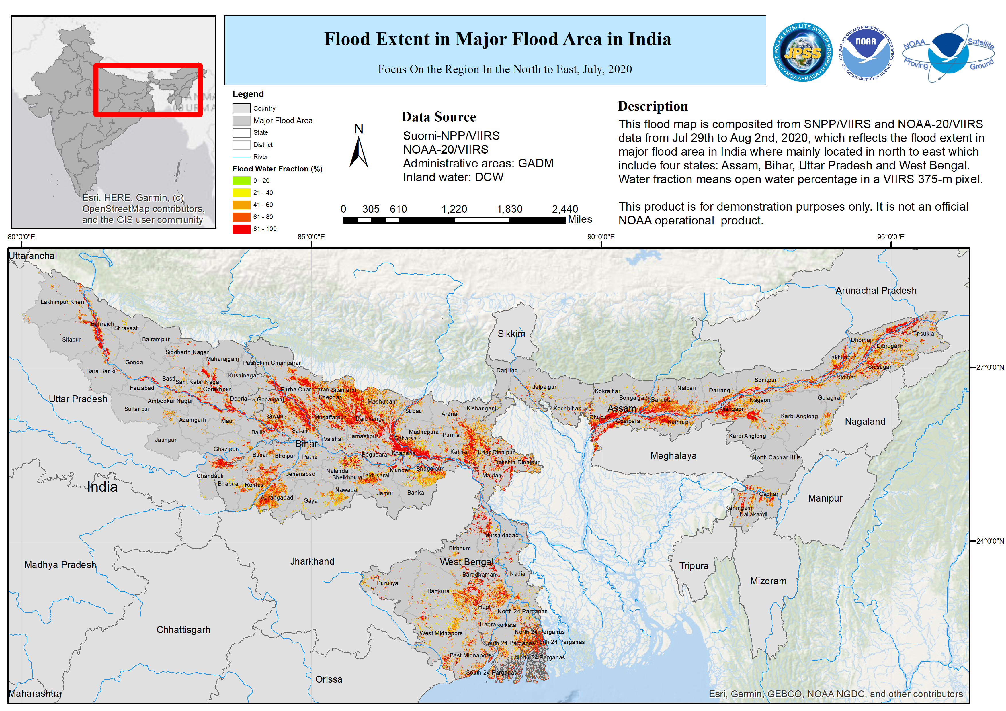
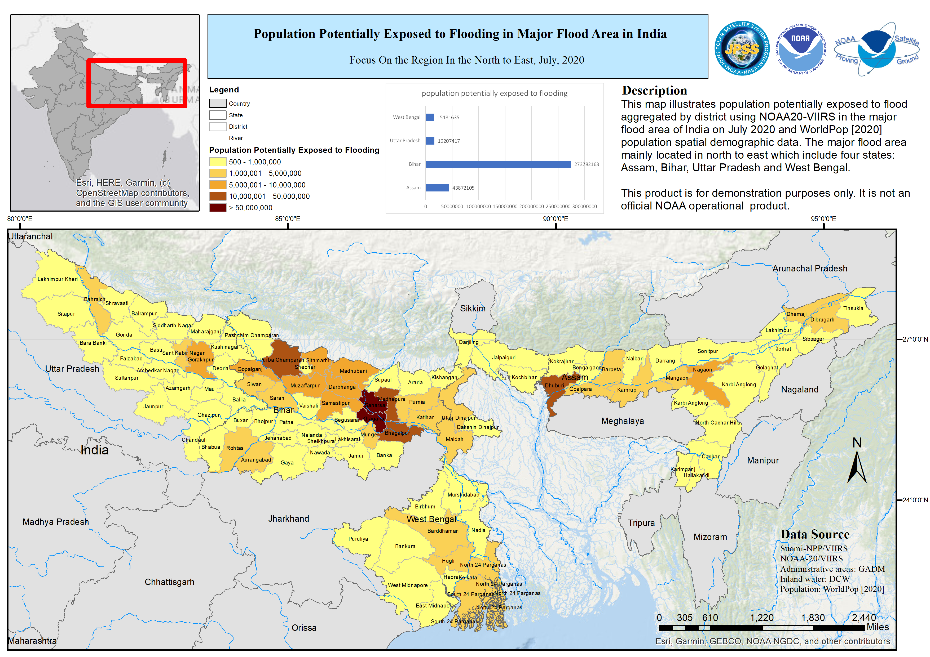
GEO/LEO/SAR Flood Pilot
Implementation Plan for Endorsement
Deliverable: Implementation plan
Geostationary/Low Earth Orbit/ Synthetic Aperture Radar Flood Risk Pilot
Way forward and Workplan
Collaborative project with regional case studies
Examine the feasibility of sharing and integrating optical, SAR and geostationary methodologies (CEOS, CGMS, and other private sector)
Assess new tools to inform flood risk mapping and disaster risk management
Pilot Regions: India, US/Canada, Argentina/Paraguay/Bolivia,
Balkans, Myanmar….
Implications and Value
Capture best practices for sharing data; combining information products from multiple sources (data plan)
Engage national and regional stakeholders
Partner with WGISS & SEO for interoperability, Coastal/Water, WGCapD; leverage GEO activities, and Int’l Charter methodologies and agreements
Example India case study : Flood composites and impacted population estimates from NOAA VIIRS, India. Flood Pilot will integrate additional satellite sources, including SAR, to improve representativeness and accuracy
Notes:
Regional Case study: Pilcomayo and Bermejo Transboundary Basins (Argentina, Bolivia, Paraguay)
Leads: CONAE: Regional Partners: Regional Commission of the Bermejo Basin (COREBE, Argentina)
SAOCOM data available for sharing but similar flood events have not yet occurred in this area during mission time.
Regional Case study: Mahanadi River Delta – Coastal Flooding and Cyclone Amphan (2020) or Cyclone Fani (2019)
Leads: ISRO; Region of interest and potential events have been defined, need to bring together available data sets from free and open sources or those shared (Sentinel-1, geostationary/LEO, Landsat/Sentinel-2) and others
Regional Case study: Pearl River Basin – Urban, Coastal Flooding, Late August 2018
Leads: Chinese Academy of Sciences (CAS)
Regions of interest and some preliminary events have been identified in 2018, may also be able to use most recent flooding event in 2020.
Regional Case study: Red River of the North Winter-Spring 2020
Leads: NRCan, NOAA, NASA: Radarsat-2 and RCM maps have been developed for recent extremes in April 2020, along with products available from ABI/VIIRS instruments. Additional mapping available from Sentinel-1, Pursuing data access through other platforms, including Sentinel-2/Landsat and Planet Seeking other SAR data to expand frequency and polarization diversity; coherence-based approaches.
Regional Case Study: Myanmar – Automated Flood Detections
2019 Monsoon Season
Leads: Luxembourg Institute of Science and Technology (LIST) Past work has examined mapping the extent of permanent water bodies, separating permanent water from flood extent, and relating flood events to impacts via population and other human settlement information
Regional Case Study; South Balkan Basins – Transboundary Late August 2018
Leads: Harokopio University (Greece) Earth Observation Team (HUA EO Team). Previous work in the region has examined SAR analysis and multi-temporal approaches to extract features of interest

Slide 5
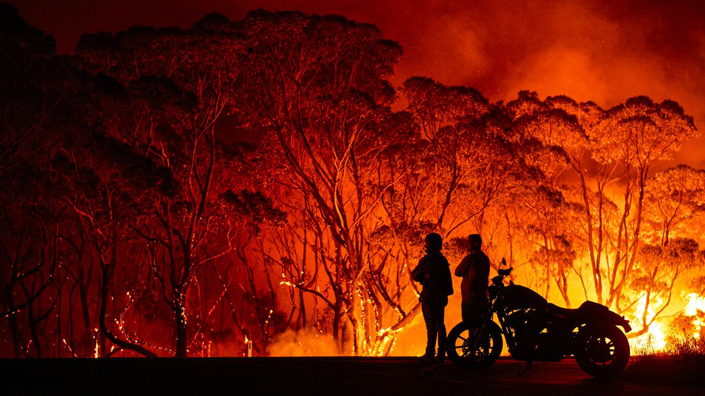
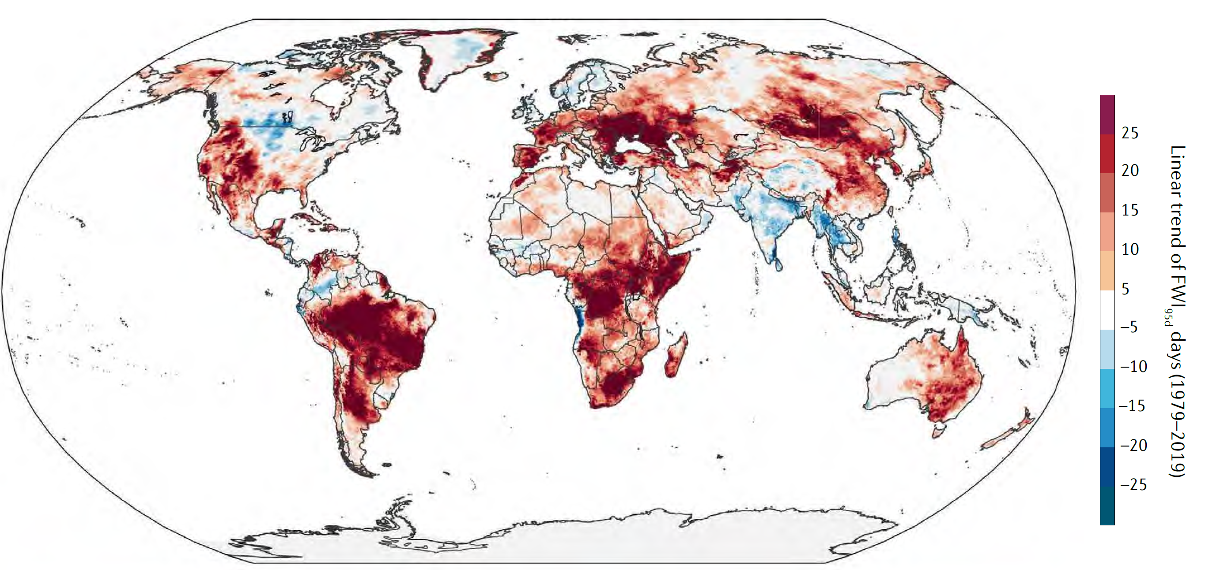
Wildfire Pilot Proposal
In Development
Invitation to contribute and draft Wildfire Pilot Proposal have been distributed to the CEOS Community
First scoping meeting held 14 October
40+ attendees representing CEOS Agency and Associate Members
Intend to submit Wildfire Pilot Implementation Plan for review AND endorsement at CEOS SIT-36
(Bowman et al., 2020)

Slide 6
WGDisasters Thanks ISRO
CEOS Chair role, vision and stewardship over the year
Contribution to the WGDisasters Flood Pilot workplan and activities
Interest in and advancement of a new Wildfire Pilot plan
Encouragement to advance thematic disasters data processing solutions

Slide 7
Questions / Discussion
Committee on Earth Observation Satellites
David Green, NASA
WGDisasters Chair
CEOS Plenary 2020
Agenda Item # 2.2
20 – 22 October 2020

