Slide 1
Polish Space Agency Application for Associate CEOS Membership
Committee on Earth Observation Satellites
POLSA
CEOS Plenary 2020
Agenda Item #1.3
20 October 2020
Michal Szaniawski
President
Polish Space Agency (POLSA)

Slide 2
Polish Space Agency (POLSA)
The Polish Space Agency (POLSA) is a national governmental agency, established by the Act of 26 September 2014 (Dz.U. 2014 poz. 1533; Ustawa z dnia 26 września 2014 r.)
POLSA is responsible for Poland’s International space matters, and supports the Polish space sector by combining the world of business and science
Poland is a European Space Agency (ESA) Member State and assists entrepreneurs in accessing suport from ESA. An important aspect of the Agency's activity is the promotion of the development of satellite technology that can be used in everyday life, including communication, navigation, environmental monitoring, and weather forecasting.

Slide 3
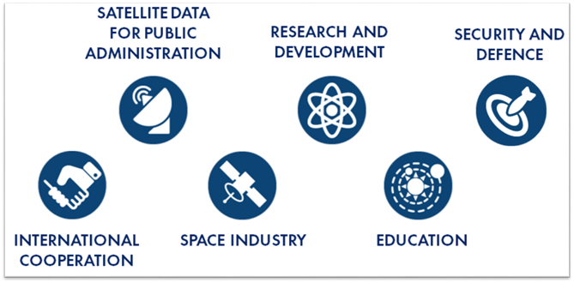
Polish Space Specializations
Within the features of the Space 4.0 era, the niches of the Polish space sector include:
Data aggregation and processing systems;
Applications for EO and GNSS data processing;
Optical observation; SSA with subsystems; software designed to process SSA data;
Space robotic systems;
Development of small satellites (power systems, on-board computers, satellite receivers for GPS and Galileo systems, integrated microwave modules, structures and production techniques, propulsion systems for satellites and exploration missions);
Optoelectronics; and
Robust Ground Support systems (EGSE & MGSE).

Slide 4
A Snapshot of POLSA Projects
European Clusters:
EUSST – European space safety cluster
PERASPERA – European robotic cluster
European Research projects:
ENTRUSTED – European Network for satellite telecommunication roadmap for governmental users requiring secure, interoperable, innovative, and standardized services
Future Space – Inspiring students to pursue careers in STEM
National projects:
Sat4envi – Operating system for gathering, sharing and promotion of digital satellite information about the environment
Cosmic hub – Cooperation and knowledge-sharing platform for startups, SMEs, and primes

Slide 5
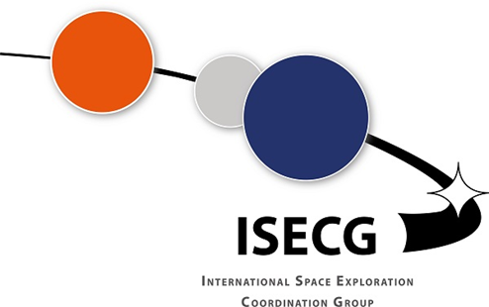
Polish Satellites and International Cooperation
The catalogue of Polish Satellites and Poland’s International Space Partners includes:
Heweliusz – Space Science; launched 2014
KRAKSat – Scientific/Technology Demonstrator; launched 2019
Lem – Space Science; launched 2013
PW – Technology Demonstrator; launched 2014
PW-2 – Technology Demonstrator; launched 2018
Swiatowid – Earth water/air monitoring spacecraft; launched 2019

Slide 6
Earth Observation Activities
Sat4Envi: An operating system for assembly, sharing, & promotion of digital satellite information about the environment
Objective:
The Sat4Envi project works to foster infrastructure for receiving, storing, processing, and distributing data from Sentinel-1, -2, -3 satellites, and related satellite products using existing Institute of Meteorology and Water Management (IMGW) resources. As a result of its implementation, data from Copernicus and other missions are accessible to Poland’s public administration entities to be applied in their activities related to environmental protection, area development and planning, development of urbanization and transport networks, and to private entities to create commercial services.
POLSA activities:
Creating an on-line e-learning platform;
Conducting workshops for public administration and preparing a handbook for satellite imagery usage;
Supporting public administration in implementing EO data-driven responses, and inventory of civil user needs;
Organizing seminars, workshops, and conferences dedicated to users and technology providers;
In 2020, POLSA prepared a pilot program for satellite data application in public administration which, in close collaboration with end-users and technology providers, supports & improves daily operations with space data;
Representing Poland in EURISY; and
Identifying gaps and barriers for public administration use of EO data.

Slide 7
POLSA Contributions to CEOS
As the National Space Agency, POLSA can support the CEOS Workplan and contribute to CEOS by:
Investigating means for increasing data utility and cost-effectiveness for operators and users, including coordination of data acquisition, sampling, and preprocessing methodologies through Polish institutions;
Helping to increase compatibility of data archives and enhancement of access to CEOS Agency databases, information products, and services;
Presenting plans for satellite remote-sensing technologies and programs, and discussing appropriate approaches for the coordination of future systems;
Addressing current developments and opportunities regarding Earth observation from space, including free-flying spacecraft, mission-specific instruments on space transportation systems, & placement of instruments on space platforms;
Seeking to ensure that the user community is made aware of its satellite programs & encouraging discussions between users and relevant satellite system operators, as necessary;
Facilitating the participation of technical experts in CEOS working groups;
Fostering awareness by CEOS Members of Poland’s EO-related capabilties;
Sharing Poland’s unique methods and experience as a Central European country shifting the approach of the public administration sector towards greater integration of EO resources in daily operations to support other nations in similar circumstances, sharing our own best practices and understandings;
Sharing unique Polish capabilities in cloud computing and creating EO platforms on a European scale;
Disseminating useful EO-related information to relevant space communities, including companies, institutions, and academia; and
Supporting seminars, workshops, and conferences dedicated to EO users and technology providers.

