Slide 1

SIT Chair Prospectus
2020-2021
Committee on Earth Observation Satellites
CSIRO & GA
CEOS Plenary 2019
Agenda Item 7.3
Ha Noi, Viet Nam
14 – 16 October 2019

Slide 2
Introduction
CSIRO and GA will take on Chair of the CEOS Strategic Implementation Team (SIT) at CEOS Plenary for a 2-year term.
SIT “..provides strategic guidance on the direction, progress, and status of implementation activities in relation to the established priorities, commitments, and partnerships of the CEOS organization”.
ESA to serve as SIT Vice Chair during this term and to take on SIT Chair in late 2021.
SIT Vice Chair Team has been consulting broadly across the organisation to set outcomes and milestones that are significant and reflect societal needs and CEOS agency priorities (and therefore resources).

Slide 3
SIT 2020-2021 Approach
Evoking the original vision for SIT – making best use of Principals’ time in SIT meetings to address significant challenges to be addressed by coordination and observing system harmonisation across space agencies.
Focused: a few priorities – reflecting major thrusts across civil EO programmes and priority needs.
Reflecting existing important CEOS WP activities that will benefit from being escalated, elevated and expedited.
  In general, a focus on outcomes.
Effective use of the different meetings.
  SIT: Significant debate and decision - for Principals.
  TW: Working Teams reporting, interaction, and prep for Plenary.
  All meetings cannot accommodate reporting of all CEOS business.
  Ensure effective intersection between CEOS management and working teams.
  Strong Troika

Slide 4
SIT 2020-2021 Headlines
Analysis Ready Data – supporting effectiveness of public EO programmes with a broad ARD strategy, with evolution of CARD4L, new thematic areas and exploring industry engagement.
Carbon and Biomass – prototype GHG products for the first global stocktake; new relationships with conventions and inventories communities; accelerated policy relevance of new above-ground biomass observing capabilities, incl. with GFOI; support to the GCOS documents update.
SDGs: organisational clarity, and a few focused demos for good practice, methods; establishing longer-term strategy for CEOS support to SDGs.

Slide 5
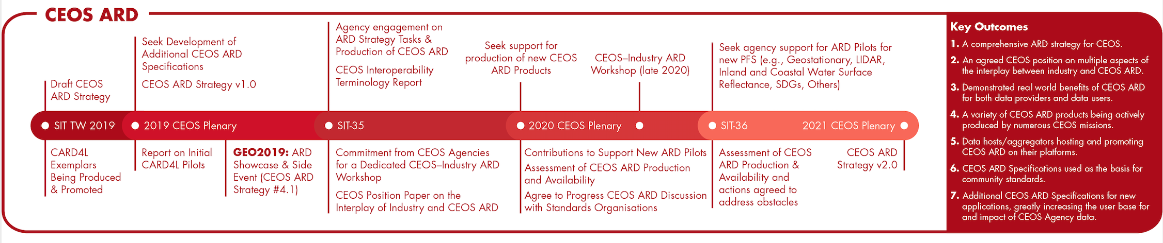

CEOS ARD Strategy
Implementation of the CEOS ARD Strategy
Production, promotion, demonstration, uptake of CARD4L
Engagement with Industry on the concept and practice of ARD
Building on CARD4L foundation and expanding the range of CEOS ARD types
SIT Chair oversight of existing and considered work to ensure coherence
  Best efforts, as usual!
  Many tasks already underway or in discussion (LSI-VC, GFOI, WGISS, GEOGLAM, GA, SEO, SIT Chair...)

Slide 6
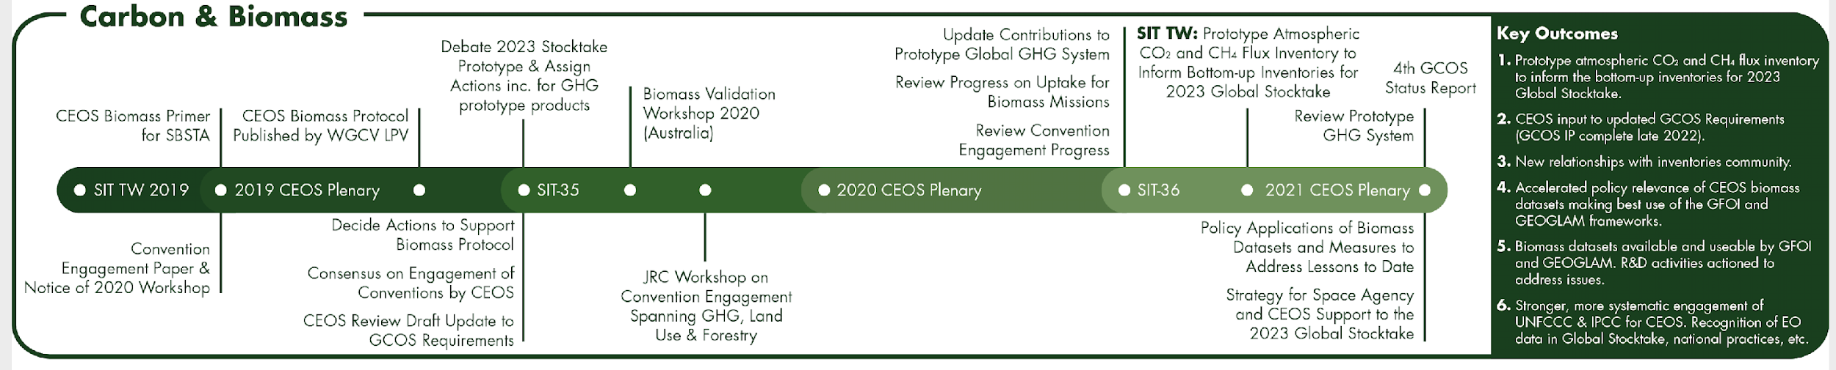
Carbon & Biomass
Supporting the GHG Roadmap process – escalating, elevating, and accelerating progress towards major milestones, including for the 2023 Global Stocktake. 2021 prototype flux products.
Encouraging stronger and more systematic CEOS engagement with convention frameworks – building on IPCC outreach
  And national inventory communities as our future users
Reflecting large investment (2018-2024) in Above-Ground Biomass missions and seeking to accelerate the policy relevance of these new data (GFOI, GEOGLAM…)
Promote uptake of biomass datasets beyond science community – forest monitoring, inventories…

Slide 7

SDGs
Ensuring efficiency in delivering CEOS SDG outcomes, as well as clarity between CEOS & GEO (EO4SDG) activities
Focusing on a few specific indicators and deliverables
  Good Practice, Methods
  Demonstrations
  ARD products (TBD)
Encouraging stronger CEOS Agency involvement and support to Ad Hoc team traction
Establishing longer-term strategy for CEOS support to SDGs
Build greater clarity around why, and how, CEOS should support the SDGs

Slide 8
Resources
Looking to escalate, elevate and encourage existing activities and capacities in CEOS
And to inspire new contributions with important outcomes
Most activities have leadership and plans already
Best efforts, as usual, and without straining CEOS capacity
Prospectus targets formulated with ‘heavy-lifting investor’ agencies

Slide 9
Meetings and Processes
SIT meetings: focused on Principals and strategic implementation discussions
TW meetings: reporting and interaction with CEOS working teams to prepare Plenary
Proposing 3-4 all-hands calls in each calendar year for CEOS working teams to provide essential reporting and seek feedback/support on obstacles, resourcing, etc.
CEOS Working Teams Day prior to SIT TW
Use new CEOS Deliverables site to keep current tasks updated – in lieu of an active CEO maintaining the CEOS WP document
No plans to directly absorb workload of CEO – CEOS to continue to seek candidates
Plan to consult directly with working teams to ensure efficient interaction between CEOS working processes and the Principals
SIT-35: Hobart, Tasmania, March 24-26 2020 (note change)
SIT-TW 2019: Zagreb, Croatia in week of 7th September 2020

Slide 10
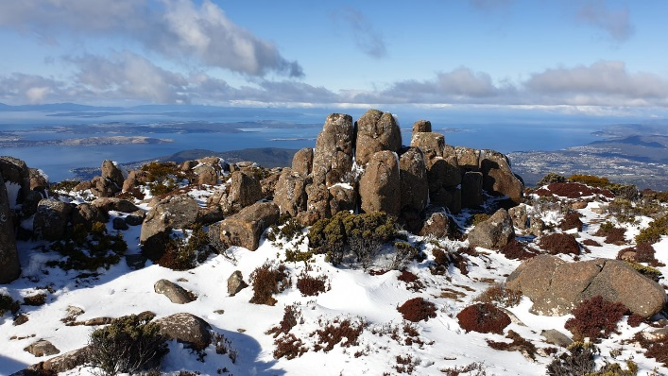
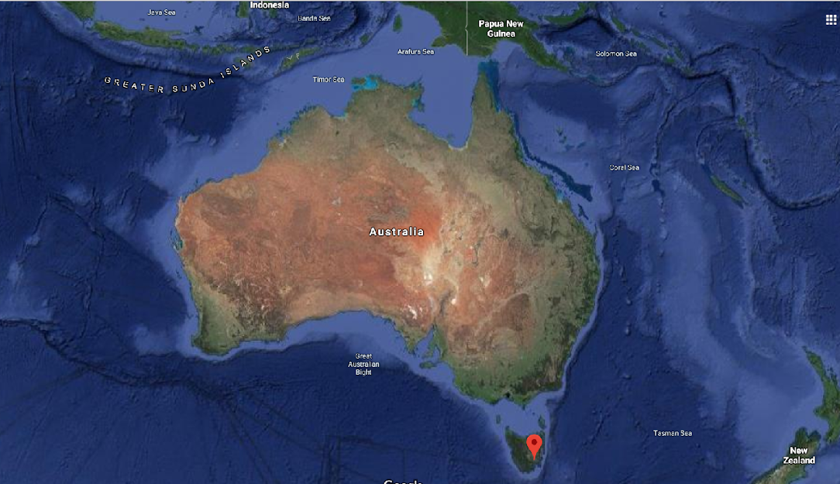


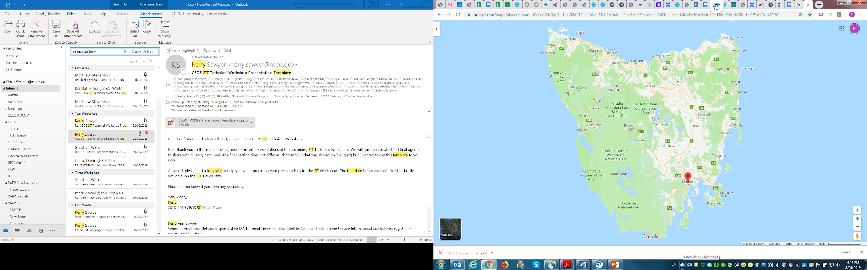
SIT-35 in Hobart, Australia
SIT-35: 25th and 26th March 2020 (with side meetings on Tuesday 24th March)
CSIRO & GA invite you to join us and experience Hobart, the capital of the Australian island state of Tasmania …
http://ceos.org/meetings/sit-35
A unique Australian place where
you can walk through snow* while
contemplating at ocean views !
*won’t be guaranteed in March though
CEOS SIT-35, Hobart

Slide 11
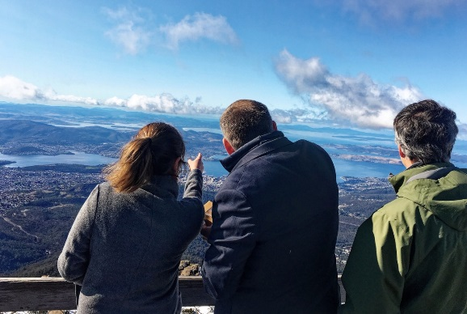
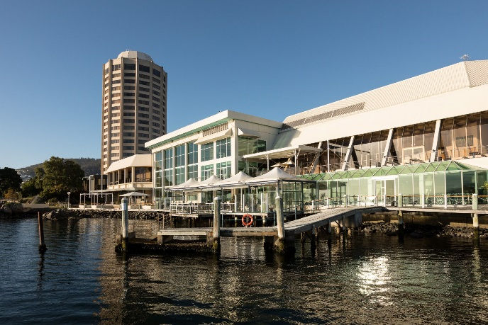
Main Venue
We have been scoping out venues….
For our next SIT meeting,
and the winner is….
WREST POINT Hotel
Fulfils our meeting’s requirements
Conveniently located on waterfront with great mountain and ocean views (only 5-10 min drive from the town centre)
Offers various accommodation room options, with a special discounted rate until 31 Jan 2020: more info soon
  a number of rooms (with different types) at discounted rates, available for direct booking (a link will be sent shortly after the Plenary)
+ several dining options onsite

Slide 12
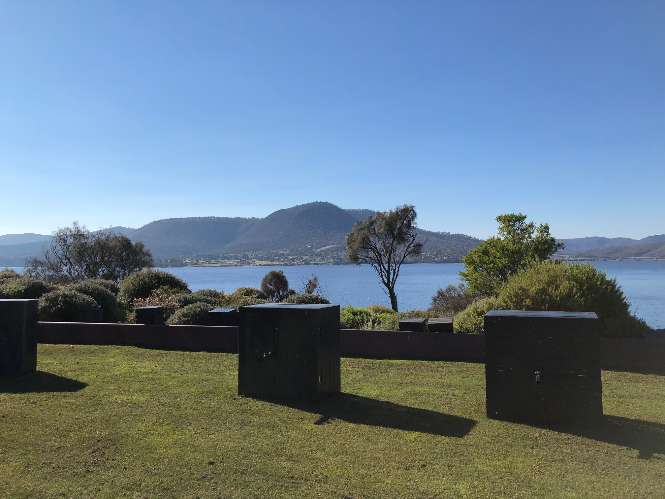


Don’t forget : Tassie
has a lot to offer
Monday 23 & Friday 27/3: free to explore, in or around Hobart such as:
MONA (Museum of Old and New Art) - a must see!
Mount Wellington
Hastings Caves and thermal hot springs
Mount Field National Park and Russell Falls
Port Arthur
Cascades Brewery co
Salamanca Markets
Vineyards
Bruny Island
Field trips and excursions options are being discussed – we’ll be happy to help you organise something so you make the most of your trip Down Under…. and even stay longer to explore the rest of the island!

