Slide 1

Report: CEOS Missions, Instruments and Measurements Database
Committee on Earth Observation Satellites
Ivan Petiteville, ESA
CEOS Plenary 2019
Agenda Item #6.1
Ha Noi, Viet Nam
14 – 16 October 2019

Slide 2
Summary
MIM remains a key ‘connective tissue’ across the CEOS community
2019 Survey has been completed – thanks to all agency contacts who responded
Traffic update approaching 1,000,000 pageviews since 2009
New and coming enhancements to the MIM website:
  Upstream: launch activity using NORAD and COSPAR tracking info
  Downstream: links data WGISS OpenSearch and Featured Datasets
  New Twitter account: @EOHandbook
  MIM API remains in work
Cross support provided to OSCAR over the past few years continues
  Provided past DB copies (2019 update copy forthcoming)
  Shared mapping of MIM to OSCAR for comparison, coordination, and efficiency

Slide 3
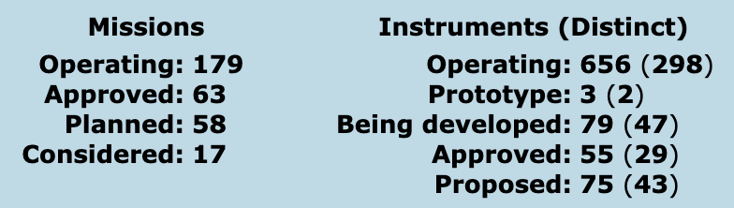
MIM Survey 2019 - Results
“The database currently features details of 317 Earth observing satellite missions and 868 instruments (419 distinct instruments, some being repeats), which are currently operating or planned for launch in the next 15 years - funded and operated by around 30 CEOS space agencies worldwide.”
28 of 38 agencies surveyed responded
  Missing: AEM (Mexico), AGEOS (Gabon), CDTI (Spain), GISTDA (Thailand), NASRDA (Nigeria), NIER (South Korea), NRSCC / CAST / CNSA (China), NSAU (Ukraine), NSMC / CMA (China), UKSA (UK)
15 new and 181 updated mission records
38 new and 182 updated instrument records
40 new instrument-measurement mappings

Slide 4

MIM Survey – Annual Effort
Circa 2008
Survey Team annual FTE effort: ~500 man.hours or 12 man.weeks
  Sustained annual effort
  Builds on 11 years of effort since the first version went online in October 2008
Approximately 30 agency points of contact putting in a variable amount of effort depending on agency size
  Some agencies are simple
  Some agencies require coordination with 10’s of mission contacts to gather technical details
  Estimate 30 x 4h (average) = ~120 hours or ~3 weeks FTE
Annual effort of at least 15 weeks FTE for CEOS Agencies

Slide 5
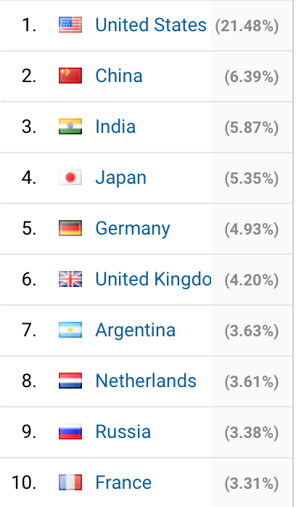
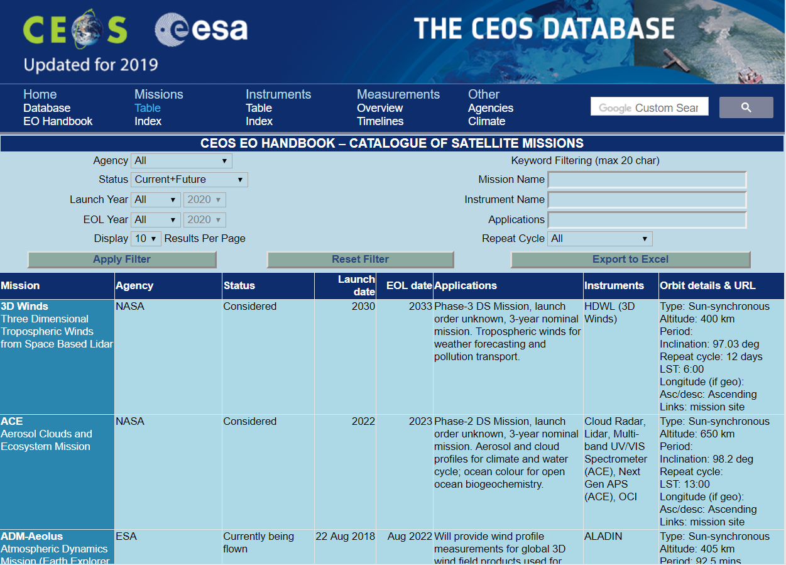



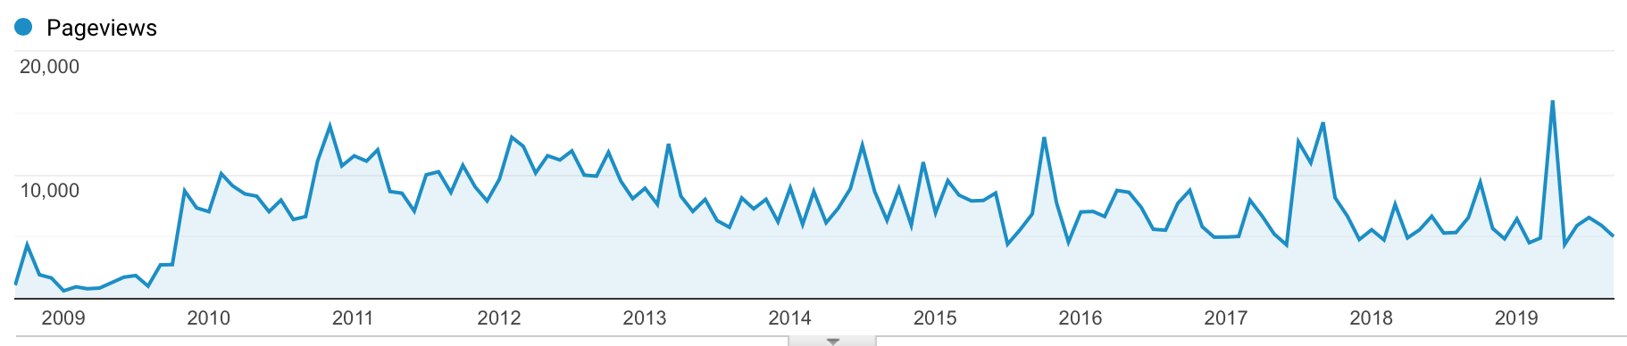
Traffic Update
Traffic (Since September 2018)
  15,834 visitors (MIM 59%, EOHB 41%)
  110,079 pageviews (MIM 85%, EOHB 15%)
Content Consumption (approx. breakdown)
  Missions: 44%
  Instruments: 33%
  Measurements: 8%
  Timelines: 5%
  Other: 10%
Mobile Device traffic up from 3.5% to 11% year-on-year
Approaching 1,000,000 pageviews at database.eohandbook.com since 2009!
(monthly)

Slide 6
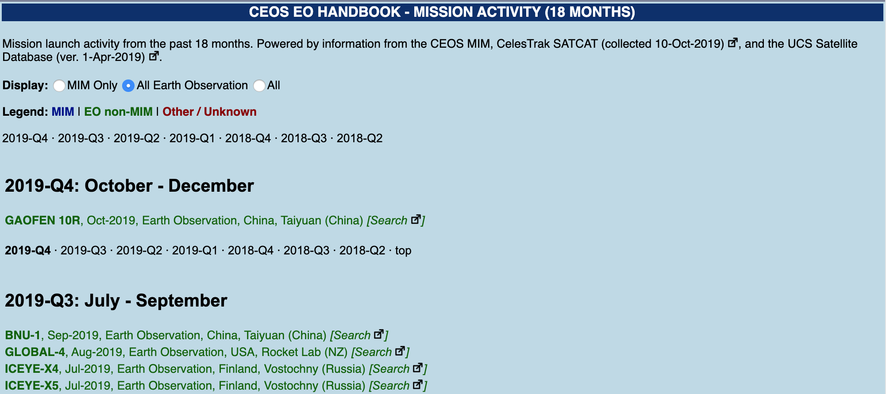
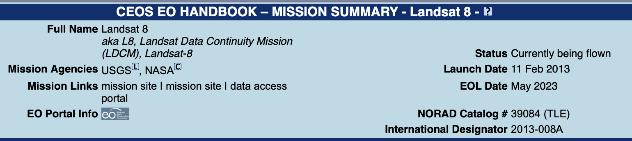
Upstream - Launch Activity
Motivated by desire to be comprehensive (e.g. new EO capabilities)
Leveraging NORAD, COSPAR and SATCAT tracking information

Slide 7
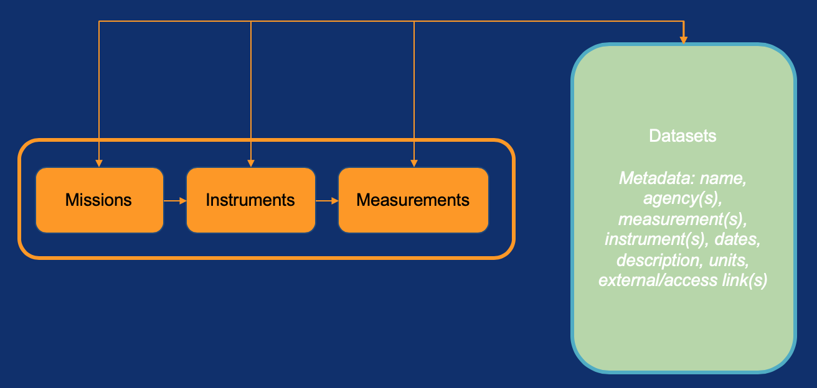
Downstream - Datasets
Desire to provide MIM users with visibility into datasets created by missions

Slide 8
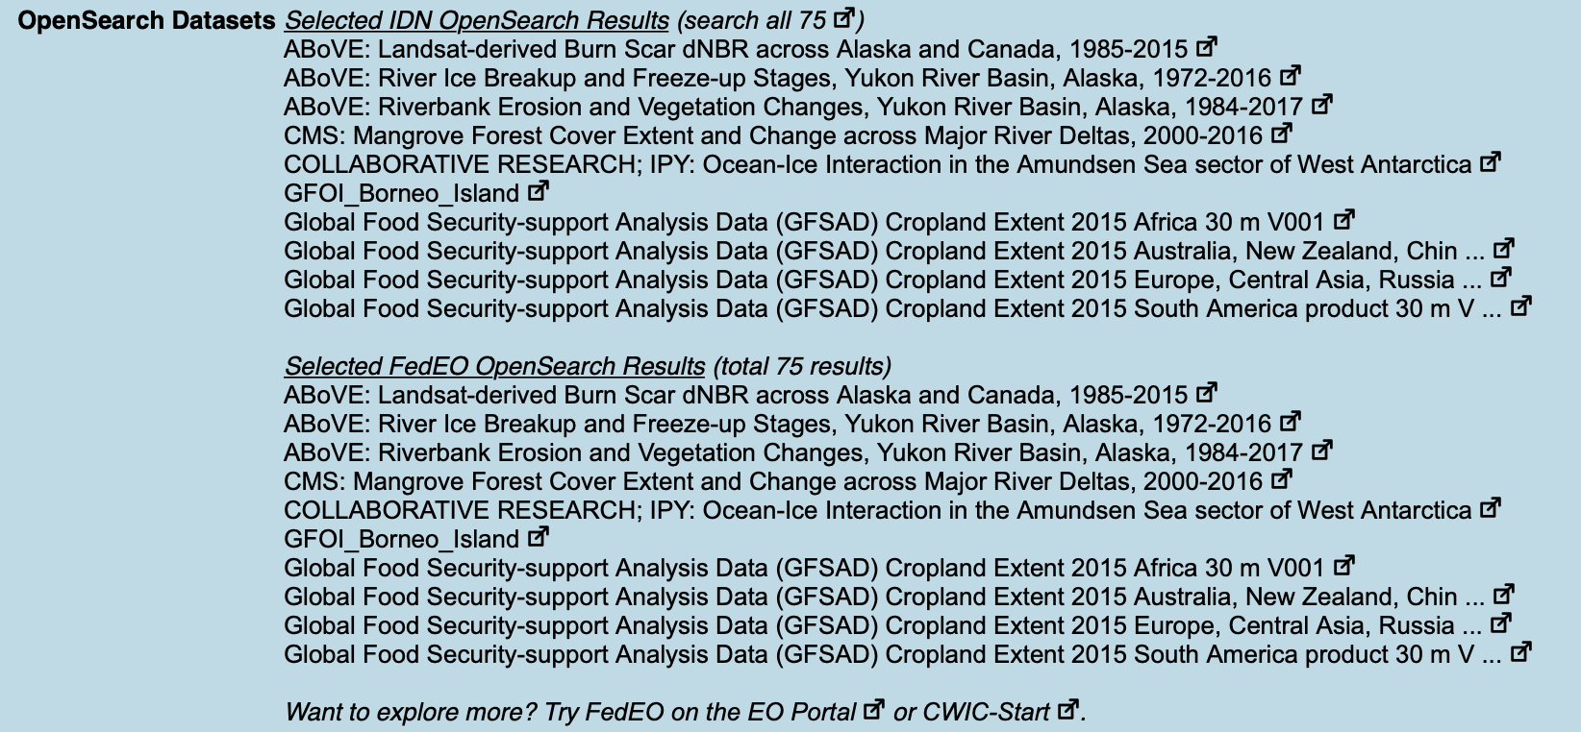
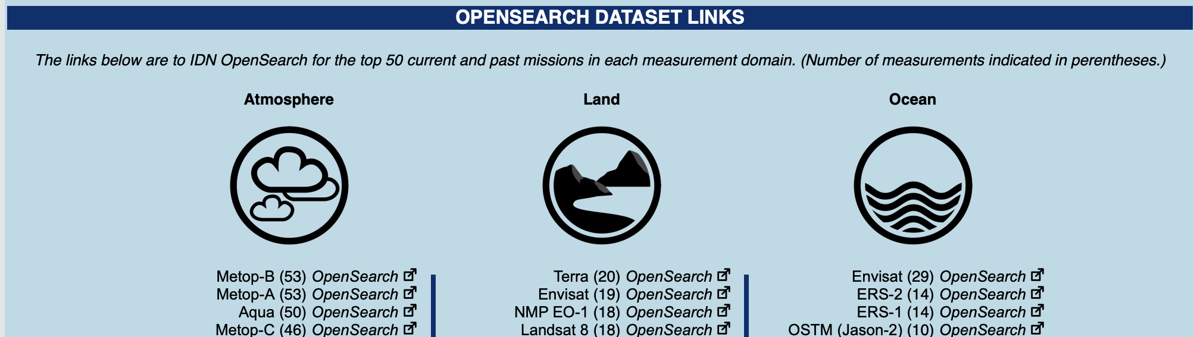
WGISS OpenSearch Integration
Access to all CEOS Agencies’ Catalogs
36,000+ OpenSearch dataset records

Slide 9
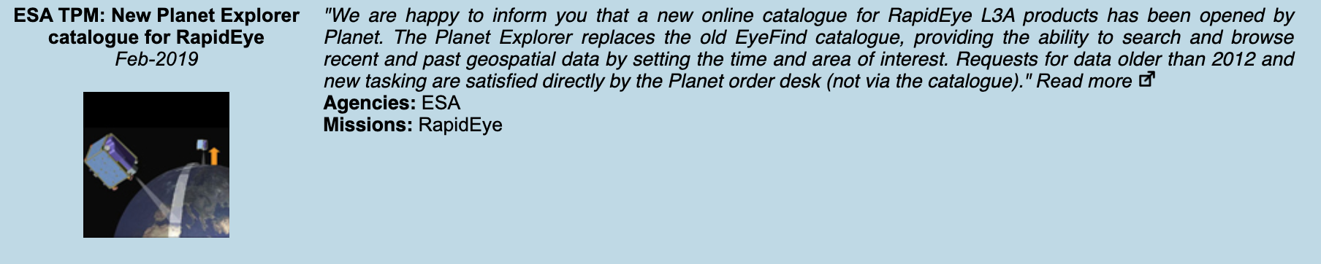
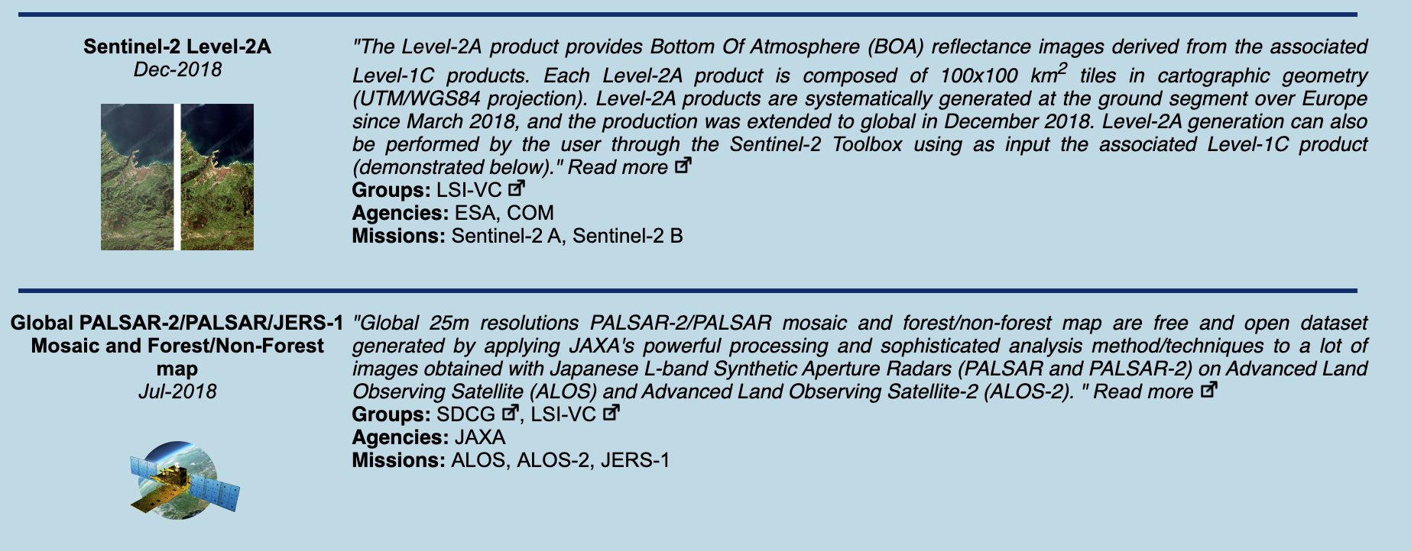

Featured Datasets
Agencies encouraged to nominate datasets!
Intention to add as suggested/nominated datasets arise
Highlight ARD, datasets nominated by VCs, WGs, AHTs
Capability may be expanded based on uptake and utility
9

Slide 10

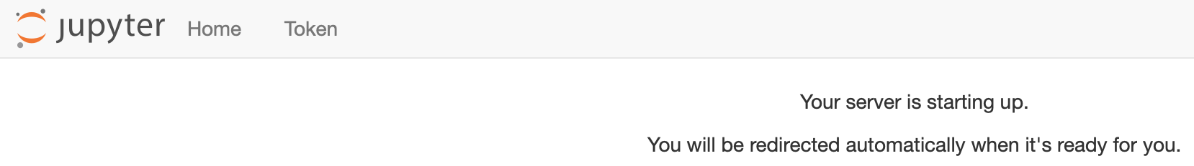
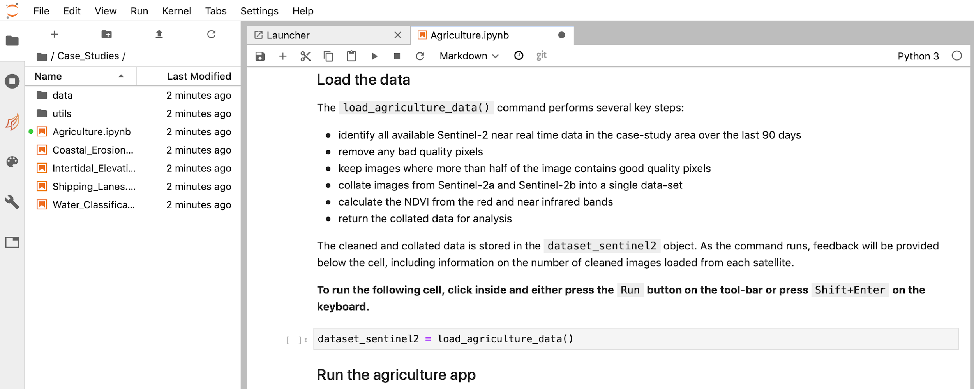

Links to Exploitation Platforms
Working to direct users to exploitation tools where possible…
10

Slide 11
Cross Support: OSCAR, ECVI and GCOS
Multiple past efforts to coordinate and support OSCAR require. updates
  Have sent out OSCAR requirements updated requests with the annual MIM survey several times in the past 10 years
  Level of detail is much higher than the MIM survey request
OSCAR requirements level of detail beyond the effort tolerance of CEOS agency MIM contacts and is not sustainable for annual updates
Ongoing support provided by MIM team to OSCAR and ECV Inventory Team
  MIM-OSCAR mapping developed by MIM team and shared
  Annual copies of the full MIM Database shared but CEOS inputs not properly reflected into OSCAR
  Expect to continue for 2019 and beyond (e.g. API), though generally not reciprocated despite past requests to share back
CEOS MIM team will continue with current level of support in 2020 onwards.
GCOS ECVs and measurements with OSCAR are aligned → MIM will look what needs to be done to ensure the same consistency.

Slide 12
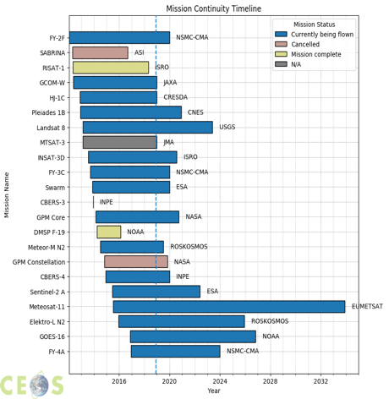
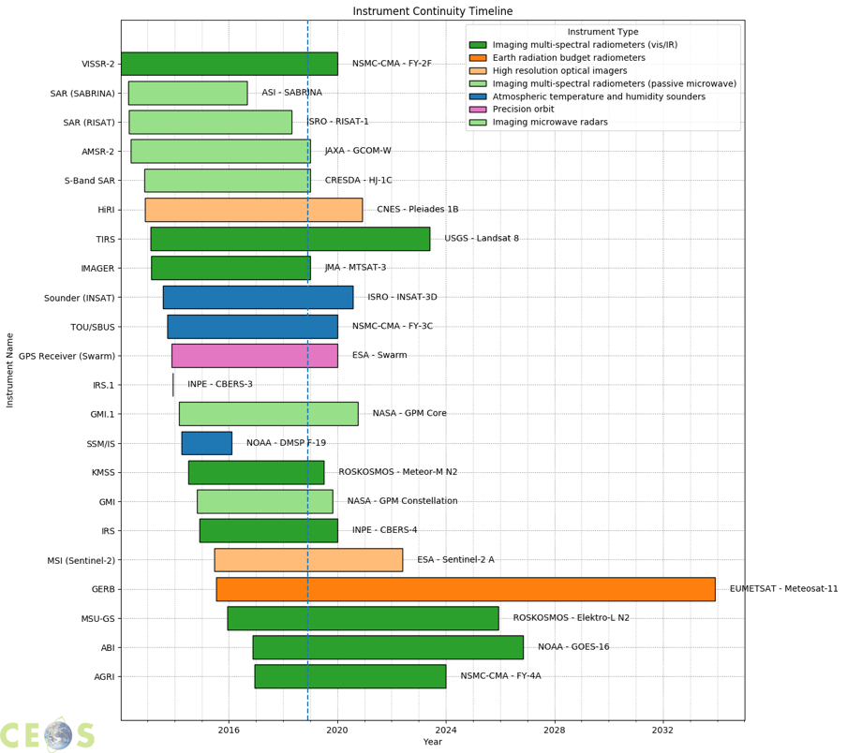
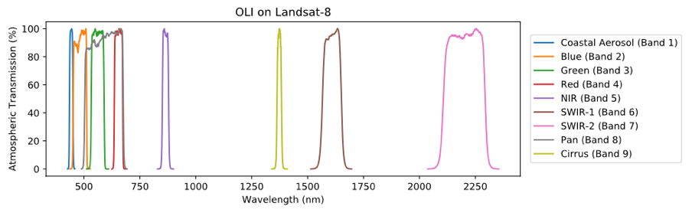
2019 Work Remaining - API
API
  Pilot version created 2018 with successful demo products (ex. below)
  Clear value articulated by several CEOS communities/groups: LSI-VC, CEOS SEO, ECV Inventory, WGISS Services
  Progress on two fronts:
    with a prototype offering from Systems Engineering Office
    with opening a limited beta test program

Slide 13
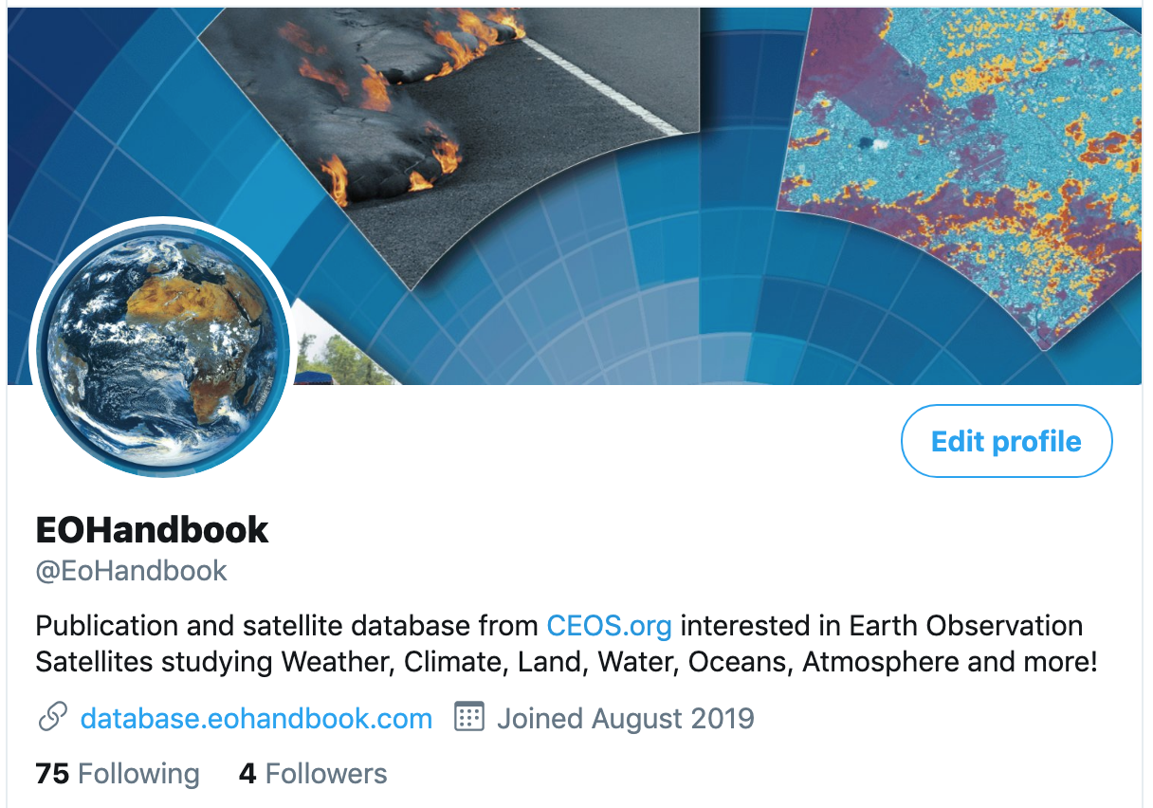
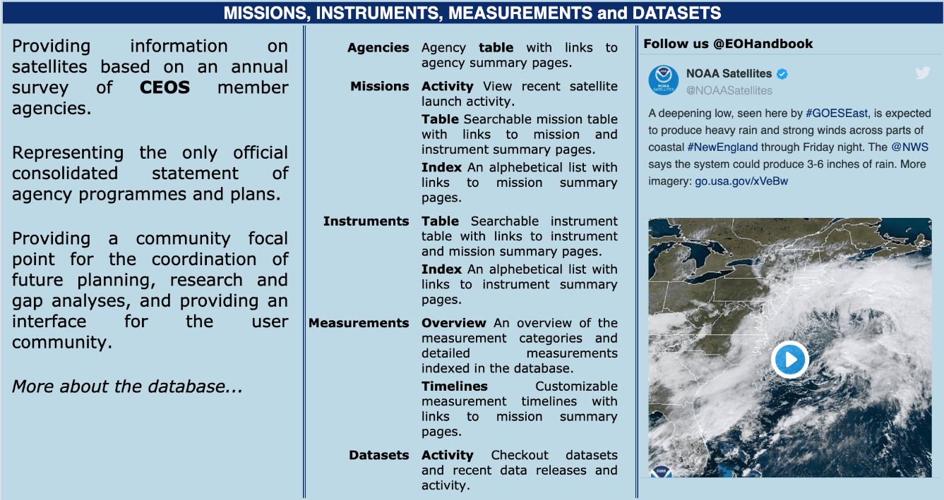
2019 Work Remaining - Social Media
Twitter created new handle @EOHandbook
  Plan to use to add fresh content to the website
  Plan to use for promotional purposes – how to engage CEOS and Agency social media teams?

Slide 14
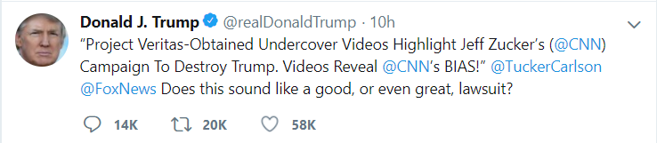

Questions?
Follow us @EOHandbook !
THANK YOU ….
CEOS MIM @EOHandbook could be a very very very good tool
but it contains FAKE news from CEOS @CEOSdotORG .
I cannot find ….. TrumpSat-1

