Slide 1

Virtual Constellations Report from the SIT Chair
Committee on Earth Observation Satellites
Steve Volz, 2018-2019 CEOS SIT Chair
National Oceanic and Atmospheric Administration (NOAA)
CEOS Plenary 2019
Agenda Item #5.7
Ha Noi, Viet Nam
14 – 16 October 2019

Slide 2
Overview
Productivity, Activities, and Accomplishments
  Year in (short) Review
  Leadership Changes
  Summary of Virtual Constellation Key Highlights
  Close-out of LEO-GEO
Approach for CEOS Coastal Observations and Applications Study Team (COAST)
  FOR DECISION
Virtual Constellation Leadership Succession
  FOR ENDORSEMENT

Slide 3
SIT Chair 2018-2019 Priorities

Slide 4
SIT Chair 2018-2019 Priorities
Ensure the efficient execution of existing SIT responsibilities as described in the SIT Terms of Reference, including addressing Working Group and Virtual Constellation (VC) continuity, sustainability, and outputs, including:
  Undertaking gap analyses for each VC, to support ongoing and likely upcoming strategic Agency observatory decisions;
  Seeking observations from VCs and WGs on best practices and possible modifications to existing practices.
Enhance the utility of new observations from next generation of geostationary satellites and exploring development of LEO/GEO combination products and data processing capabilities.
Improve and clarify CEOS relationships with CGMS, GEO, and to a lesser degree WMO, by identifying coordinated activities and, where appropriate, holistic interaction among CEOS, CGMS, GEO, and WMO, emphasizing the unique values of each.
  Identify and focus on areas of appropriate and productive collaboration.
  Take stock of trends and future directions so that CEOS can best serve the needs of its Agencies and execute its role most productively alongside CGMS, GEO, and WMO
  Identify appropriate and productive engagement approaches with commercial sector in the process.
Support initiatives undertaken by CEOS Chairs in 2018 and 2019.
Presented at SIT-32, 2017 SIT TW, 2017 CEOS Plenary, SIT-33, and SIT-34

Slide 5
Strategic Directions and Partnerships for CEOS Discussion Paper
21 March 2018
  Ensuring tangible outcomes from, and sustainable commitment to, our VCs and WGs
  Maximizing the value of VC and WG output for CEOS objectives (e.g., ECVs and SDGs) and for individual CEOS Agency objectives
  Ensuring the necessary support for our existing thematic teams to flourish and to deliver
  Clearer overall CEOS observing system assessment and desired observing strategies – and known contribution from each CEOS Entity
  AHTs to reflect and report on group trajectory and lifecycle, taking into account the outlook and evolution of long-term sustained operations and expectations levied on CEOS and Member Agency participation.
Presented at SIT-33, 2018 CEOS Plenary, and SIT-34

Slide 6
Concept Paper for Restructuring CEOS Virtual Constellations and Creation of New Working Group – March 2019
Propose for discussion and consideration: a restructure of the CEOS Virtual Constellations:
  Merge the four current ocean-related VCs into a single Ocean VC focused on creating an integrated and coordinated multi-variable picture of oceans.
  Merge AC-VC and P-VC into an Atmosphere VC.
  LSI-VC already follows this model, looking at a “family” of variables for integrated picture of the land, and is proposed to become the Land VC.
Propose a VC leadership rotation cycle.
Propose a two-year initiation cycle for standing up new AHTs. The two-year initial cycle will allow for defining the objective, evaluating the merit and value of the objectives, and determining the appropriate path forward for continued support within CEOS. All other aspects of the AHT reporting process will remain, including annual reporting at Plenary.
Propose for discussion and consideration: Establish a new Working Group focused on Information Provision, to coordinate all activities related to user outreach and applications (e.g., forests, agriculture, freshwater, land degradation, urban, biodiversity, and more in the future).
To be discussed in 5.8
Presented at SIT-34 and 2019 SIT TW
To be discussed in 5.9
To be discussed in 5.8

Slide 7
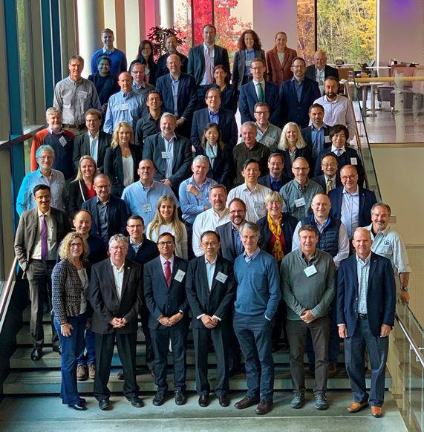
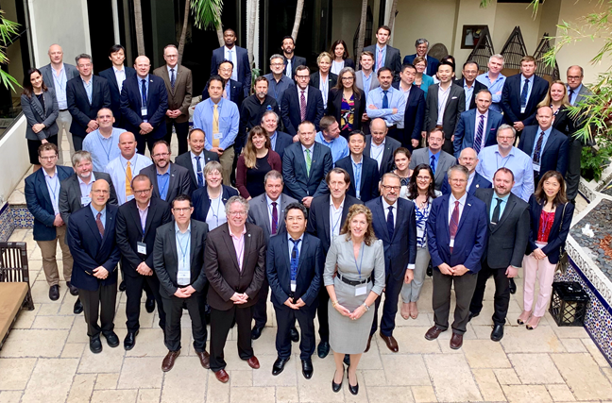
Productivity, Activities, and Accomplishments for 2019

Slide 8
Year in Review
SIT Chair-VC/WG/AHT Tag-ups (15 = 100%)
  February/March 2019
SIT-34
  April 2019
SIT Chair-VC/WG/AHT Tag-ups (17* = 100%)
  July/August 2019
2019 SIT Technical Workshop and VC/WG/AHT Working Day
  September 2019
*Plus COVERAGE and SEO

Slide 9
SIT-34 Objective
Virtual Constellations
Critical assessment results of the Virtual Constellations (VCs), including:
Ongoing activities, tangible outputs, Constellation management, continuity, and VC proposals around leadership rotation (Plenary Action CEOS-32-12).
The results may lead to recommended changes to how CEOS structures its VC activities, engagement of CEOS through the VCs with partners such as GEO and CGMS, and how to evolve and take the next step towards greater interoperability between datasets from multiple satellites and agencies.
Identify areas of concern for further attention, action, and follow-up at SIT Technical Workshop and CEOS Plenary 2019, and into the next CEOS SIT Chair Term.

Slide 10
SIT-34 Objective
CEOS Governance, Processes, and Organization
Drafting language to support potential changes to CEOS Governance, Processes, and organization resulting from discussions on VCs and AHTs and the formal processes CEOS will mandate for them.
Perform a health update on assessment of what is working well within CEOS and reflect upon CEOS internal issues such as structure, efficiency, number of entities and activities, resource allocation;
CEOS external issues such as communication, interaction with key stakeholders;
Strategy for global priorities like caring for our planet, SDGs, carbon, etc.
Consider proposals for further discussion at 2019 SIT TW, and possible recommendation for decision(s) at 33rd CEOS Plenary (Plenary Action CEOS-32-15).

Slide 11
Virtual Constellations
Current Leadership and Changes
Atmospheric Composition Virtual Constellation (AC-VC)
Ben Veihelmann/ESA Jay Al-Saadi/NASA
Land Surface Imaging Virtual Constellation (LSI-VC)
Steve Labahn/USGS Adam Lewis/GA
Susanne Mecklenburg/ESA Zoltan Szantoi/EC
Ocean Colour Radiometry Virtual Constellation (OCR-VC)
Ewa Kwiatkowska/EUMETSAT Marie-Helene Rio/ESA
Ocean Surface Topography Virtual Constellation (OST-VC)
Remko Scharroo/EUMETSAT Annick Sylvestre-Baron/CNES
Ocean Surface Vector Wind Virtual Constellation (OSVW-VC)
Stefanie Linow/EUMETSAT Paul Chang/NOAA
Rashmi Sharma/ISRO Raj Kumar/ISRO
Precipitation Virtual Constellation (P-VC)
Gail Jackson-Skofronick/NASA Riko Oki/JAXA
Sea Surface Temperature Virtual Constellation (SST-VC)
Anne O’Carroll/EUMETSAT Ed Armstrong/NASA
Ken Casey/NOAA
Red Text = Co-Lead Departure Green Text = New Co-Lead

Slide 12
Atmospheric Composition Virtual Constellation (AC-VC)
CEOS Architecture for Monitoring Atmospheric CO₂ and CH₄ Concentrations is now published! ISBN, ISSN, and DOI numbers registered.
Greenhouse Gases Roadmap White Paper – discussed previously under 2.4
Air Quality Constellation Validation Needs and Recommendations – discussed previously under 5.6
  Focus on bringing new missions into Constellations (GEMS, TEMPO, Senintell-4)
  Forward-looking by including aerosols
Submitted peer-reviewed White Papers on intercomparisons of satellite total column zone
Propose a new deliverable on satellite-informed products for air quality associated with aerosol
  Motivated by SDG 3.4 – Human Health Mortality Goal
  White Paper or peer-reviewed journal article (Q4 2021)
AC-VC has the most diversity of measurements and is showing good progress in harmonizing the products and information
from this diversity
Work Plan Deliverables
Planned: 2
On-track: 1
Completed: 1

Slide 13
Land Surface Imaging
Virtual Constellation (LSI-VC)
CEOS Analysis Ready Data for Land (CARD4L) – discussed previously under 4.2
Key Outcomes from LSI-VC-8/SDCG-16/GEOGLAM Joint Meeting
  Initiated discussions around LSI-VC contributions to SIT Chair 2020-2021 CEOS ARD priorities
    CEOS-Industry ARD Workshop
    Connecting with WGCV and WGISS on various topics including CEOS Interoperability Terminology Report
  Joint session with WGClimate with goal of rebooting LSI-VC requirements and gap analysis
    LSI-VC plans to undertake two actions from the WGClimate Coordinated Action Plan -> LST CDRs and continuity
    Discussed biomass measurements as a priority across CEOS (SDCG, GHG, etc.) -> CARD4Lidar concept
  Planned integration of SDCG for GFOI and GEOGLAM AHWG as subgroups of LSI-VC
LSI-VC is working to merge new technologies and
measurements into established datasets, including
P-band SAR and LiDARs
CEOS-32-13 | LSI-VC to draft a plan forward for the proposed merger of SDCG for GFOI and the CEOS Ad Hoc Working Group on GEOGLAM into LSI-VC. This plan would address the discussions and concerns raised at the CEOS Plenary meeting. | SIT-34
Work Plan Deliverables
Planned: 7
On-track: 5
Completed: 2
New Technologies

Slide 14
Precipitation
Virtual Constellation (P-VC)
Precipitation is a key Earth system component and is cross-cutting to several VCs and WGs including, for example: Atmospheric Composition-VC; Disasters WG; Agriculture WG; and Freshwater activities.
  Because precipitation is a global variable and linked to many Earth systems, P-VC encourages discussions among the various VCs, WGs, Ad Hoc Teams, etc.
Other groups, mainly CGMS, also have a focus on precipitation, specifically the International Precipitation Working Group (IPWG)
  During the CEOS P-VC meeting in November we are inviting relevant IPWG co-chairs (past and present) to discuss potential synergies, recommendations, and joint activities.
P-VC is keeping aware of potential future precipitation observations such as NASA’s Decadal Survey’s Aerosols, Cloud, Convection and Precipitation (ACCP) Designated Observable
P-VC can help with identifying drought and flood land areas in support of SDG Target 15.3
Work Plan Deliverables
Planned: 3
On-track: 1
Completed: 2

Slide 15
Ocean Colour Radiometry Virtual Constellation (OCR-VC)
Climate
OCR is Essential Climate Variable defined by GCOS
OCR Climate Data Records contribution to the WGClimate ECV inventory
OCR-VC Deliverable VC-09
INSITU-OCR
Implementation of White Paper recommendations
Carbon
Aquatic Carbon is a major component of the Earth system with respect to carbon cycling and carbon sequestration
“Aquatic Carbon From Space” – planning for IOCCG activities and a journal special issue (carbon stocks, sources/sinks, fluxes; methods and uncertainties)
OCR-VC
New Technologies
Hyperspectral OCR
Geostationary OCR
Polarimetry, Lidar
Water Quality
OCR provides major EO variables for Water Quality applications
IOCCG report ‘Earth Observations in Support of Global Water Quality Monitoring’ coordinated with “CEOS Feasibility Study on Satellite Missions/Instruments Focused on Water Quality Measurements” in the frame of “CEOS Strategy for Water Observations from Space”
Implementation of INSITU-OCR White Paper is advancing and following a modular approach coordinated across the space agencies
  Advancements in vicarious calibration coordination and algorithm coordination
Planning for IOCCG/OCR-VC Aquatic Carbon from Space
journal special issue
Looking forward to integrate new technologies and measurements including LiDARs, hyperspectral, polar imagery and combined LEO/GEO observations
Work Plan Deliverables
Planned: 1
On-track: 1
Completed: 0
New Technologies

Slide 16
Ocean Surface Topography Virtual Constellation (OST-VC)
OST-VC contribution to the OceanObs ‘19 White Paper: Requirements for a Coastal Zone Observing System, Front. Mar. Sci., 6, 348, doi: 10.3389/fmars.2019.00348, 2019
Update of OST-VC User Requirements Document (URD) in 2020
  “Next 15 years of altimetry”, 2009: Constellation User Requirement Documents @ Assmanhausen OST-VC meeting
    Reference mission + complementing missions: nadir altimetry only (swath altimetry mentioned), structured the current constellation (reference mission Jason + SARAL/Sentinel-3/Hy-2A/Cryosat)
  Will include:
    Analysis of user needs (systematic + exploratory)
    Swath altimetry + nadir altimetry (combined)
    Multiple applications (mesoscale monitoring, polar oceans, long-term record for sea level rise)
    Links with other observables (e.g., SST and OC)
  Planned update of full CDR from TOPEX through Jason-3
    Jason-2 retired in October 2019
Work Plan Deliverables
Planned: 1
On-track: 1
Completed: 0

Slide 17
Ocean Surface Vector Wind Virtual Constellation (OSVW-VC)
Spaceborne scatterometers (C-, Ku-band) become standard to provide global ocean surface wind vector data
  Primarily ISRO, EUMETSAT, and CMA (although CMA data are not as available)
Other remote sensing techniques have demonstrated potential for retrieving ocean surface winds:
  Microwave radiometers – Multi-frequency, Polarimetric, L-band
  Synthetic Aperture Radar (SAR)
  GNSS-R
  HF radars (regional coverage but frequent temporal refresh)
OSVW looking at how to integrate these new measurement techniques with established data record
Future Plans
  Refreshed constellation assessment with a focus on users and applications
  A workshop to be planned by early 2020; include experts from the measurement and applications communities
  Expected outcome is a report coordinated with the IOVWST assessing observing system capabilities of ocean surface wind retrievals from the
  measurement and downstream applications perspectives
New Technologies
Work Plan Deliverables
Planned: 1
On-track: 1
Completed: 0

Slide 18
Sea Surface Temperature Virtual Constellation (SST-VC)
SST-VC continues to focus on narrow group of objectives, completing activities of the last few years and transitioning to new focus area. Membership is strong, with active participation and leadership rotations in place.
SST-VC contributions to the global observing architecture and national planning purposes
  Community White paper for OceanObs ‘19, “Observational needs of Sea Surface Temperature”, recently published: https://www.frontiersin.org/articles/10.3389/fmars.2019.00420/
  Constellation White paper (action VC-19)
  98 standardized GHRSST products, spanning 7.48 million CF/ACDD netCDF data files, 167 TB, from Sep 1981 – Aug 2019
White Paper on Next Generation SST Constellation
  Likely ready for distribution end of October/early November
  Virtual endorsement by Plenary (or SIT) requested for November
Increasing concern from SST community regarding increasing impact of Radio Frequency Interference (RFI) and 5G networks on the quality of Sea Surface Temperature retrievals and therefore downstream applications
  SST-VC/GHRSST are compiling an inventory
  of RFI impacts on SST products and applications
Work Plan Deliverables
Planned: 1
On-track: 1
Completed: 0

Slide 19
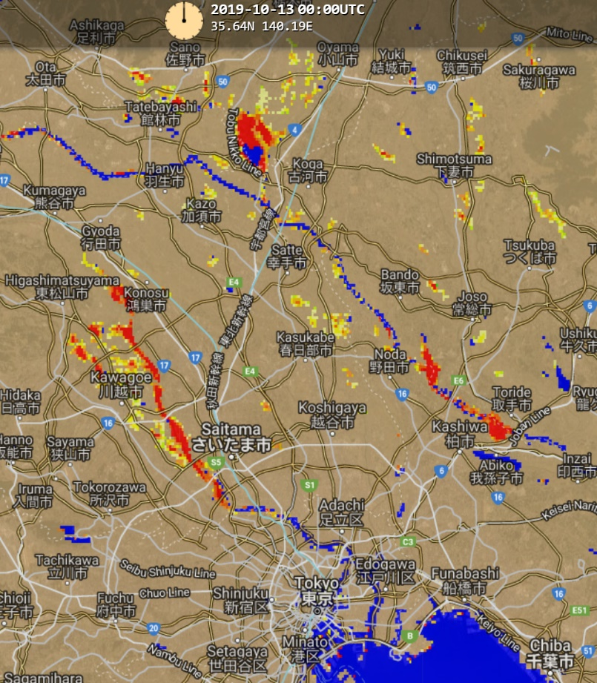
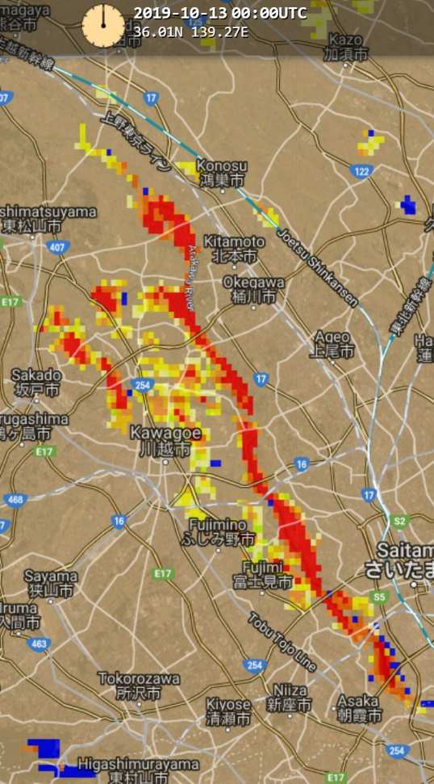
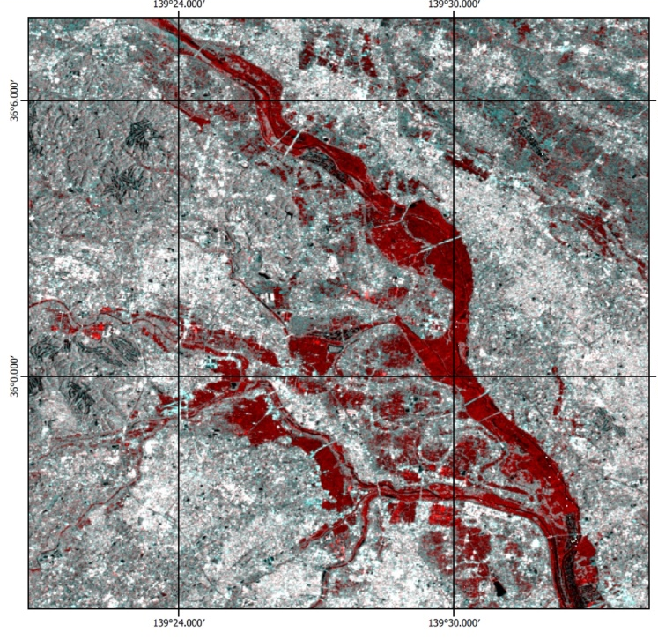
GEO-LEO Pilot
Recent example – Hagabis flooding - Japan
Himawari and JPSS Integrated Flood Map – October 12, 2019 - Sunday
Sentinel-1 Flood Map
GEO – LEO Flood Pilot demonstrated the use of operational weather satellites for “rapid” large areal flood mapping (clear conditions) – and will be extended to include other critical assets, for example higher resolution Sentinel 1 SAR as part of a Flood “Constellation” Scenario pilot to be developed within WGDisasters.

Slide 20
Trajectory for GEO-LEO Initiative
NOAA SIT Chair Team activity demonstrated utility and significant interest.
SIT Chair does not recommend continuation of a focused activity for LEO-GEO coordination. Continuing work will be done within existing CEOS Structures and Processes.
WGDisasters is working on next steps toward implementing the need for a GEO-LEO-SAR Flood-Risk Pilot Project targeting flood risk areas such as in coastal and urban areas.
  Seeks to demonstrate the potential of new products made possible by (1) sharing data, (2) integrating operational capabilities, and (3) transitioning research quickly to application while building the capacity for sustainable resilience.
  NASA and NOAA are taking the lead to scope a proposal with support expressed by CNES, ISRO, ASI, EU, ESA, DLR and others to prepare a plan for review at the next SIT and welcomes broad CEOS and CGMS community collaboration.
WGCapD, WGISS, WGCV, and LSI-VC may have future applications, and we will work with them through relevant SMEs in those groups

Slide 21
CEOS Approach for Coastal Observations and Applications Study Team (COAST) – A Proposal
Refer to CEOS_COAST_Proposal_October_2019_v2
FOR DECISION

Slide 22
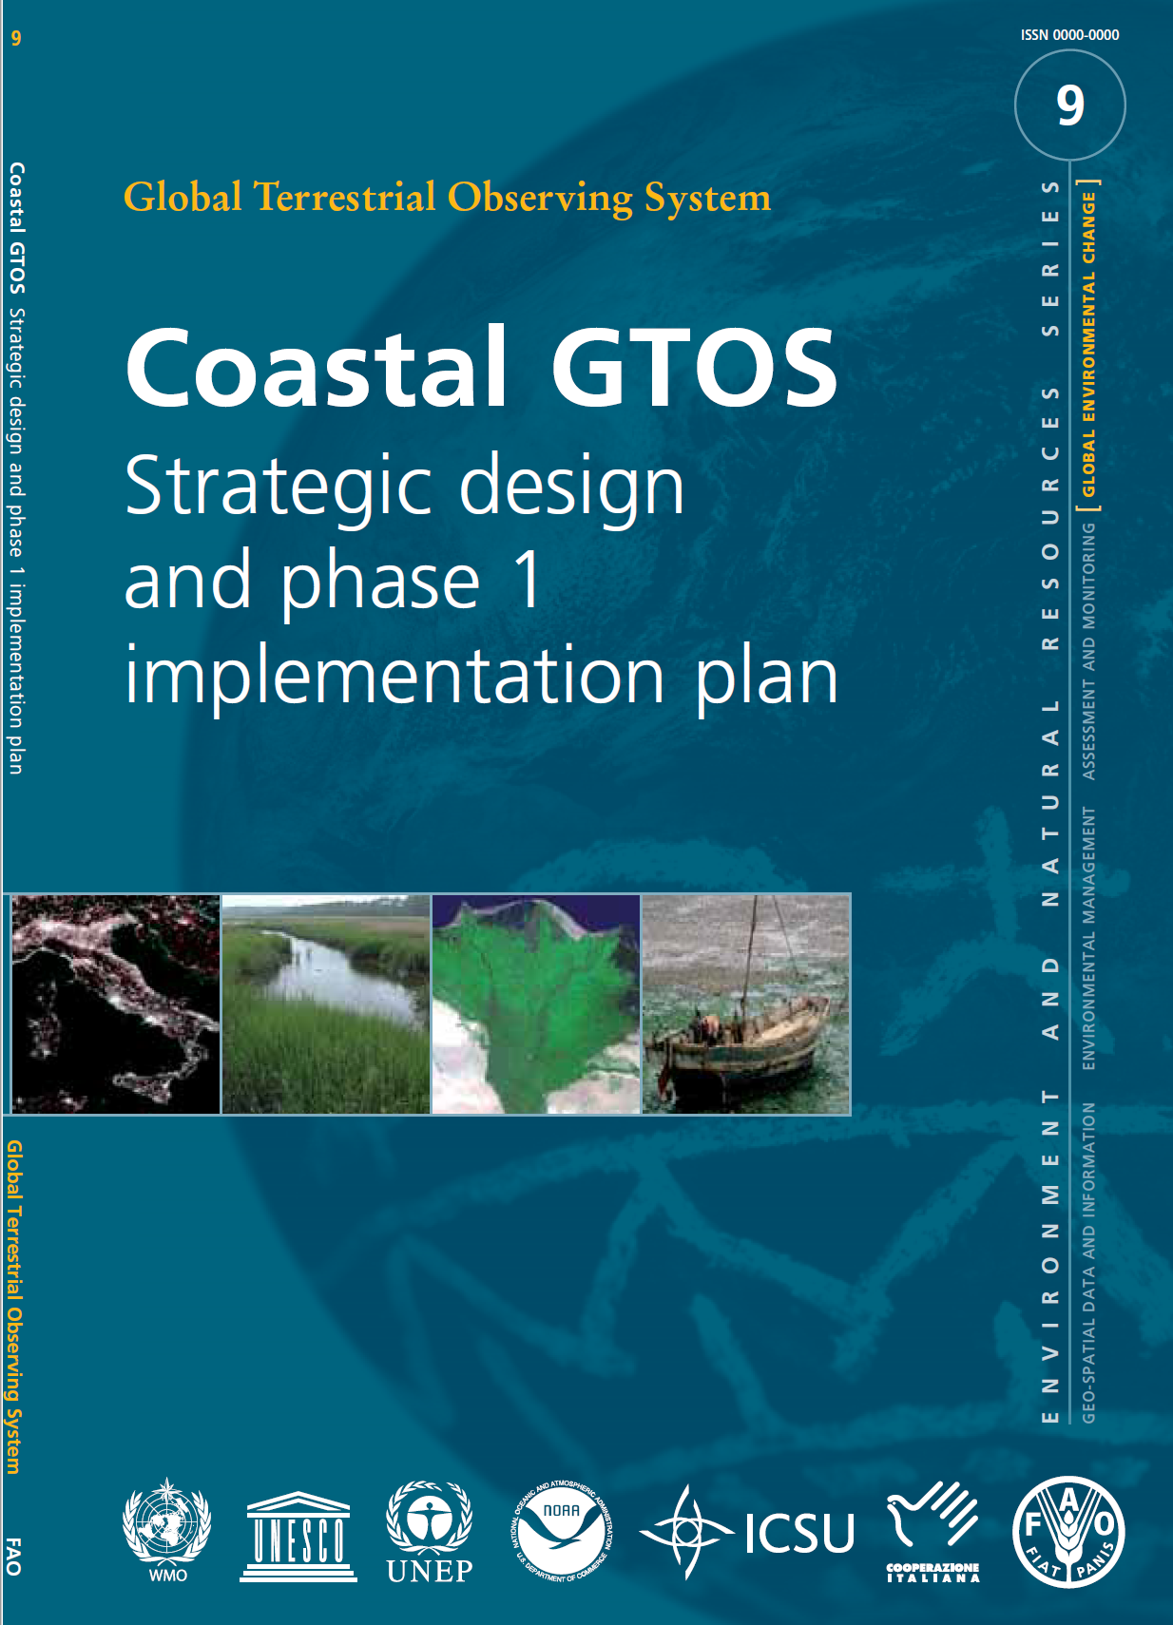
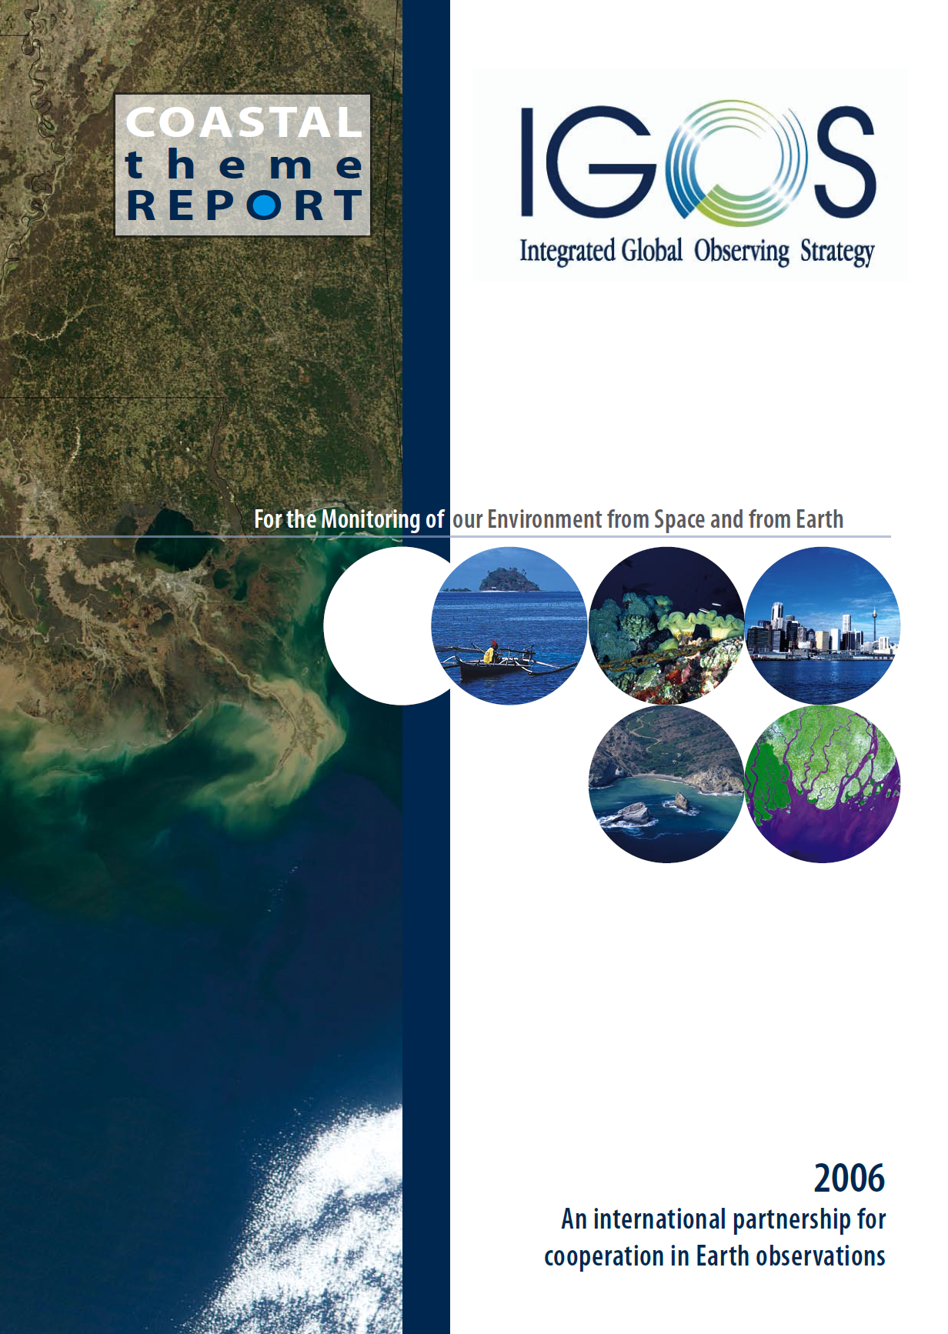
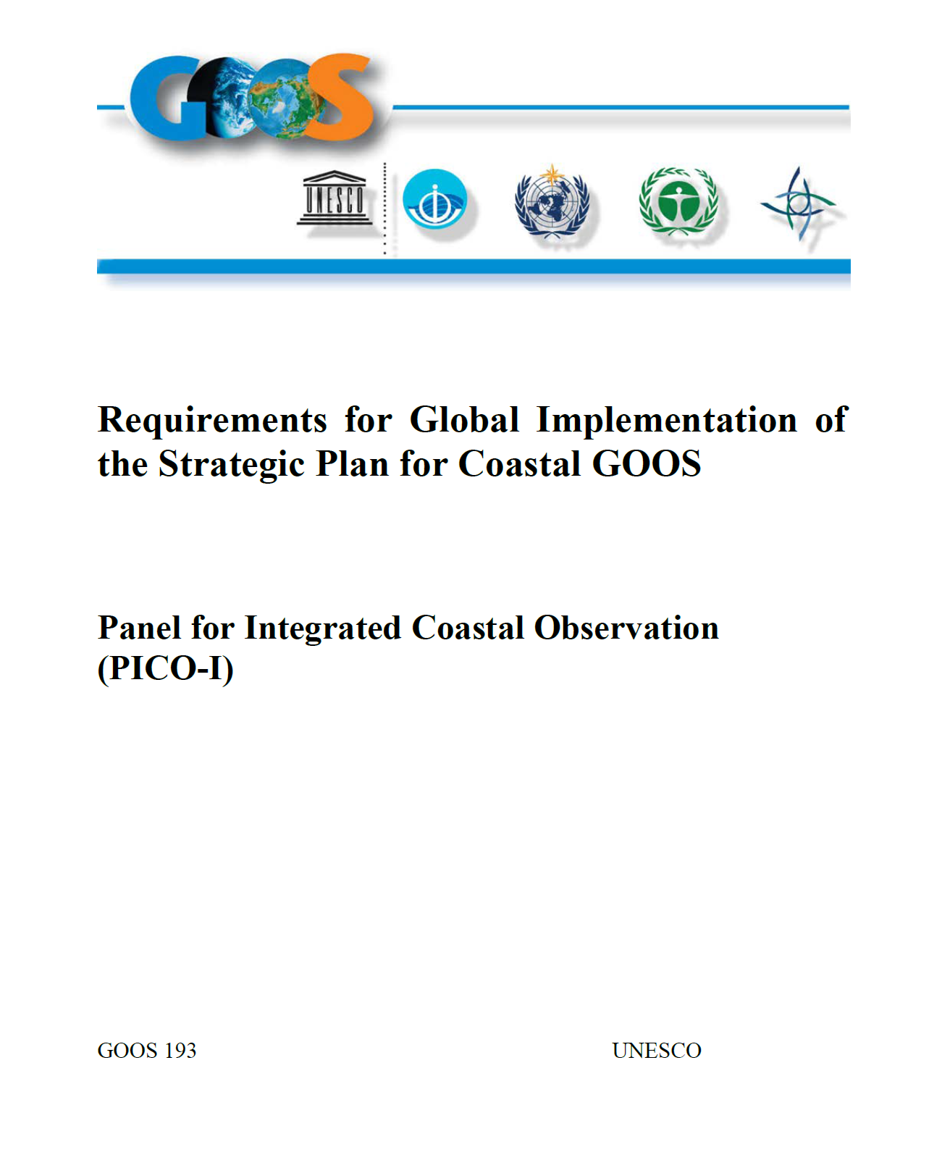
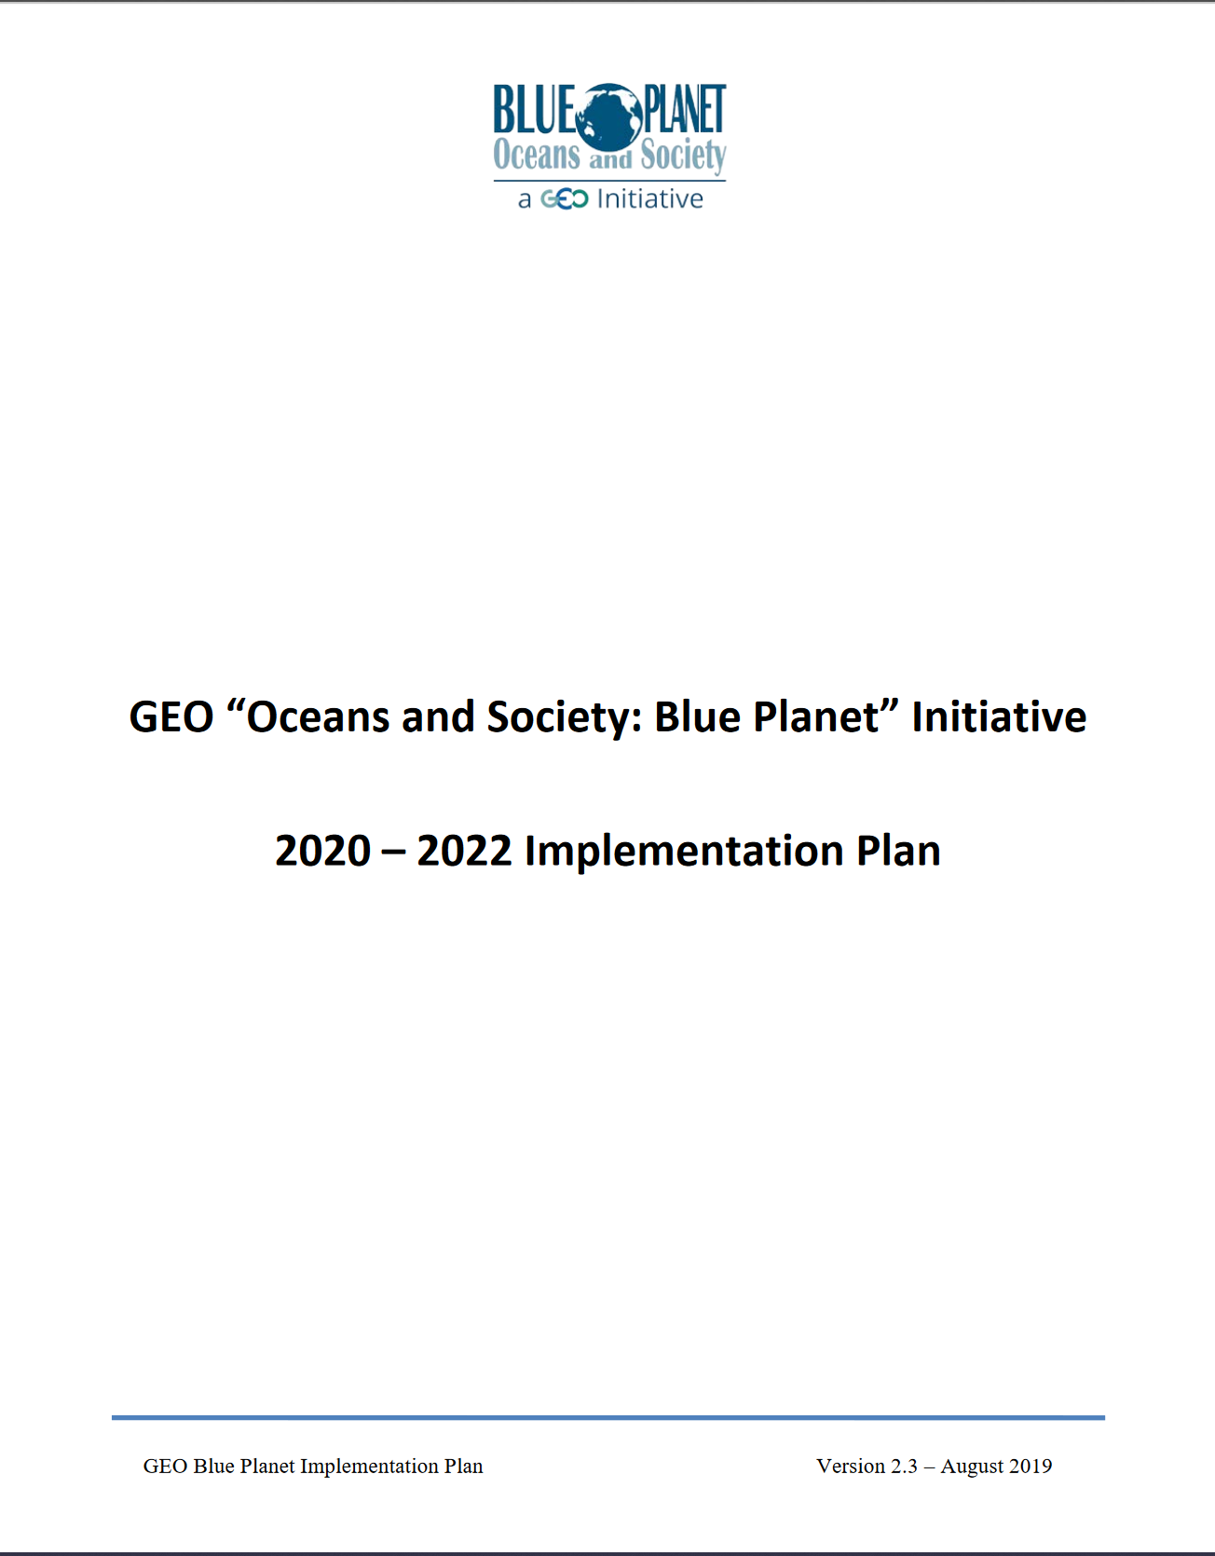
Previous Coastal/Ocean Observing Plans
Coastal GTOS, 2005
e.g., deltaic systems;
urbanization and changes
in coastal land use/cover
IGOS Coastal Theme, 2006
e.g., land-sea interface;
coastal populations &
ecosystems at risk
Coastal GOOS, 2012
eutrophication/hypoxia;
pathogens; HABs; benthic
habitats; flooding; acidification,
fisheries; integration
GEO Blue Planet, 2019
e.g., island flooding, hazards,
marine debris, aquatic diseases,
coral reefs, fisheries

Slide 23
How Should CEOS Engage and Coordinate on Coastal Theme?
How should CEOS engage internally in terms of identifying and implementing priority coastal activities and initiatives?
Internal CEOS Activities and Initiatives
  Ocean/coasts still an emerging area for CEOS; mostly VCs to date
  Increasing interest and work across CEOS entities
    GEO/LEO/SAR Integration – flooding, water quality/hazards
    WGDisasters; potential WGCV, WGCapD, WGISS engagement
    CEOS ARD potential coastal pilot to complement existing work
    COVERAGE; SDGs (SDG 6 and 14 potential); role of VCs
How should CEOS engage externally in terms of supporting international community activities relative to coastal and ocean observations and applications?
External Partner Activities and Initiatives (Many international groups, initiatives dealing with coastal and ocean observations applications)
  GEO Initiatives: Blue Planet, AquaWatch, Wetlands
  Sustainable Development Goals: SDG 6, SDG 14
  OceanObs’19 Follow-up: IOC/GOOS et al.
  United Nations Decade of Ocean Science for Sustainable Development (2021-2030)

Slide 24
How Should CEOS Engage and Coordinate on Coastal Theme?
Internal CEOS Activities and Initiatives
  Ocean/coasts still an emerging area for CEOS; mostly VCs to date
  Increasing interest and work across CEOS entities
    GEO/LEO/SAR Integration – flooding, water quality/hazards
    WGDisasters; potential WGCV, WGCapD, WGISS engagement
    CEOS ARD potential coastal pilot to complement existing work
    COVERAGE; SDGs (SDG 6 and 14 potential); role of VCs
External Partner Activities and Initiatives (Many international groups, initiatives dealing with coastal and ocean observations applications)
  GEO Initiatives: Blue Planet, AquaWatch, Wetlands
  Sustainable Development Goals: SDG 6, SDG 14
  OceanObs’19 Follow-up: IOC/GOOS et al.
  United Nations Decade of Ocean Science for Sustainable Development (2021-2030)

Slide 25
2019 SIT Technical Workshop Oceans and Coastal Outcomes
Suggestion to form a Study Team to do a scoping assessment of CEOS contributions to Coastal observations
  Need to define a specific objective or regional scope from multiple VCs
  Key CEOS objectives: moving from multi-sensor observations through the value chain to extract information which users can exploit
Engaging end users to articulate needs that EO could address is key, even if initially limited to targeted examples
  Current interface with Oceans end users is complicated and scattered across multiple international science organizations and VCs
Land, atmosphere, and precipitation could also be key contributors to the coastal zone focus

Slide 26
Requests of Plenary
Decision by Plenary for the creation of the CEOS Coastal Observations and Applications Study Team (CEOS-COAST) (not a formal AHT)
  Initial term of 12 months
  Initial work plan for 2019-2020 to be submitted by Dec 2019 for virtual endorsement by SIT
  Progress report at SIT-35
Interested Agencies to identify participants with appropriate expertise and interest to participate in CEOS-COAST
  NOAA will lead, with others, and will draft the initial work plan (P. DiGiacomo)

Slide 27
CEOS Virtual Constellation Leadership Succession Proposal and Language Changes
Refer to CEOS Governance and Processes rev1 2019 and Virtual Constellations Process Paper rev 1 2019
FOR ENDORSEMENT

Slide 28
Actions – VC Leadership (Rotation) Succession
CEOS-32-12 | Virtual Constellation Co-Leads to propose at SIT-34: a documented approach to VC leadership that includes a leadership rotation cycle. Each VC has the liberty to propose different time cycles. | SIT-34 CLOSED
SIT-34-12 | SIT Chair Team | Draft and distribute the proposed language for the proposed VC leadership rotation, which will identify at least 2, no more than 3 Co-Leads, with Co-Leads from any interested CEOS Member or Associate for a two-year, staggered term. Co-Leads can reapply for position. | Circulated: 30 June 2019 For discussion: 2019 SIT Technical Workshop CLOSED
SIT-TW-2019-12 | SIT Chair Team | Finalize and circulate the changes to the VC Leadership Succession Text that will be presented for endorsement at the 2019 CEOS Plenary. | 30 September 2019 CLOSED
CEOS-32-15 | SIT Chair to develop agenda items for discussion at SIT-34, proposal at SIT TW, and recommendation(s) for decision at CEOS Plenary 33 on: various CEOS governance, processes, and organizational issues. | CEOS-33

Slide 29
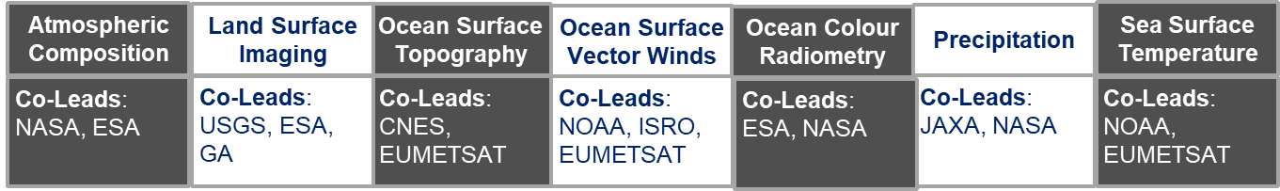
Virtual Constellations
A Little History and Current Situation
VCs were created to address gaps in missions and inform agencies on how to plan for future missions, maintain continuity of measurements and climate records, and avoid duplication and overlap in EO missions.
Four Prototype VCs created at SIT-19 (Sep 2006) to “give balance across different domains and geographies with an eye on leverage of international linkages to support continuity of funding for missions at the time which were under some threat”
  Ocean Surface Topography (NOAA and EUMETSAT) Atmospheric Composition (NASA)
  Land Surface Imaging (USGS) Precipitation (JAXA and NASA)
VCs circa 2019
“The interim goal of a Constellation is to demonstrate the value of a collaborative partnership in addressing a key observational gap; the end goal is to sustain the routine collection of critical observations. Implementation of Constellation activities is ultimately dependent on the coordination of formal agreements among participating agencies.” - Virtual Constellations Process Paper 2013

Slide 30
VC Leadership: 2006-2013

Slide 31
VC Leadership: 2014-2020

Slide 32
CEOS-32-12 and SIT-34-12
VC Leadership Rotation Proposal
# of Co-Leads | Term | Process | Other
At least two (2) and no more than three (3) Co-Leads for each VC | 2 years with no term limits; Co-Leads can “re-nominate” for another 2-year term | Minimum biennial review, with leadership open to all interested and active, engaged, and relevant VC contributors; offset leadership change to ensure continuity | Agency commitment to support Co-Leads

Slide 33
Proposed Language Changes
Two CEOS governing documents require changes per SIT 34 Actions:
  The CEOS Governance and Processes document provides guidelines on the structure, operations, and processes CEOS employs to achieve its goals.
  Virtual Constellations Process Paper defines the roles, responsibilities, and plans of the Virtual Constellations
Changes are not required to the:
  The CEOS Terms of Reference (defines the mission and scope of CEOS activities).
  The CEOS Strategic Guidance document (articulates the overarching long-term [7-10 years] purpose and goals of CEOS).
  New Initiatives Process Paper (Ad Hoc Teams are referenced twice in the Process Paper but changes are not required in the paper)
  Terms of Reference – CEOS Chair, Strategic Implementation Team (SIT) Chair, CEOS Executive Officer (CEO), CEOS Secretariat, and Systems Engineering Office (SEO)

Slide 34
CEOS Governance and Processes Changes
ADD to section on Virtual Constellations:
  Each Virtual Constellation will have at least two and no more than three Co-Leads. Co-Leads shall be from any interested CEOS Member or Associate Agency and should be an active, engaged, and relevant contributor to the VC. Every two years, the Co-Leads will be reviewed by the Constellation membership with a decision to either maintain current leadership or transition to new leadership, as outlined in the CEOS Virtual Constellation Process Paper.

Slide 35
Additional Governance and Processes Changes
ADD to section on Working Groups:
  Each Working Group is led by a Chair and a Vice Chair, with a two-year term for each position, served consecutively in the case of Vice Chair. Additional information on leadership requirements for the Working Groups is detailed in the Working Group Process Paper.
For parity, propose to add this clause about Working Groups (taken essentially verbatim from the Working Group Process Paper)
Annex 1 was updated to reflect ad hoc teams in existence from 2014-2019 and Annex 2 was updated to reflect CEOS Member and Associate Agencies have as of October 2019.

Slide 36
CEOS Virtual Constellations Process Paper Changes
ADD to Section 2 - Goals: Leadership Selection and Criteria
Each Constellation will have at least two and no more than three Co-Leads. Co-Leads shall be from any interested CEOS Member or Associate Agency and should be active, engaged, and relevant contributors to the VC. At a minimum, Co-Lead positions will be reviewed every two years by the Constellation membership to ensure appropriate Constellation leadership is maintained and to allow for interested individuals to be considered for Constellation leadership (some Constellations have a set rotation and turnover of Co-Leads detailed in existing Terms of Reference). The expectation is that any Constellation leadership changes will be staggered to ensure leadership continuity and expertise are optimized. There are no limits on how long an individual may serve as a Co-Lead as long as they are reviewed every two years and have their agency’s endorsement to continue in the role. The decision of Constellation leadership resides with the Constellation but leadership changes must be reported within two weeks to CEOS leadership (CEOS Chair, SIT Chair, SEO, and Permanent Secretariat) following any decision.
Co-Leads will be responsible for the implementation of Constellation’s goals, identification of agency support and commitments, and working with the CEOS SIT Chair in addressing CEOS and SIT priorities. Co-Leads should adhere to these basic requirements:
Nominated on an ad hominem basis; the existing Co-Lead’s agency is not obligated to provide a replacement Co-Lead if its respective Co-Lead rotates out. The Co-Lead can make inquiries to identify another Co-Lead but it is not required.
Endorsed every two years from their respective agencies (verbally or in writing).
Affiliated with a CEOS Member or Associate Agency.
For reference, full updated text provided to CEOS Members

Slide 37
Requests of Plenary
Approval of the proposed language changes to the Virtual Constellations Section of the Governance and Processes Document. Endorsement of the CEOS Governance and Processes_rev1 2019 will be requested in 5.9, after AHT Life Cycle language is presented.
Endorsement of the Virtual Constellations Process Paper rev1 2019, which includes proposed language changes, as presented.

