Slide 1
AC-VC Air Quality Constellation Validation Needs and Recommendations for Implementation Ben Veihelmann (ESA), Jay Al-Saadi (NASA), AC-VC co-chairs Dave Crisp (CalTech/NASA JPL), AC-VC GHG lead
Committee on Earth Observation Satellites
CEOS Plenary 2019
Agenda Item 6.6
Ha Noi, Viet Nam
14 – 16 October 2019

Slide 2
Overview
Background
Geo-AQ constellation
Purpose of the whitepaper ‘Geo-AQ Validation Needs’
Contributors to the whitepaper
Structure / table of content
Recommendations
Implementation strategy
Endorsement and way forward

Slide 3
Background
Several countries and space agencies are currently preparing geostationary satellites with a strong focus on Air Quality (AQ). The ‘Geo-AQ Constellation’ consists of
the Korean Geostationary Environment Spectrometer (GEMS), launch early 2020;
the Copernicus mission ‘Sentinel-4’, launch 2023;
the Tropospheric Emissions: Monitoring of Pollution (TEMPO), launch early 2022;
complemented by LEO missions with strong AQ capabilities (eg OMPS,S5P) serving as travelling standard for inter-calibration of the geostationary mission products.
Responding to the CEOS Work Plan Action VC-3, AC-VC prepared a whitepaper ‘Geostationary Satellite Constellation for Observing Global Air Quality: Geophysical Validation Needs’. Status:
Final review during AC-VC-15, June 2019, Tokyo, Japan
Version 1.0 presented at CEOS 2019 SIT Technical Workshop, September 2019, Fairbanks, Alaska
Version 1.1 addresses comments by EC: multi-view multispectral polarimeter observations added to auxiliary data for validating Geo-AQ products (Introduction, Section 4.2.1); multi-mission coordination of validation efforts recommended (Introduction, Section 4.2.1). Missing author added to the list of contributors.
Ready for endorsement by CEOS

Slide 4
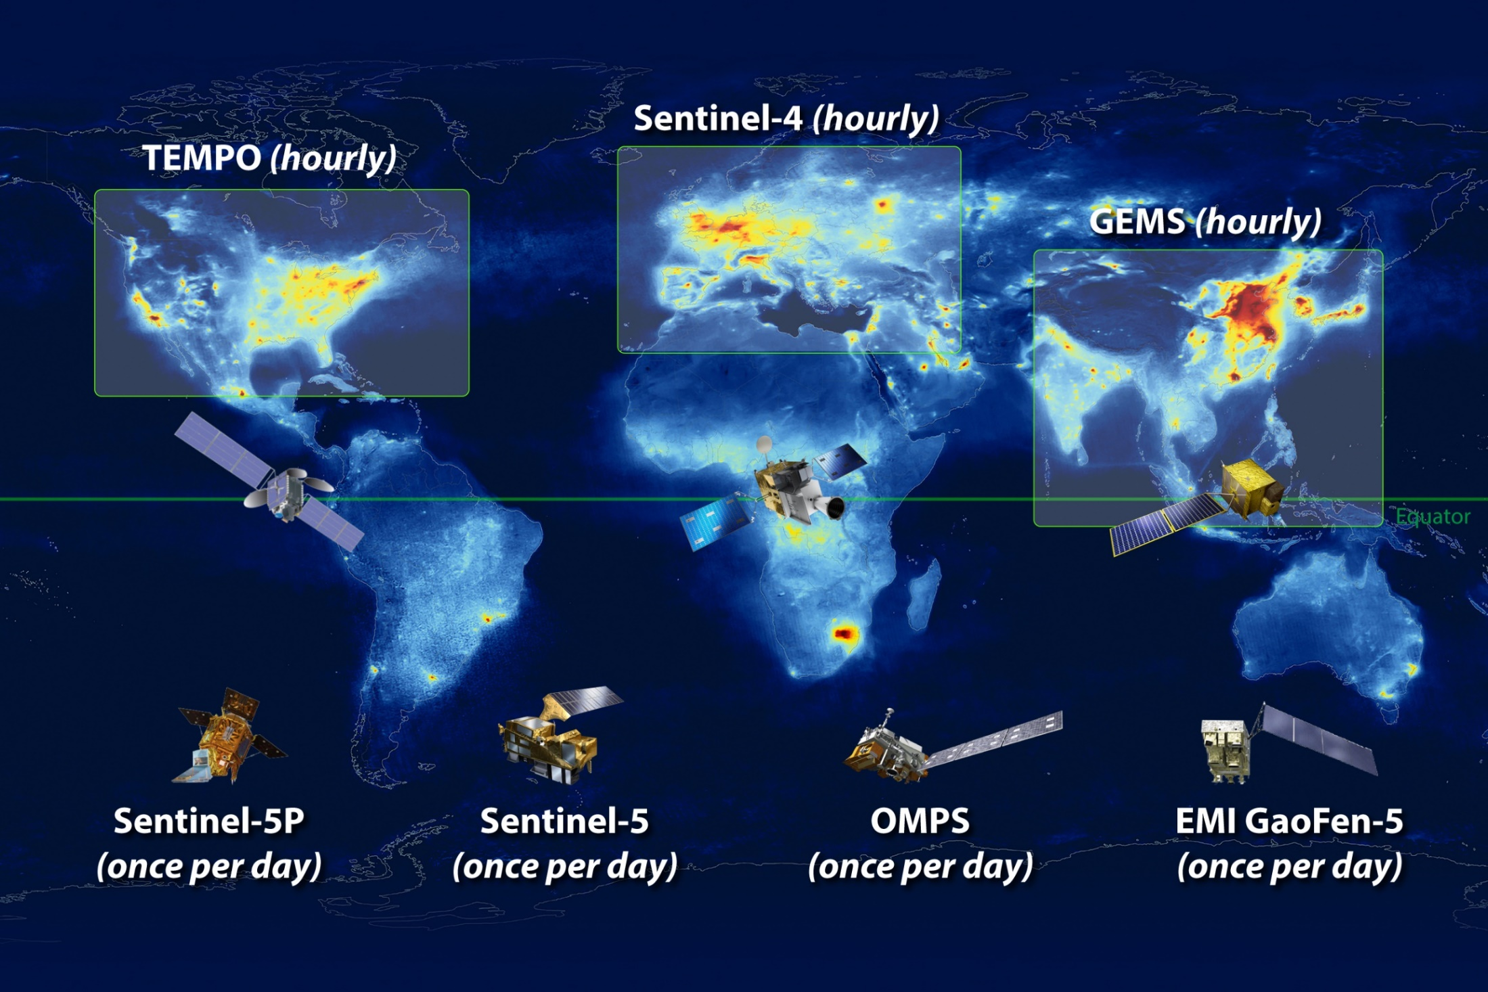
Geostationary Air Quality (Geo-AQ) Constellation
TEMPO + Sentinel-4 + GEMS
launch 2023
bb
launch early 2022
launch 2020
Complemented by LEO missions with strong AQ capabilities:

Slide 5
Purpose of the ‘Geo-AQ Validation Needs’ Whitepaper
Elaborate the validation needs of the Geo-AQ Constellation: focus on
new challenges for geostationary atmospheric composition missions (new with respect to LEO heritage)
enhancing the success of missions when seen as elements of a constellation
Identify ‘Constellation Products’
common to the Geo-AQ missions
enhanced value by establishing and monitoring inter-mission consistency
Set quantitative inter-mission consistency targets for the Constellation Products
taking into account individual product performances and the accuracy of validation methods
Identify activities needed to assess and establish this consistency
Activities to be performed consistently for each mission
Activities addressing new Geo-AQ challenges and inter-mission consistency
Coordination and continuity
Make specific and actionable recommendations

Slide 6
Contributors to the Whitepaper
The Whitepaper has been written by the science teams of the GEMS, Sentinel-4, and TEMPO missions and validation experts including
Al-Saadi, Jay (NASA, USA; AC-VC)
Cede, Alexander (Luftblick, Austria; AC-VC)
Chance, Kelly (SAO, USA; AC-VC)
Flynn, Lawrence E. (NOAA, USA, AC-VC; GSICS)
Kim, Jhoon (Yonsei University, Republic of Korea; AC-VC)
Kim, Sang-Woo (Seoul National University, Republic of Korea; AC-VC)
Koopman, Rob (ESA, EU)
Lambert, Jean-Christopher (IASB-BIRA, Belgium; AC-VC; WGCV)
Lindstrot, Rasmus (EUMETSAT, EU)
Loyola Diego (DLR, Germany; AC-VC)
Munro, Rose (EUMETSAT, EU; AC-VC; GSICS)
Van Roozendael, Michel (IASB-BIRA, Belgium; AC-VC; WGCV)
Veihelmann, Ben (ESA, EU; AC-VC)
Wang, Jun (University of Iowa, USA; AC-VC)
Yoon, Jongmin (NIER, Republic of Korea; AC-VC)

Slide 7
Structure / Table of Content of the Whitepaper
Executive Summary (1/2 page)
Summary of all Recommendations (1 page)
Geo-AQ Missions and Related LEO Missions
Product Consistency Across the Constellation
Validation Needs
Activities That Need to be Performed Consistently for Each Mission
Recommendations for Activities Addressing New Geo-AQ Challenges and Inter-mission Consistency
Coordination and Continuity
Reference Documents, List of Acronyms, Contributors, Annex: Geophysical Validation Infrastructure
40 pages without Annexes

Slide 8
Recommendations formulated in the Whitepaper
Consistently perform intensive campaigns dedicated to the validation of the capability of the Geo-AQ missions to observe the diurnal cycle of the target species.
Conduct joint validation campaigns with exchange of reference airborne and ground-based instruments.
Further develop and apply approaches to the radiometric inter-calibration of the Geo-AQ missions.
Further develop and apply approaches to the inter-calibration of the Level-2 products of the Geo-AQ missions.
Systematically process the Level-2 Constellation Products of the Geo-AQ missions, using one selected common algorithm per Constellation Product.
Further pursue the harmonization of the reference data used for validation and inter-mission consistency verification of Level-2 products.
Implement a data centre for storage and exchange of all validation data collected for the Geo-AQ missions, accessible to the entire community involved in the validation.
Implement a coordinating unit for ensuring the consistency of the approach and the metrics used for validating the Geo-AQ mission products and their inter-mission consistency.

Slide 9
Implementation Strategy for Recommendations Formulated in the Whitepaper
Recommendation 1 expresses best practices for consistent validation of the individual missions.
Remaining recommendations aim at an integrated constellation and continuity.
The strategy is cost efficient by
building on core validation activities of each individual mission needed anyway, irrespectively of the constellation.
identifying and leveraging existing activities when possible,
exploiting existing assets (LEO sensors as travelling standards, networks of inter-calibrated ground based sensors).
Possible mechanisms are identified for those activities not yet in progress.
Implementation should begin immediately, given the planned launch of the GEMS mission in early 2020.

Slide 10
Ongoing Activities Relevant to Implementation of the Recommendations
NASA and ESA investments in Pandonia Global Network
Consistently calibrated Pandora UV-Vis spectrometers and standard data protocols
Provides Fiducial Reference Measurements for Geo-AQ Constellation Products
ESA, NASA, and NIER deploy instruments, co-located with recommended ancillary measurements, at an increasing number of ground sites within the three GEO domains
Supports Recommendations 1, 2, 4, 6, 7, 8.
ESA and partner investments in inter-comparison of Fiducial Reference Measurements (CINDI, CINDI-2)
Enhance traceability, accuracy, and harmonization,
Supports Recommendations 1, 2, 4, 6, 7, 8.
Development of airborne mapping spectrometers and operations demonstrating cost-effective satellite validation capability
Validation-quality measurements have been demonstrated with two NASA instruments in several air quality campaigns (DISCOVER-AQ, KORUS-AQ, LMOS, LISTOS) conducted with international (NIER), national (US EPA, NOAA), and regional (LADCO, NESCAUM, universities) partners
Four European instruments (VITO, BIRA-IASB, IUP-Bremen, TNO, TU-Delft, KNMI) have been intercompared in the AROMAPEX campaign
Bilateral discussions underway for instrument exchanges between mission organizations
Supports Recommendations 1, 2, 4, 6
WMO GSICS initiative expanded to include reflective solar backscatter measurements UV-Vis-NIR-SWIR
Supports Recommendation 3

Slide 11
Planned Activities Relevant to Implementation of the Recommendations
Announcements of Opportunity for validation activities are being planned by the Geo-AQ mission agencies
Korea’s NIER is preparing an AO for GEMS Phase E1 geophysical validation for draft release late 2019
ESA AO for Sentinel-4 Phase E1 geophysical validation envisaged about 1.5 years before launch following the S5P approach. In addition EUMETSAT will initiate the required preparation for operational calibration and validation activities which will start in Phase E1 and continue throughout Phase E2
NASA AO for an expanded TEMPO science team, including additional validation activities, will be issued after successful TEMPO launch
These opportunities can potentially support all Recommendations
Preliminary discussions are underway for joint, companion, or harmonized science field campaign activities, including ground and airborne measurements, in 2022-23 timeframe
In addition to the science objectives, satellite product validation would be a primary focus
NASA, NIER, and other partners now beginning to plan a broader follow-on to KORUS-AQ after launches of GEMS and TEMPO
Preliminary discussions underway among NASA, DLR, and other organizations within IGAC to also include European activities after launch of Sentinel-4
Supports Recommendations 1, 2, 4, 6
Notes:
Cost efficient: travelling LEO std

Slide 12
As-Yet Unplanned Activities Relevant to Implementation of the Recommendations
Support Recommendation 5: Systematically process the Level-2 Constellation Products of the Geo-AQ missions, using one selected common algorithm per Constellation Product.
One option could be to express this as a priority within the Announcements of Opportunity planned by each organization
Support Recommendation 7: Implement a data centre for storage and exchange of all validation data collected for the Geo-AQ missions, accessible to the entire community involved in the validation of the Geo-AQ mission products, very soon after acquisition.
Demonstrated capability exists, e.g., the NASA Aura Validation Data Center (AVDC), ESA Validation Data Centre (EVDC), and NASA Airborne Science Data for Atmospheric Composition repository
It may be most practical to implement consistent centres in each geographic region, given the intended inclusion of local regulatory monitoring measurements
It would be up to one or more agencies to volunteer to host this activity
Support Recommendation 8: Implement a coordinating unit for ensuring the consistency of the approach and the metrics used for validating the Geo-AQ mission products and their inter-mission consistency.
Activity should leverage existing mechanisms, e.g. CEOS WG-VC, WMO GSICS, QA4EO framework
Prioritize continuity of the Ongoing and Planned Activities summarized on previous slides

Slide 13
Endorsement and Way Forward
Action VC-03 ‘Air Quality (AQ) Constellation Coordination’ addressed:
Whitepaper ‘Geostationary Satellite Constellation for Observing Global Air Quality: Geophysical Validation Needs’ prepared by AC-VC
Delivered to CEOS
Plenary invited to
Endorse the VC-03 white paper
SIT and Executive leadership and next Work Plan
Evolve VC-03 Deliverable to implementation

