Slide 1

Sustainable Development Goals
Ad Hoc Team
Committee on Earth Observation Satellites
Alex Held, CSIRO, Co-lead & SIT Chair
Flora Kerblat, CSIRO, Executive Secretary
Marc Paganini, ESA, Co-lead
Supported by Argyro Kavvada
(NASA, GEO EO4SDG)
CEOS Plenary 2019
Agenda Item #5.5
Ha Noi, Viet Nam
14 – 16 October 2019

Slide 2
Presenter Guidance
Presenters should name their files using the following convention:
  AgendaItemNumber_LastName_Subject_Version.pptx (e.g., 1.5_Holloway_Communications_v2.pptx)
Reporting to support discussion or decision is encouraged, but historical context and detailed reporting should be provided as pre-meeting reading material or in background slides.
Materials should explicitly highlight the decisions, endorsements, outcomes, or actions you are seeking at Plenary. The more explicit you are with the required actions, the better. Do feel free to propose draft action text for consideration – it may be revised, but will help with the efficient preparation of the Plenary actions record.
Materials should be sent to matthew@symbioscomms.com and kim.e.holloway@nasa.gov
  Documents for endorsement: no later than October 1
  Presentations: no later than October 8

Slide 3

SDG AHT objectives at Plenary 33
Be granted another year (with the same leadership or not)
With adequate support from CEOS Agencies
To organise ourselves with dedicated sub-teams on streamlined activities
To be skilled to fulfil our objectives for 2020 and beyond

Slide 4
Status of SDG-AHT deliverables
CEOS Work Plan (2019-2021)
# | Objective/Deliverable | Due date | Leading agency | Main Contributors | Status
SDG-2 | Compile and maintain a compendium of CEOS Agencies engagement on SDGs | Q2 2019 | CSIRO | All CEOS Agencies (11 so far) | Completed (to be updated when needed)
SDG-3 | Review and assess the relevance of EO to the SDG Targets and Indicators. Produce a technical compendium and a policy brief | Q3 2019 | ESA | CSIRO, NASA | Draft completed (under review by SDG-AHT members)
SDG-4 | CEOS engagement plan on SDGs | Q2 2019 | ESA | CSIRO, NASA | New version Completed (to be reviewed after Plenary with updated information from Agencies)
SDG-5 | Analyse the SDG satellite data requirements | Q4 2019 | NASA, CSIRO | ESA, JAXA | Tables drafted for 15.3.1, 6.6.1 and 11.3.1 (and 2.4.1)
SDG-6 | Open Data Cube algorithms for the SDGs | Q4 2019 | SEO (NASA) |  | On-going (SEO progress report)
CB-41 | SDG-related training and capacity building related to the use of space-based EO to meet the data challenges of the 2030 Agenda for Sustainable Development | Q3 2019 | NASA with WGCapD | SDG AHT Members | SDG Awareness webinar Indicator-specific Webinars & Training started (6.6.1, 11.3.1, 6.3.2)

Slide 5
Streamlining of CEOS SDG activities
3 Primary Indicators
As a demonstration of the effectiveness of “streamlining”, the SDG-AHT proposed at SIT 34:
to start with 3 SDG indicators
most ready to integrate EO in their processes
indicators selected by the IAEG-SDGs WGGI for the Task Stream on satellite Earth Observation data for the SDG indicators
SDG 6.6.1
Water related
Ecosystems
SDG 11.3.1
Sustainable
Urbanization
SDG 15.3.1
Land Degradation Neutrality
Changes in the spatial extent of open waters (lakes, artificial water bodies,
rivers and estuaries)
Changes in the spatial extent of vegetated wetlands (including mangroves)
WQ of lakes and artificial water bodies
Water discharge in rivers & estuaries
Mapping of Human Settlements
Mapping of Population density
(disaggregation of census data)
Functional Urban Areas
Land degradation from the changes in land cover
Land degradation from the changes in land productivity
Land degradation from the changes in carbon stock above and below ground (soil organic carbon as proxy)

Slide 6
SDG-AHT 2019-2021 workplan
Activities and Deliverables
Satellite Data Providers
Information Providers
End Users
 | # | Activity Title | Activity Deliverables | Target Audience |  |  | CEOS bodies support
SHORT TERM ACTIVITIES (2020) | 1 | Satellite Data Requirements | Technical Notes on “Satellite Data Requirements” (one TN for each SDG indicator) | X |  |  | LSI-VC (3 indicators)
 | 2 | EO Enabling Infrastructures | Technical Notes on EO enabling infrastructures for SDG indicators (one TN for each SDG Indicator) |  | X |  | WGISS, SEO
 |  |  | CEOS Community Portal on SDG for EO data discovery and access (based on WGISS IDN/CWIC/FedEO) |  | X | X | WGISS
 | 3 | EO Capacity Building | Capacity building webinars/training (organized by SDG indicator) |  | X | X | WGCapD WGISS
 |  |  | Support to EO4SDG MOOCs on SDGs (one MOOC per SDG goal) |  | X | X
MID TERM ACTIVTIES (post 2020) | 4 | EO Good Practices Guidance | EO Good Practice Guidance for SDG indicators (one GPG for each SDG indicator) |  | X |  | LSI-VC (CARDL)
 |  |  | R&D agenda on improved methods for SDG indicators (one R&D Agenda for each SDG indicator) | X |  |  | LDN sub-team?
 | 5 | EO Demonstration Cases | Collection of EO Demonstration Cases for SDG indicators. (one per SDG indicator) |  | X | X
 |  |  | Deployment of EO workflows for SDGs on the CEOS Data Cube |  | X | X | SEO
 | 6 | EO Quality Standards | EO Quality Standards for SDG indicators (one guideline per indicator) |  | X |  | WGCV/LPV

Slide 7

SDG-AHT 2019-2021 workplan
Activities and Deliverables
UN Inter-Agency and Expert Group on SDG Indicators (IAEG-SDGs)
Working Group on Geo-Spatial Information (WGGI) Task Stream II Application of satellite data for the SDG indicators
UN Environment
UN Habitat
UNCCD
6.6.1 Water
related ecosystems
11.3.1 Sustainable Urbanization
15.3.1 Land Degradation Neutrality
Surface Water Extent, Vegetated Wetlands,
Water Quality
Human Settlements,
Population Density, urban/rural
Land Cover,
Land Productivity,
Carbon Stock
CEOS SDG AHT
Satellite Data Requirements
Satellite Data Requirement Sub-team
LSI-VC
EO Enabling Infrastructures
Enabling Infrastructure Sub-team
WGISS
SEO
EO Capacity Building
Capacity Building Sub-team
WGCapD
WGISS
EO Good Practice Guidance
Water Sub-team
(e.g. GA/CSIRO, EC,
NASA, JAXA, ESA)
Urban Sub-team
(e.g. EC, NASA, DLR,
ESA, SANSA)
LDN Sub-team
(e.g. CSIRO, ESA, EC,
SANSA, NASA)
LSI-VC
EO Demonstration Cases
SEO
EO Quality Standards
WGCV
LPV
GEO EO4SDG
GEO Wetlands
AQUAWATCH
GEO Human Planet
GUOI
GEO LDN

Slide 8
CEOS activities on SDGs
Future Outlook
SDGs is one of GEO Priorities + of the new CEOS SIT Chair for 2020-2021:
how does CEOS continue to support the 2030 Agenda?
Email sent on 03/10/19 (from SDG AHT co-leads) with background documents including an Information Note and the updated Work Plan (available here on CEOS Document Management ) for their review
… Inviting CEOS Principals at the Plenary to:
  approve the renewal of an additional and final year of extension
  express their support to the implementation of the new CEOS 2020-2021 Workplan on SDGs, which is provided for information, and indicate the level of resources they are ready to assign on the CEOS work plan activities related to the three SDG indicators proposed at SIT-34 (Water related Ecosystems, Sustainable Urbanization, Land Degradation Neutrality)
  designate CEOS Agencies’ staff who can participate to the AHT sub-teams as leads or contributors
  consider the possibility to become a co-lead of the SDG-AHT for the upcoming year, in agreement with the AHT leadership rotation of the SDG-AHT Terms of Reference

Slide 9
CEOS activities on SDGs
Future Outlook
If renewed…. Our ROADMAP TO SIT-35
Update the 2019-2021 CEOS workplan on SDGs based on Principals decisions and comments at CEOS Plenary 33
Ensure Agencies’ participation and commitment to the SDG workplan is adequate to fulfil our objectives.
Fully engage with CEOS groups (VCs, WGs and SEO) listed in the WP and plan a coordinated and effective way forward (before Christmas break) with designated sub-teams
Comply with CEOS processes and work with CEOS SIT Chair towards SIT-35 (if a WG to be created by CEOS Plenary 34)

Slide 10
Background information

Slide 11
Solutions to explore against existing challenges
Focus on CEOS unique role
and on a few SDG Indicators
(start with 6.6.1; 11.3.1; 15.3.1)
Complement rather than duplicate
the GEO community efforts on SDGs
Encourage more commitment and participation from agencies
Leverage the knowledge and expertise of CEOS bodies (VCs, WGs, SEO)
to maximise impact.
Identify the key partners with whom CEOS should primarily interface
(IAEG-SDGs WGGI, custodian agencies)
The UN has established a complex governance system on the SDG Global Indicator Framework with many stakeholders involved both at UN and national levels.
Take a decision based on an
in-depth assessment of implications
(resources, reporting, etc.)
Future of the SDG AHT is uncertain. Continue or disappear? New entity (post AHT)? WG or Strategy?
The original goals of the SDG AHT were too broad in scope and not fully aligned with the CEOS mandate.
The AHT activities were too similar to the work of the GEO EO4SDG initiative, which brought some confusion on the respective roles of CEOS and GEO.
The impact of the CEOS activities on SDGs is commensurate to the level of resources available. Number of agencies actively involved has not reached the expected level.
The SDG is a very broad and cross-cutting topic (land, marine, atmosphere) requiring different EO competences (satellite data, EO infrastructures, capacity building, accuracy assessment).
Reduce the governance burden
to focus on key contributions
Creation of a new entity includes more governance paper, reporting.

Slide 12
CEOS Engagement Plan on SDGs
Criteria for streamlining CEOS activities
The CEOS activities on SDGs must focus on the unique role that CEOS should play as a coordination body of the Space Agencies.
The CEOS activities on SDGs must serve the interest of CEOS and offer tangible benefits to all CEOS Agencies.
The permanent CEOS entities (WGs, VCs, SEO) must be involved in order to leverage expertise, and maximize resource and overall benefits.
The CEOS activities on SDGs must complement rather than duplicate the GEO community efforts on SDGs (GEO EO4SDG initiative).
The CEOS activities on SDGs must be connected to the SDG processes in place in the UN (e.g. IAEG-SDGs WGGI and UN Custodian Agencies).
The CEOS activities on SDGs and deliverables must be embedded in the GEO Federated Approach on SDGs and related workflows.
The CEOS activities on SDGs and deliverables must be commensurate with the resources available in CEOS to deliver as planned.

Slide 13
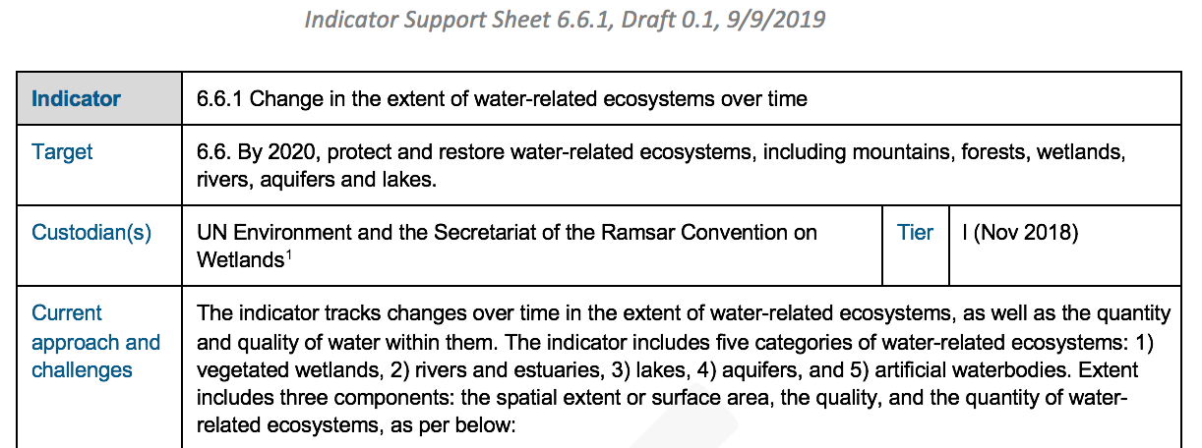
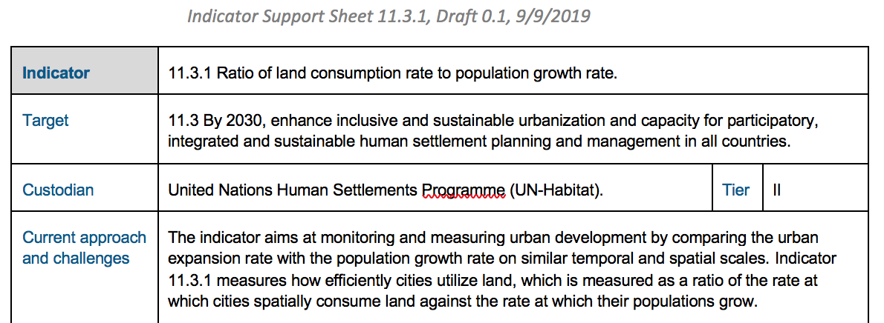
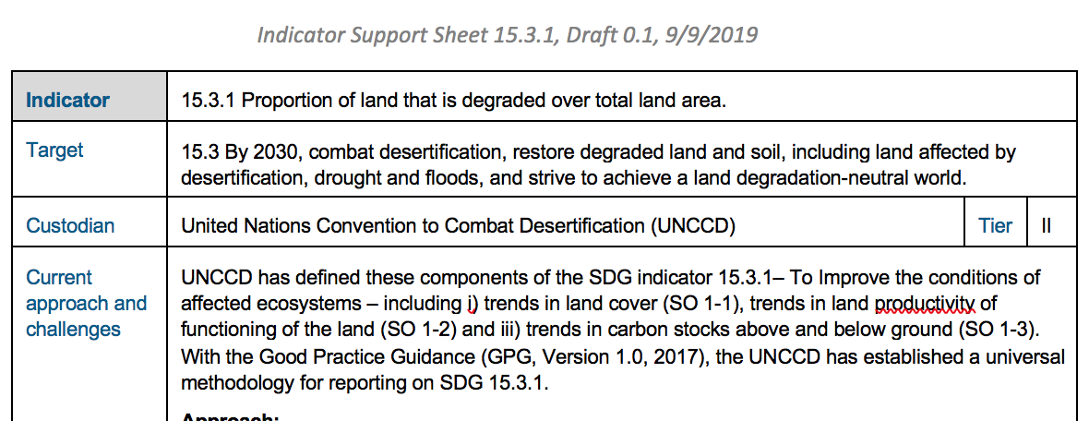
Indicators 6.6.1, 11.3.1, and 15.3.1 Progress on CEOS pilot support
Indicator Support Sheets
with analysis of challenges and opportunities for EO uptake and review of existing EO datasets, tools and platforms
Satellite Data Requirement Tables drafted in general and with regional focus (e.g. Pacific islands)
SEO started to customize CEOS ODC workflows for the 3 primary indicators.
Capacity Building organized jointly by SDG-AHT and WGCapD
(e.g. Webinars, Training by NASA during 2019 AmeriGEO Week)

Slide 14
THANK YOU
Alex Held (CSIRO, SDG AHT Co-lead and SIT Chair)
Marc Paganini (ESA, SDH AHT Co-lead)
Flora Kerblat (CSIRO, SDG AHT Executive Secretary and SIT Chair team)
Please contact us: sdg-leads@lists.ceos.org

