Slide 1

Report from WG Disasters
Committee on Earth Observation Satellites
Simona Zoffoli, ASI
David Green, NASA
CEOS Plenary 2019
Agenda Item # 5.3
Ha Noi, Viet Nam
14 – 16 October 2019

Slide 2
WG Disasters report
Key activities from 2019
Updated Terms of Reference (For Endorsement)
Vice-Chair Nomination (For Endorsement)
Handover to the New WGDisasters Chair

Slide 3
WG Disasters … at a glance
GEO Initiatives
GSNL
GEODARMA
CEOS DRM Observation Strategy
Volcano Demonstrator
Seismic Hazard Demonstrator
Recovery Observatory
Landslide Pilot
Cross-Cutting Activities
GeoHazards Lab

Slide 4
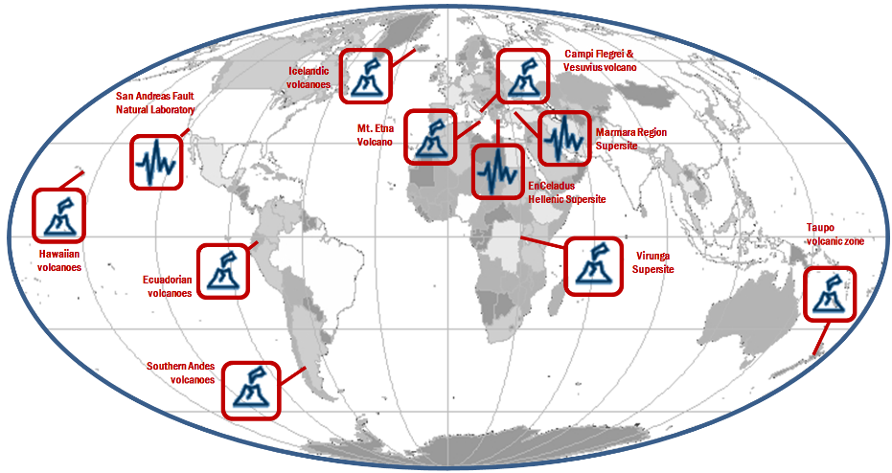


Supersite network in 2019 – 11 sites
Courtesy of Stefano Salvi (INGV)
Chair of the Supersites Advisory Committee
Notes:
GSNL network is composed of ten Permanent Supersites and one Natural Laboratory.

Slide 5
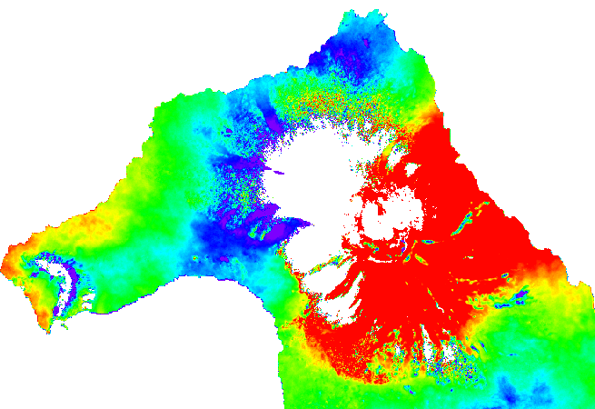
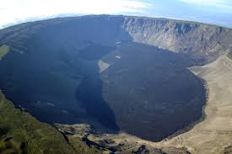
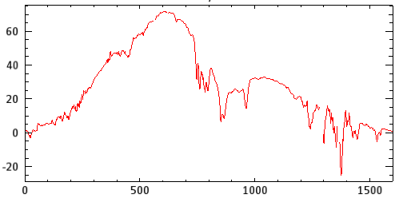
Wolf volcano, Galapagos
There are not GPS or tiltmeters in the volcano, so InSAR is the only tool to monitor patterns of deformation. Sentinel 1 data. Inflation up to 70 mm between December 2016 and August 2019 is visible in the caldera.
Displacement in LOS interferogram in the Wolf volcano between December 2016 and August 2019 (S. Aguaiza – IGEPN).
First local processing of InSAR data at IGEPN
Displacement in LOS in [mm] in the profile North-South of the caldera of Wolf volcano (S. Aguaiza – IGEPN).

Slide 6
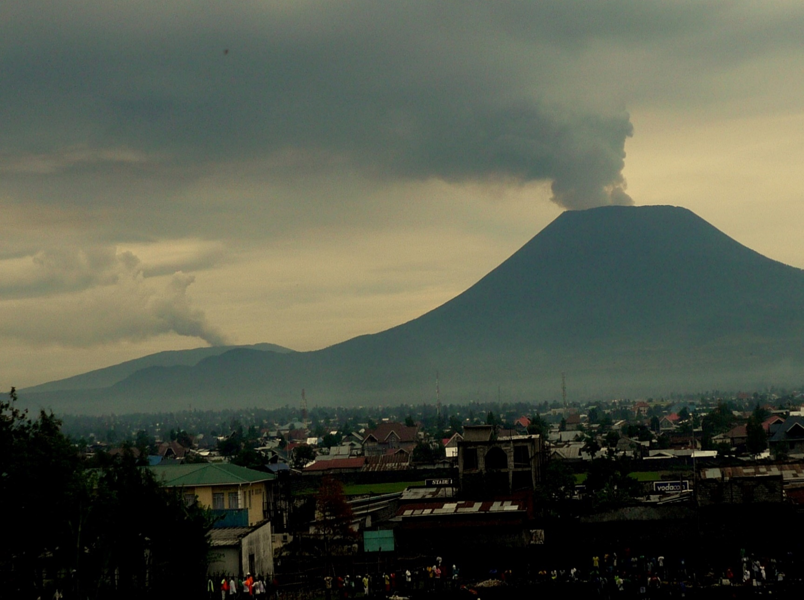
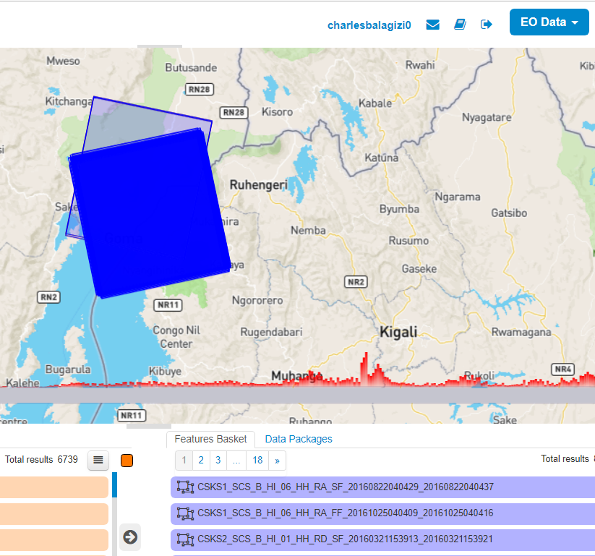

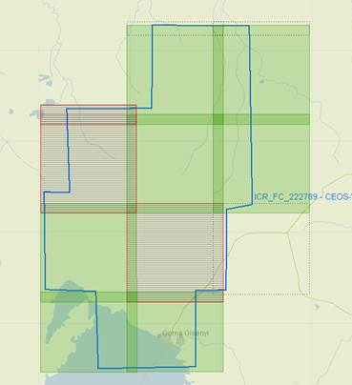


Virunga Supersite – CEOS contribution
COSMO-SkyMed SAR data are available through the ESA-GEP
Pléiades acquisition plan nearly completed

Slide 7
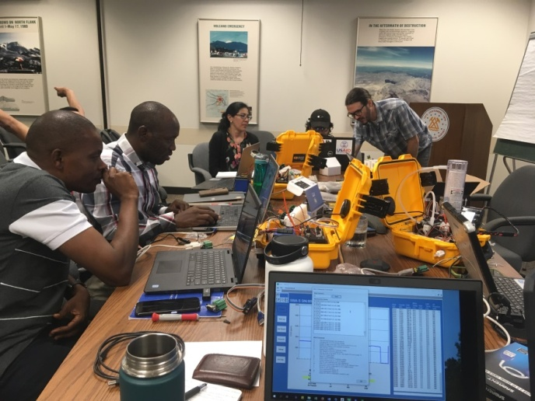
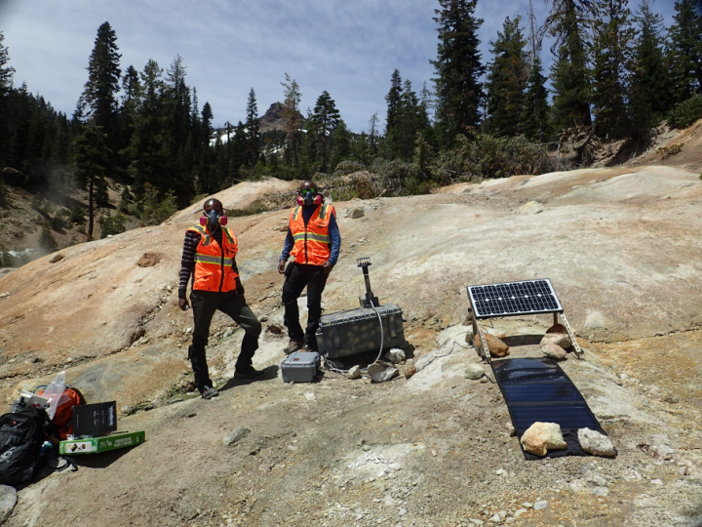
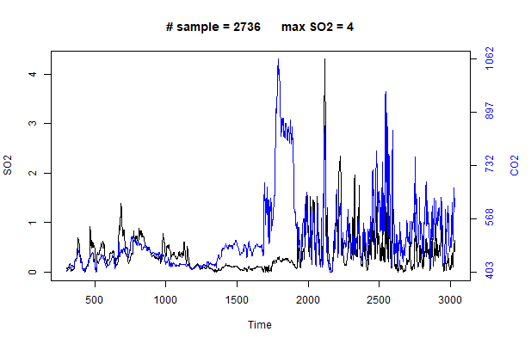
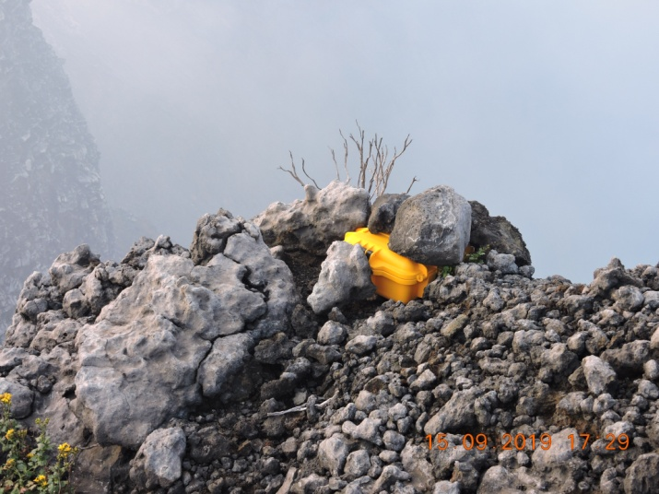
GVO scientists trained by VDAP
MultiGas training in the lab, Washington-USA
Training in the field, Lassen National Park-USA
Instrument deployed at Nyiragongo Volcano
Preliminary results from the MultiGas Nyiragongo Volcano

Slide 8
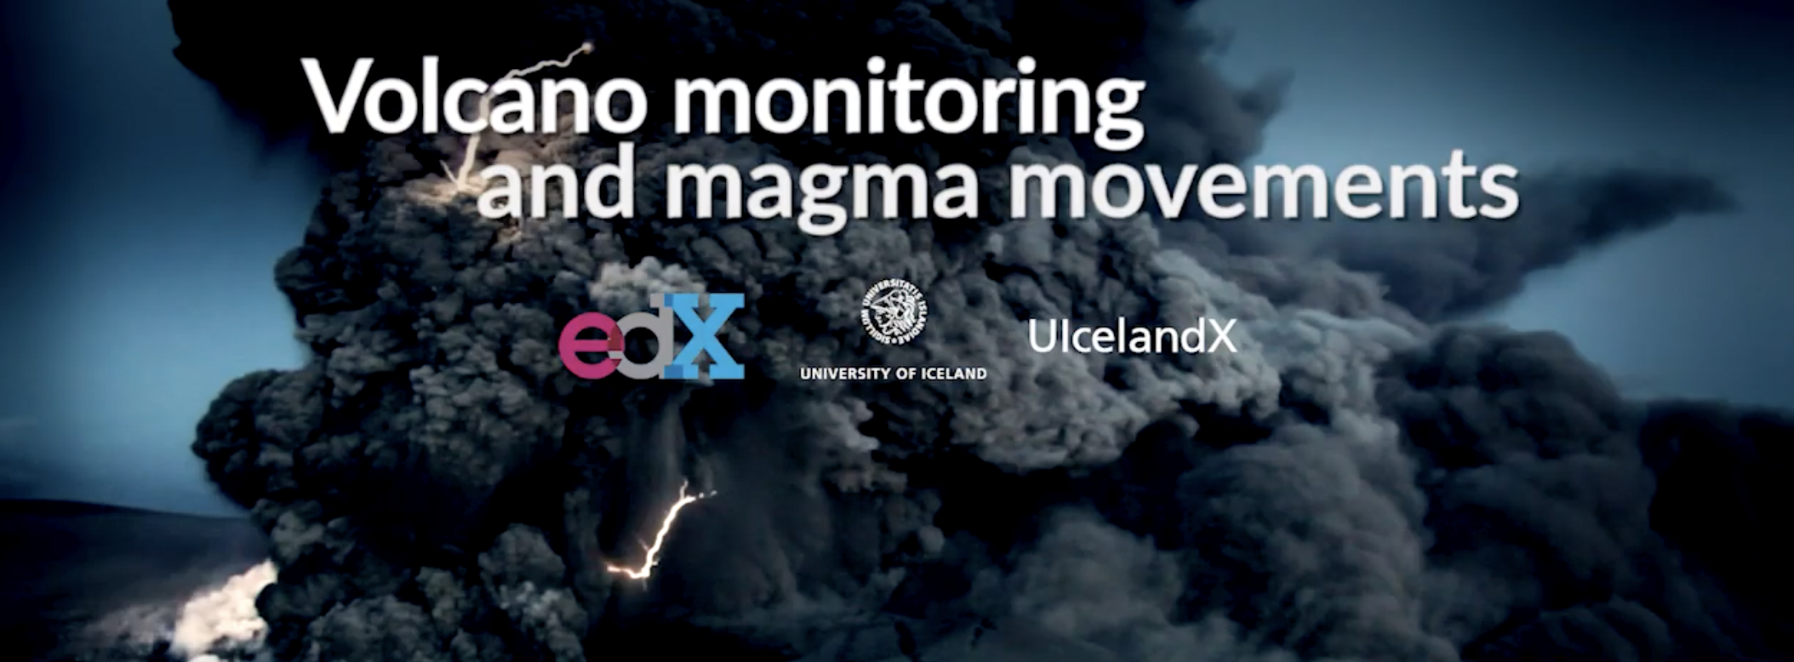
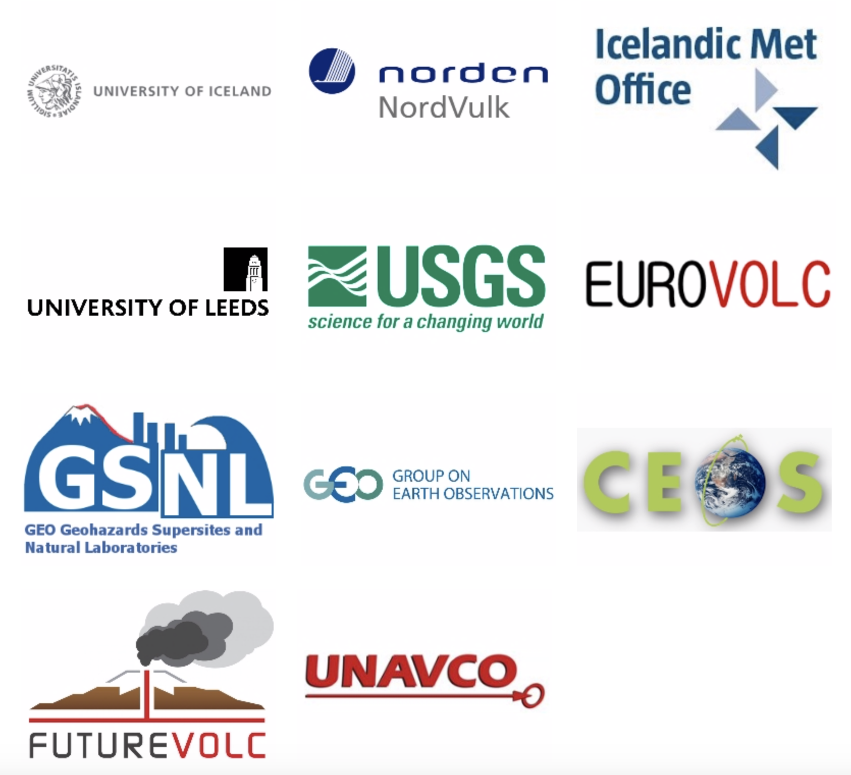
Icelandic Supersite
MOOC (massive open online) course, available for all, on volcano monitoring and magma movements, offered by University of Iceland through its participation in edX.
https://www.edx.org/course/monitoring-volcanoes-and-magma-movements
Participants: ∼ 2100, 84 countries

Slide 9
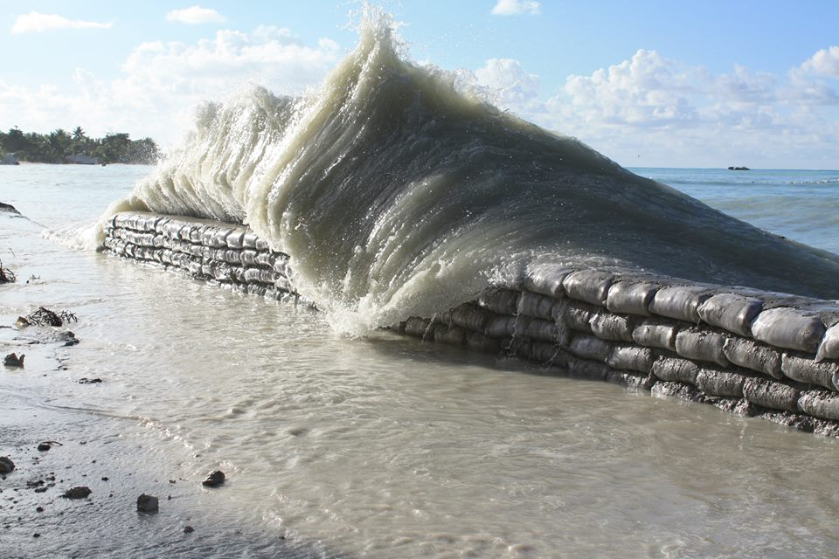
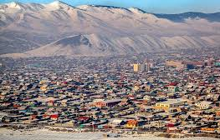
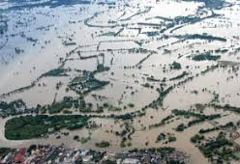
GEO-DARMA (DIS-15)
Regional assessment for Asia and Africa completed in 2018
Regional assessment for Latin America and Caribbean has been prepared and was presented at the AmeriGEO meeting in Lima, Peru in August 2019
Project proposals are being developed in each of the regions, in line with the regional assessments.

Slide 10
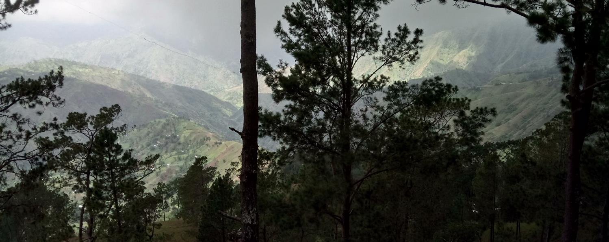
Recovery Observatory (DIS-12)
Hurricane Matthew
in Haïti
Oct 4th 2016
Triggered after the Hurricane Matthew in October 2016
A Reminder of Haiti’s diversity
Demonstrate the value of using satellite Earth Observations to support recovery after a major disaster
Work with the recovery community to define a sustainable vision for increased use of satellite Earth observations in support of recovery
Establish institutional relationships between CEOS satellite data providers and stakeholders from the international recovery community

Slide 11
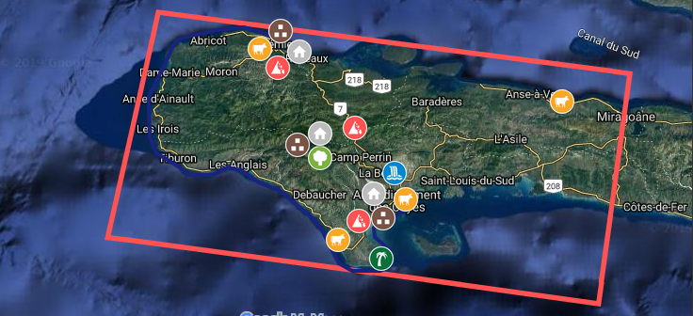







RO Thematic Products
Les Produits
 | Product | Key user | CEOS | Sat. Data
 | Buildings Mapping | CIAT / Planning Ministry | CNES/SERTIT, Copernicus EMS R&R | Pléiades, WorldView-3
 | Terrain Motion Change Detection | BME / URGeo | ASI, CNES/EOST | COSMO-SkyMed, Pléiades, Spot 6/7, TerraSAR-X
 | Watershed / Flood | ONEV / Agriculture Ministry | ASI/CIMA Foundation | Pléiades, COSMO-SkyMed
 | Agriculture | Agriculture Ministry | Copernicus EMS R&R | Sentinel-2, Spot 6/7, GeoEye-1, WorldView-2
 | Macaya Park Monitoring | ANAP / ONEV / Environment Ministry | Copernicus EMS R&R, CNES/SERTIT | Spot 6/7
 | Environmental Impact | ONEV / Environment Ministry | Copernicus EMS R&R | Sentinel-2, Spot 6/7, Pléiades, WorldView-2
 | Land Use | All | CNIGS, CNES | Sentinel-2

Slide 12
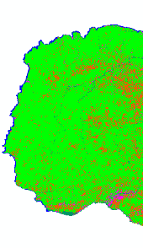
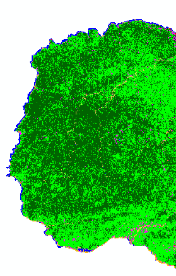
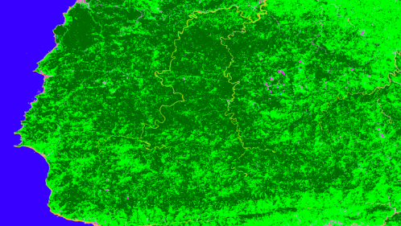
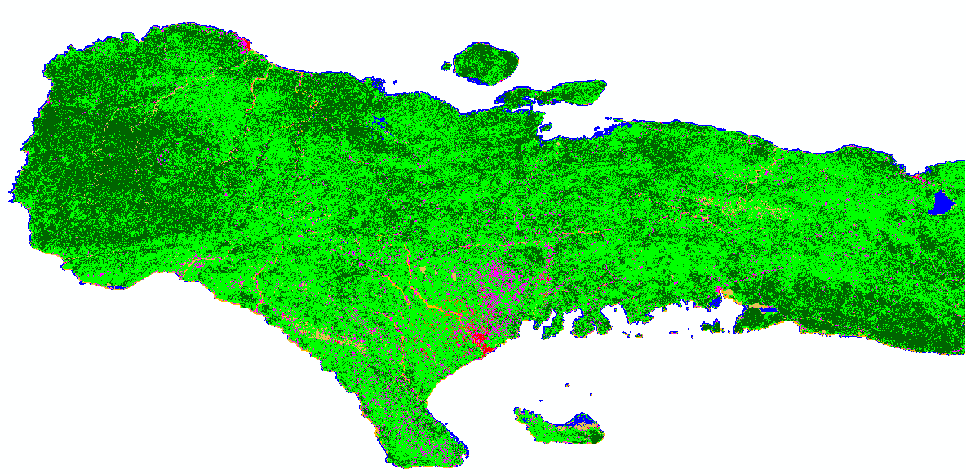
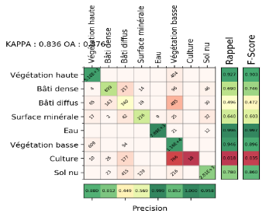

Land Use Land Cover Mapping
2018
2019
Exploitation of S2A times series to produce a LULC map using Iota2 (first map in 2018 by Cesbio / CNES)
In 2019, developments to improve LULC map with automatic sampling strategies to discriminate vegetation - high and low - or urban classes - dense or sparse
Objective : production of an annual landcover/use map

Slide 13
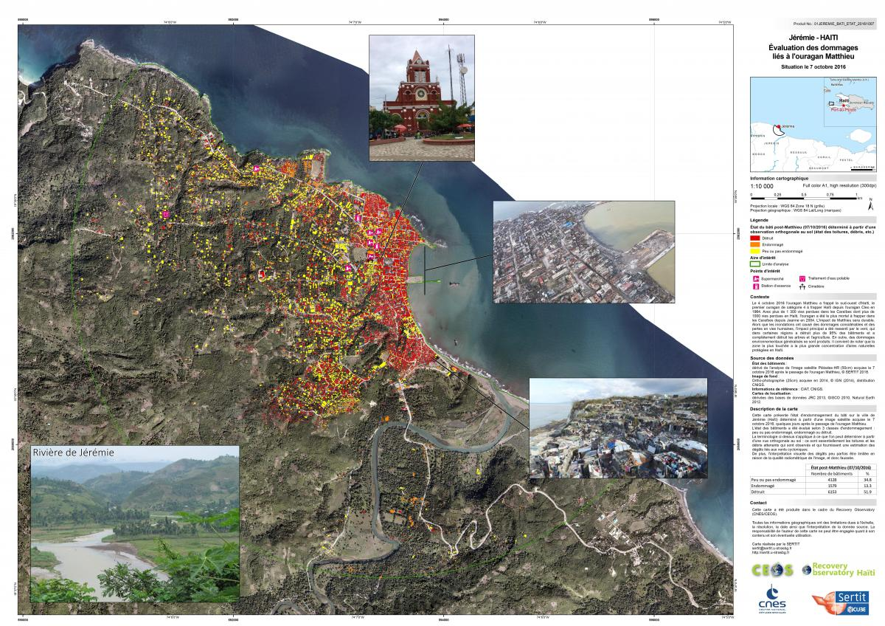
Damaged buildings in Jérémie
(End Users Map)

Slide 14
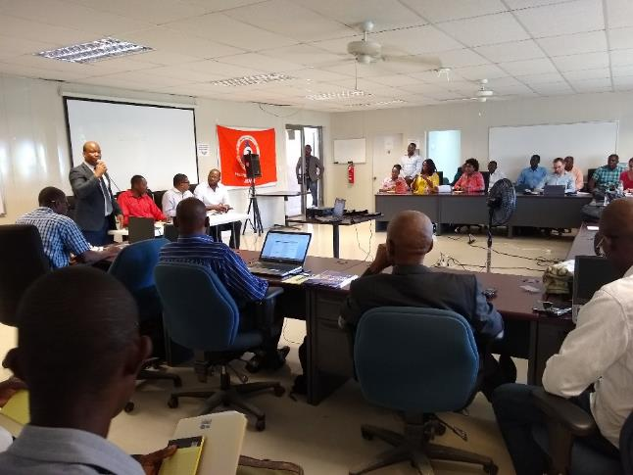
Local User Workshops #2
2nd Local User Workshop at Jérémie – April / May 2019
Presence of ASI and CNES
About 60 participants including :
  The Mayors of Jérémie and Dame Marie
  Marfranc, Irois, Beaumont municipalities
  UNDP
  Environment Min. / UGP-Macaya
  ….
Number of participants x2 compared to last year
Thematic Products Presentations
Awareness of project objectives
Clear commitment of local actors in support of the project
Identification of needs for new version of Copernicus RRM products
Opening by CNIGS director

Slide 15
Survey (DIS-12)
29 responses, mostly from end users, to the Monkey Survey questionnaire
Participants felt RO products were useful in the Haitian context and provided a useful contribution to Post-Matthew recovery.
85% of participants felt the quality of RO products was excellent or good.
Three most useful products: damage to built structures, land cover, and environmental impact.
80% of participants fully agreed or agreed that the RO fully met their organization’s expectations for the project.
A very large majority felt that the most important element to pursue and reinforce was short-term training (one to two weeks) on EO techniques and processing.

Slide 16
Advocacy Paper ToC
PREFACE 1
1. INTRODUCTION 2
1.1 The UN Experience 2
1.2 World Bank and the Global Facility for Disaster Reduction and Recovery (GFDRR) 3
1.3 EU/EC Copernicus 4
1.4 Post-Disaster Needs Assessments 5
1.5 Recovery and Peacebuilding Assessments 5
1.6 Generic Recovery Observatory ad hoc Team 6
2. RECOVERY ISSUES AND EO SATELLITE CONTRIBUTIONS 8
2.1 Early Recovery and Recovery Planning 8
2.2 Recovery Monitoring and Capacity Building 12
3. CHALLENGES AND LESSONS LEARNED 17
3.1 Institutional Arrangements 17
3.2 Addressing cost of Data and Value Adding 18
3.3 Capacity Building 18
3.4 Satellite Data Limitations 19
4. IMPLEMENTING MORE SYSTEMATIC EO SATELLITE DATA USE 21
5. ONE STEP FURTHER 24
Advocacy paper draft circulated to WGDisasters and to WGISS September 2019
Text to be e-published by GFDRR in fall 2019

Slide 17
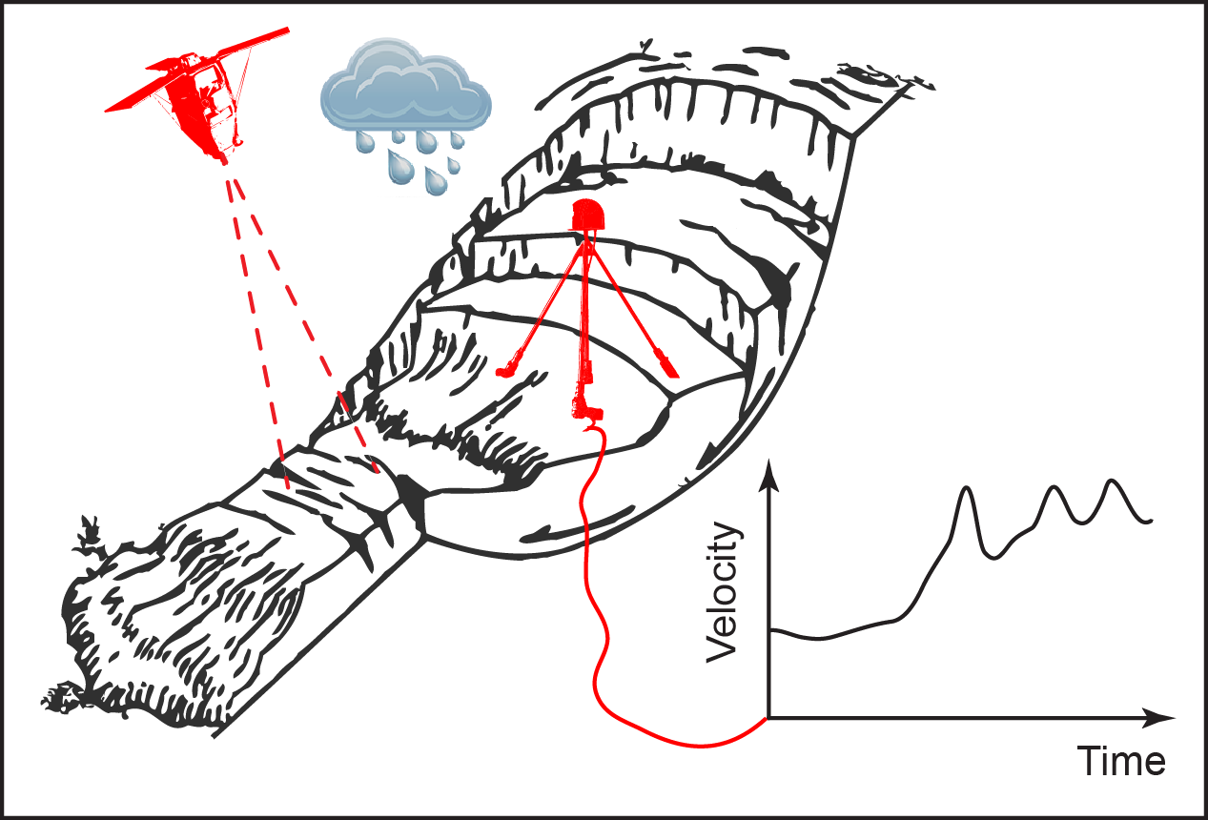
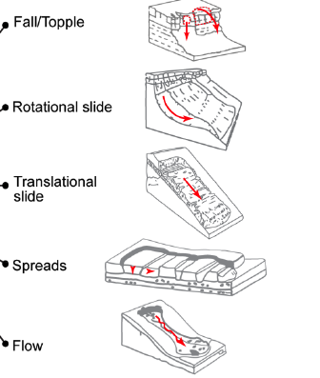
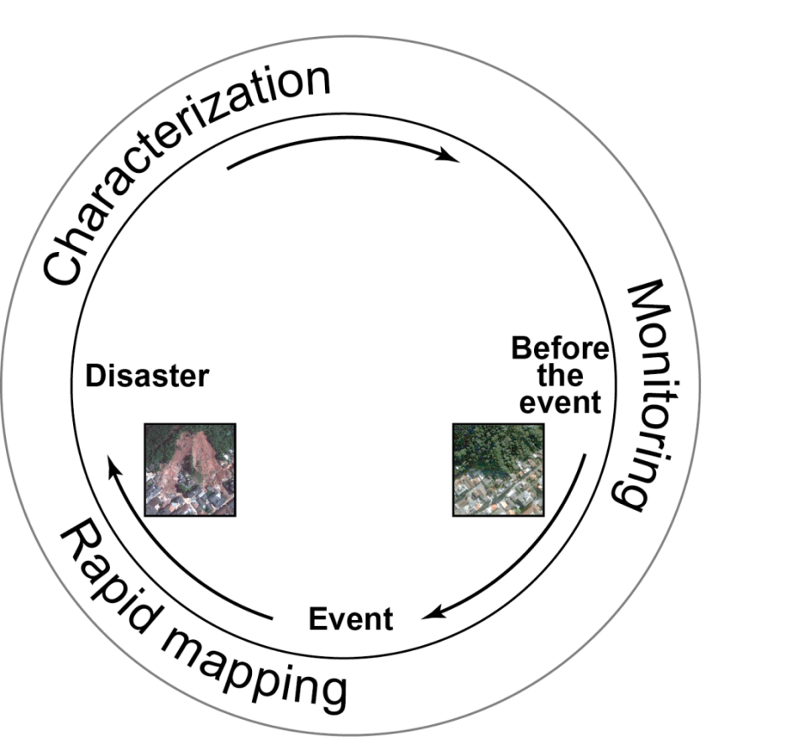
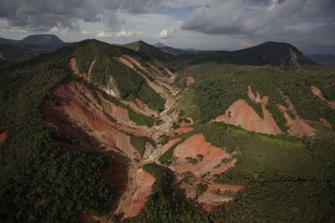
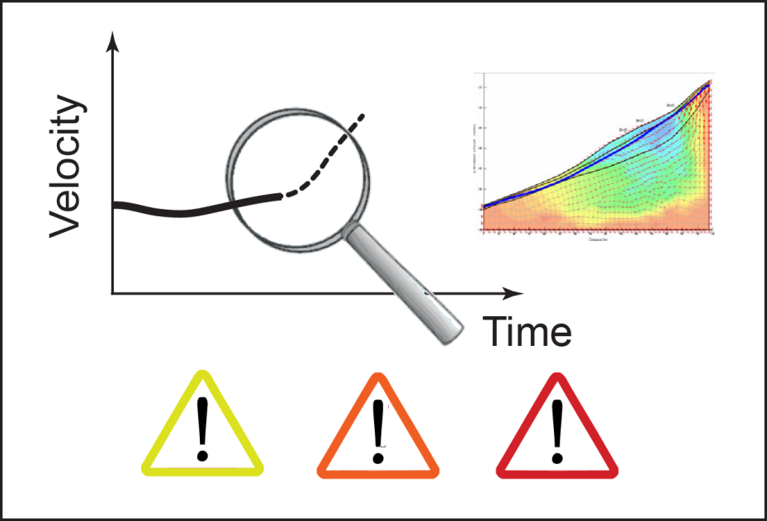

Landslide Pilot update (DIS-16)
What?
(Type, Activity)
How?
(Displacement,
Mechanism)
Fusion of multiple sensors and techniques (in situ and remote)
SAR Sensors, Optical image tracking
Landslide
cycle
Optical data,
Citizen Science and Inventory sharing
Precipitation
Earthquake triggers
Where?
(Location)
When?
(Forecast)

Slide 18
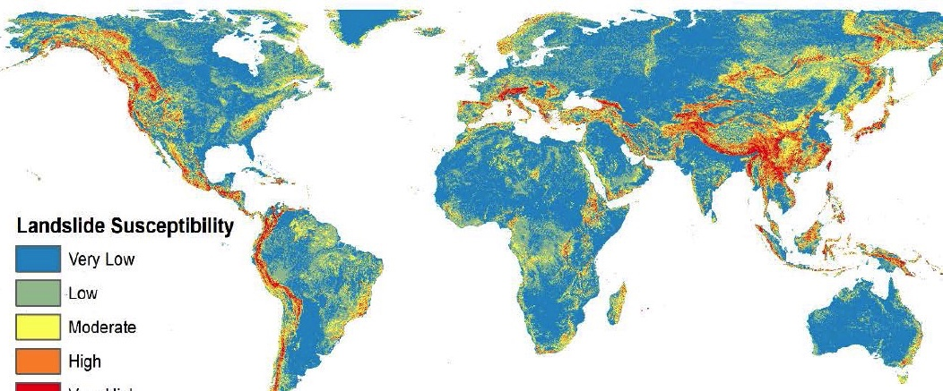
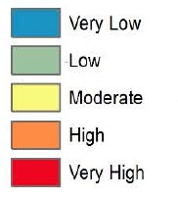
Landslide pilot – Test Sites
PNW
Nepal
China
Caribbean
EAR
Global Landslide Susceptibility
1:2M
Stanley & Kirschbaum (2015)
Continuation of data provision from Space Agencies
Results on Nepal, Pacific Northwest, Africa, Caribbean and China
Ongoing research in the study sites to develop new methodologies for processing SAR and optical data
Launch of https://landslides.nasa.gov and work with the GEP have greatly expanded the potential for inventories being shared across geographic areas

Slide 19

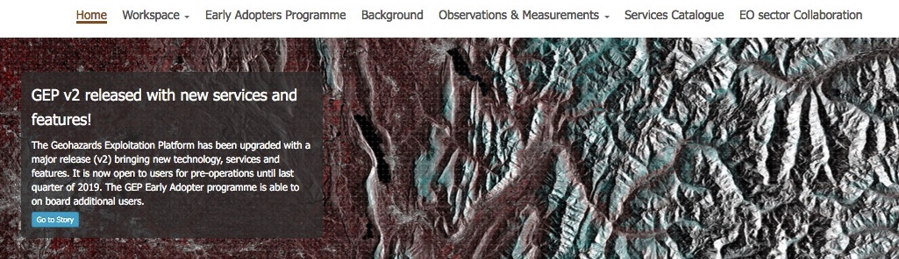

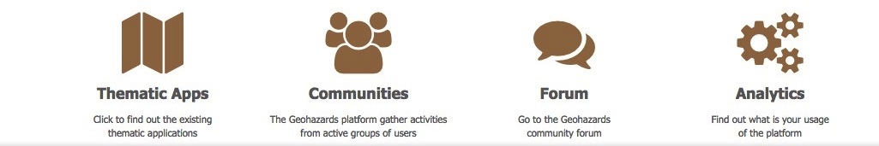
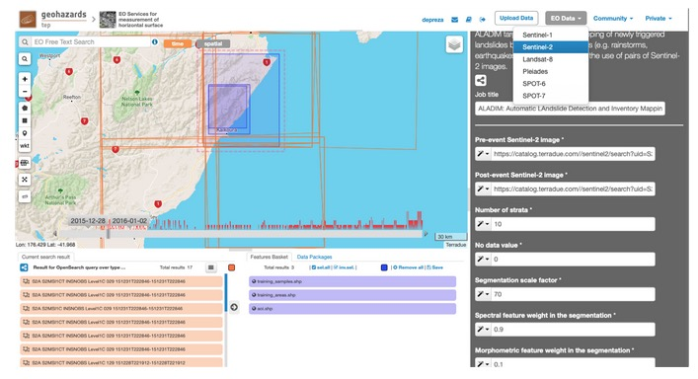
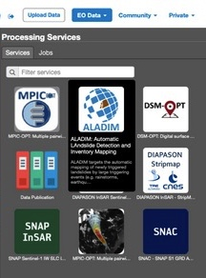
ALADIM service: automatic landslide detection and inventory mapping
Available on → ALADIM-S2 and ALADIM-VHR
Service selection
Service
use
Aline Déprez/Jean-Philippe Malet (CNRS/EOST)
Notes:
19

Slide 20
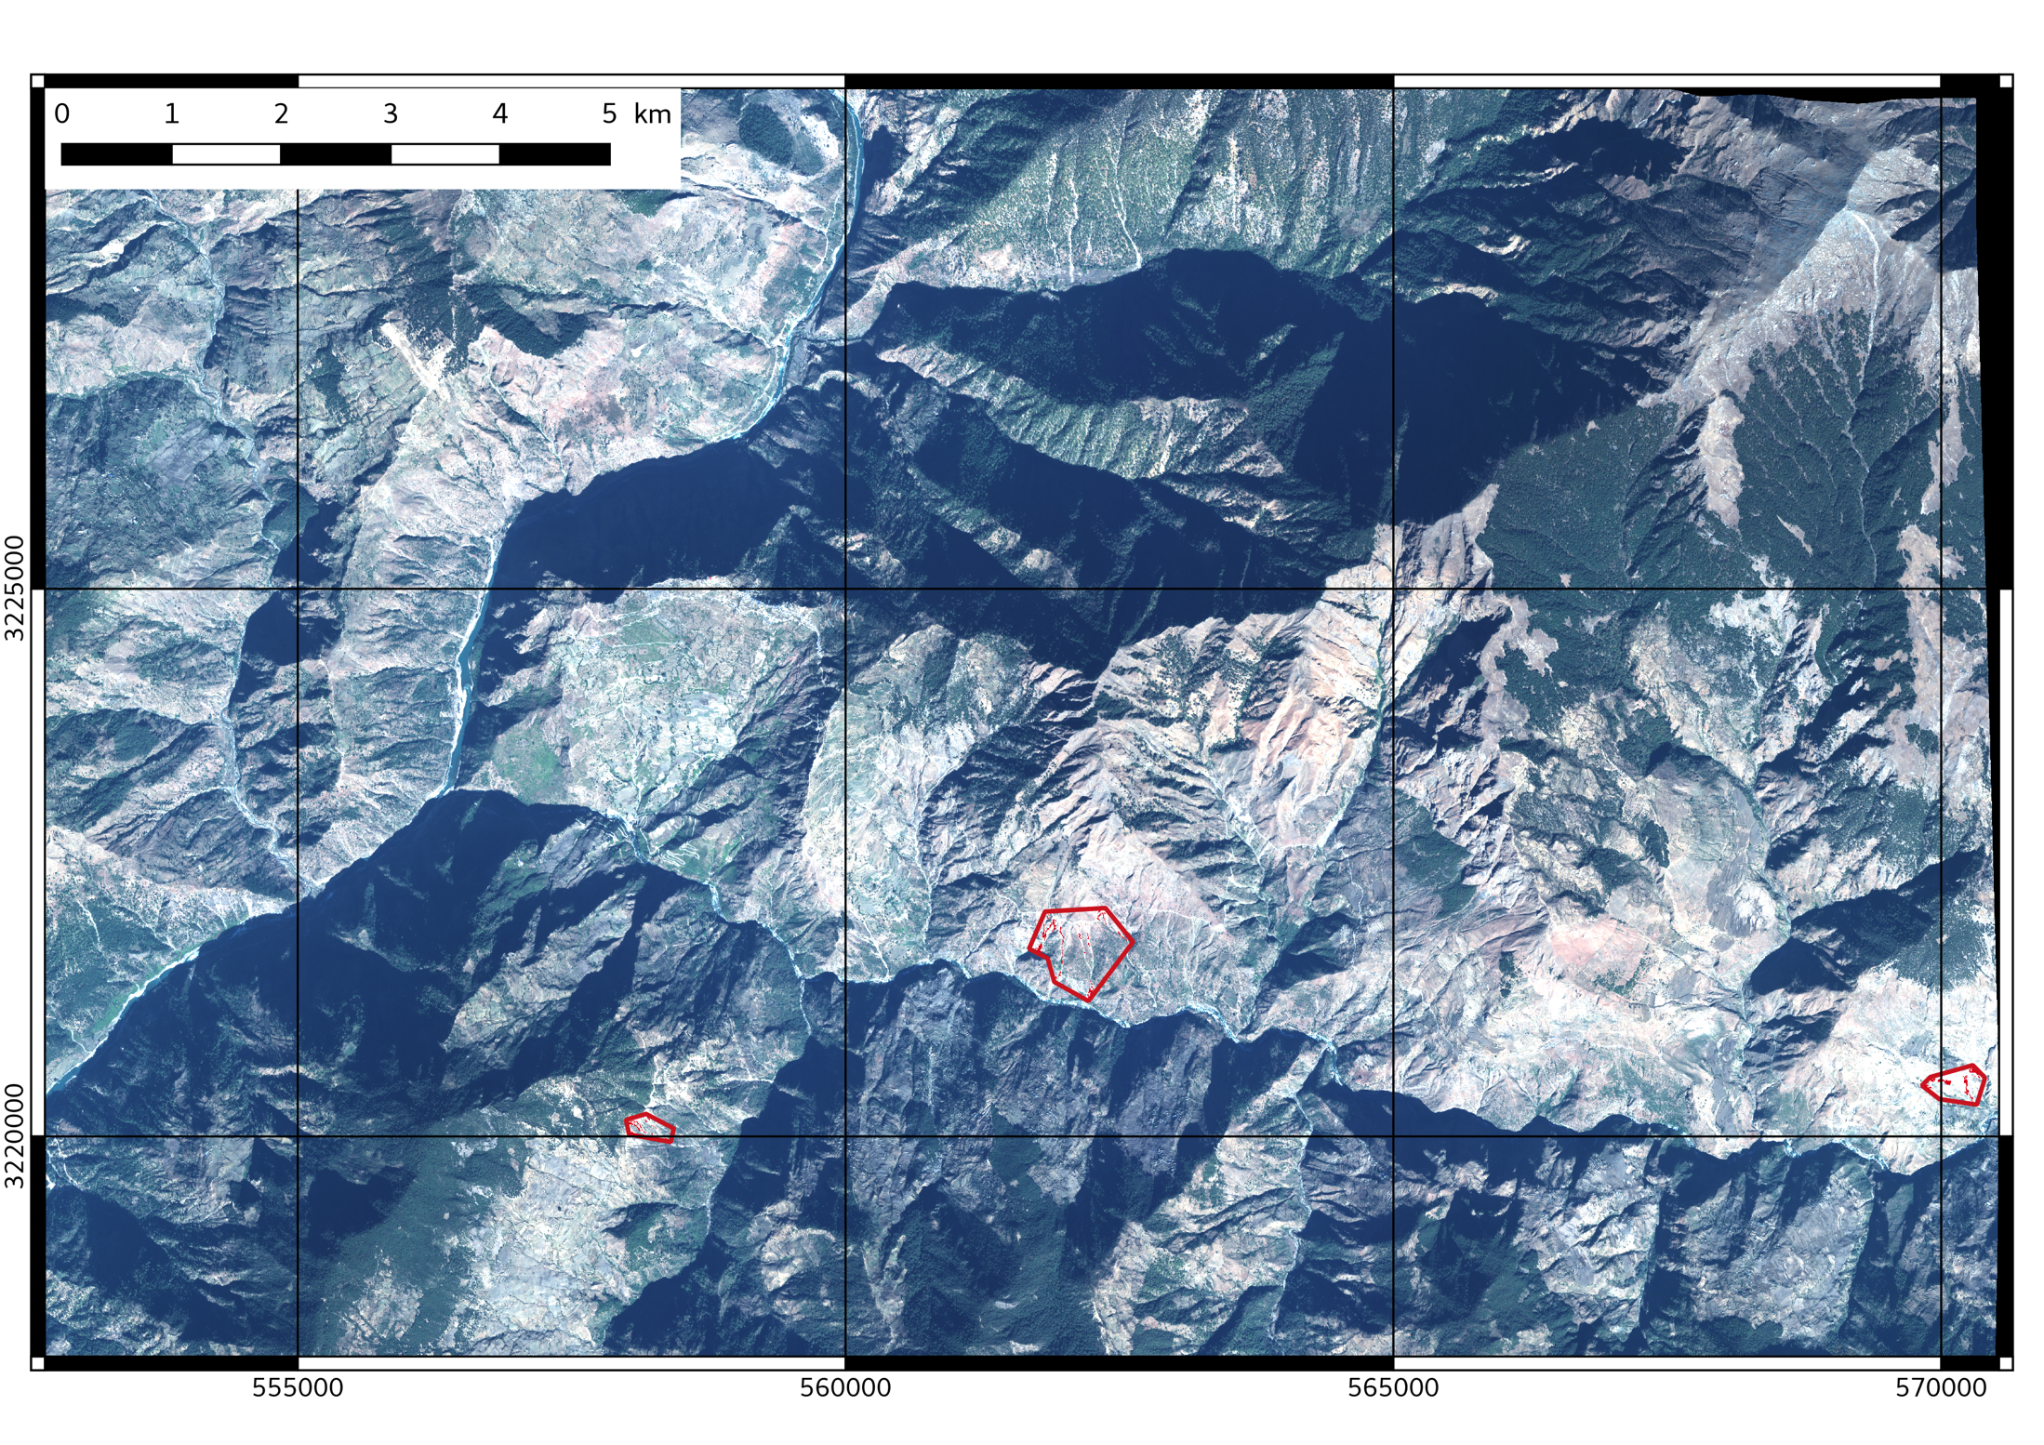

ALADIM service: automatic landslide detection and inventory mapping
Nepal / Pléiades data – Thrishuli valley
Landslide detection with ALADIM
Aline Déprez/Jean-Philippe Malet (CNRS/EOST)
Notes:
20

Slide 21
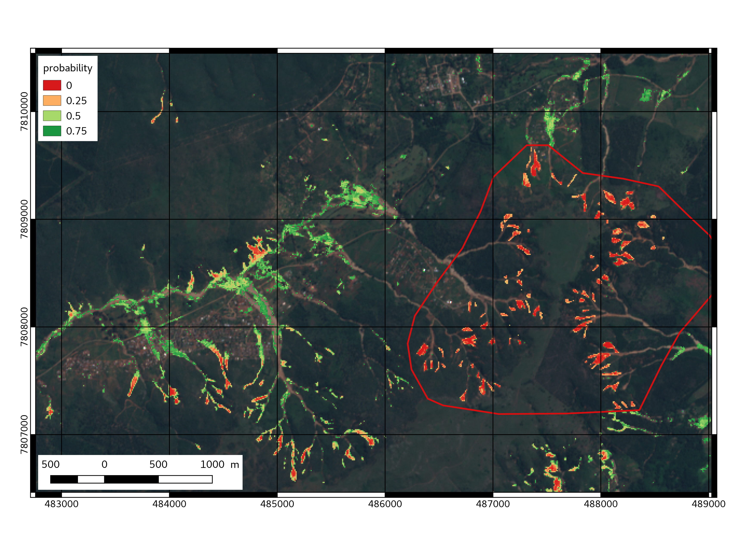
Mozambique cyclone Idai – march 2019, S2 data
imCLASS results: landslides + probability of classification
Computation: 1 hour for 1 S2 tile -> for this sub-region / experiment, 550 landslides detected …..
Zone 1
ESA/LPS317
Deprez et al. ImClass: A user-tailored Image CLASSification service for land surface mapping

Slide 22
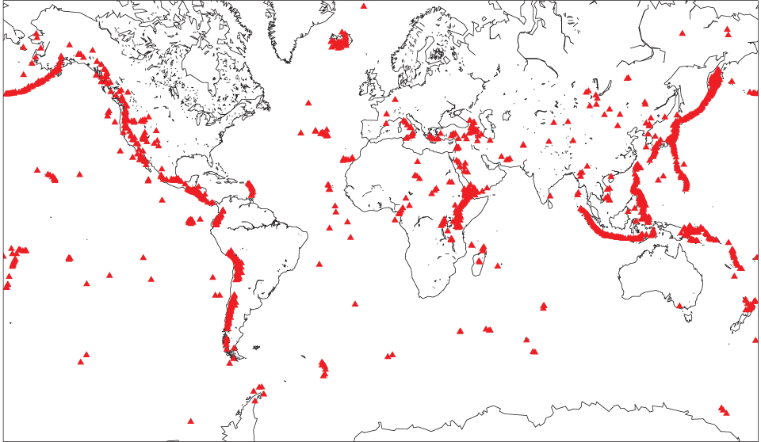
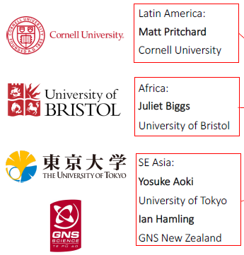
Volcano Demonstrator
International Leads:
S.Ebmeier (Univ. Leeds, UK)
M.Poland (USGS, USA)
Latin America Lead:
M.Pritchard (Cornell Univ., USA)
Africa Lead:
J.Biggs (Univ. Bristol, UK)
SE Asia Leads:
Y.Aoki (Univ. Tokyo, Japan)
I.Hamling (GNS Science, NZ)
Volcano Pilot Latin America: 2014-2017
Volcano Demonstrator :
Latin America, Africa & SE Asia 2019-2021

Slide 23
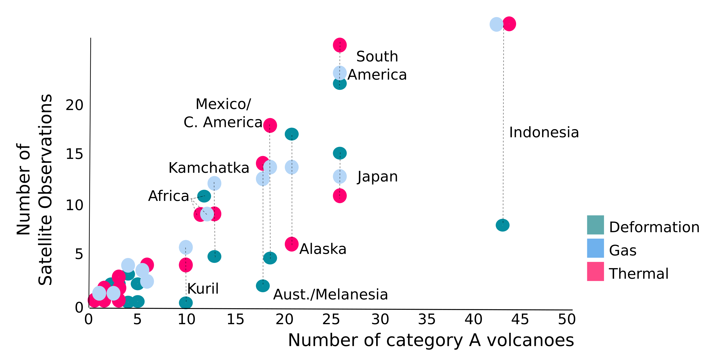

Observation Gaps
Pritchard et al., in prep
Notes:
Category A: eruption since 1990 in populated regions with PEI ≥ 2 (Loughlin et al. 2016), eruptions in all PEI regions in last 5 years (in other words 2014) and eruption from 1990, but not in last 5 years (i.e. before 2014) with a PEI of 1-2

Slide 24
FUEGO, Guatemala
2018 eruption of Fuego, Guatemala
Application of radar backscatter to detect fresh deposits and quantify co- and post-eruptive changes
Fresh pyroclastic flow deposits altered by successive lahars (volcanic mud flows)
Figures: Edna Dualeh, PhD researcher Leeds

Slide 25

Capacity Building developments
• Proposal put together by Matt Pritchard & others accepted for Cities on Volcanoes 11, May 2020. Funded by VDAP, WOVODAT, UK NERC & GLOVOREMID with joint goals of increasing capacity in remote sensing and cataloguing monitoring capacity
Workshop aims to build understanding of current monitoring capacity from ground and space, and solicit feedback on online tools designed to make satellite imagery accessible
Supported places for volcano observatory scientists.

Slide 26
Seismic Hazard Demonstrator
Over 50 capitals of the least developed countries are located on or near a major fault and are at increasing risk from earthquakes.
Proxy for Seismic Hazard Increasing

Slide 27
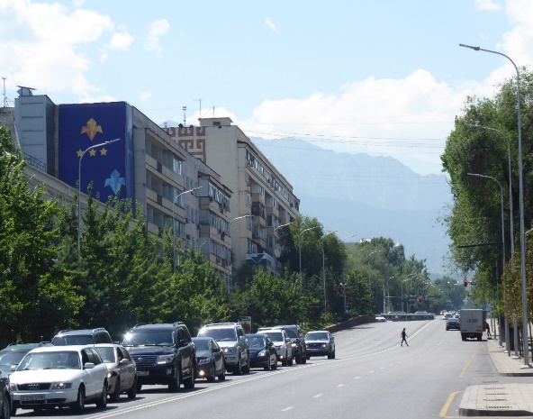
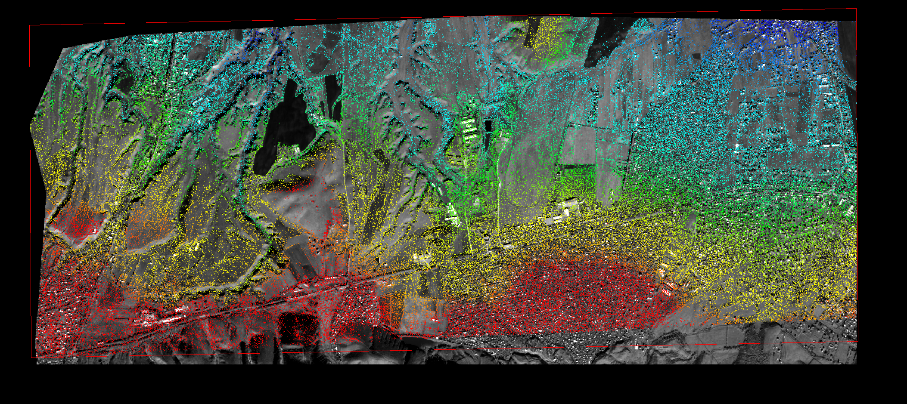
Pleiades Stereo
We can derive high-resolution DEMs to better map small splays in the city

Slide 28












GeoHazards Lab Initiative
Geohazards Lab:
A platform with federated resources to provide data access and an online processing and e-collaboration environment to exploit EO data to assess geohazards and their impact
  Supports and complements the CEOS WG Disasters activities (on-going pilots, follow-on activities and the RO), GSNL, GEODARMA and users from the broader geohazards community
  Maximize use of EO techniques and cloud processing by the EO expert community
  Achieve acceptance of EO products by the non-EO scientific community and decision makers
Landslide Pilot
Seismic Hazards Demonstrator
Volcano Demonstrator
Geohazards Lab
Recovery Observatory
CEOS WG Disasters

Slide 29
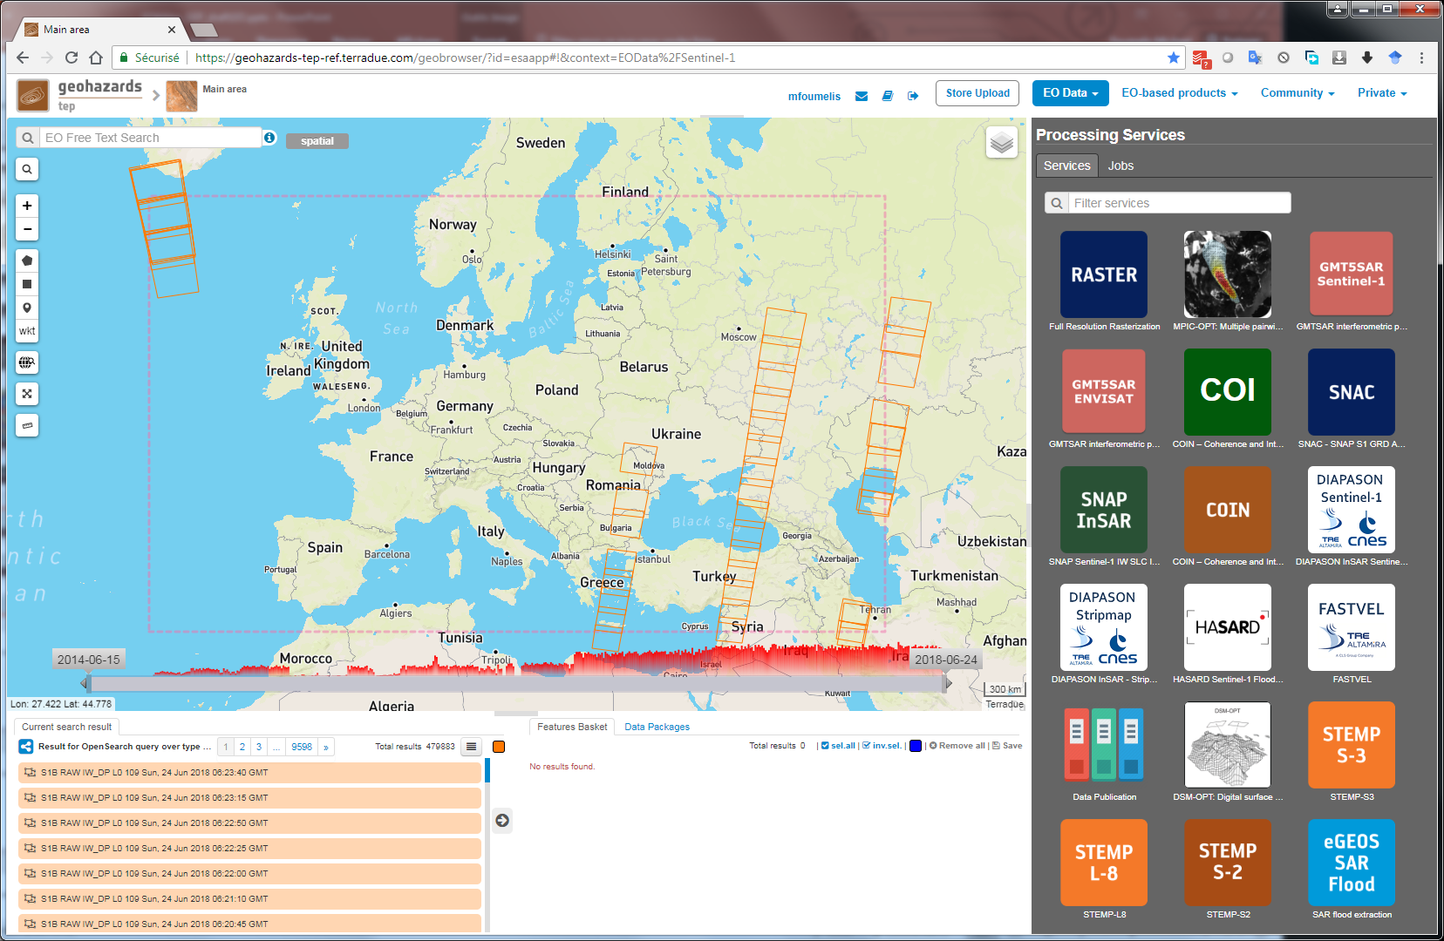
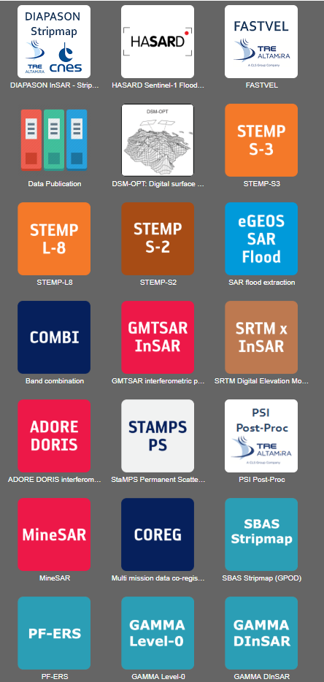
Geohazard Exploitation Platform
Support CEOS WG Disasters initiatives with data storage, data access, hosting processing and on line tools.

Slide 30
GEO / LEO Progress
GEO/LEO participants and members of the WGDisasters team have met virtually in a series of conference calls following the last SIT gathering in Miami – emphasis in discussions have been on how to explore integration of SAR as a LEO contribution.
GEO/LEO and WGDisasters see opportunities for collaboration:
  Identify a small number of impactful flood events with known, rich volumes of GEO/LEO and complementary SAR data
  Identify additional past cases and new, unfolding cases emphasizing availability of multi-frequency and new SAR missions
Bring together GEO/LEO optical and additional SAR maps to explore practices for combining their information.
  Leverage ongoing work in the community to infer water depth from extent mapping to improve mapping of impacts
Explore integration opportunities with CEOS ARD Strategy, Data Cube, WGISS and WGCapD efforts.

Slide 31
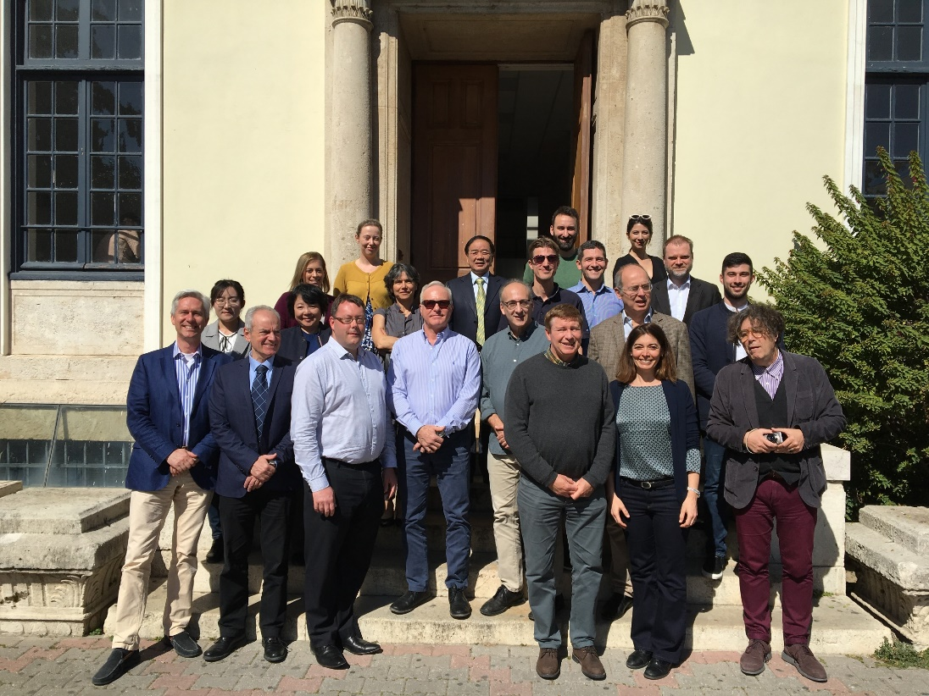
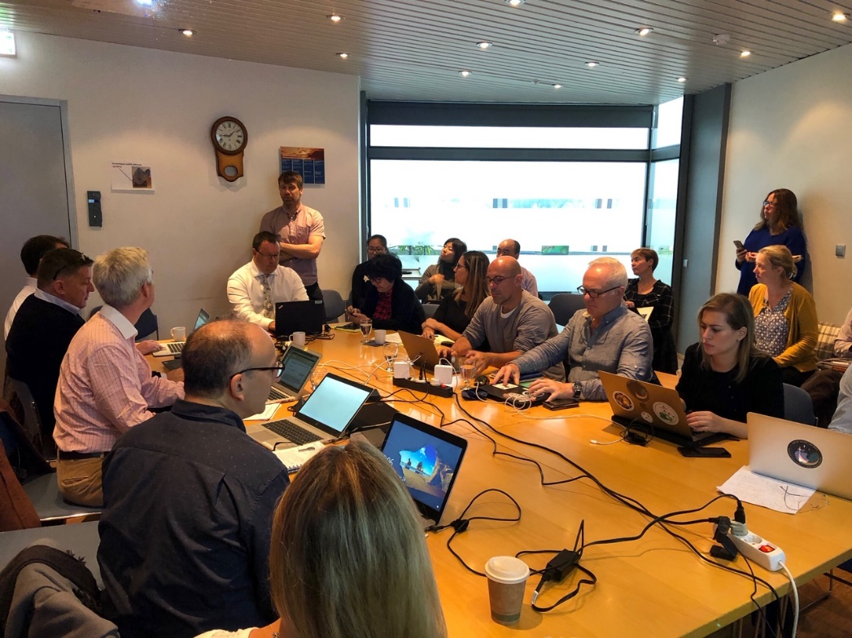
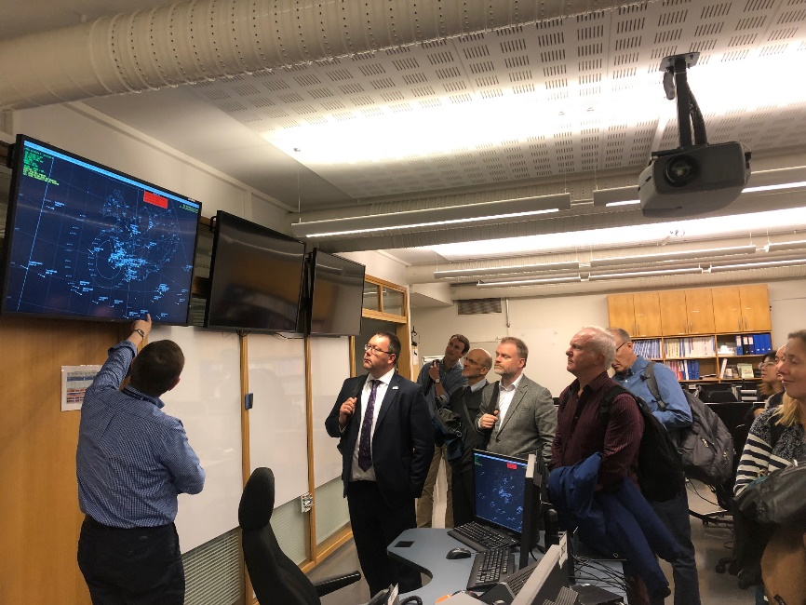
2019 Meetings
Harokopio University Athens,
Athens, March 2019
University of Iceland, Reykjavik,
September 2019

Slide 32
Term of Reference - Endorsement
WG Disasters ToR, approved at Plenary 2013
WG Disasters review of the ToR in 2019 on the basis of new Sendai Strategy
Updated ToR shared with the SEC in July, presented at the SIT TW in September
  new high-level objectives, reference to the Sendai Framework for DRR and in particular to Prority 1, Understanding Risk
  Emphasis on
    Risk (hazard, exposure, vulnerability)
    Full cycle of DRM,
    Multiple hazards type
    User driven approach
  Identification of a sub group, the Data Coordination Team (DCT), responsible to coordinate the response to data request for disaster related activities
Request for endorsement at CEOS Plenary 2019

Slide 33
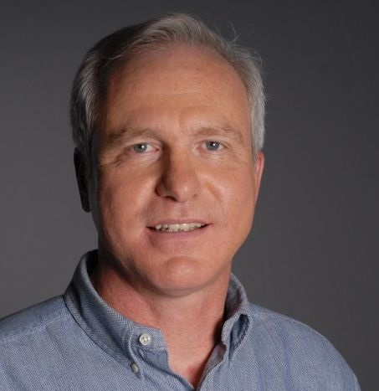
Vice Chair Nomination - Endorsement
Working Group Vice Chair Nomination
Current Chair term terminates with
CEOS plenary 2019
Need of Vice Chair nomination
Candidate: Pierric Ferrier /CNES
  Currently in charge of the Space and Risk /
  Disaster thematic at CNES since Mid-2018
  Previously: Satellite project Manager for Venµs: an Earth observation mission combining high resolution, spectral richness and frequent revisit time.
CEOS WGDisasters recommends the nomination of Dr Ferrier
Request for endorsement of Dr Ferrier as incoming Vice-Chair 2019-2021

Slide 34
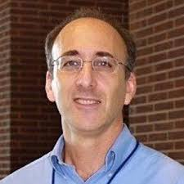

Chairmanship handover
New WG Disasters Chair
David Green – NASA
Disasters Program Manager

Slide 35

THANK YOU

