Slide 1

WG Capacity Building & Data Democracy (WGCapD)
Committee on Earth Observation Satellites
Dr. Prakash Chauhan, ISRO, WGCapD Chair
Dr. Nancy D. Searby, NASA, WGCapD Vice Chair
CEOS 2019 Plenary
Agenda Item # 5.2
Ha Noi, Viet Nam
14-16 October 2019

Slide 2
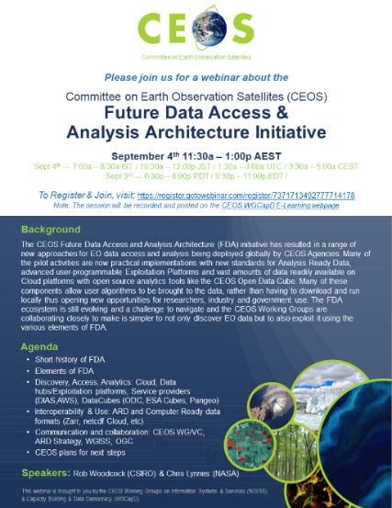

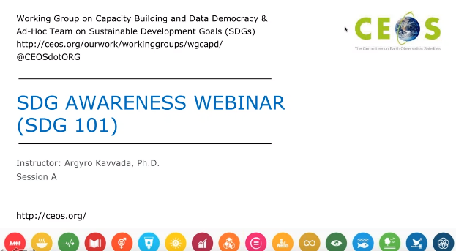
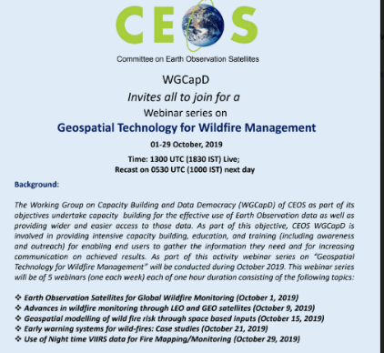
Accomplishments:
Webinars & MOOCs Supported
CB-41
Collaboration between AHT-SDG and WGCapD to organise SDG-related training and capacity building related to the use of space-based EO to meet the data challenges of the 2030 Agenda for Sustainable Development
SDG Awareness Webinar
Dec 19, 2018
FDA-5
FDA awareness building and outreach
FDA Awareness Webinar
Sept 4, 2019
CB-28
Conduct global capacity building courses through a multi-lingual MOOC on radar backscatter
Introduction to Radar Remote Sensing MOOC
Available: Sept 16, 2019
CB-28
Webinar series (5 nos) on Geospatial Technology for Wildfire Management supported by ISRO-NASA-ECMWF started during
Webinar Series: Oct 1-29, 2019

Slide 3
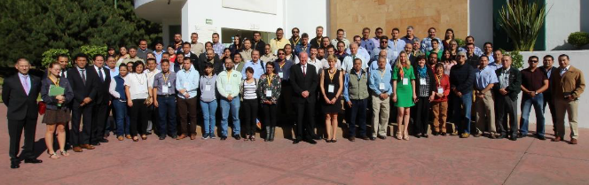
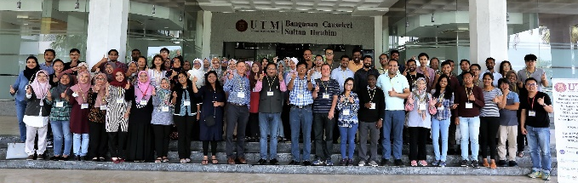
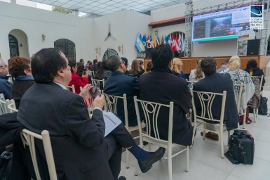
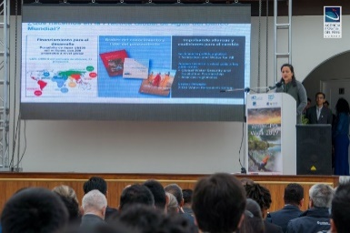
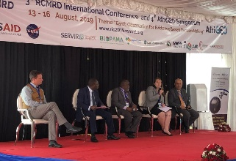
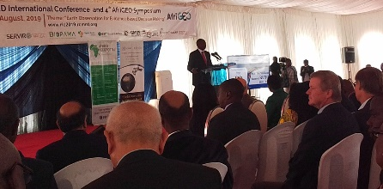
Accomplishments:
Trainings & Events Supported
CB-33: Provide SAR and other EO data training in support of VNSC Chair initiative – Workshop in Hanoi, Vietnam: Feb 20-22, 2019
CB-39: Provide hands-on training on forest monitoring and Orfeo Tool Box for AEM – Training in Guadalajara, Mexico: Feb 26-28, 2019
CB-32: Provide regional hands-on training in LCLUC topics in GEOSS regions – Training in Johor Bahru, Malaysia: July 25-27, 2019
CB-35: Provide CB support to AmeriGEO Week 2019 in Peru – Supported Event & 2 Trainings on Water SDGs in Lima, Peru: Aug 9-13, 2019
CB-36: Provide CB support to AfriGEO Symposium 2019 – Supported Event in Nairobi, Kenya: Aug 13-16, 2019
CB-40: Provide hands-on training for flood monitoring for Vietnam School of Earth observation – Training in Quy Nhon, Vietnam: Sept 8-14, 2019
CB-33-2: Provide hands-on SAR and other EO training disaster applications – Land Subsidence Training in Vietnam: Sept 23-26, 2019

Slide 4

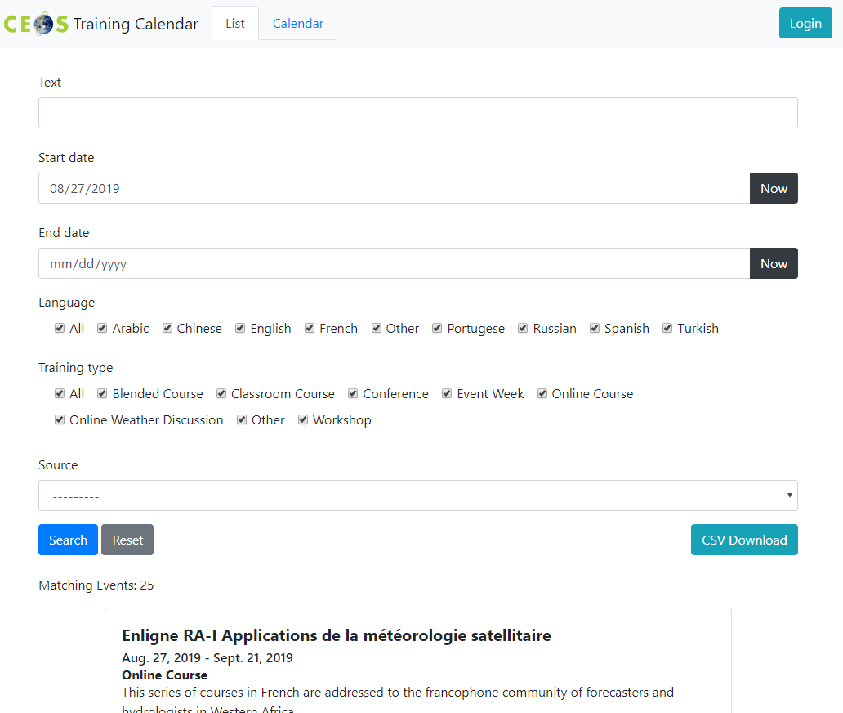
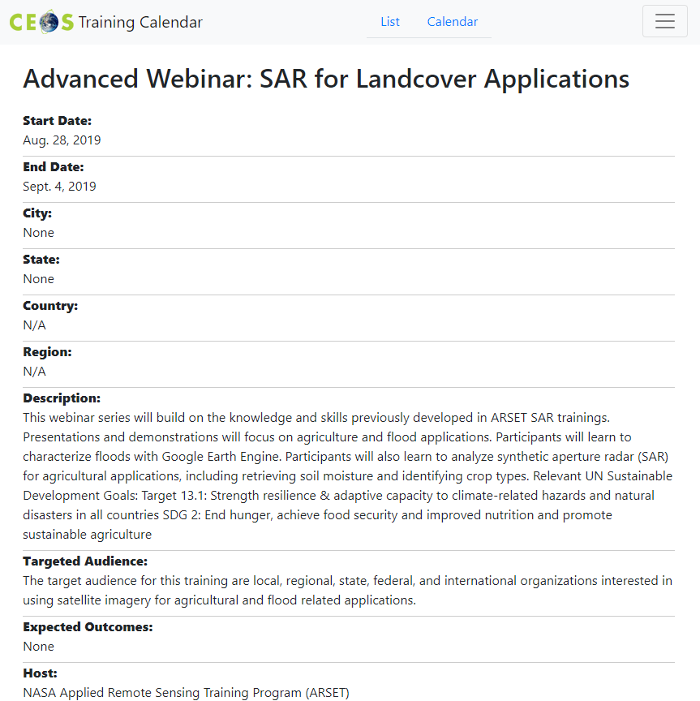
Accomplishments:
Infrastructure & Papers
Training Calendar
CB-37: CB White Paper
https://training.ceos.org
Calendar is live
21 fields
Current content sources: EUMETSAT and WMO training calendar sites
NASA and DLR training calendars are in progress and will “feed” the master CEOS training calendar
Looking for:
  Feedback on structure & format
  Additional sources of training events
  Ad hoc training events to add
White paper describing approaches for capacity building networks supported by others, e.g. UN, can work together
Completed & submitted to SIT
Submitted & approved for peer-review publication in the Journal of Space Policy
POCs:
Andrew Lubawy, SEO
Andrew.M.Lubawy@ama-inc.com
Lauren Childs-Gleason, WGCapD
Lauren.M.Childs@nasa.gov

Slide 5
WGCapD Work Plan 2019-2021
17 deliverables: 13 in 2019, 4 in 2020, * new this year
Global Activities
  CB-28, 30, 31: MOOCs on Radar Backscatter (Q1 2019: Available Sep 2019), SAR applications (Q4 2019: Will go online Nov. 2019), LCLUC (Q4 2019: delayed)
  CB-29: Webinar series on multiple topics, e.g. GEOGLAM, Hyperspectral Remote Sensing and disasters (Q4 2019), LCLUC (Q3 2020)
Regional Activities – Training in GEO Regions
  CB-35, 36: AmeriGEO (Q3 2019: completed), AfriGEOSS (Q3 2019: completed)
  CB-27: AOGEOSS (Q4 2020)
  CB-32: Regional hands-on training in land cover land use change: Malaysia (Q3 2019: July 2019), Thailand (Q4 2019)
National In-person Training *
  CB-33: SAR & EO data training for VNSC Chair Initiative (Q3: completed 1 of 2 workshops)
  CB-39: hands-on training on forest monitoring & Orfeo Tool Box for AEM (Q1: completed)
  CB-40: hands-on training on flood monitoring for Vietnam School of Earth Observation (Q3: completed)
COMPLETED

Slide 6
WGCapD work plan 2019-21
17 deliverables: 13 in 2019, 4 in 2020; * new this year
CB Infrastructure
  CB-21: portal-based access to CB and training resources (Q4 2020)
  Training Calendar pilot (completed in Q3 2019)
CB Training Materials *
  CB-38: hyperspectral training resources on line (Q2 2020)
WG Collaborations
  CB-41: with SDG AHT, promote use of EO for SDG’s (Q3 2019)
    Hands-on with AmeriGEO Week on SDG 6.6.1/6.3.2
  FDA-5: FDA´s awareness building and outreach (Q3: completed)
Broader CB Collaborations
  CB-37: White paper describing how CB networks, e.g. UN’s, can work together with WGCapD (Q2 – completed; provided to SIT; submitted & accepted for peer-review publication)
COMPLETED

Slide 7
Sustainable Commitment
Active Agencies in WGCapD:
  WGCapD Core has 13 Deliverables due this year: CNES, DLR, ESA, INPE, ISRO, NASA, VNSC
  Annual meeting held in India and virtual participation also included: SANSA, UK’s National Center for Earth Observation (UK NCEO), CRECTEALC, GODAN, GEO Sec CD Coordinator, AfriGEO, AmeriGEO, VLab
  ROSCOSMOS has sent a letter to formally join CEOS WGCapD and identified members
Future Leadership rotation:
  Current: Dr. Prakash Chauhan, ISRO (Chair) and Dr. Nancy D. Searby, NASA (Vice Chair)
  2019-2021: Dr. Nancy D. Searby, NASA (Chair) and Dr. Pham Thi Mai Thy, VNSC (Vice Chair)
Status & Outlook:
  We have a well-engaged core group and are growing

Slide 8
Synergies w/CEOS Teams
Synergies:
WGISS – participation in each others’ meetings, joint FDA-5 FDA awareness webinar delivered on 4 Sept 2019
SEO – working jointly on the training calendar pilot
SDG AHT – joint awareness webinar delivered Dec 2018 and SDG water quality training at AmeriGEO Week delivered Aug 2019
WGDisasters – joint virtual meeting discussion in March, discussing joint deliverables and opportunities, need to identify next steps / paths forward
GEOGLAM AHT – overlapping people engaged in both, potential to strengthen further – need to explore opportunities
GFOI SCDG – same agencies engaged in both, potential to collaborate – need to explore opportunities
WGClimate, WGCV – have explored synergy, WGCapD member looking to submit use cases for upcoming climate report
VCs – no engagement - looking for opportunities
Obstacles/Barriers & Path to Overcome Them:
Travel constraints prohibit attending other WG/AHT/VC meetings – exploring virtual meetings to discuss work planning

Slide 9

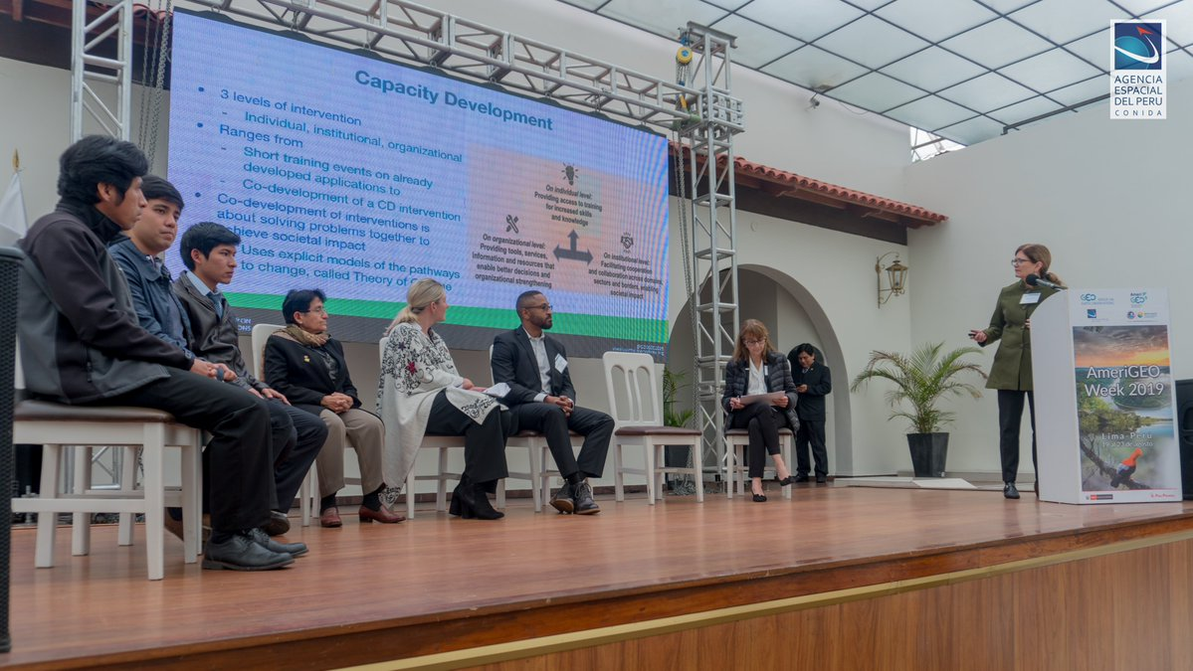

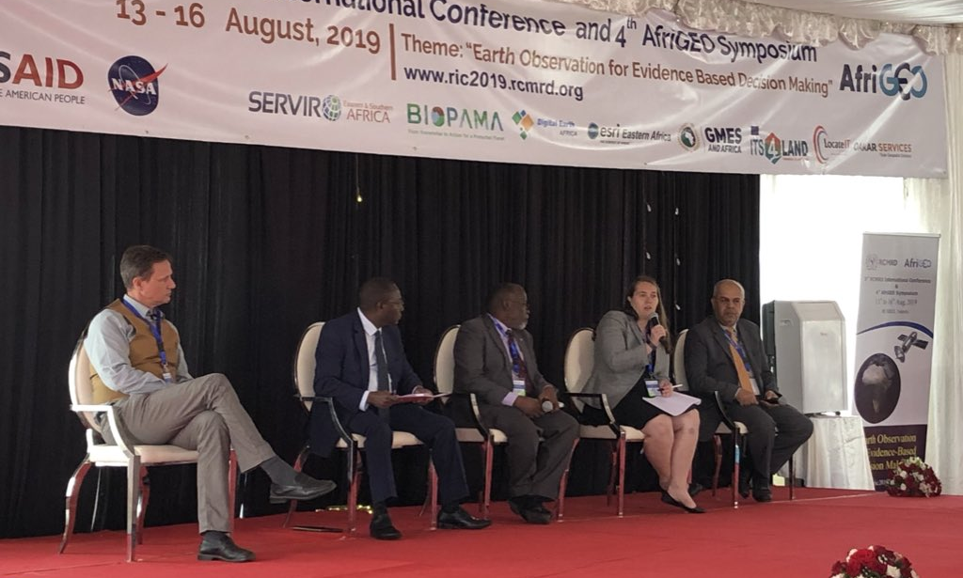
GEO Regional Synergies
Overlap of agencies supporting CEOS WGCapD and AmeriGEO
Support trainings at annual AmeriGEO Week: 1 in 2018, 2 in 2019
Engaged for multiple years & participate in annual symposium
Supported SAR training at 2019 AfriGEO Week
AfriGEO Secretariat is now located at RCMRD in Nairobi, Kenya

Slide 10


GEO Thematic Synergies
GEOGLAM
GEOGLAM: Strengthens global ag monitoring by improving the use of remote sensing tools for crop production projections and weather forecasting to reinforce the international community's capacity to produce and disseminate relevant, timely, and accurate forecasts of agricultural production using EO data
Includes a component focused on development of capacity to use EO and aims to respond to varying levels of uptake by countries
WGCapD Overlaps: Capacity building efforts focused on use of SAR for rice, damage assessment of crops due to floods, and operational use of EO data for agriculture monitoring using optical and microwave data are relevant to GEOGLAM
Opportunities: Joint capacity development activities in Asia, Africa, and South America. ISRO-IIRS (WGCapD), GEOGLAM, and AsiaRiCE (as well possibly SARI) will plan a training for participants of Asia-Pacific Countries (Nov, 2019) and a webinar series in early 2020
Explore joint meetings for GEOGLAM and WGCapD for planning future trainings and CB resources together
GFOI
GFOI: Global partnership for coordinating international support on forest monitoring & MRV for REDD+ and related forums
Includes a capacity building component which has supported land cover change methods train-the-trainer workshops, open-source tool applications, and improved methods for monitoring and estimating land cover change that include getting started with Google Earth Engine, land use change algorithms such as LandTrendr and CCDC, and platforms such as SEPAL (from FAO), Terra-I (from CIAT), and Collect Earth Online (Silva Carbon & SERVIR)
Space Data Coordination Group (SDCG) for GFOI AHT – established in 2011, emphasis on data accessibility and usability
WGCapD Overlaps: Supporting MOOCs, webinar series, and regional hands-on trainings focused on LCLUC, SAR, and forest monitoring
Opportunities: Looking for ways to engage and contribute towards GFOI’s capacity building activities – explore kick off of discussions at the CEOS Plenary or GEO Week

Slide 11
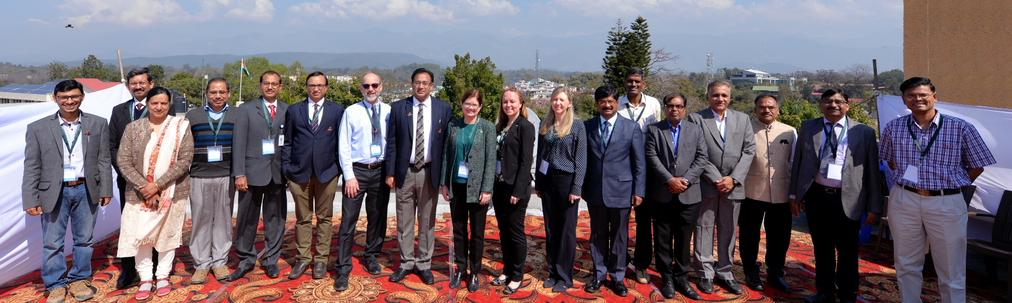
WGCapD-8 Annual Meeting March 6-9, 2019 Dehradun, India
WGCapD-9 Annual Meeting
March 10-12, 2020
Mountain View, California

Slide 12
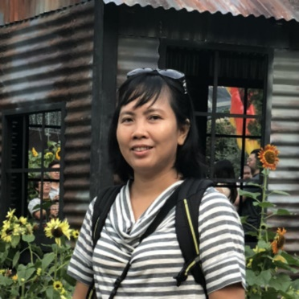
WGCapD Leadership Transition
Welcome Pham! Looking forward to serving as Chair!
Chair:
Dr. Nancy Searby (NASA)
Thank You
Chair: Dr. Prakash Chauhan (ISRO)
Vice Chair: Dr. Nancy Searby (NASA)
& WGCapD Members
For Endorsement:
Vice Chair:
Dr. Pham Thi Mai Thy
(VNSC)

