Slide 1

Ad Hoc Team continuity decisions
Committee on Earth Observation Satellites
Steven Hosford
CEOS Executive Officer
CEOS Plenary 2019
Agenda Item 5.10
Ha Noi, Viet Nam
14 – 16 October 2019

Slide 2
Summary
Plenary decision required on continuity of
Space Data Coordination Group for GFOI
Ad Hoc Working Group on GEOGLAM
SDG Ad Hoc Team

Slide 3

Space Data Coordination Group for GFOI

Slide 4
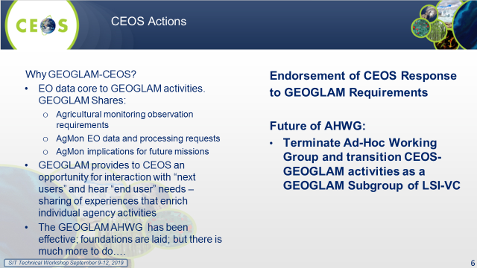
Ad Hoc Working Group on GEOGLAM

Slide 5

Sustainable Development Goals
Ad Hoc Team

