Slide 1
CEOS Analysis Ready Data
Strategy
Committee on Earth Observation Satellites
Adam Lewis, GA, 2020-2021 SIT Chair Team
CEOS Plenary 2019
Agenda Item 4.3
Ha Noi, Viet Nam
14 – 16 October 2019

Slide 2
2020-2021 SIT Chair Priorities
CSIRO/GA will serve as the SIT Chair for 2020-2021
Intention for the term is to escalate, elevate and encourage accomplishment of ongoing pieces of CEOS work.
Three priority areas:
CEOS ARD
Carbon and Biomass
UN Sustainable Development Goals

Slide 3
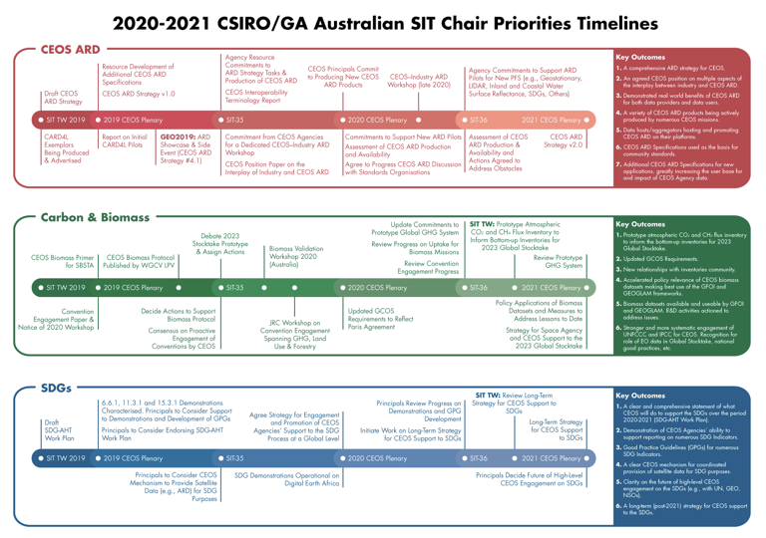
2020-2021 SIT Chair Priorities

Slide 4
CEOS Analysis Ready Data
Key CEOS Analysis Ready Data Outcomes
A comprehensive ARD strategy for CEOS
An understanding of the interplay between industry and CEOS ARD
Demonstrated real world benefits of CEOS ARD for both data providers and data users
A variety of CEOS ARD products being actively produced by numerous CEOS missions
Data hosts/aggregators hosting and promoting CEOS ARD on their platforms
Engagement with standards organisations
Additional CEOS ARD Specifications for new applications, greatly increasing the user base for and impact of CEOS Agency data

Slide 5
CEOS Analysis Ready Data Strategy
Main objectives of the strategy:
ensure effective engagement of the three key stakeholder groups: EO data providers (both public and private); Big Data hosts and aggregators who stage increasing amounts of CEOS Agency free and open data; and data users;
manage expectations of all stakeholders as to the status and outlook for ARD availability – so that all might plan and invest with confidence;
establish priorities for which products and applications might follow on from the current CARD4L PFS – forming a rational and orderly queue for future efforts;
ensure appropriate organisational responsibilities across the CEOS structure for the definition and execution of the way forward on ARD.
This Strategy aims to escalate, elevate and encourage accomplishment of ongoing and resourced pieces of CEOS work through coordination under a collective banner.

Slide 6
CEOS Analysis Ready Data Strategy
Four pillars:
CEOS ARD User Needs & Specifications
Assured Production & Access
Pilots & Feedback
Communication & Promotion
Foreseen as an informal collection of ongoing and resourced pieces of CEOS ARD-related activities across the CEOS structure, with light oversight and coordinated reporting supported by SIT.

Slide 7
1: CEOS ARD User Needs & Specifications
1.1: Continue development of the Product Family Specifications
CARD4L for SAR, CARD4Lidar.
1.2: Identify the need for and prioritise development of future target products as the basis for new CEOS ARD specifications
1.3: Develop further CEOS ARD technical specifications based on established need and prioritisation
1.4: CEOS Interoperability Terminology Report
Define various terms related to Analysis Ready Data, interoperability, and harmonization.

Slide 8
2: Assured Production & Access
2.1: Engage Big Data hosts and aggregators and establish formal pipelines and procedures to promote CEOS ARD hosting and uptake on their platforms
streamline movement of data to global platforms
improve consistency and provenance of data
2.2: Facilitate discovery of and access to CEOS Agency ARD
WGISS task – leveraging Connected Data Assets infrastructure
One-stop-shop discovery of and access to CEOS Agencies’ ARD
2.3: Survey users’ needs with regard to ARD accessibility and provide feedback to all data providers
2.4: CEOS Paper on the Interplay of Industry and CEOS ARD

Slide 9
3: Pilots & Feedback
3.1: Production of CEOS ARD and supply to data aggregators and platforms
Capture and communicate CEOS Agency commitments to producing CEOS ARD
Ensure this data is easily accessible by the public, both through in-house, proprietary access portals but also through redistribution by third-party global IT platforms
3.2: Gather and report on feedback on CEOS ARD products through key programs, e.g.:
Digital Earth Africa (DE Africa)
GFOI
GEOGLAM Pilot
Mekong Data Cube Pilot
Other

Slide 10
4: Communication & Promotion
4.1: GEO Week Side Event: Big EO: Big Data
4.2: CEOS–Industry ARD Workshop
inviting agencies and the private sector
engagement between EO data providers (public and commercial), big data hosts/aggregators
4.3: CEOS ARD stocktake and outlook
current and future availability of ARD datasets
access details
4.4: Engagement with standards organisations
explore whether CEOS ARD specifications might be used as the basis for broader, official community standards
4.5: Promotion of CEOS ARD to data providers
4.6: Communication with CEOS ARD users

Slide 11
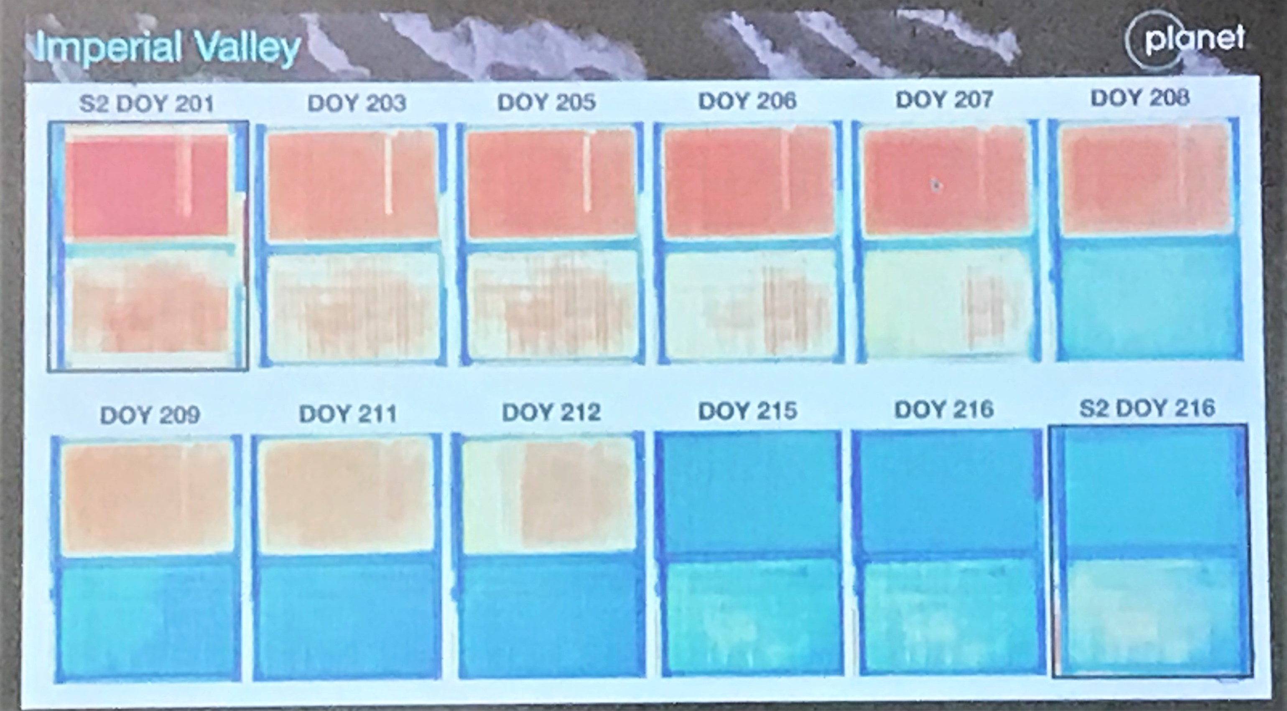
ARD19 industry-led conference

Slide 13
Resources
This Strategy aims to escalate, elevate and encourage accomplishment of ongoing and resourced pieces of CEOS work through coordination under a collective banner
And to inspire new contributions with important outcomes
Most activities have leadership and plans already
Respecting that CEOS is a ‘best efforts’ organisation and recognising that work will proceed within CEOS capacity

Slide 14
CEOS Analysis Ready Data Strategy
Document for endorsement at CEOS Plenary 2019
A well-executed strategy will ensure CEOS Agency missions increase the users and uses of data and continue informing decision-making for a prosperous and sustainable future for humankind.
CEOS Mission Statement
Agency contributions to tasks and other inputs are very welcome.
The SIT Chair Team looks forward to working with all of CEOS to realise the vision of the Strategy.

