Slide 1
CEOS ARD for Land (CARD4L)
Steve Labahn, USGS, LSI-VC Co-Lead
Adam Lewis, GA, LSI-VC Co-Lead
Zoltan Szantoi, JRC/EC, LSI-VC Co-Lead
CEOS Plenary 2019
Agenda Item #: 4.2
Ha Noi, Viet Nam
14-16 October 2019

Slide 2
Definitions
In the context of Earth remote sensing, the terms Analysis Ready Data (ARD), interoperability, and harmonisation are often used and, to a large extent, used inconsistently
As it relates to Earth observation products, interoperability represents a continuum of potential compatibility for products to work in numerous information technology systems and with other like-prepared data products
  Ultimate product interoperability (i.e., a fully harmonised dataset) is achieved when products have a fully consistent spectral, radiometric, geometric, metadata, and file format implementation where applications can interact fully with the data interchangeably, automatically, and without modification
Specifically, 5 terms have been defined:
  Analysis Ready Data (ARD)
  CEOS ARD for Land (CARD4L) Products
  Interoperable Products
  Harmonised Products
  Fused Products

Slide 3

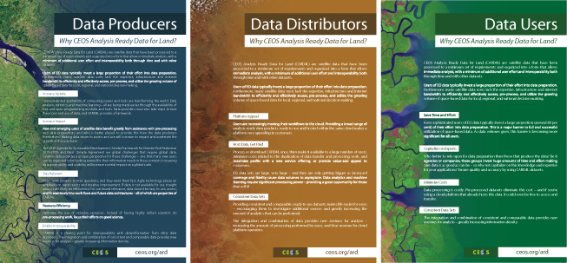
CARD4L
CEOS Analysis Ready Data for Land (CARD4L) are satellite data that have been processed to a minimum set of requirements and organized into a form that allows immediate analysis with a minimum of additional user effort and interoperability both through time and with other datasets.
CARD4L offers numerous benefits for data producers, data distributors, and data users.
Data Producers Increase Uptake Increase Impact Stay Relevant Increase Efficiency Enable Interoperability | Data Distributors Platform Appeal Consistent, High- Quality Data Sets | Data Users Save Time and Effort Capitalize on Experts Minimize Costs Consistent, High- Quality Data Sets
More info: http://ceos.org/ard/

Slide 4
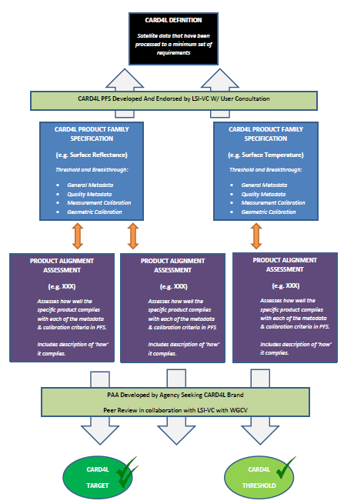
CARD4L Framework http://ceos.org/ard/
CARD4L Definition
Product Family Specifications (PFS)
Optical Surface Reflectance (CARD4L-OSR)
Surface Temperature (CARD4L-ST)
Normalized Radar Backscatter (CARD4L-NRB)
* Additional radar PFSs are under consideration
Providers self-assess how well their products meet the specifications
Providers submit self-assessment to CEOS WGCV for peer review
CARD4L-compliant stamp!

Slide 5
LSI-VC-8 / SDCG-16 / GEOGLAM Joint Meeting
4-6 September 2019
Anchorage, AK USA http://ceos.org/meetings/lsi-vc-8-geoglam-sdcg-16-joint-meeting/
3rd joint meeting of LSI-VC with CEOS SDCG for GFOI and CEOS GEOGLAM
Continued progress on CARD4L
  USGS, JAXA, ESA, and GA progressing CARD4L self-assessments. Expect these to begin WGCV peer review shortly.
  WGCV CARD4L peer review process presented at WGCV-45 was agreed. An initial pool of reviewers were also identified. WGCV is now in a position to peer review the CARD4L self-assessments when requested. Thanks to WGCV for their support!
  Discussed CARD4L promotion and pilots with thematic groups (CEOS SDCG for GFOI and CEOS GEOGLAM)
  KARI joined for the first time. Assessing their products against CARD4L and producing some initial ARD based on CARD4L with sub-10m data from KOMPSAT (for use with Open Data Cube)
Initiated discussions around LSI-VC contributions to SIT Chair 2020-2021 CEOS ARD priorities
  CEOS-Industry ARD Workshop
  Connecting with WGCV and WGISS on various topics including CEOS Interoperability Terminology Report
Joint session with WGClimate with goal of rebooting LSI-VC requirements and gap analysis
  LSI-VC plans to undertake two actions from the WGClimate Coordinated Action Plan -> LST CDRs and continuity
  Discussed biomass measurements as a priority across CEOS (SDCG, GHG, etc.) -> CARD4Lidar concept
New LSI-VC Co-lead nomination

Slide 6
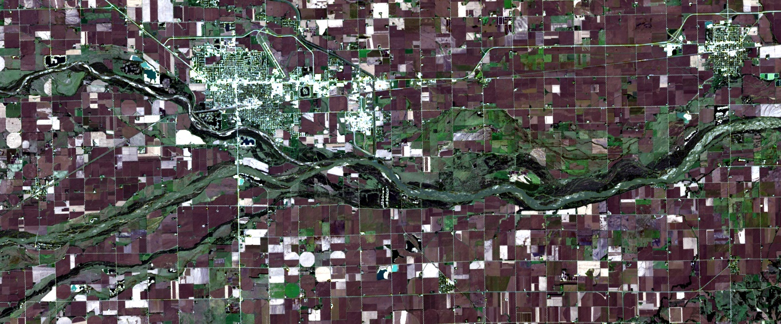
USGS Collection 2
Landsat 8 Level-2 Surface Reflectance
Path 29 / Row 31
October 8, 2016
True-color RGB (4/3/2)
LPGS v15.2.0 (7/22/2019)
LaSRC 1.4.1 (SR)
Single-Channel 1.3.0 (ST)

Slide 7
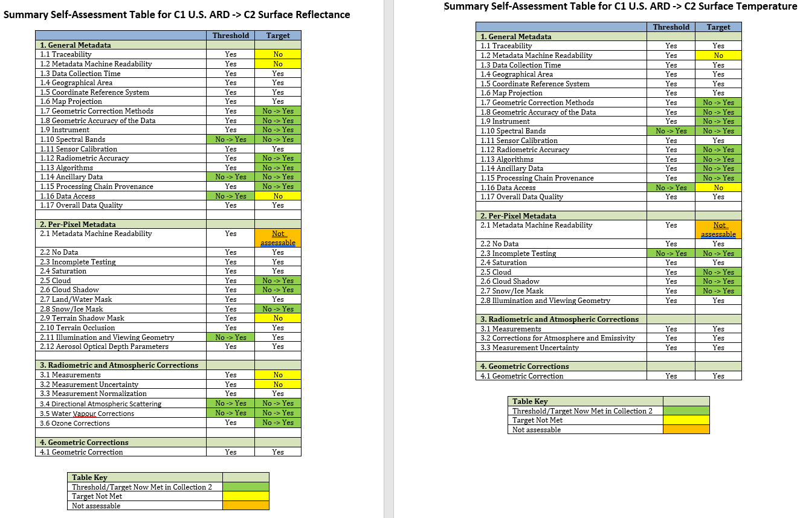
CARD4L Self-Assessment
USGS Landsat Collection 1 U.S. ARD -> Collection 2

Slide 8
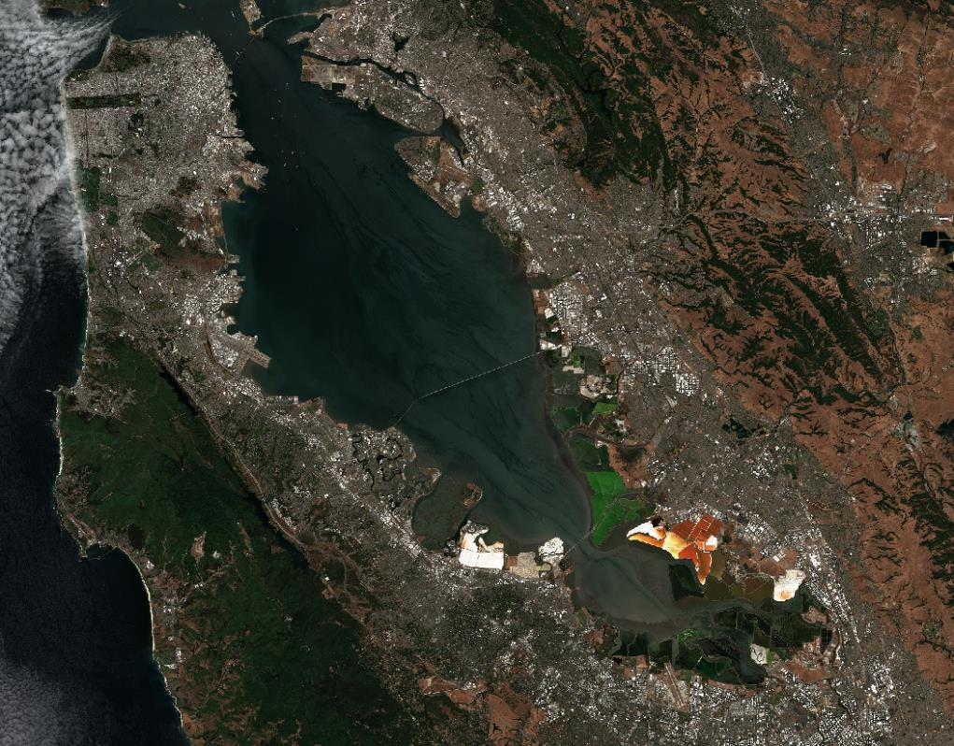
ESA Sentinel-2
Level-2A
Surface Reflectance

Slide 9
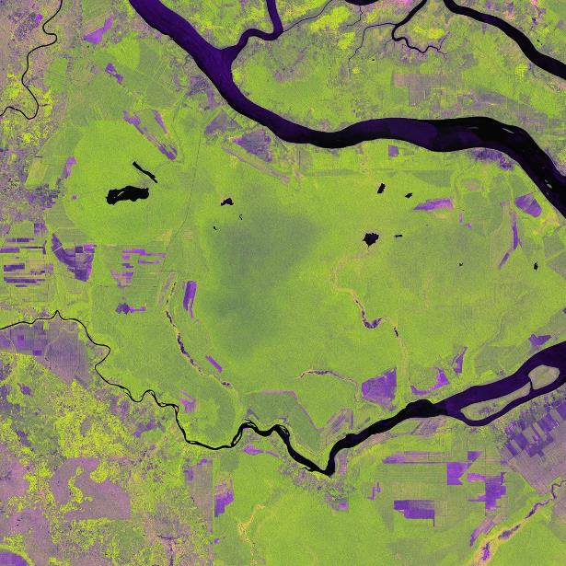
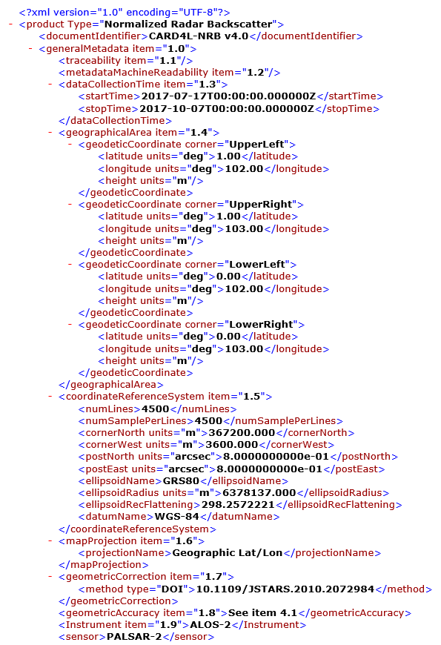
JAXA ALOS-2 PALSAR-2
Normalised Radar Backscatter

Slide 10
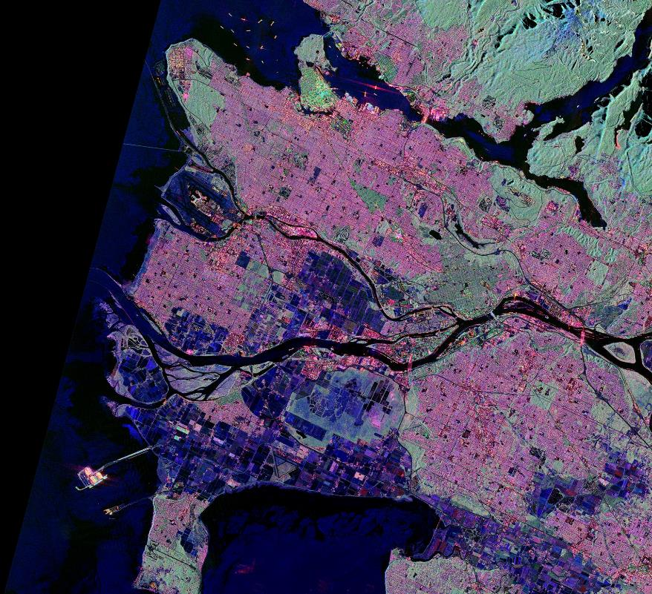
JAXA ALOS-2 PALSAR-2
Polarimetric Decomposition

Slide 11
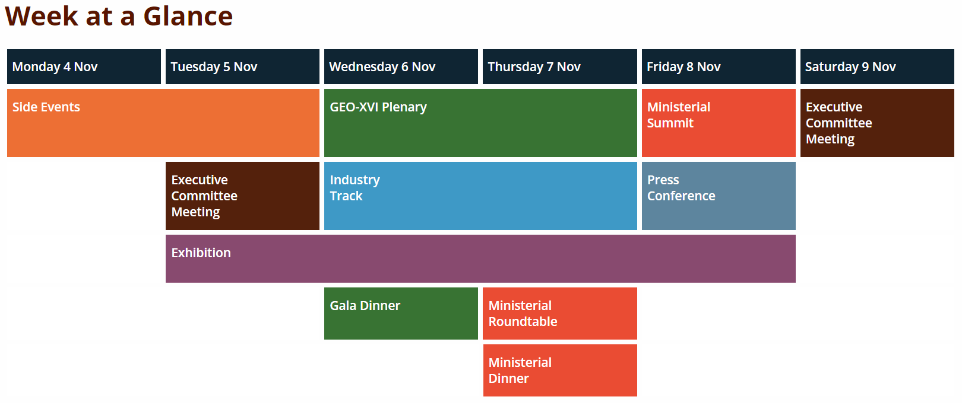

GEO Week 2019 http://www.earthobservations.org/geoweek19.php
Ministerial Summit / GEO-XVI Plenary / Industry Track / Exhibition / Side Events
4-9 November 2019
Canberra, Australia

Slide 12
Contacts
We very much look forward to continued engagement and
collaboration with the entire EO community!
For further information, please contact:
Matt Steventon, Symbios, LSI-VC Secretariat, matthew@symbioscomms.com
Steve Labahn, USGS, LSI-VC Co-Lead, labahn@usgs.gov
Adam Lewis, GA, LSI-VC Co-Lead, Adam.Lewis@ga.gov.au
Zoltan Szantoi, EC, LSI-VC Co-Lead, Zoltan.SZANTOI@ec.europa.eu

Slide 13

Questions?

