Slide 1
Enhancing WMO and CEOS COLLABORATION
WMO,
Carolin Richter, on behalf WMO Space Programme W. Balogh
CEOS Plenary 2019
Agenda Item 3.7
Ha Noi, Viet Nam
14 – 16 October 2019

Slide 2




WMO Strategic Plan 2020-2023
VISION 2030
A world where all nations, especially the most vulnerable, are more resilient to the
socioeconomic impact of extreme weather, climate, water and other environmental events, and
empowered to boost their sustainable development through the best possible weather, climate and water services
OVERARCHING PRIORITIES
Preparedness for, and reducing losses from hydrometeorological extremes
Climate-smart decision-making to
build resilience and adaptation to climate risk
Socioeconomic value of weather, climate, hydrological and related environmental services
CORE VALUES
Accountability for Results
and Transparency
Collaboration and Partnership
Inclusiveness and Diversity
1
2
3
4
5
LONG-TERM GOALS
Services
Better serve
societal needs
Infrastructures
Enhance Earth system observations and predictions
Science & Innovations
Advance targeted research
Member Services
Close the
capacity gap
Smart
Organization
Strategic realignment of structure and programmes
STRATEGIC OBJECTIVES
FOCUSED ON
2020-23
Strengthen national multi-hazard early warning/alert systems
Broaden provision of policy- and decision-supporting climate, water and weather services
Optimize observation data acquisition
Improve access to, exchange and management of Earth system observation data and products
Enable access and use of numerical analysis and prediction products
Advance scientific knowledge of the Earth system
Enhance science-for-service value chain to improve predictive capabilities
Advance policy-relevant science
Enable developing countries to provide and utilize essential weather, climate, hydrological and related environmental services
Develop and sustain core competencies and expertise
Scale up partnerships
Optimize WMO constituent body structure
Streamline WMO programmes
Advance equal, effective and inclusive participation

Slide 3







Enhanced Collaboration with Partners
Joint bodies
Working arrangements
Programmes/Projects
More interaction and collaboration with
partners from all relevant areas
Including with CEOS
Etc., etc., etc …
See e.g. https://public.wmo.int/en/governance-reform/joint-wmo-ioc-collaborative-board

Slide 4
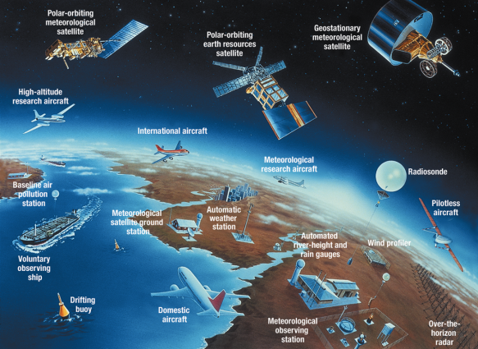
WMO Integrated Global Observing System (WIGOS)
Earth System Approach
Implemented through WIGOS
Evolution of surface- and space-based observing system components guided by the Vision for WIGOS in 2040
CEOS missions are relevant to WMO Members
Need to strengthen the connections between WMO and CEOS

Slide 5
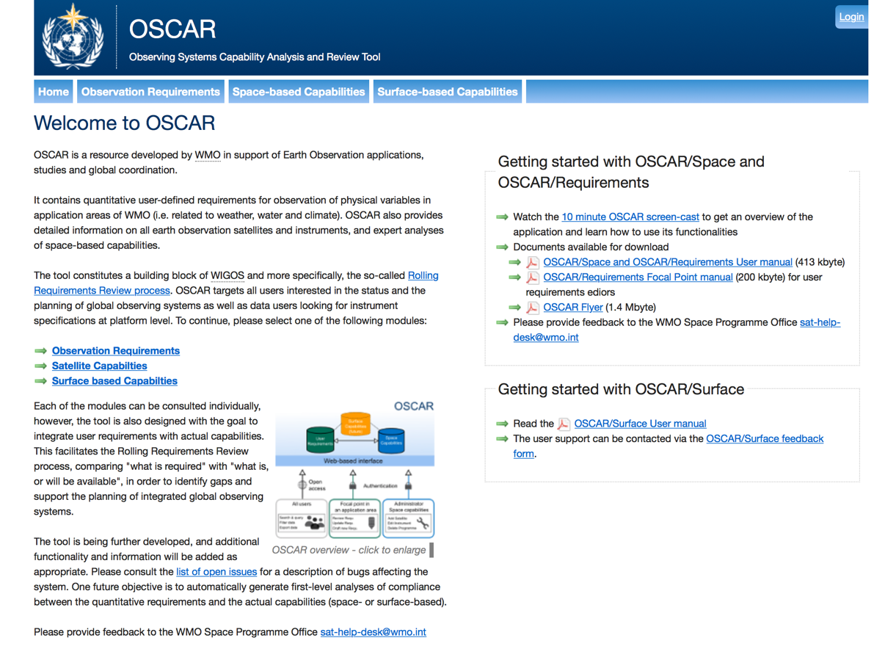
Observing System Capability Analysis and Review Tool
See http://oscar.wmo.int

Slide 6
CEOS Member Input to OSCAR
First step is request to CEOS Members to designate focal points to WMO
To provide updated information on Earth Observation satellites for recording in the OSCAR/Space database
See WMO letter to CEOS Principals

Slide 7
Conclusions
WMO has adopted Earth System Approach
CEOS missions are becoming increasingly more relevant to WMO Members
Request to CEOS Members to designate focal points to WMO for updating OSCAR/Space database
WMO would like to pursue further bilateral engagement with CEOS and we will provide additional suggestions for strengthening the relationship with CEOS at a later date

Slide 8
http://www.wmo.int/sat

