Slide 1

VNSC status
Committee on Earth Observation Satellites
Vietnam National Space Center
CEOS Plenary 2019
Agenda Item 3.7
Ha Noi, Viet Nam
14 – 16 October 2019

Slide 2
Functions and tasks
On Sep. 16, 2011, Vietnam National Satellite Center was established under Vietnam Academy of Science and Technology (VAST) by the Vietnamese PM’s decision
Based on Decree No. 60/2017/NĐ-CP, from July 17, 2017, the Vietnam National Satellite Center is officially changed to Vietnam National Space Center
VNSC
Space Science and Education
Space Technology
Vietnam Space Center project
Space Utilization

Slide 3
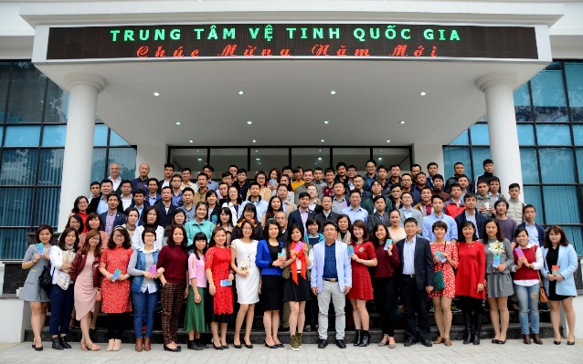
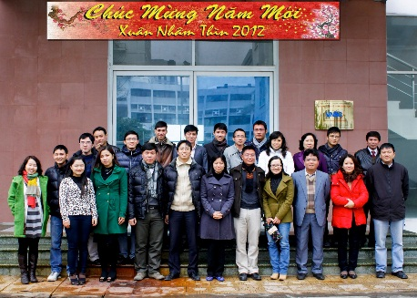
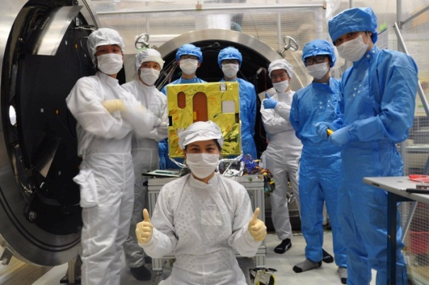
Capacity Development
31
77
126
150
200
2023
2020
2018
2013
Doctoral: 16
Master: 67
80% under 40-year olds
2012
2011

Slide 4

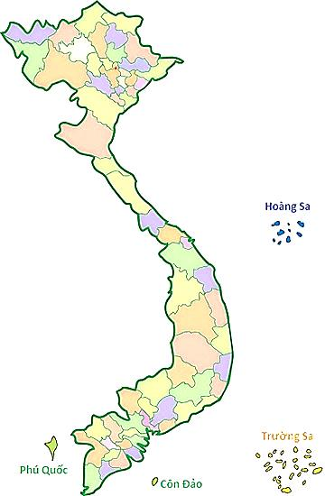

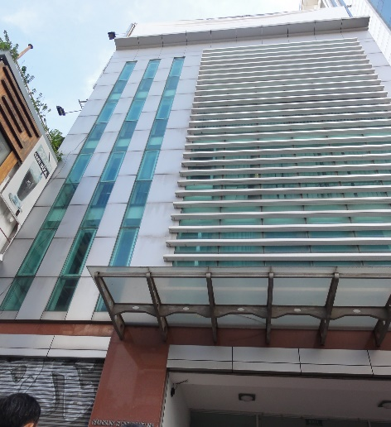
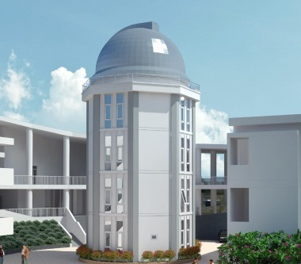
Infrastructures
Ha Noi
Hanoi
(2017)
Hoa Lac
(2021)
Nha Trang
Hồ Chí Minh
Nha Trang
(2017)
Hochiminh City
(2016)

Slide 5
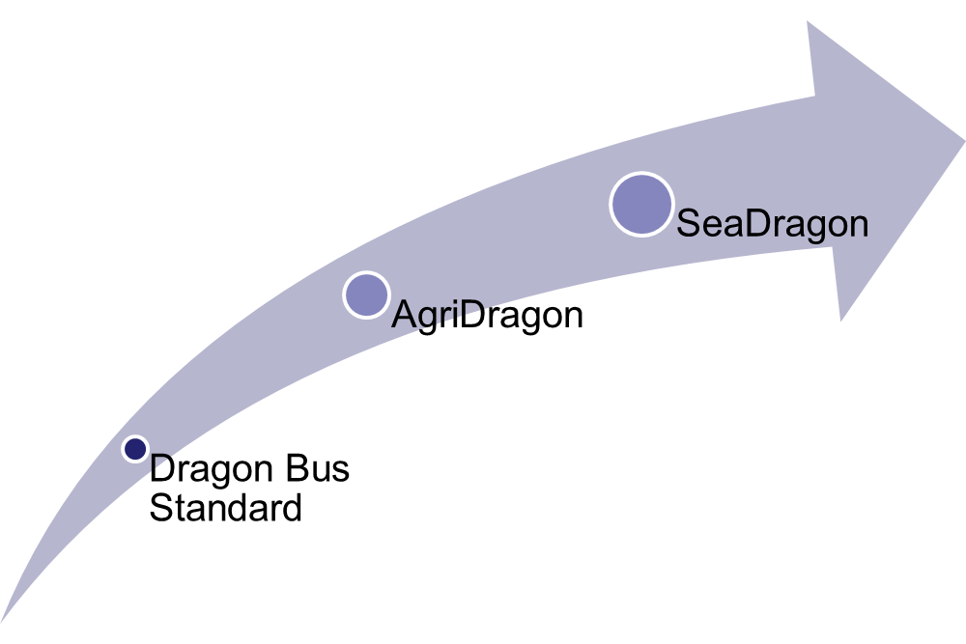
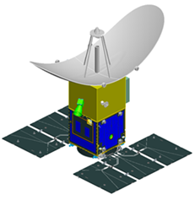
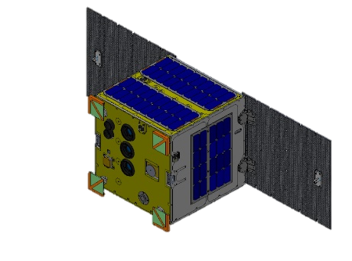
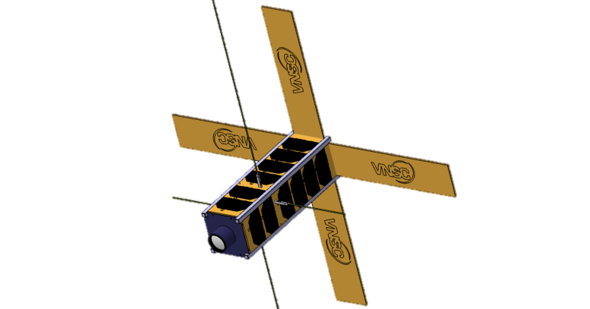
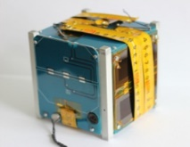
“Made in Vietnam” satellites
Aim to develop national product for small satellites bus concept
2011 Start
2013
(1 kg)
2017-2020
(4-6 kg)
2013-2018
(50 kg)
2019-2023
(600 kg)
LOTUSat-1
MicroDragon
NanoDragon
PicoDragon

Slide 6
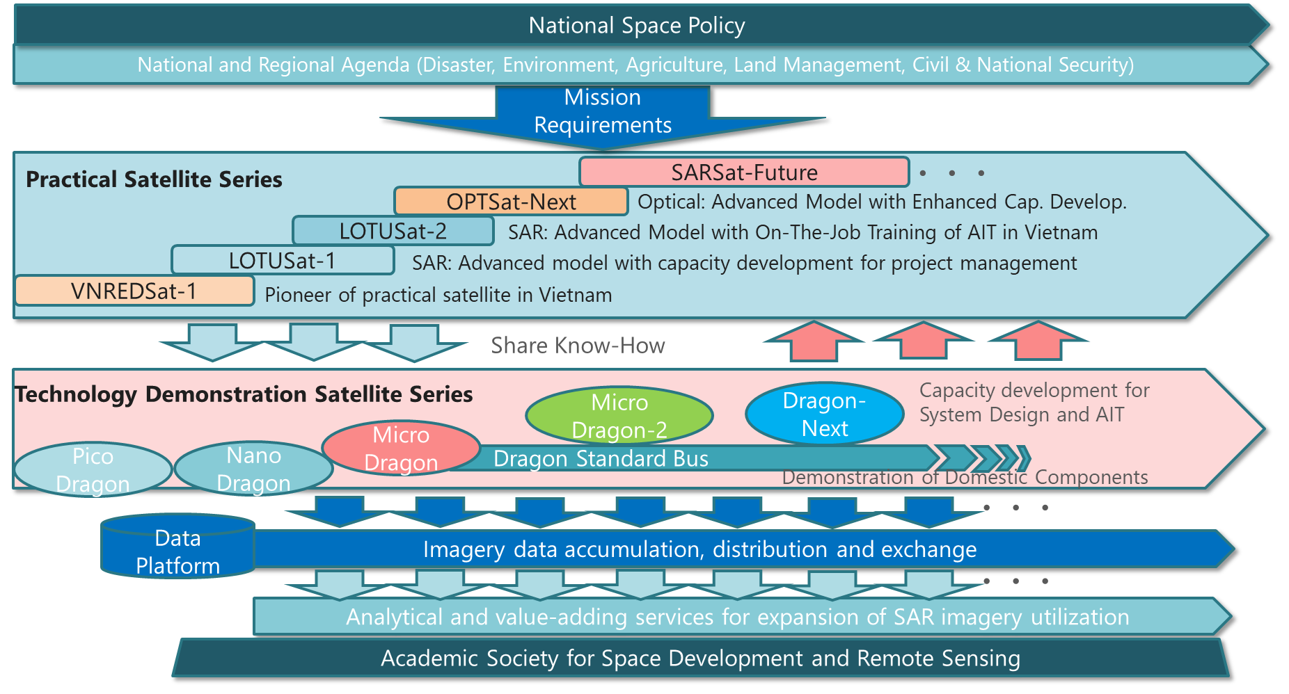
Roadmap for Vietnam EO satellites

Slide 7
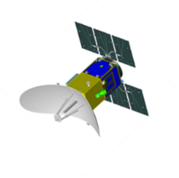
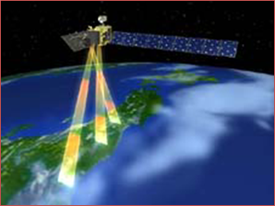
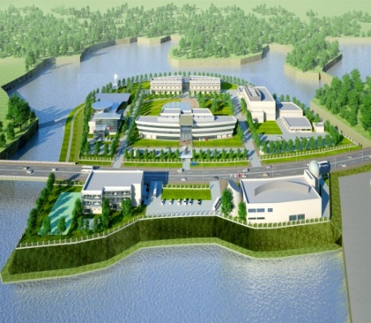
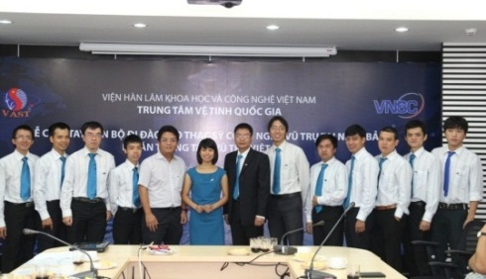
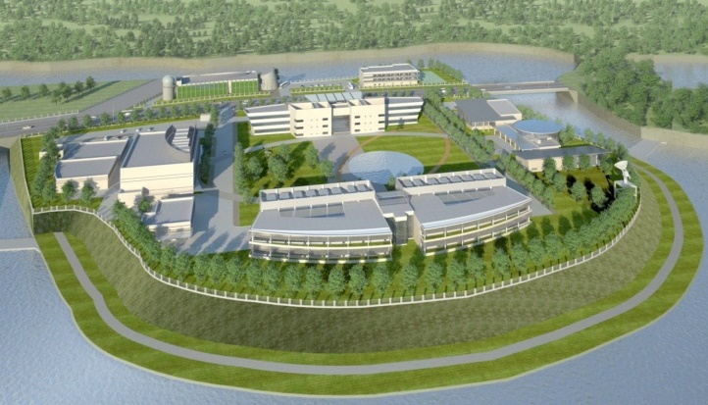
Vietnam Space Center project
  Total Investment: 310 mil. USD (ODA & Counterpart fund)
Implementation timeline: 2012 to 2023
Satellite Technology
LOTUSat-1 (570 kg)
Human Resource
Infrastru-cture/ Facilities
Capacity Building for
Satellite Development
R&D equipment and AIT facilities for small satellites up to 180 kg

Slide 8
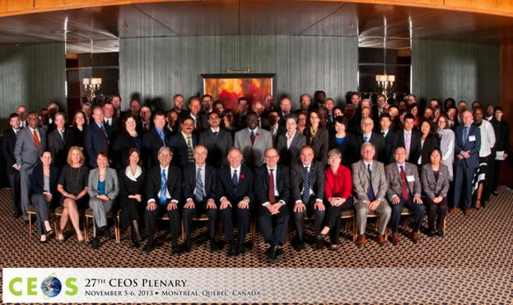
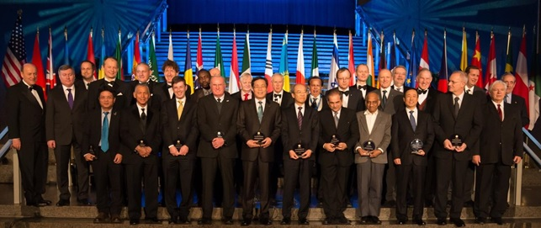
International cooperation
VAST/VNSC is an official member of:
Group on Earth Observations (GEO): 96th member since 2014
Committee on Earth Observation Satellites (CEOS): since 2012
International Astronautical Federation (IAF): from 2012
International Academy of Astronautics (IAA): from 2012
Asia-Pacific Regional Space Agency Forum (APRSAF)
Sentinel Asia

Slide 9

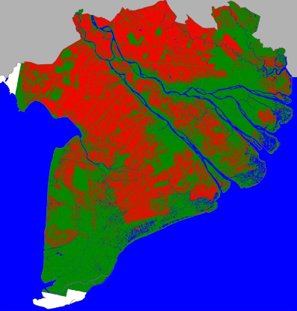
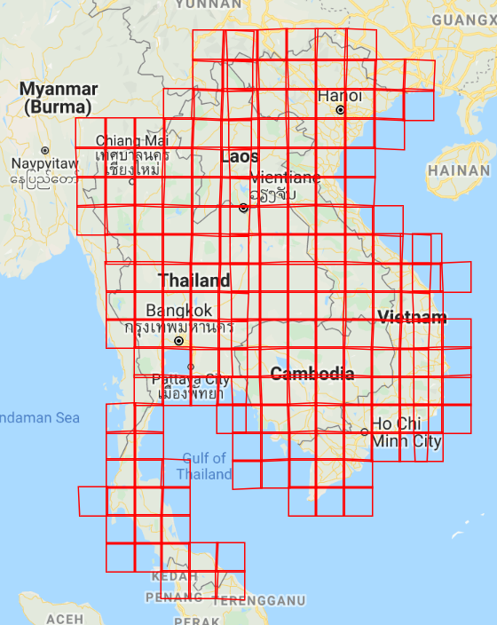
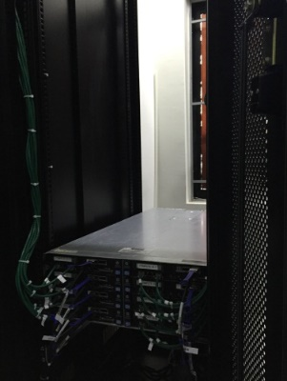
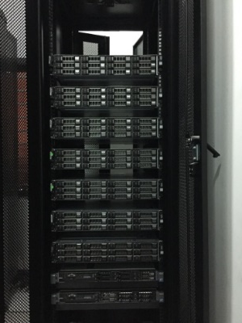
Vietnam Data Cube
Under 2019 CEOS Chair Initiative
In South East Asia (Cambodia, Lao PDR, Thailand, and Vietnam) for rice and forest monitoring
Data from USGS, ESA, EC and JAXA
Technical support from CSIRO (Australia), CESBIO/CNES (France), GEORice and IMSG (USA)

Slide 10
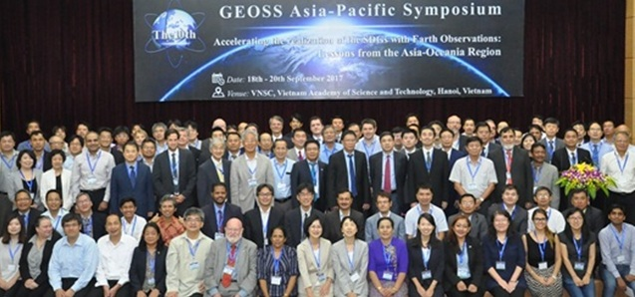
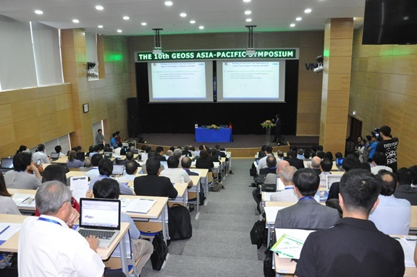
International events hosted by VNSC
10th GEOSS Asia-Pacific Symposium 2018

Slide 11
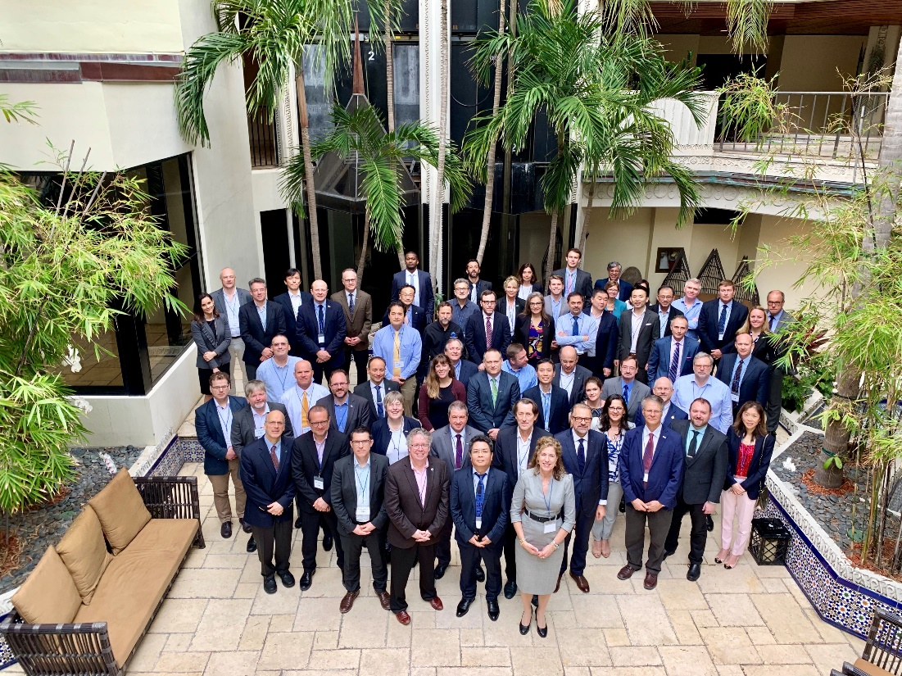
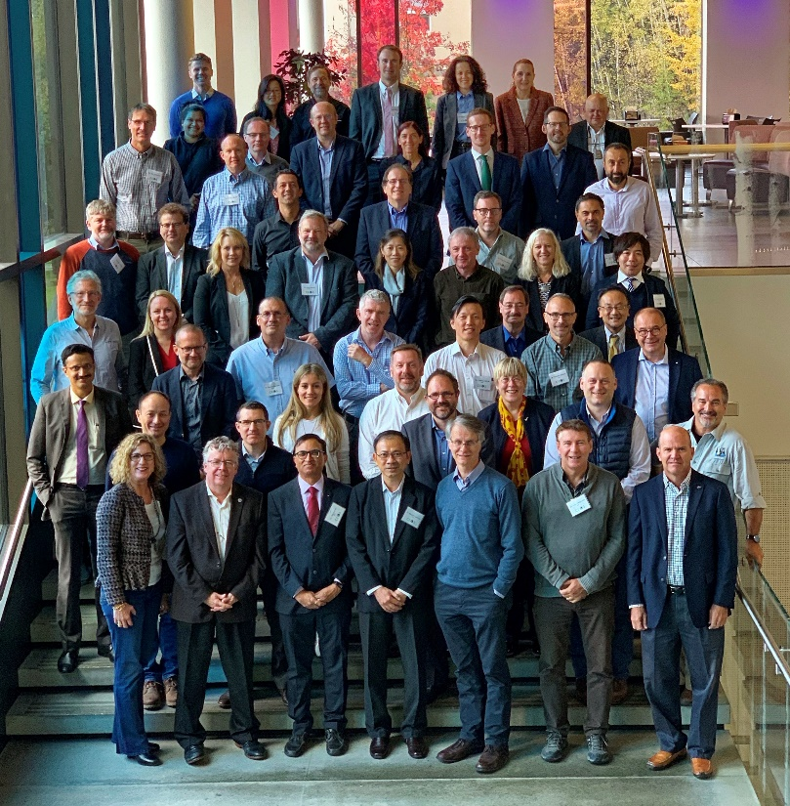
International events hosted by VNSC
CEOS Chair 2018-2019 & CEOS Plenary 2019 (14-16 Oct 2019) in Hanoi
The 34th Meeting of the CEOS Strategic Implementation Team, April 2nd - 4th, 2019, Miami
The 2019 SIT Technical Workshop, 9-12 September 2019, Fairbanks, Alaska

Slide 12

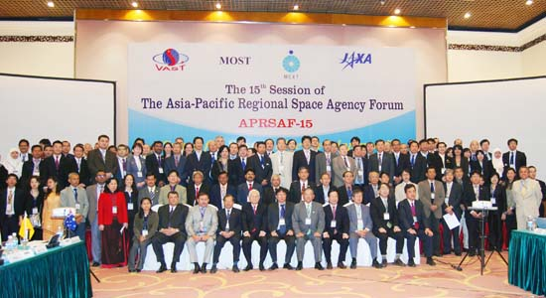
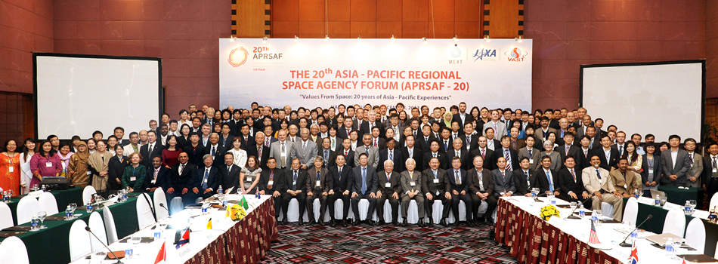
International events hosted by VNSC
Future Host of 27th APRSAF 2020 in Hanoi
APRSAF-15 (2008)
APRSAF-20 (2013)

Slide 13
Thank you for your attention!

