Slide 1
KMA Space program: Current Status and Application Plan
Committee on Earth Observation Satellites
Korea Meteorological Administration
CEOS Plenary 2019
Agenda Item 3.7
Ha Noi, Viet Nam
14 – 16 October 2019

Slide 2
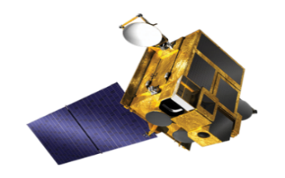
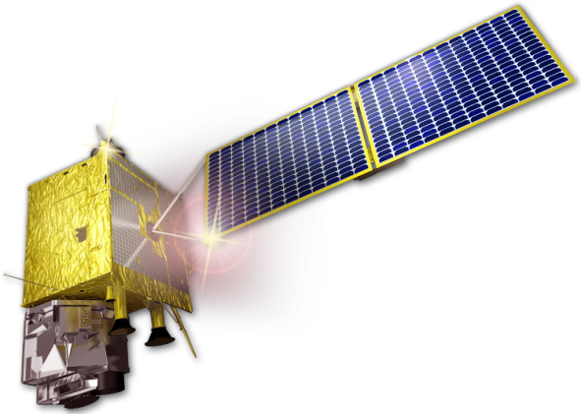
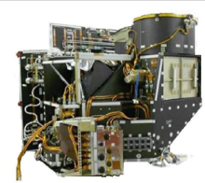
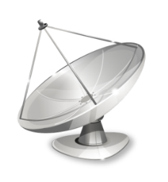
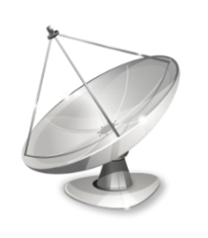
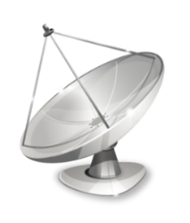
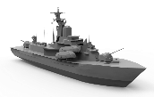
GK2A Operation
COMS
GK-2A (128.2°E)
Launched on June 27, 2010
KSEM
(Korean Space wEather Monitor)
Taking over the role of
the COMS
1
Communication Ka-band Antenna
AMI
(Advanced Meteorological Imager)
2
Ocean GOCI
3
Meteorological MI
Satellite Broadcasting Service
Transmit : S-band
Receive: X-band/L-band
Landline Service
User
Exclusive Line
Data Process/Dissemination
(NMSC/KMA)
Satellite Control
(KARI)
Duplexing Backup
Triplexing Backup
Notes:
Geo-KOMPSAT-2A was launched in the last December,
after the in orbit test during seven months,
we started official operation from twenty-fifth July 2019.
Geo-KOMPSAT-2A has two kinds of payloads,
as name of AMI for the meteorological observation
and the KSEM for the space weather monitoring.
The ground station of Geo-KOMPSAT-2A
is a concept that complements each other.
KMA has a role as a data processing and dissemination center
and also a backup satellite control center,
KARI has a function as the satellite control center
and also a backup data processing and dissemination center.
Two ground stations are 100km away.

Slide 3
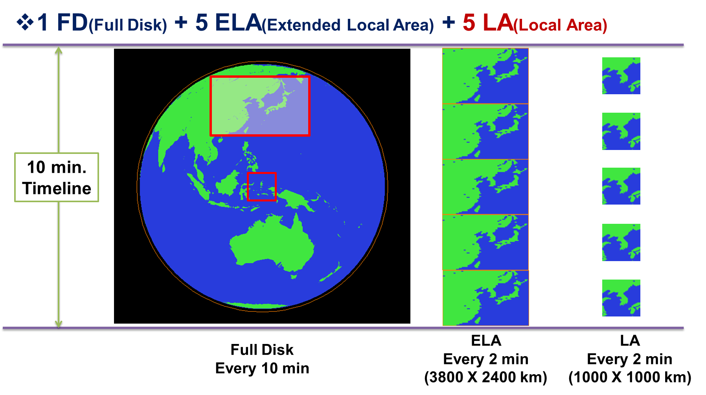
Observation and Schedule
1 FD + 5 ELA + 5 LA : 10 min
Full Disk (FD)
Extended Local Area (ELA) : 3800 X 2400 km (EW X NS)
Local Area (LA) 1000 X 1000 km
Notes:
For the meteorological observation, 10 minutes of timeline is under consideration, that consists of 3 observation area are defined with full disk, extended local area (ELA with 3,800 by 2,400 km²) and local target area (LA with 1000 by 1000 km²).
The timeline includes one FD image, 5 ELA and 5 LA images.

Slide 4
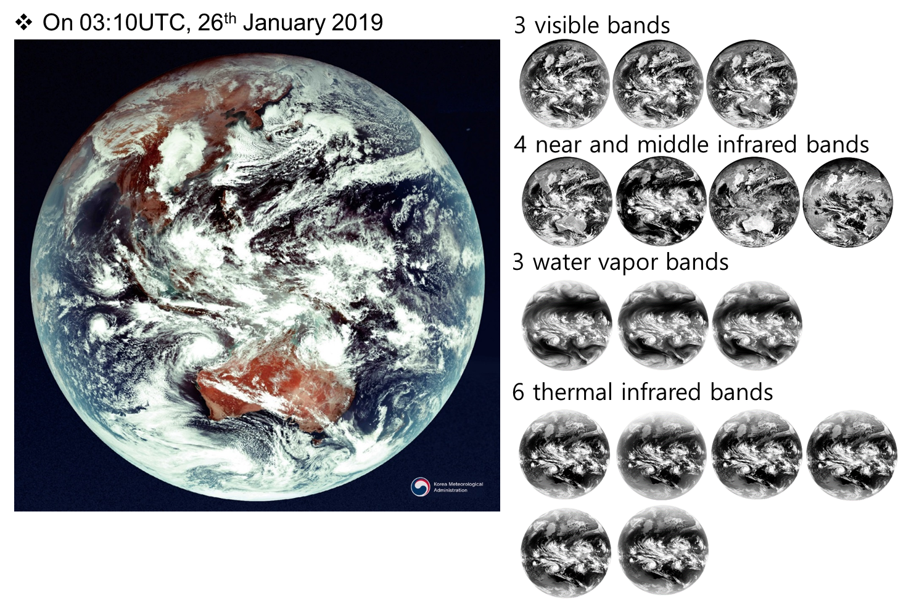
First Image of GK2A AMI
Notes:
GK-2A took the first image successfully. There are outflow of cold-dry continental high pressure over warmer sea surface around Korean peninsula.

Slide 5
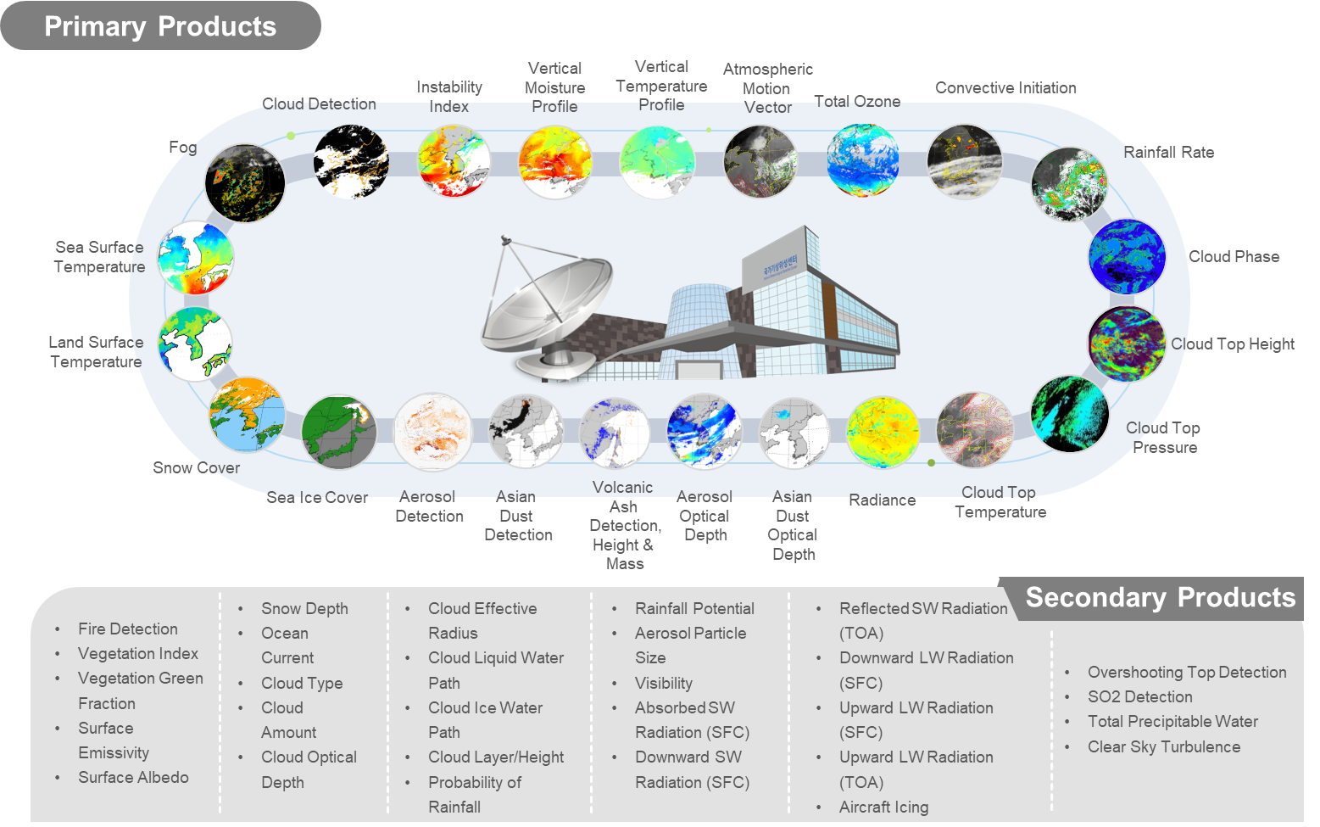
GK2A Geophysical Products
Notes:
This table shows 52 GK-2A/AMI geophysical products with many kinds of information such as scene/surface, cloud/rainfall, radiation/aerosol, and atmospheric condition and aviation.
These products has been validated to evaluate the maturity and improve their algorithms

Slide 6
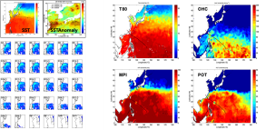
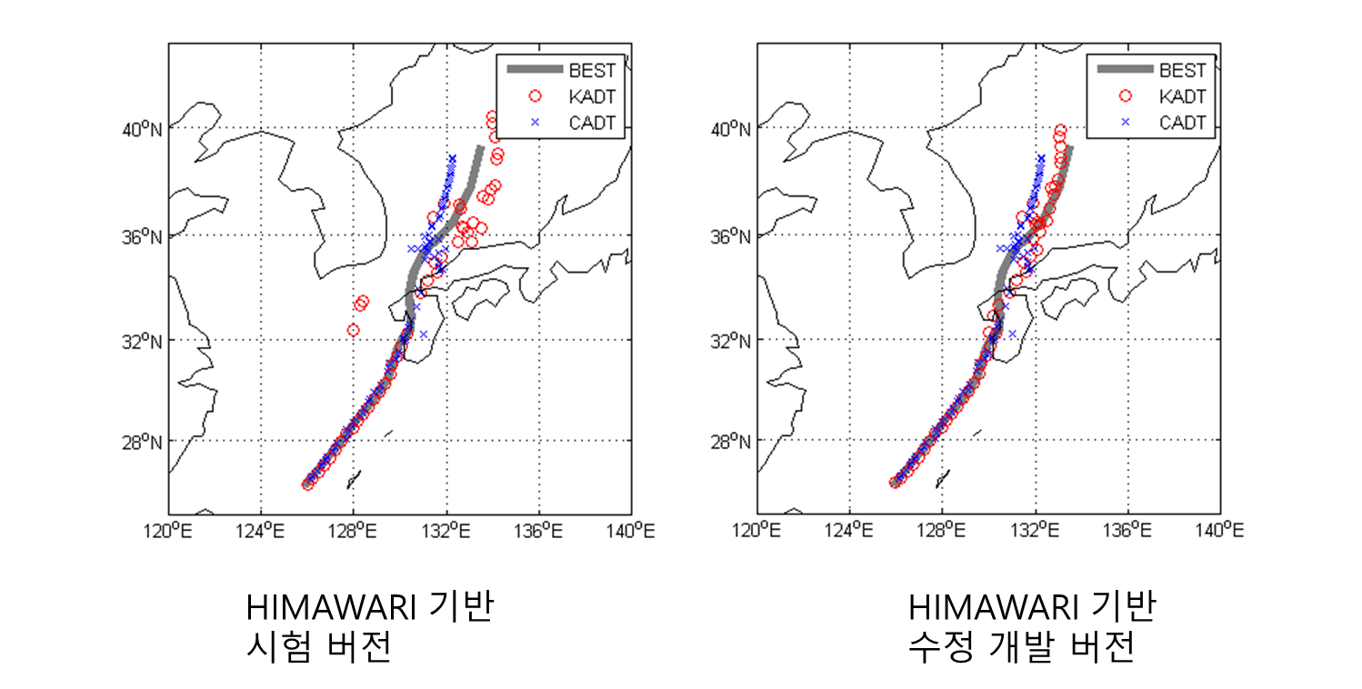
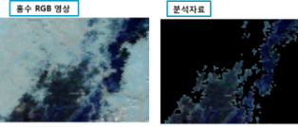
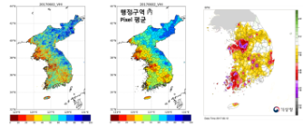
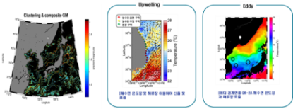
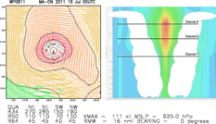
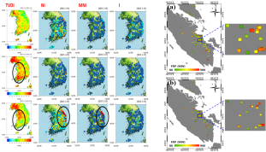
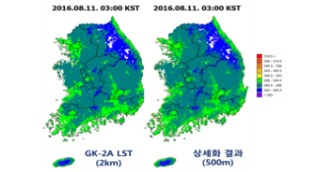
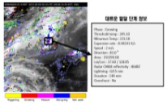
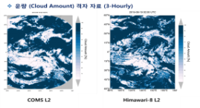
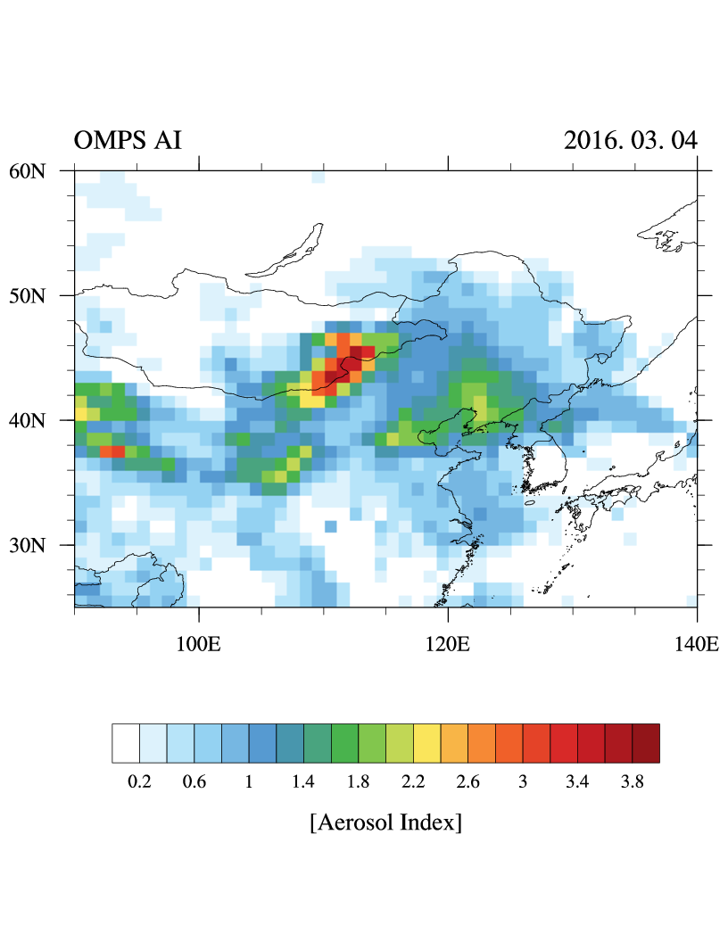
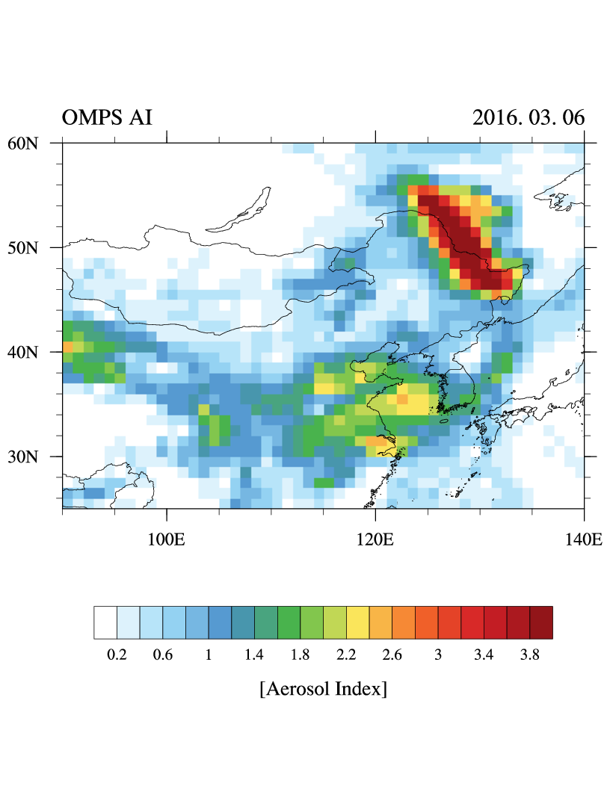
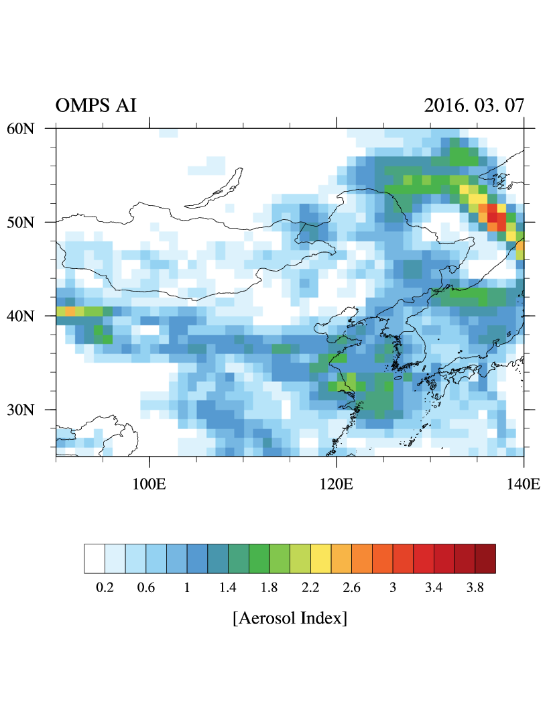
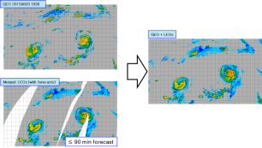
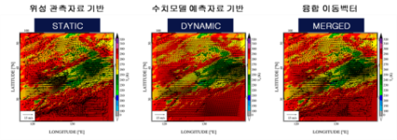
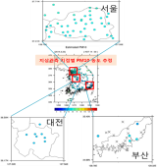
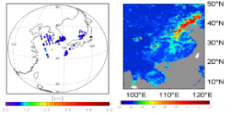
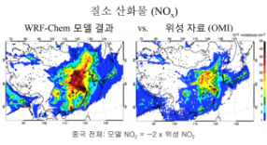
Advanced Application using GK2A Products
Ambitious applications of the AMI observations and products in various areas.
User friendly, value added information are provided by the additional use of all available data including LEO products, ground observations and NWP together with GK-2A/B.
Typhoon/Ocean
Surface/Hydrology
Estimating the intensity change of tropical cyclone
Objective analysis of tropical cyclone
Soil moisture & flood
Drought
Ocean environment monitoring and analysis
Sea surface wind and 3-D horizontal winds
Forest Fire
Blending, Downscaling, Validation Strategy
Nowcasting
Climate/Environment
smoke
Objective cloud analysis
Convective cloud life cycle monitoring and analysis
Climate study
Greenhouse gas monitoring
Multi-platform precipitation merging and analysis
Satellite image prediction
Aerosol peak height / surface concentration
Air Quality modeling support
Notes:
We are working on the development of ambitious applications of the AMI observations and products.
We are developing “GK-2A data application technology” for nowcasting, Typhoon and ocean analysis, hydrology and land surface analysis, and climate and environmental applications. The rest of areas except for Typhoon and Nowcasting represent the non-Meteorological applications.
Those products also use all available data including LEO products, ground observations, NWP forecast as well as GK-2A and 2B observation data.
we will provide more user friendly satellite data support and maximize the usability of GK-2A observations and products.
These results will be implemented on the “Meteorological Data Analysis system” with the analysis guidance for various satellite data users.

Slide 7
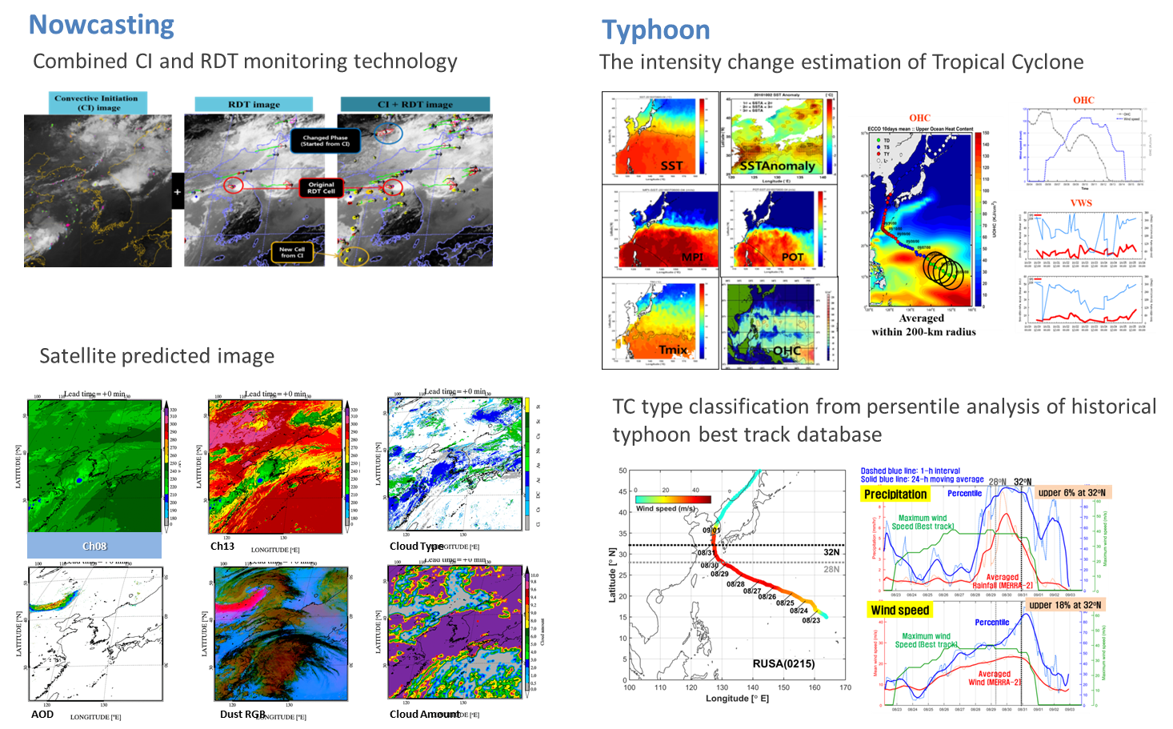
Application area: Nowcasting and Typhoon
Notes:
These are some examples of Nowcasting and Typhoon analysis we are developing. We are trying to develop or optimize the NWC-SAF RDT (Rapidly developing Thunderstorm) algorithm, so called K-RDT. Especially, K-RDT combines convective cloud initiation(CI) product and RDT algorithm technology and uses more channel data available from GK-2A AMI.
<In the RDT image, red circle represents cells defined from original RDT. Orange circle represents new cells detected from CI. RDT products can support heavy rainfall analysis, tracking and forecast. We are developing to provide satellite predicted images using combined motion from image extrapolation and NWP wind. This will apply to the basic channel image, RGB image and some products, such as cloud type, cloud amount, AOD (aerosol optical depth) and so forth.>
we are trying to optimize Advanced Drorak Technique. We will provide the guidance and analysis tools for estimating the intensity change of TC using thermodynamic and dynamic predictors, such as maximum potential intensity (MPI), intensification potential (POT), ocean heat content (OHC), and so on. Typhoon analysis technique also estimates the percentile of tropical cyclone-induced rainfall and wind intensity compared to historical TCs.

Slide 8
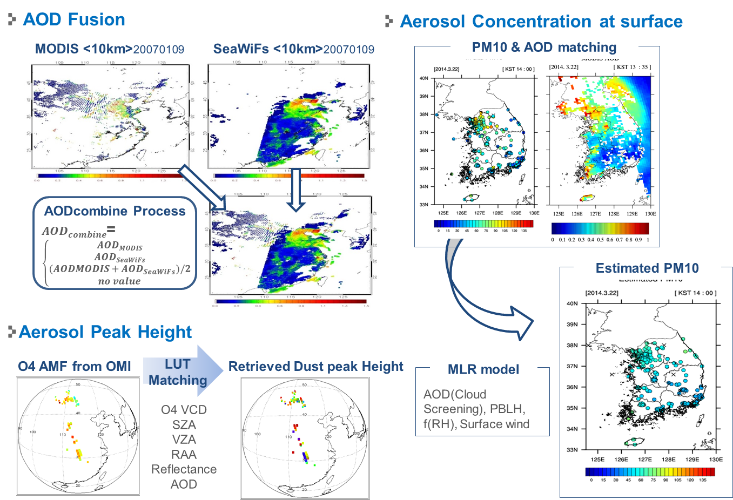
Application area: Dust Height & Dust at Surface
Notes:
Most important products for human life among non-meteorological data seem to be aerosol products. Since COMS, NMSC provides aerosol detection and aerosol optical depth to support weather forecast and to satisfy the people’s demand. After GK-2A launch, NMSC expands aerosol products, AOD Fusion, Dust peak height, Surface Dust Concentration.
AOD fusion will be made using BME (Bayesian Maximum Entropy) method and AMI, GOCI, Himawari-8, MODIS AOD data. Aerosol height which is based on O4 air mass factor from GK-2B will be estimated by statistical regression equation model using aerosol optical depth, surface observation, other meteorological element.
Right images show aerosol concentration at surface, which is calculated using empirical statistics considering AOD-PM10 relationships.

Slide 9
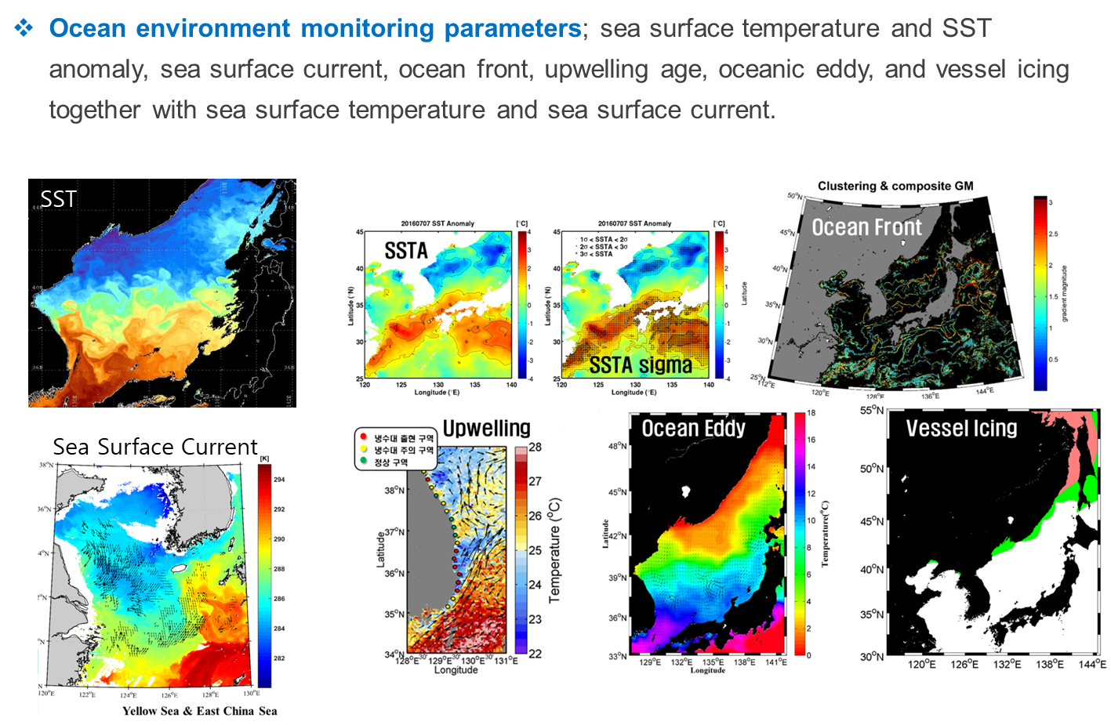
Application area: Ocean
Notes:
We are developing ocean environment monitoring parameters. Especially, sea surface temperature from GK-2A plays an important role of monitoring of ocean environment change. We will produce new parameters such as ocean front, upwelling age, ocean eddy, vessel icing using by SST and Sea surface current from GK-2A including LEO satellite products. These results are provided not only fishery related information, but also micro-weather prediction using multiple satellite observation.

Slide 10
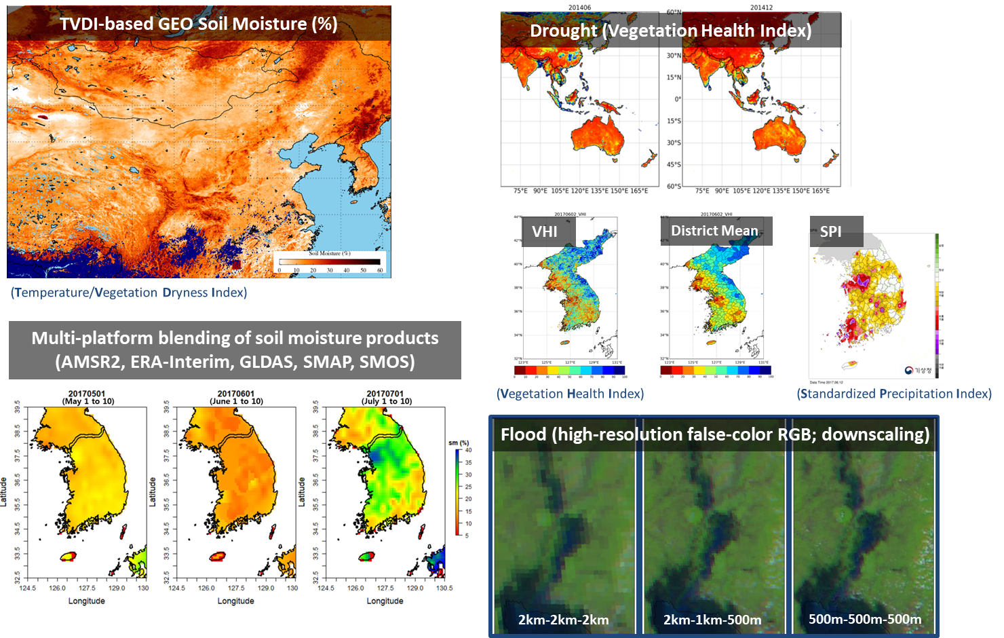
Application area: Surface Property & Hydrology
Notes:
Using GK-2A and other available LEO satellite data, KMA will provide some surface hydrology information. These are soil moisture, drought and flood monitoring products.
Satellite soil moisture maps can contribute to managing food production and agriculture, understanding of hydrological or water cycle, thermodynamic energy balance, climate change and other various area.
More frequent soil moisture trend monitoring is available from TVDI-based geostationary soil moisture product.
Multi platform blended soil moisture can provide more quantitative analysis. To do this, KMA uses products from microwave sensors, such as AMSR2, SMAP, SMOS, and model based data from ERA-interim and GLDAS.
Moreover, vegetation health index (VHI) based drought monitoring product and 500m resolution flood RGB image will be provided from GK-2A measurement, as well.
TVDI : temperature/vegetation dryness index
VHI : vegetation health index
SPI : Standardized Precipitation Index
GLDAS : Global Land Data Assimilation System

Slide 11
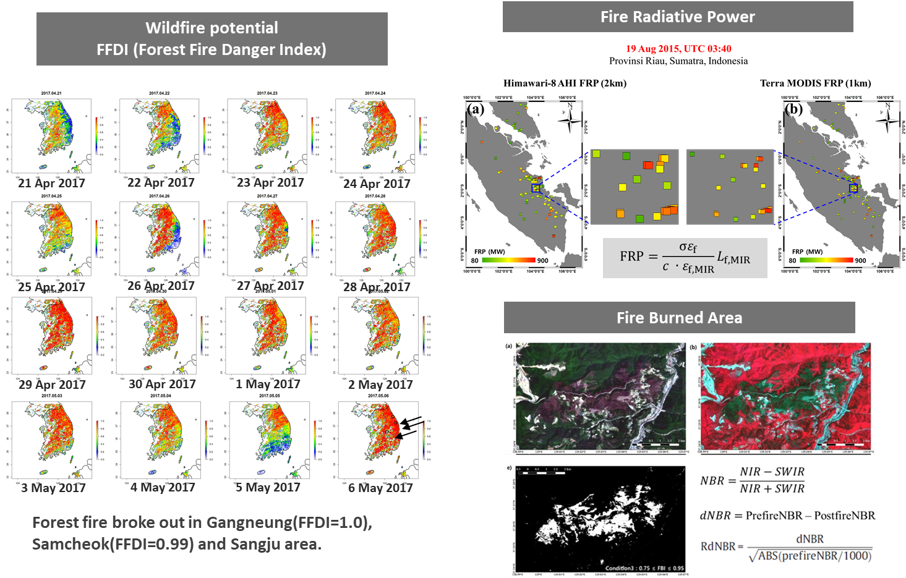
Application area: Forest Fire Monitoring
Notes:
We have been developed wildfire monitoring products.
Using the Forest Fire Danger Index (FFDI), KMA will monitor the condition of wildfire potential.
Left figures show the distribution of wildfire potential in April and May, 2017. It was very dry and the FFDI showed higher, and the forest fire broke out in Gangneung, Samcheok and Sangju area as shown by three arrows in right bottom figure (6 May 2017)
When fire is burning, fire radiative power is estimated to analyze the fire intensity and its risk. After putting out the wildfire, fire burned area is estimated to understand the damage and to restore.
Because the wildfire in the Korean Peninsula is a relatively small scale. Thus, we will also use the high resolution Sentinel data.

Slide 12
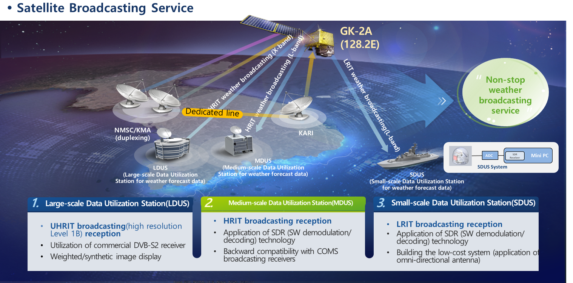
Data Service
Notes:
For the satellite broadcasting service,
we provide three types of format.
As same as COMS,
a distribution key is given to registered users.
LDUS users can receive UHRIT data
including full resolution all 16 bands of AMI data.
For the MDUS users,
KMA broadcasts HRIT data in L-band for five channels.
And COMS MDUS users can receive GK2A data
after software patching using same systems,
the patch software is uploaded to the NMSC website.
For marine weather support,
SDUS was redesigned for using on a ship mounting
with 2 axis tracking antenna.

Slide 13
Status of KMA LEO Program
Current status of KMA LEO program in 2019
KMA LEO program based on CAS500 was not approved by the decision of special feasibility test in 2018
Not the program terminated but postponed to 2-3 years
Feasibility study in 2020
To investigate the user requirements and application since the program postponed to late 2020’s
To investigate the development roadmap followed by updating proposed payloads
Development of GNSS-RO receiver (2nd payload)
To develop GNSS-RO receiver (< 15kg) for NWP application as second payload
To collaborate with related ministries for final decision in late 2019
Notes:
KMA LEO program based on CAS500 (compact Advanced Satellite 500kg) was not approved by the decision of special feasibility test in 2018. However, KMA will keep continuing the LEO program even postponed 2-3 years
KMA plan to have feasibility study in 2020 to investigate the user requirements and application to reflect the changed environment,
and to investigate the development roadmap followed by updating proposed payloads
In addition to LEO program, KMA started to develop GNSS-RO receiver as 2nd payload since 2018.

Slide 14
Thank you!

