Slide 1
Agency Report: Team Australia
Dr Trevor Dhu
The 33rd CEOS Plenary
Ha Noi, Viet Nam
14-16 October 2019

Slide 2
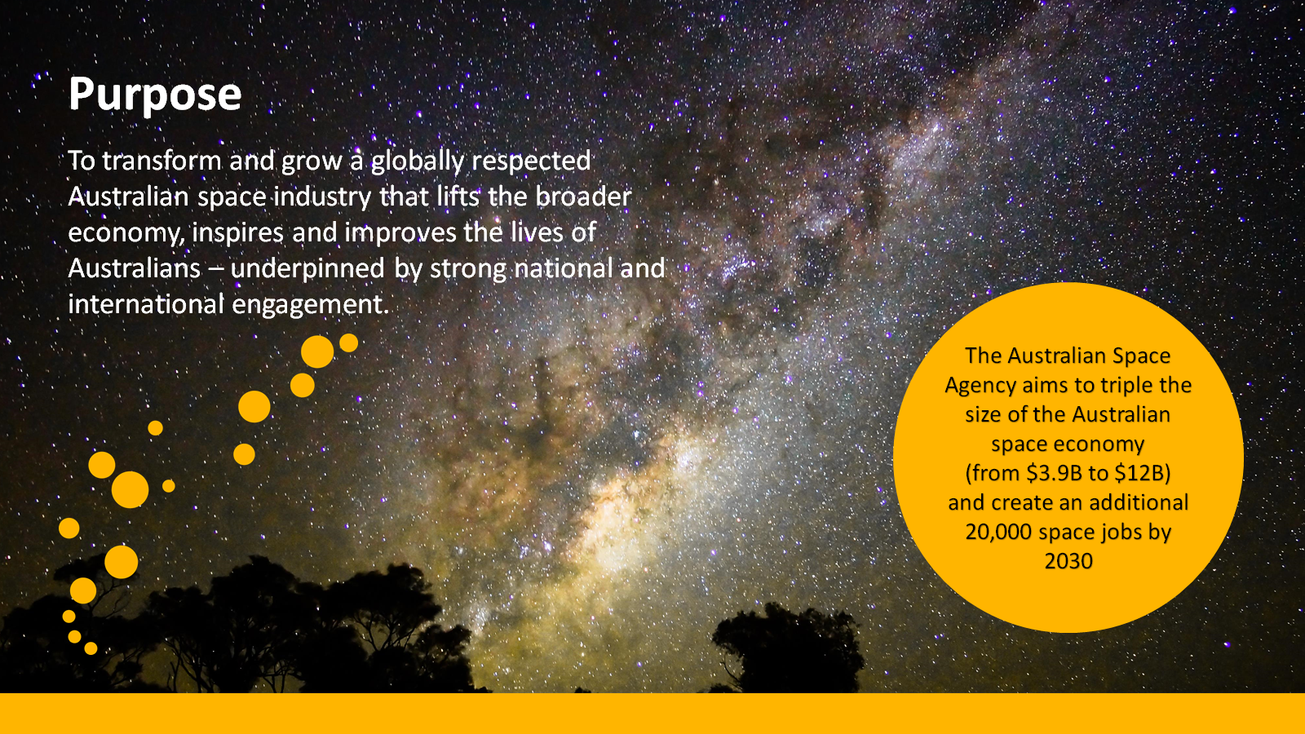
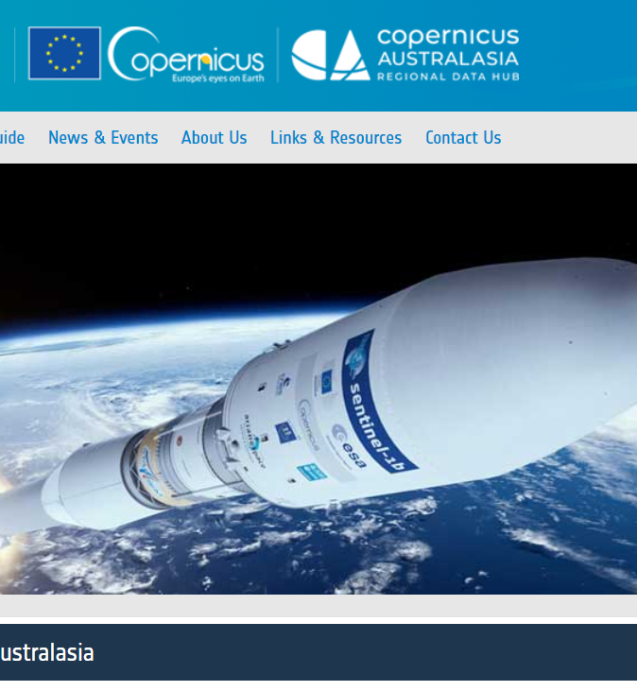
Australian Space Agency
Regional Copernicus Data Hub
Regional hub supporting Copernicus
Provide access to data from Europe's Sentinel satellite missions for the South-East Asia and South Pacific region
Sentinel Australasia Regional Access (SARA)
    Hosted at the National Computational Infrastructure and operated by the Regional Copernicus Data Hub consortium
    https://copernicus.nci.org.au/sara.client/#/home
Notes:
slide provided by ASA

Slide 3
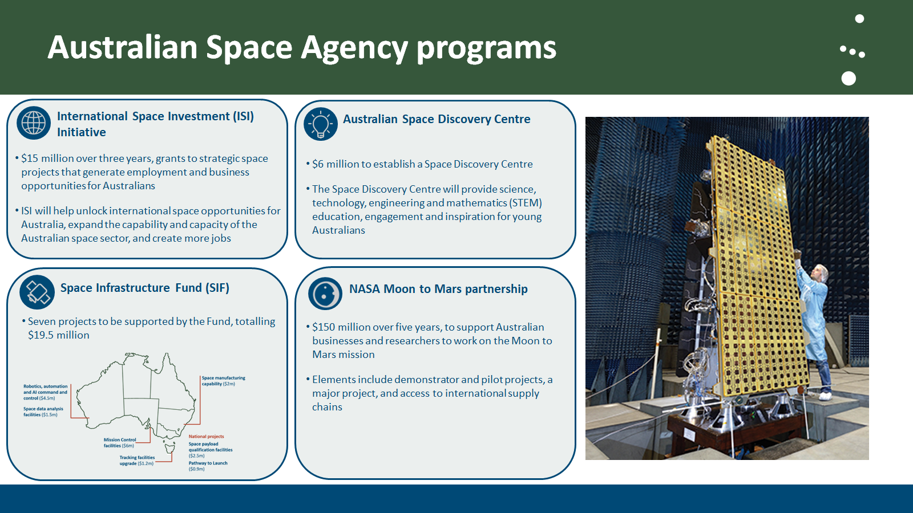
Notes:
slide provided by ASA

Slide 4
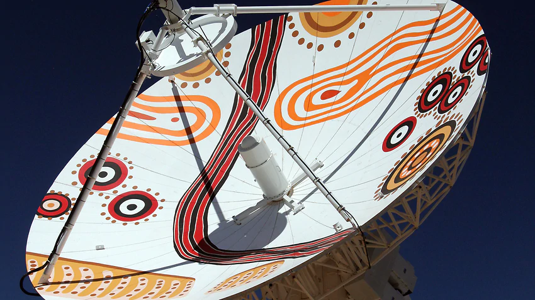
Notes:
2019 marks the 40th anniversary of Australia’s participation in the USGS Landsat program. Geoscience Australia’s Alice Springs satellite ground station hosts two 9-metre antennas, a 2.4-metre antenna, and associated infrastructure. The satellite ground station is one of three forming a global Landsat satellite ground station network and has been in operation since 1979. In November the Landsat Ground Station Operators Working Group meeting will be held in Alice Springs and will include an event to mark the 40th anniversary of GA’s collaboration with the USGS Landsat program.
In addition to the primary antenna being painted in 2016 with artwork based on a painting by an Aboriginal Australian artist, the secondary antenna has recently been painted with artwork based on a traditional Native American quilt gifted to GA by the USGS. This artwork will be formally commissioned at the ground station in November during the 40th anniversary event.
Working towards LGN certification of the secondary antenna.
Preparation for acquisition of Landsat 9 is on-going with Level 5 testing now complete.

Slide 5
Data Quality in Australia
CARD4L Self Assessment for Australian Produced Surface Reflectance
Landsat
Sentinel-2
Landsat
Sentinel-2
THRESHOLD
TARGET

Slide 6
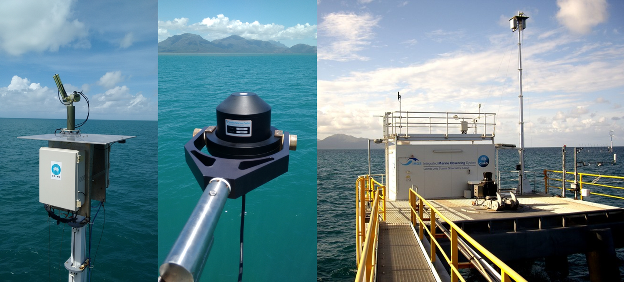
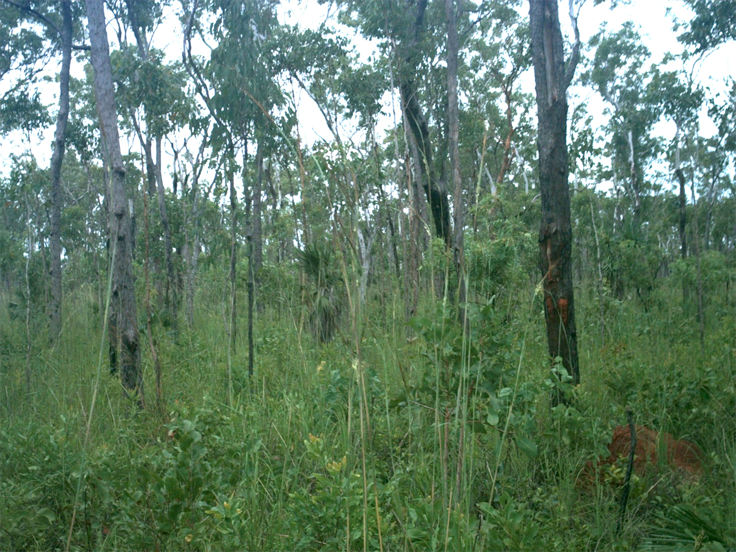
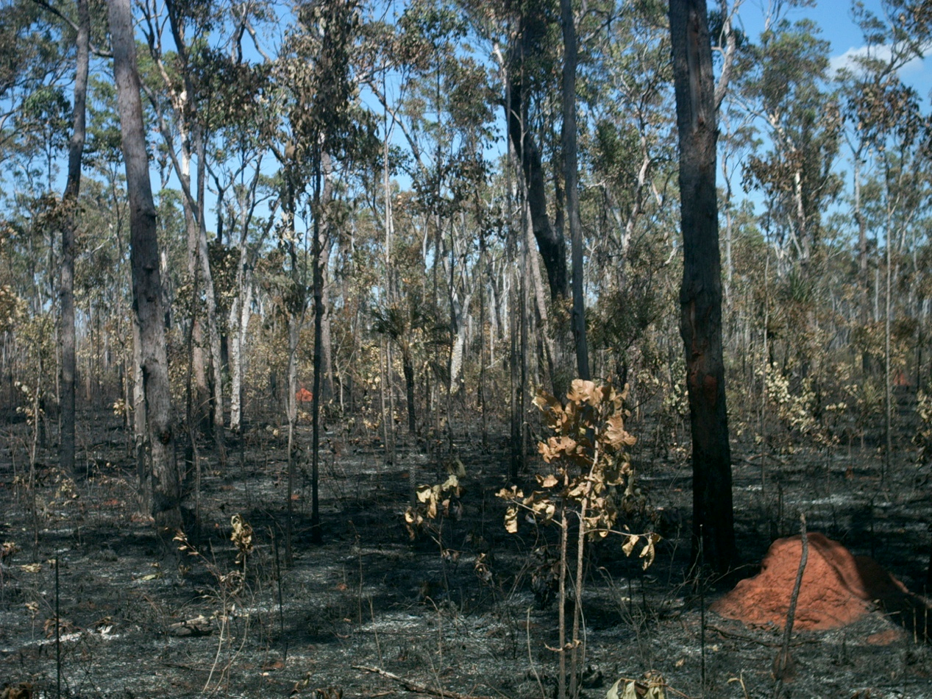
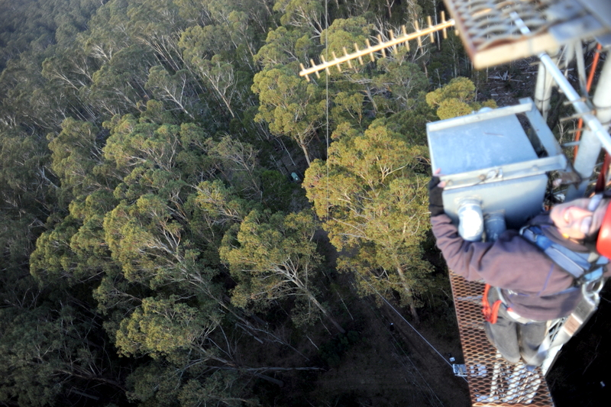

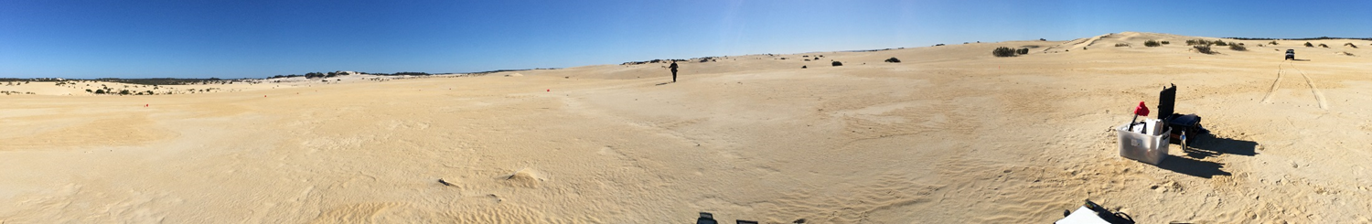
The Australian National Facility for Earth Observation Satellite Calibration & Validation (AusCalVal)
Vision: A convenient single point of access to a network of best-in-class Earth observation calibration and validation sites and scientific experts.
Leveraging Australia’s existing infrastructure and unique:
Expertise;
Climate;
Environmental Diversity; and
Location
Lucinda Jetty Coastal Observatory
Litchfield Tropical Savanna
Pinnacles Desert Optical Vicarious Calibration
Tumbarumba Wet Eucalypt
Notes:
Scientific & technical expertise with a long history of supporting international missions across different sensor technologies;
Easily accessible, sustained, often multiple validation measurements at well characterised, instrumented sites across unique & diverse landscapes build by experienced & large user community across a range of applications;
Favourable climatic & environmental conditions ie. away from urban, clear skies, large uniform areas, etc.
Southern hemisphere location advantages for northern hemisphere winter launches eg. EO1 Hyperion;

Slide 7
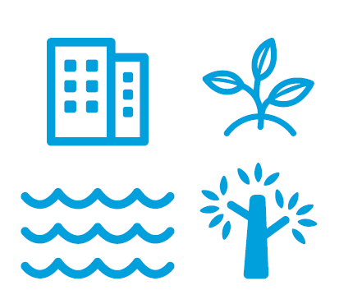

Digital Earth Australia
Improve how the government manages our natural resources.
Drive growth across the Australian economy.

Slide 8
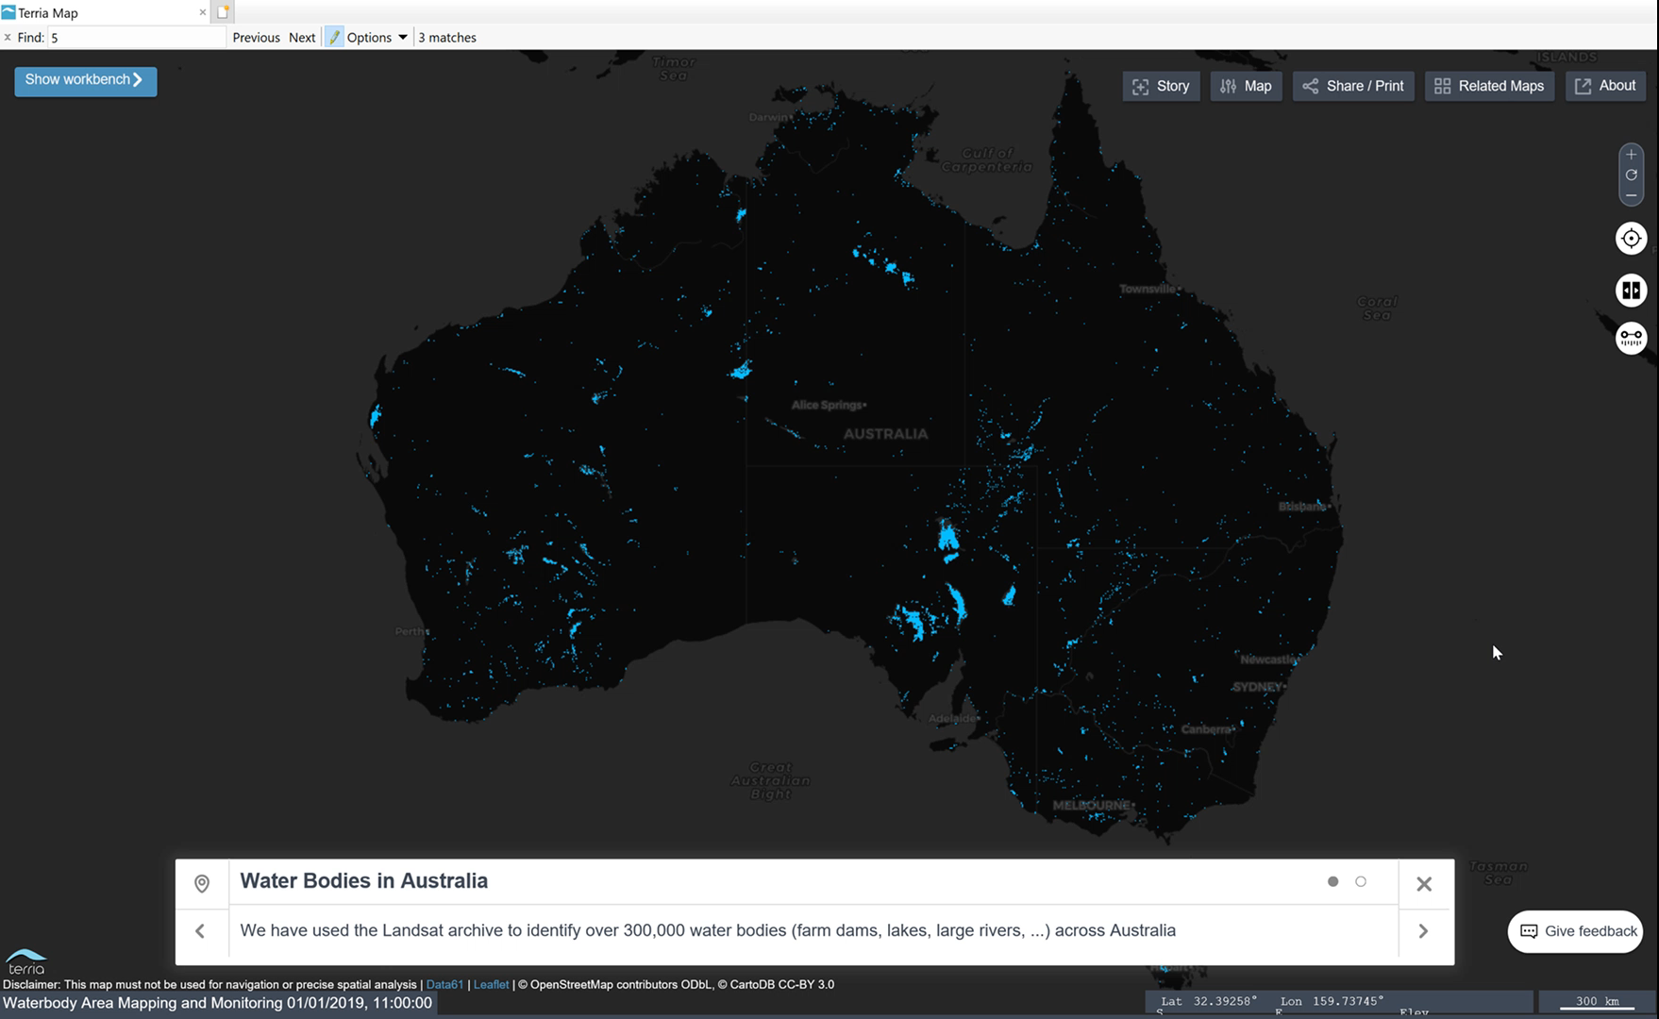
Monitoring Water Availability

Slide 9
Digital Earth Africa
An African capability, based in and governed by Africa
  Funded by Australia and the Helmsley Charitable Trust (AUD24m, 2019-20)
  Use CEOS Analysis Ready Data, Open Data Cube & Amazon
  Leveraging the great work of the SEO in the ARDC
  Aligning with other major initiatives in Africa (eg. GMES & WGCapD)
  Strategic partnership with GEO
Will be an important source of user-needs and data quality feedback for CEOS Members

Slide 10

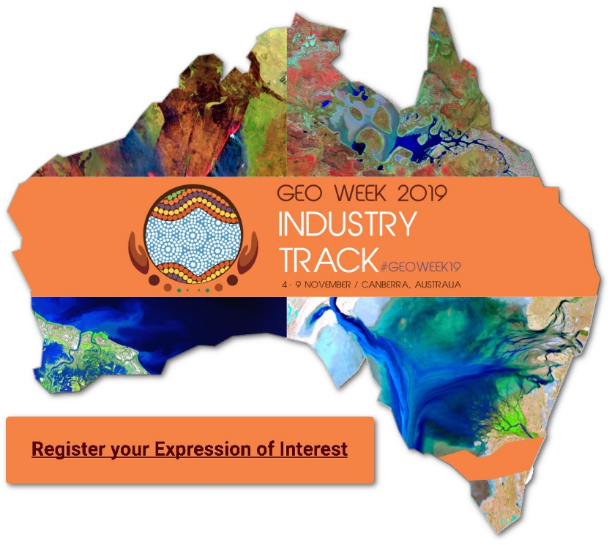

Thank You
GEO Week 2019 4-9 Nov 2019 Canberra

