Slide 1

Copernicus
Committee on Earth Observation Satellites
European Commission
CEOS Plenary 2019
Agenda Item # 3.7
Ha Noi, Viet Nam
14 – 16 October 2019

Slide 2
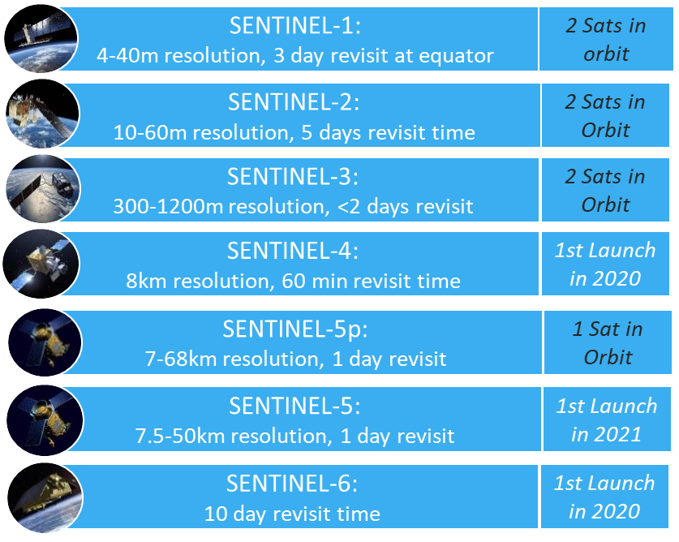
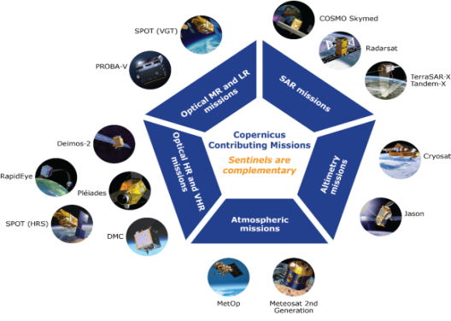
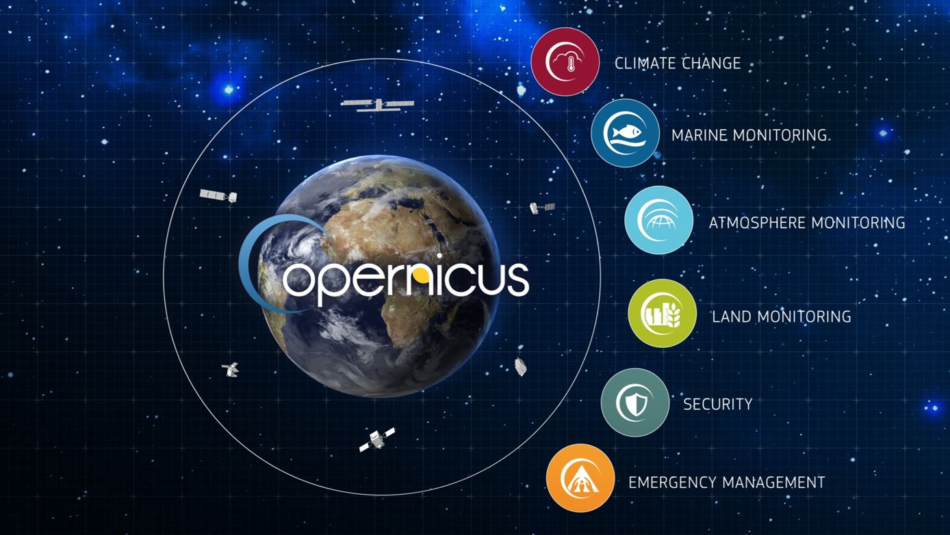

COPERNICUS architecture
FULL, FREE AND OPEN
6 services use Earth Observation data to deliver
added-value products
Contributing missions
Sentinels

Slide 3
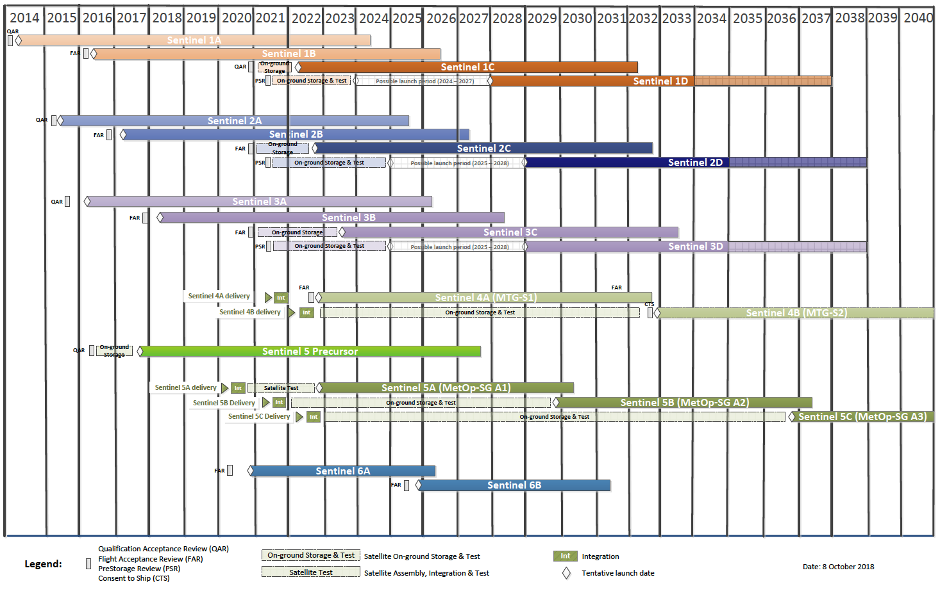
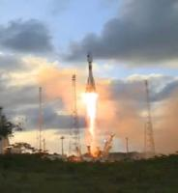
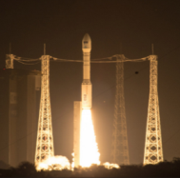
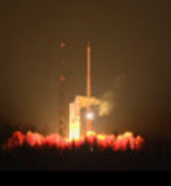
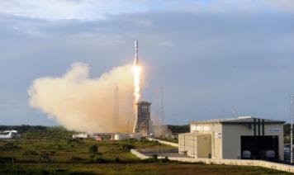
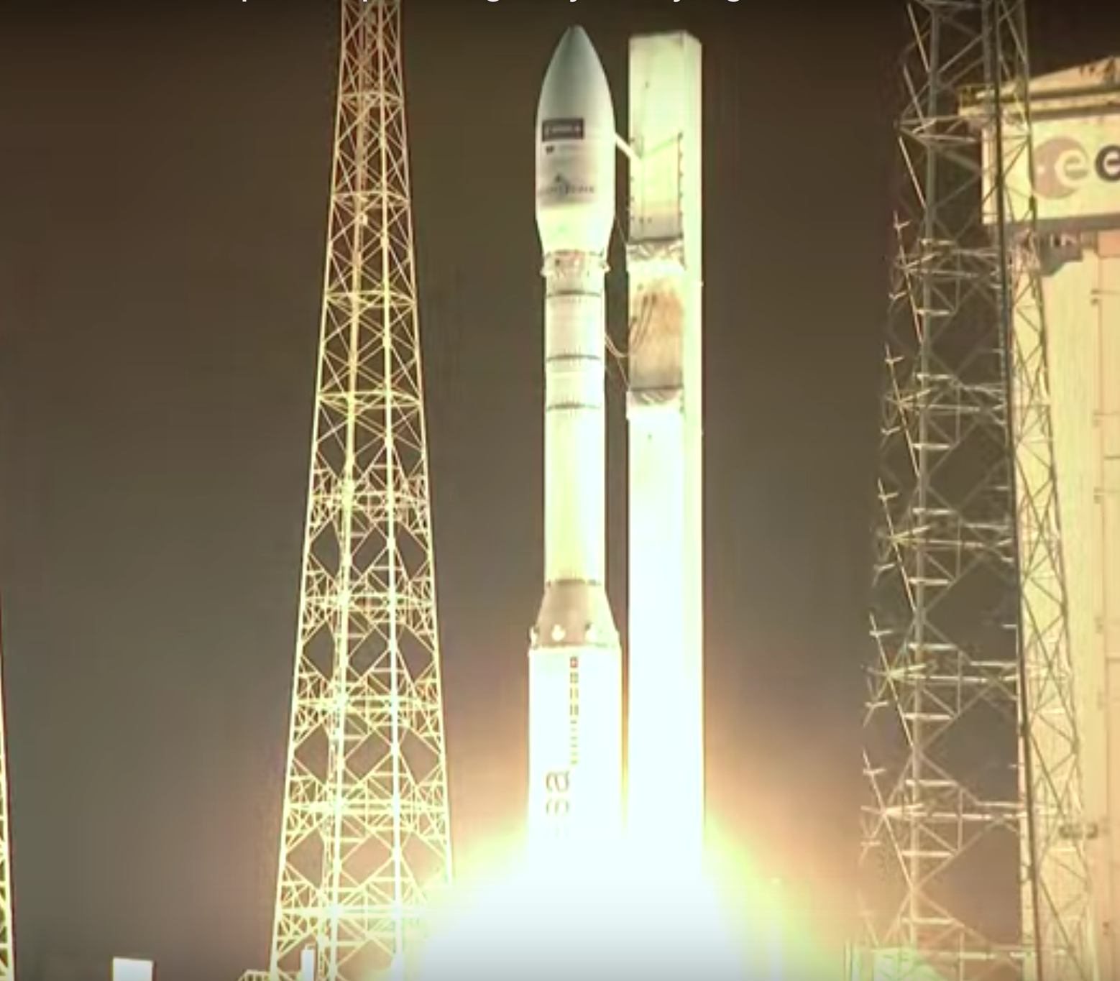
Deployment Schedule
Continuity up to 2030 and beyond
✓
✓
✓
✓
✓
✓
✓
Operational predictability & continuity allows business plans to emerge
Over 10 Petabyte/year of new data
with just Sentinels-1, -2 and -3 fully operational

Slide 4
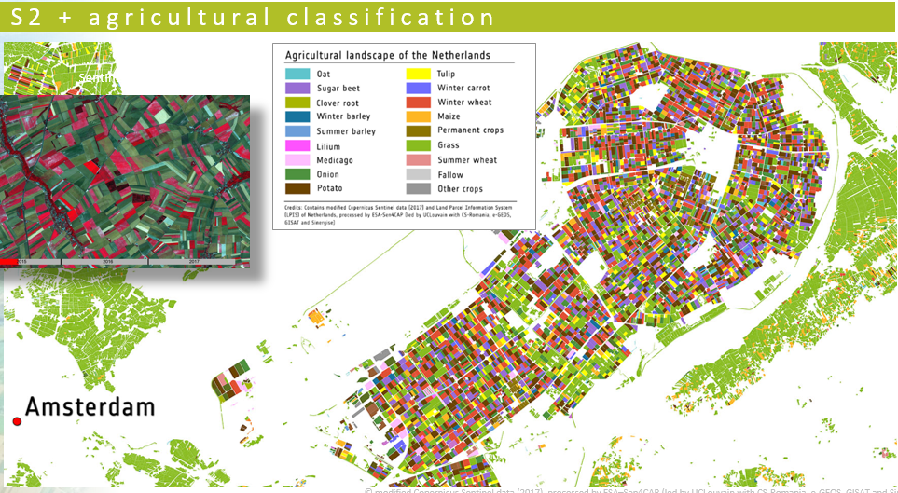


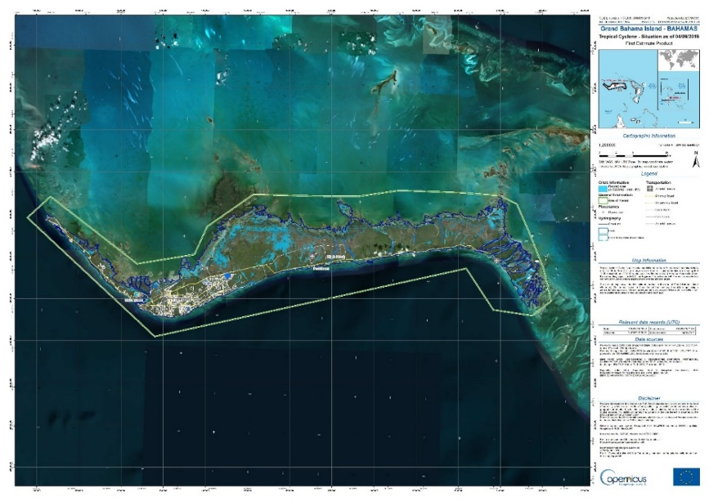

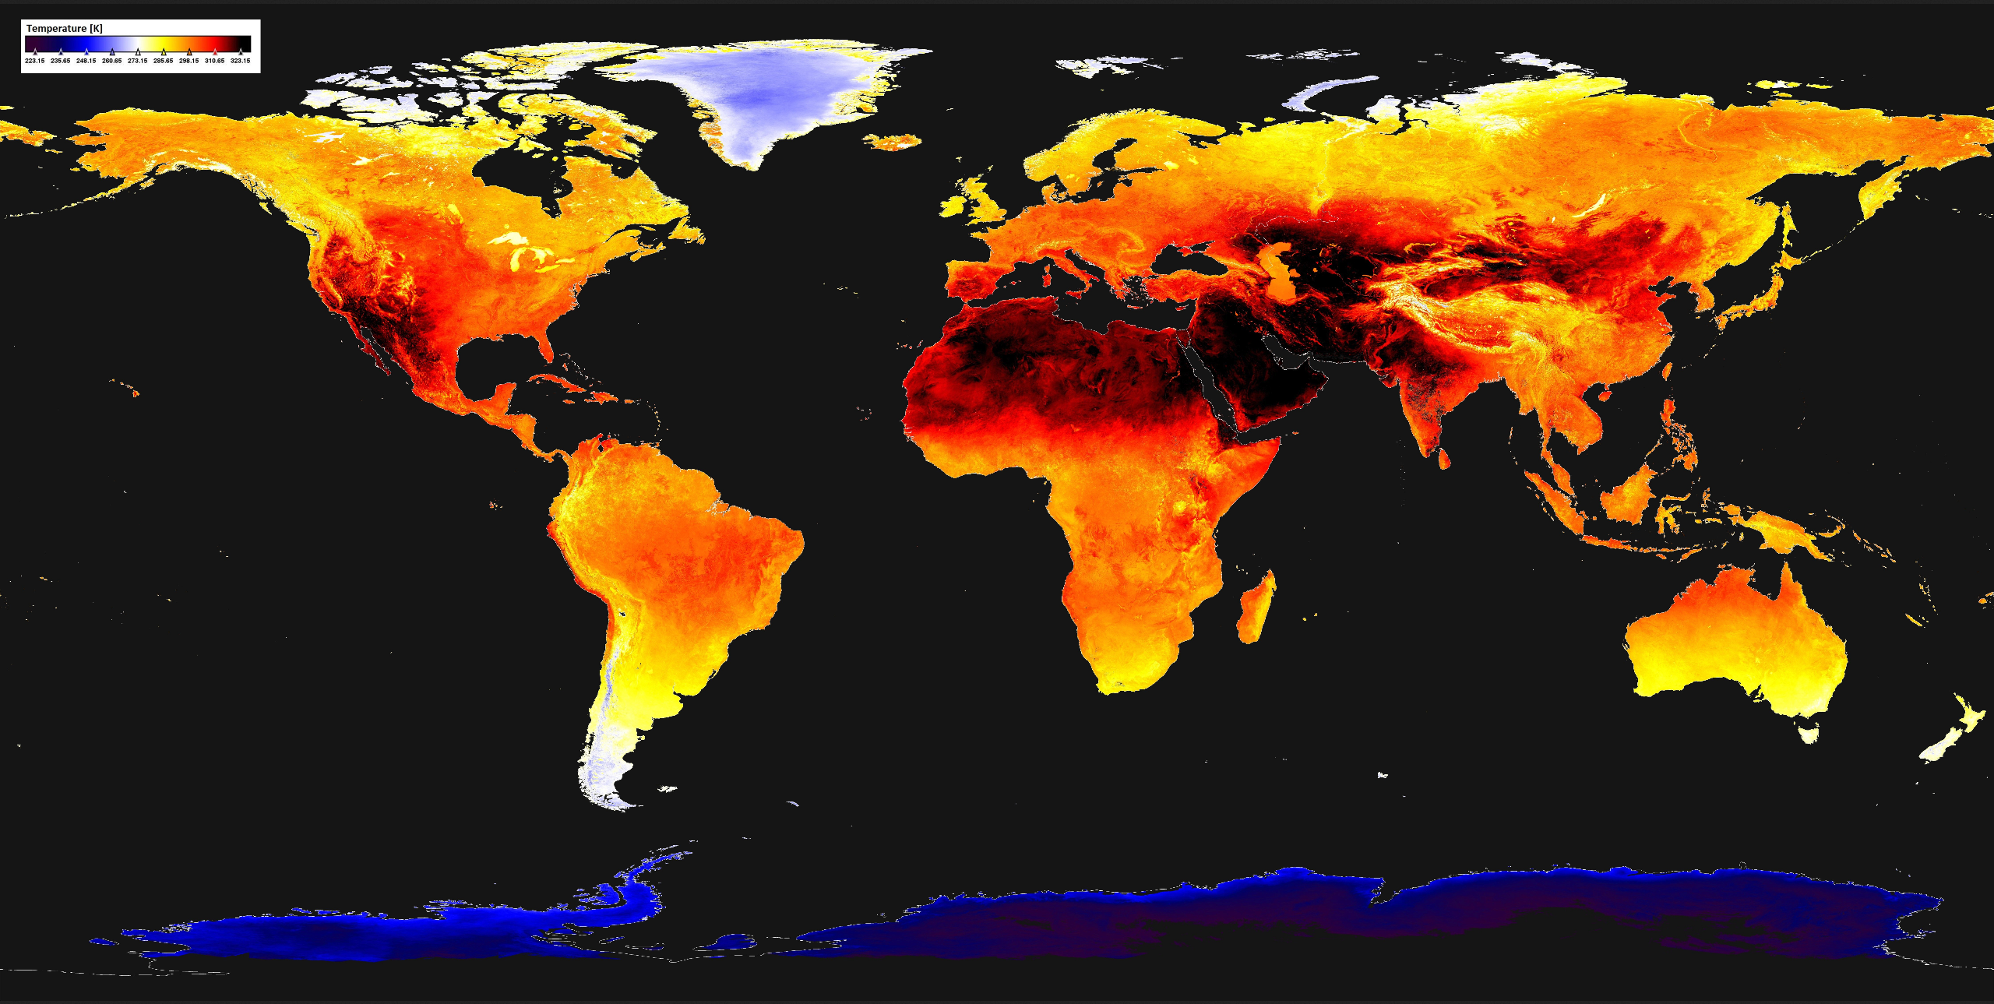
Sentinels 1,2,3 – regular ingestion into mature products
Impact of cyclone Dorian
Copernicus Emergency Management Service: Activation EMSR385
Authorized User: EC Services | DG ECHO
© modified Copernicus Sentinel data (2017), processed by ESA–Sen4CAP (led by UCLouvain with CS-Romania, e-GEOS, GISAT and Sinergise)
Sentinel-3 SLSTR
Daytime Land Surface Temperature [June 2019]
https://www.earthstartsbeating.com/2019/08/29/land-surface-temperature
Copyright: Contains modified Copernicus Sentinel data (2019) / processed by CEMS – GAF-AG released by e-geos
Copyright: Contains modified Copernicus Sentinel data (2019)

Slide 5
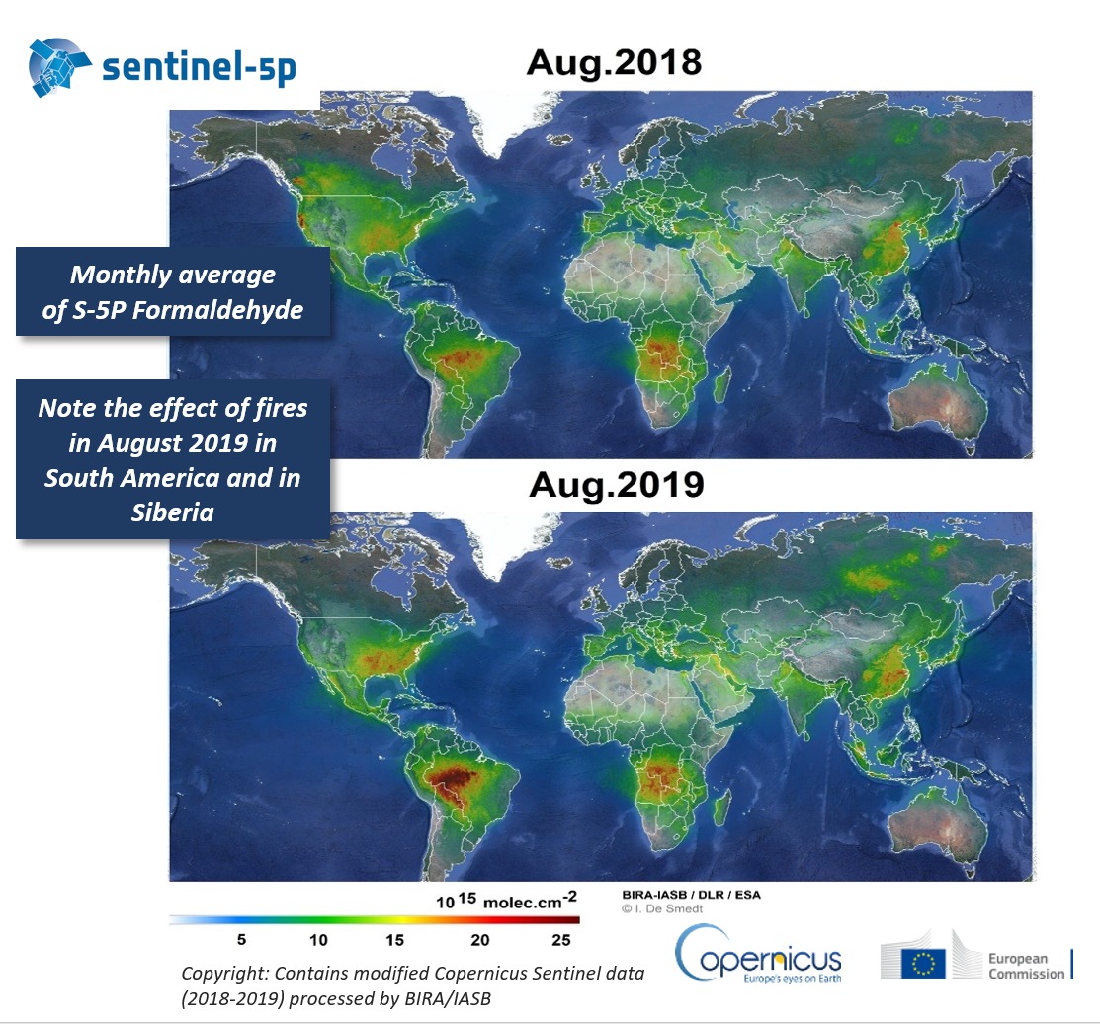
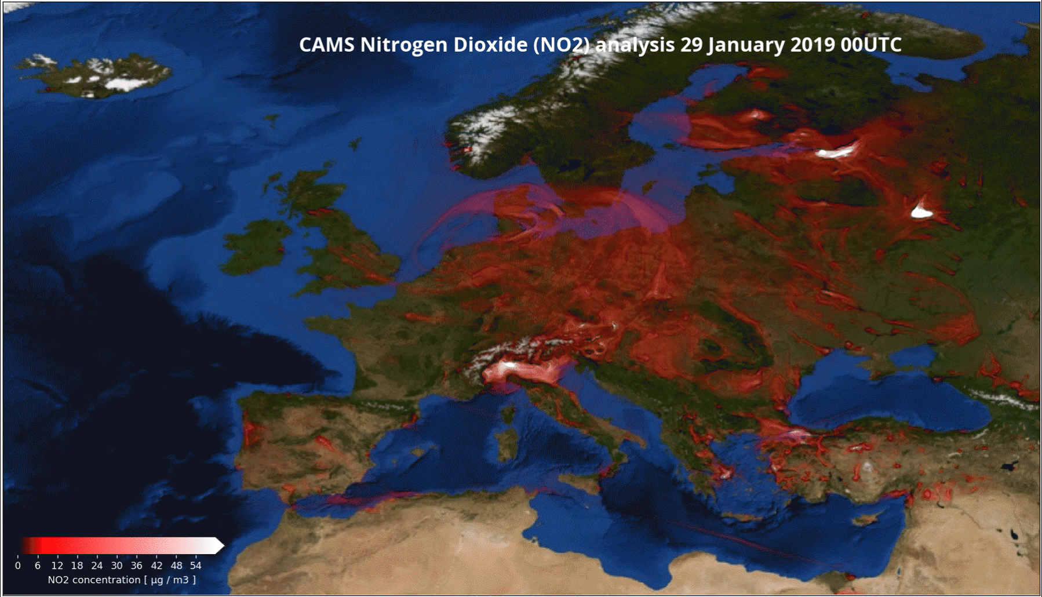
The newest kid on the block - Sentinel 5p

Slide 6
F Future and Evolution
    Main Objectives:
      Continuity: strong investment in existing services
      Evolution to match the needs: climate change, the arctic and sustainable development; security/defense, IoT; improve distribution (DIAS …)
      Adaption to new realities: new space, strategic autonomy on key systems, geopolitical realities, digital evolution (AI, High Performance Computing, ..)
      5.8 Billion Euros planned for period 2021-2027
Notes:
Full text: "Enhanced continuity and user-driven development of current activities, data and services […] to ensure investment continuity, encourage scientific and technical progress, support the competitiveness and innovation capacity of the European space industry, in particular small and medium-sized enterprises, start-ups and innovative businesses;"
Evolution: to match the needs: Climate change; security/defense, IoT
Adaption to new realities: New space, strategic autonomy on key systems, geopolitical realities

Slide 7
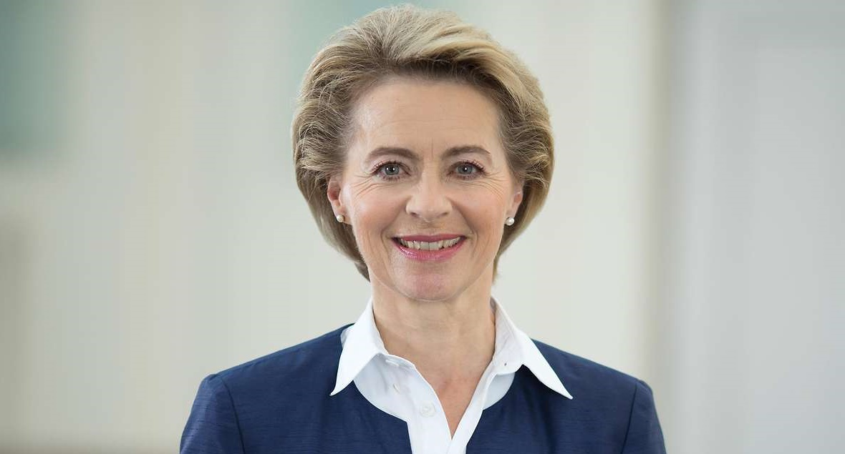
Future and Evolution
Mission letter for Commissioner-designate
for Space matters (10 September 2019)
“You will implement the future Space Programme…
You should explore ways in which we can make the most of our assets to deliver on climate objectives, including the use of Copernicus to monitor CO2 emissions”
Copernicus services and products enable the full implementation of the EGD by:
    tackling climate change issues
    reducing emissions
    respecting international commitments (e.g. Paris agreement)
    Controlling the effective implementation of the circular economy, the sustainability of a bio-economy and the protection of biodiversity.
Synergies with environment, climate, agriculture, transport and energy policies.
Creation of new Directorate General
#vdLcommission

Slide 8
SPACE COMPONENT EVOLUTION:6 Missions
Based upon these inputs, 6 possible satellite missions have been identified:
Priority 1: Anthropogenic CO2 Monitoring Mission (CO2 Mission)
Copernicus Polar Ice and Snow: Passive Microwave Radiometer Mission (CIMR)
Land Surface Temperature Monitoring (LSTM)
Copernicus polaR Ice and Snow Topographic Altimeter (CRISTAL)
Radar Observing System for Europe L-Band SAR (ROSE L)
Copernicus Hyperspectral Imaging Mission for the Environment (CHIME)
Priorities not yet defined
+ Sentinels Next Generation

Slide 9






Copernicus Services evolution
Entrusted Entities have been invited to present their first ideas
General trend : Climate dimension in all services, SDGs indicators, inclusion of big data, regional to global scale, international contribution, enhanced service desk
Service
Scope
Impact
Service
Scope
Impact
An integrated blue-green-white ocean forecast
High resolution boundaries
What-if scenarios and indicators
Arctic policy
MFSD Phase II
CFP
Internat. Ocean gov.
A unified service
CLC+
SDGs
Land dynamics services
Regional policies
MFSD
WFD
S4-S5 integration
Support to national Uptake
Air pollution
Health
Emiss. & deposition of pollutants
High resolution services
Expansion of EMS Risk & Recovery
Climate risks
DG ECHO
EEAS
Sendai Framework
50 ECVs
SDGs
Attribution service
CO2 monitoring
Paris Agreement
GCOS
Climate in EU policies
Inclusion of non-space data
High resolution services
Integrated with intelligence
Defence action plan
CFSP
EEAS

Slide 10
F Spectrum concerns
      The passive frequency band 23.6 – 24.26 GHz is used by Copernicus
      The International Mobile Telecommunications is looking to use the band above 24.26 GHz
      Unwanted emissions from above 24.26 GHz may have a negative impact on the data from the satellites
      Seeking support for ensuring the protection of the passive band at World Radiocommunication Conference (WRC-18) starting on 28 October
Notes:
Full text: "Enhanced continuity and user-driven development of current activities, data and services […] to ensure investment continuity, encourage scientific and technical progress, support the competitiveness and innovation capacity of the European space industry, in particular small and medium-sized enterprises, start-ups and innovative businesses;"
Evolution: to match the needs: Climate change; security/defense, IoT
Adaption to new realities: New space, strategic autonomy on key systems, geopolitical realities

Slide 11
Thank you for your attention

