Slide 1

Agency Report - EUMETSAT
Committee on Earth Observation Satellites
EUMETSAT
CEOS Plenary 2019
Agenda Item 3.6.
Ha Noi, Viet Nam
14 – 16 October 2019

Slide 2

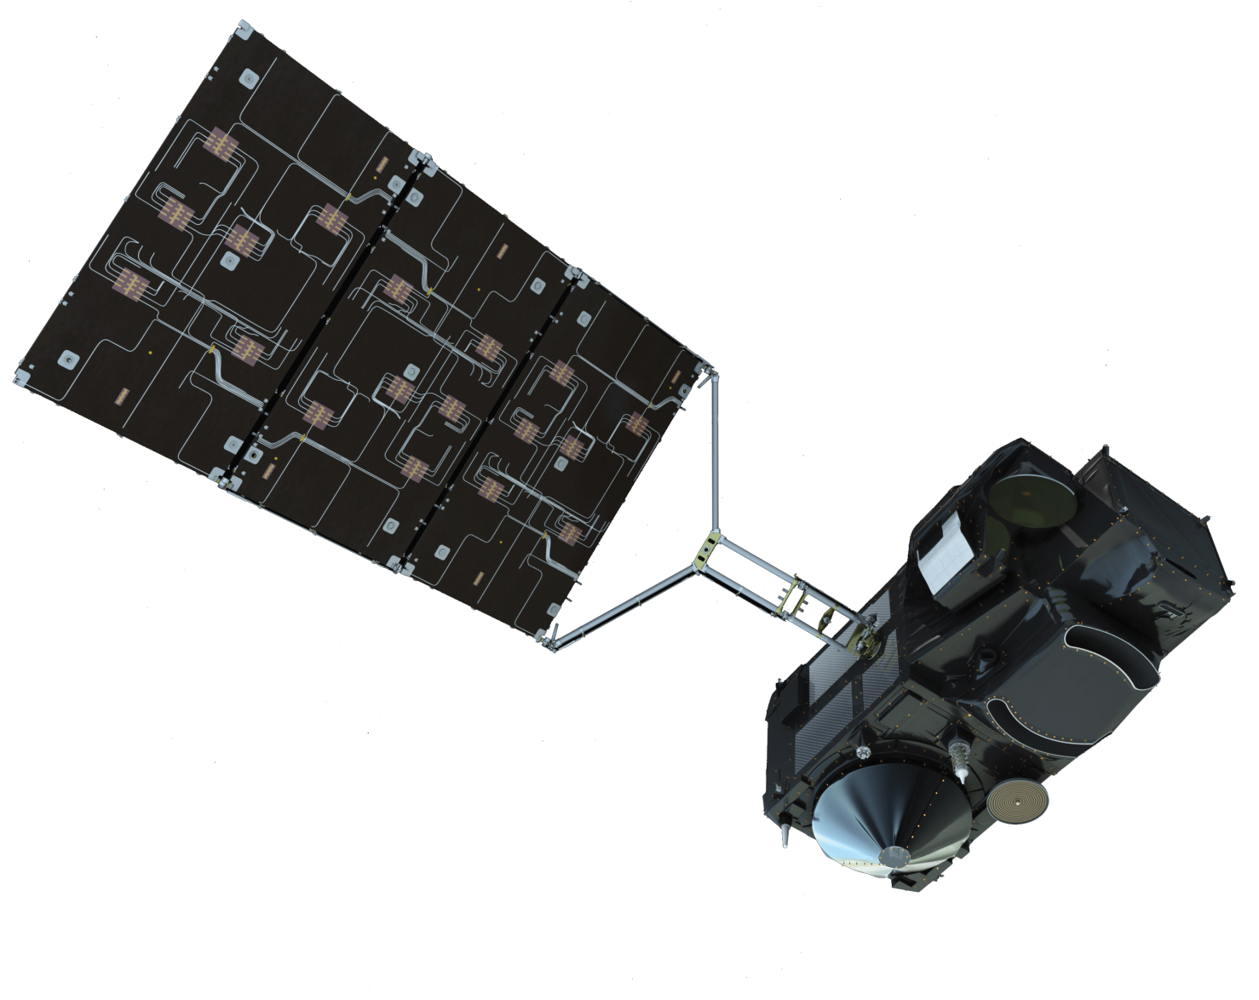
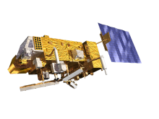
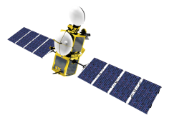
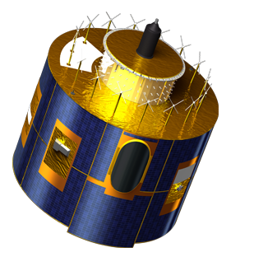
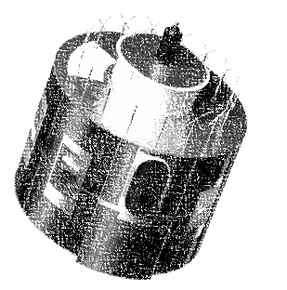

11 Satellites in Orbit
METOP-A, -B & -C (98.7° incl.)
JASON-2 & -3 (63° incl.)
LOW EARTH, SUN-SYNCHRONOUS ORBIT
LOW EARTH, non-SYNCHRONOUS ORBIT
EUMETSAT Polar System (EPS) /
INITIAL JOINT POLAR SYSTEM
Ocean Surface Topography mission, shared with CNES/NOAA/EU
SENTINEL-3A & -3B (98.65° incl.)
Jason-3 is a Copernicus mission
LOW EARTH, SUN-SYNCHRONOUS ORBIT
COPERNIcus satellites delivering Marine and Land Observations
METEOSAT-8 (41.5° E)
GEOSTATIONARY Orbit
Meteosat 2nd generation providing IODC from February 2017 – mid-2020
METEOSAT-9, -10, -11
Geostationary Orbit
two-satellite system
Meteosat 2nd generation
Full disc imagery mission (15 mins) (Meteosat-11 (0°))
Rapid scan service over Europe (5 mins) (Meteosat-10 (9.5° E))
BACKUP SATELLITE and gap filler for RSS (Meteosat-9 (3.5°E))

Slide 3
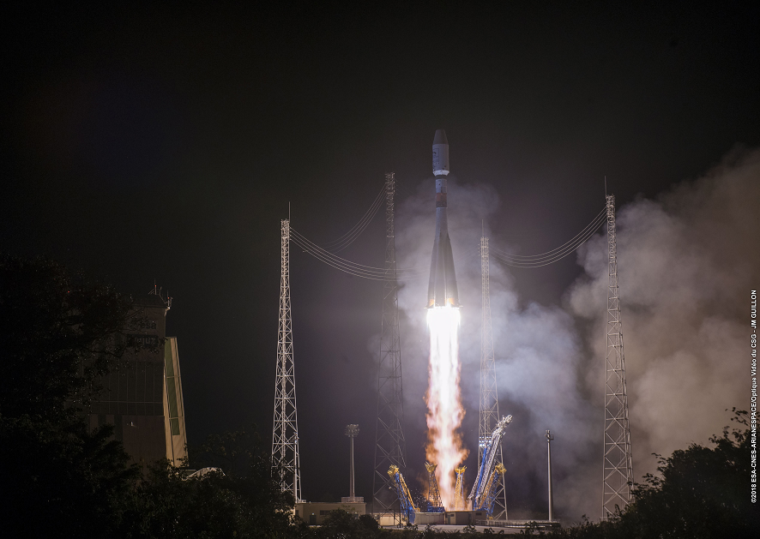

Metop-C launch – 7 Nov. 2018
Metop-C entered in operations on 3 July, as part of a 3 Metop Constellation

Slide 4
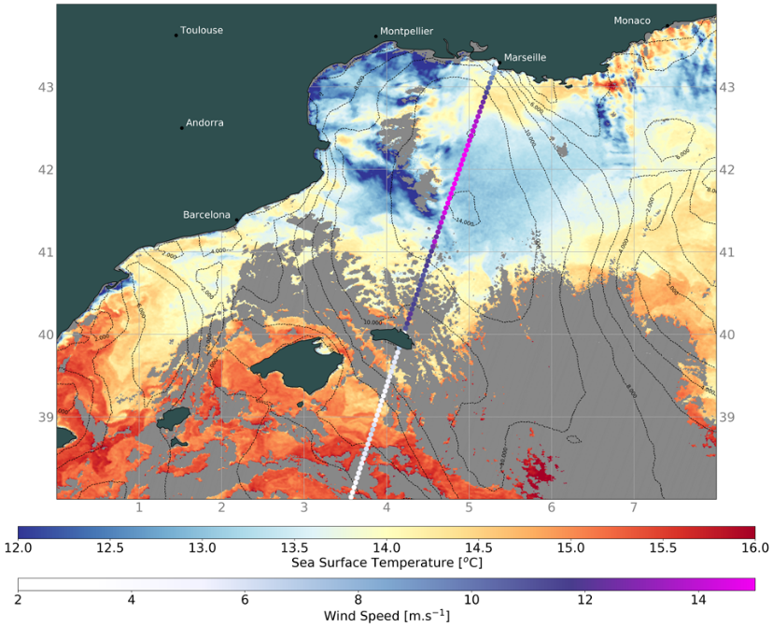
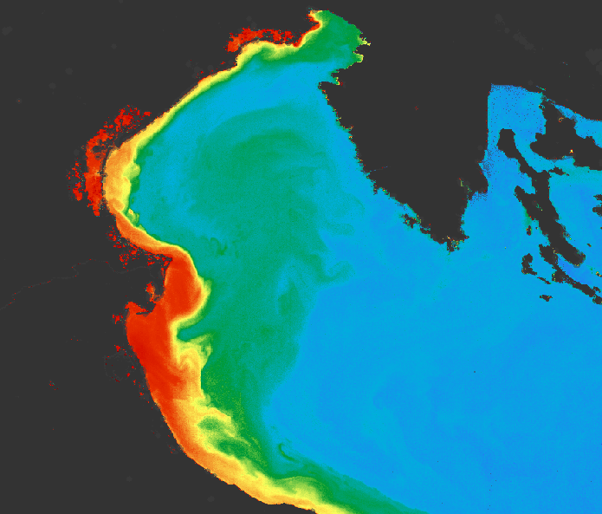
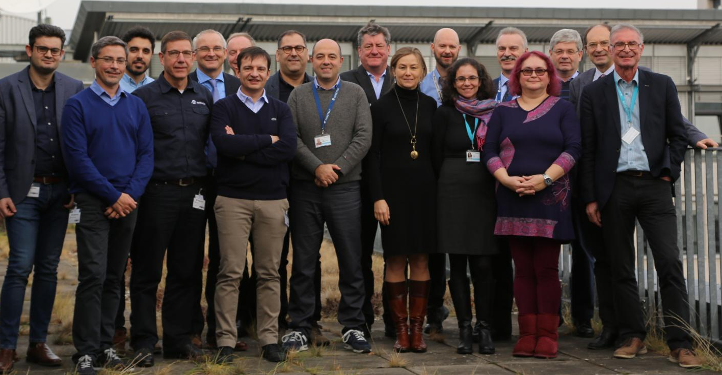


Start of Routine Operations of Sentinel-3B
Flight operations handed over of EUMETSAT on 28 November
Routine operations started on 27 March, after release of Level 2 products and RORR

Slide 5
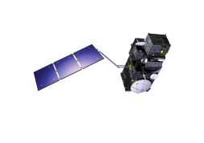

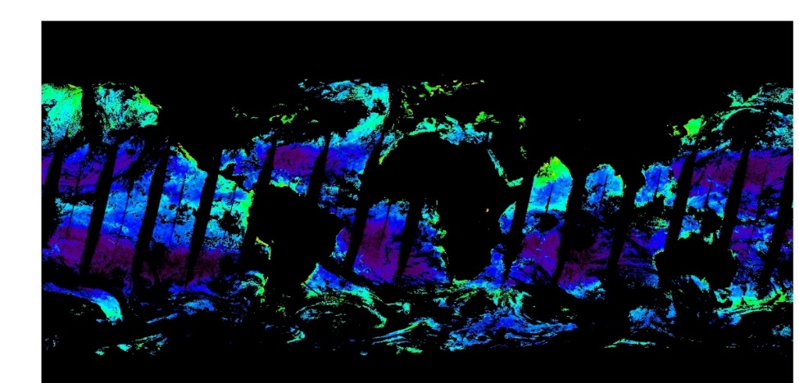
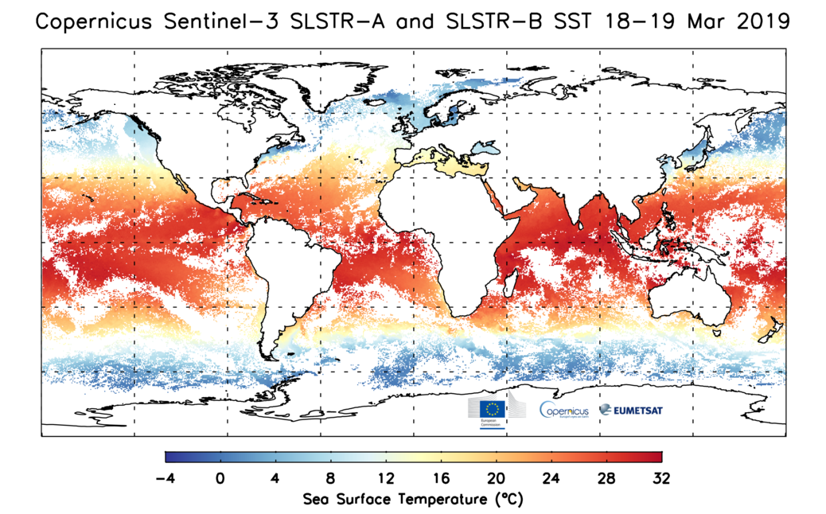
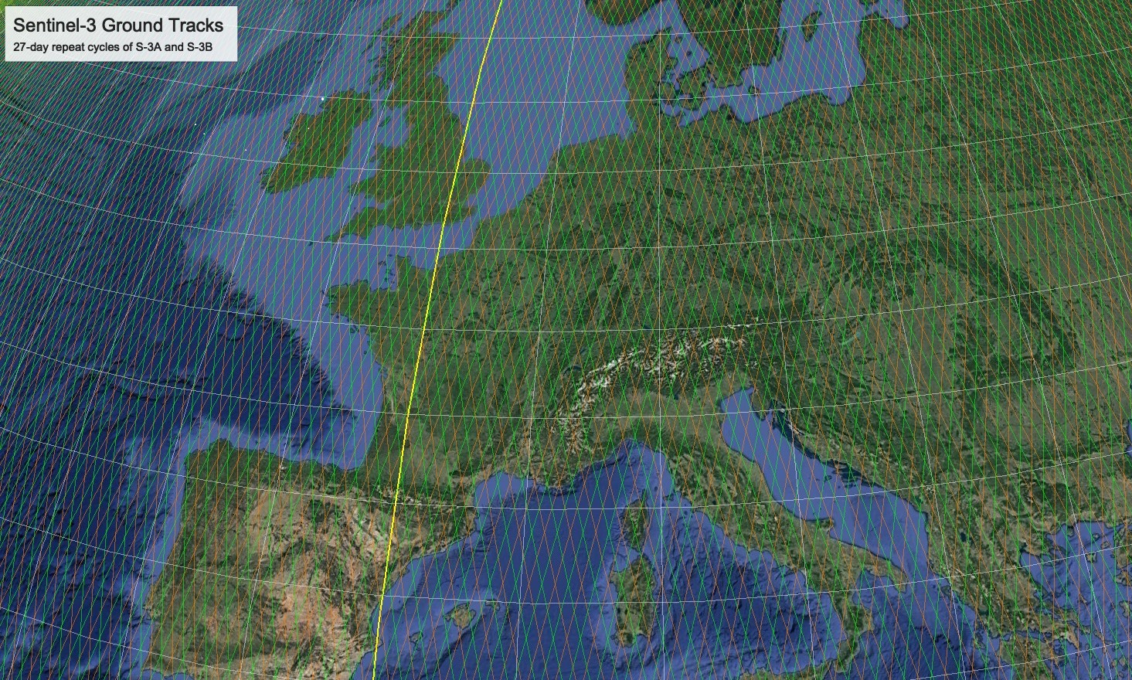
Start of S3 dual marine mission operations : 27 March 2019

Slide 6
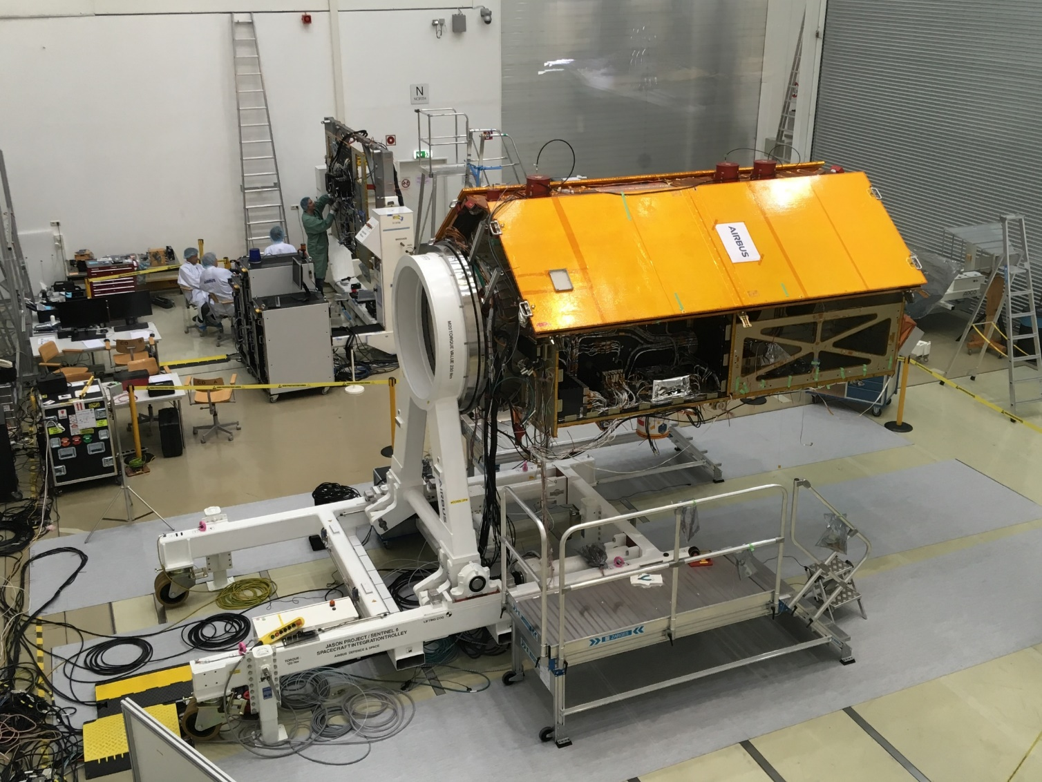




Preparing for launch of Sentinel-6 / Jason-CS : November 2020

Slide 7
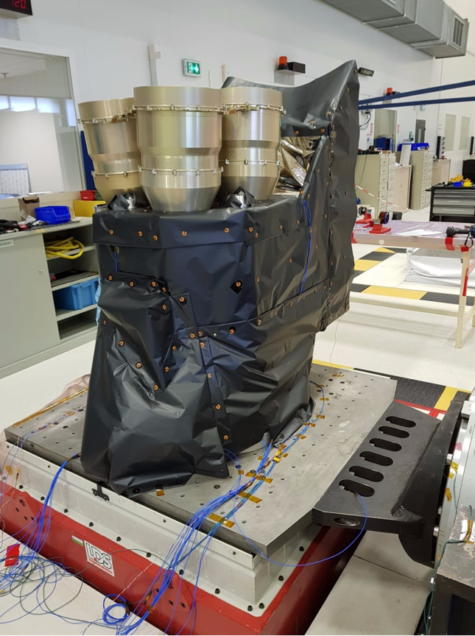
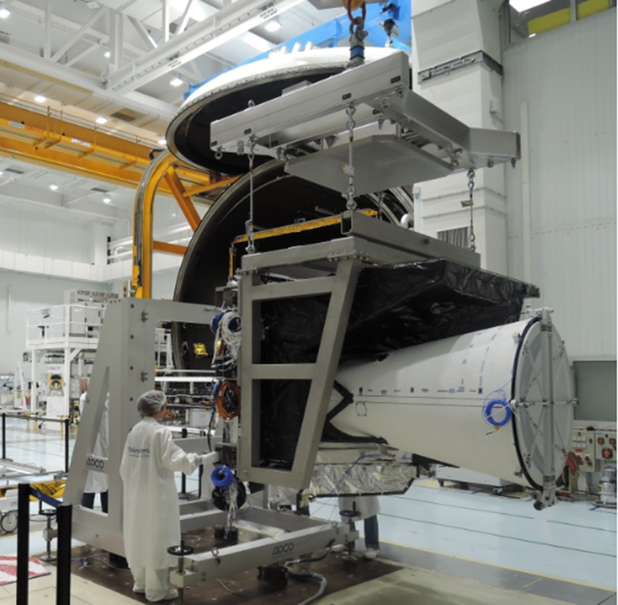
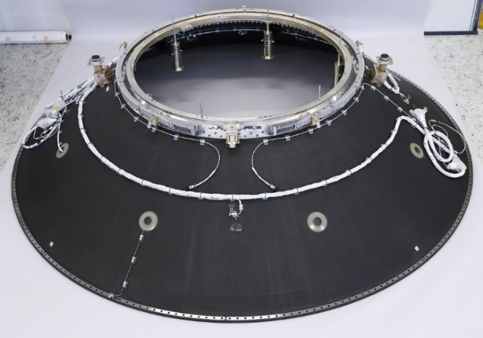
Next Generation MTG : Q4/2021
FCI Structural and Thermal Model (STM)
Picture TAS
LI Structural Model (SM) before vibration test
Picture Leonardo
Launcher adapter for MTG-I after its qualification
Picture RUAG

Slide 8
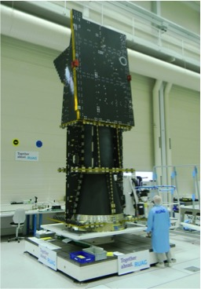
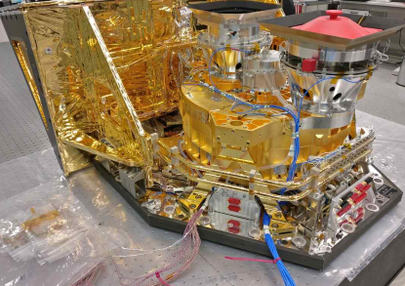
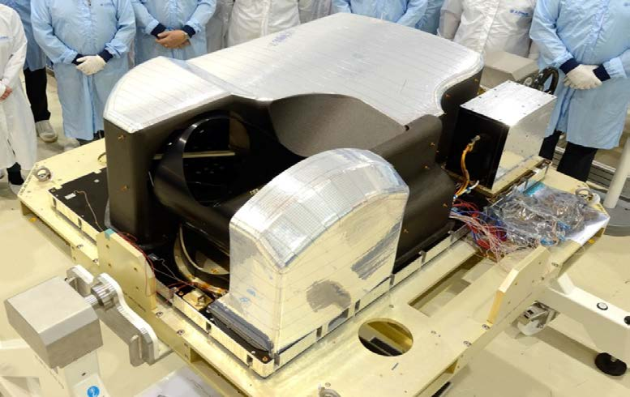
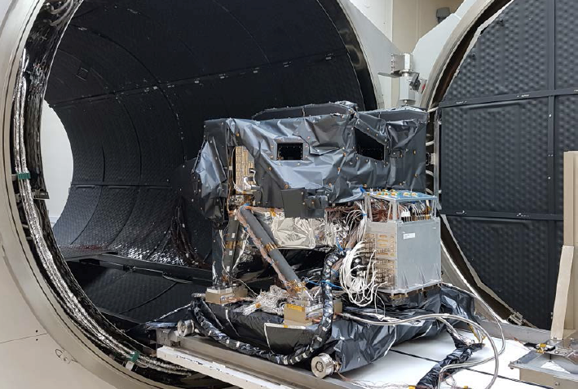
Next Generation EPS-SG : Q1/2023
3MI STM
MWS STM
Satellite structure STM
Sentinel-5 STM
(Photos courtesy ESA)

Slide 9
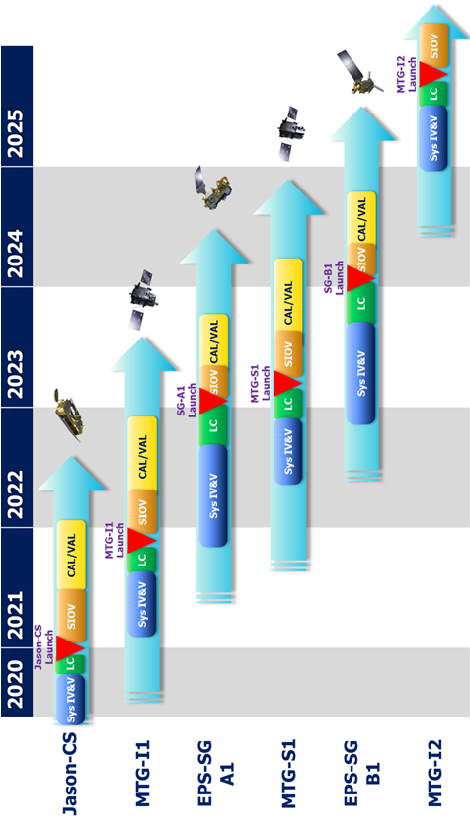
The Future : 1 launch per year in 2020-2025

Slide 10


Big Data Services to support operational data access to users
EXTENDED USER VALIDATION PHASE FOR PATHFINDERS
Member State
NMHSs feedback
Secretariat
Feedback
analysis/
response
Extended
Validation
Phase
Pilot
Phases
Initial Validation
Phase
Workshop
(March)
Readiness
Review (May)
August
Report
(October)
February
STG-AFG
(May)
C91
(July)

Slide 11


Coherent with Copernicus and European Weather Cloud
European Weather Cloud - EWC
Copernicus WEkEO

