Slide 1
USGS Status
Jenn Lacey, USGS
CEOS Plenary 2019
Agenda Item #: 3.6
Ha Noi, Viet Nam
14-16 October 2019

Slide 2
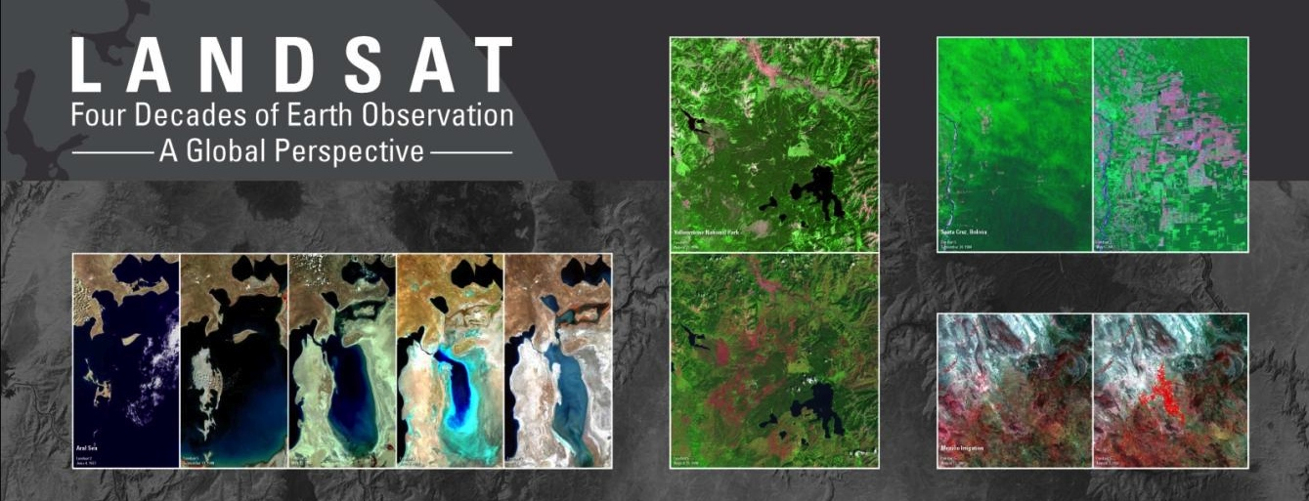
Landsat – The longest and most comprehensive record of the Earth
Landsat archive: 8.5+ million images (216 billion sq. km), 1972-present, spanning the globe
Landsat 7 and Landsat 8 missions currently operational
Landsat 9 is targeting a December 2020 launch

Slide 3
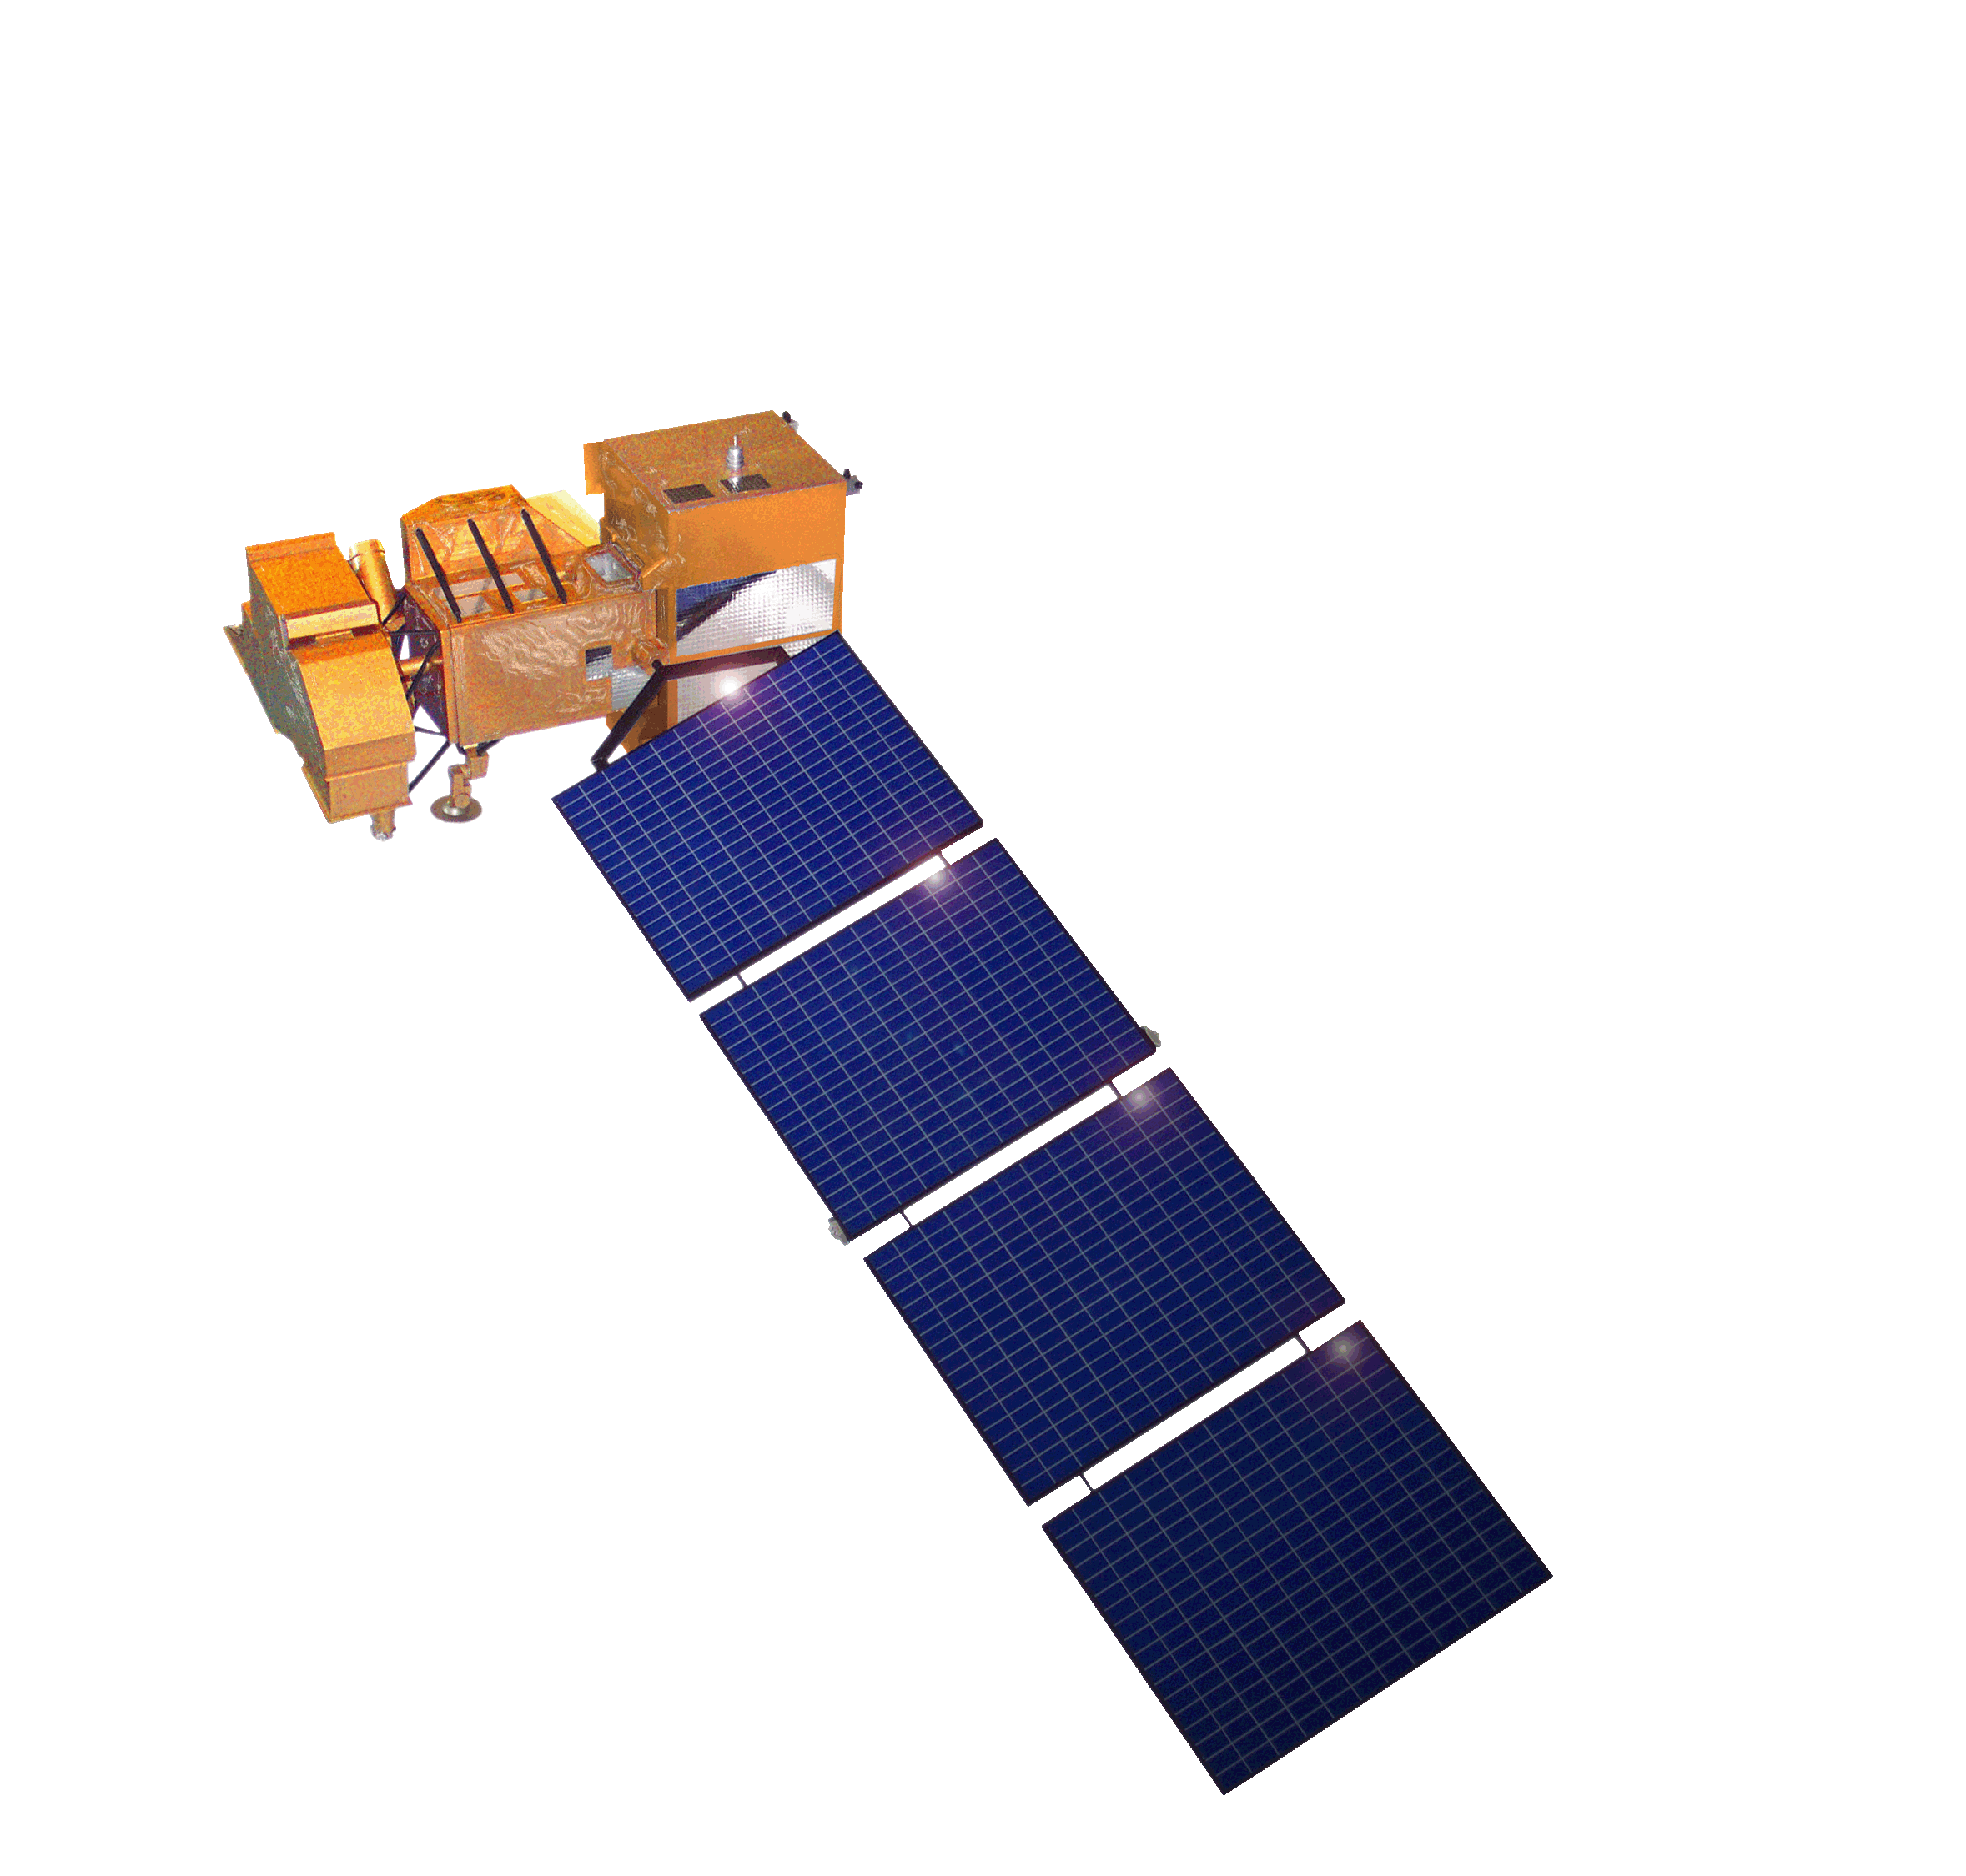
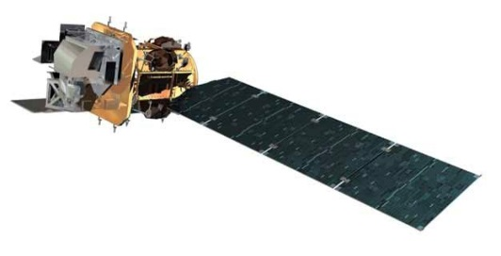
Landsat Operational Mission Status
Landsat 7
Acquiring image data at a rate of ~470 scenes per day through a continental acquisition strategy
On-orbit performance of Landsat 7 observatory continues to be outstanding
Finalized end of mission planning to extend Landsat 7 science operations to overlap with Landsat 9 launch readiness
  Assumes December 2020 launch readiness date for Landsat 9
  Science mission life-cycle potential extends to July 2021
  Decommissioning will follow the launch of Landsat 9 or the end of science mission operations, whichever comes first
Landsat 8
Acquiring image data at a rate of ~740 scenes per day with continental acquisition strategy
On-orbit performance of Landsat 8 observatory continues to be outstanding
TIRS Scene Select Mirror (SSM) Encoder Circuit B-side operations concept performing very well
Enhanced Landsat Ground Network (LGN) robustness and reliability through use of international partnerships
International Cooperator (IC) network currently at 21 certified IC stations and growing
Flight Operations now performed under USGS contract for combined mission operation and Landsat Multi-satellite Operations Center (LMOC) development

Slide 4
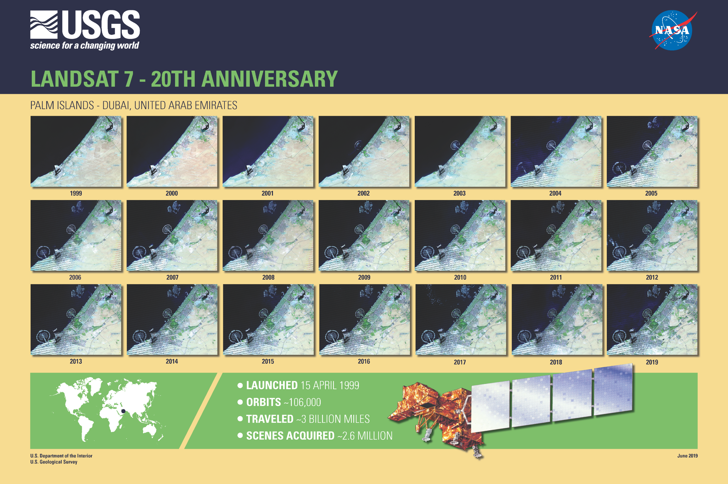

Slide 5
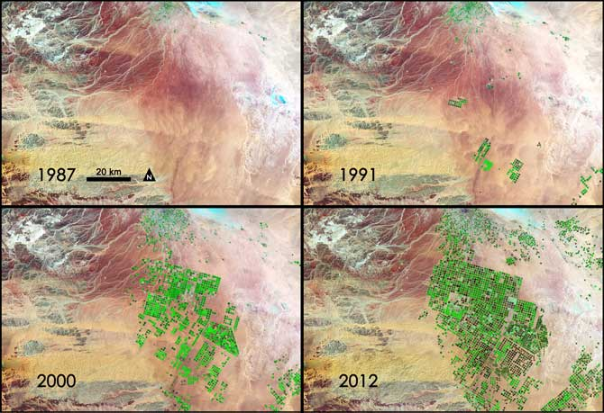
Landsat 9 Mission Overview
  Mission Objectives
Provide continuity in multi-decadal Landsat land surface observations to study, predict, and understand the consequences of land surface dynamics
  Core Component of Sustainable Land Imaging program
  Mission Parameters
Single Satellite, Mission Category 1, Risk Class B
  5-year design life after on-orbit checkout
  At least 10 years of consumables
Sun-synchronous orbit, 705 km at equator, 98°inclination
16-day global land revisit
Partnership: NASA & USGS
  NASA: Flight segment & checkout
  USGS: Ground system and operations
Category 3 Launch Vehicle
Launch: Management Agreement – January 2021
Agency Baseline Commitment – November 2021
  Mission Team
NASA Goddard Space Flight Center (GSFC)
USGS Earth Resources Observation & Science (EROS) Center
NASA Kennedy Space Center (KSC)
Instruments
Operational Land Imager 2 (OLI-2; Ball Aerospace)
    Reflective-band push-broom imager (15-30m res)
    9 spectral bands at 15 - 30m resolution
    Retrieves data on surface properties, land cover, and vegetation condition
Thermal Infrared Sensor 2 (TIRS-2; NASA GSFC)
  Thermal infrared (TIR) push-broom imager
  2 TIR bands at 100m resolution
  Retrieves surface temperature, supporting agricultural and climate applications, including monitoring evapotranspiration
Spacecraft (S/C) & Observatory Integration & Test (I&T)
Northrop Grumman Innovation Systems (NGIS), formerly Orbital ATK (OA)
Launch Services
United Launch Alliance (ULA) Atlas V 401
Mission Operations Center (MOC) and Mission Operations
General Dynamics Mission Systems (GDMS)
Increase in pivot irrigation in Saudi Arabia from 1987 to 2012 as recorded by Landsat. The increase in irrigated land correlates with declining groundwater levels measured from GRACE (courtesy M. Rodell, GSFC)

Slide 6
Sustainable Land Imaging (SLI) Architecture Study Team (AST)
NASA/DOI/USGS SLI AST kicked off a study for the design and implementation approach of a spaceborne system to provide global, continuous Landsat-quality multispectral and thermal infrared measurements for approximately a fifteen-year period starting in 2026
Oversight provided by the NASA Associate Administrator for Science Mission Directorate and the DOI Assistant Secretary for Water and Science
AST-2019 will inform NASA and DOI/USGS on options for both the space and ground segments, potential contributions from international partners and commercial Earth Observation data suppliers, and business model alternatives
Ground System a major driver for AST-2019 (and USGS)

Slide 7
Evaluation of a Range of Landsat
Data Cost Sharing Models
In 2018, USGS was asked to consider fees to recover costs for Landsat data. USGS referred this request to an independent panel of experts known as the Landsat Advisory Group (LAG).
The LAG considered two cost recovery options:
  Option 1: Charging fees for Landsat data with the characteristics of Landsat 8 and 9, and
  Option 2: Charging fees for “enhanced” (future) Landsat data such as improved spatial or spectral resolution over Landsat 8 and 9, or tailored image-collection requests.
The LAG recommended:
  Option 1: that DOI not implement any fees for Landsat data with the characteristics of Landsat 8 and 9.
  Option 2: the LAG outlined certain issues and challenges that would require further study and issued a set of related recommendations.
USGS expects no changes to be made to the current full, free, and open policy for provision of Landsat data.
The report will provide useful input to the joint NASA/USGS Sustainable Land Imaging Architecture Study Team.
https://www.fgdc.gov/ngac/meetings/june-2019/ngac-paper-evaluation-of-a-range-of-landsat-data.pdf

Slide 8
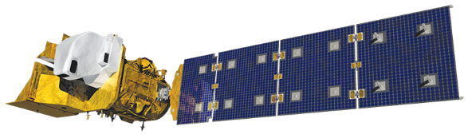
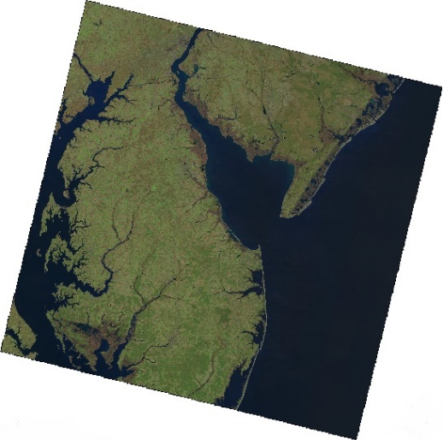
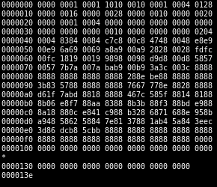
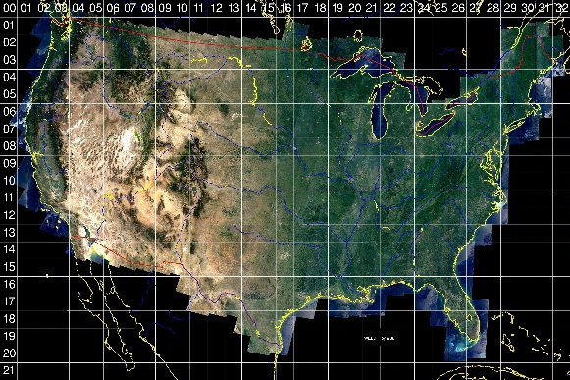
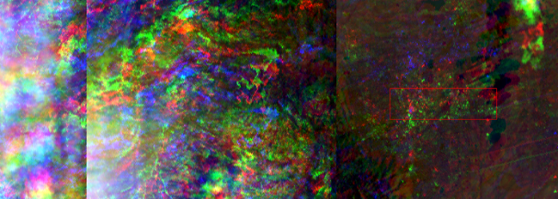
Landsat Processing Flow
Level-0 Processing
Mission data files are combined into a single Earth interval
Spacecraft / instrument ancillary data are ingested and corrected
Basic characterization of image data is performed
Level-1 Processing
Intervals are subset into WRS-2 framed scenes
Radiometric and geometric corrections are applied
Scenes are terrain corrected and registered to a common baseline
Level-2 Processing
Auxiliary data is used to remove atmospheric effects from the imagery
Surface Reflectance (SR) and Surface Temperature (ST) bands are generated
Downlink
Mission data files are downlinked from the spacecraft to the Landsat Ground Network (LGN)
Mission data is permanently archived for long-term safekeeping

Slide 9
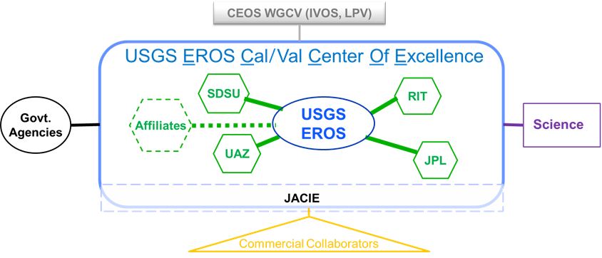
EROS Calibration/Validation Center of Excellence (ECCOE)
EROS Cal/Val Center of Excellence (ECCOE) established 2017 for: “improving the accuracy, precision, and efficiency of radiometric, geometric, and spatial characterization, calibration, and cross-calibration of optical remote sensing systems to achieve the highest degree of interoperability of remote sensing data products.”

Slide 10

Questions?

