Slide 1

Committee on Earth Observation Satellites
Earth Science Program
CNES
CEOS Plenary 2019
Session 3 Agency and Partner Updates
Ha Noi, Viet Nam
14 – 16 October 2019

Slide 2
CNES EO missions in development or operation
Atmosphere
Calipso (2006-) with NASA
Megha-Tropiques (2011-) with ISRO
IASI-A (2006-) with EUMETSAT
IASI-B (2012-) with EUMETSAT
IASI-C (2018) with EUMETSAT
Strateole2 (2018-2024)
Merlin (2024) with DLR
Microcarb (2021) with UKSA
IASI-NG (2022) with EUMETSAT
Ocean
Saral (2013-) with ISRO
Jason 2 (2008) with EUMETSAT NASA NOAA
Jason 3 (2016-) with EUMETSAT NASA NOAA
CFOSAT (2018-) with CNSA
Ocean & Continental Surfaces
SMOS (2009-) with ESA
SWOT (2021) with NASA, CSA, UKSA
TRISHNA (2024) with ISRO
Continental Surfaces
Pléïades 1A (2011-) with several european partners
Pléïades 1B (2012-) with several european partners
Venus (2017) with ISA
BIOMASS (2022) with ESA
Solid Earth
SWARM (2013-) with ESA
+ Contribution to Copernicus Sentinels : Sentinel 2, 3 and 6
+ ∼ 10 pre-phase A studies conducted every year → Preparation of the future
    A diversity of partners : NASA, EUMETSAT, DLR, ESA, CNSA, ISRO, ISA, …
    All components of the Earth System are adressed, and their interactions
    Several multi-thematic missions : SMOS, SWOT, …

Slide 3
Earth Science Program
  For scientific needs
    Recommendations of regular prospective seminars (Séminaire de Prospective Scientifique)
    Annual recommendations of scientific committees
    TOSCA (Committee for Earth Observation) supporting the CPS (CNES Scientific Committee)
  For operational needs
    By closed interaction with users
      Defense: with a Defense Team
      IGN, Météo-France, Eumetsat, Copernicus, civil protection etc.
  Taking into account international context
    European programs (Earth Explorer, Copernicus, MTG, Post-EPS, etc.)
    Bilateral cooperation perspectives (ESA, NASA, Eumetsat, ISRO, DLR, China, ISA, JAXA…)
    Other European programs & competences in order to avoid duplication
    International (multilateral) coordination programs (CEOS, GEO, WMO, etc.)
  Taking into account French competences (laboratories, industry, CNES)

Slide 4
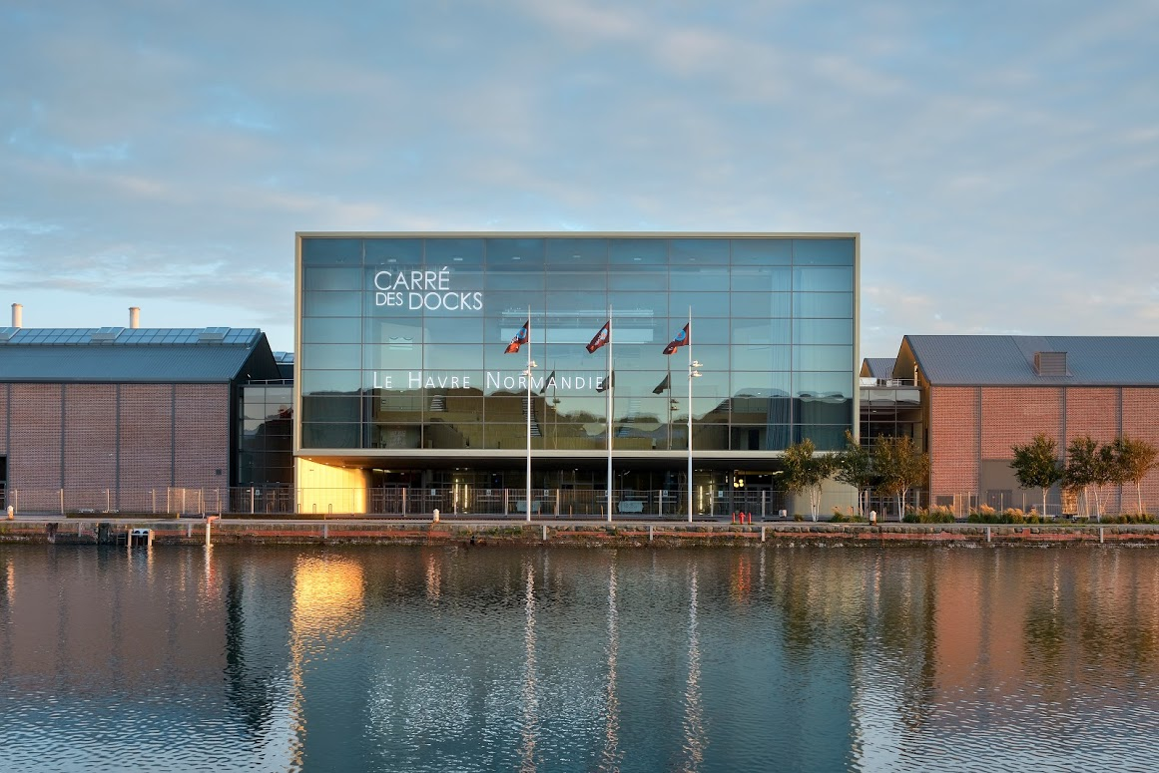

Science Prospective Seminar
Le Havre, 8-10 October 2019
Call for proposals : 6 August 2018
Large consultation of the French Science community
Last edition was held in 2014 (La Rochelle)
Establishment of science priorities for the the next 5 – 10 years
European and international context (program of records) taken into account.
Additional focus on : data / nanosats / technology
75 proposals
17 reports online submitted to the community,
300 participants at Le Havre Seminar
~120 Research laboratories
  Will provide Earth Science orientation for future CNES programs and activities
https://sps2019.com

Slide 5
Priorities for Earth observation from space
Long series of essential variables:
  Copernicus, EUMETSAT and international space agencies programs are essential for long-term monitoring of essential variables.
    An opportunity for developing more innovative/research missions that can join (or not) theses operational programs.
  Need to continue the aerosol/cloud lidar series after Calipso/EarthCare.
New essential variables to be covered:
  Earth Explorer missions are essential.
  Priorities for future missions: Coastal dynamics, Evapotranspiration, Aerosol speciation, surface current, biodiversity essential variables, gravity and magnetic fields.
Need for increased spatial resolution and precision:
  Crucial to study specific domains: coastal regions, cryosphere, cities.
  Required for effective merging with highly precise in-situ data at Earth System Models resolutions.
Nanosats:
  A real opportunity for new missions, a strong interest from the research community for train or swarms.

Slide 6
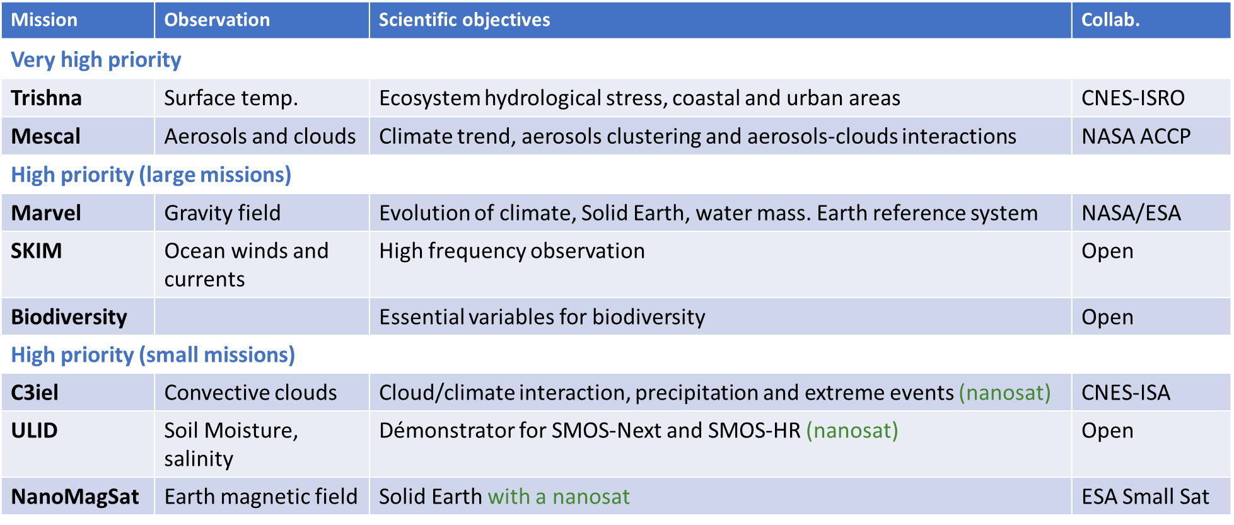
High priority missions for Earth observation
Other recommendations and priorities for Copernicus Long Term Scenario

Slide 7
Phases A underway :
  TRISHNA (ISRO/CNES): TIR mission
  WISA : wide-swath altimetry concept for Sentinel-3NG
  CO3D : Optical constellation (3D)
  SKIM : Ocean currents
  ACCP (with NASA, cloud + aerosol lidar / MW radiometer)
  ULID (Demo of SMOS-Next)
Transitioning to phase A:
  C3IEL (Study of cloud at decametric resolution, with ISA)
  Nanomagsat (magnetic fields measured from nanosats)
  Hyperspectral
  SMASH (constellation of low-cost, miniaturized altimeters for operational hydrology)
  SMOS-HR –(Soild Mositure and Ocean Salinity at higher spatial resolution)
Phase 0 underway
GRICE (geodesy / atomic interferometry)
EXPE-VAL (lidar/hyperspectral – forets)
CHIMERE (hyperspectral, coastal,vegetation)
SMOS-HR
SCALE (new lidar concept)

Slide 8
Recommandations for Earth observation from space
Data and data processing
  Data management should be included at early stage of any space mission program.
  Infrastructure for data archiving and processing, including in-situ/airborne/spaceborne observations as well as model simulations, should be strengthened at national and European level.
  Processing centres need to be close to archiving facilities in order to benefit from emerging data processing technique (IA, machine learning, etc) and to consider volume of coming data.
  Reprocessing of long time series is fundamental and requires a good coordination between agencies.
Ground-based and airborne infrastructures
  Cal/val activities and sites should be organized from a multi-mission point of view and would benefit from coordination between agencies.
  Building on the strength of existing IR (SAFIRE and balloon program), a fully coordinated aircraft-balloon-drone program should be implemented to enable technological innovation, cal/val activities and research.
Europe
  It is mandatory to strengthen action towards European program through coordinated actions of national institutions.

Slide 9
