Slide 1
A request from GEO to CEOS: the need for image data cubes
Gilberto Câmara
GEO Secretariat Director

Slide 2
The importance of CEOS to GEO
Terra
Sentinel-1/1A
Sentinel-2/2A
Landsat-8
Sentinel-3
CBERS-4/4A

Slide 3
The zero download model
open data
The Global South will only use EO information which is free at the point of access. How to pay for it?
Software
Results
Empowered users
Cloud platforms

Slide 4
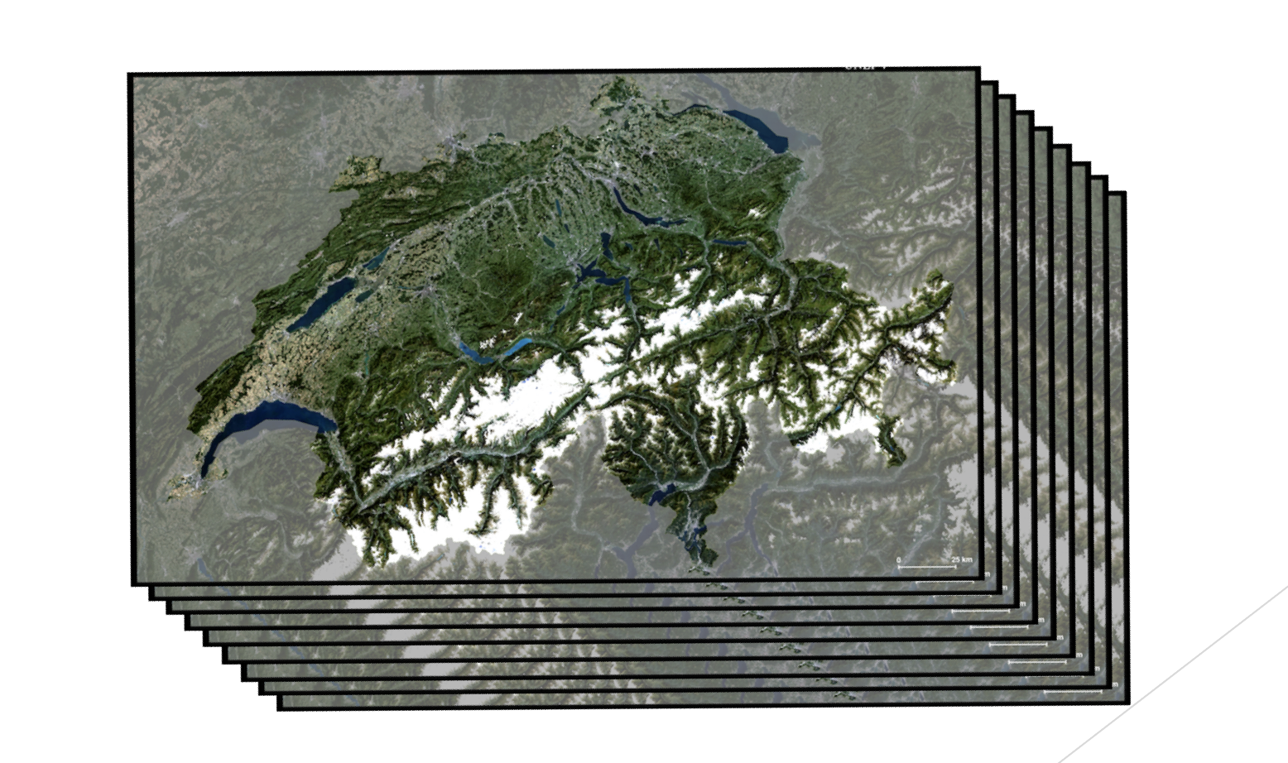
Challenge to CEOS and GEO: Organising EO data as data cubes openly available in cloud platforms
image source: Swiss Data Cube

Slide 5
What is an image data cube?
An image data cube is a 3D array with two spatial dimensions, one temporal dimension, and an arbitrary number of attributes with the following properties:
Spatial dimensions refer to a spatial reference system;
Cells of a data cube have a constant spatial size;
There is no spatial or temporal overlap between the cells;
The temporal reference is a known set of temporal intervals;
For every combination of dimensions, a cell has a vector of attributes.
adapted from Appel and Pebesma (2018)

Slide 6
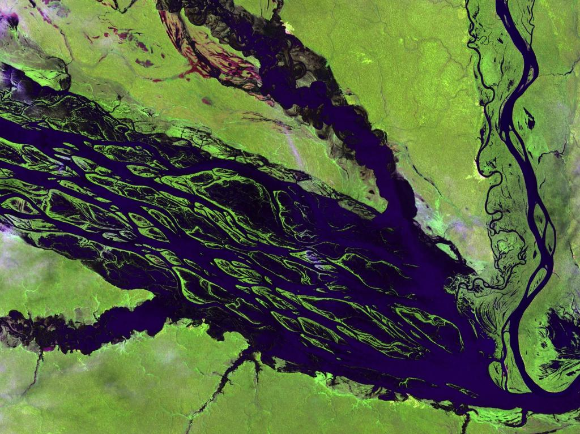
Slicing a data cube in time
image: USGS
positions: 2Dspace values: soil reflectances
An Australian Geoscience Data Cube

Slide 7
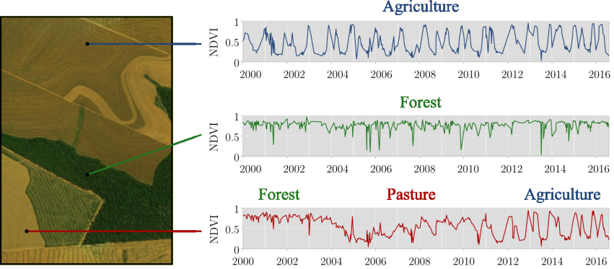
Slicing a data cube in space
Time series capture land system trajectories
graphics: Rolf Simoes (INPE)

Slide 8
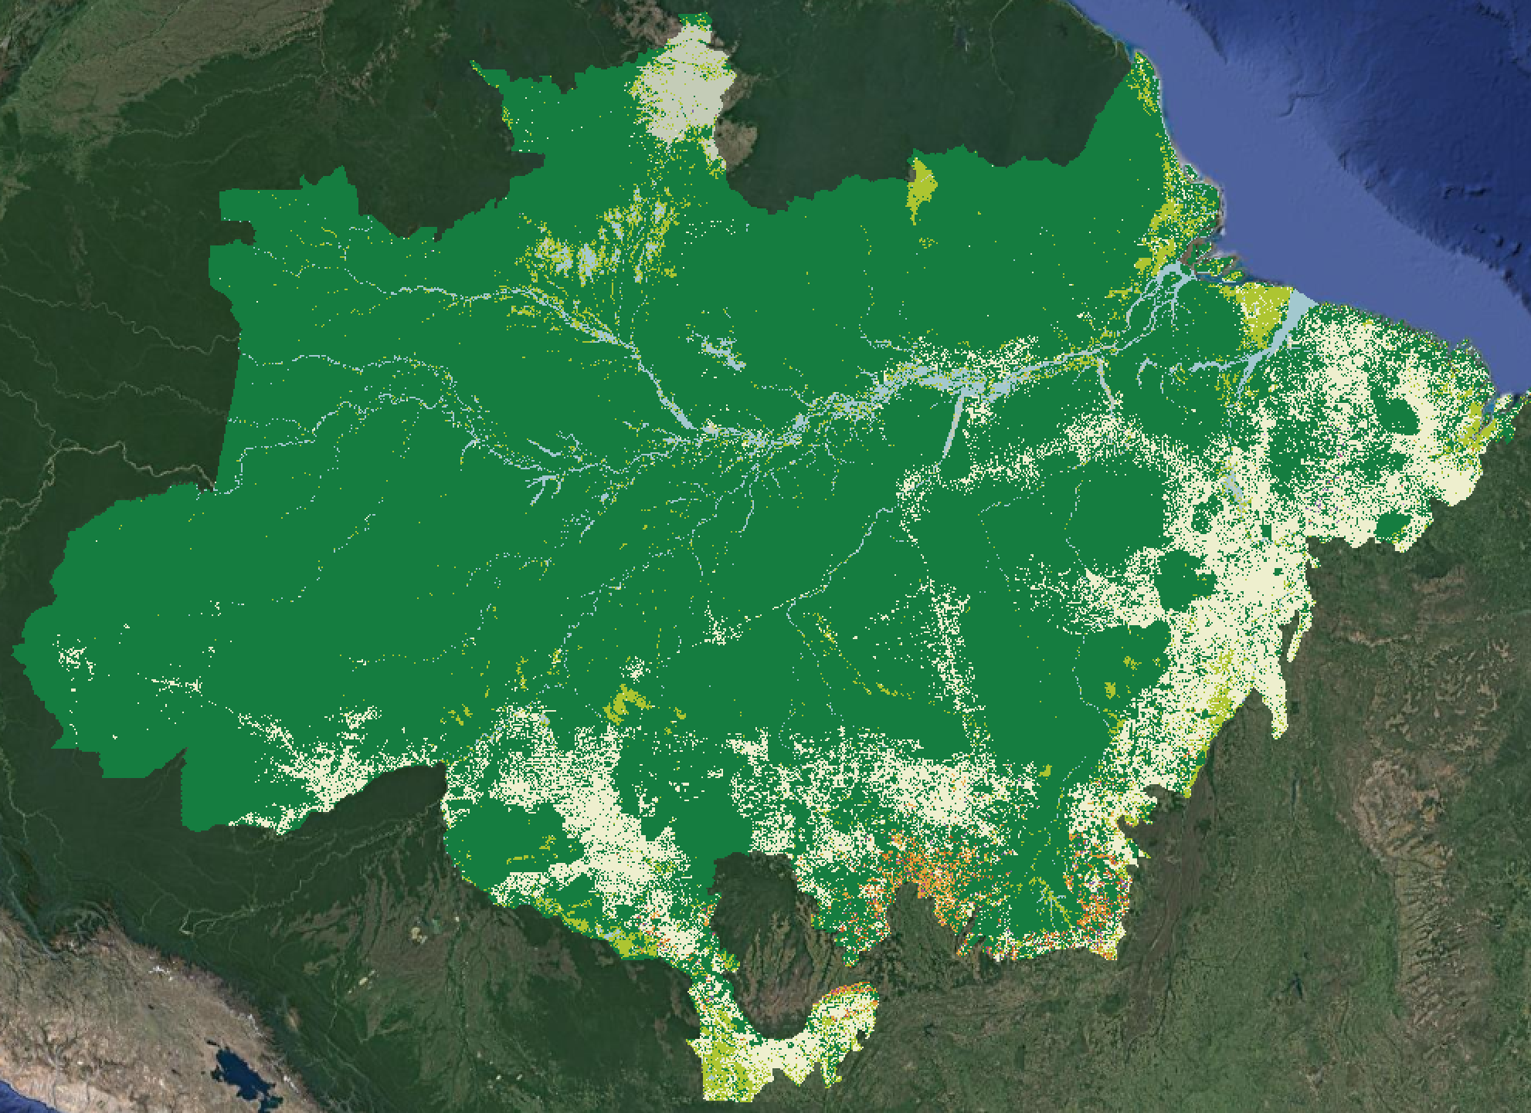
Analytics need good in-situ and good quality data cubes
Model | 5-fold validation accuracy
SVM | 97.6%
Random Forest | 98.5%
Perceptron | 99.2%
FCNN | 98.9%
tempCNN | 99.1 %
ResNet | 99.0%
MODIS data cube (MOD13Q1)
33,000 samples
source: INPE and G.Camara

Slide 9
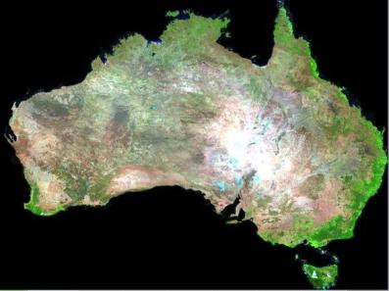
Data cubes: the challenge
Shared resources where individual interests may conflict with public good (tragedy of the commons?)
image source: Geosciences Australia

Slide 10
EO data clouds: private gains from public investment?
Two options for GEO:
(a) public open clouds, (b) grants programmes

Slide 11
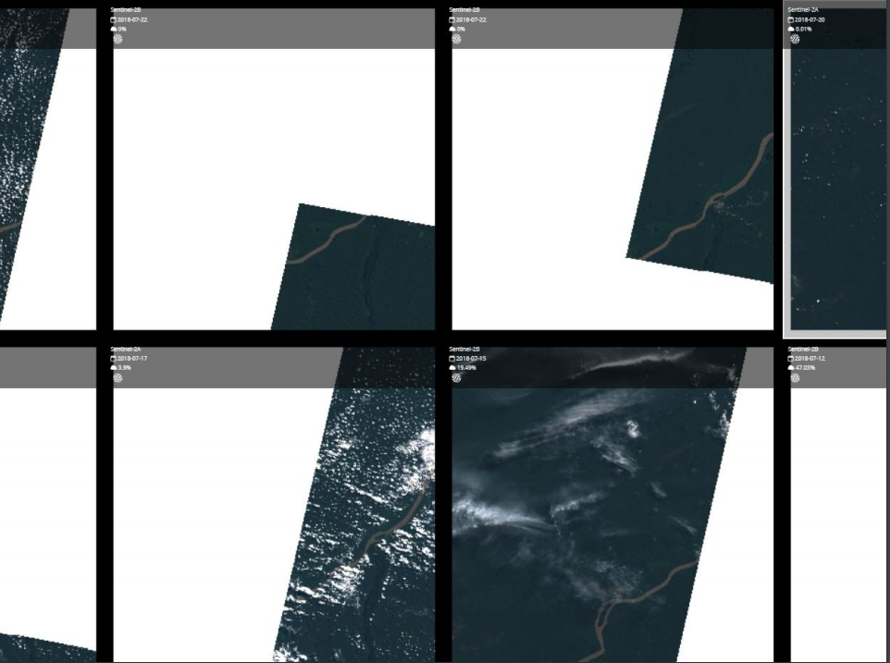
Building a data cube is hard
Merging parts of images

Slide 12
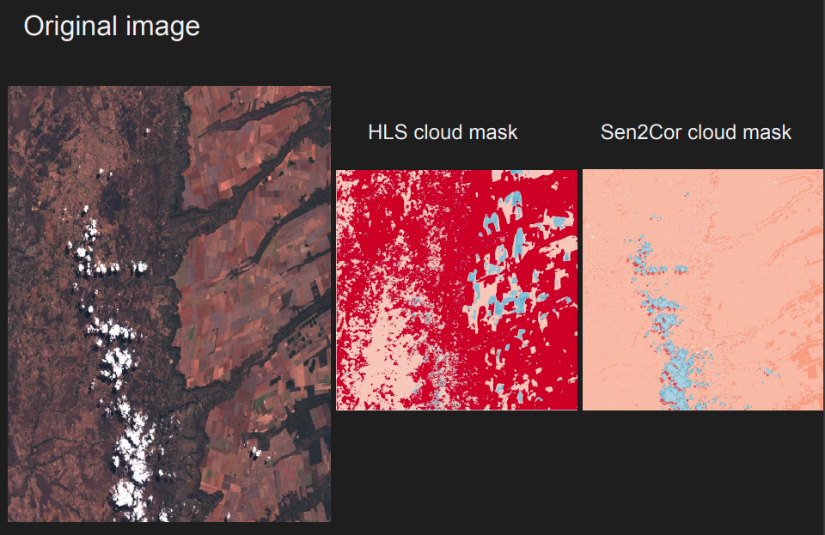
Building a data cube is hard
Which cloud mask?

Slide 13
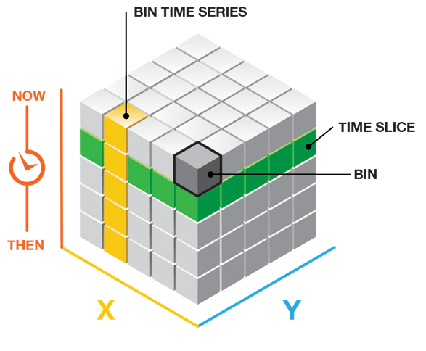
Data cube implementations can be very different!
Google Earth Engine
Climate Data Store
Brazil Data Cube
Open Data Cube

Slide 14
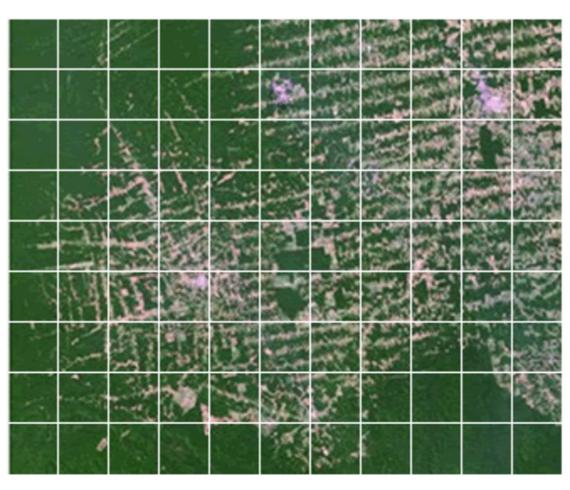
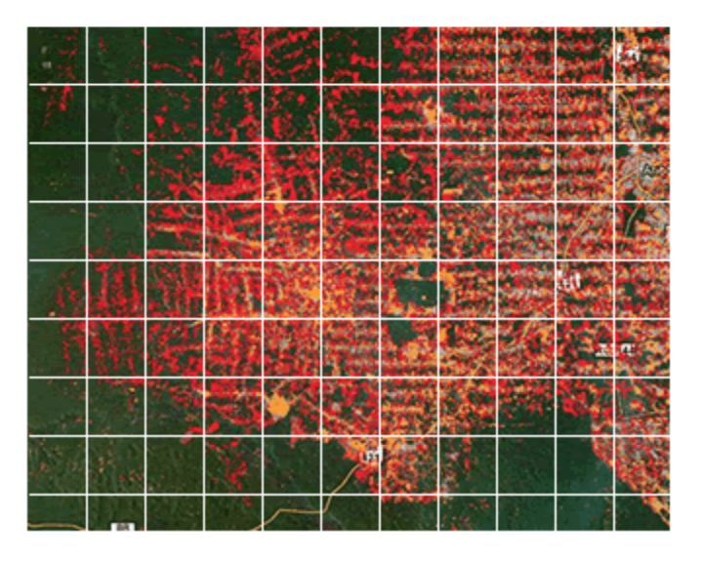
Google Earth Engine: spatial partitions
Optimised for spatial processing
image source: David Thau (Google)

Slide 15
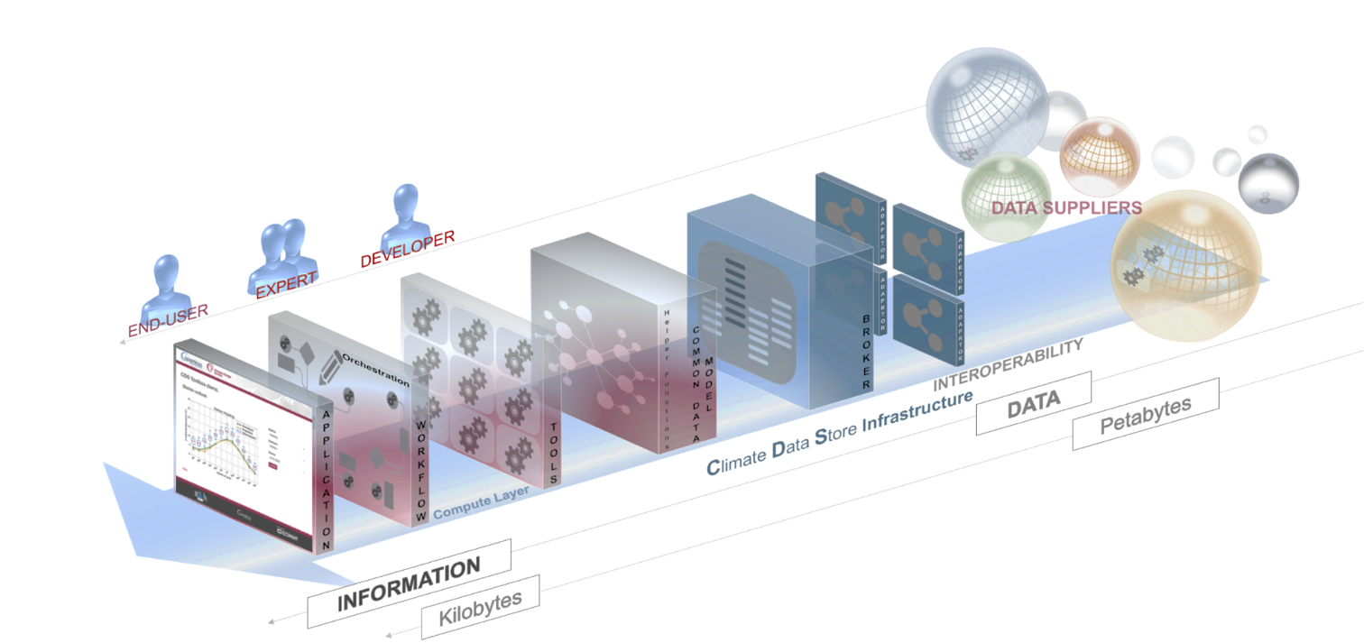
Climate Data Store: public cloud modelled after GEE
Distributed processing, no user added data

Slide 16
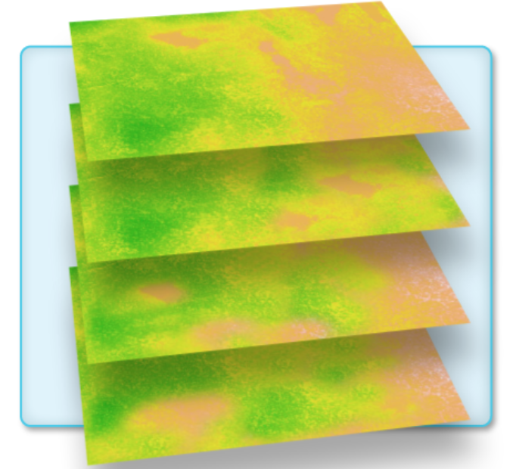
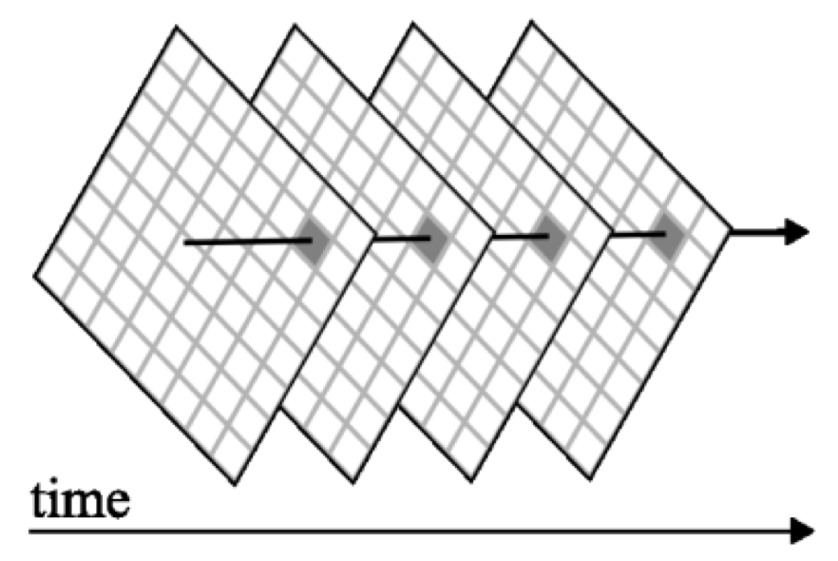
Brazil data cube: raster “bricks”
Band 1 (all times)
Band 2 (all times)
Band 3 (all times)
Optimised for time series processing

Slide 17
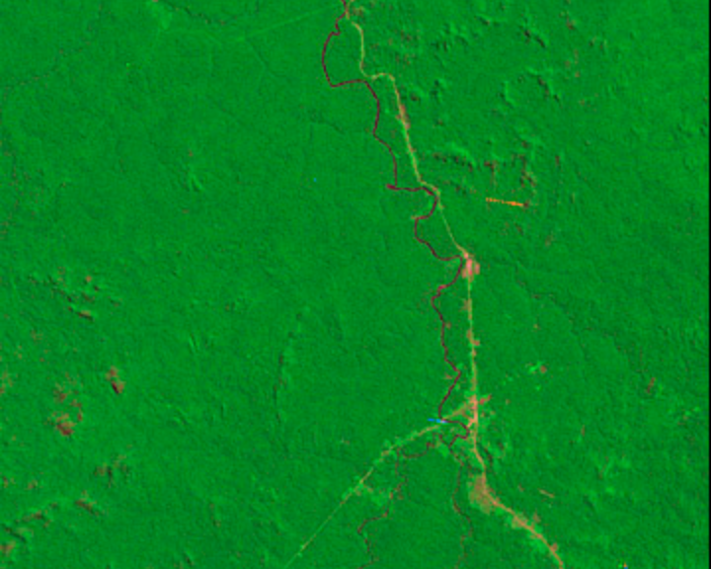
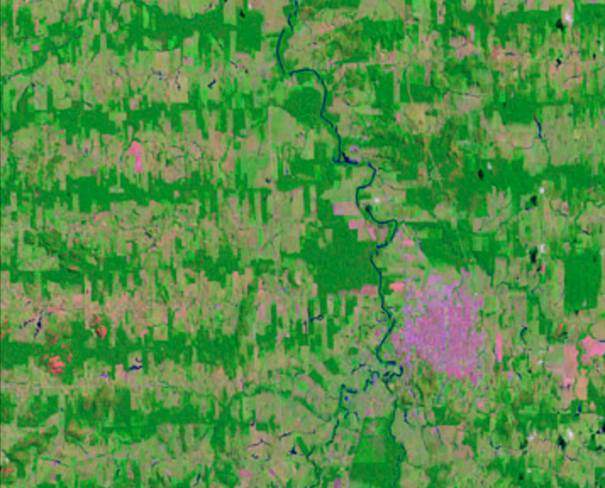
Open data cube: files into memory
......
1975
1992
ODC back-end
Postgres DBMS
Load into memory
Flexible,
memory-constrained

Slide 18
Common API for EO data cubes
Brazil data cube
sits
gdalcubes
One code, many platforms...
Common representation of data analytics
Need consistency by all providers

Slide 19
Web services for EO data cubes
Brazil data cube
sits
gdalcubes
Services describe themselves
(Tell me who you are...)
application independence
low cost communication

Slide 20
Web time series service (WTSS)
Brazil data cube
sits
gdalcubes
Given a data cube, get a time series for location

Slide 21
Web EO data cubes service
Brazil data cube
sits
gdalcubes
Given a data cube, give me access to its content

Slide 22
Request of GEO to CEOS
Produce data cubes as organised sets of cloud-optimised files with a catalogue (STAC?)
Engage with OGC and GEO to conceive and develop web services for data cubes
Image source: Griffiths et al, RSE (2019)

Slide 24
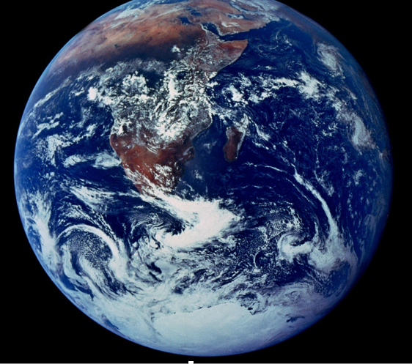
What is the GEO knowledge hub?
Organising the reproducible knowledge produced by the GEO community

Slide 25
Achieving reproducible knowledge
Exposing all parts of an application
image: Peng (Science, 2011)

Slide 26
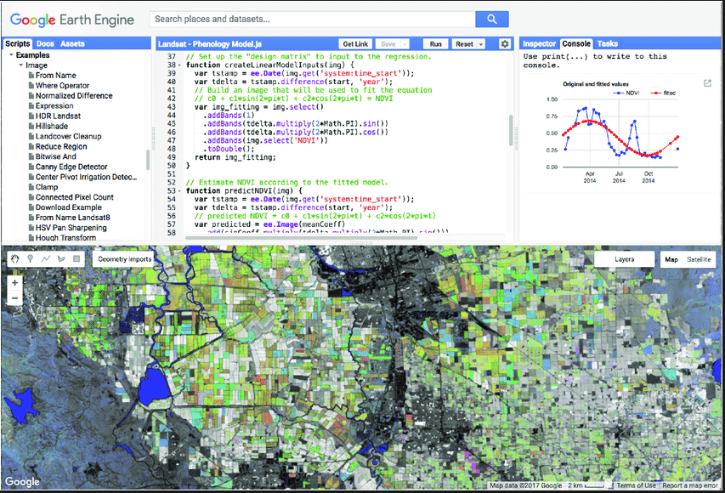
GEE: functional programming paradigm
// select an image collection
var l8 = ee.ImageCollection('LANDSAT/LC08/C01/T1_TOA’);
// get a data cube (called “Image” in GEE)
var landsat2016 = l8.filterDate('2016-01-01', '2016-12-31’);
// Compute the Normalized Difference Vegetation Index (NDVI). var nir = landsat2016.select('B5'); var red = landsat2016.select('B4'); var ndvi = nir.subtract(red).divide(nir.add(red)).rename('NDVI');

Slide 27
Open data cube
# Define a collection
import datacube
dc = datacube.Datacube(app = "chad_rainfall")
# loading a data cube
ds = dc.load(
product='ls8_level1_usgs’,
measurements = ('red','green','blue’))
Define a collection
Load a DC in memory

Slide 28
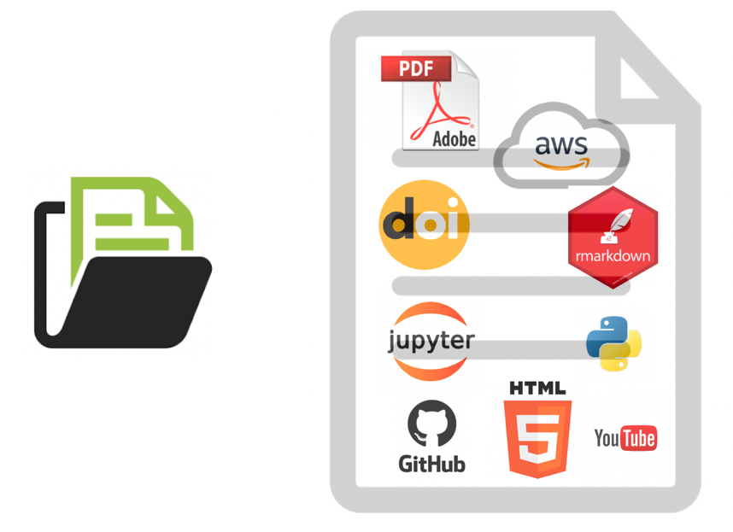
Knowledge hub: collection of curated, indexed documents
Unique ID
Unique ID
Unique ID
paper
data
software
GEO KH document
Unique ID

