Slide 1

Forest & Biomass
(inc GFOI)
Committee on Earth Observation Satellites
CEOS Lead for GFOI & SDCG SEC
CEOS Plenary 2019
Agenda Item 3.4
Ha Noi, Viet Nam
14 – 16 October 2019

Slide 2
GFOI Status
The Global Forest Observations Initiative (GFOI) is an informal partnership to help coordinate international support to developing countries on forest monitoring and greenhouse gas (GHG) accounting for REDD+ and related activities.
One of GEO Flagships since 2011
Phase 2 has continued emphasis on Capacity Building aspects & country engagement to develop National Forest Monitoring System (NFMS) and Monitoring, Reporting, Verification (MRV)
GFOI-UNFCCC meeting in Bonn September 24-25 to discuss “Policy Mandate” associated with Paris Agreement (i.e. NDC, Global Stocktake)
  CEOS engaged UNFCCC Global Stocktake process (Florin Vladu)
GFOI Plenary will be at FAO in Rome, 9-13 March 2020, CEOS is one of Organizing members

Slide 3
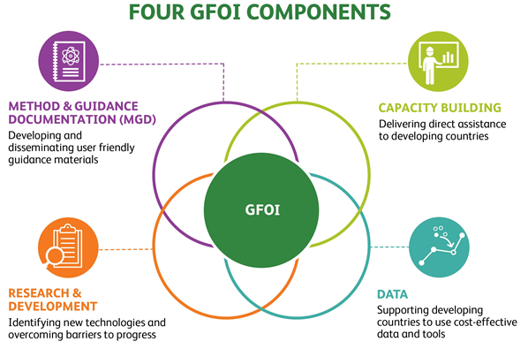
GFOI Status
GFOI Lead Team
  Australia, CEOS(JAXA), ESA, FAO, Germany, Norway, UK, US and the World Bank
GFOI Office (FAO)
4 Components
  Capacity Building (FAO and SilvaCarbon)
  MGD (Australia)
  R&D (ESA)
  Data (CEOS, FAO and the World Bank)
SilvaCarbon/USGS/USAid volunteered new Data Component Manager(s)
  Chris Barber (space - USGS/EDC), Sara Geoking (insitu - USFS)

Slide 4

2019 Refinement IPCC Guideline (AFOLU)
2019 Refinement to the 2006 IPCC Guidelines for National Greenhouse Gas Inventories on AFOLU (Agriculture Forestry and Other Land Use)
Volume 4 (AFOLU), Chapter 2,
Page 2.20, BOX 2.0D (NEW) REMOTE SENSING TECHNOLOGIES
Optical, Synthetic Aperture Radar (SAR) and Light Detection and Ranging (Lidar) sensors are available currently as remote sensing data sources for producing biomass density maps.
SAR and LiDAR are active sensors available as air borne and space borne instruments whose derived metrics are used to predict height, volume or biomass of woody plants and trees.
Referring missions: Landsat, Sentinel-1/2, ALOS-1/2, BIOMASS, NISAR, GEDI, ICESAT-2, Rapideye, and SPOT

Slide 5
SDCG for GFOI
SDCG
Space Data Coordination Group (SDCG) core business has been stable and sustainable - Satellite data acquisition and provision of assurance of data suitable for annual NFMS reporting
Reduced agency attendance through personnel changes, budgets, natural evolution so that Work Plan updated to reflect slimmer profile
Focus on Data Use and Value Added
  Improve data access and formats by supporting to LSI-VC on ARD pilots
  Work with FAO to link their SEPAL platform with Open Data Cube
  Work through new USGS Co-chair (Chris Barber) to SilvaCarbon

Slide 6
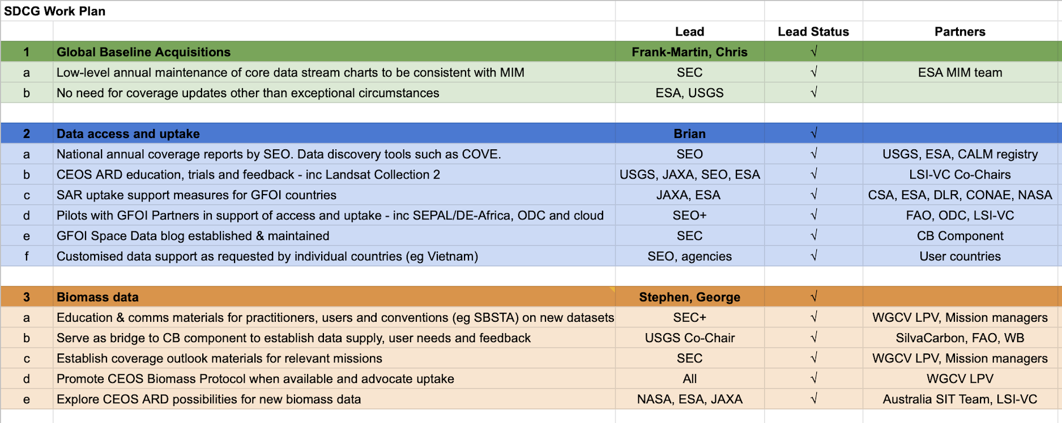
New SDCG Work Plan

Slide 7
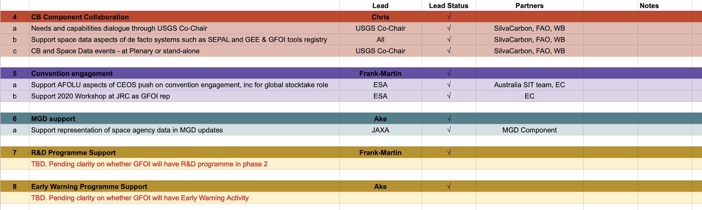
New SDCG Work Plan
SDCG WP

Slide 8
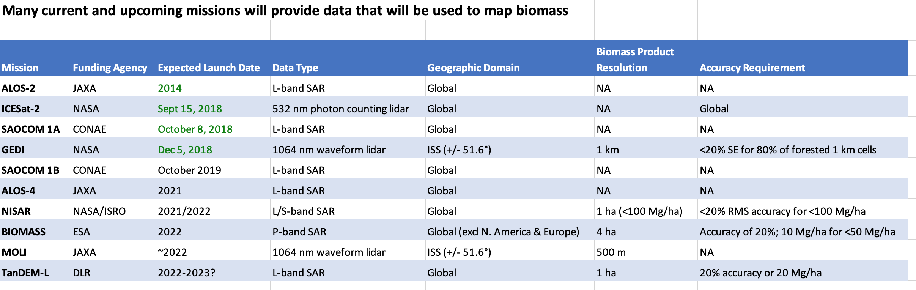
Biomass missions
Biomass data

Slide 9
CEOS Biomass mission coordination
SDCG
Biomass, will potentially become an increasingly important topic for CEOS to address from multiple points-of-view in the forthcoming years.
GFOI requested CEOS improvements to biomass estimation
Biomass linking to GHG Roadmap and Global Stocktakes would be a high-level and worthy goal for CEOS engagement enhancing the WGCV/LPV CEOS Biomass Protocol team.
Encourage CEOS agencies to consider how to form the best and comprehensive structure in CEOS and send specialists for more discussion.

Slide 10
Proposed Actions
Discussions in CEOS
Plenary invited to:
  Endorse evolution of the AHT SDCG for GFOI to an LSI-VC thematic subgroup on Forests & Biomass
  Discuss merits of increased attention to biomass observations in CEOS WP and structure – and consider exploration of a target in relation to global stocktakes & GHG roadmap
  Support the proposed CEOS Biomass workshop – likely 4-5 March 2020, Brisbane

