Slide 1

2019 Refinement to the 2006 IPCC Guidelines
Committee on Earth Observation Satellites
Kazuo Tachi, JAXA
CEOS Plenary 2019
Agenda Item #2.5
Ha Noi, Viet Nam
14 – 16 October 2019

Slide 2
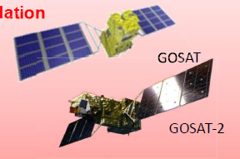
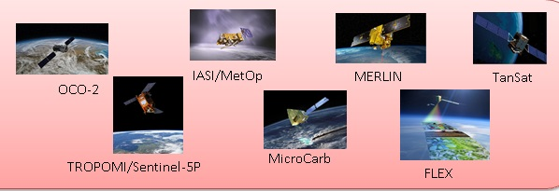
Follow-up to the Paris Agreement
Parties of the Paris Agreement are required to submit Nationally Determined Contributions (NDC) every 5 years.
Reporting of national GHG emissions and removals is required to comply with the GHG guidelines adopted by IPCC. The guidelines are important to enhance transparency framework for building mutual trust and confidence and promote effective implementation of the Paris agreement.
The guidelines was developed in 2006 and refined in 2019
○ 25th Session of the IPCC (in 2006, Mauritius)
Even the availability of satellite-borne sensors for greenhouse gas concentration measurements will not fully resolve this problem, due to limitations in spatial, vertical and temporal resolution.
○ 43rd Session of the IPCC (in 2016, Kenya)
To maintain the scientific validity of 2006 IPCC Guidelines, certain refinement may be required, taking into account scientific and other technical advances that have matured sufficiently since 2006.
○ 44th Session of the IPCC (in 2017, Thailand)
Lead authors must consider all recent scientific developments and national methods used by countries in their inventories.
○ 49th Session of the IPCC (in 2019, Japan)
In addition to the ground networks, there is aim for Satellite data to be included as one of methods to support accuracy of national GHG emissions and removals. (As reference data)
2009～
＋

Slide 3





Road to IPCC Guidelines
Support coordination with IPCC
IPCC Guidelines
(refined in 2019)
D
Engagement with International Bodies
CEOS Review
Methodology document
Satellite-based GHG Data
C
Develop methodology document to support for national statistician to use GHG data for the accuracy of the greenhouse gases inventory.
Provide high accurate data set and documents (ATBD)
Calibrations and validation for quality control
MOE/NIES “Methodology Document”
B
WGCV
CEOS
AC-VC
Quality Control and Accuracy of GHG Data
Provide and share GHG data
A
Space Agencies
Ministry of Environment/NIES
Ministry of Education, Sports, Culture, Science and Technology
JAXA
GOSAT/
GOSAT-2(*)
NASA
OCO-2
GeoCarb
ESA
Sentinel-5p,
FLEX
CNES
IASI, MicroCarb, MERLIN
DLR
MERLIN
CMA
TanSat
Engagement with Space Agencies
*GOSAT/GOSAT-2 are joint projects by Ministry of Environment, NIES and JAXA .
Notes:
2018年のPlenaryで使用したスライド。これまでのIPCCとのエンゲージメント活動の全体像

Slide 4
Timeline for the Guidelines Refinement
29 – 31 Aug 2016 | Scoping Group meeting
17 – 20 Oct 2016 | IPCC decision on outline
7 – 14 Jul 2017 | First Lead Author Meeting (LAM1)
25 – 28 Sep 2017 | Second Lead Author Meeting (LAM2)
4 Dec 2017 - 11 Feb 2018 | First Order Draft Expert Review
10 - 13 Apr 2018 | Third Lead Author Meeting (LAM3)
2 July - 9 Sep 2018 | Second Order Draft Government & Expert Review
4th week of Oct 2018 | Forth Lead Author Meeting (LAM4)
14 Jan – 10 Mar 2019 | Final Government Distribution Government Review
2019 Refinement was adopted by IPCC at its 49th Session in May 2019 Kyoto, Japan (Decision IPCC-49-9)
Notes:
ガイドラインの改訂のスケジュール。5月のIPCC総会で承認された。

Slide 5
Summary of Refinement
[Old] 2006 IPCC Guidelines for GHG Inventories
Volume 1 Chapter 6: Quality Assurance /Quality Control and Verification [6.10.2 Comparisons with atmospheric measurements] Considering the limited monitoring network currently available for many of the greenhouse gases and the resulting uncertainties in the model results, inverse modeling is not likely to be frequently applied as a verification tool of national inventories in the near future. Even the availability of satellite-borne sensors for greenhouse gas concentration measurements will not fully resolve this problem, due to limitations in spatial, vertical and temporal resolution (*).
[New] Refinement to 2006 IPCC Guidelines for GHG Inventories
Volume 1 Chapter 6: Quality Assurance/Quality Control and Verification Delete: Descriptions about limitation on availability of satellite observations (* the left) Add: Many descriptions on usability and roles of satellite data as a comparison tool of inventories. Particularly, a new section of “Satellite Observations” are included. Improvement of estimation accuracy of model by satellite data utilization at the area that in-situ data is not ready fully. Prospects that satellite data estimation will quickly improve because of increase in the number of observations by new GHG observation satellites (TROPOMI, GOSAT-2, GeoCarb, TanSat etc.)

Slide 6

Thank you very much for your support!

