Slide 1

2019 CEOS Chair Initiative
Committee on Earth Observation Satellites
Vietnam National Space Center
CEOS Plenary 2019
Agenda Item 1.6
Ha Noi, Viet Nam
14 – 16 October 2019

Slide 2
Content
Achievements
Societal Benefits for the Region
Next Steps and Evolution

Slide 3
2019 CEOS Chair Initiative
In 2019, CEOS Chair activities have focused on two specific applications:
Carbon Observations, including forested regions: to coordinate EO observations to support the effective monitoring and management of the forests in the region, through its Ad Hoc Space Data Coordination Group for GFOI, in support of the development of national forest monitoring and measurement, reporting and verification (MRV) systems;
Observations for Agriculture: in line with the CEOS Ad Hoc WG on GEOGLAM, and within the GEOGLAM Asia-Rice regional network, a key focus is being addressed on the practical use of CEOS data, especially SAR for rice crop monitoring in Asia.
Focus on the Mekong basin, which is across boundary region strongly affected by climate change and human activities.
To enhance contribution and cooperation in the region of the CEOS agencies;
To promote the sharing of CEOS agency data by improving access and use of such data in thematic studies and applications for the whole region.

Slide 4
Proposed Initiative

Slide 5
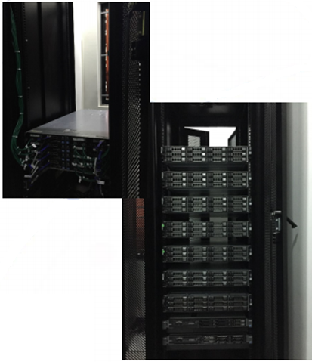
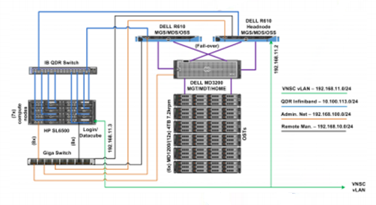
Vietnam Data Cube
Landsat ARD
Data collection:
Landsat (by USGS)
Time: from 1986 to now
ALOS-2 (by JAXA)
Time: from November 2016 to now
Sentinel-1 (from ESA, ARD by CESBIO/CNES)
S-1 images (VH and VV polarisation)
Time: from October 2014 to now
Data Ingestion: in collaboration with CEOS SEO, CSIRO, CNES
Constantly update with new data.

Slide 6
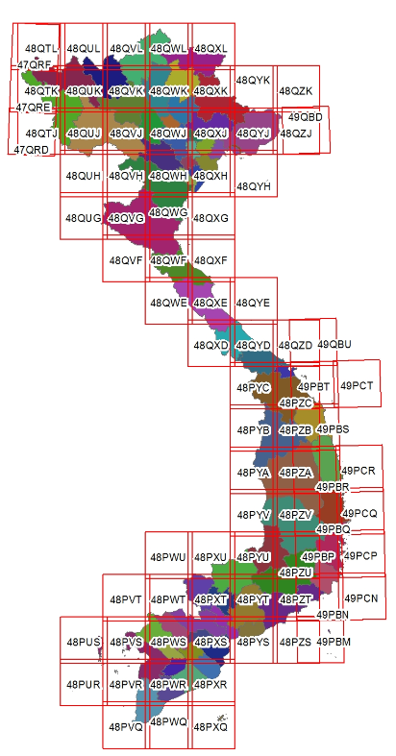
Forest monitoring - Achievements
Objectives of Forest Initiative:
To provide a space-based system to support monitoring and management of the forests for the countries in the region
Achievements:
    Forest cover change monitoring in Vietnam with focus on monthly “forest loss” developed by VNSC and by CNES CESBIO, validation in-progress.

Slide 7
Forest monitoring - Achievements
Forest monitoring for the Mekong region
Algorithms:
  Developed by VNSC: using combination of SAR (Sentinel-1) and optical data (Landsat)
  Developed by CESBIO: using time series of Sentinel-1 data, and using yearly ALOS-PALSAR mosaic data
In situ data: 2018 and 2019 data collected in central highland, Vietnam
Next step:
Evaluation by user organisations: Ministry of Agriculture and Rural Development (MARD) of Vietnam, Mekong River Commission
Extension to Mekong region.
Yearly forest disturbances and regrowth

Slide 8
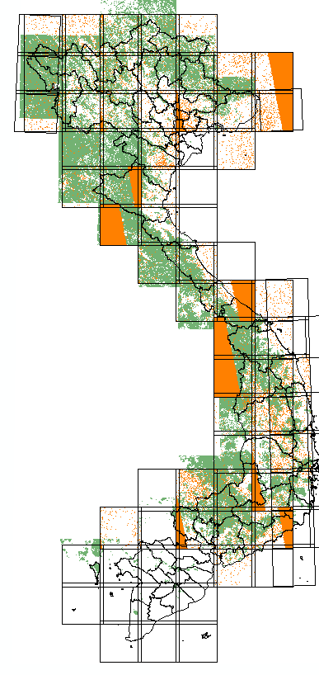
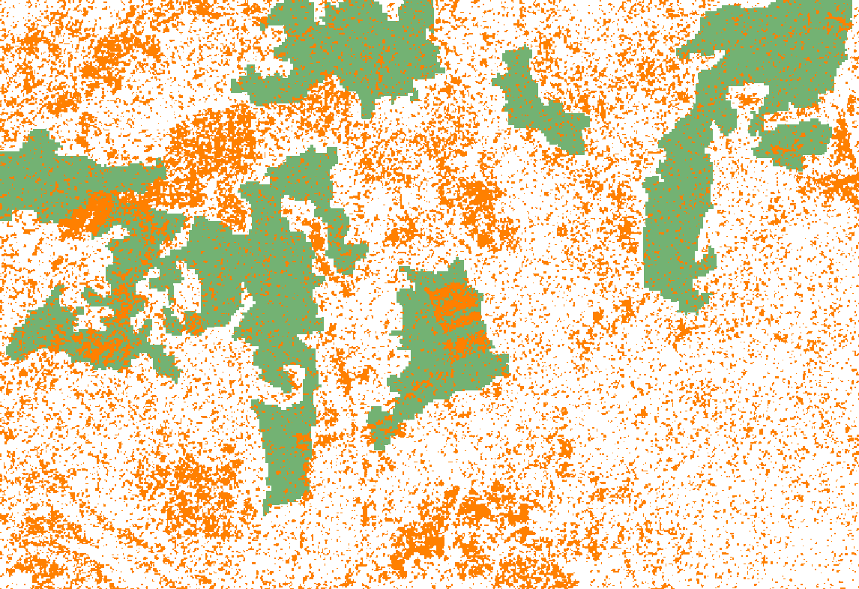
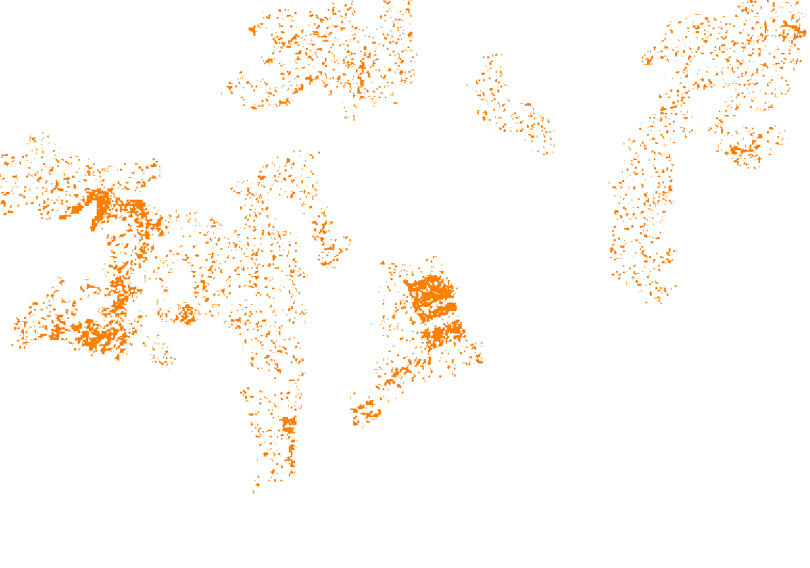

Forest monitoring - Achievements
Result:
Monthly forest change
Oct. 2017 to Aug. 2018 data

Slide 9
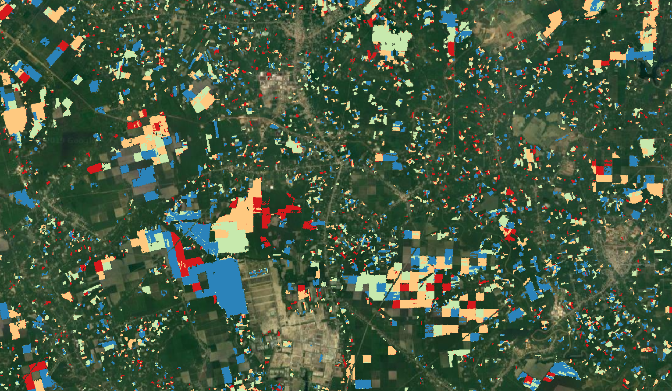

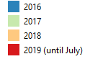
Forest monitoring - Achievements
Forest cover change using Sentinel-1, 2016-2019
Background image: Google Earth (optical image 24 Feb 2016)

Slide 10
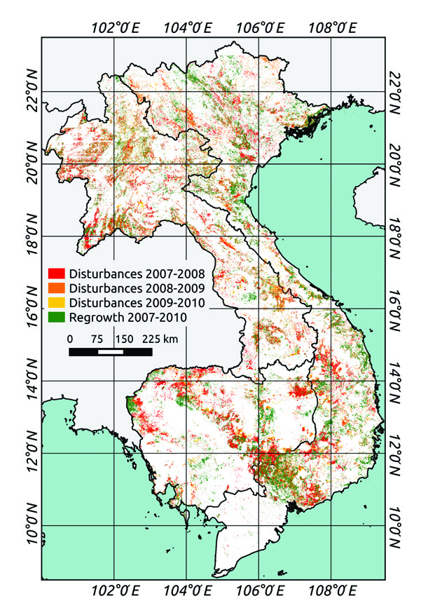
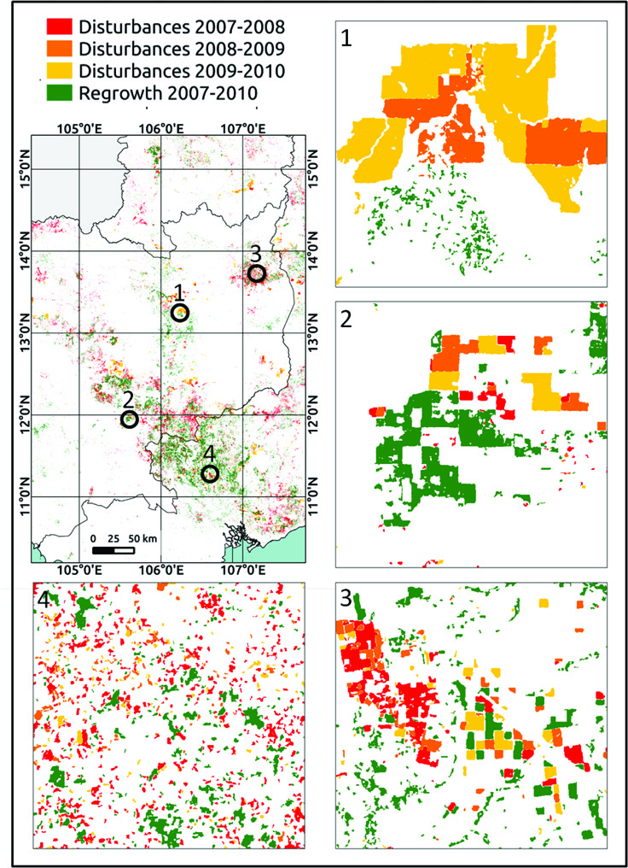
Forest monitoring - Achievements
Forest cover change using ALOS-PALSAR,
planned to be implemented in VDC

Slide 11
Rice monitoring - Achievements
Objectives of Rice Initiative: To provide a space-based system to support rice monitoring for the countries in the region
Linked with VNRice, ESA GEORice, JAXA and GEOGLAM Asia-Rice.
Achievements
Rice maps (crop season product) of Vietnam and the Mekong area
Rice phenology / growth stage monthly product (of the Mekong Delta and Red River Delta, Vietnam).
Rice crop production / yield estimation (crop season product) of provinces in the Mekong Delta and Red River Delta, Vietnam.
Rice maps being evaluated by MARD
Continued development of GEOGLAM National Crop Monitor with NASA Harvest.

Slide 12
Rice monitoring - Achievements
Algorithm
    Algorithm developed by VNSC for the Mekong Delta and Red River Delta have been validating using in situ data and extending to whole country.
    CNES CESBIO using the Sentinel-1 time series data for different rice ecosystems and tests the ESA GEORICE rice mapping algorithms in 4 countries.
    JAXA analyses the ALOS-2 time series data with JAXA’s rice crop monitoring tool named “INAHOR” NEO (machine learning version) and generating prototype of rice crop map in 2018 rainy season using available ground observation data and statistical information for 4 countries in cooperation with 4 countries related organizations.
Validation: In situ data collected by VNSC over the Red River Delta and Mekong Delta region to validate the rice maps provided by CNES CESBIO and JAXA.

Slide 13

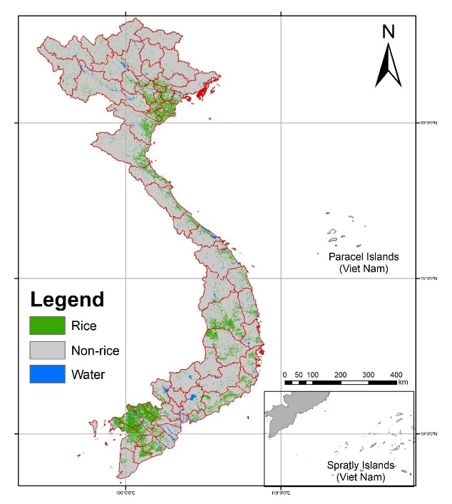
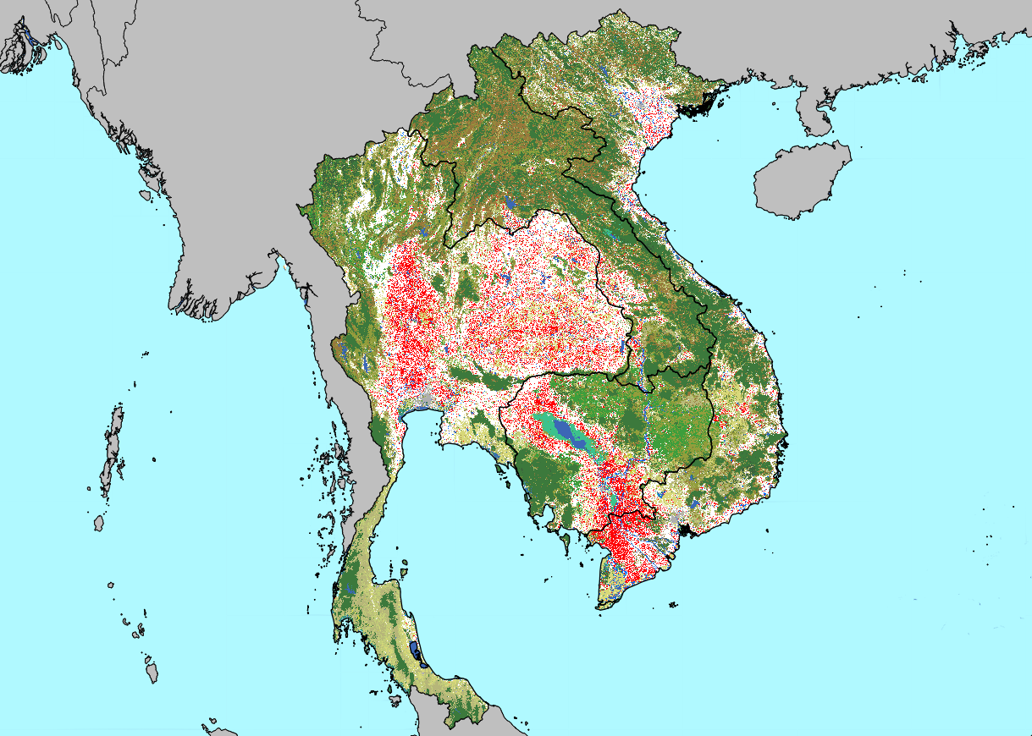


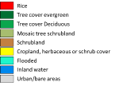
Rice monitoring - Achievements
Work in progress: Cross comparison among rice maps of Mekong region by VNSC (using S1), JAXA (ALOS-2) and CESBIO (S1) in cooperation with respective countries (space agencies and ministries of agriculture) under APRSAF SAFE and other regional framework.
VNSC/S1
ALOS-2/ INAHOR
GEORICE /S1

Slide 14


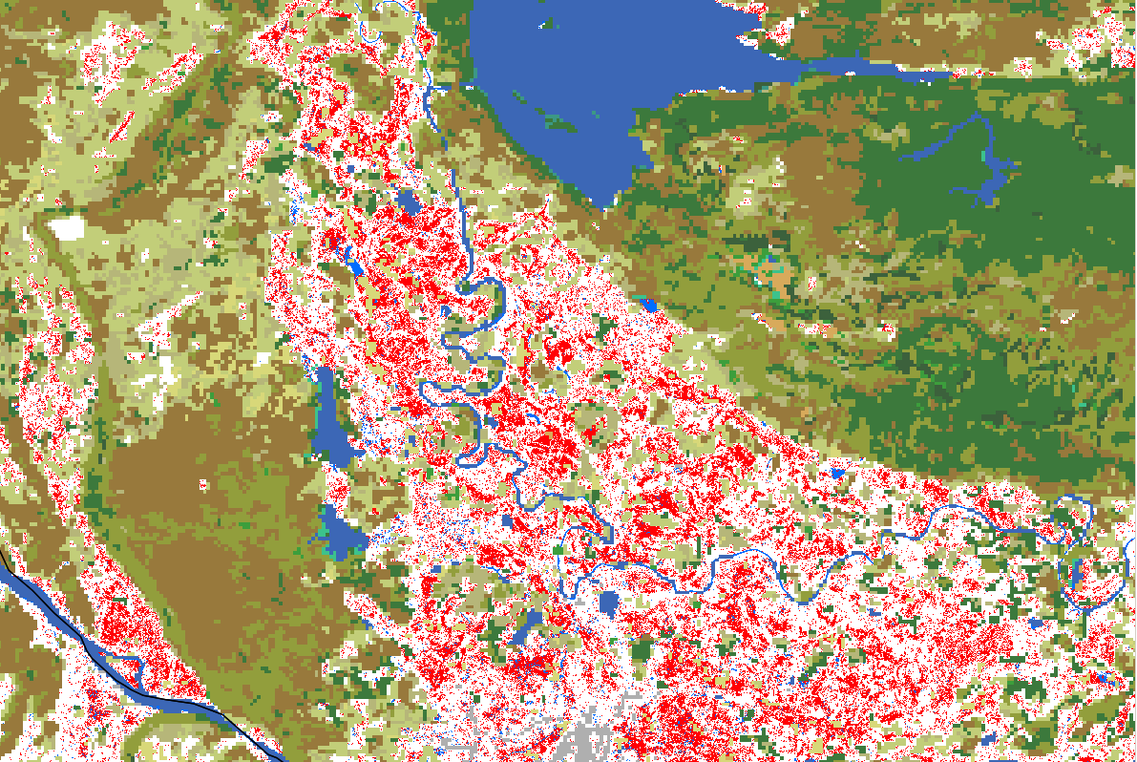
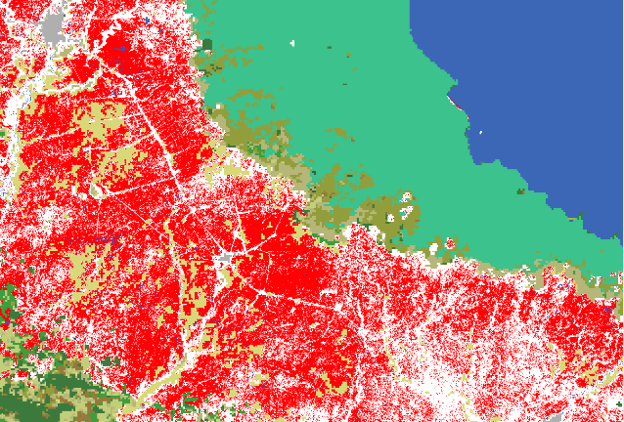
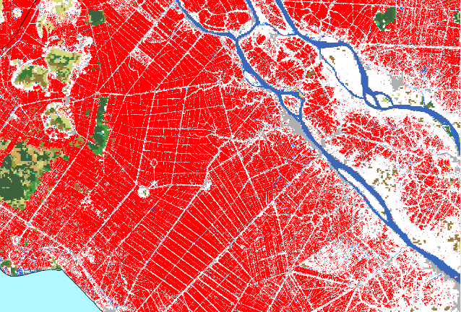
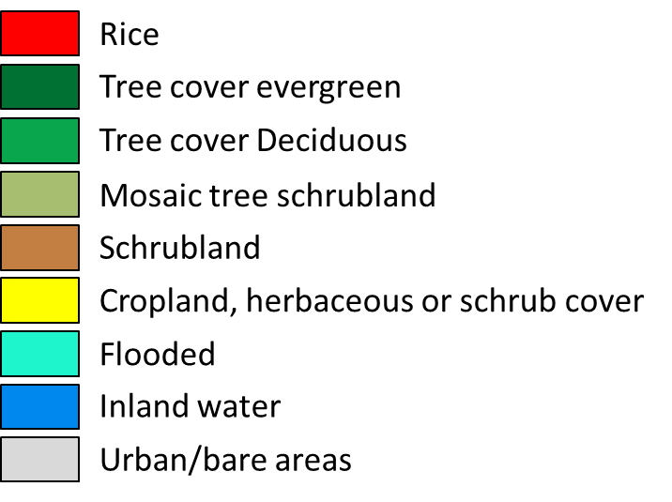
Rice monitoring - Achievements
GEORICE regional rice map
Rainy season 2018
Using Sentinel-1 time series at 10 m resolution

Slide 15
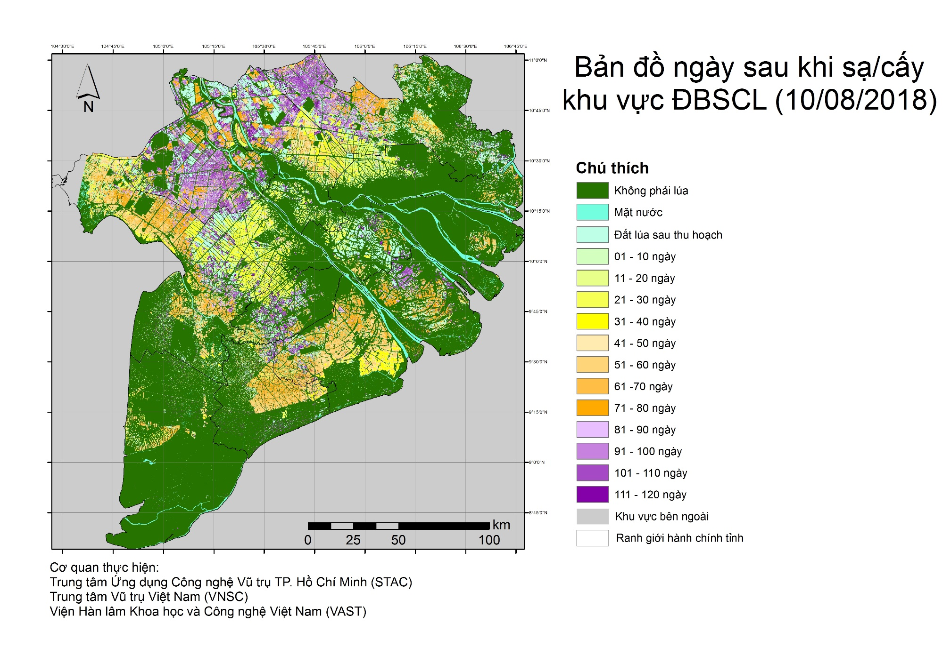
Rice monitoring - Achievements
Days after rice sowing/transplanting in the Mekong Delta (Aug 10, 2018), will be developed on VDC

Slide 16
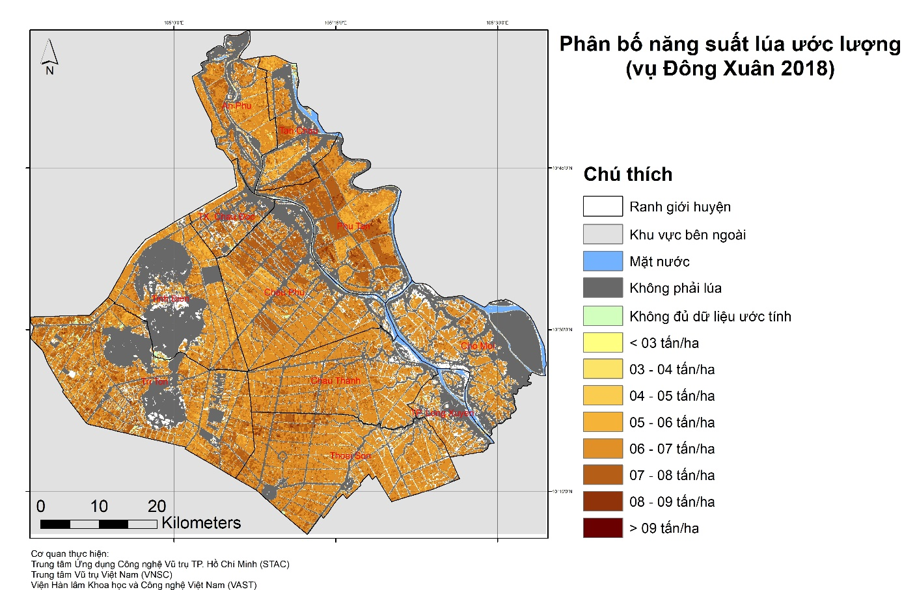
Rice monitoring - Achievements
Distributed map of estimated rice yield of WS 2018 in An Giang - MD, will be developed on VDC

Slide 17
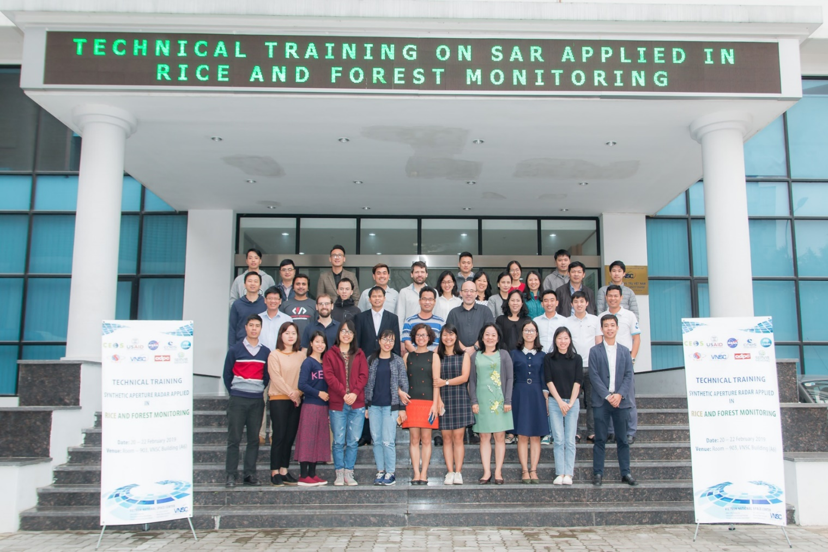
Capacity building
Technical training on SAR applied in rice and forest monitoring (Hanoi, Vietnam, 20-22 Feb. 2019)
Organisation: VNSC; Contribution: CNES CESBIO, NASA SERVIR Mekong

Slide 18
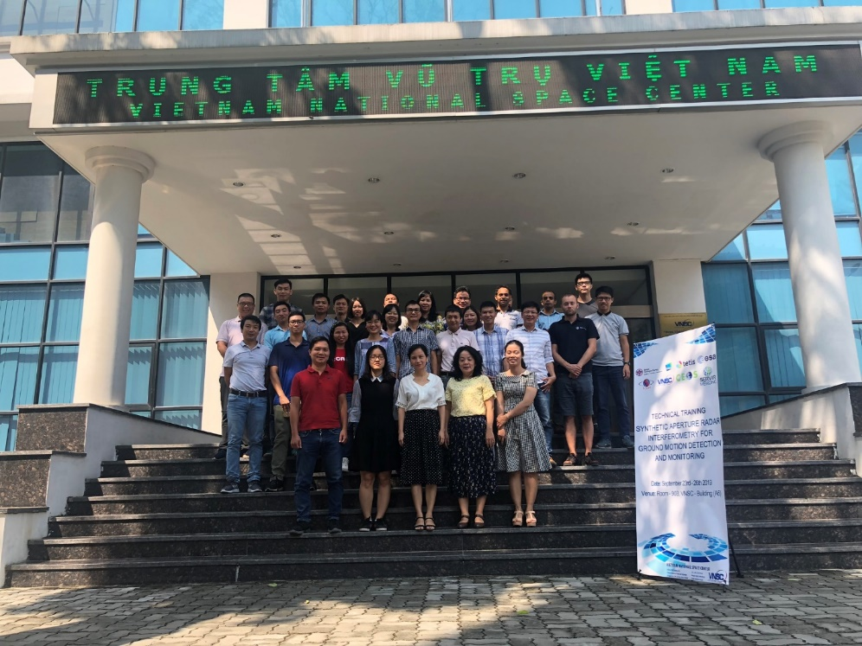
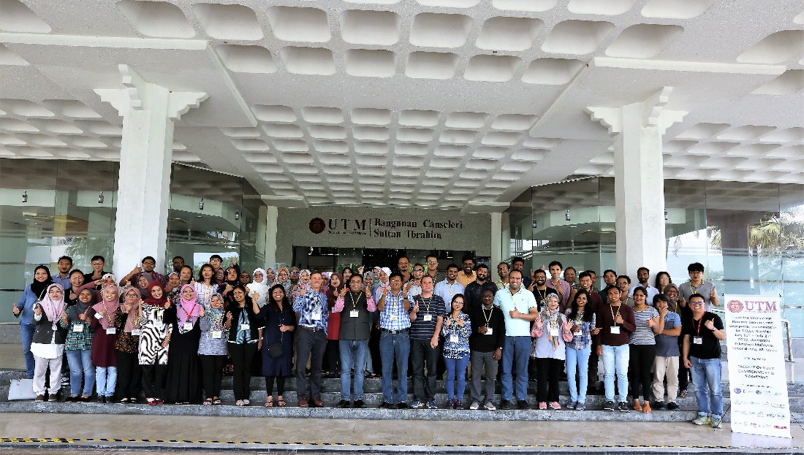
Capacity building
Training workshop: SAR interferometry for ground motion detection and monitoring, Hanoi, Vietnam, 23-26/9/2019
Organisation: VNSC; Contribution: BGS (UK), ESA, NASA SERVIR Mekong
Training on SAR for flooding, wetland at 2nd VSEO Vietnam School of EO, Quy Nhon, Vietnam, 8-14/9/2019
Organisation: USTH; Contribution: CNES, ESA.
Training workshop at Land Use/Cover Changes, Environment and Emissions in South/Southeast Asia – An International Regional Science Meeting, Johor Bahru, Malaysia, 25-27/7/2019.
Organisation: NASA; Contribution: CNES-CESBIO

Slide 19
Societal Benefits for the Region
  Benefits to Vietnam: Capacity building from application deployment in Vietnam;
  Benefits to region: Get information frequently and independently to serve the Mekong region for national monitoring program;
  Benefits to CEOS: demonstration of downscaling global applications such as forest monitoring and rice monitoring to regional scale (in GFOI and GEOGLAM Asia-Rice) .

Slide 20
Next Steps and Evolution
  Follow on funded projects:
  ESA: Sentinel Observations of Forests in the Tropics (SOFT), focusing on the Mekong region (GlobEO, CESBIO, VNSC), 2019-2020
  CNES and VAST for SCO: Vietnam and the Mekong region Space Climate Observatory focusing on the impacts/interactions of climate change on forest and rice agriculture (CESBIO, VNSC and other Vietnamese organisations), potentially for 5 years project, starting from 2020.
  VNSC commits to invest for the long term operational cost of the VDC system,
  The applications can be expanded for other “hot” issues in the region such as disaster management, water management.

Slide 21
Thank you

