Slide 1

Report on
CEOS Executive Officer functions
Committee on Earth Observation Satellites
Organization
CEOS Plenary 2019
Agenda Item #1.4
Ha Noi, Viet Nam
14 – 16 October 2019

Slide 2

CEO Role
CEOS “Executive Officer” role created in 2006 to support CEOS interactions with the emerging Group on Earth Observations
Quickly evolved toward marshalling CEOS efforts to respond to GEO’s first 10-year Work Plan

Slide 3




Principal CEO Functions
Work planning and monitoring
Internal information flow
Interface for external contacts
CEOS housekeeping

Slide 4


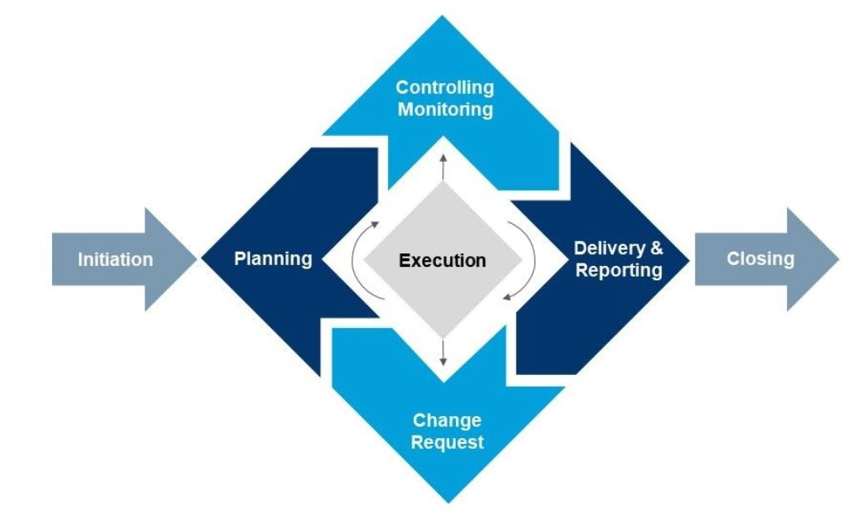

Work Planning and monitoring
Rigorous work planning, execution and monitoring is critical to CEOS’s credibility
CEOS Work Plan
Progress reported
annually
CEOS Work Plan
updated annually

Slide 5
Work Planning and monitoring
July
June
August
May
SIT TW
April
Deliverable
Updates
September
SIT
WP Progress
Report (CEO)
March
CEOS Work Plan
ENDORSED
October
CEOS
Plenary
November
February
December
January
Work Plan development

Slide 6
Work Planning and monitoring
CEOS Work Plan annual update: November – February
Organisation and implementation of WP update process
Update of generic parts of WP and monitoring of the update/creation of 100+ deliverables
Checking and completion of WP with contributors
Submission of WP to CEOS Principals for validation
CEOS Work Plan Progress reporting: August – October
Organisation and implementation of WP progress reporting process
Generation of CEOS Work Plan Progress Report
Submission to CEOS Principals at CEOS Plenary
Contribute to maintaining/developing CEOS deliverable tracking database
Total time investment ~4.5 months FTE

Slide 7

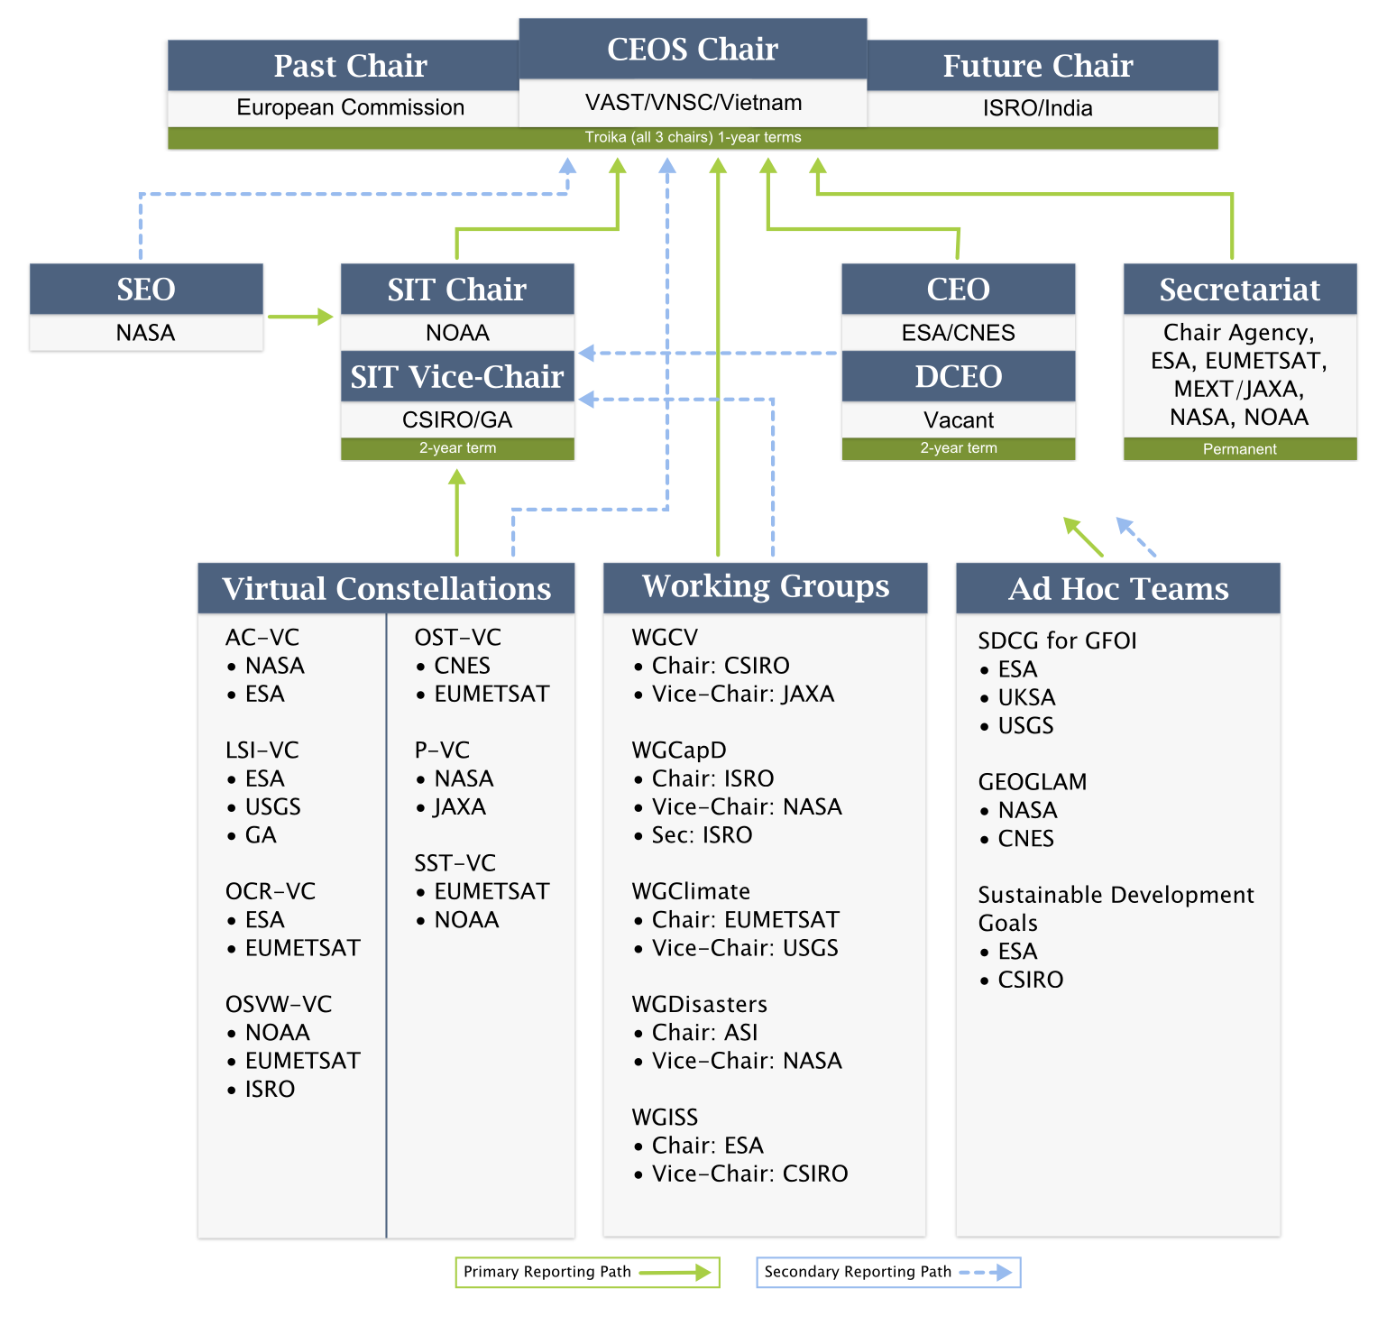
Internal Information Flow

Slide 8
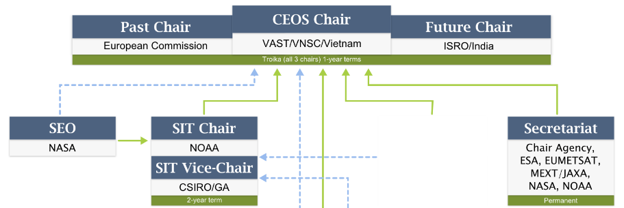
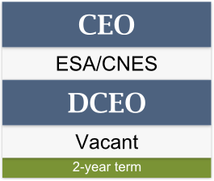
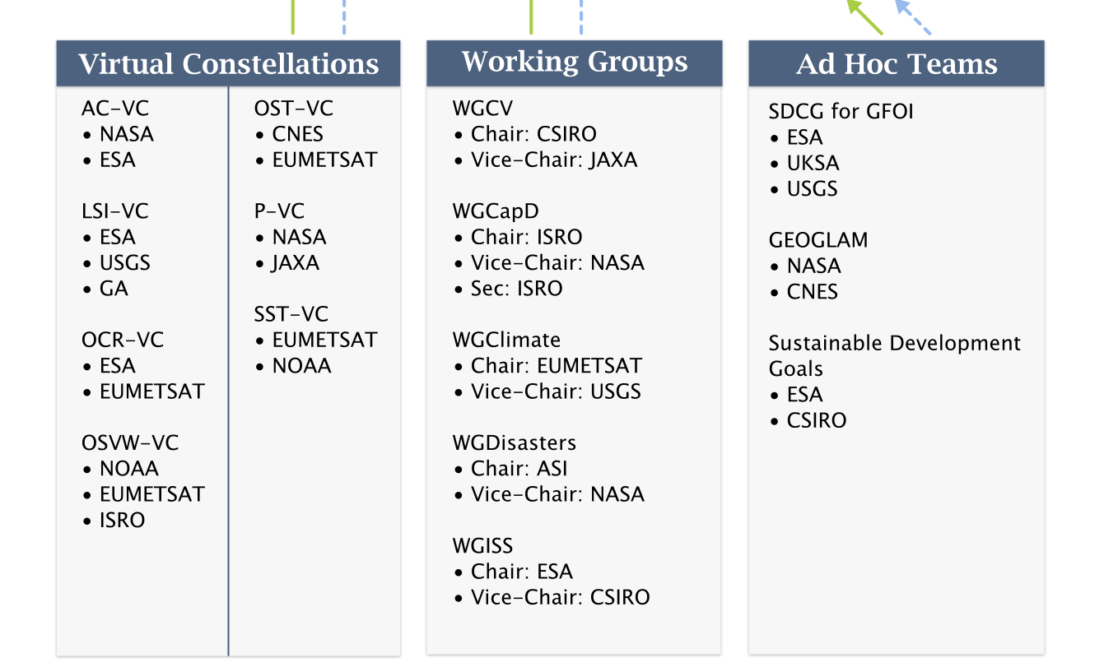
Internal Information Flow

Slide 9
Internal Information Flow
Opportunities for information flow between CEOS Leadership and WGs/VCs/AHTs:
2 annual telephone tag-ups with SIT Chair
3 Major meetings: SIT, SIT Tech Workshop, Plenary
Monthly CEOS-SEC calls
CEO is the reference for all CEOS entities on governance and process questions
+Detail
+Frequency

Slide 10
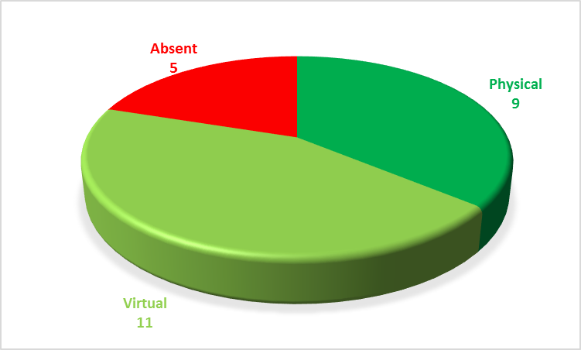
Internal Information Flow
CEO participates in as many WG/VC/AHT meetings as possible
Either in person or virtually
Providing a “CEOS news and context” presentation which relays news and info “down”
Since Plenary 2017, 25 WG/VC/AHT meetings
9 Physical participations
11 Virtual participations
5 Absences
Total time investment ~ 3.5 months FTE

Slide 11

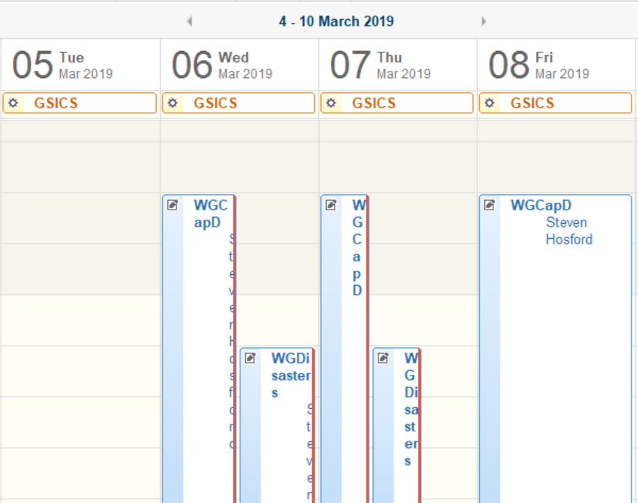

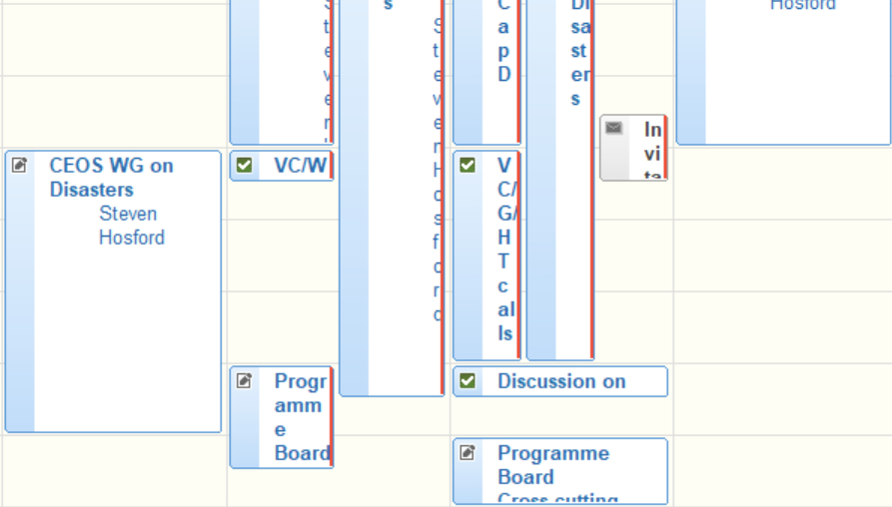
WGCapD
India
UTC+530
WGDisasters
Greece
UTC+2

Slide 12
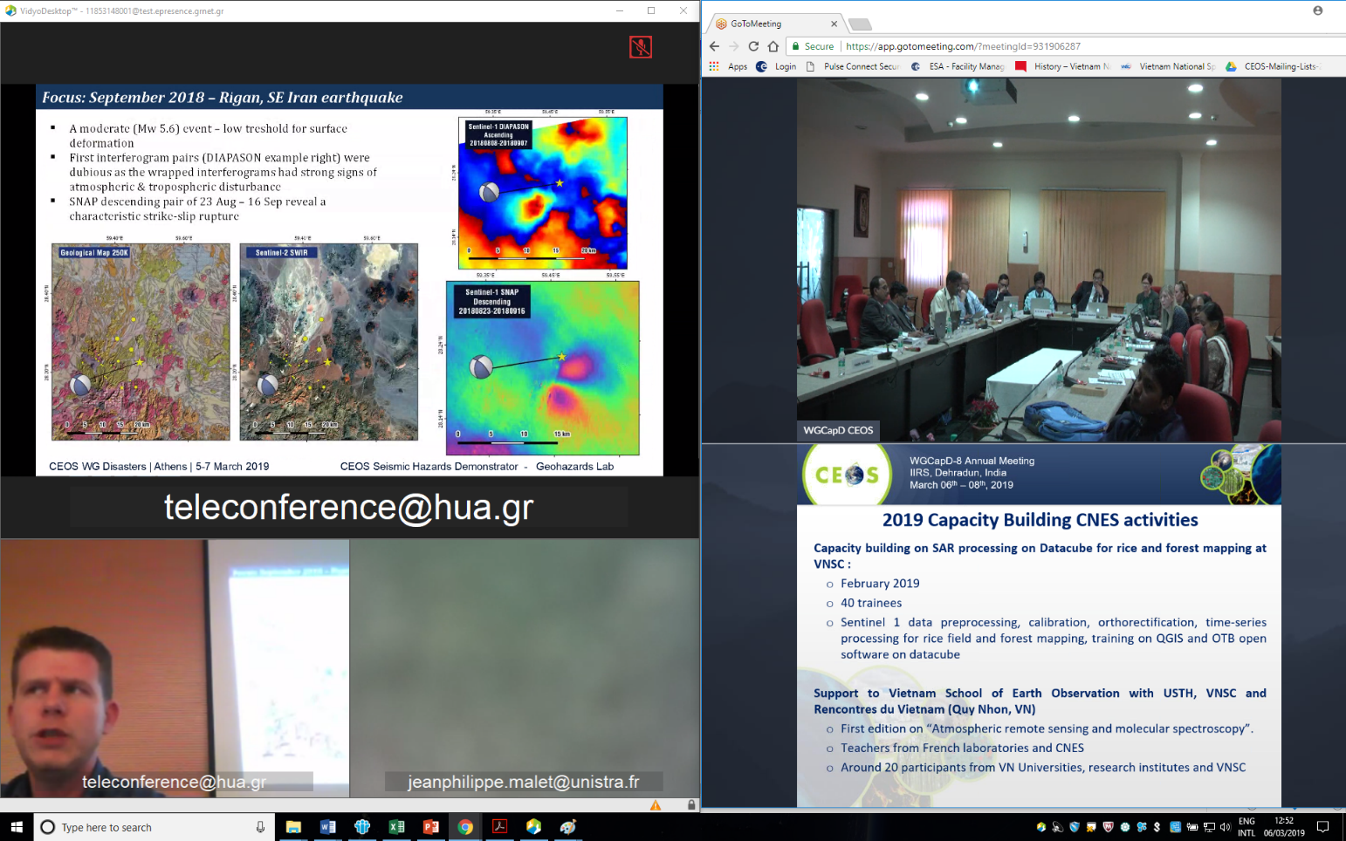
Internal Information Flow

Slide 13
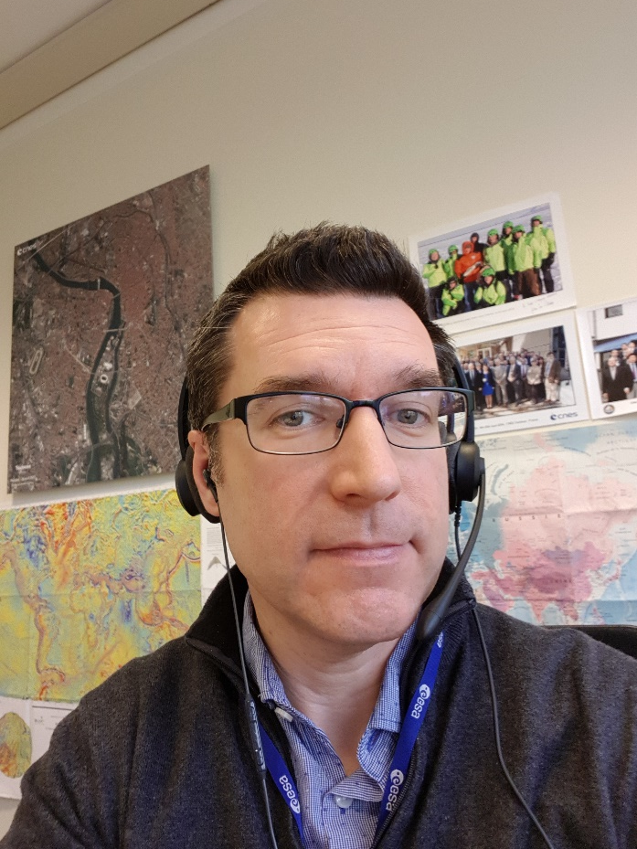
Internal Information Flow
WGDisasters
WGCapD

Slide 14







Internal Information Flow

Slide 15


Interface for external contacts
Relationship with GEO
CEOS-GEO Bilateral
CEOS representative (or alternate) to Programme Board
CEOS delegation to ExCom
CEOS representation at GEO meetings (GEO Plenary, Work Plan Symposium)
CEOS inputs to GEO Work Programme
Relationship with UN and other agencies (as required)
Contact point for all general external inquiries
Support to CEOS leadership for correspondance (letters, emails etc.) with external entities

Slide 16

Interface for external contacts
Contact point for external activities that want to work with CEOS or CEOS data (potential new initiatives)
For the CEO to be an effective POC for CEOS:
Need for clear contact information to CEOS Executive Officer on CEOS Website
Requirement to inform external partners at each change in CEOS Executive Officer
… alternatively, create a CEO@ceos.org email address that reroutes communications
Total time investment ~ 1.5 months FTE

Slide 17

CEOS Housekeeping
CEOS Website @ www.ceos.org
Maintain full site up-to-date, including frequent updates to:
Agency representatives
Organisation chart
CEOS entity presentation pages
Calendar / Meeting pages
Total time investment ~ 1.5 months FTE

Slide 18
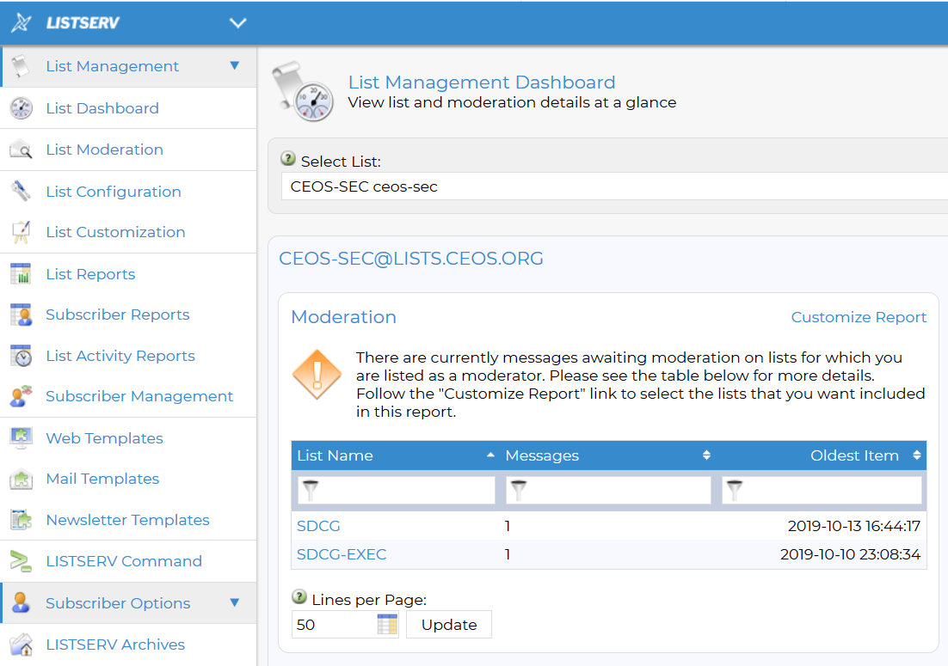
CEOS Housekeeping
Email distribution lists
Maintain consistency with updates to agency representatives and CEOS entity leadership
Some synchronising required after system upgrade implemented in July

Slide 19
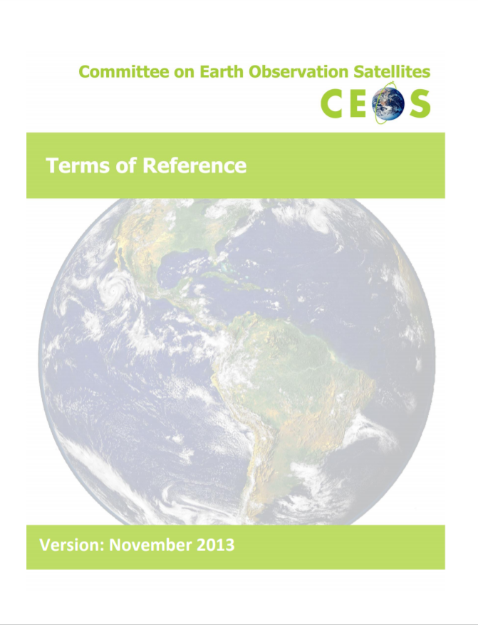



CEOS Housekeeping
Governing documents
CEO is responsible for maintaining CEOS guiding documents and other documentation up-to-date
Total time investment ~ 1.5 months FTE

Slide 20

Conclusions
CEOS Executive Officer is a vital role for CEOS.
It is the oil that allows many of the moving parts of CEOS to keep turning.

