Slide 1

CEOS Work Plan Progress Report
Committee on Earth Observation Satellites
Steven Hosford
CEOS Executive Officer
CEOS Plenary 2019
Ha Noi, Viet Nam
14 – 16 October 2019

Slide 2
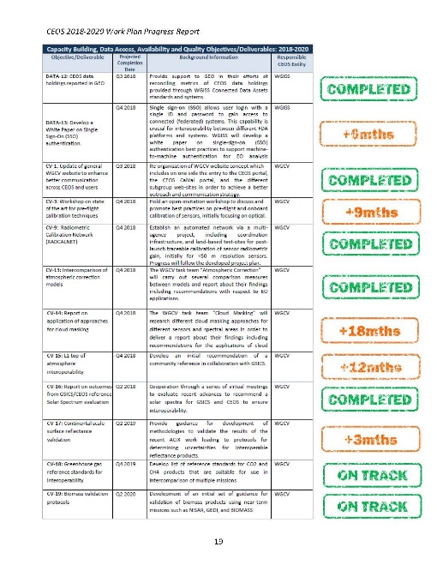



Overview
Progress against CEOS 2019-2021 Work Plan
Changes to work planning
Overview of progress against WP
Conclusions
CEOS 2020-2022 Work Plan Development

Slide 3

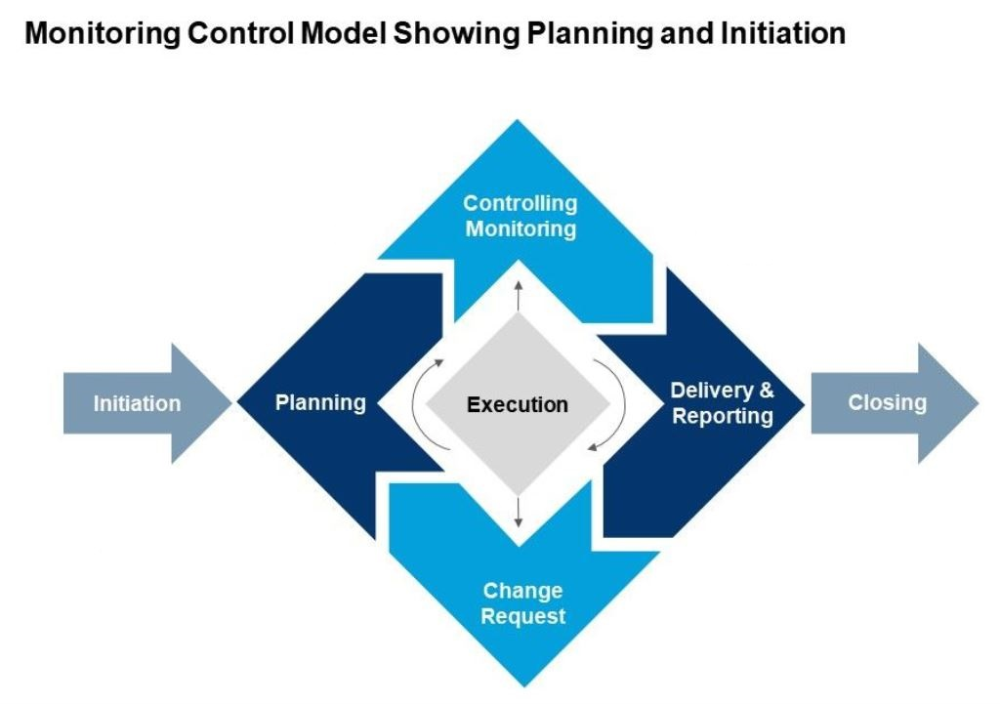

Why? Work Planning and monitoring
Rigorous work planning, execution and monitoring is critical to CEOS’s credibility
CEOS Work Plan
Progress reported
annually
CEOS Work Plan
updated annually

Slide 4
Work Planning and monitoring
July
June
August
May
SIT TW
April
Deliverable
Updates
September
SIT
WP Progress
Report (CEO)
March
CEOS Work Plan
ENDORSED
October
CEOS
Plenary
November
February
December
January
Work Plan development

Slide 5


2019-2021 WP Development
- Proposed changes
Using the WP to improve work traceability
Better define WP deliverables
  Who: CEOS entity (+ nominative), Contributing agencies (+nominative), Resource estimates
  What: More detailed deliverable descriptions and breakdown into milestones (where relevant)
  When: Temporal information on milestones/resources
… gradual implementation/upgrading of deliverable tracking tools.
Links from CEOS WP deliverables to GEO Work Programme elements
As the Space Arm of GEO, we need to know where our work is supporting the implementation of the GEOSS.
Resource estimates,
and milestones needed
Some info provided,
Improvements needed

Slide 6
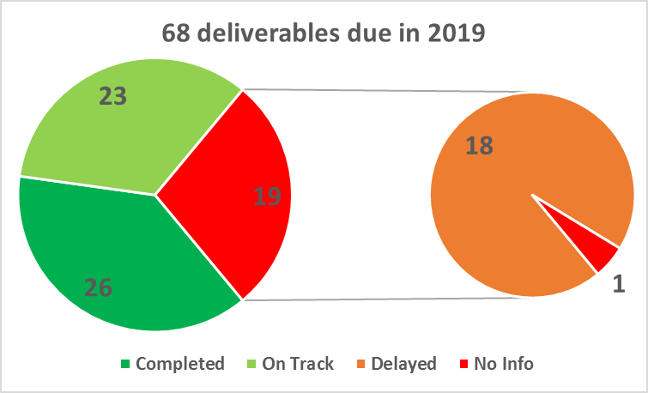
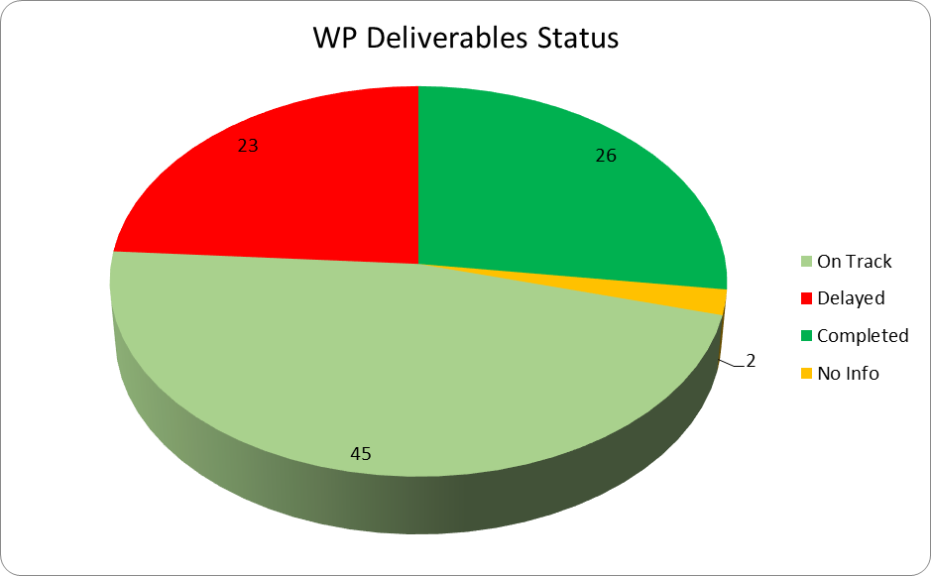
Progress against 2019-2021 WP
Better progress made! (see detailed WP Progress report)
  Updated information provided on 98% of deliverables
  All WP: 74% Completed/On track, 24% delay + new due dates
  Due 2018: 72% Completed/On track, 26% delay + new due dates
Need to stay on track!

Slide 7
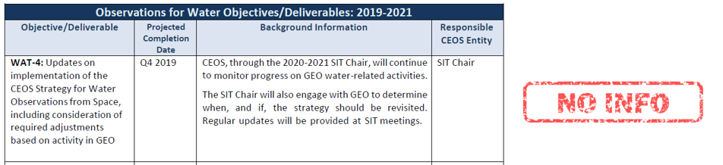

Naming and shaming
Information provided
since 30th September

Slide 8
Cross-analysis 2018/2019
Statistics & Conclusions
All deliverables scheduled to complete within 3 years
  Continued tendancy to use the Work Plan as a short-term planning tool
70% of Ds were scheduled to complete in 2019, of these 72% are Completed or On Track
Of new 2019 Ds to be completed in 2019, 83% are Completed or On Track, up from 57% last year
  Deliverable descriptions and estimates are improving
Despite additional indicators built into the deliverables database, a longer perspective will be necessary to draw conclusions

Slide 9
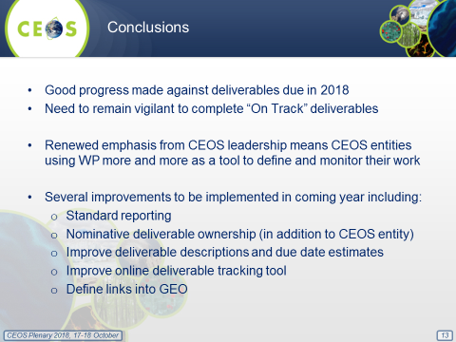
2018
2019
Better

Slide 10
CEOS 2020-2022 Work Plan
CEO emails CEOS entities requesting updates
?^{th} November
Deadline for updates
?^{th} November + 10 days
Work Plan V0 released
?^{th} January
Work Plan V0 comments by
?^{th} January + 14 days
Work Plan V1 released
?^{nd} February
10 days for
CEOS Entity inputs
2 weeks for
CEOS Entity feedback

Slide 11


CEOS (still) needs you!
July
June
August
May
April
September
SIT-34, TBD, USA,
1st-5th Oct
March
CEOS 32nd Plenary, Brussels, 16th-18th Oct
October
November
February
GEO-XV Plenary, Kyoto, 31st-1st Nov
CEOS needs you!
December
January
CEOS Work Plan
inputs from CEOS entity leads

