Slide 1

Action Status Review
Committee on Earth Observation Satellites
Steven Hosford
CEOS Executive Officer
CEOS Plenary 2019
Agenda Item 1.3
Ha Noi, Viet Nam
14 – 16 October 2019

Slide 2
32nd CEOS Plenary, October 2018
SIT-33, April 2019
2019 SIT Technical Workshop, September 2019

Slide 3
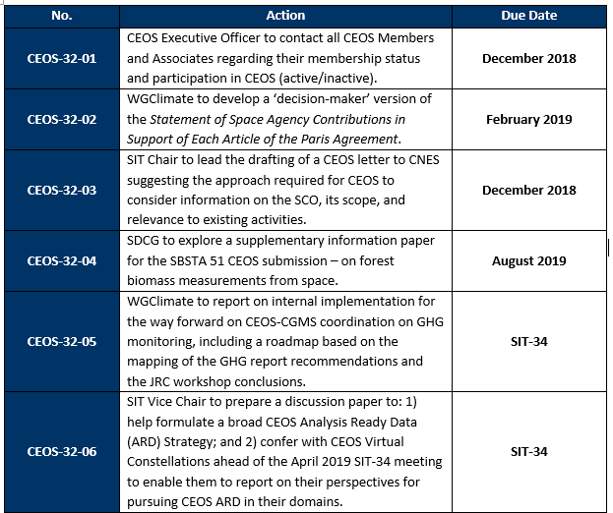

32nd CEOS Plenary
Agenda 2.2
Agenda 2.6

Slide 4
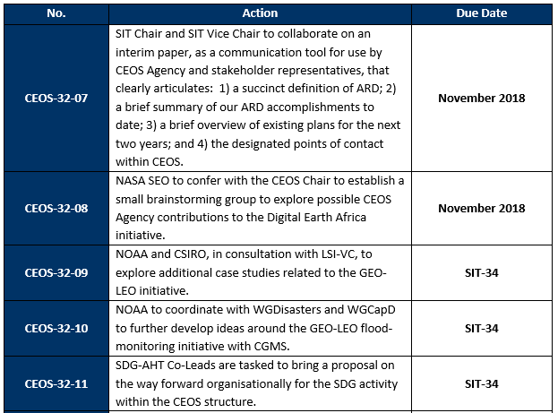
32nd CEOS Plenary
Agenda 5.7
Agenda 5.5

Slide 5
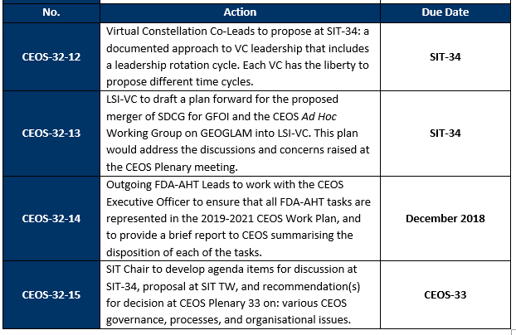
32nd CEOS Plenary
Agenda 5.8
Agenda 5.7 and 5.9

Slide 6
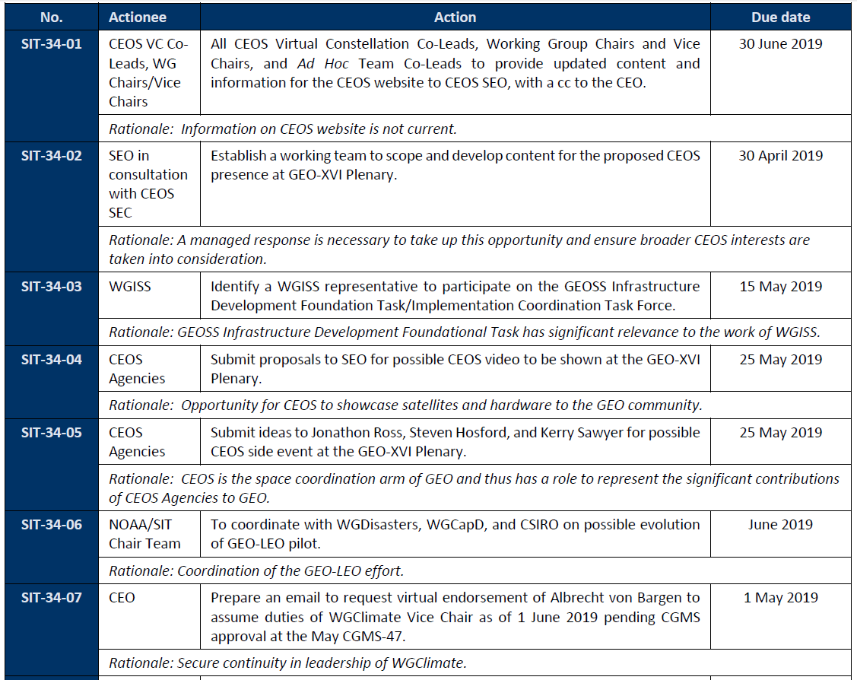

SIT-34
Agenda 1.5

Slide 7
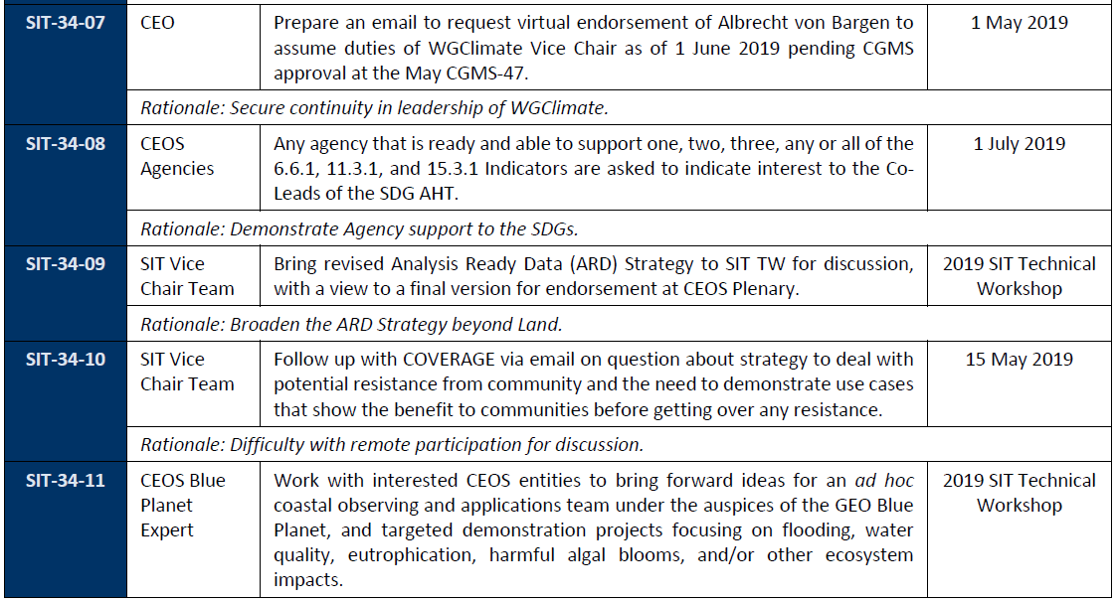
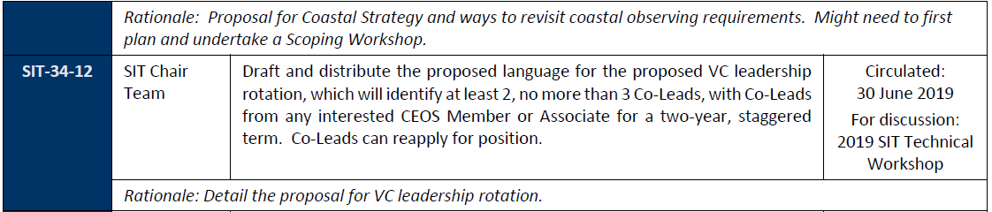
SIT-34
Agenda 5.5

Slide 8
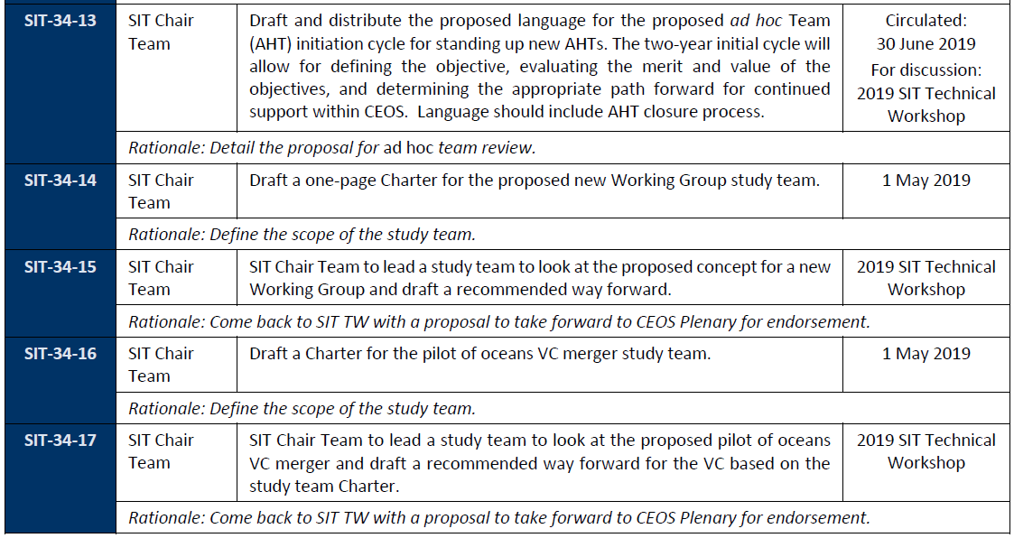
SIT-34

Slide 9
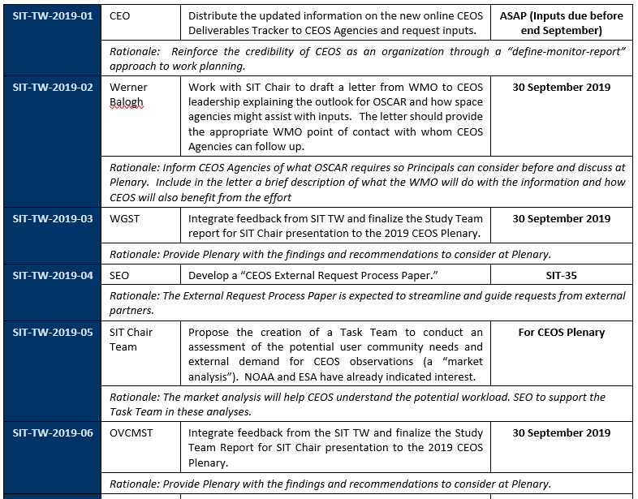
SIT TW 2019
Agenda 5.8

Slide 10
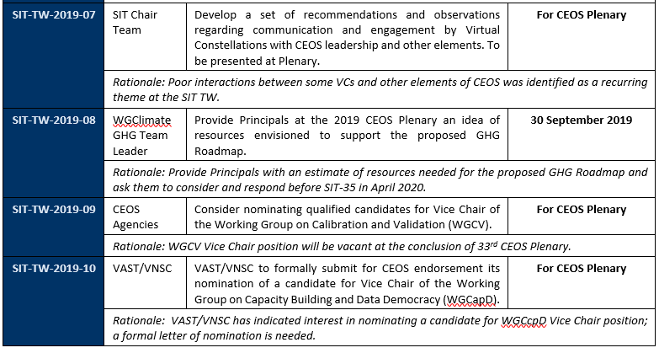
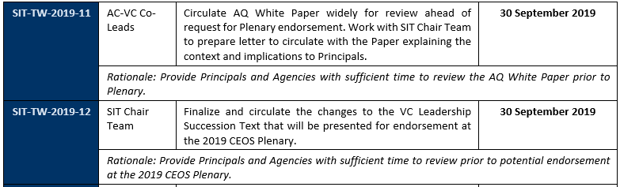
SIT TW 2019
Agenda 5.7
Agenda 2.4

Slide 11
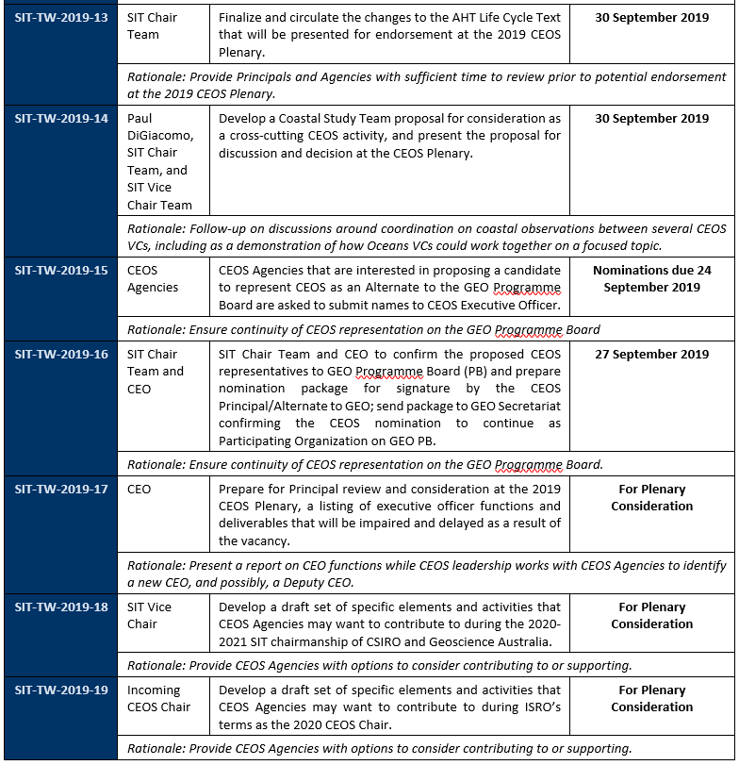
SIT TW 2019

Slide 12
SIT TW 2019
Agenda 7.3
Agenda 7.5

