Slide 1
2020 CEOS Chair Priorities & CEOS Agency Contribution Opportunities
P.G. Diwakar, ISRO
CEOS 2020 Plenary
Agenda Item # 7.5
Ha Noi, Viet Nam
14-16 October 2019

Slide 2
CEOS Chair 2020 Objectives
ISRO will ensure the continuity of the priorities and initiatives identified by the 2018 Chair (European Commission), 2019 Chair (VNSC) and outgoing SIT Chair (NOAA).
Work closely with WGs for their WP.
Priorities of the WP will be done in discussion with current SIT Chair (GA/CSIRO).

Slide 3
CEOS Chair 2020 Objectives
ISRO would pursue the following initiatives:
Focus on Virtual Constellation (VC) with regard to EO satellites - Gap analysis in priority areas, global studies….
Applications focus on SDGs for BIMSTEC Region - Vegetation, LULC, Water etc.
Renewable energy assessment (Solar & Wind) from Space
Explore new tools for disasters management: Geo-Leo based solution !

Slide 4
Analysis & Gaps in Virtual Constellation (VC)
Various LEO satellites are presently - operational, approved & planned
  E.g. Winds, Forest ecosystem, Disaster situation
Discussions on optimum coverage and observing system requirements
Observation requirements may vary depending on the phenomena
For Example
Many Scatterometers in orbit / planned, but Gap exists with regard to temporal coverage
At least 3 Scatterometers, with proper phasing is needed, to meet 6-hourly observations (WMO requirements)
Multiple instruments with proper inter-calibration
Need for Study teams to regularly analyse Operational / Approved / Planned missions, as part of Gap Analysis

Slide 5
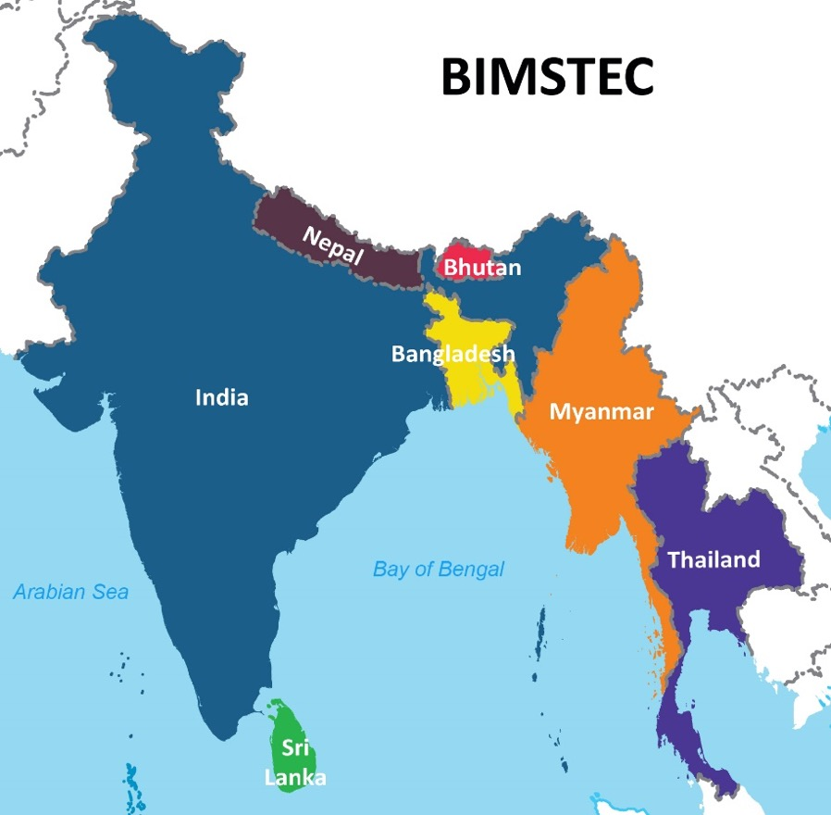
Applications focus on SDGs
Continuity of the efforts of CEOS (USGS, GA, VNSC….) on SDGs
Add-on to Mekong Cube and build a regional data cube
Align actions w.r.t incoming SIT Chair priority (GA); CEOS ARD for Land (CARD4L)
Active participation of CEOS agencies for BIMSTEC region
Capacity building for BIMSTEC
Bay of Bengal Initiative for Multi-Sectoral Technical and Economic Cooperation

Slide 6
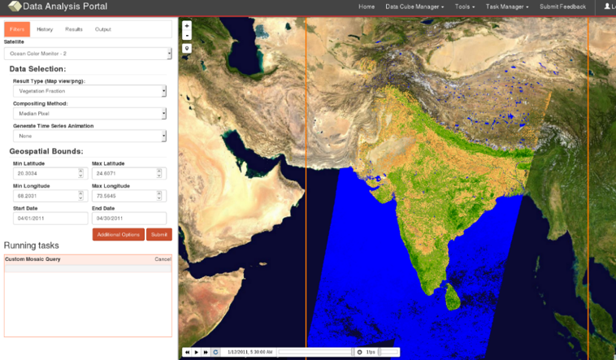
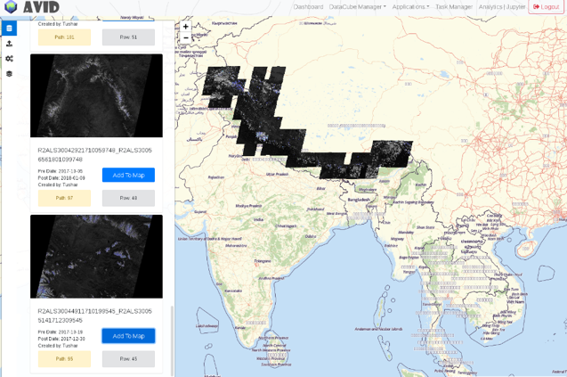
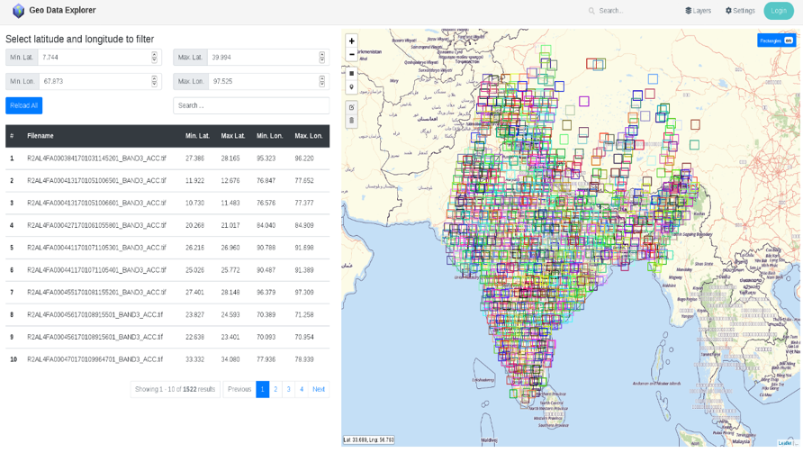
Potential Applications Development
Ice flow Application
OCM2 and RS2/2A Datacube Portal
Real time Geo Data Explorer

Slide 7
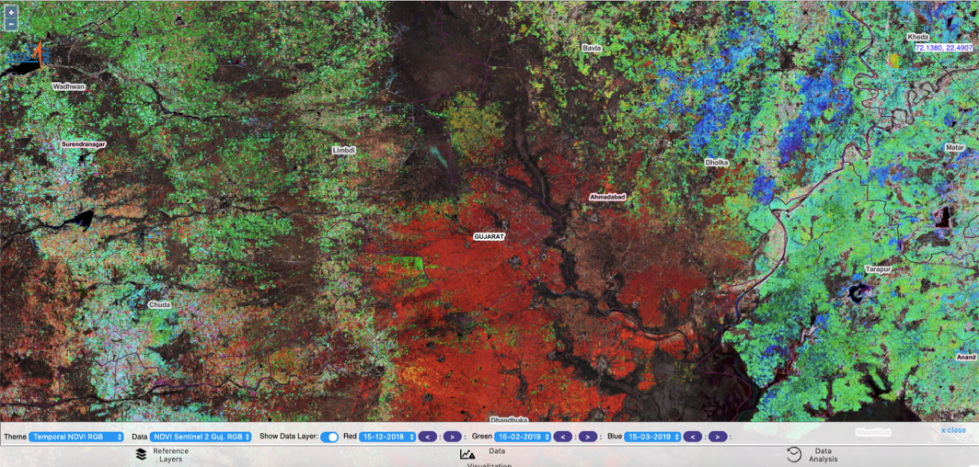
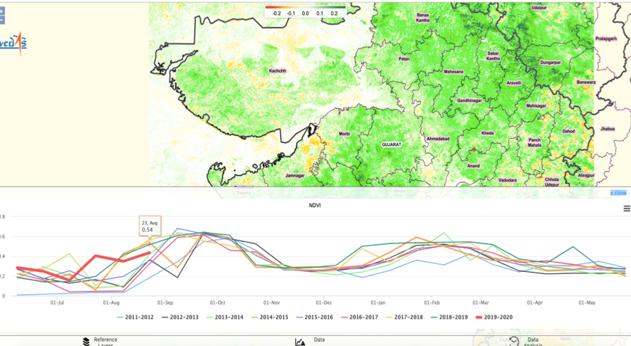
Vegetation and Crop Monitoring
Major Capabilities
Compare NDVI Profile & NDVI Difference
Temporal data analysis
Data Aggregation
VCI Dashboards
Datasets
NDVI MODIS 16 day composite/NDVI PROBA 10 day comp.
NDVI OCM 15 day comp./NDVI OCM daily/NDWI MODIS
SWI SMAP
Soil Moisture SMAP
INSAT Rainfall
NOAA CPC Rainfall

Slide 8
CEOS agencies participation
Expectations from CEOS Agencies
  Inter-sensor calibration approaches and Satellite datasets
  Atmospheric correction - methods development
  Organize harmonized long term datasets
Deliverables
  Forest Cover, LULC Change, Rice crop monitoring, Urban Growth….
  Synergy with GEO - LINKAGE with ASIA RICE, GEOGLAM etc

Slide 9

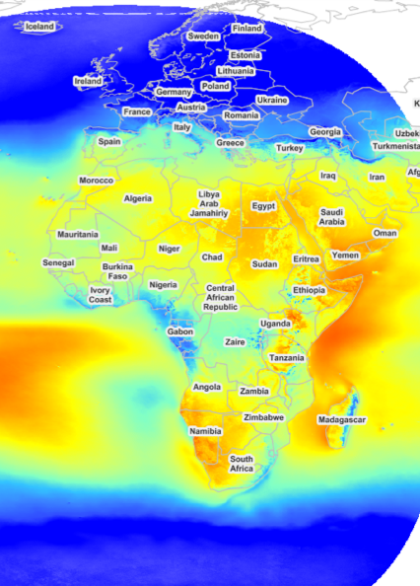
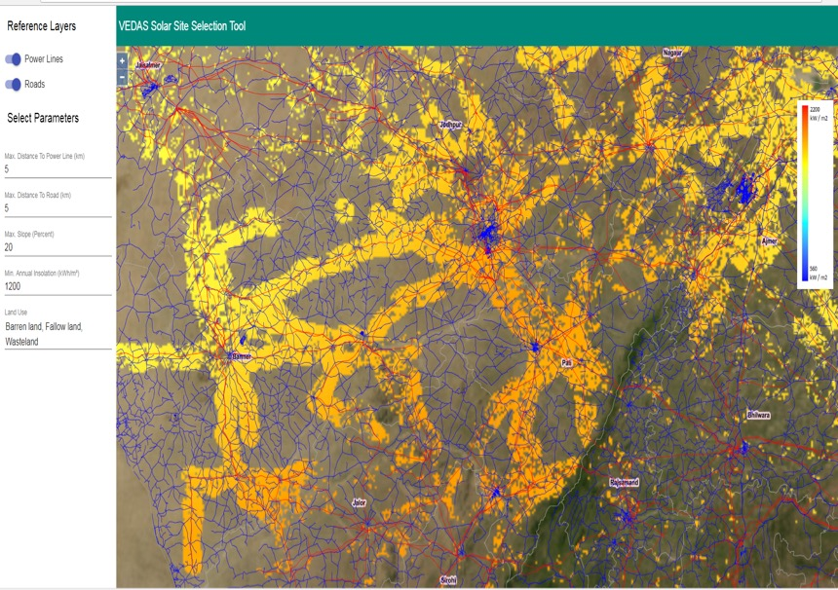
Renewable Energy (Solar & Wind)
Monthly / Annual Digital Energy Atlas (Solar & wind )
Met data from various Geo platform (many CEOS agencies) as input
Solar and Wind energy calculator : Mobile Apps
Solar energy calculator for Africa is demonstrated (Int. Solar Alliance)
Site Selection Tool for solar energy (Land cover, slope, distance from road/grid line)

Slide 10
Expectations from CEOS agencies
Deliverables/ Demonstrations
  Synthesis of Solar Energy Potential Maps
  Ocean Wind Energy Potential Maps
  Site selection Tools
Setup as a new Initiative under CEOS - Ad Hoc Team (for Endorsement)
Linkage with GEO-VENER (Vision for Energy - Geo initiative)

Slide 11






New data processing tool for disaster
Leo-Geo based applications
Floods
Earthquake
Flood Inundation Maps
Damage Assessment
Hazard Zonation
Bank Erosion Studies
Damage Assessment
Cyclone
Landslide
Inundation Maps
Recession Maps
Damage Assessment
Damage Assessment
Hazard zonation
Drought
Forest Fire
Monthly Agri. Drought Report
End-of-the-Season Agri. Drought Report
Active Fire Detection
Damage Assessment
MNCFC

Slide 12
Expectations from CEOS agencies
Approach
  Work with WG-Disasters and explore Leo-Geo services
  Tools for quick data processing platform - disaster response
  Real-time data delivery
Demonstration of Leo - Geo based technologies for Disasters & real time data delivery - Case studies
Linkage with WGDisaster & LEO-GEO

Slide 13
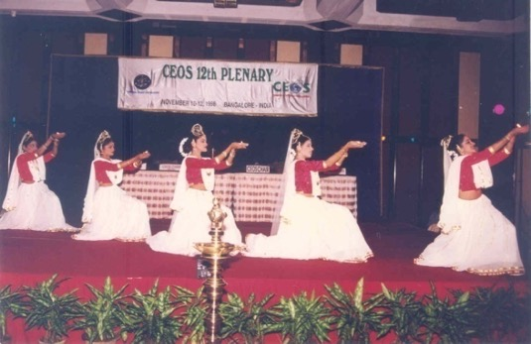
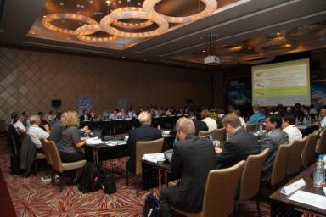
CEOS Plenaries in India
12th CEOS Plenary
November 10-12, 1998
Bangalore, INDIA
26th CEOS Plenary
October 25-26, 2012
Bangalore, INDIA
Ahmedabad, India
34th CEOS Plenary
October 19-21, 2020
Ahmedabad, INDIA

Slide 14
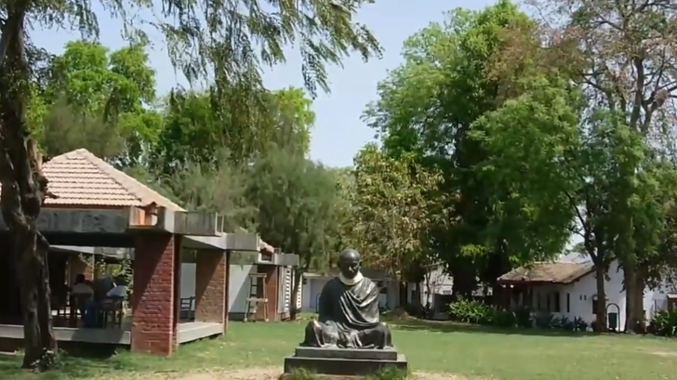
CEOS 2020 - Welcome to All
Gandhi’s Ashram

Slide 15

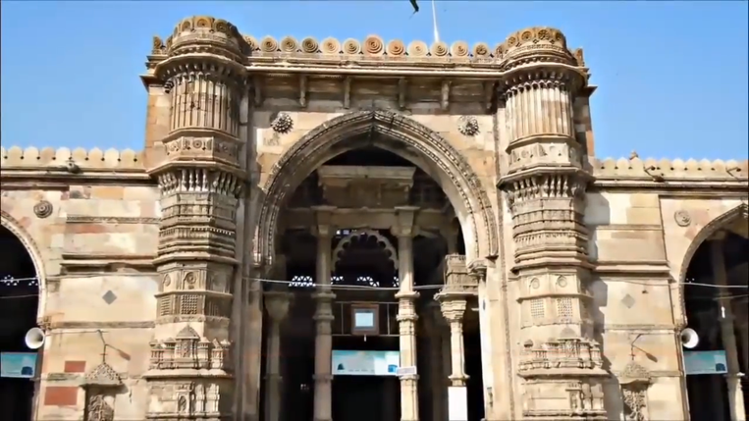


Slide 16
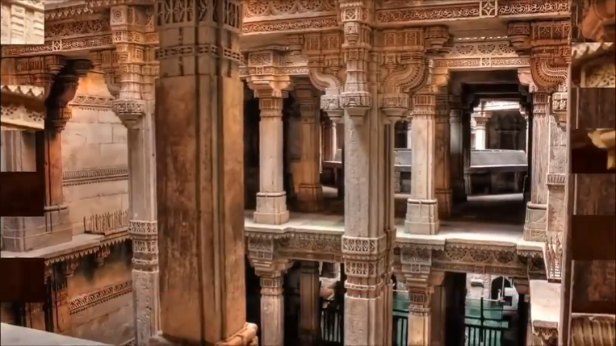
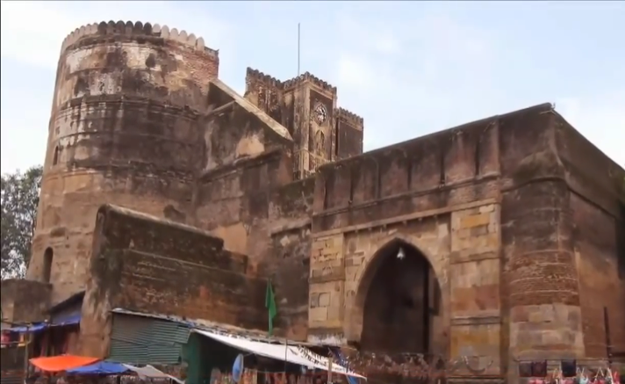
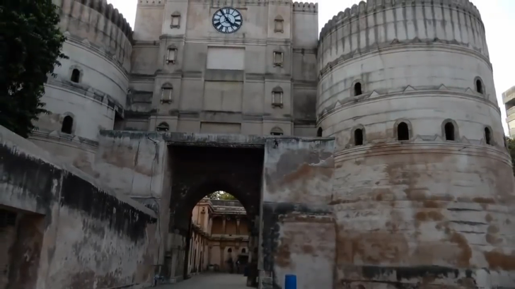
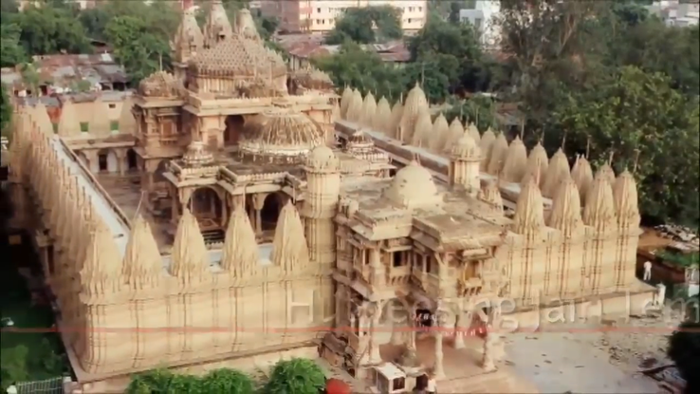

Slide 17


Ahmedabad :
Venue for CEOS Plenary

Slide 18
2020 CEOS Plenary
Side meetings 19th October 2020 (Monday)
34th CEOS Plenary 20th – 21st October 2020
WELCOME To Ahmedabad, INDIA
34TH CEOS PLENARY
ISRO invites you all. . . . .

Slide 19
The ISRO Team
DK Das (Chair), SAC, Ahmedabad
PG Diwakar, ISRO Hq, Bangalore
Raj Kumar, SAC, Ahmedabad
M. Ravichandran, Earth Science Ministry
Prakash Chauhan, IIRS, Dehradun
Rajeev Jaiswal, ISRO HQ, Bangalore

Slide 20
THANK YOU
CEOS Plenary 2019, 14-16 October

