Slide 1

Sustainable Development Goals
Ad Hoc Team
Committee on Earth Observation Satellites
Alex Held, CSIRO, Co-lead & SIT Chair
Flora Kerblat, CSIRO, Executive Secretary
Marc Paganini, ESA, Co-lead
Supported by Argyro Kavvada
(NASA, GEO EO4SDG)
CEOS Plenary 2019
Agenda Item #5.5
Ha Noi, Viet Nam
14 – 16 October 2019

Slide 2


SDG AHT objectives at Plenary 33
Be granted another year (nominations open for AHT leadership)
Calling for CEOS Agencies contributions and feedback to the Work Plan (sent to Principals)
  sub-teams to be created to work on streamlined activities (see slide 5)
  Technical expertise needed

Slide 3
Status of SDG-AHT deliverables
CEOS Work Plan (2019-2021)
# | Objective/Deliverable | Due date | Leading agency | Main Contributors | Status
SDG-2 | Compile and maintain a compendium of CEOS Agencies engagement on SDGs | Q2 2019 | CSIRO | All CEOS Agencies (11 so far) | Completed (to be updated when needed)
SDG-3 | Review and assess the relevance of EO to the SDG Targets and Indicators. Produce a technical compendium and a policy brief | Q3 2019 | ESA | CSIRO, NASA | Draft completed (under review by SDG-AHT members)
SDG-4 | CEOS engagement plan on SDGs | Q2 2019 | ESA | CSIRO, NASA | New version Completed (to be reviewed after Plenary with updated information from Agencies)
SDG-5 | Analyse the SDG satellite data requirements | Q4 2019 | NASA, CSIRO | ESA, JAXA | Tables drafted for 15.3.1, 6.6.1 and 11.3.1 (and 2.4.1)
SDG-6 | Open Data Cube algorithms for the SDGs | Q4 2019 | SEO (NASA) |  | On-going (SEO progress report)
CB-41 | SDG-related training and capacity building related to the use of space-based EO to meet the data challenges of the 2030 Agenda for Sustainable Development | Q3 2019 | NASA with WGCapD | SDG AHT Members | SDG Awareness webinar Indicator-specific Webinars & Training started (6.6.1, 11.3.1, 6.3.2)

Slide 4
Streamlining of CEOS SDG activities
3 Primary Indicators
As a demonstration of the effectiveness of “streamlining”, the SDG-AHT proposed:
to start with 3 SDG indicators, open for new proposals pending capacity
most ready to integrate EO in their processes
indicators selected by the IAEG-SDGs WGGI for the Task Stream on satellite Earth Observation data for the SDG indicators
SDG 6.6.1
Water related
Ecosystems
SDG 11.3.1
Sustainable
Urbanization
SDG 15.3.1
Land Degradation Neutrality
Changes in the spatial extent of open waters (lakes, artificial water bodies,
rivers and estuaries)
Changes in the spatial extent of vegetated wetlands (including mangroves)
WQ of lakes and artificial water bodies
Water discharge in rivers & estuaries
Mapping of Human Settlements
Mapping of Population density
(disaggregation of census data)
Functional Urban Areas
Land degradation from the changes in land cover
Land degradation from the changes in land productivity
Land degradation from the changes in carbon stock above and below ground (soil organic carbon as proxy)

Slide 5
SDG-AHT 2019-2021 workplan
Activities and Deliverables
Satellite Data Providers
Information Providers
End Users
 | # | Activity Title | Activity Deliverables | Target Audience |  |  | CEOS bodies support
SHORT TERM ACTIVITIES (2020) | 1 | Satellite Data Requirements | Technical Notes on “Satellite Data Requirements” (one TN for each SDG indicator) | X |  |  | LSI-VC (3 indicators)
 | 2 | EO Enabling Infrastructures | Technical Notes on EO enabling infrastructures for SDG indicators (one TN for each SDG Indicator) |  | X |  | WGISS, SEO
 |  |  | CEOS Community Portal on SDG for EO data discovery and access (based on WGISS IDN/CWIC/FedEO) |  | X | X | WGISS
 | 3 | EO Capacity Building | Capacity building webinars/training (organized by SDG indicator) |  | X | X | WGCapD WGISS
 |  |  | Support to EO4SDG MOOCs on SDGs (one MOOC per SDG goal) |  | X | X
MID TERM ACTIVTIES (post 2020) | 4 | EO Good Practices Guidance | EO Good Practice Guidance for SDG indicators (one GPG for each SDG indicator) |  | X |  | LSI-VC (CARDL)
 |  |  | R&D agenda on improved methods for SDG indicators (one R&D Agenda for each SDG indicator) | X |  |  | LDN sub-team?
 | 5 | EO Demonstration Cases | Collection of EO Demonstration Cases for SDG indicators. (one per SDG indicator) |  | X | X
 |  |  | Deployment of EO workflows for SDGs on the CEOS Data Cube |  | X | X | SEO
 | 6 | EO Quality Standards | EO Quality Standards for SDG indicators (one guideline per indicator) |  | X |  | WGCV/LPV

Slide 6

SDG-AHT 2019-2021 workplan
Activities and Deliverables
UN Inter-Agency and Expert Group on SDG Indicators (IAEG-SDGs)
Working Group on Geo-Spatial Information (WGGI) Task Stream II Application of satellite data for the SDG indicators
UN Environment
UN Habitat
UNCCD
6.6.1 Water
related ecosystems
11.3.1 Sustainable Urbanization
15.3.1 Land Degradation Neutrality
Surface Water Extent, Vegetated Wetlands,
Water Quality
Human Settlements,
Population Density, urban/rural
Land Cover,
Land Productivity,
Carbon Stock
CEOS SDG AHT
Satellite Data Requirements
Satellite Data Requirement Sub-team
LSI-VC
EO Enabling Infrastructures
Enabling Infrastructure Sub-team
WGISS
SEO
EO Capacity Building
Capacity Building Sub-team
WGCapD
WGISS
EO Good Practice Guidance
Water Sub-team
(e.g. NOAA, GA/CSIRO, EC, NASA, JAXA, ESA)
Urban Sub-team
(e.g. EC, NASA, DLR,
ESA, SANSA)
LDN Sub-team
(e.g. CSIRO, ESA, EC,
SANSA, NASA)
LSI-VC
EO Demonstration Cases
SEO
EO Quality Standards
WGCV
LPV
GEO EO4SDG
GEO Wetlands
AQUAWATCH
GEO Human Planet
GUOI
GEO LDN

Slide 7
CEOS activities on SDGs
Future Outlook
SDGs is one of GEO Priorities + of the new CEOS SIT Chair for 2020-2021:
how does CEOS continue to support the 2030 Agenda?
Email sent on 03/10/19 (from SDG AHT co-leads) with background documents including an Information Note and the updated Work Plan (available here on CEOS Document Management ) for their review
… Inviting CEOS Principals at the Plenary to:
  approve the renewal of an additional and final year of extension
  express their support to the implementation of the new CEOS 2020-2021 Workplan on SDGs, which is provided for information, and indicate the level of resources they are ready to assign on the CEOS work plan activities related to the three SDG indicators proposed at SIT-34 (Water related Ecosystems, Sustainable Urbanization, Land Degradation Neutrality)
  designate CEOS Agencies’ staff who can participate to the AHT sub-teams as leads or contributors
  consider the possibility to become a co-lead of the SDG-AHT for the upcoming year, in agreement with the AHT leadership rotation of the SDG-AHT Terms of Reference

Slide 8
CEOS activities on SDGs
Future Outlook
If renewed…. Our ROADMAP TO SIT-35
Update the 2019-2021 CEOS workplan on SDGs based on Principals decisions and comments at CEOS Plenary 33
Coordinate Agencies’ participation and commitment to the SDG workplan is adequate to fulfil our objectives.
Fully engage with CEOS groups (VCs, WGs and SEO) listed in the WP and plan a coordinated and effective way forward (before Christmas break) with designated sub-teams
Comply with CEOS processes and work with CEOS SIT Chair towards SIT-35 (if a WG to be created by CEOS Plenary 34)

Slide 9
THANK YOU
Alex Held (CSIRO, SDG AHT Co-lead and SIT Chair)
Marc Paganini (ESA, SDH AHT Co-lead)
Flora Kerblat (CSIRO, SDG AHT Exec. Secretary and SIT Chair team)
Please contact us: sdg-leads@lists.ceos.org

Slide 10
Background information

Slide 11
Solutions to explore against existing challenges
Focus on CEOS unique role
and on a few SDG Indicators
(start with 6.6.1; 11.3.1; 15.3.1)
Complement rather than duplicate
the GEO community efforts on SDGs
Encourage more commitment and participation from agencies
Leverage the knowledge and expertise of CEOS bodies (VCs, WGs, SEO)
to maximise impact.
Identify the key partners with whom CEOS should primarily interface
(IAEG-SDGs WGGI, custodian agencies)
The UN has established a complex governance system on the SDG Global Indicator Framework with many stakeholders involved both at UN and national levels.
Take a decision based on an
in-depth assessment of implications
(resources, reporting, etc.)
Future of the SDG AHT is uncertain. Continue or disappear? New entity (post AHT)? WG or Strategy?
The original goals of the SDG AHT were too broad in scope and not fully aligned with the CEOS mandate.
The AHT activities were too similar to the work of the GEO EO4SDG initiative, which brought some confusion on the respective roles of CEOS and GEO.
The impact of the CEOS activities on SDGs is commensurate to the level of resources available. Number of agencies actively involved has not reached the expected level.
The SDG is a very broad and cross-cutting topic (land, marine, atmosphere) requiring different EO competences (satellite data, EO infrastructures, capacity building, accuracy assessment).
Reduce the governance burden
to focus on key contributions
Creation of a new entity includes more governance paper, reporting.

Slide 12
CEOS Engagement Plan on SDGs
Criteria for streamlining CEOS activities
The CEOS activities on SDGs must focus on the unique role that CEOS should play as a coordination body of the Space Agencies.
The CEOS activities on SDGs must serve the interest of CEOS and offer tangible benefits to all CEOS Agencies.
The permanent CEOS entities (WGs, VCs, SEO) must be involved in order to leverage expertise, and maximize resource and overall benefits.
The CEOS activities on SDGs must complement rather than duplicate the GEO community efforts on SDGs (GEO EO4SDG initiative).
The CEOS activities on SDGs must be connected to the SDG processes in place in the UN (e.g. IAEG-SDGs WGGI and UN Custodian Agencies).
The CEOS activities on SDGs and deliverables must be embedded in the GEO Federated Approach on SDGs and related workflows.
The CEOS activities on SDGs and deliverables must be commensurate with the resources available in CEOS to deliver as planned.

Slide 13
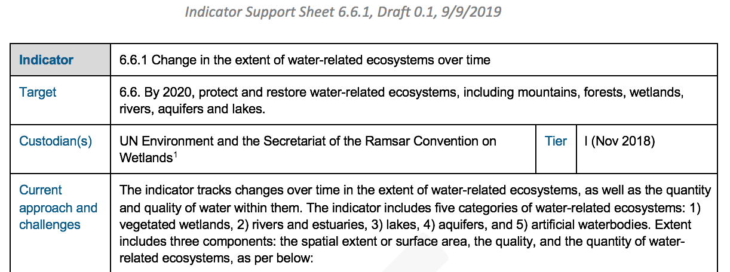
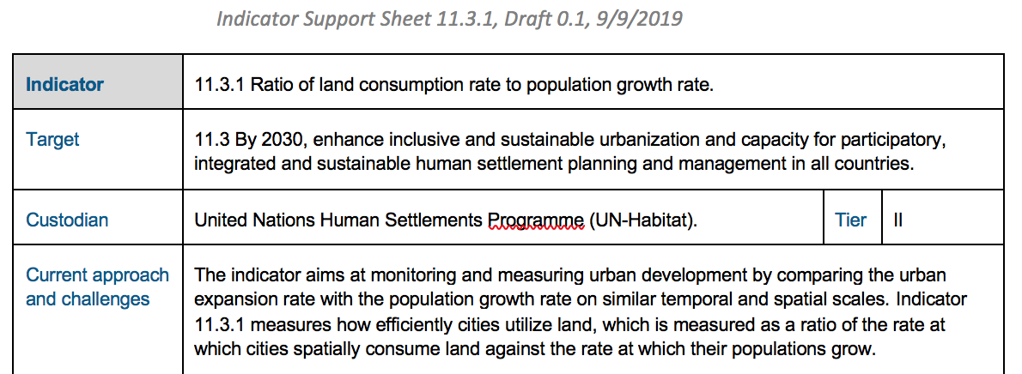
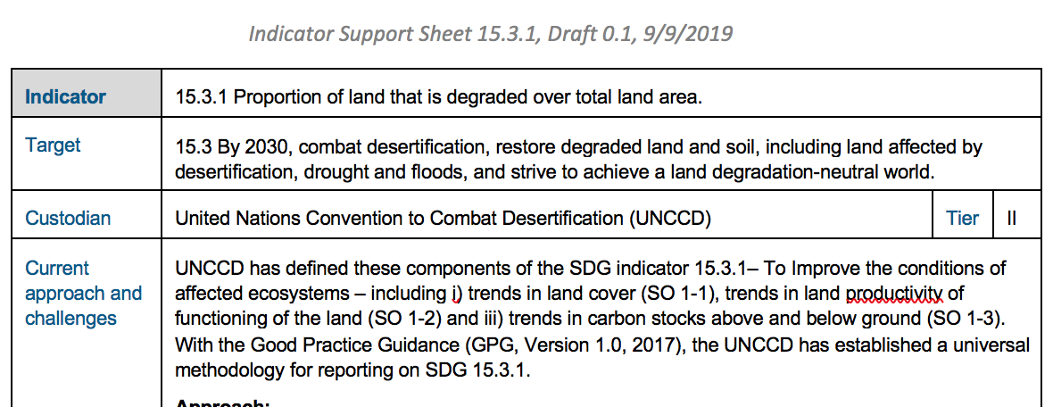
Indicators 6.6.1, 11.3.1, and 15.3.1 Progress on CEOS pilot support
Indicator Support Sheets
with analysis of challenges and opportunities for EO uptake and review of existing EO datasets, tools and platforms
Satellite Data Requirement Tables drafted in general and with regional focus (e.g. Pacific islands)
SEO started to customize CEOS ODC workflows for the 3 primary indicators.
Capacity Building organized jointly by SDG-AHT and WGCapD
(e.g. Webinars, Training by NASA during 2019 AmeriGEO Week)

Slide 14
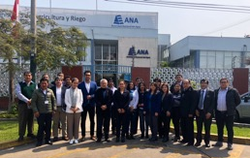
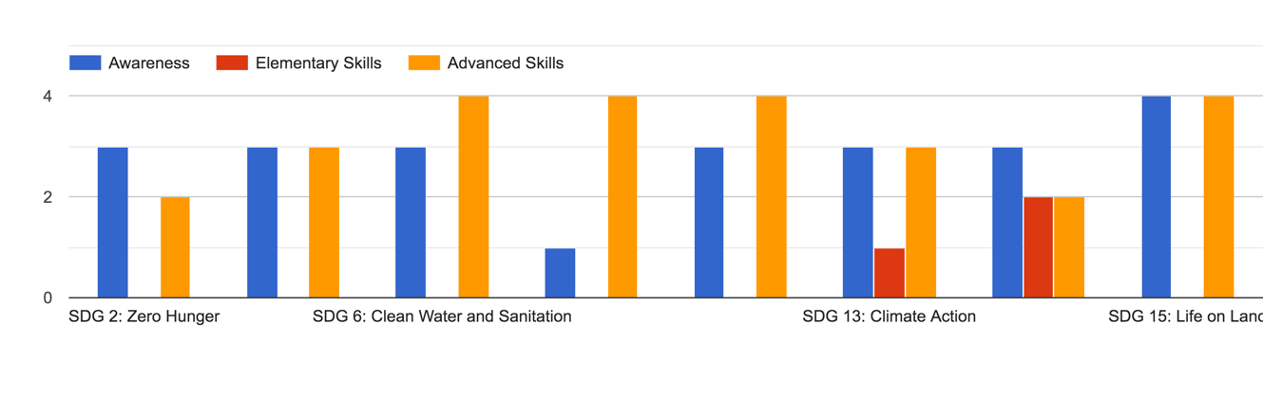
Capacity Building activities
CB-35 – SDG Awareness Webinar (Dec 2018)
Organizing Committee: Argyro Kavvada, NASA, Hilcea Ferreira, INPE, Robert Eckardt, University of Jena, Nancy Searby, NASA
78 Registered, 32 Participants (~43% of registered), 2 Sessions on Dec 19, 2018
Feedback Survey: 8 Responses
Learning Material and Recorded Session: http://learningcenter.obt.inpe.br/
Lessons Learned:
  Coordinate with CEOS WGs & GEO Initiatives in conducting future trainings
  Review and incorporate training best practices
  Better planning (timeline from announcement to survey distribution to completion, training tool)
SDG 15: Life on Land
Interest in additional trainings on SDG topics including general awareness & trainings to develop elementary and/or advanced skills with specific SDG Targets/ Indicators.
Training on Applications of Remote Sensing in Aquatic Systems
AmeriGEO Week Training Course
1-Day Training: August 21, 2019
NASA, INPE
Training Participants: Government, Academia, NGOs
Site visit with Peru’s National Water Authority (SDG 6 Focal Point)
Training Content
Basic concepts of hydrologic optics
Remote sensing applications in inland water & case studies
Remote sensing of water quality
Tool demonstration for SDG 6.6 monitoring & reporting
Notes:
Challenges
Timing of training webinar
Overall timeline (from announcement to survey distribution & completion)
Training Tool (Go To Webinar)
Limited participation of registered participants
Lessons Learned & Future Plans
Engage with broader CEOS and sustainable development community to increase the number of individuals & institutions benefiting from SDG trainings (e.g., SDG Academy)
Review and incorporate training best practices from CEOS & GEO CB contributors;
Collaborate with CEOS Agencies as well as GEO thematic initiatives in conducting future trainings (on specific SDG areas / awareness)

Slide 15
Satellite Data requirements – Agricultural Sustainability
SDG-5 Requirements – draft examples
EO Variables & their Observation Requirements for Indicator 2.4.1 - draft |  |  | Spatial Res | 100 - 1000 m | 50-500 m | 5-25 km | 30-100m | 10-30m | 10-30m | 10-30m | 10-30m | 5-10m | 5-10m | < 5m | < 5m | < 3m | <30m
 |  |  | Spectral Range | optical | optical | passive microwave | thermal | VIS NIR + Red Edge + SWIR | SAR dual polarization | SAR coherence | SAR Multifrequency | VIS NIR + Red Edge + SWIR | SAR dual polarization | VIS NIR | VIS NIR | VIS NIR | SAR Multifrequency
 |  |  | Cloud Free Obs Frequency | Twice daily | 2-5 per week | Daily | 2 to 7 per week | Weekly | 2-4 per week | 2-4 per week | Weekly | Weekly | 2-4 per week | 3/year (2 in + 1 out of season) | 1 to 2 per 3 years | 1 to 2 per month | Weekly
 |  |  | Extent of Obs | Wall-to-Wall | Cropland extent | Wall-to-Wall | Cropland extent | Cropland Extent | Cropland extent | Cropland extent | Cropland extent | Cropland Extent | Cropland extent (cloudy & rice) | Cropland extent every 3 years | Cropland extent | Refined Sample of All Fields | Cropland extent (cloudy)
Supporting Variables | Core Variable (or Product???) | Update Frequency
 | Within Season Crop Mask | Monthly in Season |  |  | X |  |  | X | X | X | X | X | M/S | S |  | S
Within Season Crop Type Mask | Crop (Type) Area Indicator | Mid of Season |  |  |  |  |  | M/L | M/L | M/L | M/L | X | X | M/S |  | X
 | End of Season Yield Estimation | End of Season |  | L | L | X | X | X | X | X |  | X |  |  |  | X
 | Soil Moisture | Daily |  |  |  | X | X |  | X | X | X |  | X |  |  |  | X
 | ET, Water Use, Water Productivity LST | Daily |  |  | X | X | X | X | X | X |  | X | X
 | Irrigation Map
 | Field delineation | Every 3 years |  |  |  |  |  | L | L | L |  | L |  | M/S | M/S | M/S
Current Crop Phenology & Ag Practices: Temperature; Precip | Crop Condition Indicators | Weekly |  | X | X | X | X | X |  |  |  | X
 | Cover Crop Mapping | Annual
 | Rangeland Map | Annual
 | Tillage Mapping | Annual
Provided by Alyssa Whitcraft, GEOGLAM / NASA Harvest
Notes:
Addendum Optical: 700-1400 nm (VIS NIR) + 1400-3000 nm (SWIR) + 8000-14000 nm (thermal) Optimal bandwidths and channel locations to-be-articulated; 1900, 2000, 2100 broadly useful for soil classification (applications in precision management) Passive Microwave: emphasis on continuity (SMAP, AMSR-E, SMOS, TRMM) SAR: C-band is highest priority, followed by X and L-band
** Field Sizes (indicated in gray section) X = All sizes S = < 1.5 ha M = 1.5 - 15 ha L = > 15 ha
*** General Guidance Latency: <2 days for most products and applications Pre-processing levels: all to a minimum of terrain-corrected surface reflectance Cirrus band must be included for atmospheric adjustment + bands for efficient cloud screening
EO listed as alternative option (data source)
EO-based information is explicitly identified as an “alternative data source” for a variety of 2.4.1 sub-indicators, including farm output value per hectare (e.g. via crop mapping and area estimation), prevalence of soil degradation, variation in water availability, management of fertilizers, and use of biodiversity-supportive practices (e.g. tillage mapping, cover crop monitoring, and crop residue monitoring).
EAVs sit just above data and are precursors to higher information products such as crop type and yield. In essence, EAVs represent information “building blocks” that are rudimentary indicators of state and change in our domain and as such, these low-level indicators can be built up and integrated with other information for monitoring across multiple policy dimensions (e.g. SDGs, Paris Accord, and Sendai).

Slide 16
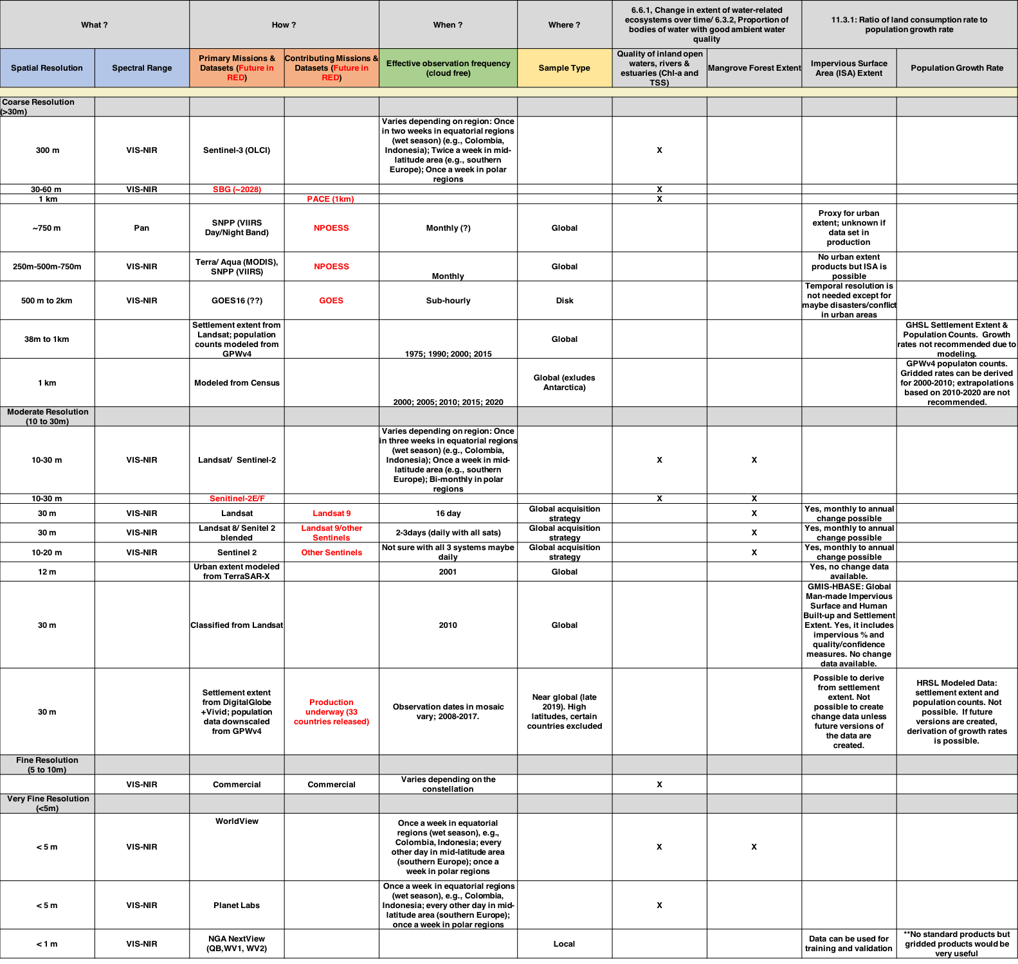
SDG indicators – preliminary inputs
11.3.1 & 6.6.1
NASA inputs
Notes:
CEOS task to be undertaken in consultation with SDG stakeholders and EO community (end-users)
Some notes
Water Quality
Current Missions [only missions NASA colleagues currently use]
Landsat/Sentinel-2A/B
Spatial resolution
10-30m
Spectral range
Visible and near-infrared
Effective revisit time (average)
Once in three weeks in equatorial regions (wet season) (e.g., Colombia, Indonesia)
Once a week in mid-latitude area (e.g., southern Europe)
Bi-monthly in polar regions
Complementary satellite (European colleagues use it)
Sentinel-3A/B
Spatial resolution
300m (nominal/nadir)
Spectral range
Visible and near-infrared
Effective revisit time (average)
Once in two weeks in equatorial regions (wet season) (e.g., Colombia, Indonesia)
Twice a week in mid-latitude area (e.g., southern Europe)
Once a week in polar regions
Commercial satellites
Worldview 2/3
Spatial resolution
< 5 m
Spectral range
Visible and near-infrared
Effective revisit time (average)
Once a week in equatorial regions (wet season) (e.g., Colombia, Indonesia)
Every other day in mid-latitude area (southern Europe)
Once a week in polar regions
Planet Labs (not high-quality for SDG 6.3.2 but can help identify major hazards qualitatively)
Spatial resolution
< 5 m
Spectral range
Visible and near-infrared
Effective revisit time (average)
Once a week in equatorial regions (wet season) (e.g., Colombia, Indonesia)
Every other day in mid-latitude area (southern Europe)
Once a week in polar regions
Future Missions
SBG (~ 2028)
30-60m
Senitinel-2E/F (~ 2030)
10-30m
Landsat-10 (~2028)
------
11.3.1 - Population Datasets
The issue of population growth rates is tricky since it is very dependent on the resolution, quality, and temporal consistency of the underlying boundary and census data (vector), not on the resolution of a raster population layer. It's not really possible to compute population growth rates at high resolution from existing gridded population datasets unless substantial effort has been made to ensure that downscaling of the census data has taken into account changes in boundaries, admin units, etc. This is particularly difficult for the land consumption indicator, since there isn't an accepted cross-national definition of urban built-up areas vs. rural areas (though JRC has been working on this).
Table reflects available population/settlement data products, including GPW/census-based product, the radar-based Global Urban Footprint from the DLR, the Global Human Settlement Layer from JRC, and the High Resolution Settlement Extent based on Digital Global data that Bob Chen’s group has been developing with Facebook (not yet fully global).

Slide 17
SDG requirements – Pacific focus (draft)
CSIRO inputs

