Slide 1

Working Group on Information Systems and Services (WGISS)
Committee on Earth Observation Satellites
Mirko Albani, ESA, WGISS Chair
CEOS Plenary 2019
Agenda Item #4.1
Ha Noi, Viet Nam
14 - 16 October 2019

Slide 2

Outline
Data Preservation and Stewardship
Data Discovery and Access
Interoperability and Use (including Future Data Architectures)
Technology Exploration
WGISS Cooperation
CEOS 2019 – 2021 Work Plan Deliverable Item

Slide 3
Status of Deliverables
Actions | Title | Q2 2019 | Q3 2019 | Q4 2019 | Q1 2020 | Q2 2020 | Q3/Q4 2020
CARB-15 | Carbon Data Portal prototype | Portal issued & available to users. Delivered
DATA-9 | ECVs/CDRs Discovery and Access through WGISS Systems | Coordination on-going with WGClimate. Several CDR registered but need extension to complete full ECV Inventory. |  |  | Due Date extended to Q2 2020
DATA-11 | Data and Technology Exploration webinars and workshops | Several workshops held in 2018-19, last in September 2019. On track for delivery.
DATA-13 | Develop a White Paper on Single Sign-On (SSO) authentication | First Draft issued. Comments under review. | Due Date extended to Q4 2019
DATA-15 | Explore emerging trends and disrupting technologies (i.e. AI) | Dedicated sessions on Artificial Intelligence held at WGISS#46-47-48. On track for delivery.
DATA-16 | CEOS data holdings reported and accessible in GEO and other international relevant contexts | CEOS agencies data discoverable in the GEOSS Platform through the WGISS CDA infrastructure. On-going task renewable each year.
FDA-5 | Promote awareness of FDAs | Several sessions held at WGISS meetings, FDA webinar held in Sep. 2019. Delivered.
FDA-8 | Establish common description of Future Data Architecture | Draft architecture drafted. Need to redirect activities towards the generation of a set of best practices for each major function. |  | Due Date extended to Q2 2020
FDA-9 | Inventory and characterize existing FDAs | Inventory finalised with contribution from several agencies. Discovery system implemented with SEO. Delivered.
FDA-10 | Finalize inventory of Software and Tools | Inventory finalised. Discovery system implemented with SEO and to be published on CEOS web site. |  | Due Date extended to Q4 2019
FDA-14 | Facilitate tools & services discovery and access for end users via CDA | Services metadata model being defined and agreed. Access to services identified in the OSS and FDA inventories through database implemented with SEO (step-1) and then through WGISS CDA (Step-2). On track for delivery.
DATA-2 | Full representation & accessibility of CEOS agencies datasets through WGISS CDA Infrastructure | WGISS Connected Data Assets Infrastructure continuously populated with new data collections from current abd new CEOS partner agencies. On-going task renewable each year.

Slide 4
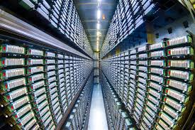

Data Preservation and Stewardship
WGISS accomplishes its Data Preservation and Curation efforts through the Data Stewardship Interest Group (DSIG)

Slide 5
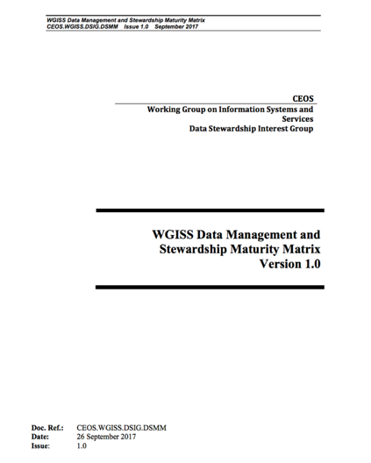
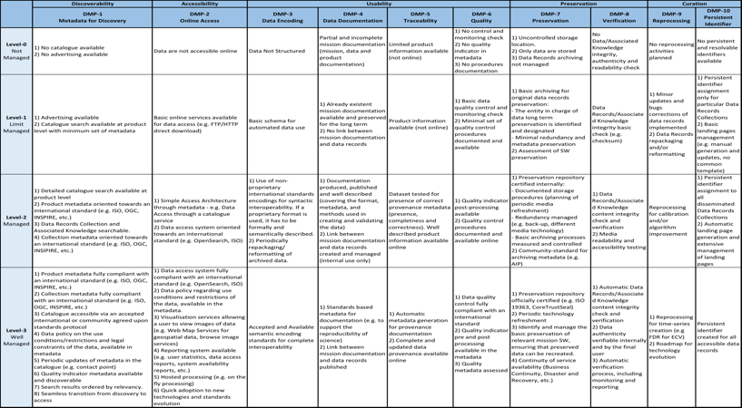
Data Stewardship Best Practices
Document Tree
EO Data Stewardship
Cooperative Framework
Policy Documents
CEOS Agencies EO Space Data Sets
Updated Version and Self-Assessment Questionnaire coming next year
Applied to
Recommended for
application
Data Purge Alert Procedure & White Paper
Recommended / Reference
Individual organizations'
policies (stewardship, access, ...)
Recommended /
Reference
Technical Documents
Reference Model for Data Stewardship
Glossary of Acronyms and Terms
General guidelines and best practices
Input to GEO Data
Management Principles
Support
Preservation Workflow
EO Data Preservation Guidelines
Preserved Data
Set Content
Associated Knowledge Preservation
WGISS Maturity Matrix
Persistent Identifiers Best Practice
Guidelines and best practices on specific topics
Technical implementation procedures
EO Data Set
Consolidation Process
…
Image Source: http://eastenders.wikia.com/wiki/File:Under-construction.png

Slide 6


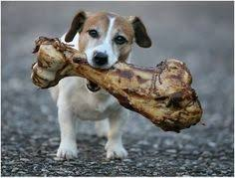
Discovery & Access
WGISS accomplishes its Data Discovery and Access efforts through the WGISS Connected Data Assets System Level Team (SLT)

Slide 7
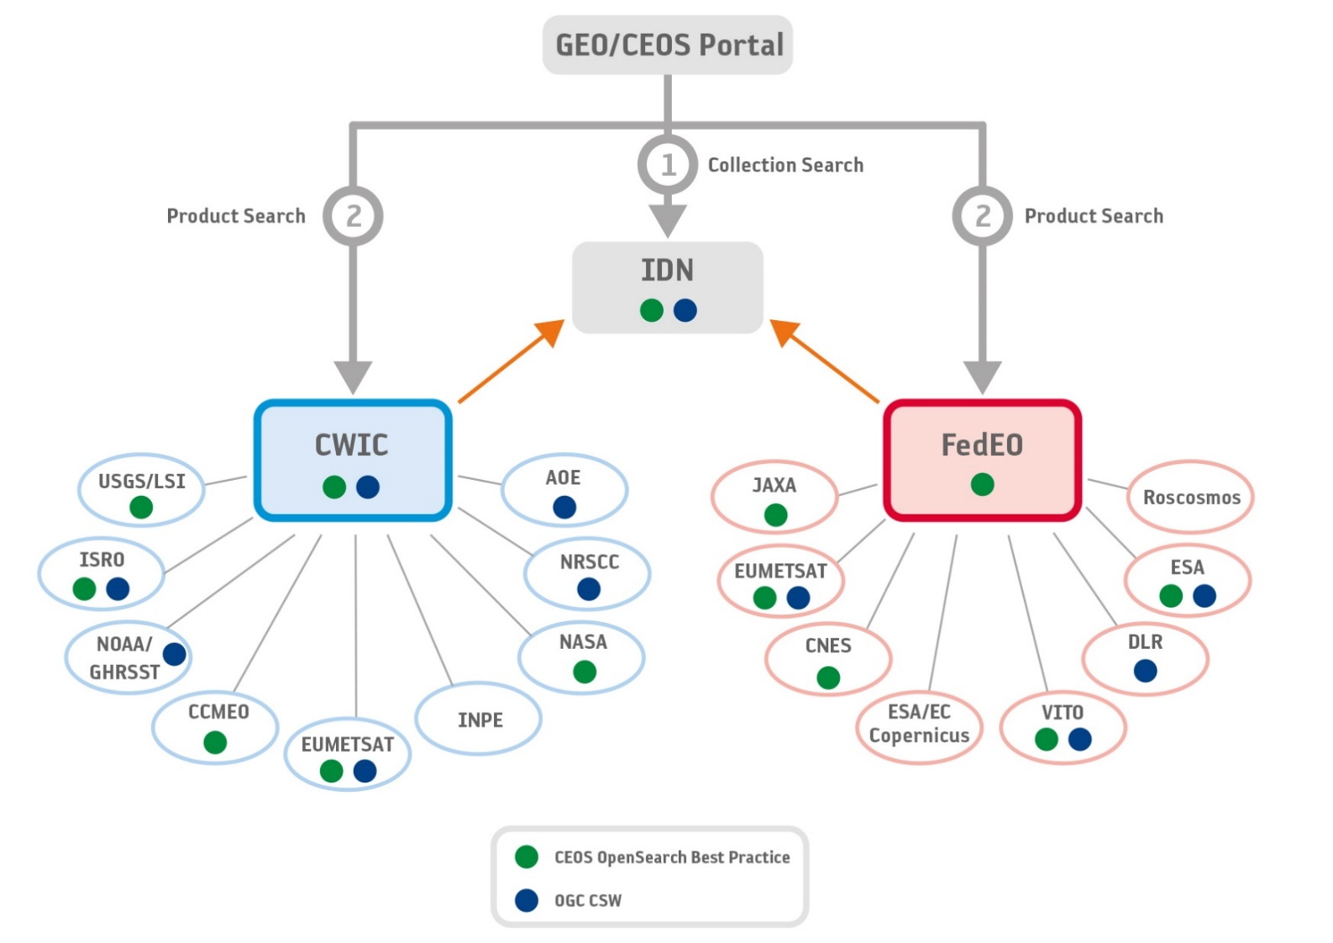
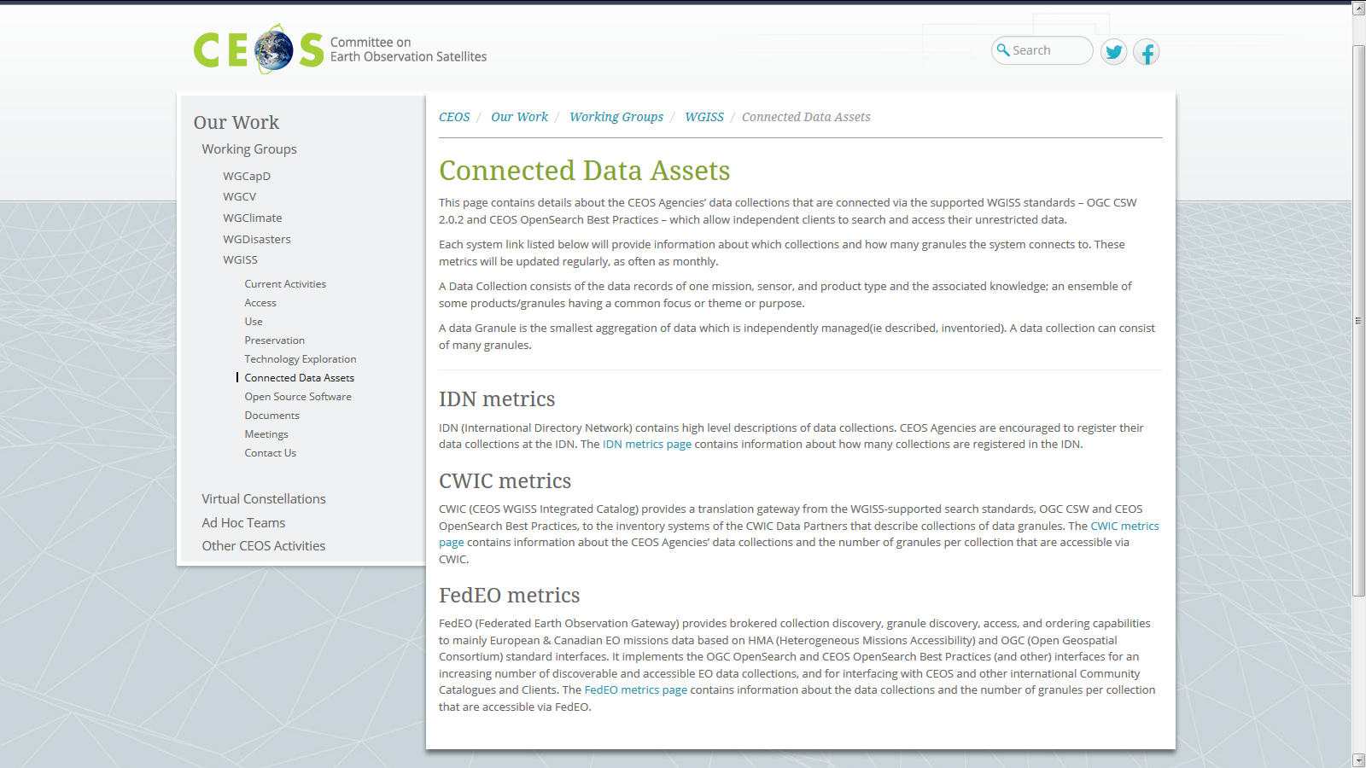
WGISS Connected Data Assets (CDA)
Relying on IDN/CWIC/FedEO components, provides a single entry point for external clients to discover and access CEOS agencies data
Search over 32,500 collections in IDN & Access over 5,000 collections with associated over 313+ million granules (granule search)
Continuously enlarged with new data and partners
CEOS Service
On-track
    DATA-2: Full representation and accessibility of CEOS Agency datasets through WGISS Standards and Connected Data Assets Infrastructure (i.e. IDN, CWIC, FEDEO). Q2 every year

Slide 8
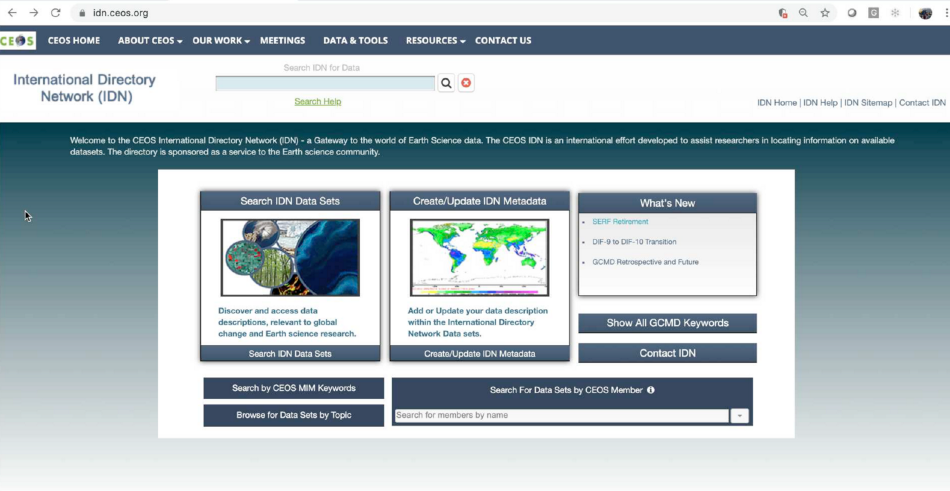
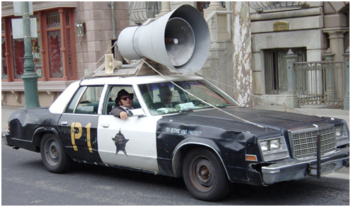
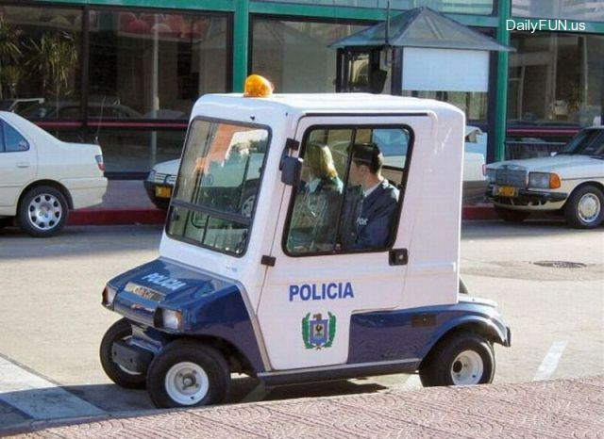
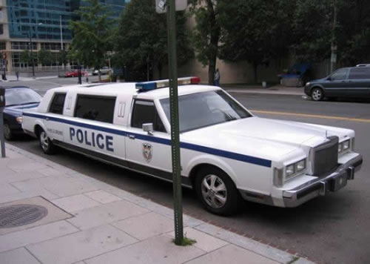
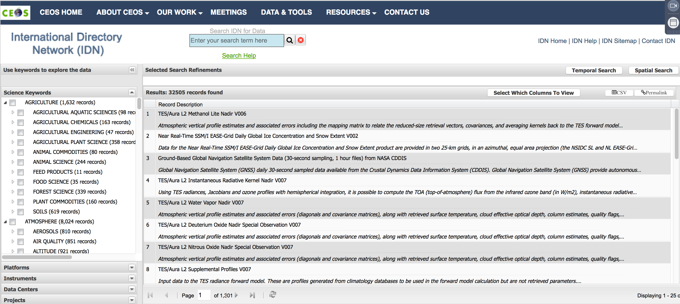
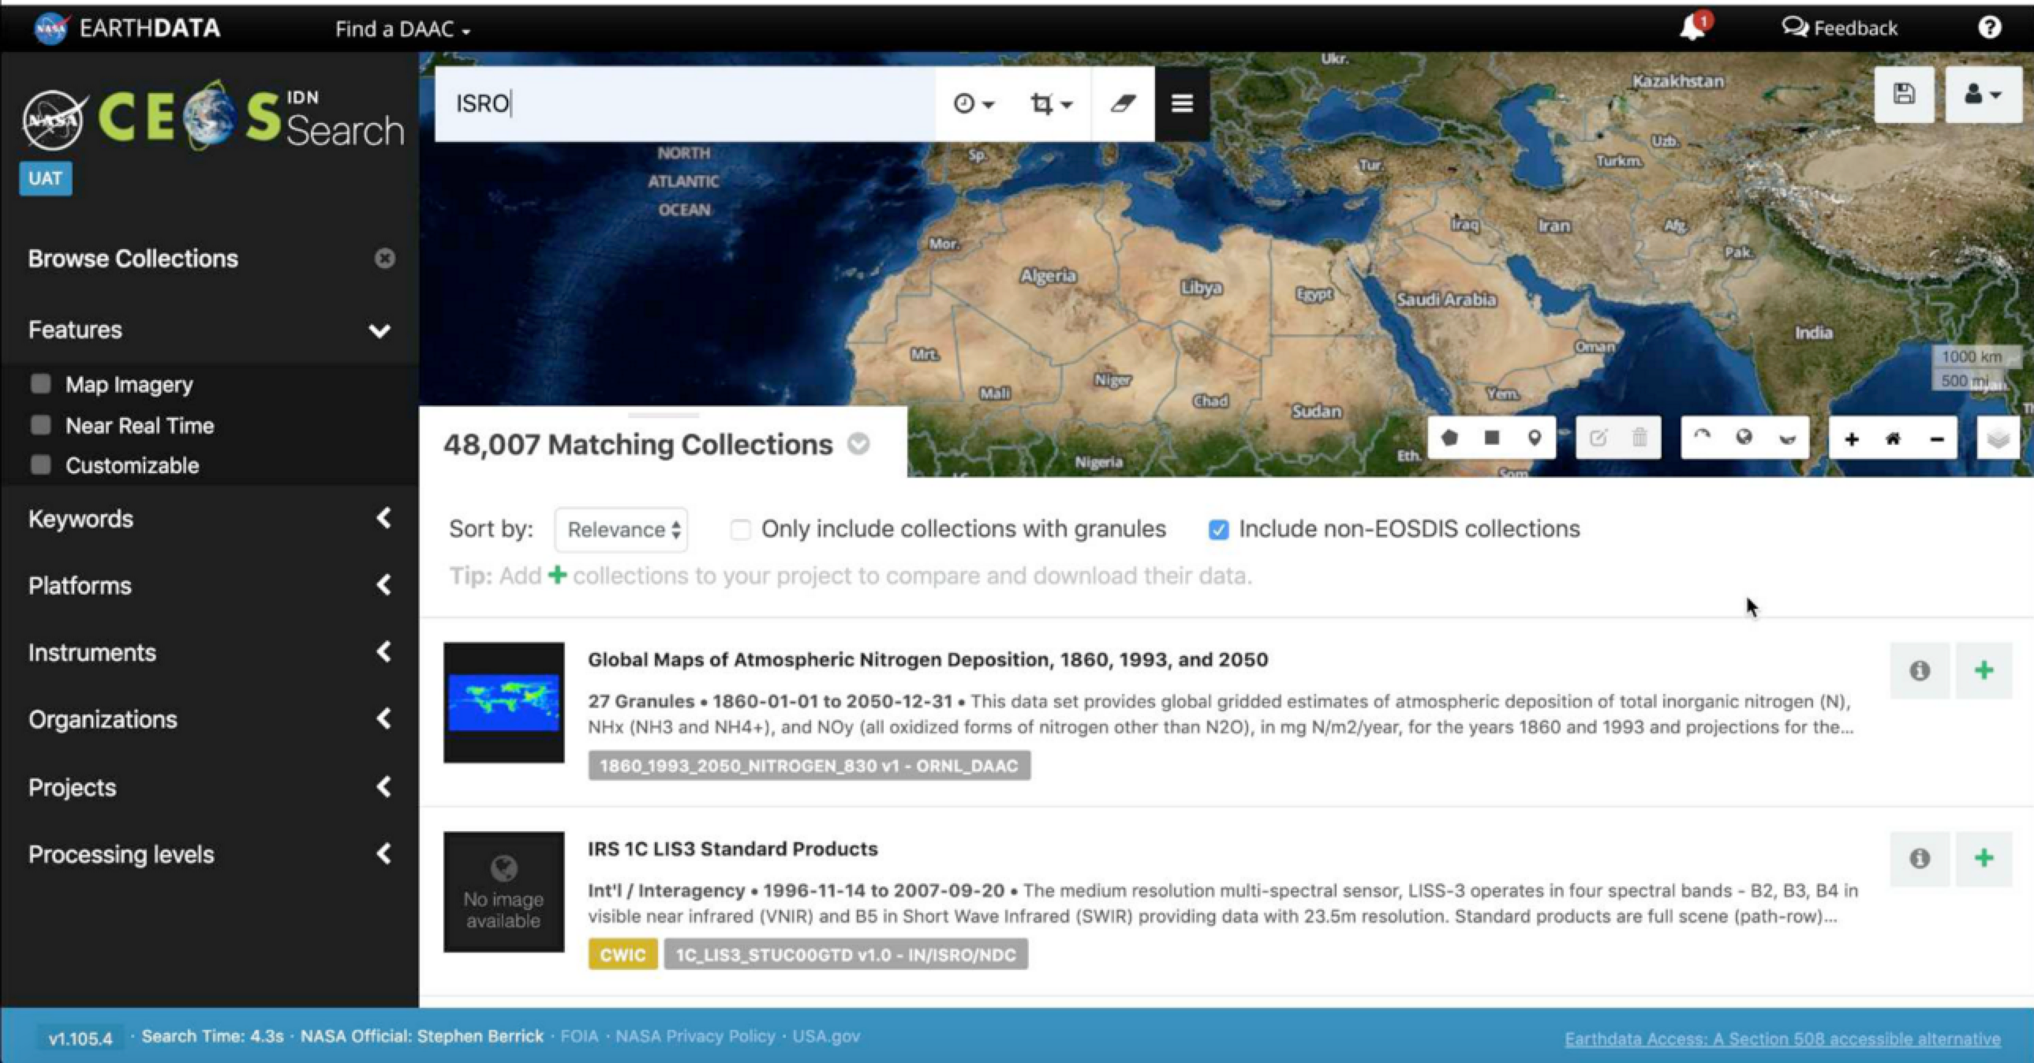

WGISS Connected Data Assets (CDA) Evolution
Map-based search in IDN re-using NASA OSS EarthDATA client
ALL WGISS CDA elements with same harmonized CEOS branding
Today WGISS CDA is like that !!
Some years ago WGISS CDA was like that !!!
We are working to make WGISS CDA like this !!

Slide 9
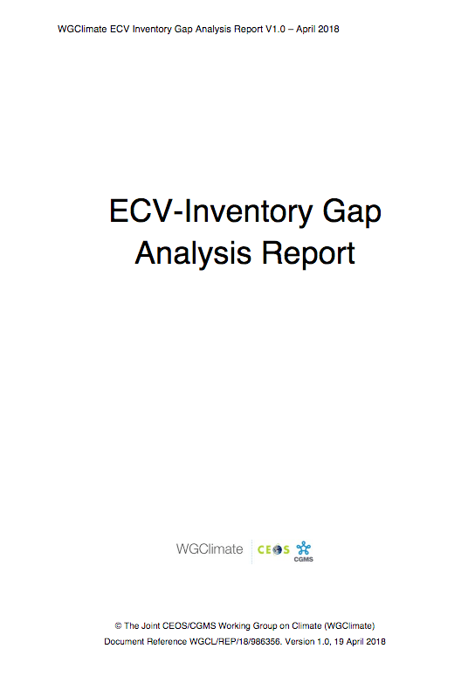
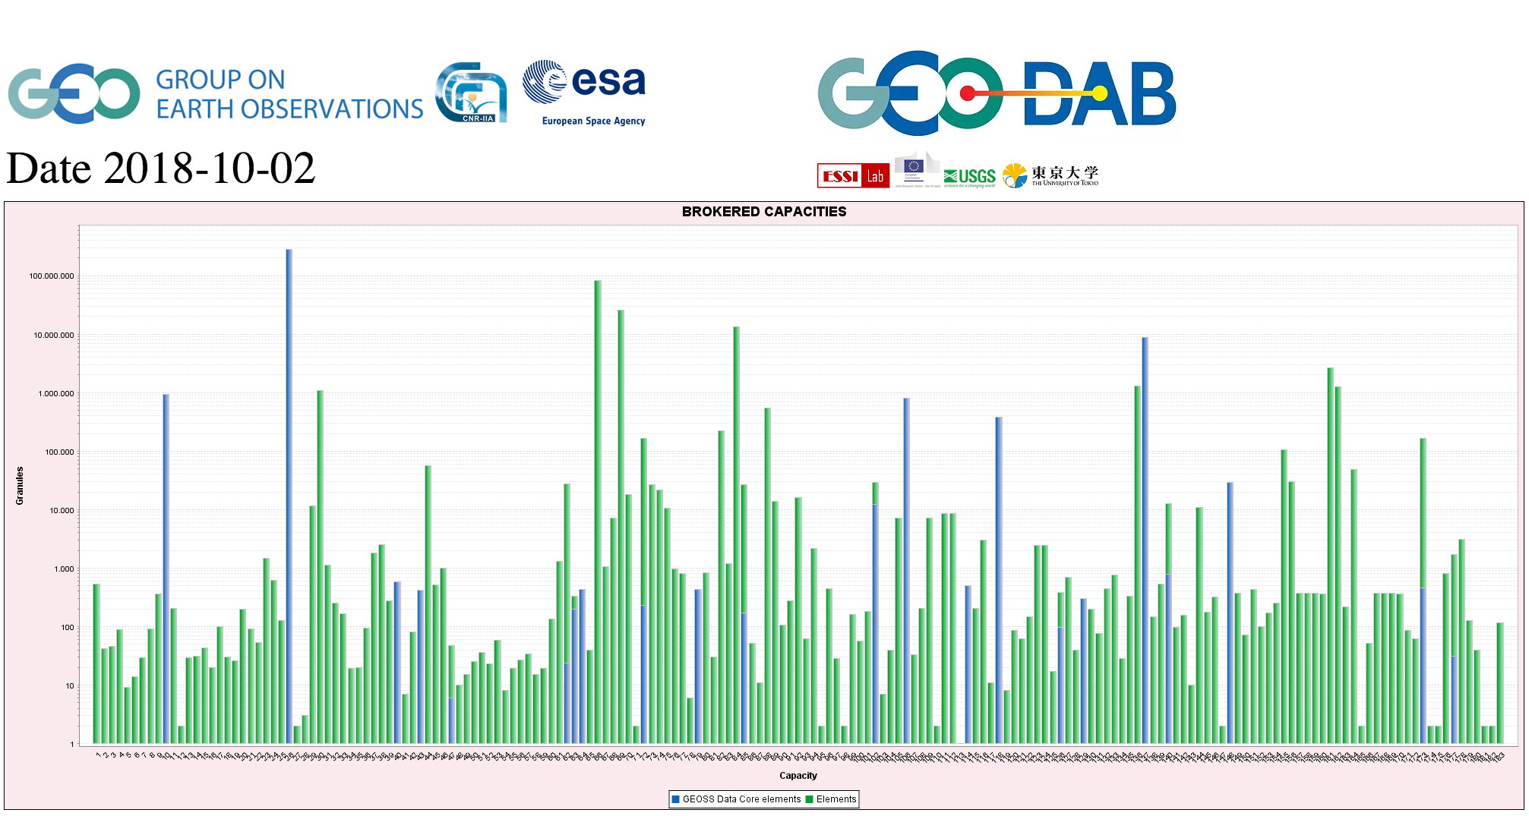
CEOS Agencies Data Discovery and
Access through WGISS CDA
GEOSS PLATFORM DISCOVERABLE DATA PRODUCTS
CWIC
FedEO
    DATA-9: ECVs/CDRs Discovery and Access through WGISS Systems. Q4 2019
DATA-16: CEOS data holdings reported and accessible in GEO and other international relevant contexts. Q4 2019
Delayed
On-track

Slide 10
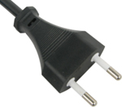

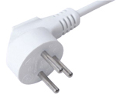
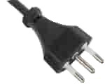

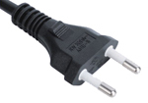
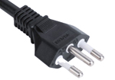
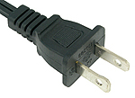
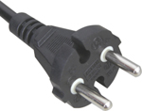
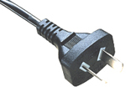
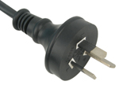
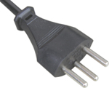
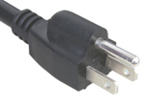
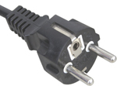

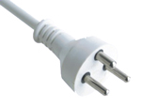
Interoperability and Use
(including Future Data Architectures)
WGISS accomplishes its interoperability and data use efforts through the Interoperability Interest Group.

Slide 11
FDA activities in WGISS
Proceeding along several lines
Making FDA services/tools/elements discoverable through WGISS CDA
Pursuing interoperability between FDA elements through a manageable number of possibly standardized interfaces
  Data Cubes interoperability (ODC / ESA-HMDC / Euro Data Cube)
  Follow-up standardization activities in OGC (e.g. OGC APIs, STAC)
Showcasing FDA Elements and how they can support CEOS/GEO Initiatives:
  Data Cubes for WGCV (ESA-HMDC and ODC DEA)
  GEOhazards Thematic Exploitation Platform (TEP) in support to WGDisasters
  WGISS Carbon Portal in support to CEOS Carbon Team / WGClimate
  Showcased at WGISS-47/48 → Convergence in the agency approaches
Outreach and awareness raising on FDA in cooperation with WGCapD

Slide 12
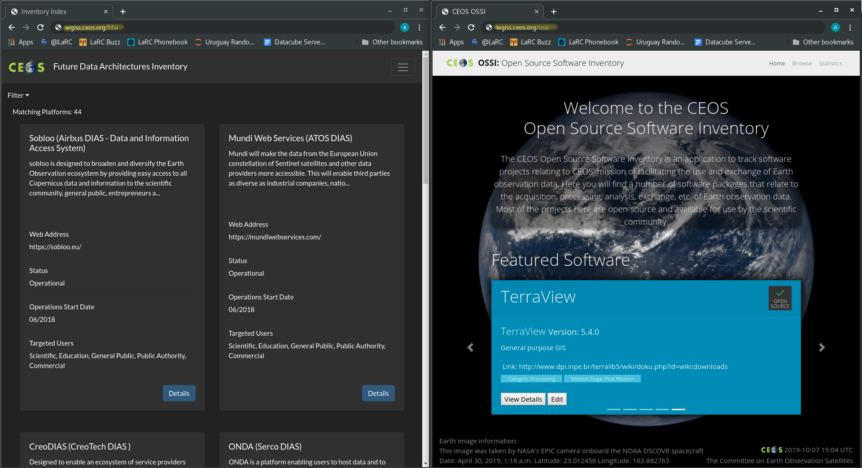
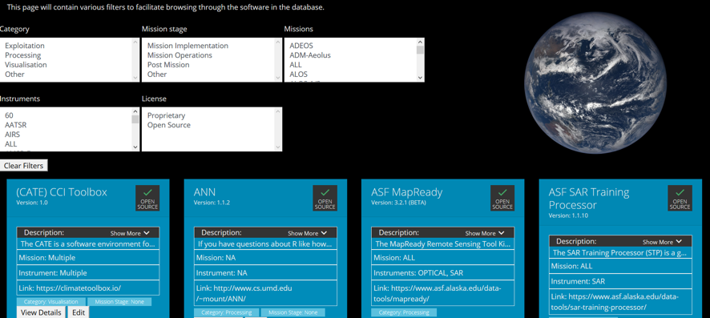
Open Source SW and FDA Elements Inventories
Should be made accessible through CEOS Web site at http://ceos.org/data-tools/
Delayed
  FDA-9: Inventory and characterize existing FDAs operated by both public and private entities. Q4 2019
  FDA-10: Finalize inventory of CEOS agencies (Open Source) Software and Tools and implement a mechanism for discovery and access. Q3 2019
  FDA-14: Facilitate discovery and access for end users to data analytics and processing tools and services through WGISS Connected Data Assets Infrastructure. Q4 2020
Delivered
On-track

Slide 13
Future Data Architectures (FDA) Interoperability
Agencies approaches on FDA are converging, major functions have been identified.
A family of best practices for each major function will be produced in 2020.
  FDA-8: Establish a common description of Future Data Architectures functional blocks and identify interfaces and interoperability approaches. Q3 2019
Delayed

Slide 14
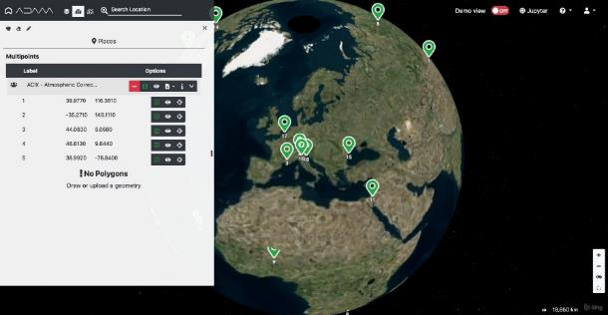
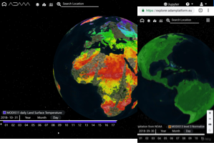
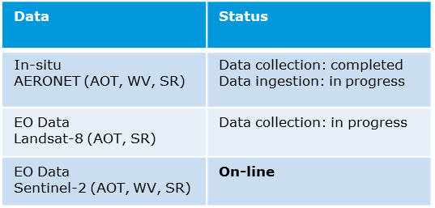

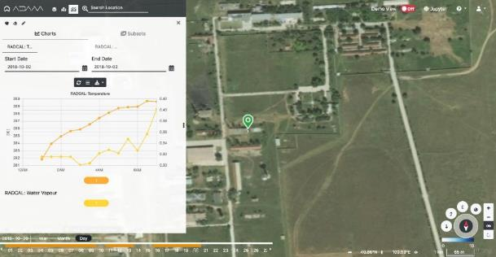
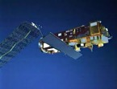
FDA Elements Showcasing –
Data Cubes for WGCV
ESA HM Data Cube - https://preops.eodatacube.eu/
Use cases defined and implemented in cooperation between WGISS and WGCV.
Provides Discovery/Visualization/Pixel Access to Radiometric Calibration Network (RadCalNet) In-Situ data and Atmospheric Correction Inter-Comparison Exercise (ACIX) (In-situ and S-2/L-8) data.
Provides Jupyter notebooks to reproduce ACIX use cases: http://calvalportal.ceos.org/results
Web based GUI
Jupyter Notebook
Pre-configured list of sites
Data Discovery
DAS
OGC WCS Server
Direct access to the selected site
In-situ Data Visualization and pixel access;
Landsat-8/Sentinel-2
Data
In-Situ: ACIX and
RadCalNet
Notes:
Atmospheric Correction Inter-Comparison Exercise (ACIX)
ACIX II-land: 115 sites selected, one-year measurements with 7000 images acquired by Sentinel-2A, -2B and Landsat-8;
ACIX-Aqua exercise: Phase I, compare processors over coastal waters and Phase II, processors over inland waters
Radiometric Calibration Network (RadCalNet) Support post-launch TOA radiometric calibration and validation of optical EO data

Slide 15
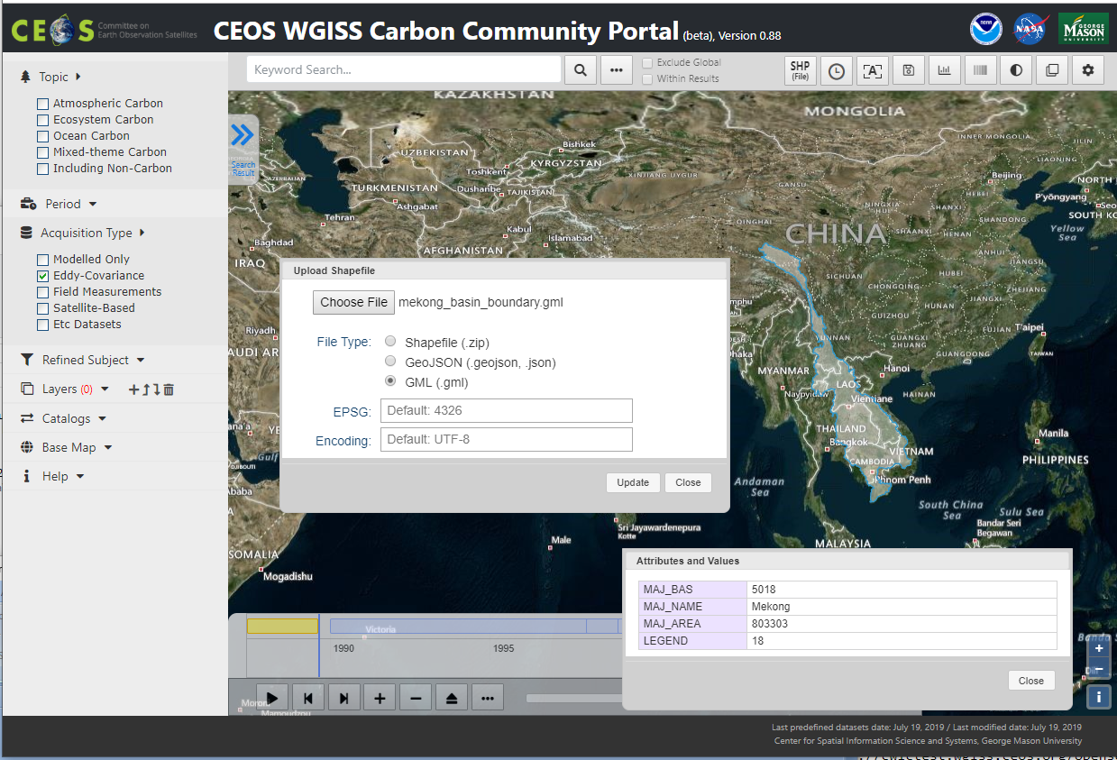
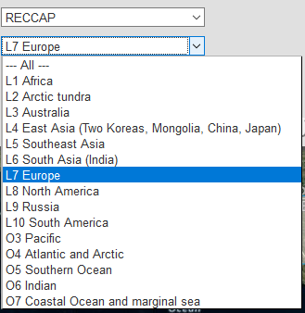
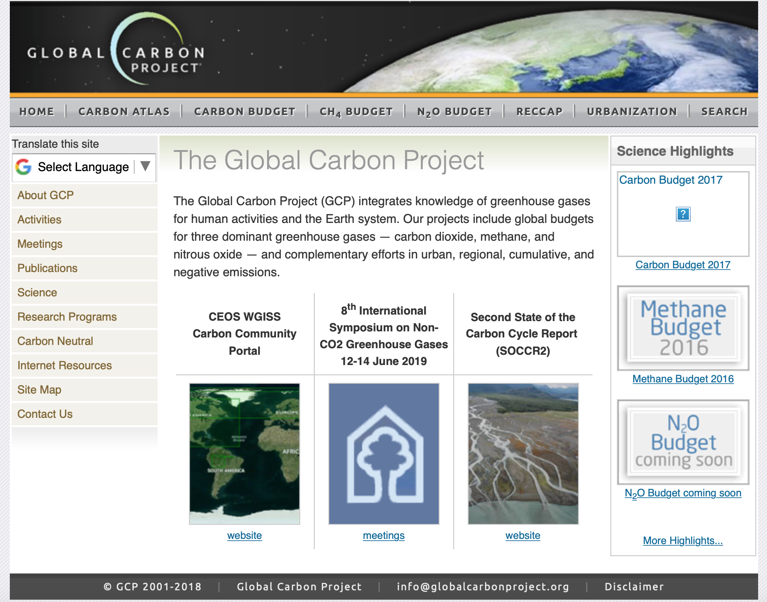
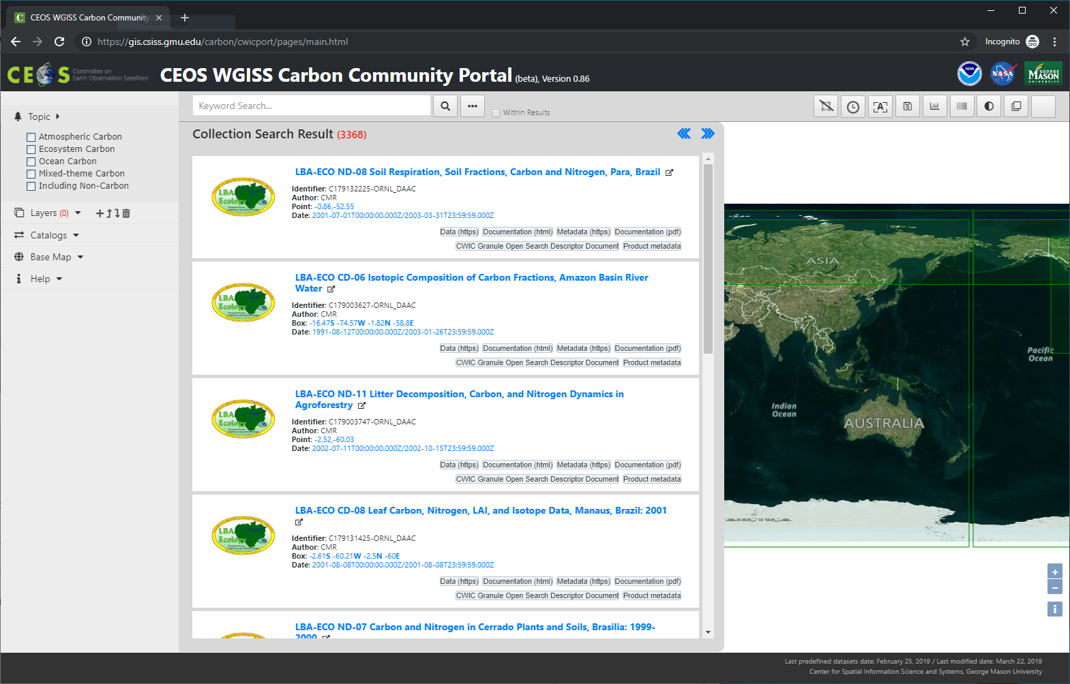
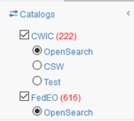

FDA Elements Showcasing –
WGISS Carbon Portal
Led by NOAA and GMU
Search: Special Regions, Temporal, Pre-defined Carbon topics/datasets, Keywords
Returns records from WGISS CDA
Working with communities:
Carbon Team / WGClimate
Global Carbon Project
VNSC Chair Team
https://cloud.csiss.gmu.edu/carbon/cwicport/
Delivered
  CARB-15: Carbon Data Portal prototype. Q2 2019
Notes:
The goal of the CEOS WGISS Carbon Science Community Portal (called the Carbon Portal, or simply the Portal hereafter) is to support Carbon Science Mission in CEOS and other communities/organizations and demonstrate the usage of CEOS WGISS Connected Assets by providing easy discovery of and access to carbon-related data resources in CEOS member agencies.
Search in Special Regions: Global, RECCAP, TransCom, Country Names, ECV Inventory)
Temporal Searches: support for time range and specific date
Pre-defined Carbon topics/datasets: (Atmospheric, Ecosystem, Ocean, Mixed-Theme)
Keywords (auto-completion with IDN Science Keywords)
Return records from both CWIC and FedEO

Slide 16



Technology Exploration
The Technology Exploration interest group serves as a forum for exchange of technical information and lessons-learned experience about current and trending technologies, services and other WWW / Internet related software technologies.

Slide 17


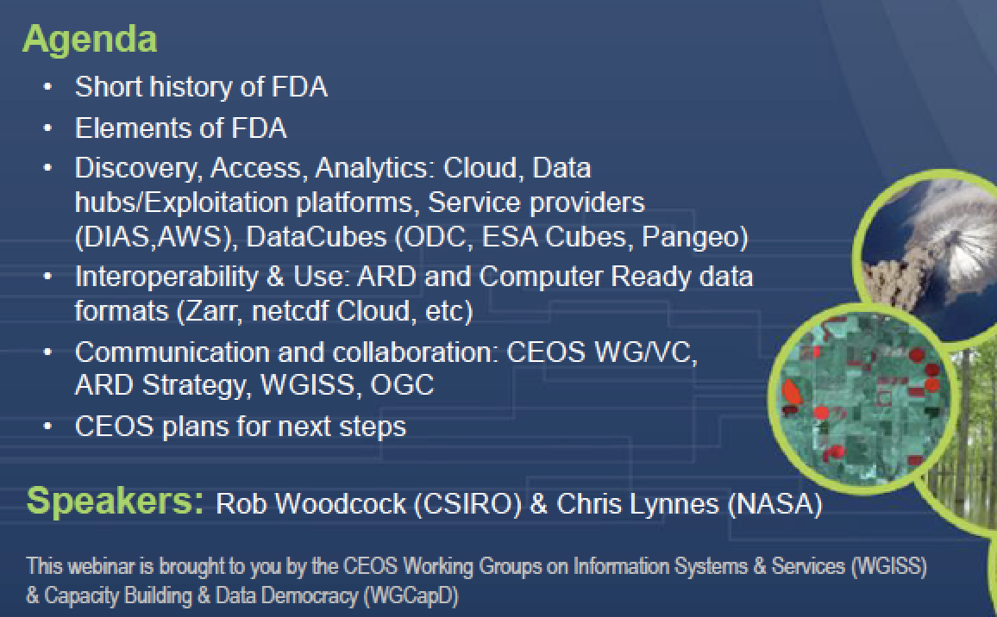
Technology Webinars
Joint webinars and advertising with:
  WGCapD
  GEO (e.g NextGEOSS, GEOSS Evolve)
  Federation of Earth Science Information Partners (ESIP)
http://ceos.org/ourwork/workinggroups/wgiss/technology-exploration/
  DATA-11: Data and Technology Exploration webinars and workshops. Q4 2019
FDA-5: Promote awareness of FDAs (with SEO and WGCapD). Q3 2019
On-track
Delivered

Slide 18
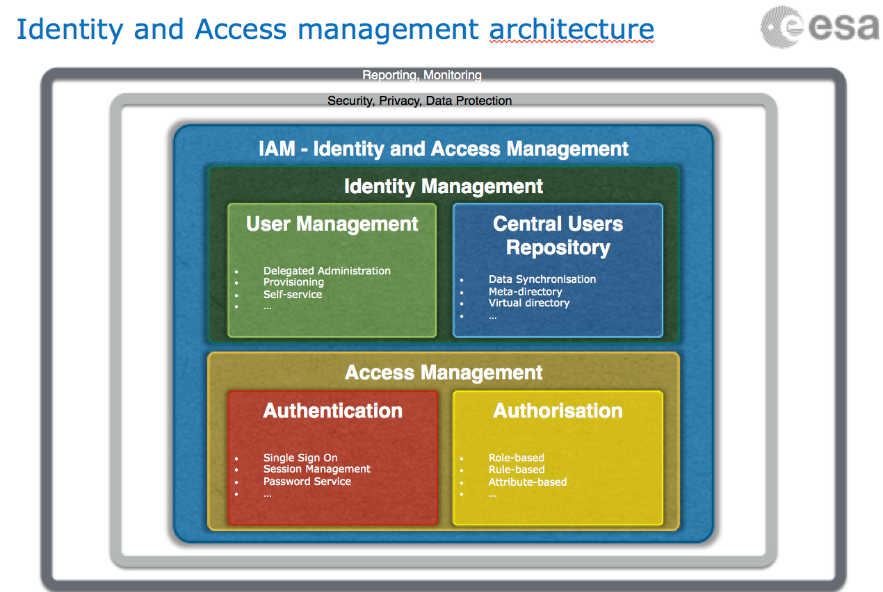

Technology Exploration
Single Sign-On white paper being finalized with comments received from WGISS members.
Ad-hoc sessions on Artificial Intelligence and Machine Learning held at WGISS-46 / 47 / 48.
Delayed
  DATA-15: Explore emerging trends and disrupting technologies for adoption in EO. Summarize as white papers. Q4 2020
  DATA-13: Develop a White Paper on Single Sign-On (SSO) authentication. Q2 2019
On-track

Slide 19


Cooperation and Way Forward

Slide 20

Cooperation
WGClimate
CEOS Carbon Team
WGCV
WGISS
SDG AHT
SEO
Virtual
Constellations
WG
Disasters
Notes:
CEOS Carbon Team/WGClimate - Carbon Portal development and possible use for next phase of carbon strategy, ECV/CDRs registration in IDN, ECV inventory update automation.
WGDisasters - possible cooperation on generic recovery observatory.
WGCV - Data cube prototypes (ESA and GA/CSIRO) supporting CAL/VAL activities through providing access to ACIX (16 sites), RadCalNet (4 sites) and LPV (3 sites) cal/val data; CEOS Data Maturity matrix.
Virtual Constellations - inventory of VC data to be updated to review discoverability/accessibility through WGISS CDA infrastructure. Maturity Matrix and self assessment.
WGCapD - joint organization of technology webinars and FDA events.
SEO - COVE tool harvesting WGISS metadata, data cubes coordination, implementation of web pages for tools/SW discovery.
SDG AHT - discovery of SDG indicators relevant data via WGISS CDA.
GEO: GEOSS Platform accessing CEOS data via WGISS CDA; WGISS contribution to GEOSS-EVOLVE initiative, GEO Expert Advisory Group (EAG) and GEO Technology Workshops; GEO Sec reporting during WGISS meetings; Joint Workshops on GEOSS-WGISS interoperability and FDA at WGISIS-43/46, GEO Knowledge Hub side event at SIT-34. Identified two foundation tasks in next GEO Work Programme for WGISS contribution, awaiting WP approval and formal procedure for representatives nomination in task teams and working groups. DMP, WGISS CDA, IF Development/Evolution

Slide 21

Endorsement
Vice Chair Nomination
Working Group Vice Chair Nomination
Current Chair term terminates with CEOS plenary 33
Candidate: Dr. Makoto Natsuisaka - Japan Aerospace
Exploration Agency (JAXA)
Dr. Makoto Natsuisaka is an associate senior engineer at the Satellite Applications and Operations Center (SAOC) of JAXA. His interest is to facilitate interoperability between CEOS resources through information technologies to facilitate understand of our planet Earth and contribute to the resolution of ecological and social challenges.
CEOS WGISS recommends the nomination of Dr. Makoto Natsuisaka
Request for endorsement of Dr. Makoto Natsuisaka as incoming Vice-Chair 2019

Slide 22


WGISS Chair Handover
New WGISS Chair
Dr. Robert Woodcock - Commonwealth Scientific and Industrial Research Organisation (CSIRO)

Slide 23
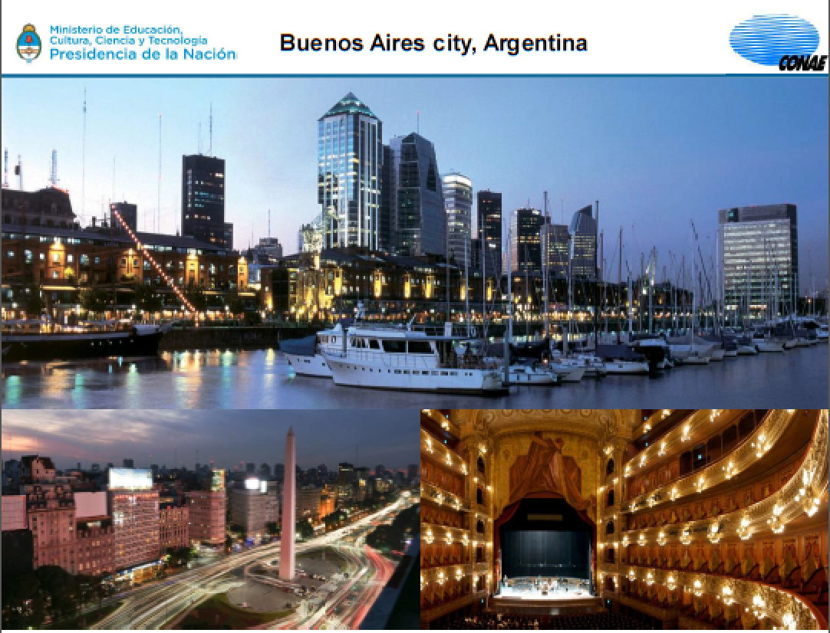
WGISS-49, 20-24 April 2020,
Buenos Aires (Argentina)

Slide 24


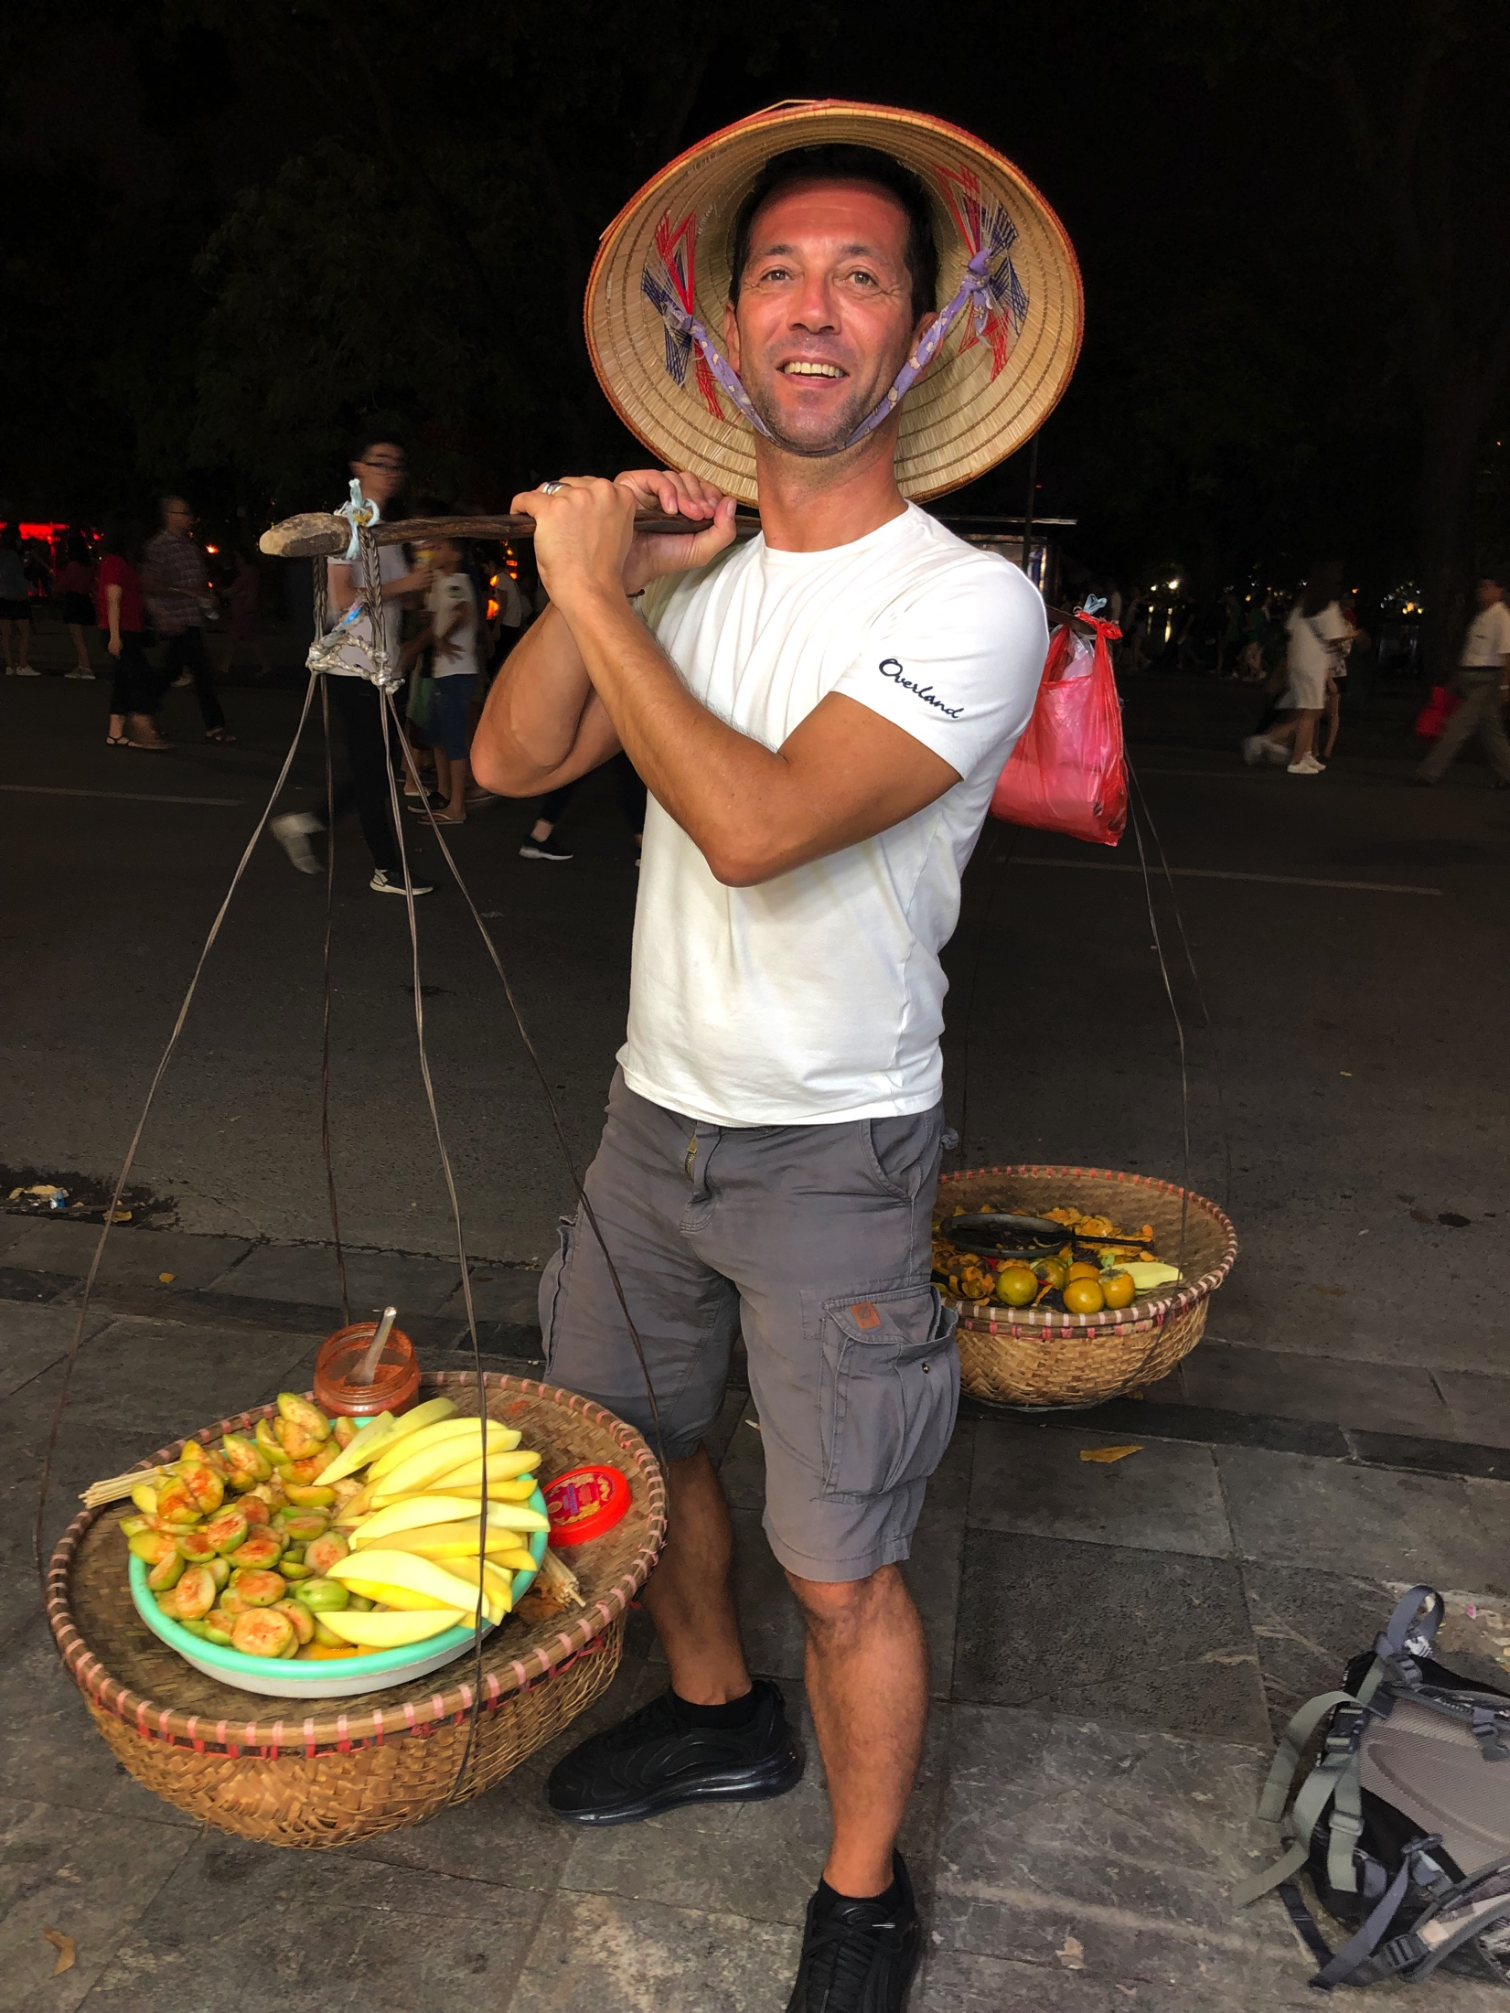
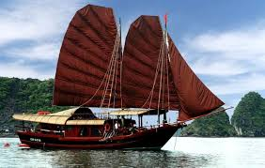
Thank You
cảm ơn bạn
(thank you)
WGISS

