Slide 1
KMA Space program: Current Status and Application Plan
Committee on Earth Observation Satellites
Korea Meteorological Administration
CEOS Plenary 2019
Agenda Item 3.7
Ha Noi, Viet Nam
14 – 16 October 2019

Slide 2
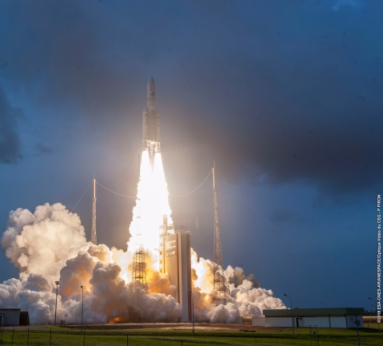
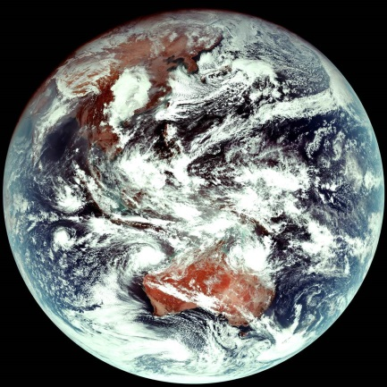
Successful GK2A Launch
GK2A Launch
December 4, 2018 20:37UTC
Notes:
We have launched GK2A successfully at December 4, 2018. After one month, we got first image from GK2A AMI. As you know, AMI have 16 channels and we can also have true color image from the RGB composite. There are outflow of cold-dry continental high pressure over warmer sea surface around Korean peninsula. After launch, there was in-orbit test for seven months. Then we started operation officially from twenty-fifth July 2019.

Slide 3
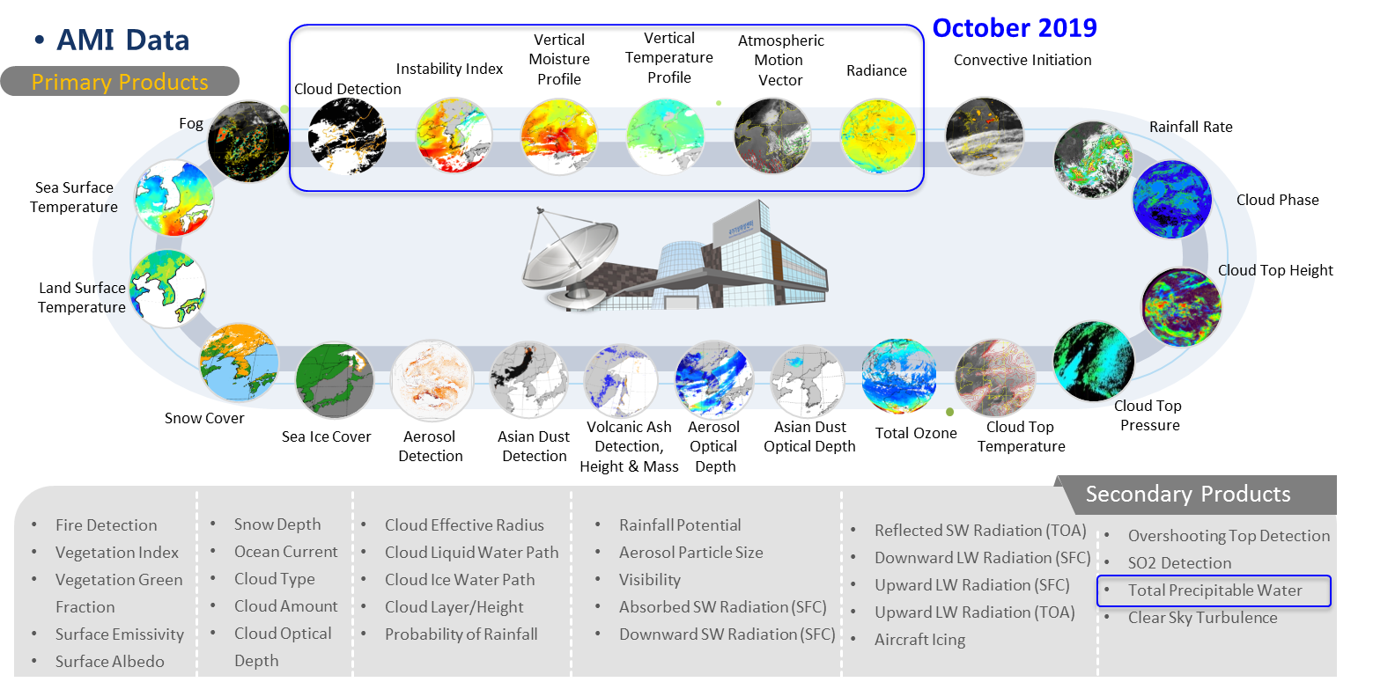
GK2A Geophysical Products
Notes:
We have 52 types of AMI level 2 products including sea surface temperature, fire detection and Asian dust.
The level 2 products are now in the testing phase. We plan on official release in four stages from the end of this month for the 7 products, to June 2020.

Slide 4
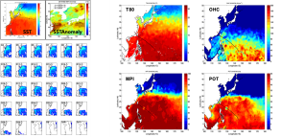
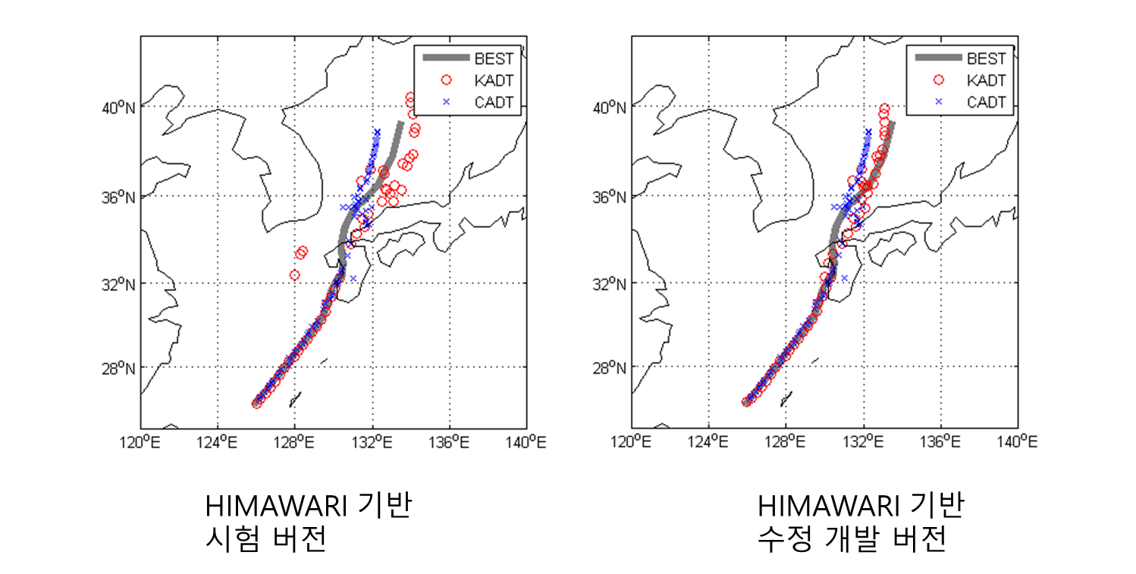
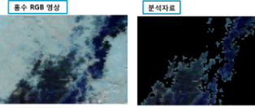
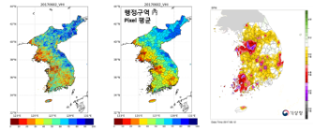
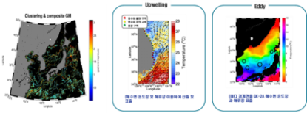
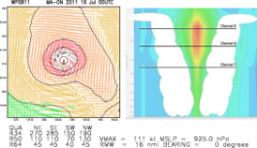
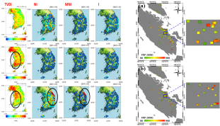
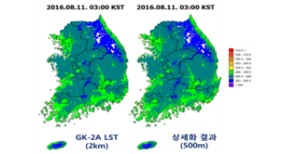
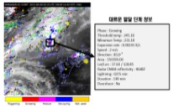
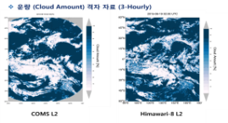
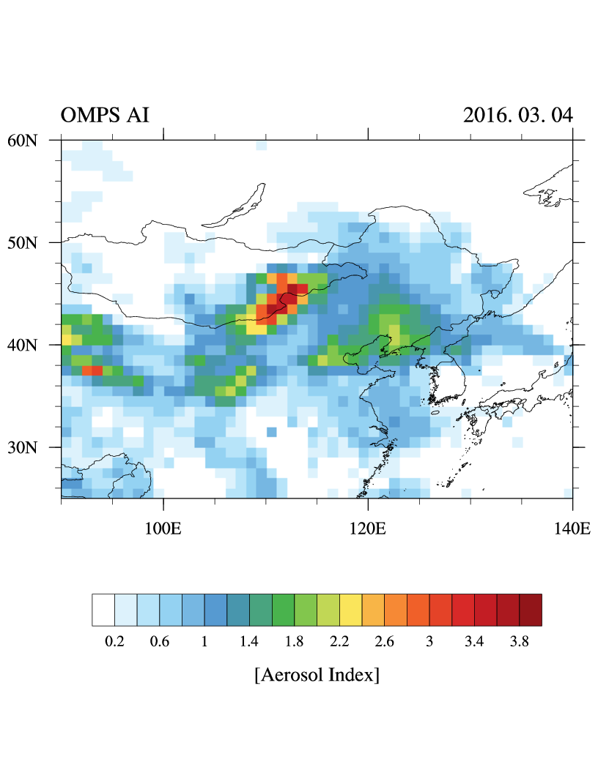
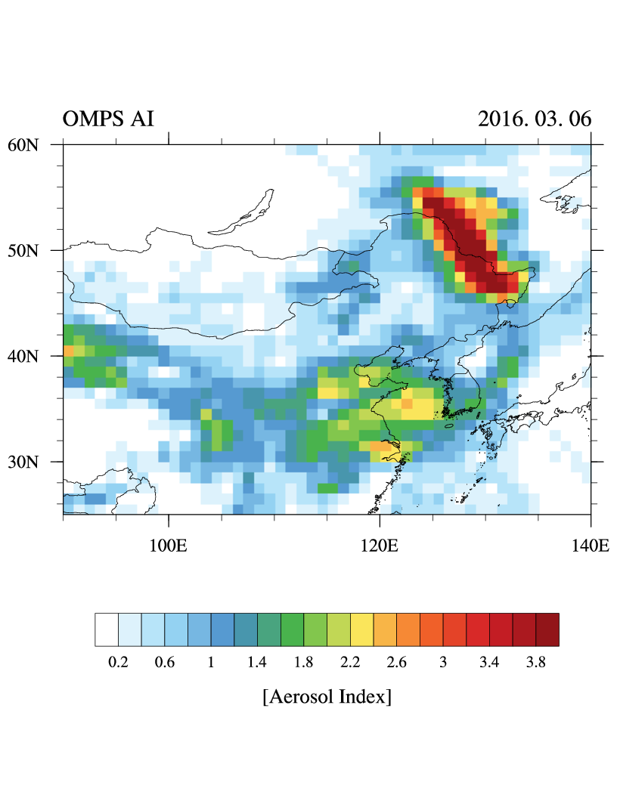
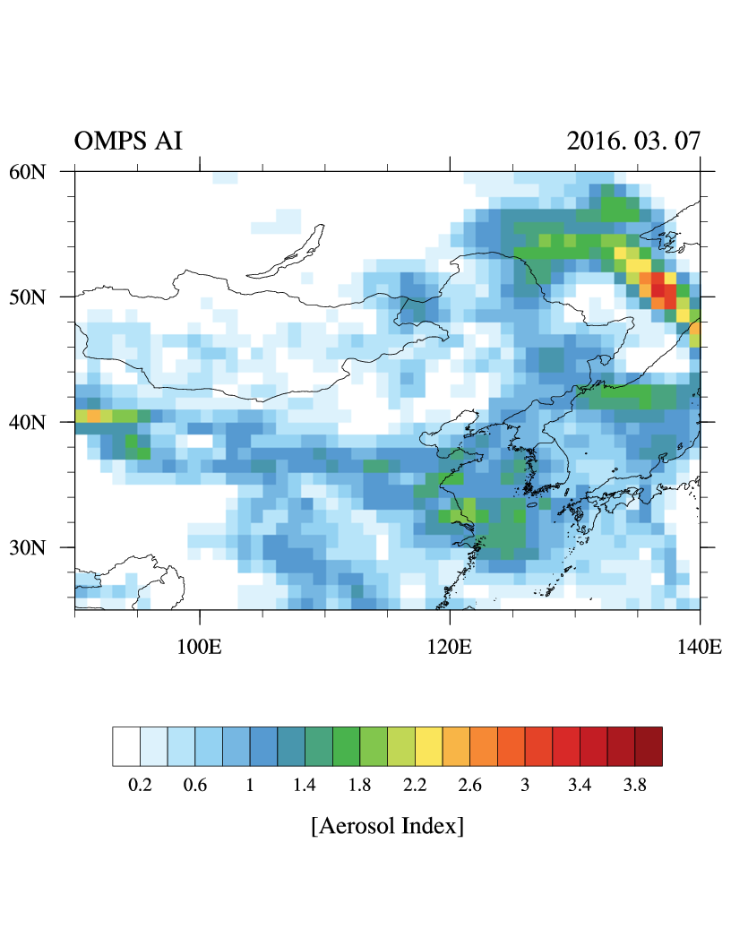
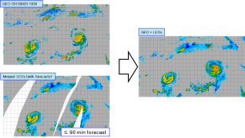
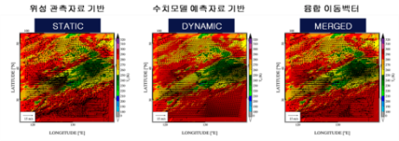
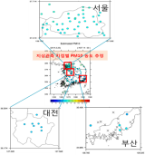
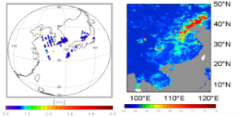
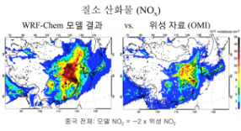
Advanced Application using GK2A Products
Ambitious applications of the AMI observations and products in various areas.
User friendly, value added information are provided by the additional use of all available data including LEO products, ground observations and NWP together with GK-2A/B.
Typhoon/Ocean
Surface/Hydrology
Estimating the intensity change of tropical cyclone
Objective analysis of tropical cyclone
Soil moisture & flood
Drought
Ocean environment monitoring and analysis
Sea surface wind and 3-D horizontal winds
Forest Fire
Blending, Downscaling, Validation Strategy
Nowcasting
Climate/Environment
smoke
Objective cloud analysis
Convective cloud life cycle monitoring and analysis
Climate study
Greenhouse gas monitoring
Multi-platform precipitation merging and analysis
Satellite image prediction
Aerosol peak height / surface concentration
Air Quality modeling support
Notes:
We are developing “GK-2A data application technology” for nowcasting, Typhoon and ocean analysis, hydrology and land surface analysis, and climate and environmental applications. The rest of areas except for Typhoon and Nowcasting represent the non-Meteorological applications.
Those products also use all available data including LEO products, ground observations, NWP forecast as well as GK-2A and 2B observation data.
we will provide more user-friendly satellite data support and maximize the usability of GK-2A observations and products. These results will be implemented on the “Meteorological Data Analysis system” with the analysis guidance for various satellite data users.

Slide 5
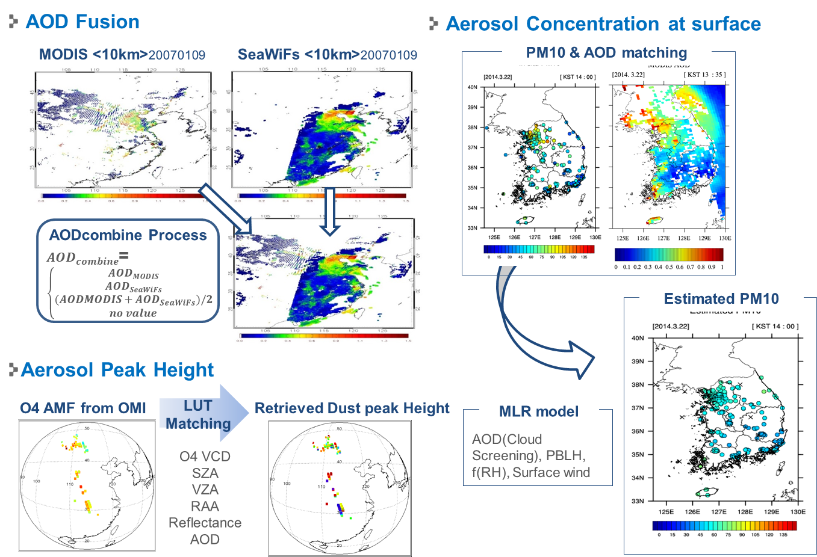
Application area: Dust Height & Dust at Surface
Notes:
Most important products for human life among non-meteorological data seem to be aerosol products. Since COMS, NMSC provides aerosol detection and aerosol optical depth to support weather forecast and to satisfy the people’s demand. After GK-2A launch, NMSC expands aerosol products, AOD Fusion, Dust peak height, Surface Dust Concentration.
AOD fusion will be made using BME (Bayesian Maximum Entropy) method and AMI, GOCI, Himawari-8, MODIS AOD data. Aerosol height which is based on O4 air mass factor from GK-2B will be estimated by statistical regression equation model using aerosol optical depth, surface observation, other meteorological element.
Right images show aerosol concentration at surface, which is calculated using empirical statistics considering AOD-PM10 relationships.

Slide 6
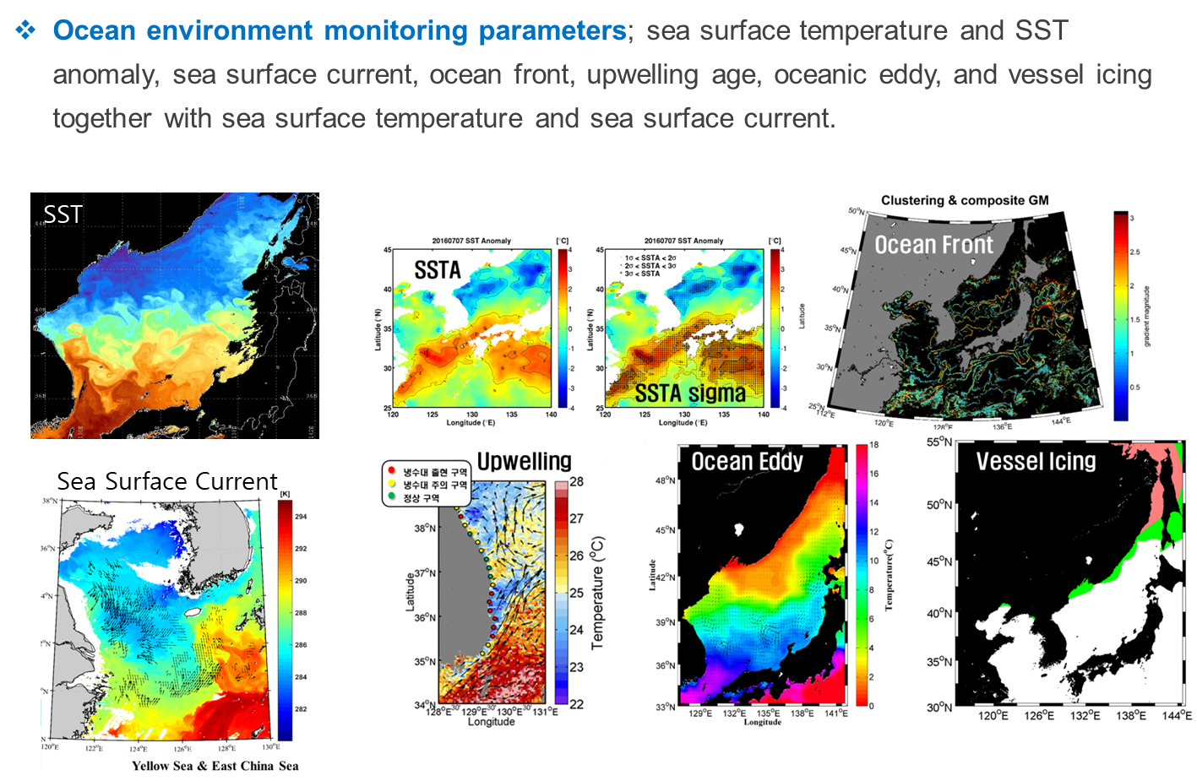
Application area: Ocean
Notes:
We are developing ocean environment monitoring parameters. Especially, sea surface temperature from GK-2A plays an important role of monitoring of ocean environment change. We will produce new parameters such as ocean front, upwelling age, ocean eddy, vessel icing using by SST and Sea surface current from GK-2A including LEO satellite products. These results are provided not only fishery related information, but also micro-weather prediction using multiple satellite observation.

Slide 7
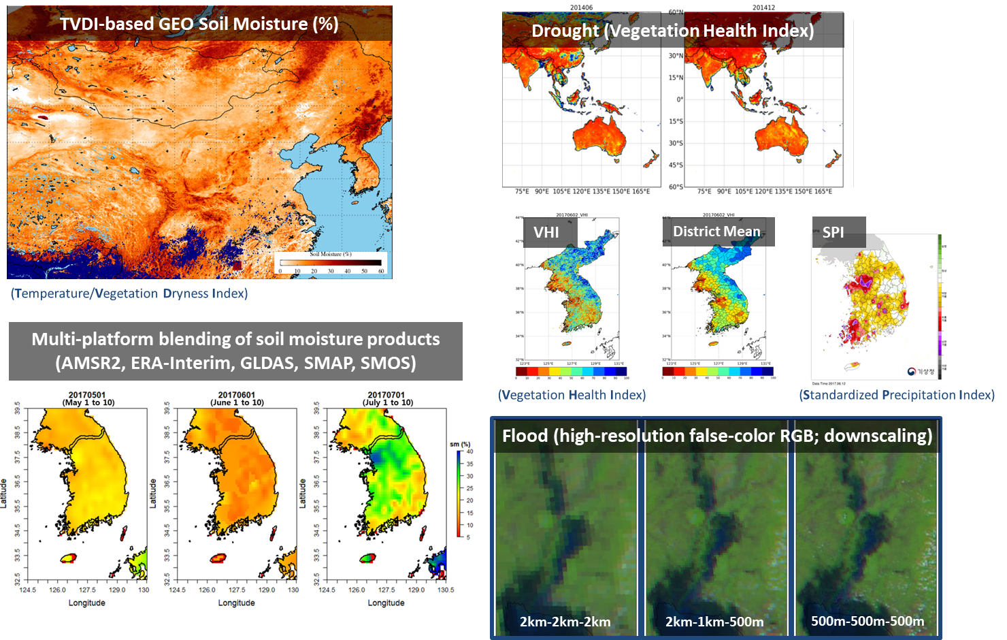
Application area: Surface Property & Hydrology
Notes:
Using GK-2A and other available LEO satellite data, KMA will provide some surface hydrology information. These are soil moisture, drought and flood monitoring products.
Satellite soil moisture maps can contribute to managing food production and agriculture, understanding of hydrological or water cycle, thermodynamic energy balance, climate change and other various area.
More frequent soil moisture trend monitoring is available from TVDI-based geostationary soil moisture product.
Multi platform blended soil moisture can provide more quantitative analysis. To do this, KMA uses products from microwave sensors, such as AMSR2, SMAP, SMOS, and model based data from ERA-interim and GLDAS.
Moreover, vegetation health index (VHI) based drought monitoring product and 500m resolution flood RGB image will be provided from GK-2A measurement, as well.
TVDI : temperature/vegetation dryness index
VHI : vegetation health index
SPI : Standardized Precipitation Index
GLDAS : Global Land Data Assimilation System

Slide 8
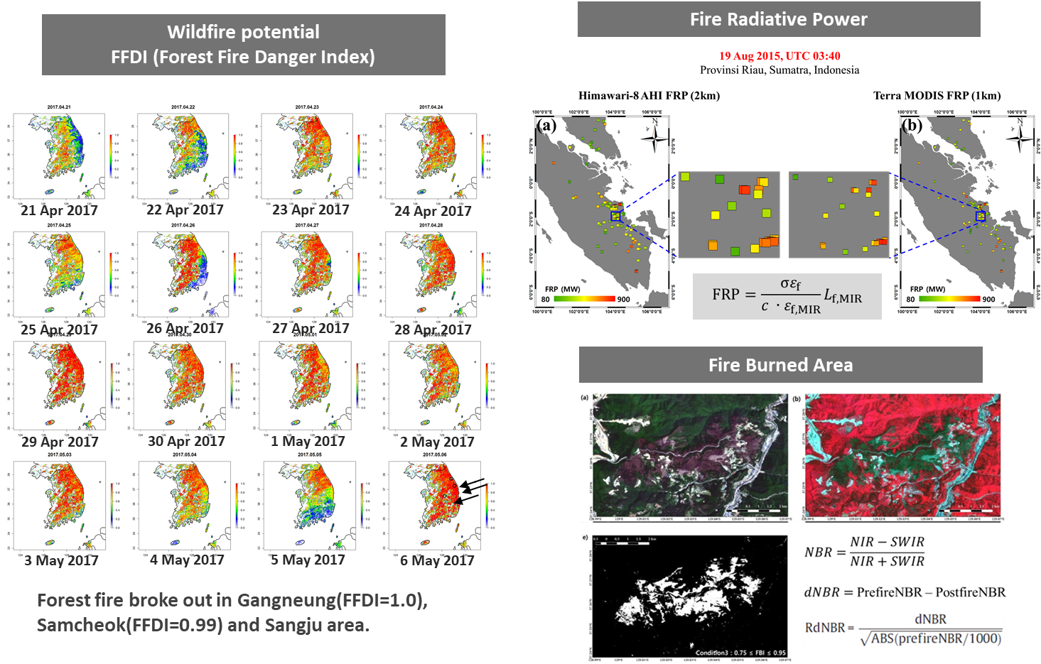
Application area: Forest Fire Monitoring
Notes:
We have been developed wildfire monitoring products.
Using the Forest Fire Danger Index (FFDI), KMA will monitor the condition of wildfire potential.
Left figures show the distribution of wildfire potential in April and May, 2017. It was very dry and the FFDI showed higher, and the forest fire broke out in Gangneung, Samcheok and Sangju area as shown by three arrows in right bottom figure (6 May 2017)
When fire is burning, fire radiative power is estimated to analyze the fire intensity and its risk. After putting out the wildfire, fire burned area is estimated to understand the damage and to restore.
Because the wildfire in the Korean Peninsula is a relatively small scale. Thus, we will also use the high resolution Sentinel data.

Slide 9
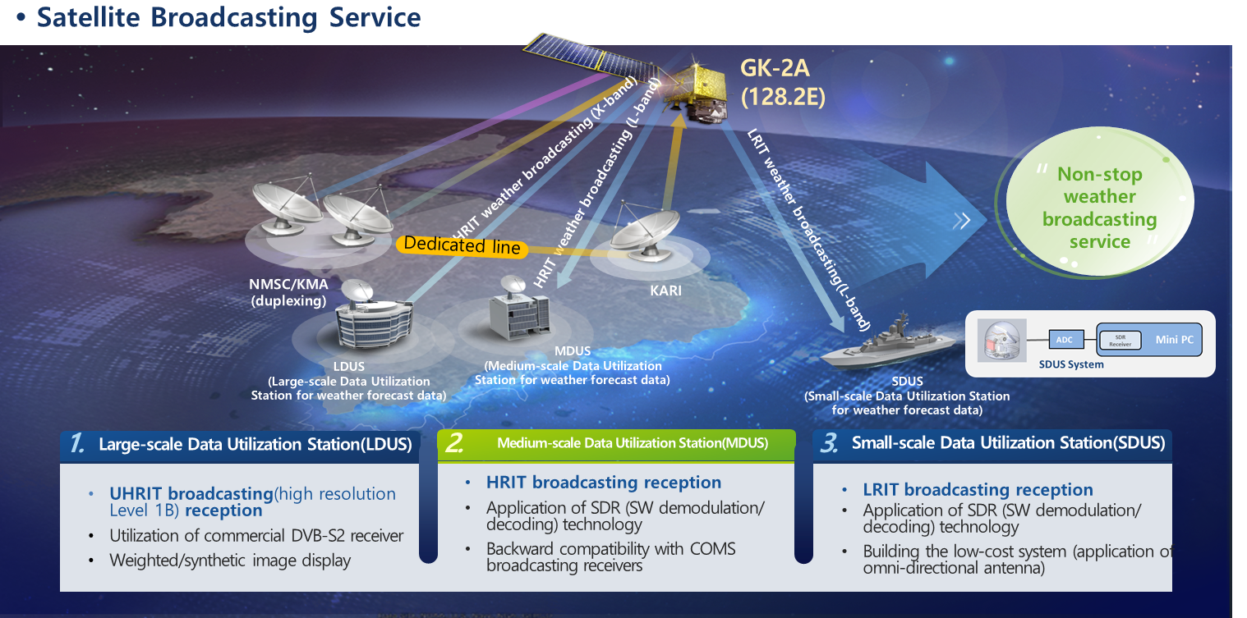
Data Service
Notes:
For the satellite broadcasting service, we provide three types of format. As same as COMS, a distribution key is given to registered users.
LDUS users can receive UHRIT data including full resolution all 16 bands of AMI data. For the MDUS users, KMA broadcasts HRIT data in L-band for five channels. And COMS MDUS users can receive GK2A data after software patching using same systems, the patch software is uploaded to the NMSC website. For marine weather support, SDUS was redesigned for using on a ship mounting with 2 axis tracking antenna.

Slide 10
Status of KMA LEO Program
Current status of KMA LEO program in 2019
KMA LEO program based on CAS500 was not approved by the decision of special feasibility test in 2018
Not the program terminated but postponed to 2-3 years
Feasibility study in 2020
To investigate the user requirements and application since the program postponed to late 2020’s
To investigate the development roadmap followed by updating proposed payloads
Development of GNSS-RO receiver (2nd payload)
To develop GNSS-RO receiver (< 15kg) for NWP application as second payload
To collaborate with related ministries for final decision in late 2019
Notes:
KMA LEO program based on CAS500 (compact Advanced Satellite 500kg) was not approved by the decision of special feasibility test in 2018. However, KMA will keep continuing the LEO program even postponed 2-3 years. KMA plan to have feasibility study in 2020 to investigate the user requirements and application to reflect the changed environment, and to investigate the development roadmap followed by updating proposed payloads. In addition to LEO program, KMA started to develop GNSS-RO receiver as 2nd payload since 2018.

Slide 11
Thank you!
geunhyeokryu@korea.kr

