Slide 1

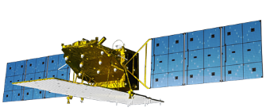
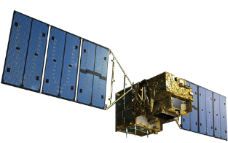
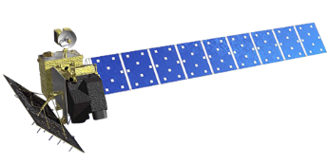
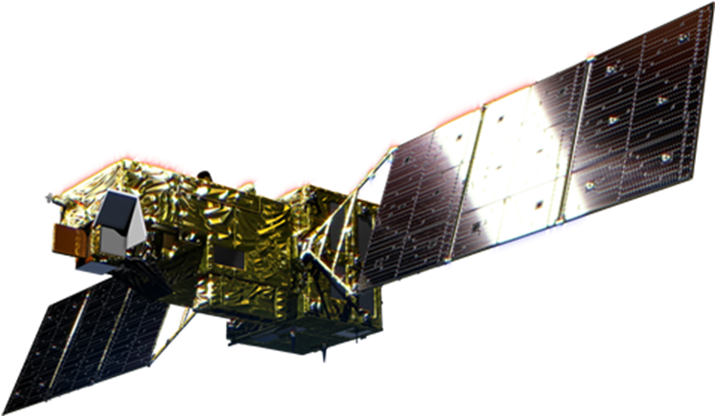
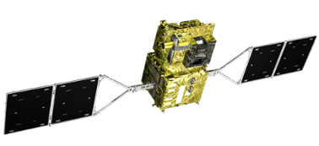
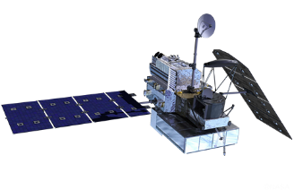
JAXA agency report
October 15, 2019
Kazuo Tachi
Associate Director General
Space Technology Directorate I
Japan Aerospace Exploration Agency

Slide 2
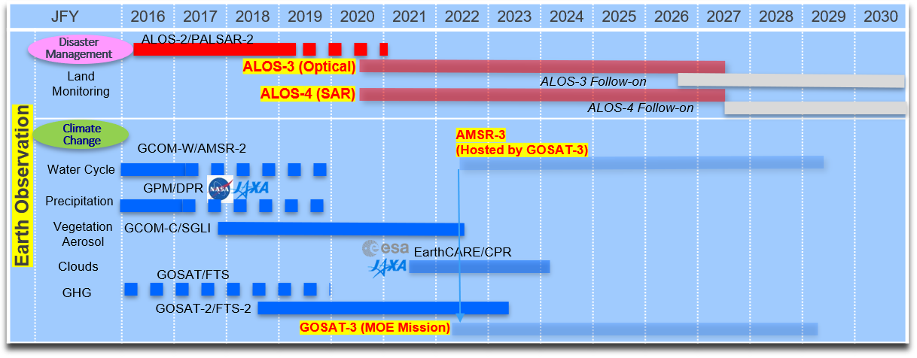
JAXA’s Satellite Development and Operation Schedule

Slide 3
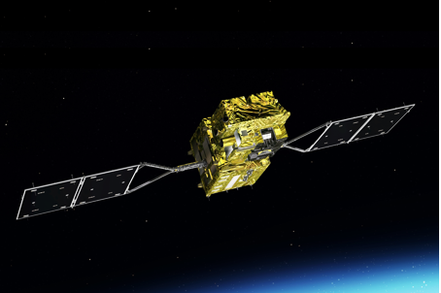
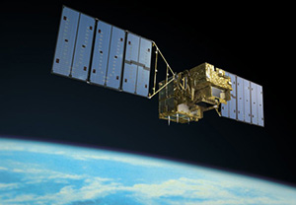
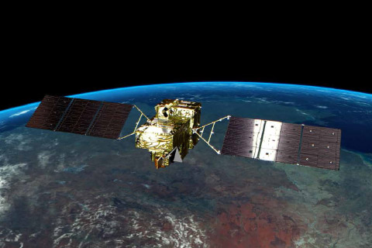
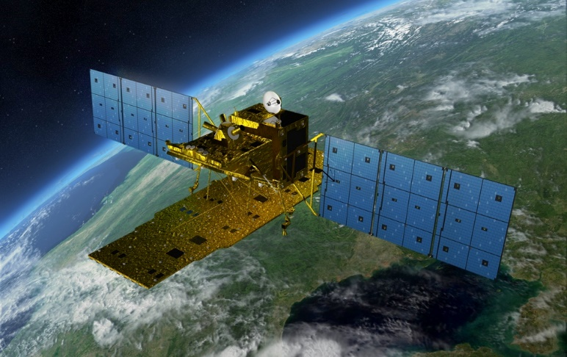
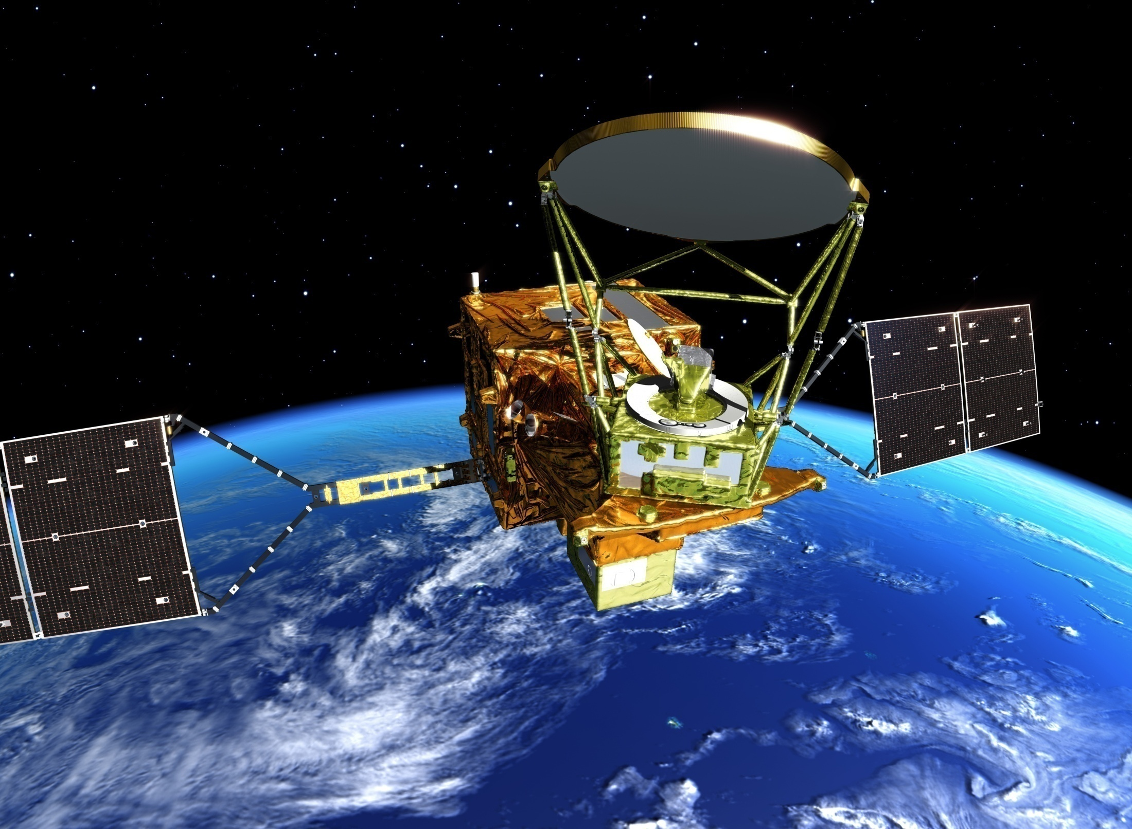
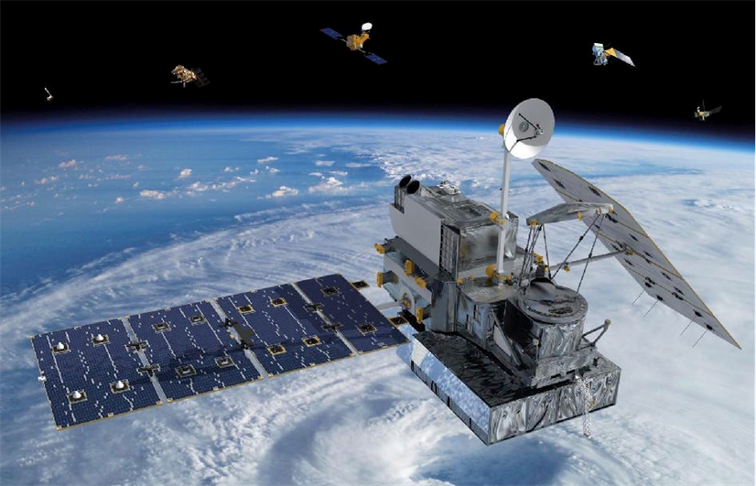


Current JAXA Earth Observation Satellites
Climate Change
Disaster Risk Management
GOSAT
GOSAT-2
GCOM-C
ALOS-2
Launched:
23 December 2017
Cloud/
Aerosols/
Vegetation
Launched: 2009
Launched:
29 October 2018
Greenhouse Gases
GCOM-W
GPM
DPR:
Dual Frequency Radar
Precipitation
Land Surface
(Radar)
Launched: 2014
Launched: 2012
Water Cycling
Launched: 2014
Courtesy of NASA
2

Slide 4
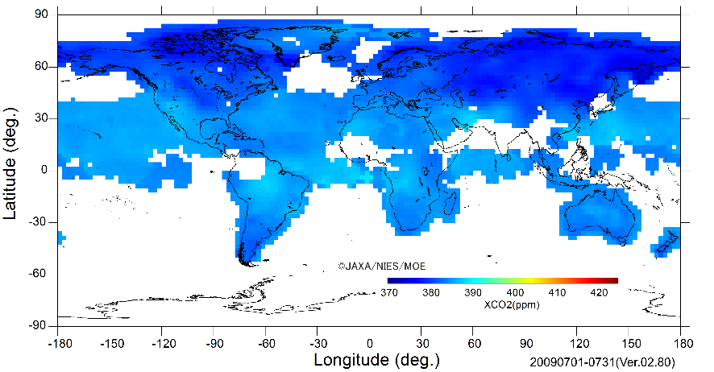
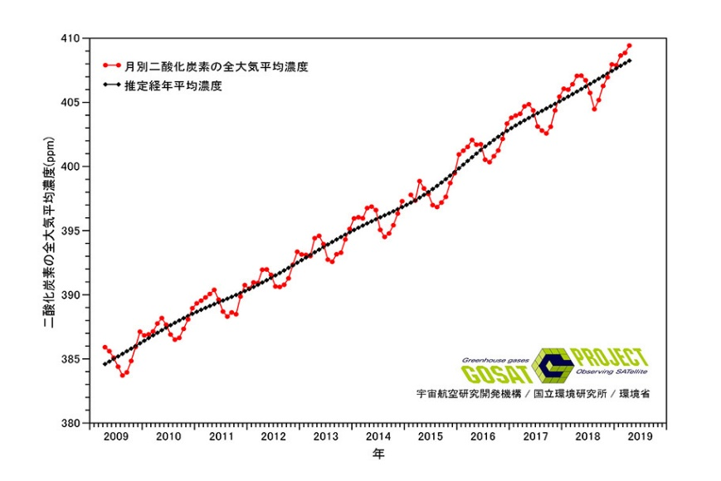
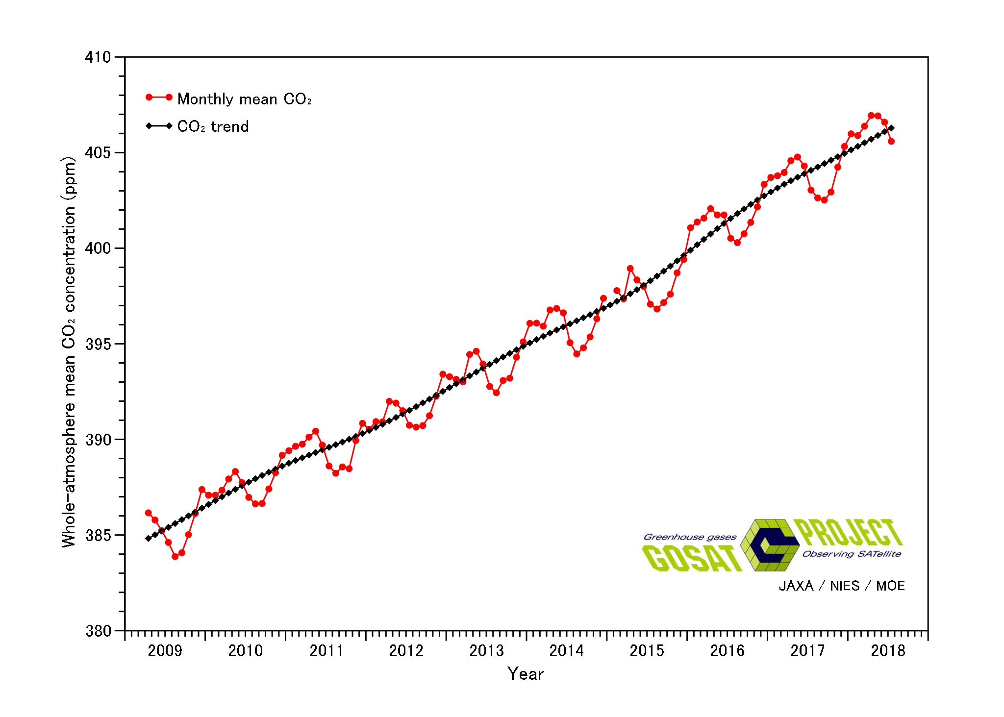
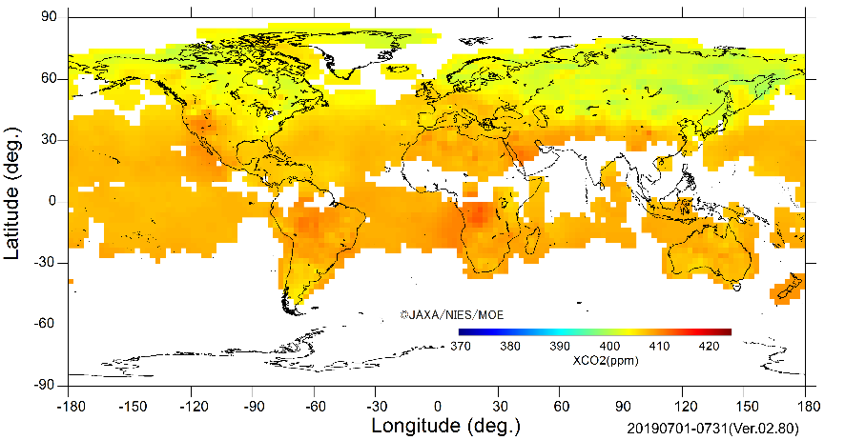
Watching on Greenhouse gases
Whole-atmosphere monthly mean CO2 concentration based on GOSAT observations － Recent data －
http://www.gosat.nies.go.jp/en/recentglobalghg.html
Monthly mean CO2
August 2019 (August 2018)
407.2 ppm(404.5 ppm)
CO2 trend
August 2019 (August 2018)
409.0 ppm(406.6ppm)
2.4 ppm/year
July 2009
CO2 growth in the past one year
August 2019 - August 2018
GOSAT Whole-atmosphere Mean CO2
April 2009 – April 2018
April 2019
409.4 ppm
Exceeded 400ppm December 2015
July 2019
3

Slide 5
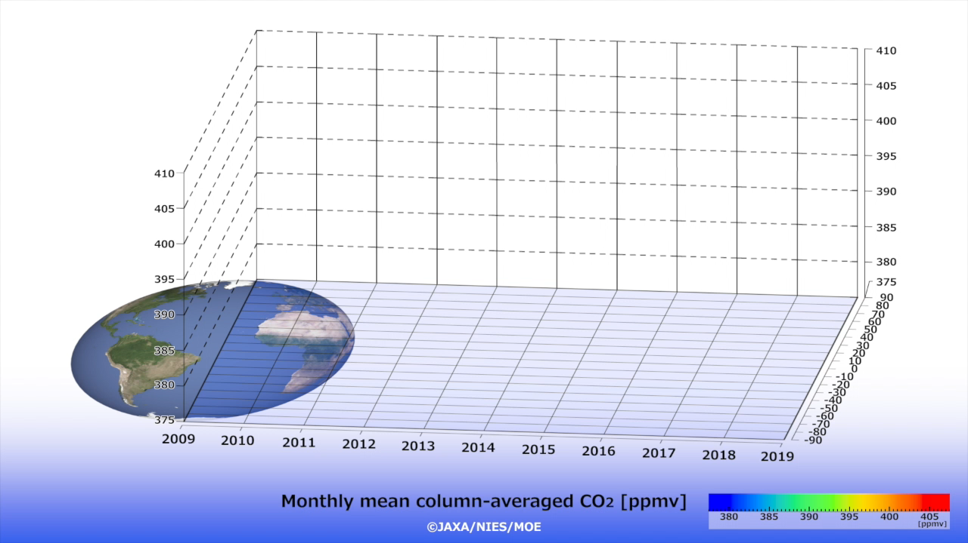
A Decade-Long Global GHG Observation by GOSAT
4

Slide 6
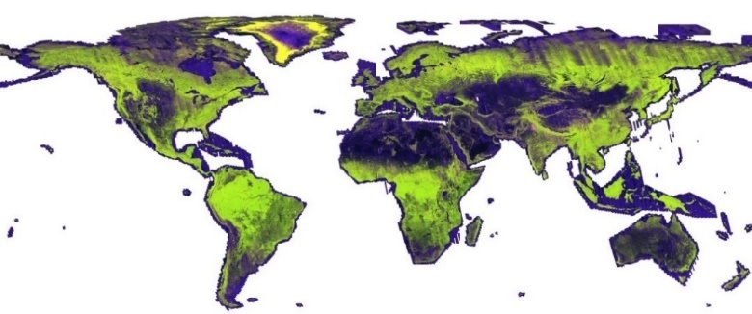
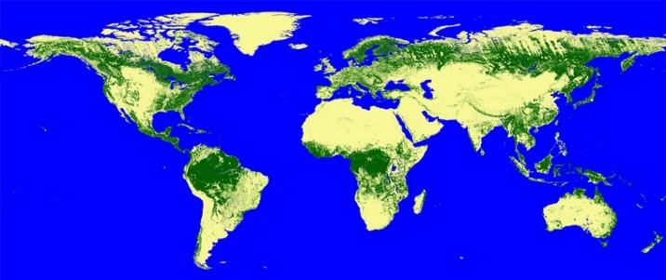

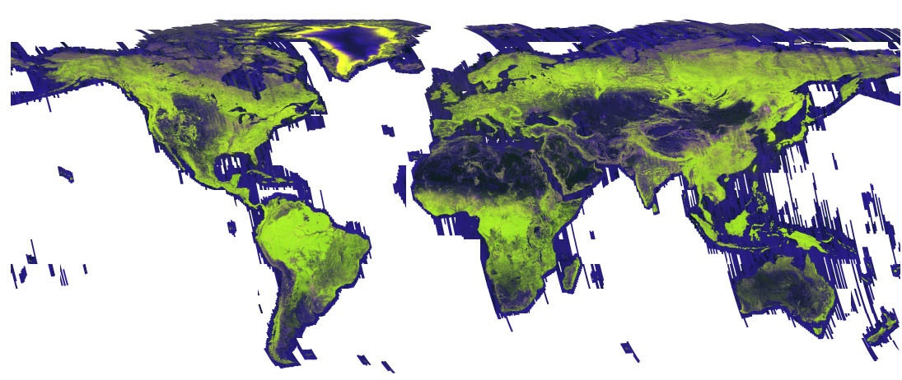
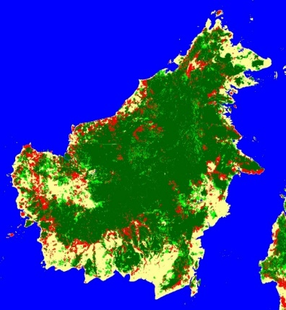

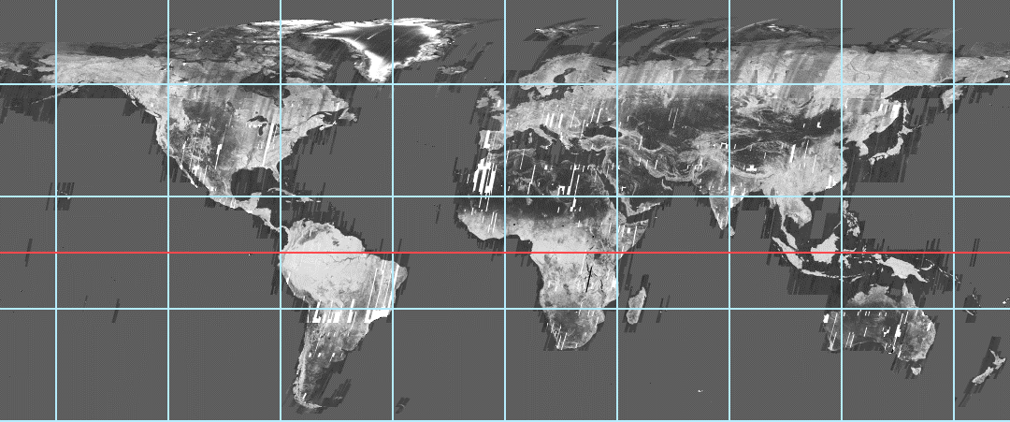
Sustainable Forest Management:
Monitoring Forest Changes for More Than 20 Years
JAXA has released annual global mosaic and Forest / Non-Forest (FNF) map by SARs
JERS-1 (1996) ~ ALOS (2007-2010) ~ ALOS-2 (2014-2017) > Changes over 20 years
2017 FNF Map by ALOS-2
2017 ALOS-2
2009 ALOS
Forest change between 2008 and 2016. (red: deforestation, light green: reforestation)
1996 JERS-1
(only HH-pol.)
5
Notes:
And, forest.
With ALOS PALSAR, which had been in operation until 2011, we created Global Forest/Non-Forest map.
It is an important geophysical information on investigating the temporal forest land change, terrestrial causes on global warming, and proceeding the activity on
Reducing the Emission from Deforestation and forest Degradation (REDD+).
Please note that L-band SAR (PALSAR, PALSAR-2) is more suitable ...

Slide 7
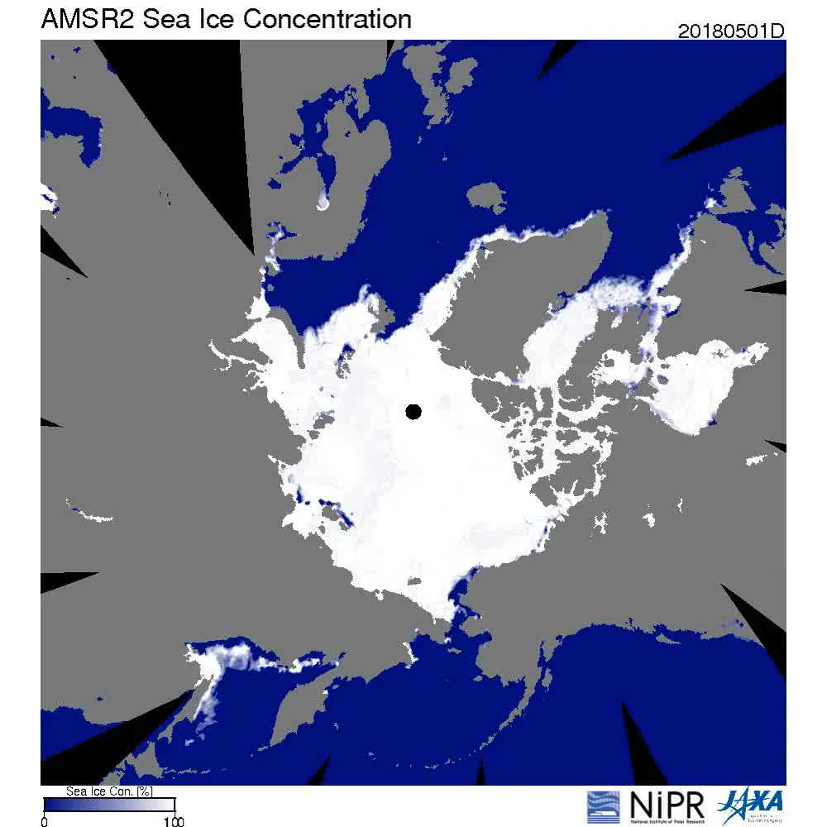
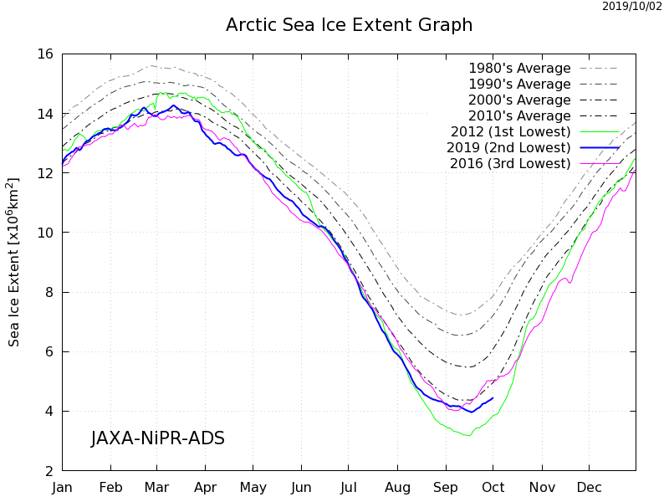
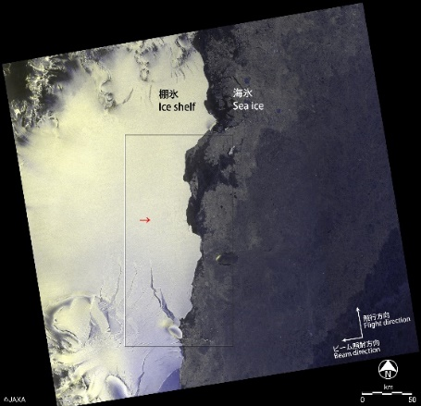
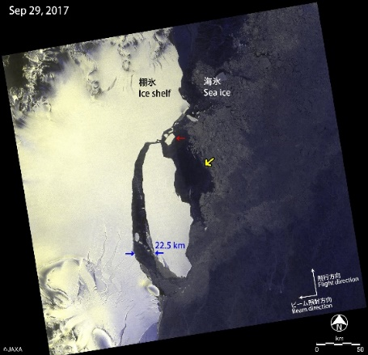
In Arctic
Monitoring Sea Ice
GCOM-W/AMSR2 observes sea ice concentration everyday.
August, 2016
September, 2017
In Antarctic
ALOS-2/PALSAR-2 Observation results on detachment of a large iceberg from Larsen-C Ice Shelf in Antarctic Peninsula.
6

Slide 8
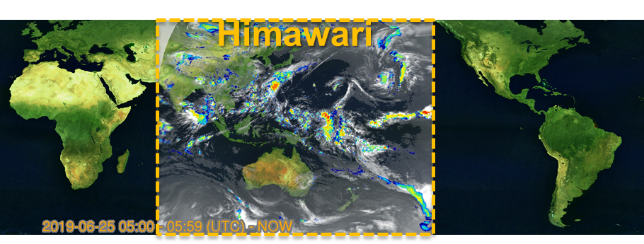

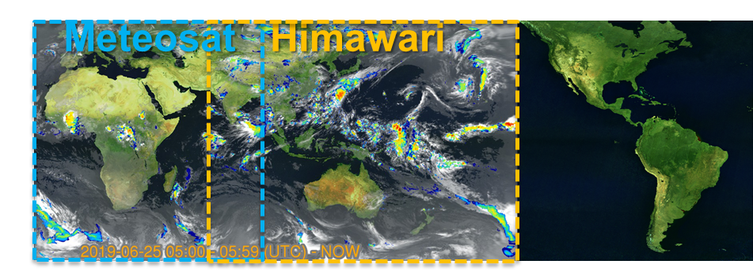
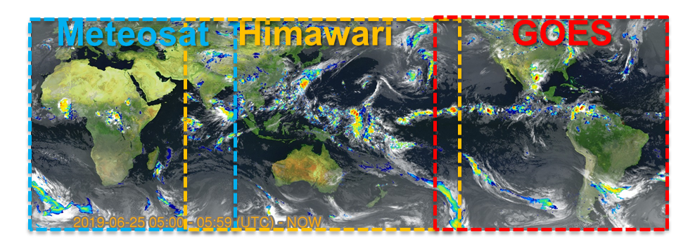
Global Rainfall watch (GSMaP)
GSMaP_NOW was extended to the whole globe!
Nov.2015
Open to the public
Within Himawari region
Nov.2018
Extended to Meteosat region
Jun.2019
Extended to GOES region
=Whole globe!

Slide 9
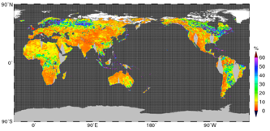
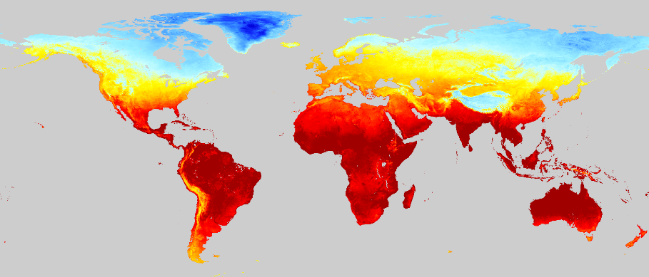
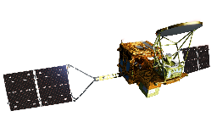
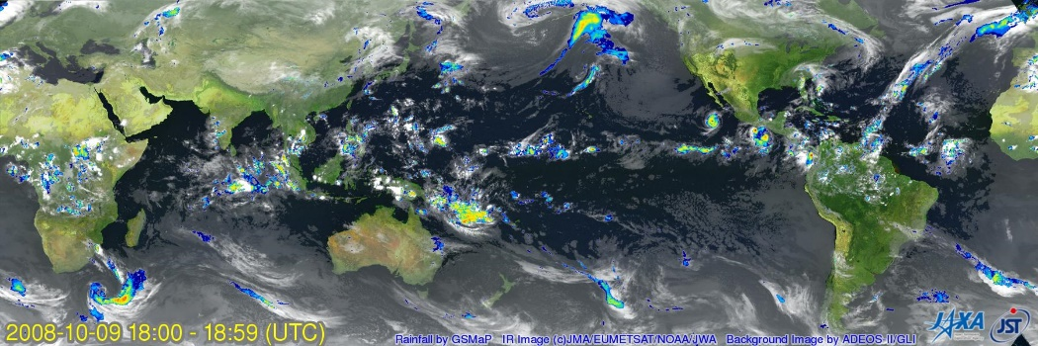


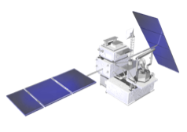
Global Datasets by Earth Observations
GCOM-C
Soil Moisture
GCOM-W
Land Surface Temperature
ALOS-2
Precipitation
GPM
+ other satellites
Forest/Non-Forest
8
Notes:
GCOM-W soil moisture 50km,+-10% GCOM-C LST 500m, +-3K GPM precipitation (GSMaP) 11km, 0.41mm/h ALOS-2 FNF 25m

Slide 10
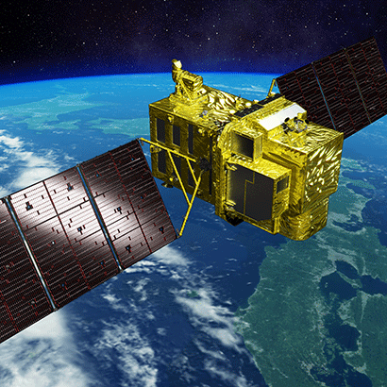
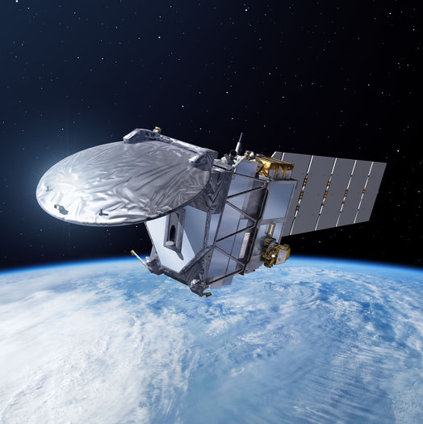
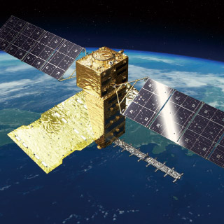
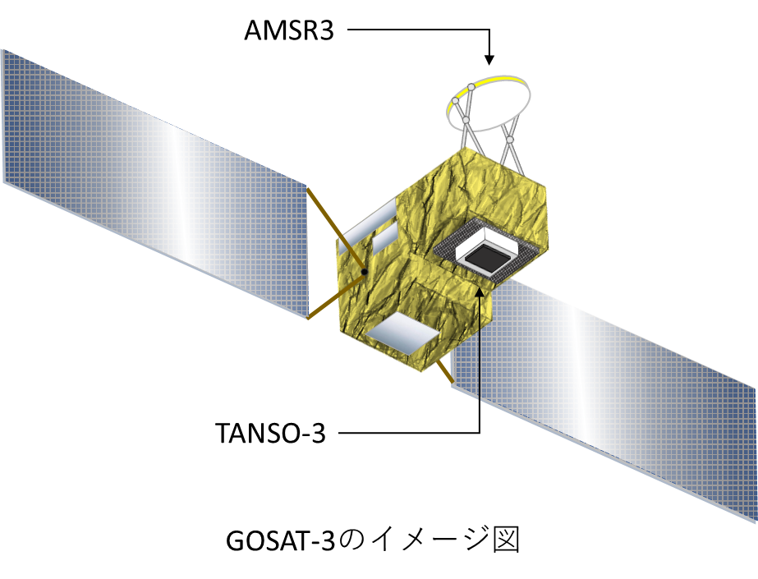

Future JAXA Earth Observation Satellites
2020-2021
2021-2022
2022-2023
ALOS-3, ALOS-4
Launch
EarthCARE
Launch
GOSAT-2 Follow-on Mission
/ AMSR3
Launch
Land
Surface
Cloud/Aerosol
Radiation Budget
Water Cycling
Land
Surface
ALOS-3
(Optical)
CPR:
Cloud Profiling Radar
GHG
ALOS-4
(Radar)
(MOE Mission)
9

Slide 11
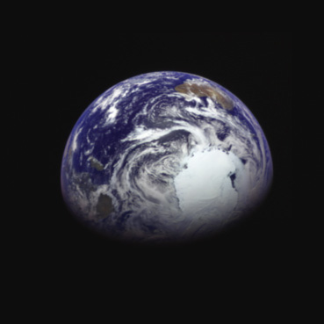
For Our Sustainable Future
Thank you for your attention.
Images of the Earth about 340,000 km from the center of the Earth took by the Hayabusa2 after the swing-by on December 4, 2015.
10

