Slide 1
GCOS update CEOS Plenary 15-16 October 2019 Hanoi, Vietnam
GCOS Secretariat
Carolin Richter

Slide 2
GCOS and its international partners:
GOS
Framework for
terrestrial observations
WMO Integrated Global Observing System (WIGOS)

Slide 3
CLOUD PROPERTIES
SEA LEVEL RISE
GROUNDWATER
EVAPORATION
FROM LAND
SEA SURFACE TEMPERATURE
EARTH RADIATION BUDGET
OZONE
ALBEDO
ABOVE GROUND BIOMASS
OXYGEN
UPPER AIR WIND SPEED & DIRECTION
LAND COVER
SUBSURFACE
SALINITY
SOIL CARBON
SOIL
MOISTURE
SURFACE WATER VAPOUR
ANTHROPOGENIC GREENHOUSE GAS EMISSIONS
OZONE
ANTHROPOGENIC WATER USE
TRANSIENT
TRACERS
LIGHTNING
OCEAN COLOUR
SURFACE WIND SPEED & DIRECTION
SURFACE STRESS
SEA STATE
SURFACE TEMPERATURE
GLACIERS
PRECIPITATION
INORGANIC CARBON
FIRE
SURFACE CURRENTS
LAND SURFACE
TEMPERATURE
PRESSURE
PERMAFROST
LEAF AREA INDEX
SURFACE
SALINITY
LAKES
UPPER AIR WATER VAPOUR
SEA ICE
SNOW
SURFACE RADIATION BUDGET
PLANKTON
PRECURSORS
CARBON DIOXIDE, METHANE AND OTHER GREENHOUSE GASES
RIVER DISCHARGE
MARINE HABITAT PROPERTIES
FAPAR
SUBSURFACE TEMPERATURE
ICE SHEETS &
ICE SHELVES
UPPER AIR TEMPERATURE
SEA SURFACE TEMPERATURE
NUTRIENTS
AEROSOLS
The Tool: GCOS defines 54 Essential Climate Variables

Slide 4
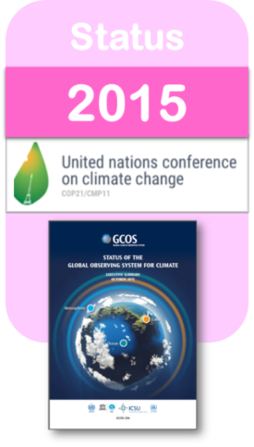
How GCOS works
Identification and Review of ECVs by expert panels
Regular Reviews of the observing systems for ECVs
Planning to ensure continues improvement of observation systems
GCOS Reports
2015,
next iteration planned for 2021
2016,
next iteration planned for 2022

Slide 5
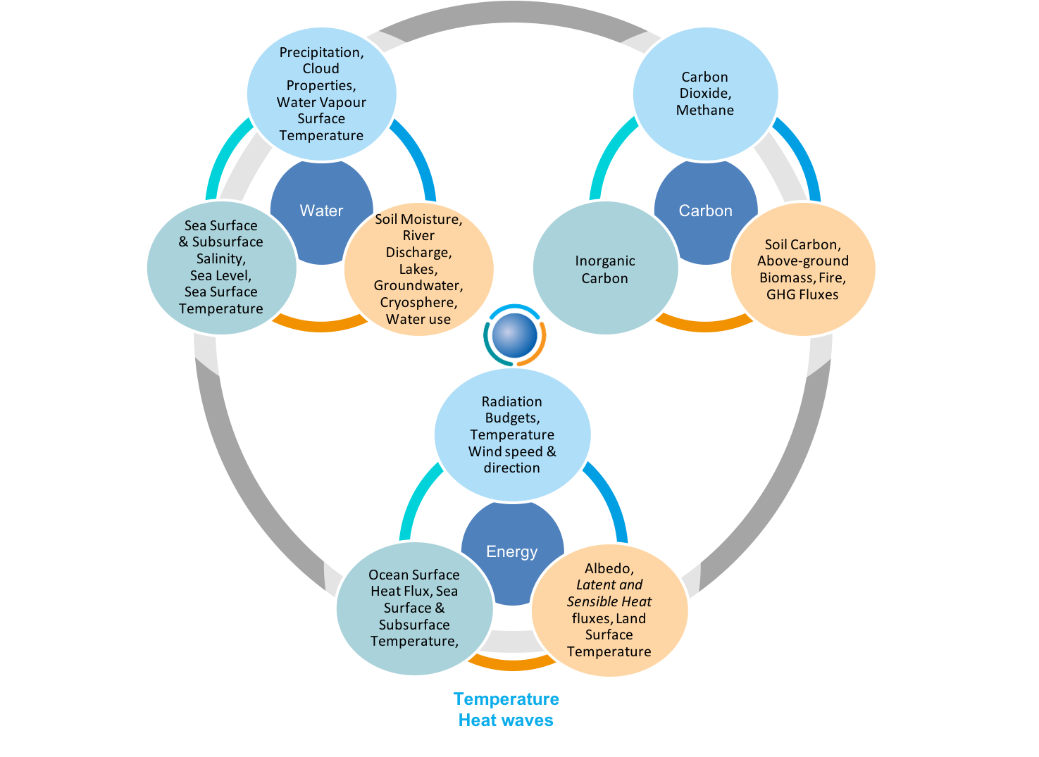
GCOS IP Actions related to Observing the Water Cycle
G31: Improve gravimetric measurements from Space
A22: Develop a repository of water vapour climate data
A25: Continuity of global satellite precipitation products
O32: Satellite sea-surface salinity
T14: Operational groundwater monitoring from gravity measurements
T15: Satellite soil-moisture data records
T16: Multi-satellite, soil-moisture data services
T24: Allocate additional resources to extend the geodetic dataset
T25: Extend the glacier-front variation dataset both in space and in time
T32: Continuity of laser, altimetry and gravity satellite missions
T34: Mapping of seasonal soil freeze/thaw
T38: Improve snow and ice albedo products
T40: Production of climate data records for LAI, FAPAR and Albedo
Notes:
In order to improve the understanding and close the budget as envisaged, data availability of all relevant ECVs is key.
The implementation plan is recommending a suite of actions which implemented will increase / improve / complement the data availability.

Slide 6
Identified issues by WGClimate - Acknowledgment by GCOS
GCOS Working with CEOS & CGMS
Mapping definitions & OSCAR
Application areas
Alignment with review process
Timeline for implementation plan
Notes:
Letter from WGClimate – recorded
Mapping definitions & OSCAR
MoU → application areas
Align with review process
IP timeline

Slide 7
Identified issues by WGClimate for requirements & Solutions #1
Homogeneity and Format of Requirements:
more homogenous use of ECV formats
Be clear on the scale requirements applying to global scale (typically for atmosphere) , and to smaller scales (e.g. river flows)
To use physical units , in which also accuracy and stability should be given
To indicate the application for ECVs
Solution:
Mapping of ECV product names within OSCAR/Requirements database
Aligning definitions of ECV products with definition in OSCAR/Requirements
Notes:
Letter from WGClimate – recorded
Mapping definitions & OSCAR
MoU → application areas
Align with review process
IP timeline
Homogeneity and format of Requirements:
The format of ECV requirements is not homogeneous and sometimes it is necessary to go to an additional level to make sense of the requirements (i.e. ECV > ECV Product > Physical Quantity) and sometimes not.
Sometime ECV product requirements are at a truly global scale (typically for atmosphere) and sometimes at a much smaller scale (e.g. river flows) - see footnote
All ECV products lack the provision of a physical unit in which also accuracy and stability should be given
Sometimes the requirements are on the observations rather than the CDR;
Within the Satellite Supplement there is an indication of the Application that will make use of the ECV, but this is not done systematically for all ECVs.

Slide 8
Identified issues by WGClimate for requirements & Solutions #2
Process for Updating Requirements:
Formalize and better structure the overall process for updating requirements needs (as recognized in Action G10 of the 2016 GCOS IP).
Scope of Requirements Gathering :
Example: understanding of changing water vapour/cloud feedbacks
Solution:
Plan for the update of requirements
GCOS is coordinating with other entities (e.g., WCRP, GAW, IPCC WGs, OCG, WGMS) during the process of updating ECV requirements. For example, the Joint Panel Meeting identified collaboration with WCRP in terms of global cycles and observation requirements for closing the cycles.
Notes:
Process for Updating Requirements:
the overall process for updating requirements needs to be more formalised and structured (as recognised in Action G10 of the 2016 GCOS IP).
Scope of Requirements Gathering :
understanding of changing water vapour/cloud feedbacks is absolutely core to climate and this is not reflected in the 2016 GCOS IP

Slide 9
Identified issues by WGClimate - Application Areas
OSCAR (Observing Systems Capability Analysis and Review Tool)
is an important building block of the “Rolling Requirements Review” process (user requirements for observations are compared with the capabilities of present and planned observing systems).
It allows the consultation of:
User requirements for observation of 14 WMO application areas
(GCOS: Climate Monitoring)
Facts and capabilities of space-based observing systems
Facts and capabilities of surface-based observing systems
By comparing capabilities with requirements, a critical review and gap analysis can be performed.
Notes:
OSCAR/Requirements :
http://www.wmo-sat.info/oscar/requirements
is the official repository of requirements for observation of physical variables in support of WMO and co-sponsored programmes.
Variables are defined in a technology-free manner, i.e. without being constrained by space- or surface-based measurements. They do not necessarily overlap with the direct output of a specific instrument. The requirements are organised by Application Area (14 application areas – GCOS Climate Monitoring) and by geophysical variable

Slide 10
GCOS Long-range Objectives
GCOS will ensure that climate observations must be enhanced and continued into the future to enable users to:
detect further climate change and determine its causes;
model and predict the climate system;
assess impacts of climate variability and change;
monitor the effectiveness of policies for mitigating climate change;
support adaptation to climate change;
develop climate information services;
promote sustainable national economic development;
meet requirements of the international environment conventions and agreements and those of the UNFCCC.
Review process for requirements per application area – to be discussed at upcoming steering committee meeting.
(MoU 1998 & GCOS Programme Review 2014, GCOS-181)
Notes:
We need to have discussion on future processes:
Review process for requirements per application area ?

Slide 11
Identified issues by WGClimate for requirements & Solutions #3
Mapping of ECV product with OSCAR variables & Review process
Mapping of names and definitions has been completed for Atmosphere ECVs. Ocean and Terrestrial ECVs work in progress.
AOPC and ECV stewards have delivered definitions for the ECV products and added new products when necessary
Tables were reviewed at the IPET-OSDE Workshop on OSCAR/Requirements held in Geneva on December 3-4 2018.
Most of the definitions proposed by AOPC have been accepted by IPET-OSDE and will be implemented in OSCAR/requirements.
Panels have started working on updating requirements for the ECV products.
Process for updating of requirements well established now
Notes:
Mapping of names and definitions has been completed for AOPC. TOPC is in the process of working on it.
Panels have started working on updating requirements for the ECV products.
Process for updating of requirements well established now
Annex A IP : ECV products in GCOS 200 https://library.wmo.int/opac/doc_num.php?explnum_id=3417

Slide 12
ECV | ECV products as in GCOS IP Annex A | Revised ECV product (AOPC) | Definition (matching definition in OSCAR) | Units | OSCAR Variables
Earth Radiation Budget | Top-of-atmosphere ERB longwave | Upward long-wave irradiance at TOA | Flux density of terrestrial radiation emitted by the Earth surface and the gases, aerosols and clouds of the atmosphere at the top of the atmosphere | W/m2 | Upward long-wave irradiance at TOA
 | Top-of-atmosphere ERB shortwave (reflected) | Upward short-wave irradiance at TOA | Flux density of solar radiation, reflected by the Earth surface and atmosphere, emitted to space at the top of the atmosphere | W/m2 | Upward short-wave irradiance at TOA
 | Total solar irradiance | Downward short-wave irradiance at TOA | Flux density of the solar radiation at the top of the atmosphere | W/m2 | Downward short-wave irradiance at TOA
 | Solar spectral irradiance | Solar spectral irradiance | Total Solar Irradiance (TSI); when measured as a function of wavelength it is the spectral irradiance | (W/m2/μm) | No equivalent variable in OSCAR. Added.
 |  | Radiation Profile (New ECV product) | Vertical profile of upward and downward LW and SW radiation components | W/m2 | No equivalent variable in OSCAR. Added.
EXAMPLE
Notes:
Specific slide on details of agreeing definitions compliant to OSACR database,
This is to facilitate the work of WGClimate

Slide 13
Review of ECV Requirements: Guidelines
Background information/explanation for each value mandatory
In order to make the process transparent and allow for discussions
Have 3 values: “threshold”, “breakthrough” and “goal”
Threshold – minimum for useful data, Goal – maximum beyond which there is no need to go, Breakthrough – enables additional uses within climate monitoring.
Information on Relevance for Capturing Extremes and for Adaptation
Review (2021) and update (2022) IP actions
Need to update requirements by 2022 (UNFCCC Global Stocktake)

Slide 14
Timeline
Panels on-going monitoring of observations of ECV and IP actions
Panels draft SR4
Public review
Panels finalise SR4
Panels on-going monitoring of observations of ECV and IP actions
Panels revise requirements
Public review
Panels consider issues arising: workshops on specific issues etc as needed.
Panels draft IP4
Public review
Panels finalise IP4
Jan 2019
Jan 2020
Jan 2021
Jan 2022
Jan 2023
MARCH: Panel Meetings
Revise Requirements based on public review
MARCH: Panel Meetings
Agree revised SR and start drafting revised IP
MARCH: Panel Meetings
Agree revised IP
OCTOBER: SC Meeting, provides guidance
OCTOBER: Reviews progress
SEPTEMBER: 4th Status Report published following approval by Sponsors and SC
OCTOBER: Considers Conference outcomes
OCTOBER: SC Meeting: 4th Implementation Plan published following approval by Sponsors and SC
The 4th Implementation Plan (IP4) needs to be published in October 2022 to be provided to the 2022 UNFCCC COP.
The 4th Status report (SR4) should be published before the GCOS Climate Observation Conference in October 2021 and provided to the 2021 UNFCCC COP.
These deadlines imply that the review of updated requirements needs to be in Jan-Feb 2020. This also allows time for any issues arising to be addressed before IP4 is drafted.
The Steering Committee (SC) in 2021 will be immediately after the co-located GCOS Climate Observation Conference
OCTOBER: Climate Observation Conference (TBC)
gcos.wmo.int 10/7/2019
Notes:
You will find the time line also in the Work plan and Guidelines for updating the GCOS 2015 Status Report and 2016 Implementation Plan, available since July 2019 from GCOS Secretariat.

